Slide 1
APRIL CHARACTER TRAIT
CHARITY
2024-2025

Slide 2
CAMPUS MATRIX
CHARITY

Slide 3
OBJECTIVES
The learner will be able to:
define CHARITY.
recognize various community, national, and global concerns and ways in which people help.
CHARITY

Slide 4
Insert District Video Here
CHARITY

Slide 5
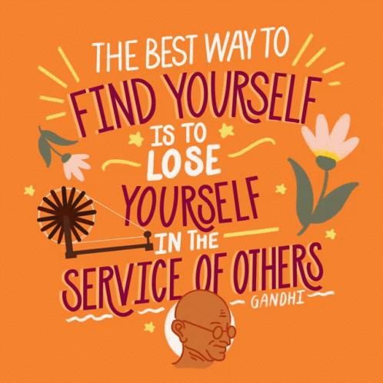
Reflect
Can you think of a time when you or someone else gave and/or received charity?
Share any reflections you may have after watching the video.
CHARITY

Slide 6
What is CHARITY?
Aid, assistance, or support given to those in need.
CHARITY

Slide 7
Class Discussion
How can sharing with others improve our community and the lives of people throughout the world?
CHARITY

Slide 8
Class Discussion
Discuss a time when you have been helped by someone or you were able to help someone else.
How did the experience make you feel?
CHARITY

Slide 9
Brainstorm
As a class, create a T-Chart with a list of local, national, or global concerns on one side and a list of charity organizations that would help those concerns on the other.
CHARITY
Notes:
An example would be that we have a local concern of people in our community going without food. An organization that helps distribute food to the less fortunate is Cy Hope.

Slide 10
Work with a Partner
Pick one of the organizations you feel strongly about and create a colorful, persuasive poster to encourage others to help.
CHARITY

Slide 11
Home Connection: Compassion in Action
Find a charity that you and your family can consider volunteer with on the weekends.
CHARITY

