Slide 1

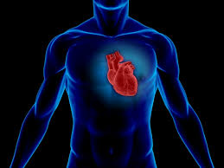

I can take care of my body, brain, and my heart.

Slide 2


I take care of my body by eating right, exercising, and sleeping well .

Slide 3
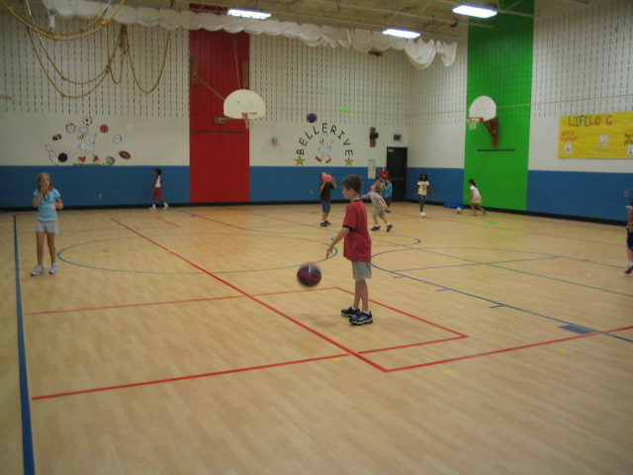

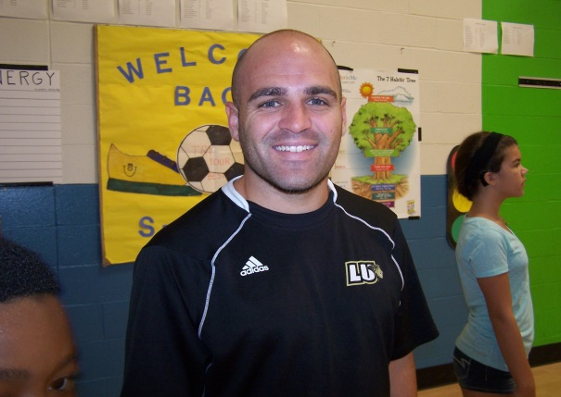
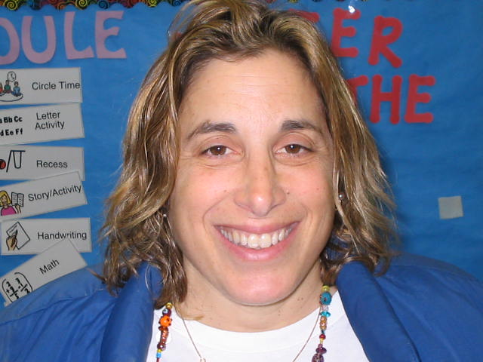
I like to go play and exercise in P.E. with Mr.Fink, Mr.Bunton, and Ms.Liz.

Slide 4



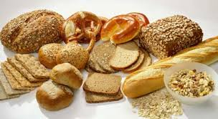
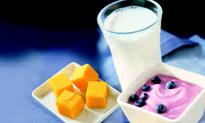
I like to eat all kinds of foods.

Slide 5

I like to go to sleep at my bedtime and stay in bed until morning.

Slide 6
I can take care of my body, brain, and my heart.

Slide 7

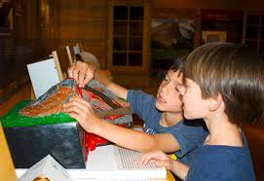
I take care of my brain by learning new things. I can learn anywhere, not just at school.

Slide 8


I like to learn new things by reading and exploring books and places around me.

Slide 9

I like to take walks outside to explore and learn about things like plants and animals.

Slide 10
I can take care of my body, brain, and my heart.

Slide 11

I take care of my heart by being a good friend.

Slide 12

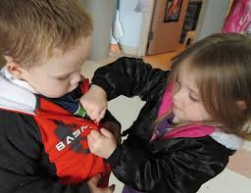
I like to be a good friend by helping and playing with the people that care about me.

Slide 13
I can take care of my body, brain, and my heart.

