Slide 1

WELCOME!
WELCOME!
Bienvenido
akeyi
환영
WELCOME!

Slide 2
Annual Title I Parent/Guardian Meeting
Media Center
August 8, 2021
3:00 p.m.
Presented by Dr. Cindy Gibson, Superintendent and
Jennifer Minter, Parent Mentor
Georgia Academy for the Blind
Dr. Cindy Gibson, Superintendent
2895 Vineville Avenue
Macon, Georgia 31204
www.gabmacon.org

Slide 3
What is a Title I School?
Title I is a program that provides federal funds to local educational agencies and public schools with high numbers or percentages of children in poverty to help ensure that all children meet challenging state academic content and student academic achievement standards
TITLE I. October 1, 2016 we transitioned to the legislative changes of Every Student Succeeds Act (ESSA)
GAB is qualified to receive federal funding under this act.
Georgia Academy for the Blind is a Schoolwide Title I School. ALL students benefit from Title I resources.
SEC. 101. IMPROVING THE ACADEMIC ACHIEVEMENT OF THE DISADVANTAGED.
Title I of the Elementary and Secondary Education Act of 1965 (20 U.S.C. 6301 et seq.) is amended to read as follows:
TITLE I--IMPROVING THE ACADEMIC ACHIEVEMENT OF THE DISADVANTAGED

Slide 4
Educating The WHOLE Child
Addressing students’ well-being in the learning process.
Exploring new ways to provide an excellent, relevant, meaningful education to every child.
Recognizing that all children learn at different rates and have individual needs.
Addressing non-academic factors that impact student achievement, and it maximizes educational opportunities for students.

Slide 5

School climate!
“the quality and character of school life”
“patterns of students’, parents’, and school personnel’s experiences of school life.”
“sustainable, positive school climate supports people feeling socially​, emotionally and physically safe. In a positive school climate people are engaged and respected.”
Georgia is the first state in the nation to include school climate as an early indicator in its academic accountability system, the College and Career Ready Performance Index (CCRPI).
State law (O.C.G.A. § 20-14-33) requires the development and use of a "star rating" to address school climate. THANKS TO ALL WHO’VE COMPLETED THIS YEARLY

Slide 6
what IS A STAKEHOLDER? You
Mother – Father – Grandparent - Aunt – Uncle - Sister
*In education, the term stakeholder refers to anyone who is invested in the welfare and success of a school and its students, including administrators, teachers, staff members, students, parents, families, community members, business leaders, and elected officials.

Slide 7



Where Does GAB money come from?
Local School Districts
VS
State Schools: (GAB, GSD, AASD )
Federal Grants
Federal Grants
State Funds
State Funds
Local funds
We must eat the “ice cream” from the bottom up!

Slide 8
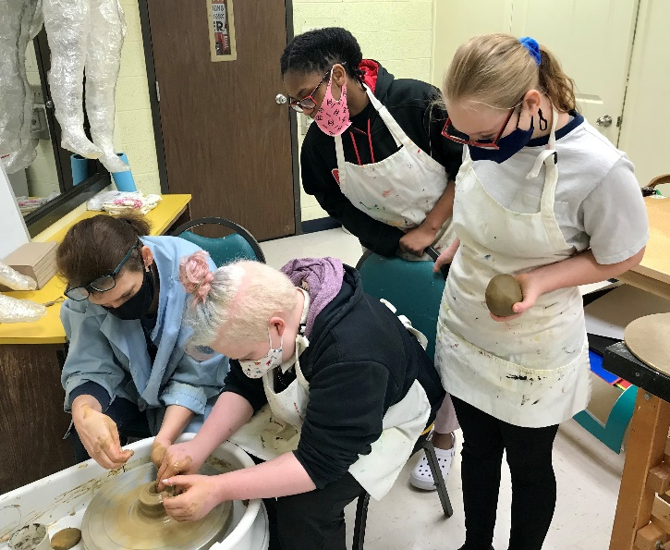
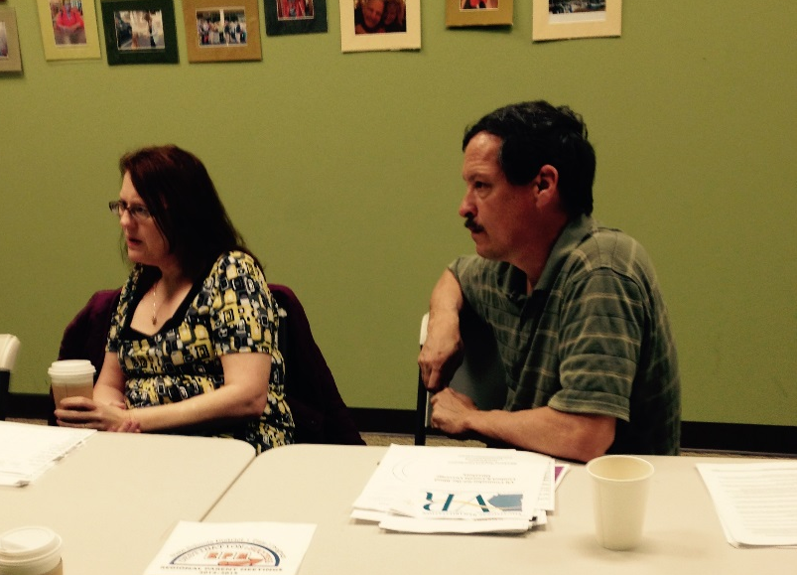
How Does Our School Spend Title I Money?
After School Program
Family Engagement Activities
Instructional Supplies and Equipment
Family Resource Room materials
Regional Parent/Guardian Meetings’ materials
Technology

Slide 9

Additional Supports in Place to Help us Reach our Goals:
Additional supplies for all students
Small student - teacher ratio
Professional Learning for Staff
Extended Learning Time
Use of Assessment for and of learning
Formative and Summative Assessments
Pacing guides, planning calendars, curriculum maps, and unit frameworks for teachers
DOE School Improvement Specialists
National Educational Consultants in Visual Impairment Strategies
Community collaboration for transition and work-based learning
Middle Georgia Regional Educational Service Agency

Slide 10
Family Engagement Plan and Student-School-Parent/Guardian Compact
  Available:
  on the school website www.gabmacon.org
  on Registration Day
  in the Family Resource Room
  at all Regional Parent Meetings
  at IEP meetings
  at all on-campus parent/guardian gatherings (Winter and Spring music and art programs, Prom, Awards Day, Spring Festival, etc.)
Revised each year based on input from all stakeholders (parent/guardians, faculty/staff, and community partners) at each of the events described above

Slide 11
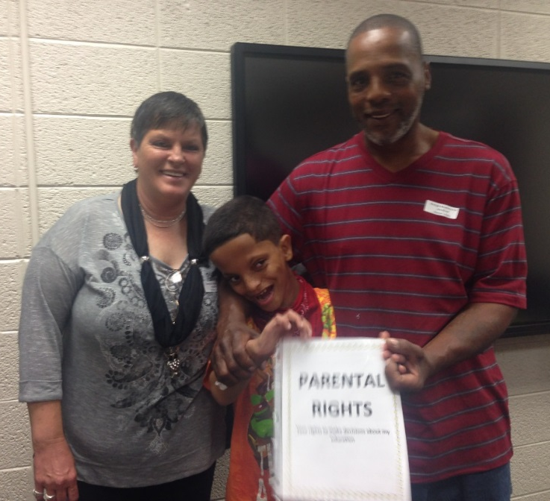
What is allowed by Law for Parental Involvement?
Request the qualifications of your child’s teacher.
Request opportunities for regular meetings with staff in order to make suggestions.
Receive Parents/Guardians’ Right Booklet yearly.
Participate in IEP development and meetings to make decisions n the education of your child.
At least 1 annual parent-teacher conference must be offered for elementary school students.
Input in the revisions of the Parental Involvement Plan, Compact, and School Improvement Plan.
Input into the Comprehensive LEA Improvement Plan (CLIP)
Timely communication of school announcements to the home through all available means:
  newsletters and flyers sent home
  emails
  text messages through Talking Points
  website and Facebook page

Slide 12
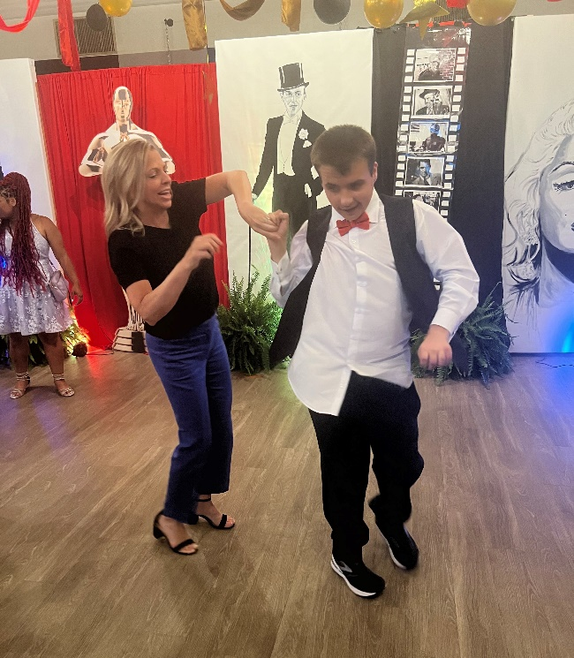
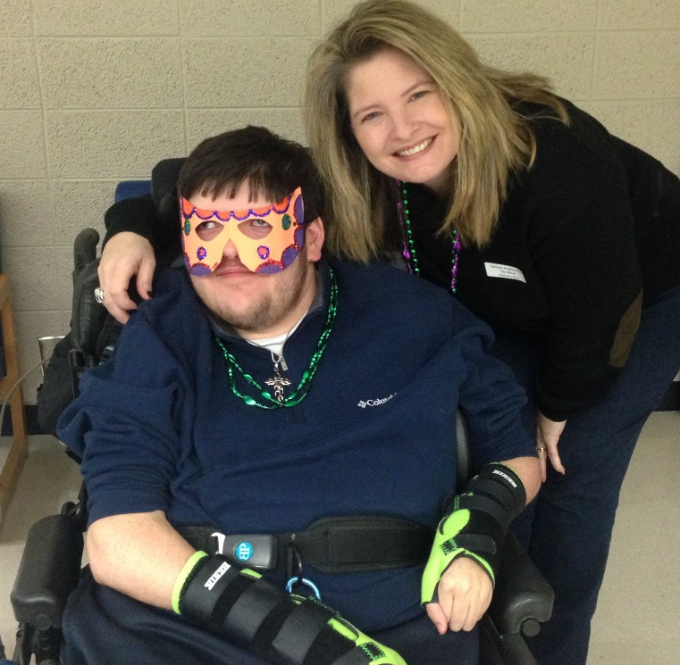
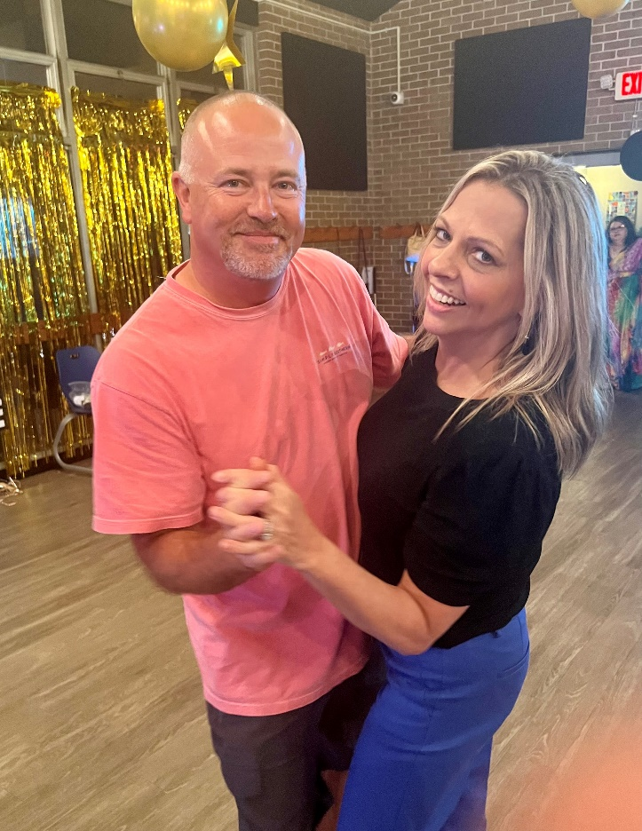
Are there Opportunities for families to be Involved at GAB?
Absolutely!!

Slide 13
How can parents/guardians get involved?
Volunteer and be involved in school activities. (Must complete volunteer application).
Observe in your child’s classroom. (Must obtain permission and at least 24 hours notice and adhere to State Schools visitors policy).
Attend schoolwide events such as the winter and spring musicals.
Attend SCASB and Special Olympics events.
Learn ways to provide home support for your child’s education.
Participate in school decision-making through, Better Seeking Team, PBIS, Diversity Culture and Climate Committee and School Council.
Attend Registration Open House and the Annual Title I Parent/Guardian Meeting.
Provide feedback and suggestions on parental involvement programs through surveys and comment cards after meetings and events.
Stay informed!
Visit website and Facebook page.
Opt in to receive text and voice messages
Read weekly “Panther Press”
Notify us when there is a change of address and/or phone number
But wait! There IS MORE!!

Slide 14
Family Resource Room
Office of Parent Mentor, Jennifer Minter
Includes items for check-out and use at home to improve student achievement, behavior, and health
Family Engagement Program: State and Federal Parental Involvement Resources
Georgia Parent Mentor Partnership Program: Statewide program with Parent Mentors throughout the state
Ongoing regional resource manuals (Community Resources nearest our families)
Items for the entire family
Information on Waivers and Guardianship

Slide 15
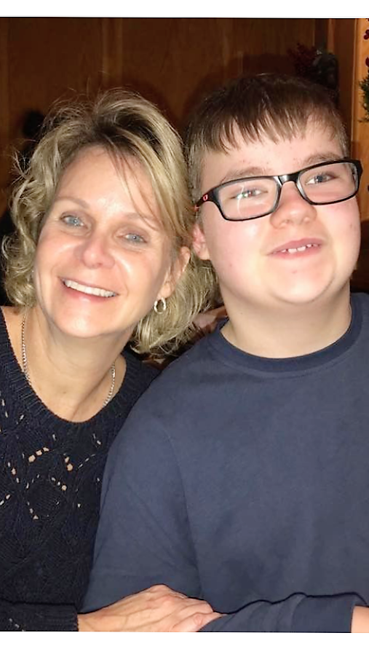
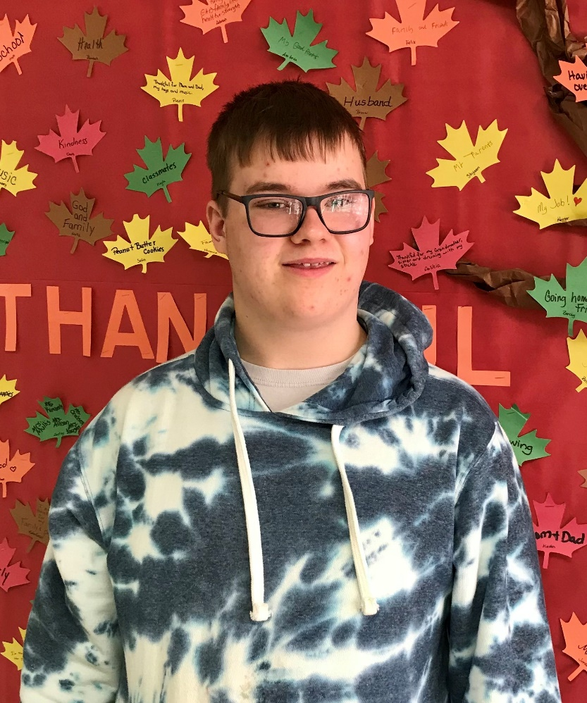
GAB Family Member appointed to serve on
State Advisory Panel for Special Education
She wants to hear from YOU! lthornberg@yahoo.com

Slide 16
Helping you stay informed –
Communication is key!
Emails from Parent Mentor
Text messages from Parent Mentor
Contact list of GAB staff
School Calendar
School Council Meeting Schedule

Slide 17
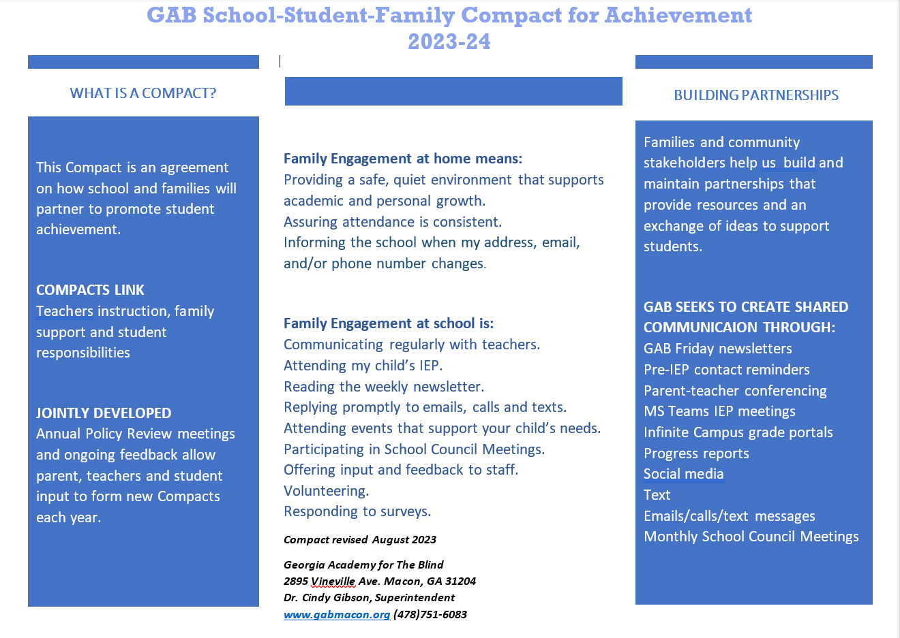

Slide 19
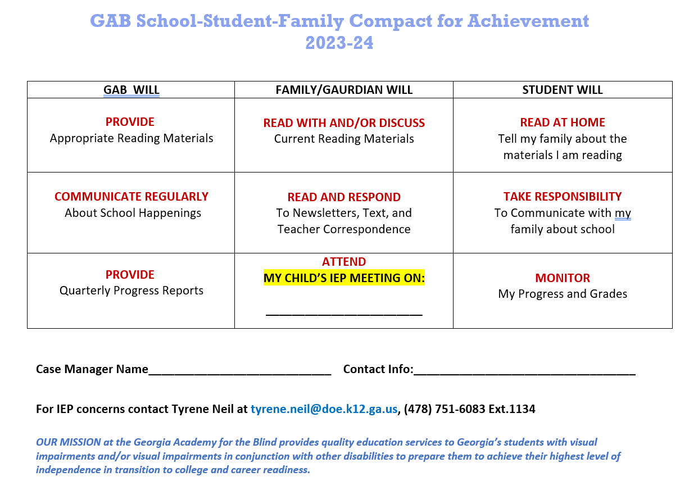

Slide 20


Slide 21
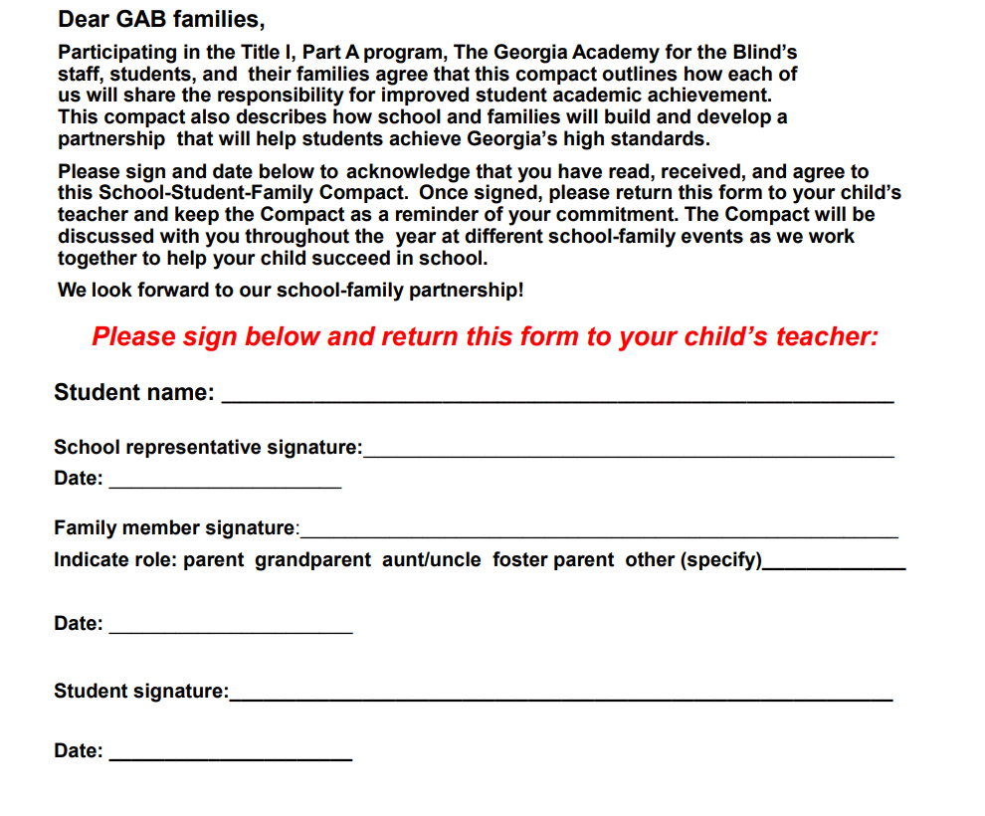

Slide 22



