Slide 1

Web Community Manager
Managing the Section Workspace, Basic Workshop
Today’s Trainer: Talia Kamenir

Slide 2
At the end of today’s hands-on workshop you will :
Understand the layout of the Section Workspace
Access Section Workspace Tools & Resources
Designate a user as a Section Editor
Understand the elements of a Page
Add Pages to a Section
Manage Page Apps and Layout
Organize, delete, and recover Pages in a Section.
Notes:
http://bit.ly/basicmsw

Slide 3
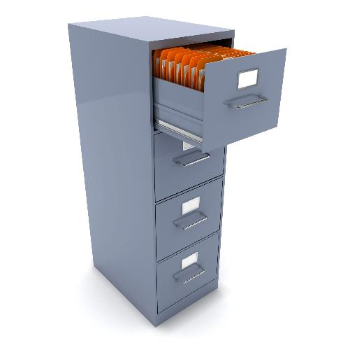

This File Cabinet Represents your site/sub-site.
Within each Channel
(DRAWER) is one or more folders or SECTIONS.
Within each Section
(folder) are the PAGES of information about that section.
Each CHANNEL is
like a DRAWER-
containing similar
information.

Slide 4
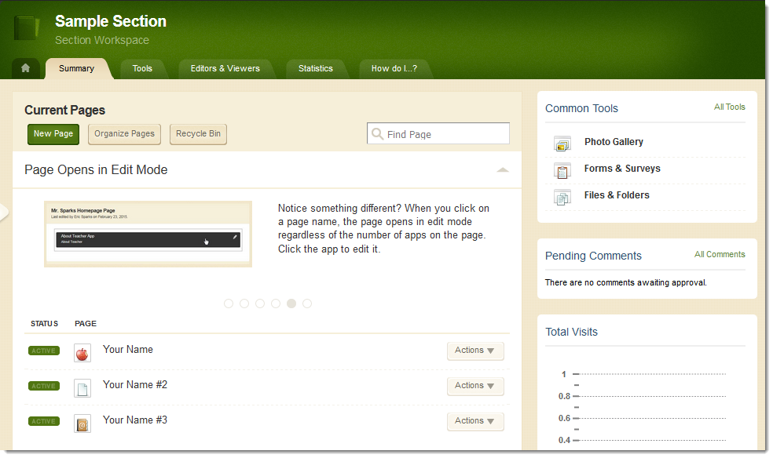
Section Workspace
Summary Tab
  Edit/organize current pages
  Create new pages
  Access the recycle bin
  Hot Topics Billboard

Slide 5
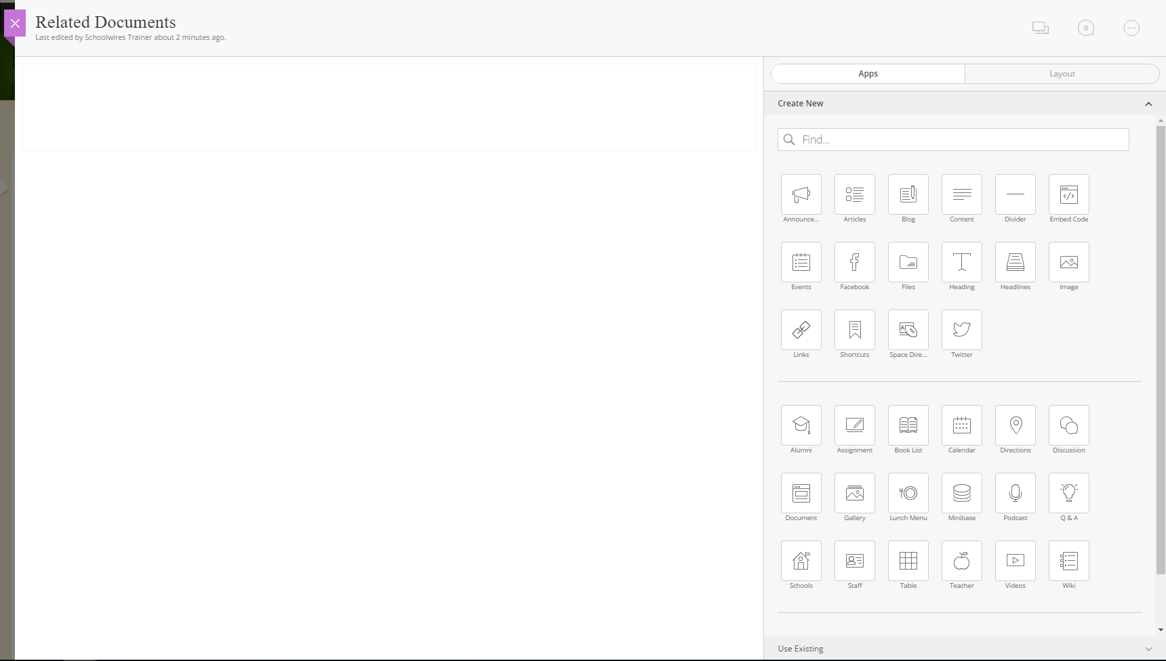
Page: Canvas and Apps

Slide 6
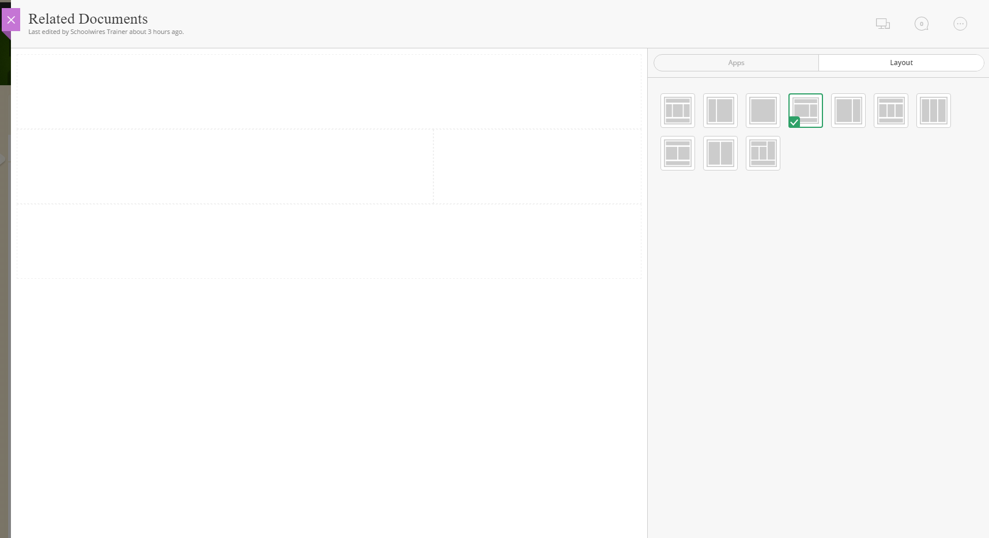
Page: Canvas and Layout

Slide 7
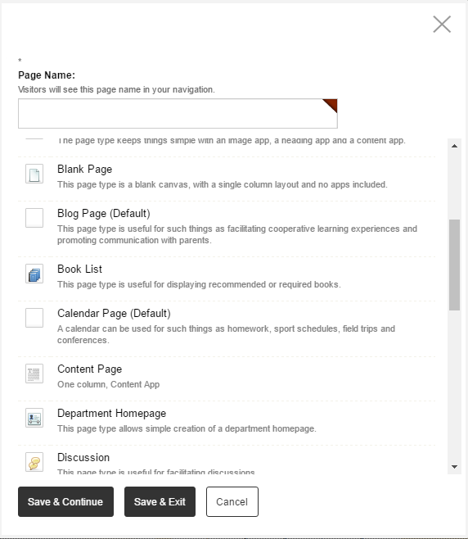
Activity: Add a Content Page Type
Now It’s Your Turn.

Slide 8
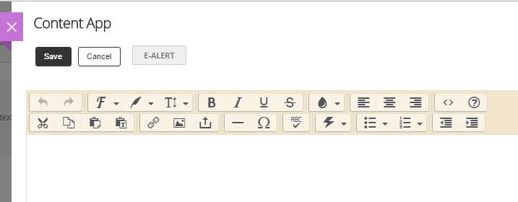
Activity: Add text, image, and links
  In your Content App
  Add Text (type or paste)
  Add an Image
  Add a Link or File
  Save
Now It’s Your Turn.

Slide 9
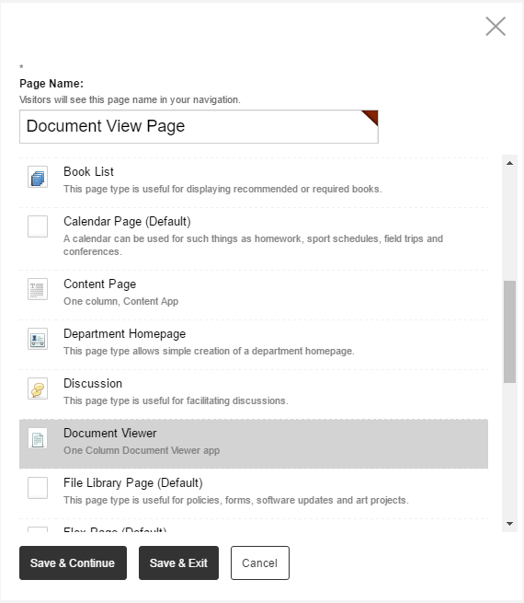
Activity: Add a Document Viewer Page
Now It’s Your Turn.

Slide 10
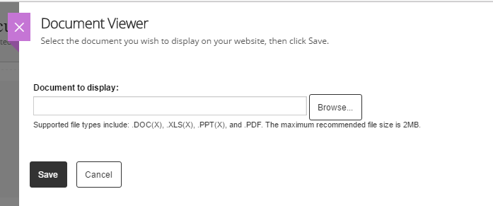
Activity: Add a Document to Display
Now It’s Your Turn.

Slide 11
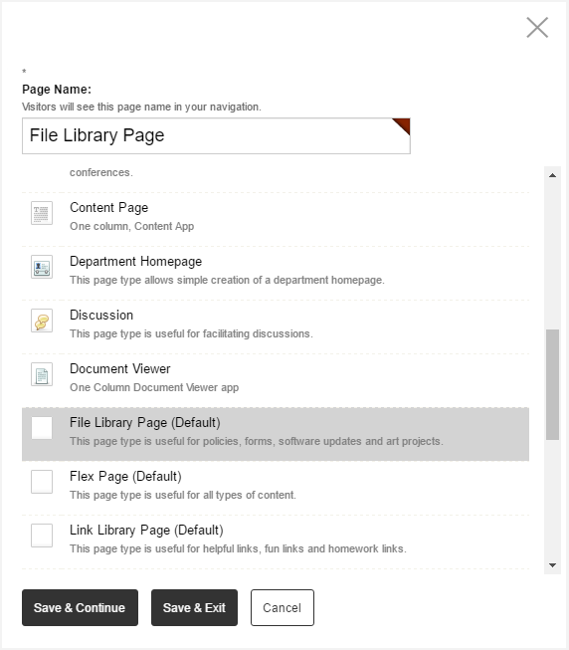
Activity: Add a File Library Page
Now It’s Your Turn.

Slide 12
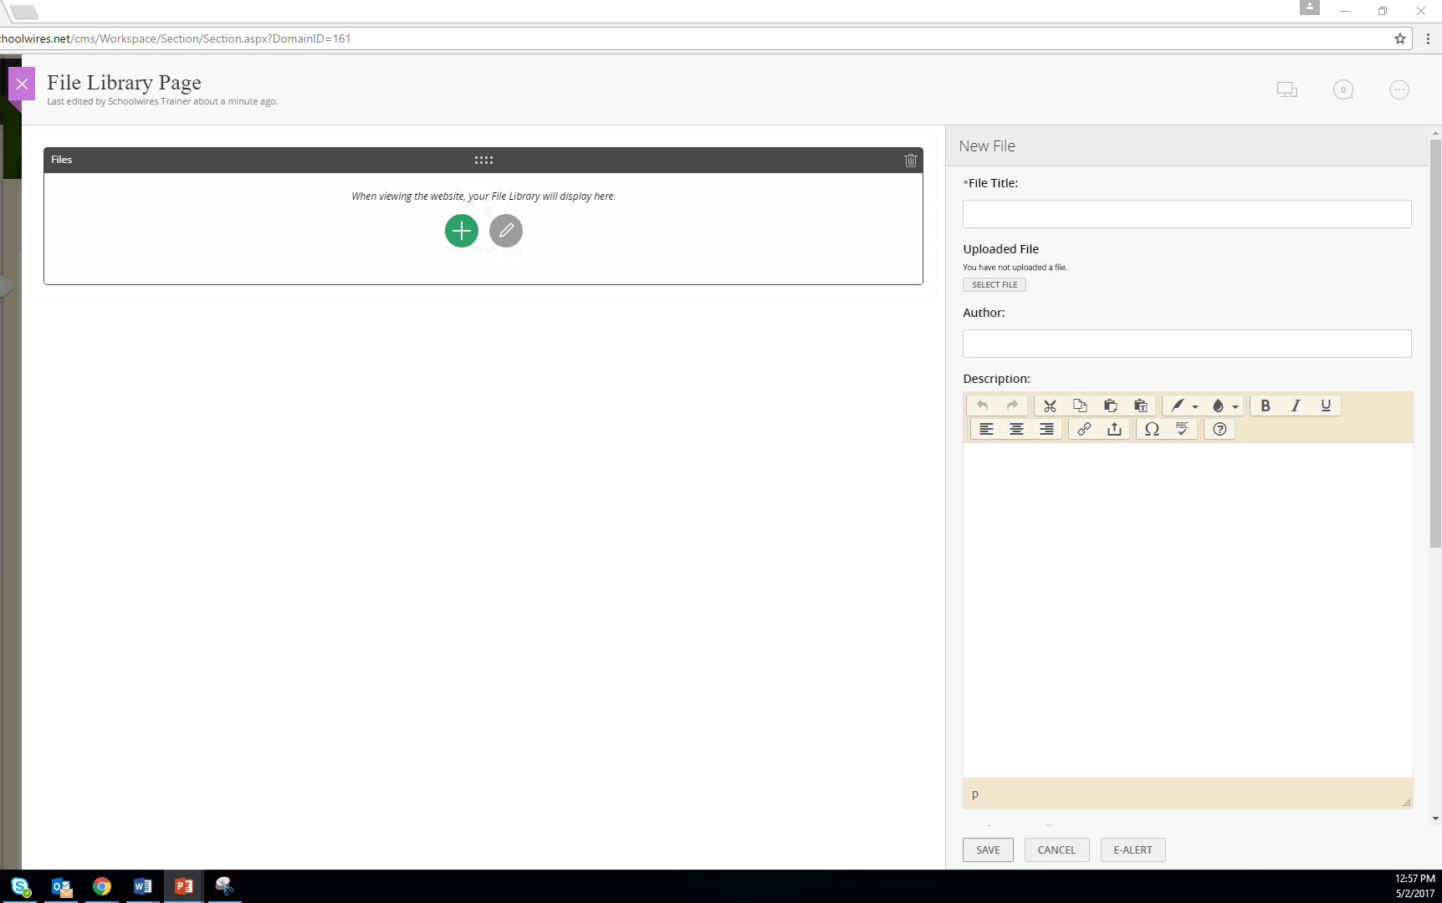
Activity: Add a File
Now It’s Your Turn.

Slide 13
Commonly Used Apps
Announcements App - Short and timely reminders
Calendar App - Events, Schedules, Appointments
Content App - Text, images, links, files
Document Viewer App - View a single document in a page
File Library App - Multiple documents for download
Link Library App - List of links with descriptions
Photo Gallery App - Slide show for multiple images
Site Shortcuts App - Links to popular pages or external sites
Upcoming Events App - Links to your Schoolwires calendar and shows next few events
Notes:
http://mmertz.schoolwires.net/Page/2628

Slide 14
Activity: Modify the Page Layout
Now It’s Your Turn.

Slide 15
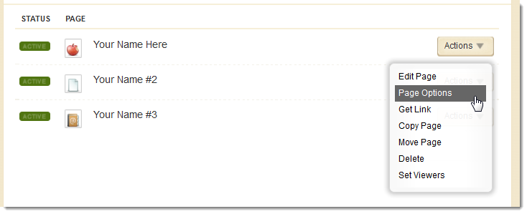
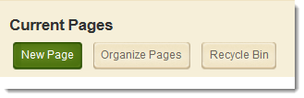
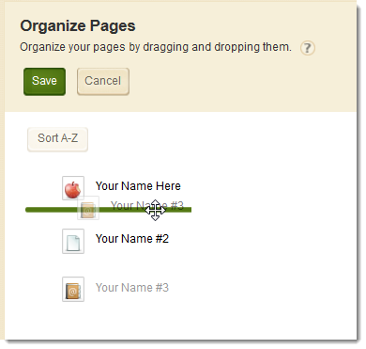
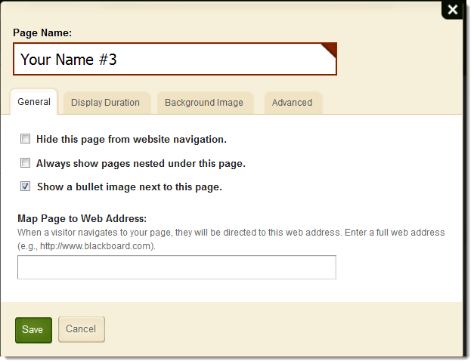
Activity: Page Options & Organizing Pages
1
2
Now It’s Your Turn.

Slide 16
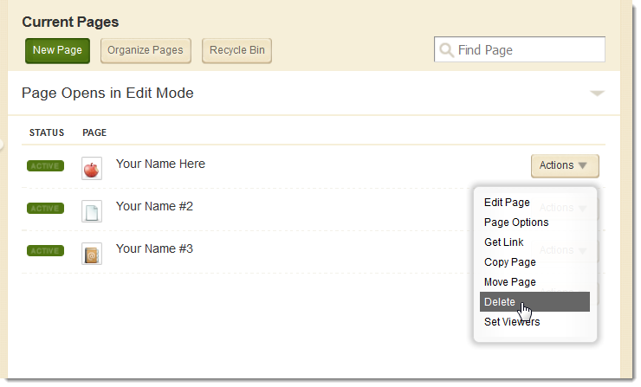
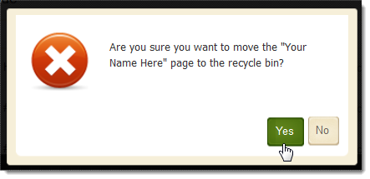
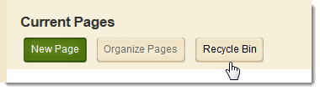
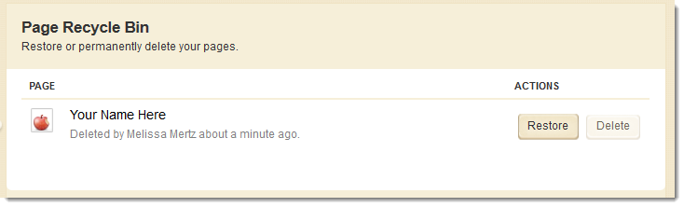
Activity: Delete and Restore Page
1
2
Now It’s Your Turn.

Slide 17
In today’s workshop our focus was to help you:
Understand the layout of the Section Workspace
Access Section Workspace Tools & Resources
Designate a user as a Section Editor
Understand the elements of a Page
Add Pages to a Section
Manage Page Apps and Layout
Organize, delete, and recover Pages in a Section.

Slide 18
We hope you’ve enjoyed today’s Workshop.
Let us know how we’re doing!

