Slide 1

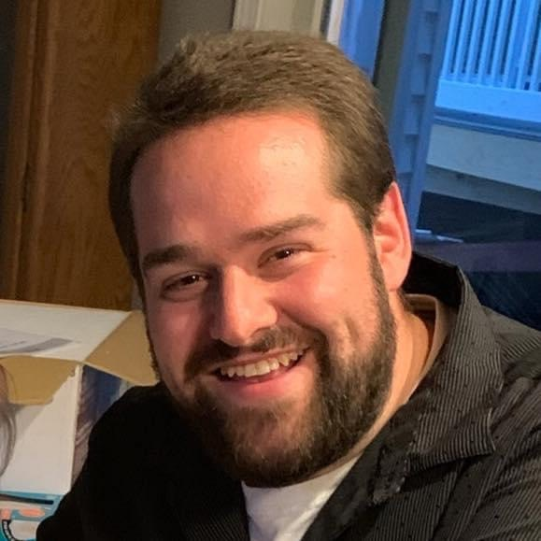
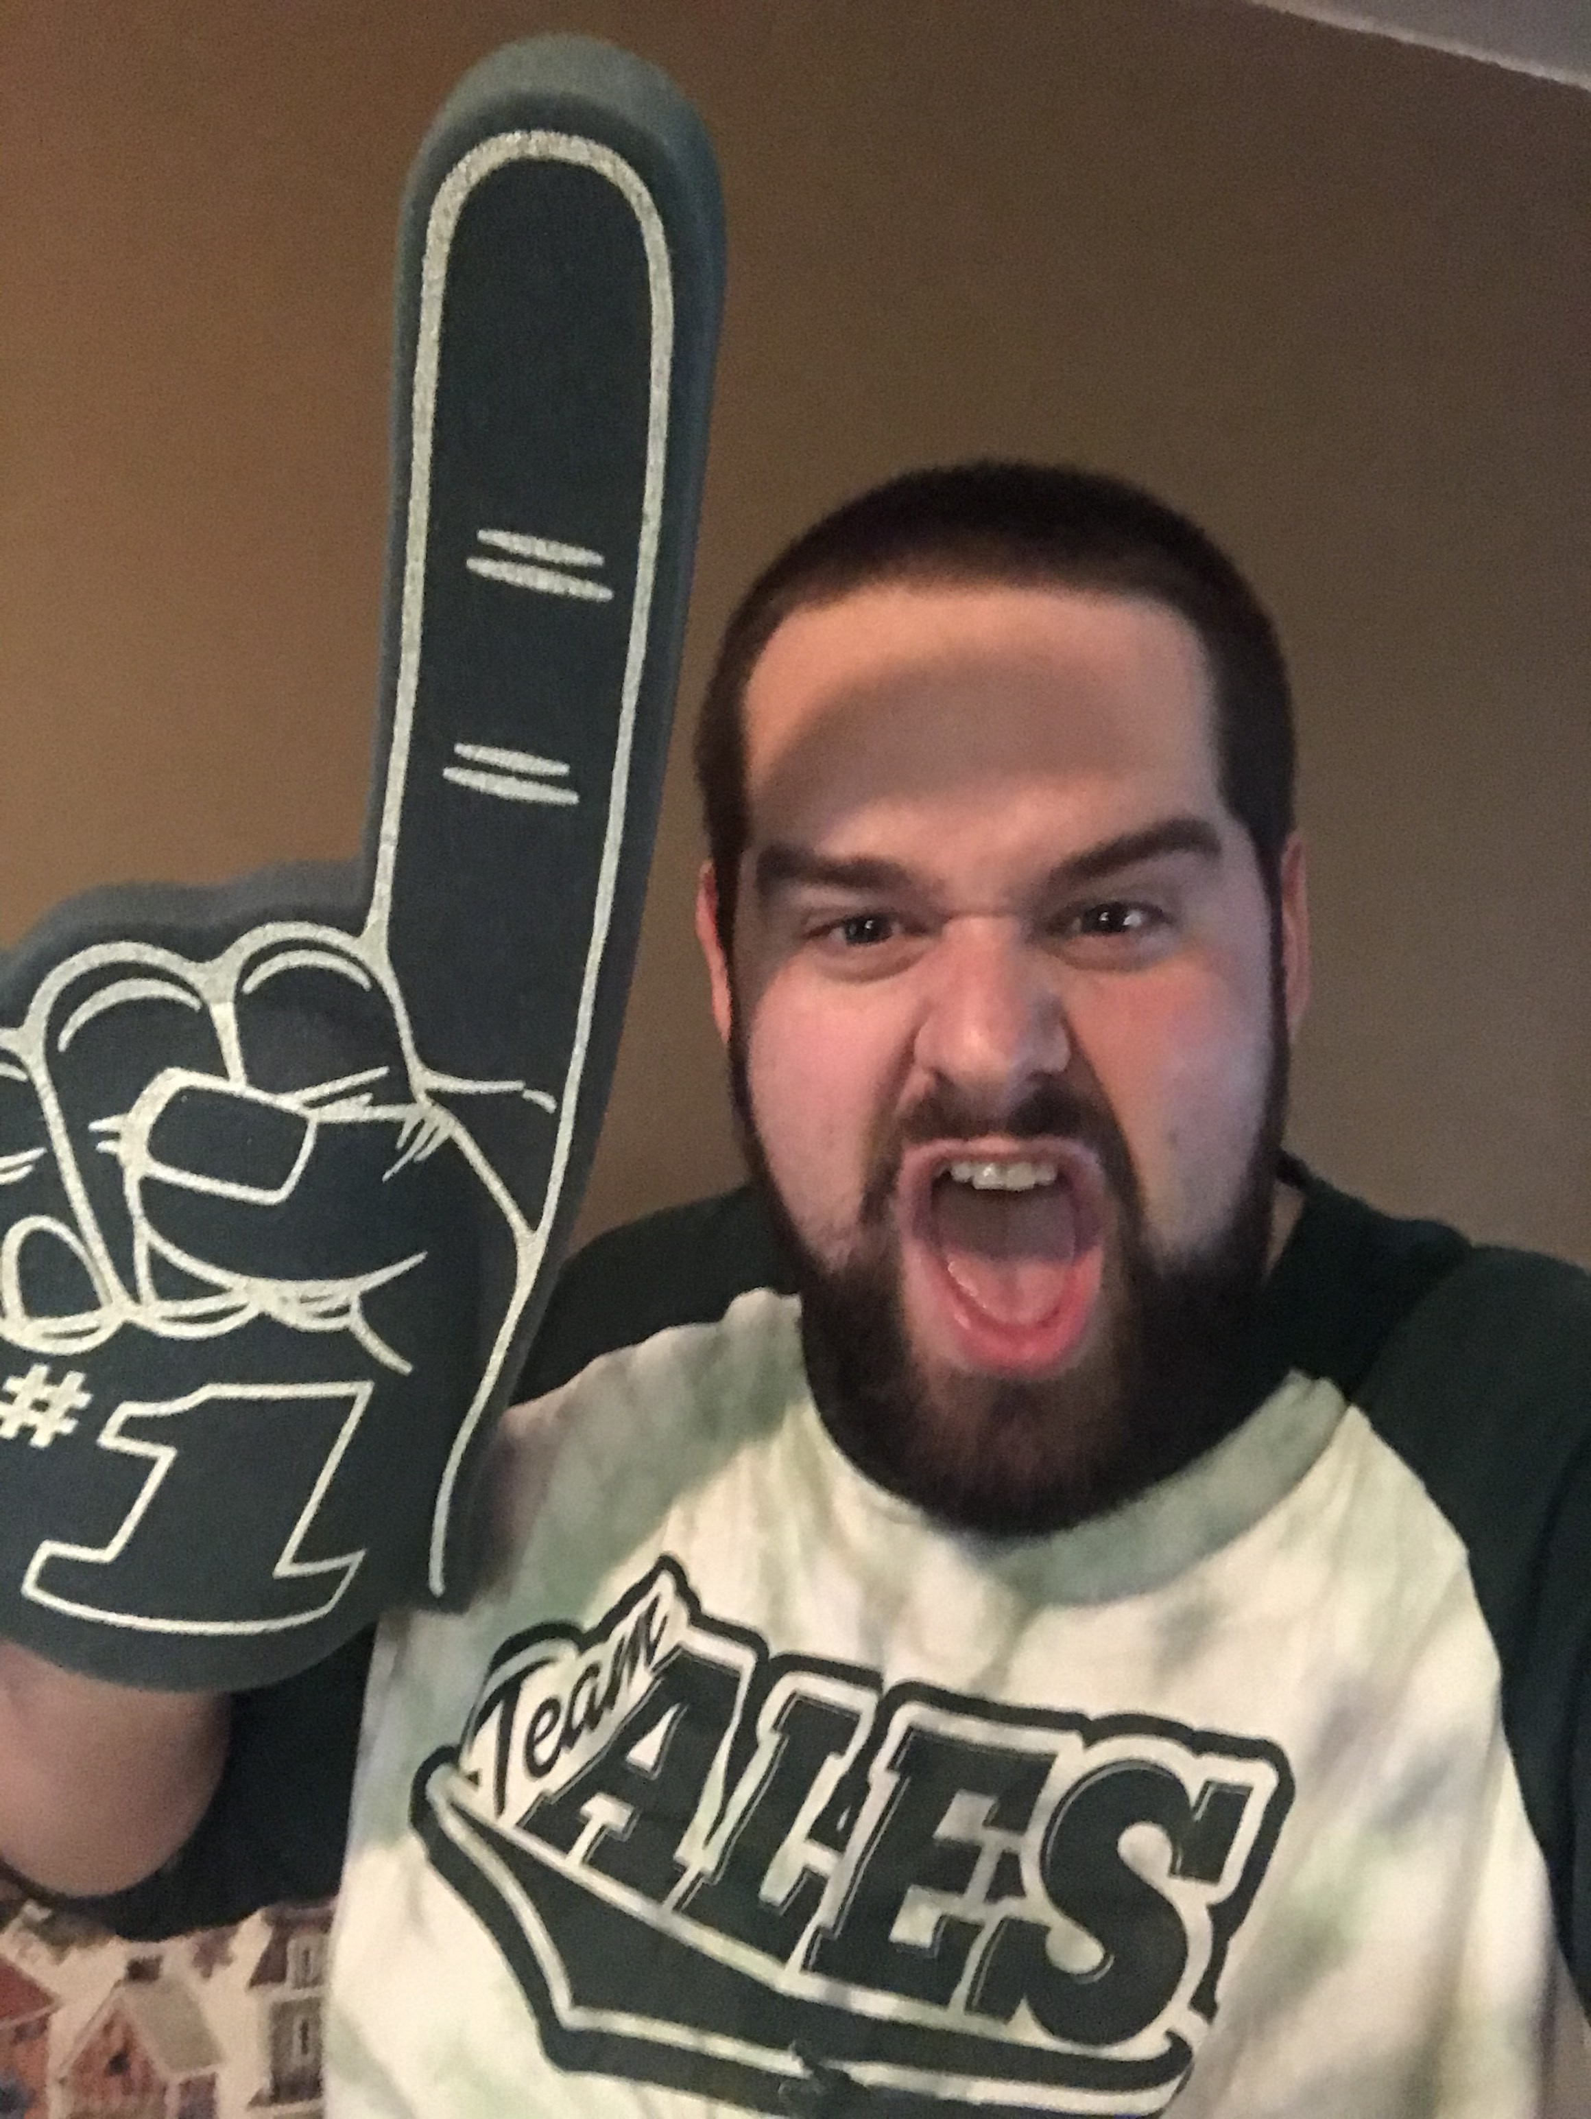

Hello! My name is Mr. Erik Jones and I will be teaching 5th Grade Math and Science this year. I am just starting my seventh year of teaching at ALES. A few years ago, I taught 5th grade ELA and Social Studies, and then 5 years in 2nd Grade. I’m finally back in 5th Grade in a different aspect. I hope you are just as excited for 5th Grade as I am!
Back in 2013, I graduated from St. Bonaventure University with a Bachelor’s Degree in Elementary/Special Education. A year later, I received my Master’s Degree in Differentiated Instruction.
I’m a true Allegany-Limestone Gator after having been one since I was in Kindergarten. I graduated from ALCS back in 2009 and have lived here ever since! I recently just bought a house in the area! When I’m not in school, I enjoy taking photos of nature, stopping by Tim Hortons, or going for walks!
I’m really excited to be spending this next year with you! We are going to learn so many interesting and fascinating things in 5th Grade Math and Science. It’s going to be a new adventure for all of us!
If your parents have any questions or concerns this year, please don’t hesitate to contact me. My email is ejones@alcsny.org, and my school number is (716) 375-6600 ext. 4201
MY FAVORITES
Food: Steak
Movie: Mr. Holland’s Opus
Colors: Red, White, and Blue
Drink: Large Double Double (Tim Hortons)
Season: Autumn
Sports Team: Buffalo Bills, NY Mets, Bonnies
Animal: Elephant
Bands: Coldplay and Billy Joel
Vacation: Lake Tahoe

