Slide 1

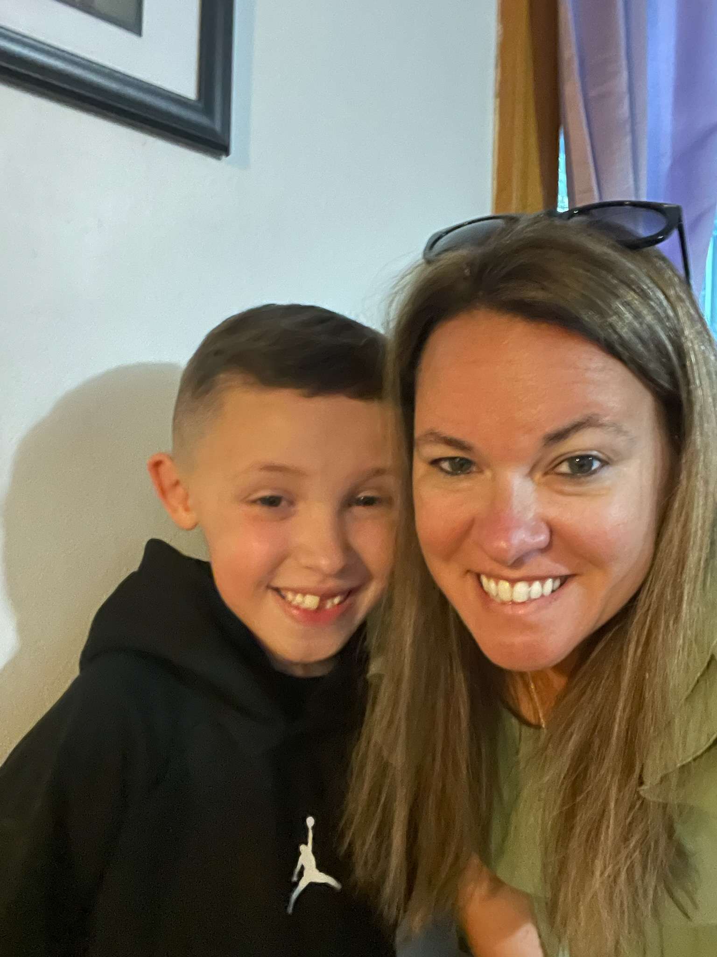
A Few of my
Favorite Things:
My family
Pizza
Allegany State Park
Sunflowers
Hello! I’m Mrs. Dawn Acosta. I am the 6th Grade Special Education Teacher. I live in Olean with my husband and children. We love going for drives through Allegany State Park, fishing and spending time with our close friends and family.
Contact Info:
Dacosta@alcsny.org
716-375-6600 ext 2171
Please contact me with any questions or concerns.

