Slide 1
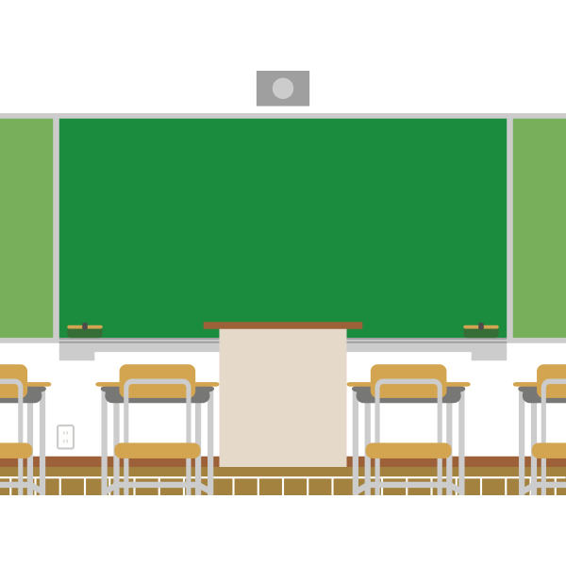

Welcome Back High School Students
Class of 2021
Class of 2023
Class of 2022
Class of 2024
We are all in this together!
Notes:
Teacher should choose the correct script below for the classmen which they are speaking…
Welcome back to the Class of 2021 - final year -- This you will plan for future after graduation. You’ll continue to research colleges and applyto college. You’ll continue to think about your careers and what education is required. You’ll also get through the financial aid process for college and trade schools.
Welcome back to the Class of 2022 - Junior year - Likely your most challenging year academically. You have full schedules with English or Developmental, Algebra 2 and History. You’ll also take your SAT’s and continue your career exploration and college search.
Welcome back to the Class of 2021 - Sophomores - You are no longer new to high school. Your second year might be filled with new goals based on what you learned from last year. You have a full schedule of graduation requirements and should begin to exploration of careers and possible majors in college, and start search for colleges you might be interested in.
Welcome Freshman - Class of 2024 - We are so thrilled to have you start this journey! You have a fresh start academically. Every final grade and future activity enhance your application to college. May you have a rewarding year fill with much successes to build upon throughout high school.

Slide 2
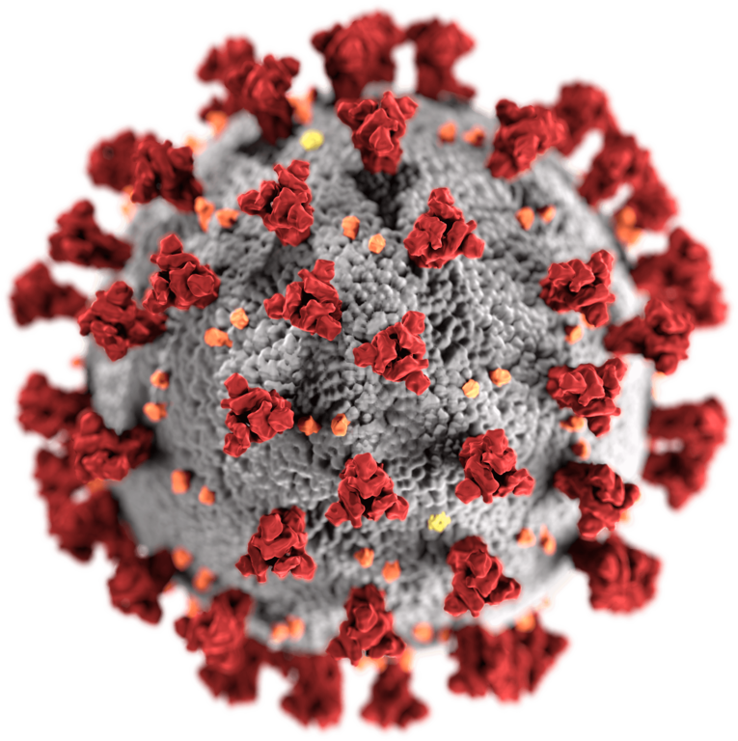
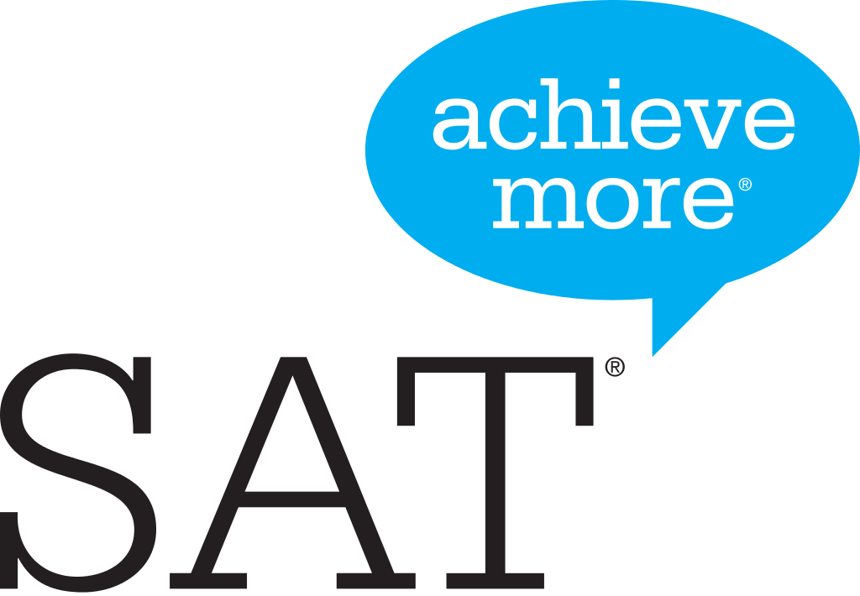

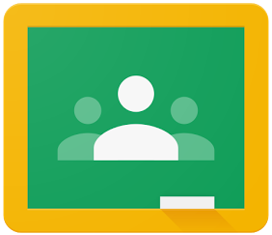

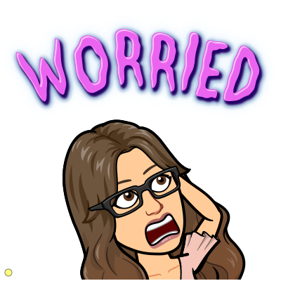


We know you might be nervous about starting school..
Notes:
We know you might be nervous about coming back. You are bombarded with news about COVID-19. There have been many changes in the process for SATs. You might not want to use Google Meet and might be unsure about Google Classroom, Google Slides, and Google Drive. You might also be worried about getting through school from home, even college applications.

Slide 3

We’ve got your back!
Notes:
But we’ve got your back!
Our school is always available to support you feel comfortable. The school counselors are available to support you with any academic, social or personal concern you may have. At the end of the presentation, you will see how to contact them virtually while we are out of the school building. Your school staff may not have any superpowers to make problems disappear but we can help you with tools to cope and assist you with your academics, social/emotional, and college and career needs!

Slide 4

The 5 Competencies Social Emotional Learning
Self-Awareness
Self Management
Social Awareness
Relationship Skills
Responsible Decision-Making
Notes:
Paterson Public Schools is planning on incorporating all these ideas into the fabric of your day at school. Now, with much of our learning moving to a virtual setting it is even more critical to be aware of and practice these 5 competencies of social emotional learning. These standards are self-awareness, self-management, social awareness, relationship skills, and responsible decision making will help you throughout your life. As you will see in the rest of this presentation, mastering these 5 standards will make you an excellent co-worker, friend, partner, and member of society.
Remote learning will require so much more of you. It preps you for being an adult and being self-driven. Unlike many adults in their jobs virtually, you’ll have the support of your teachers, counselors, and other school based support staff whenever and however often you need us. We will all be focused on supporting your social emotional learning so that you can succeed academically this year.
Lets watch a video to break down these 5 competencies of social emotional learning…
(click to next slide for video)

Slide 5
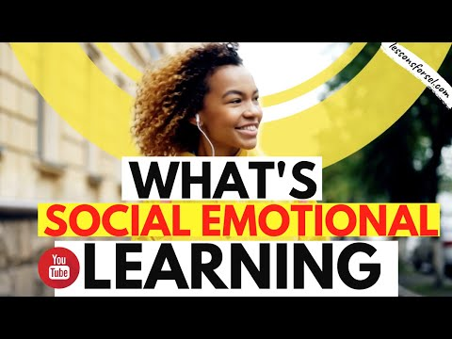

Slide 6
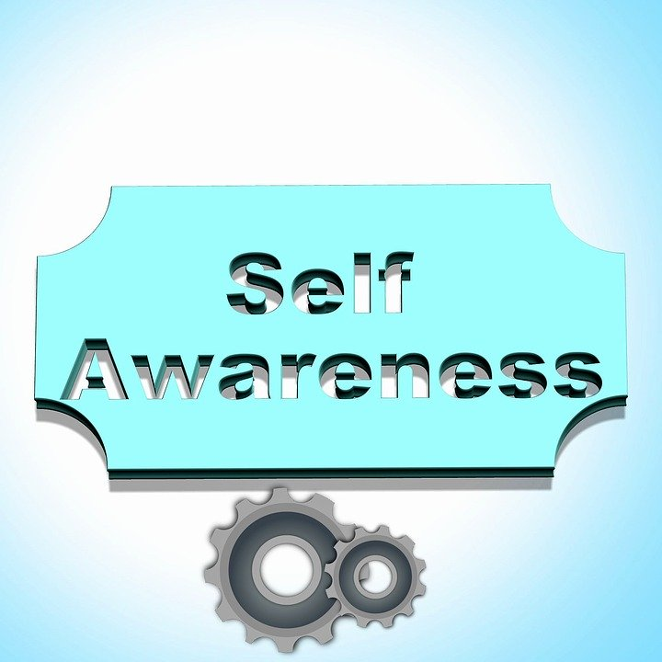
Notes:
Our first competency is Self Awareness

Slide 7
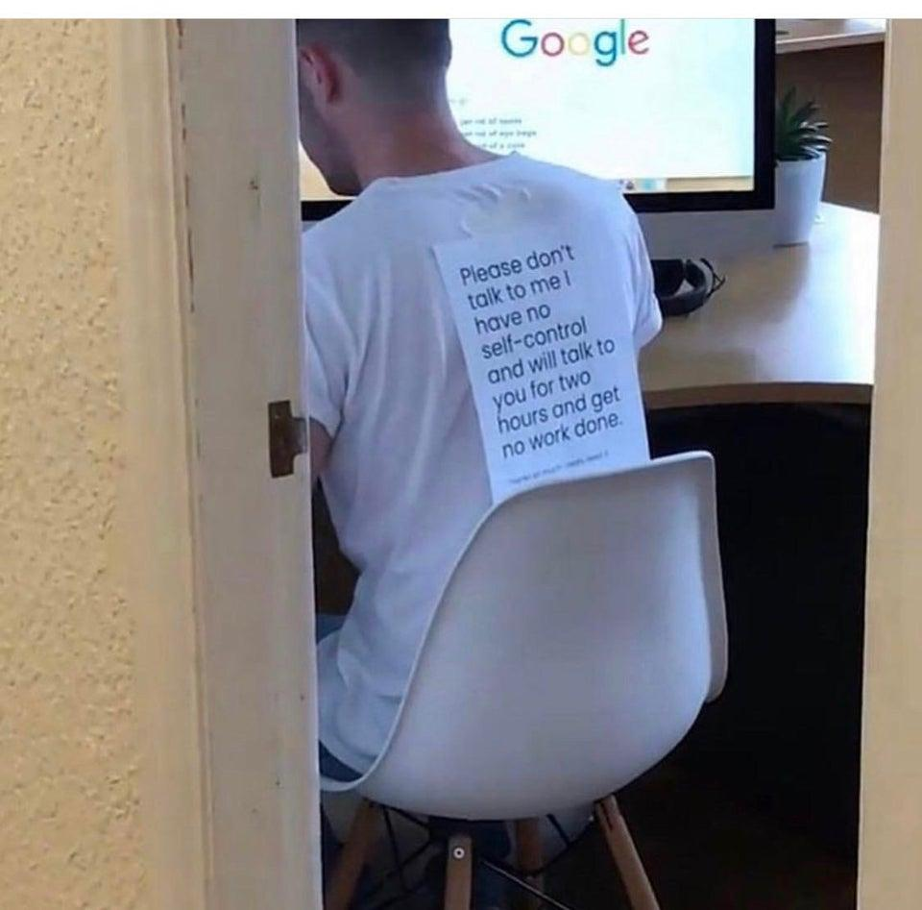
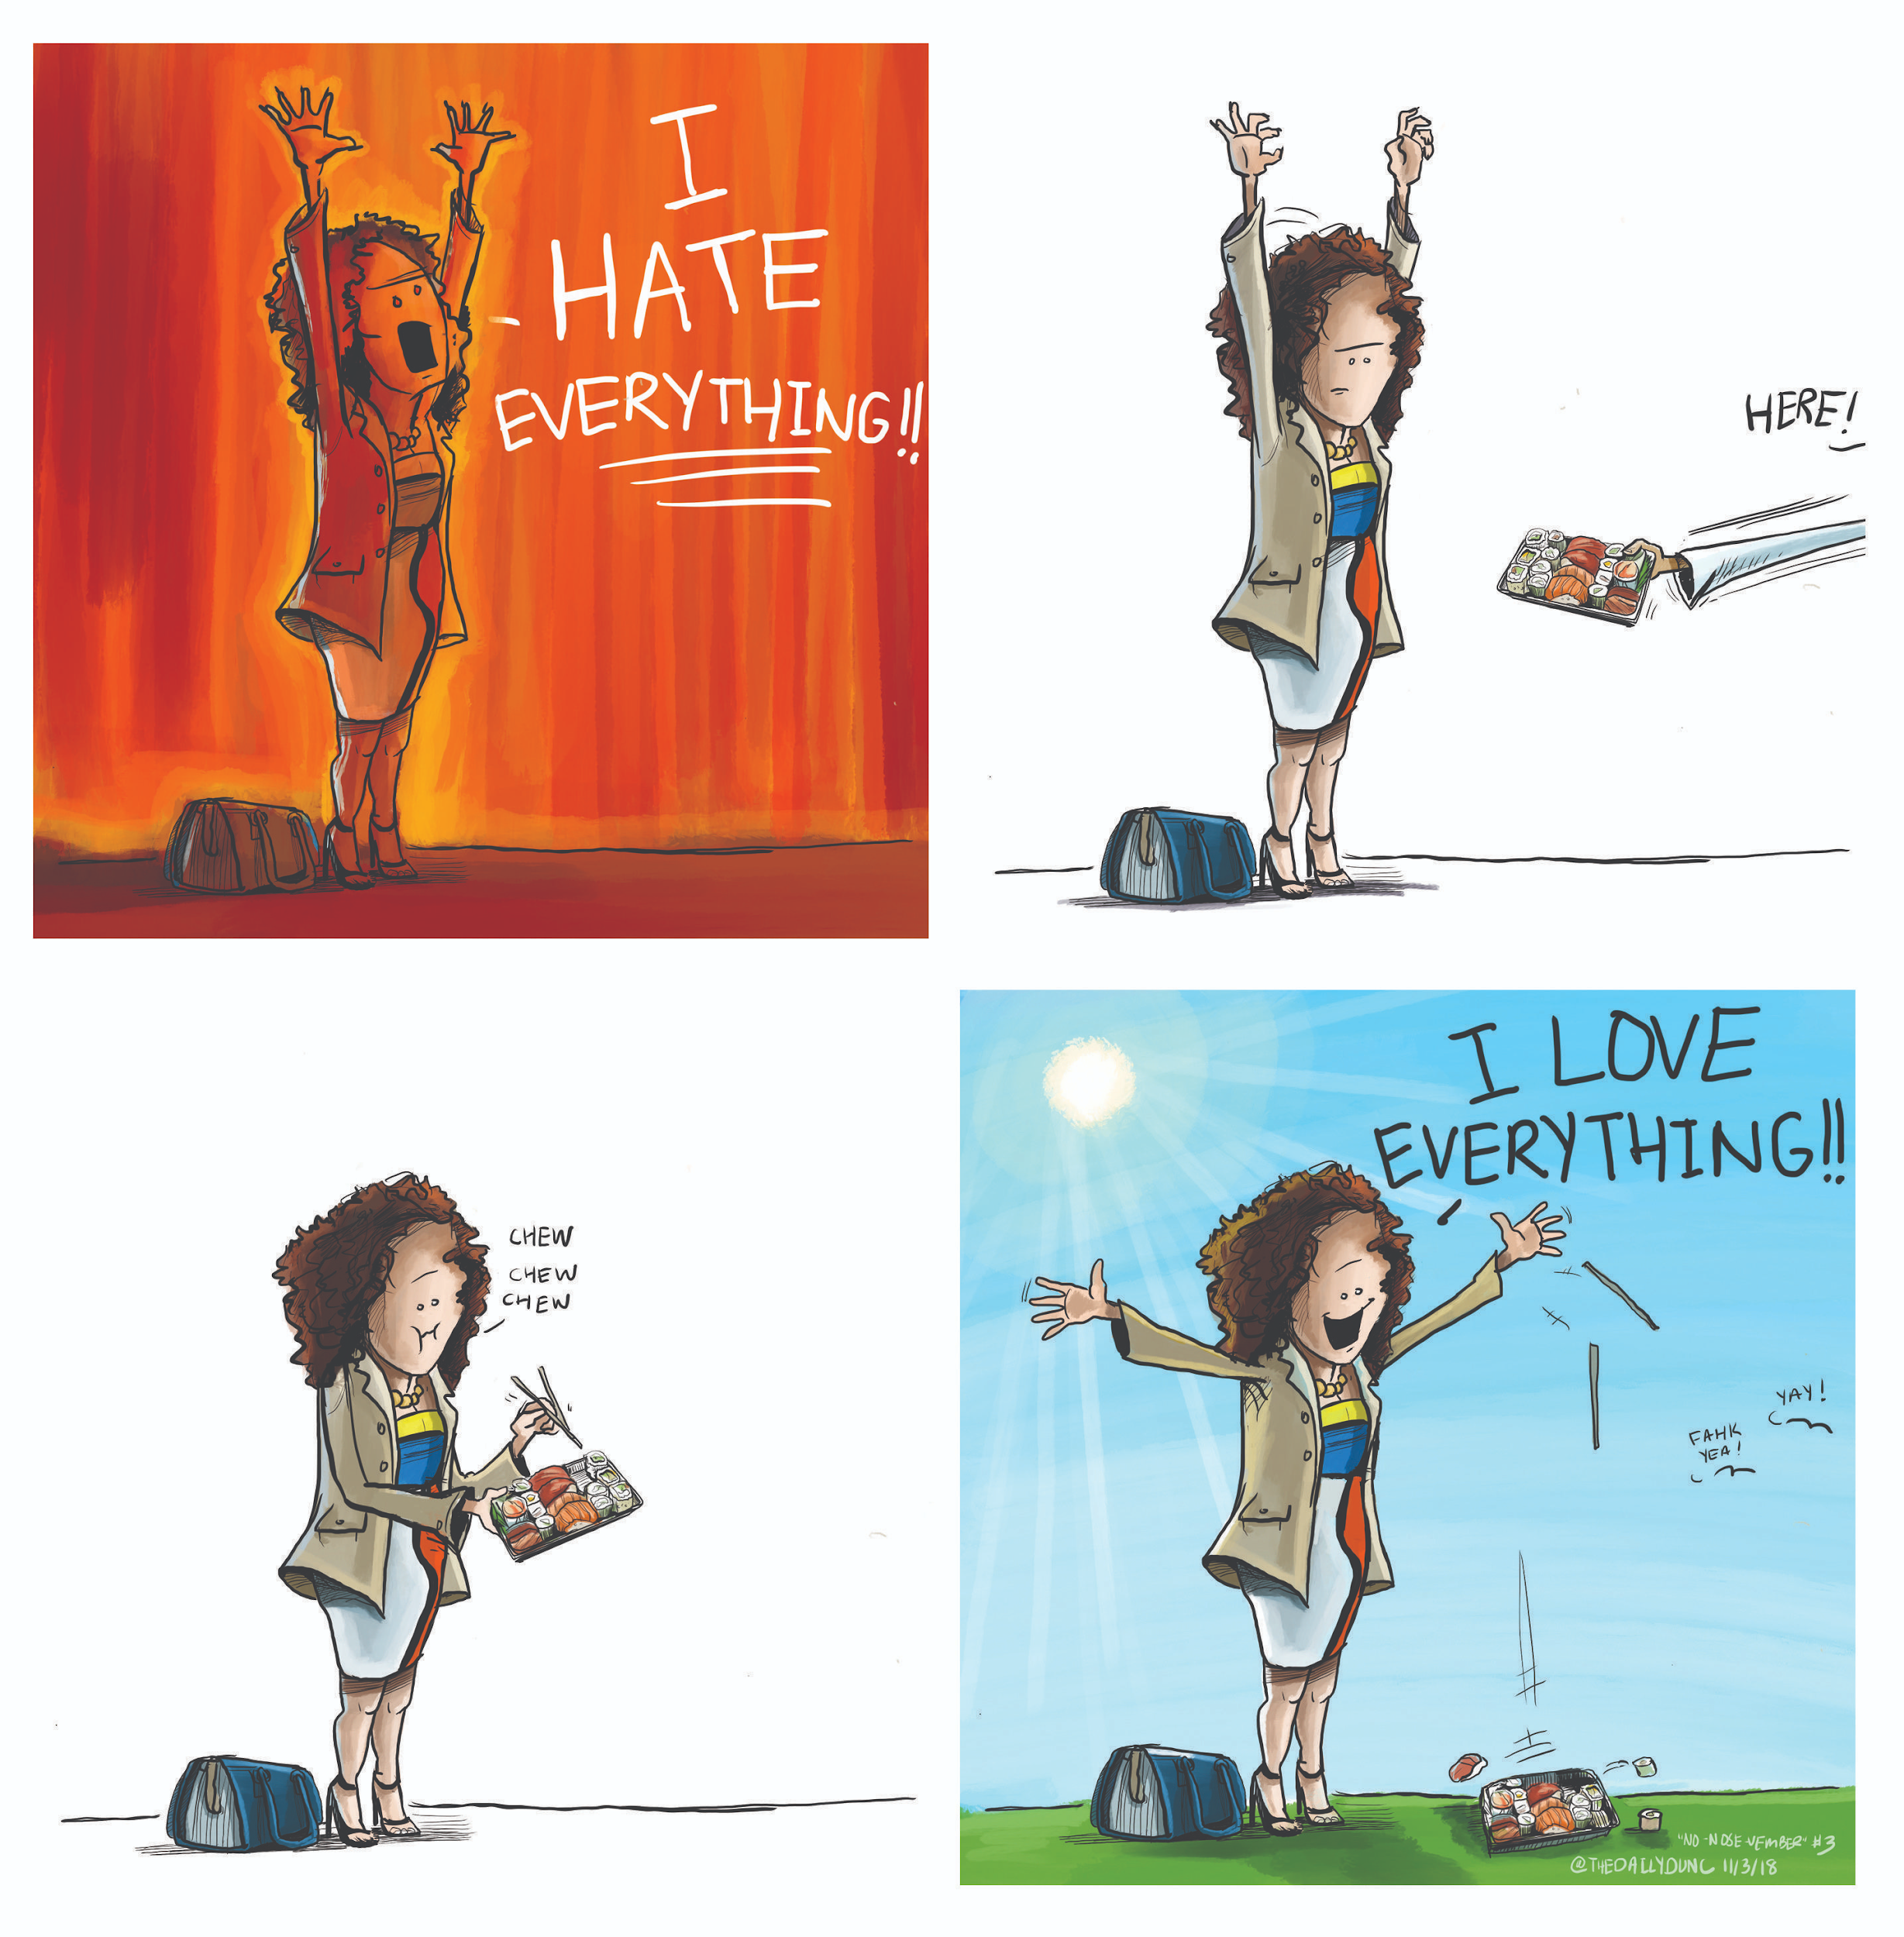
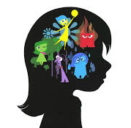
SELF AWARENESS
Understanding one’s emotions, thoughts, and values, and how this influences your behavior.
It also includes evaluating our strengths and limitations.
Notes:
Pixar’s movie Inside Out is a great example of how feelings affect our behavior. It’s not easy to recognize our emotions many times.
Your teachers might also use mindfulness activities in the classroom to help you recognize where you might hold stress and tension in your body. Give these ideas a try. You might find a few that work for you. You aren’t expected to love every activity. For example, guided meditation may not be for you but maybe you love to write or draw in a journal. Although you may not love all the activities, it is important that you get experiences with many different types of stress and tension-easing activities so you have them in your personal self-care toolbox.
A more concrete example is being HANGRY. How many of you have every been so hungry and you feel angry? Attempting to get schoolwork or anything done when you are hangry is difficult. The same applies when we are feeling stressed or overwhelmed. Many of us keep issues bottled up inside, similar to the girl in Inside Out. Talking to someone helps! Talk to you teachers, your friends, and your counselors! You might find that having an understanding friend or staff member is enough support to get you through whatever you are struggling with.
Another important part of self awareness is knowledge of our our strengths and weakness - It’s important to know your own limitations - like the picture. Know what you need to have set up to get your work done. This is not universal - it is different for everyone. Virtual learning will encourage you to figure this out now rather than in college. It’s prepping you and getting you ready for life.

Slide 8
“The first challenge that I faced with virtual learning was the work that I was getting from some of my teachers. The content of the work was not an issue, as was the amount of it. Some teachers were pretty normal and standard with the amount of work that they were assigning, however, some others were not. I was getting packets of work with 30+ pages, bi-weekly, if not weekly, that was expected to be completed in a short amount of time, completely disregarding the amounts of work that I was getting from all of my other classes.”
“When we went to virtual school last March, it was very difficult for me to concentrate. Over time it got better. I learned that I need to be focused and have a quiet environment to do my work.”
Naomi Estrada
Class of 2021
Gabriel Torres
Class of 2021
Notes:
Check out a testimonial from two self-aware students.
[Teacher to read Naomi’s testimonial on slide]
Naomi learned that she needs a quiet environment to complete her work. Maybe you do not, but when the teacher is teaching via google it’s important to ensure that you are not distracted. We all understand things may happen at home while doing your work.. Remember you can mute yourself when participating in the google meet if necessary.
Lets see what Gabriel says..
[Teacher to read Gabriel’s testimonial on slide]
Can anyone else relate to his struggles? I bet you can. Self-awareness can help your relate to others. It can help you recognize how you are feeling, and that maybe others are feeling the same way. Ask questions during class so you don’t have the feeling of being so lost that you don’t know where to start.

Slide 9
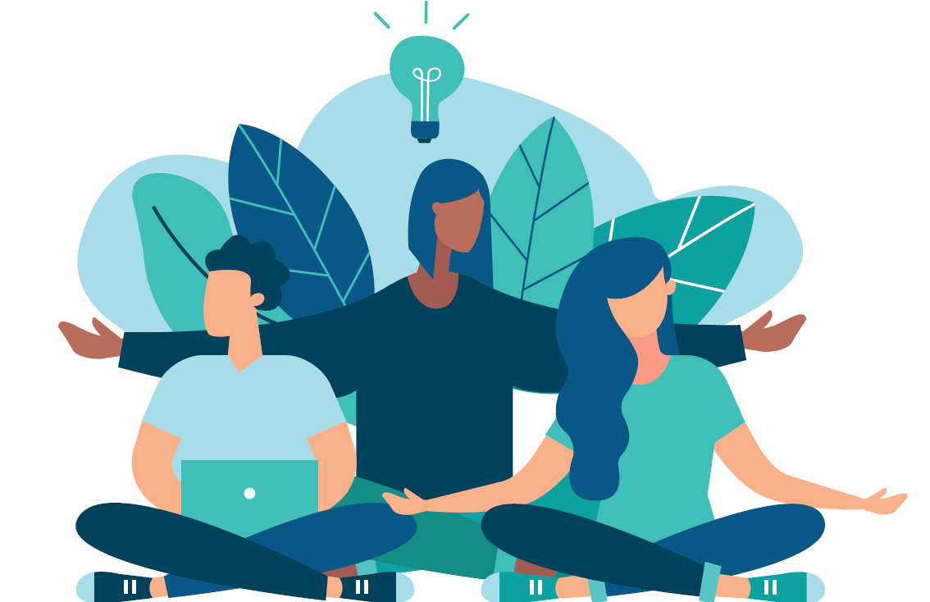
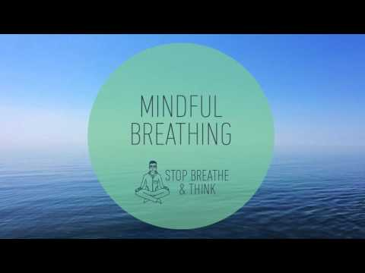
PRACTICING MINDFULNESS
Notes:
You may be asking yourself… “what happens when no matter how hard I try, the stress I feel is so overwhelming (school work, college application process, family issues, grief and loss, trying to find a job, relationship issues).
Well, let me introduce you to a little thing called mindfulness. What exactly is mindfulness you ask? Mindfulness is like your very own super power...but it must be harnessed in order to be effective.
Let’s try this 3 minute mindfulness meditation to activate your super power.
(start video and upon completion move to next slide)

Slide 10

Did you find this 3 minute meditation useful?
ⓘ Start presenting to display the poll results on this slide.
Notes:
Now let’s get interactive. Take out your phones and please go to the website on the screen or scan the barcode and answer the live polling questions.
📣 This is Slido interaction slide, please don't delete it.
✅ Click on 'Present with Slido' and the poll will launch automatically when you get to this slide.

Slide 11
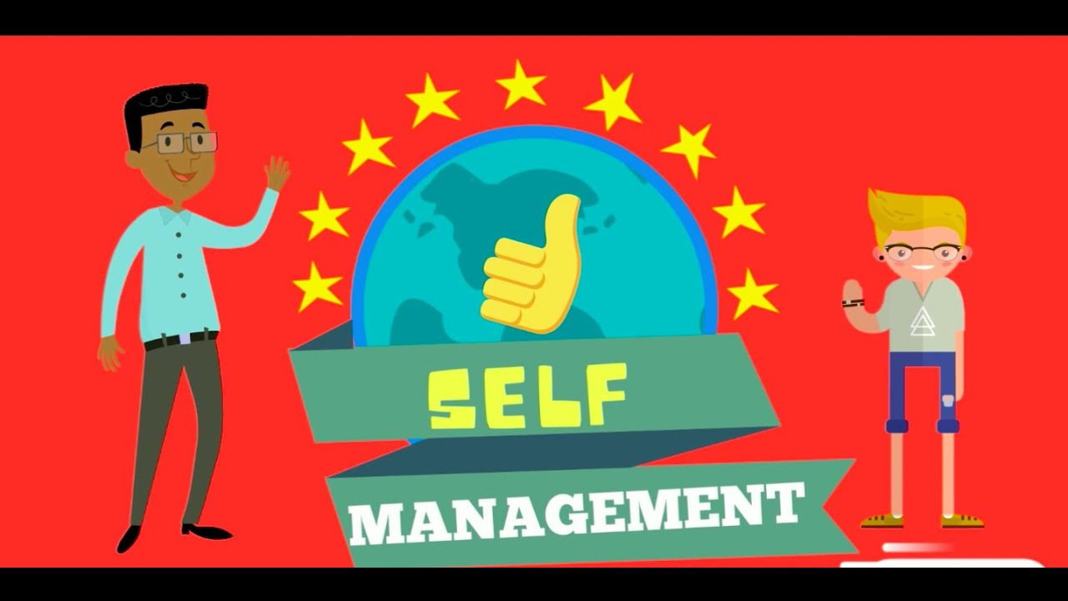
Notes:
Our 2nd competency is self management

Slide 12




“At first, I was excited to take online classes because I needed that time at home to catch up on my assignments, but I really prefer to be physically in class. I don't like having to listen to someone talk all day on the computer. Nevertheless, I would say that the best thing about online classes is the ease of choosing what time and for how long to study, creating flexible and appropriate study schedules.”
I got a lot of notifications from google classroom and gmail but I knew how to handle them. I downloaded both apps on my phone since I am always on it. I was notified any changes or new activities that the teachers assigned. Also, I created an agenda so I could keep up with all my classes.
Lorennys Garcia
Class of 2022
Tip: You can use google calendar to create a schedule for yourself. Add your calendar for your classes, work, and homework.
Click on the youtube image for a link on how to use Google calendar
Notes:
While this new situation isn’t ideal, it does give you some more freedom to work when you feel most productive. You must attend school on your assigned days and your assigned class times but you will have to work from and complete your assignments at home. Take time to make a plan for how and when you will complete your work. You get to be in charge of yourself. It’s a lot of adult and college level of responsibility. You got this!
Lorennys Garcia suggested making an agenda. It’s easy to make a template of an agenda is google docs or google slides. You can also use google calendar for all your classes, and other responsibilities outside of school.

Slide 13
Are you interested in using google calendar?
ⓘ Start presenting to display the poll results on this slide.
Notes:
Ok pull your phones back out and answer poll question #2. Are you interested in using google calendar?
📣 This is Slido interaction slide, please don't delete it.
✅ Click on 'Present with Slido' and the poll will launch automatically when you get to this slide.

Slide 14





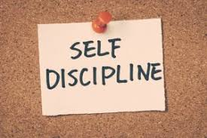

Self management is the ability to successfully regulate one’s emotions, thoughts, and behaviors in different situations
Notes:
Self management at any age can be difficult because emotions are REAL (emphasize). Even as adults, emotions can get the best of us at times. Anger, frustration, annoyance, embarrassment, love, and hate are just a few of the emotions you can feel at any given point in time. But how you handle them makes the difference between a positive outcome or negative outcome.

Slide 15
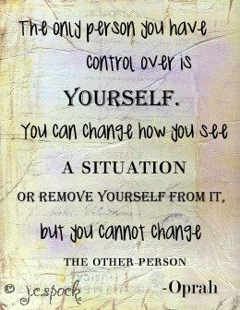
Notes:
[teacher should read quote on slide]
Try and remember this quote the next time you get into a situation with some - a friend, classmate, teacher, enemy - and you think you HAVE to put them back in their place, whether physically or verbally. THE ONLY PERSON YOU CAN CONTROL IS YOU! PERIOD.

Slide 16
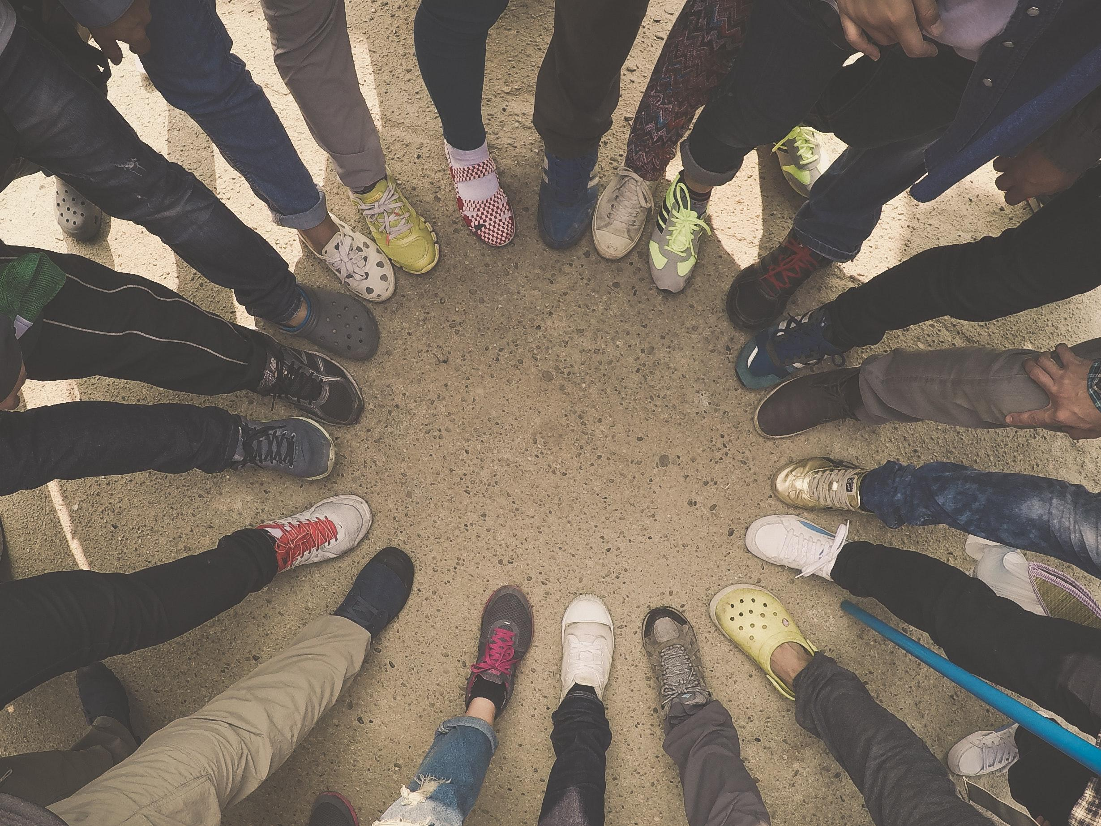
Social Awareness
“Put yourself in someone else’s shoes”
Notes:
Competency #3 is social awareness.
Social awareness is our ability to understand the emotions and experiences of others. It includes understanding individuals of different religions, cultures, ages, and abilities.
Wouldn’t you like to have a socially aware person as a boss, co-worker, teacher, or friend?

Slide 17
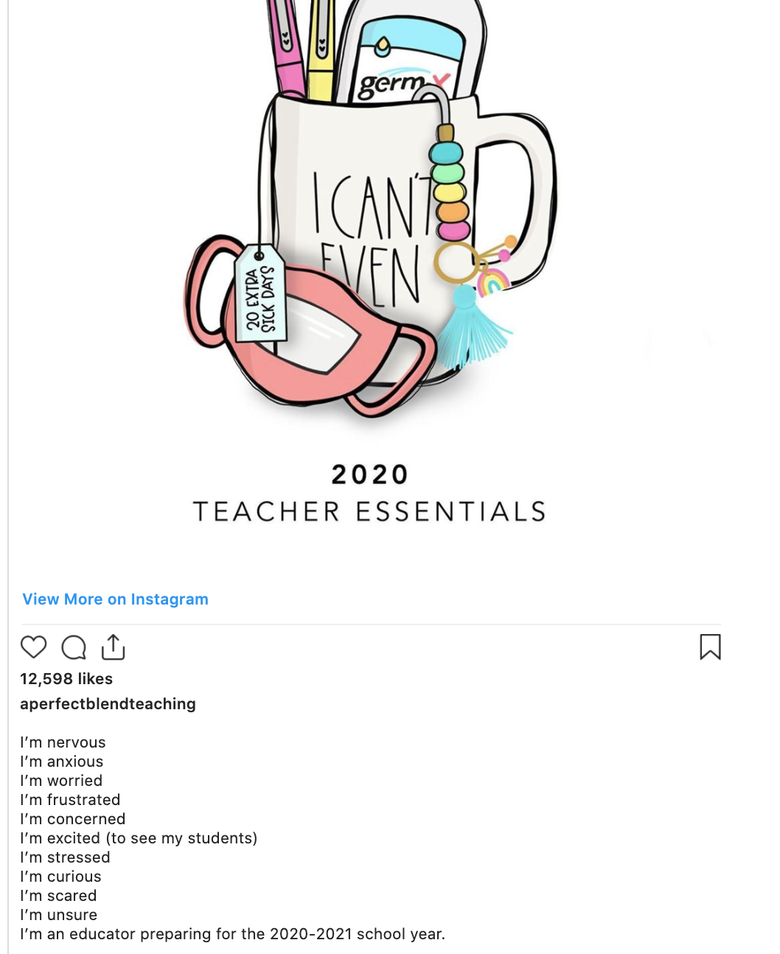
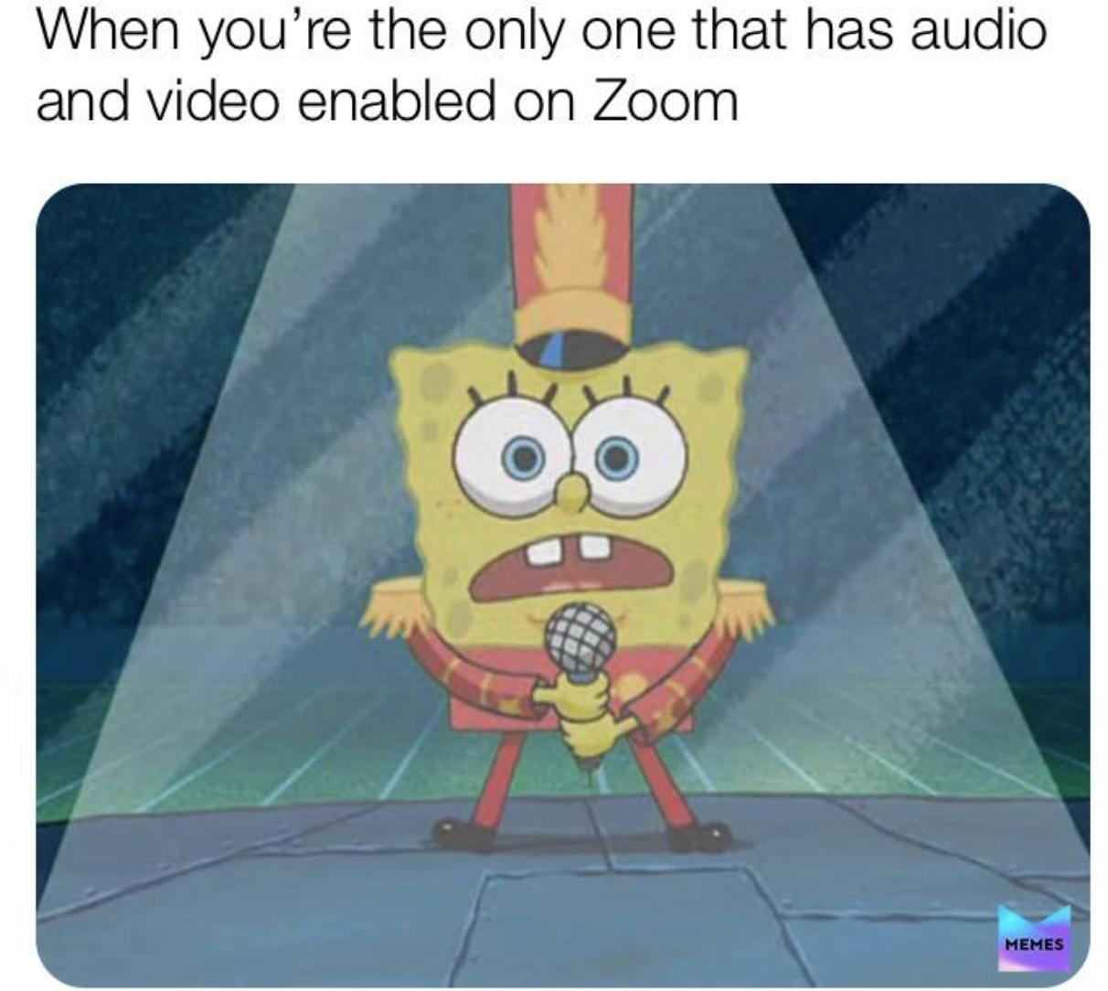
Notes:
Virtual school gives you an opportunity to practice social awareness. Be sensitive to how your peers are feeling and to your teachers. Practice compassion. Think about the classmate who might need some help with translating assignments.
Your teachers are learning a whole new way to teach. Many times they won’t be able to see your faces to be able to check if you understand. Turn on the audio and video in your meets, if possible; take a chance. If not, use the chat to ask questions and show that your understand or don’t understand.

Slide 18
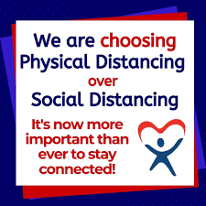
When I didn’t understand an assignment I mostly asked my friends for help or I would ask the teacher. Sometimes the teachers took too long to respond so asking other students for was the most helpful.
Reyismel Valerio
Class of 2022
Notes:
Everyone’s talking about social distancing. Keeping our 6 feet of physical distance will keep us healthy, but we can connect socially. I hope that you do take time to connect with your friends, your counselors, and school staff. We are born with a need for connection. A lack of meaningful social connection can have a negative impact on our health and well-being. Furthermore, research shows that social connectedness is a buffer against stress.
Teacher, calling out directly to the class: What does everyone think? Is there a peer that you can help? How can you connect in a meaningful way with others during this time? Can you help your teacher, yourself, and your peers by getting involved and making connections with others?
Everyone will benefit!

Slide 19

Relationship Skills
The ability to establish and maintain healthy and rewarding relationships with diverse individuals and groups. The ability to communicate clearly, listen well, cooperate with others, resist inappropriate social pressure, negotiate conflict constructively, and seek and offer help when needed.
Communication
Social engagement
Relationship-building
Teamwork
Notes:
The 4th competency of socio-emotional learning is Relationship Skills.
[teacher reads slide]
Lets view a video that will explain to us why relationship skills are so important and essential to our everyday life.
(click to next slide to view video)

Slide 20
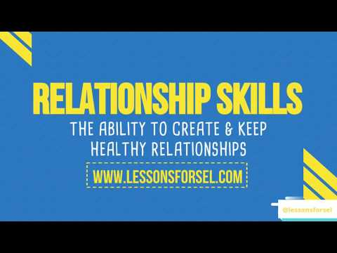

Slide 21
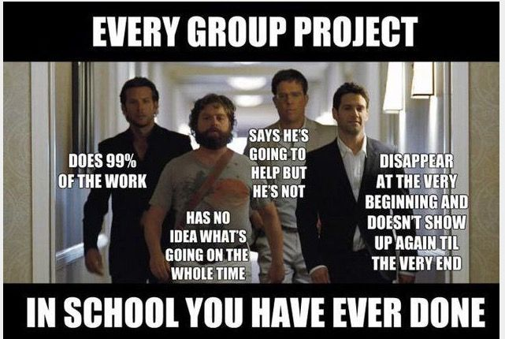
It takes hard work to function effectively in a group.
While many of you don’t love group work, it prepares you for your future career.
Have open communication with your group members. Use group work as a chance to practice your relational skills.
** click on the image for a link to group work tips
Notes:
Whenever anyone hears, group project, you can almost immediately hear the murmurs of disappointment in the classroom. You may think, “why would my teacher punish me like this?!” Simple….to develop relationship skills. Group work feels just like the meme on this slide. Even as adults, some shiver when you hear “group project.” But the bottom line is, it takes hard work to function effectively in a group and it will absolutely prepare you for your future career or job.
[Teacher to read the yellow box within slide]
Be sure to view the tips by clicking on the meme. You can save the page in your favorites on your internet browser.

Slide 22

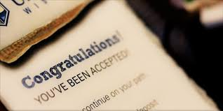

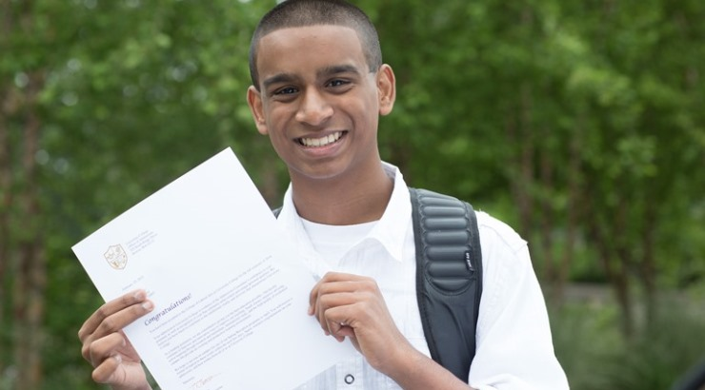


Notes:
Relationship skills play a major role in how you interact with the world outside of the school setting. It can help you get hired for your dream job (and keep that job), win a scholarship, make new friends, and have a healthy relationships with your significant others.

Slide 23
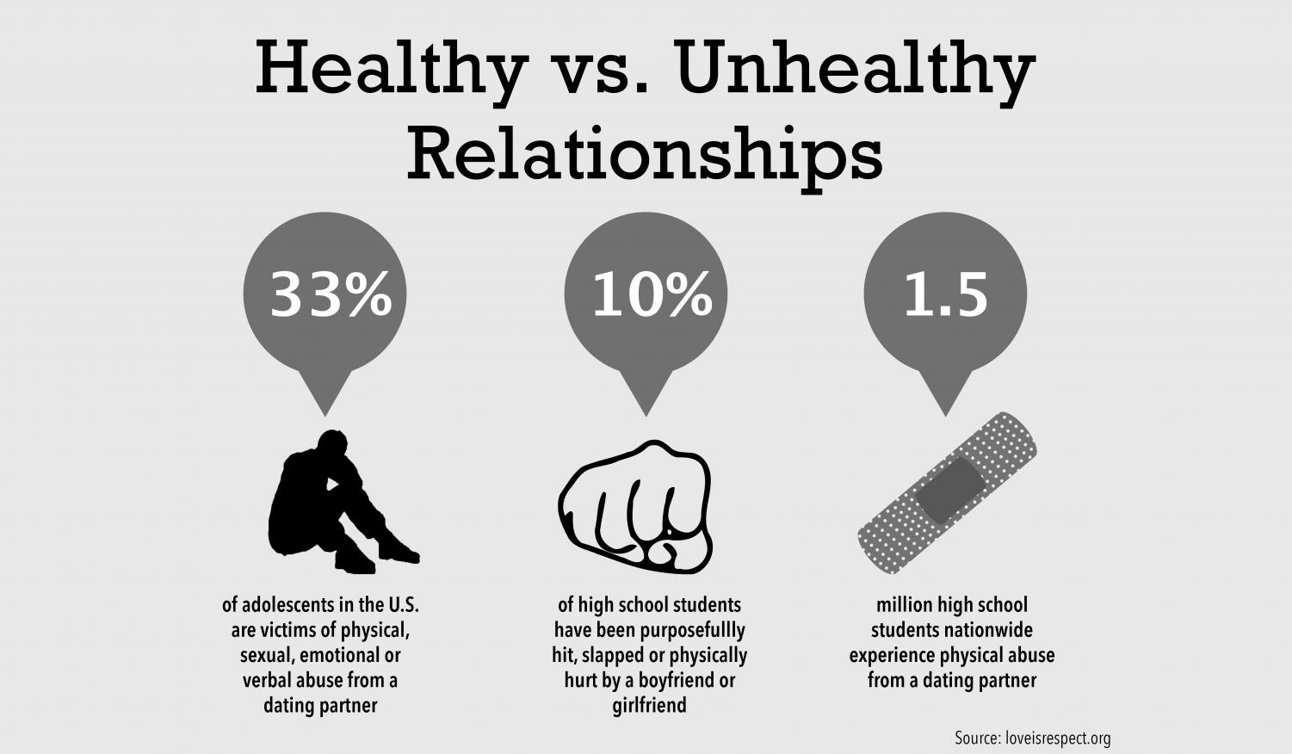
Click here!
Notes:
When we use the world relationship, we often think of it in term of something you do with other people. However relationship building starts inward. It starts inside of you! In order to create healthy relationships with others, you must first develop a healthy relationship with yourself. If you can’t treat yourself right, why would anyone else…
One in three adolescents in the U.S. is a victim of emotional, physical, or sexual abuse from a dating partner, a figure that far exceeds other types of youth violence. Research shows that 1 in 10 high school students have experienced violence by someone they are dating. On your screen, you may click on the link for resources on this topic.

Slide 24

At school, it is important to build healthy relationships with your peers and adults. These are the people you can talk to when you are upset or need help.
Notes:
[Teacher should read slide]
Asking for help is not a weakness….I repeat. ASKING FOR HELP IS NOT A SIGN OF WEAKNESS. It is the actually the ultimate sign of strength! Asking for help requires some socio-emotional skills we discussed today:
Self-awareness: the ability to recognize in yourself I don’t have the tools to do this alone,
Social awareness: the ability to recognize who displays empathy towards you, and
Relationship skills: the ability to respectfully make a meaningful connection with someone

Slide 25


Responsible decision-making means gathering information to make decisions.
Notes:
Our last competency is responsible decision making.
Your brain engages a constant process of development. Your prefrontal cortex continues to develop until your mid- to late- twenties. This area is responsible for skills like planning, prioritizing, and controlling impulses. Because these skills are still developing, you are more likely to engage in risky behaviors without considering the potential results of their decisions. Imagine that! With that being said, adults don’t expect you to be perfect all the time .. we do however, expect you to try and stop and think first before making a decision.

Slide 26
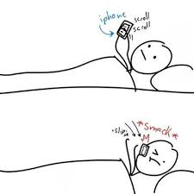
“The most difficult challenge I faced when switching to remote learning was the schedule. Naturally, I began to wake up later in the day because I knew that I didn’t have to go anywhere and my work could be completed in the afternoon. The remote learning came as a surprise and it took me a little while to adjust my sleep schedule. “
Click on the meme below for suggestions on how to adjust your sleep
Kayla Parkinson
Class of 2021
Notes:
Lets listen to how Kayla had issues with remote learning.
[teacher reads or plays orange bubble audio]
I think many of you can share Kayla’s feelings that it is difficult to wake up to join a class on the computer and start school on time. Part of responsible decision making involves making better choices the night before school or the morning off school. Maybe you need to stick to a bedtime. Turn your phone or games off at a set time.
[teacher should pose to students…. What else can we do?]

Slide 27
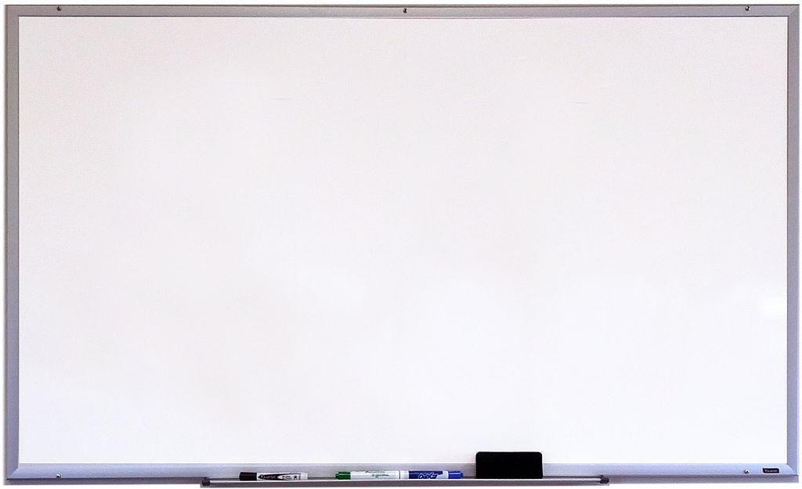
Responsible Decision Making
At times, your peers may influence your decisions. You may want to make a decision in order to impress your friends or to avoid embarrassment.
Bottom line. Think first, weigh your options, and then decide. Remember, your decisions should not have a negative impact on others or yourself.
Notes:
Teacher should read slide.

Slide 28
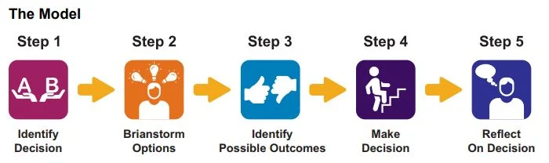
Notes:
Here are 5 simple steps you can use to help strengthen your decision making skills.
[Teacher should read all steps]
You can speak with your counselor and teachers to help you with all these steps.
Seniors, you have so many important decisions this year. It will be critical for you to reach out to someone you respect for assistance. Maybe you might want to speak with an adult who has a career you are interested in pursuing. Talk to your counselor. Read his/her emails and resources shared on google classroom.

Slide 29

Before making a decision consider how your choice will affect you, your family and friends, your school ,and your community
You should feel good about the decisions you make and typically expect a positive outcome.
Notes:
[Teacher should begin by reading slide]
Not everything works out the way we hope, but taking a more thoughtful approach to your actions will increase the likelihood of positive outcomes.
We can’t control everything (everyone has learned this hard lesson with the spread of COVID-19), but we can control our actions (wearing a mask, washing our hands, and physically distancing as we work to slow the spread).

Slide 30
You have to make many decisions in your day.
Try to consider your options and think about the outcomes before you act.
friends
work
The most difficult issue I faced with virtual school was trying to get everything done on time. There was so much work to do and it had to be done at a specific time, but I also had a job! It was hard
health
family
school & homework
food
fun
sleep
Iamdra Tapia
Class of 2021
Notes:
[Teacher should begin by reading the red text at top of slide]
Let’s listen to what Iamdra experienced.
[Teacher should either read orange bubble or click to play audio recording]
Friendships, work, your health, food, fun, sleep, schoolwork, and family are all important parts of your life. Lamdra realized this, she had to make decisions regarding work and schoolwork. You can do this too!

Slide 31

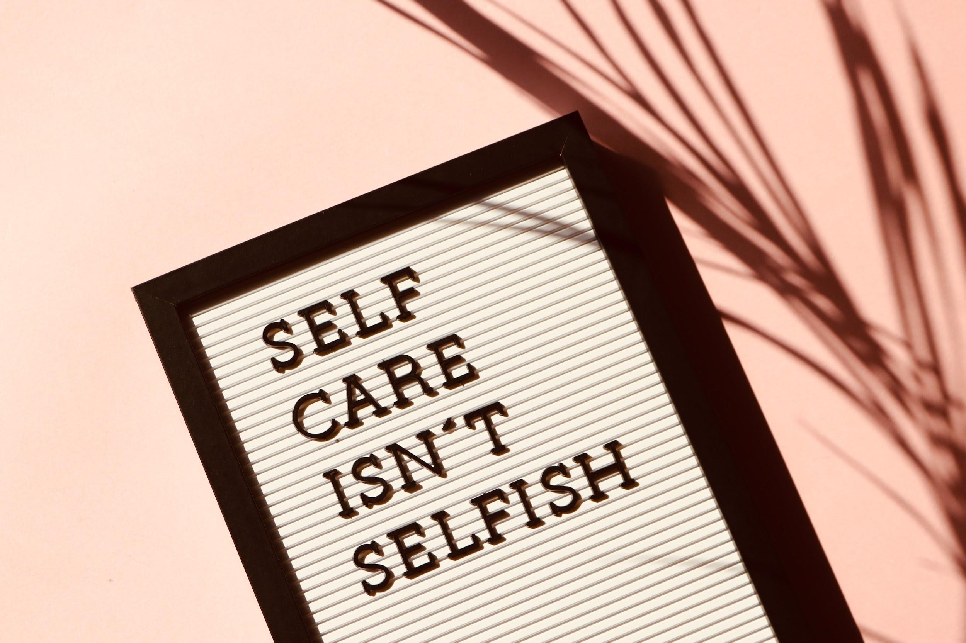



All these areas are important
Social Life
Academics
Hobbies
Work
Taking care of yourself
You have to make decisions regarding what’s best for you in the long run!
At different times, one area must take priority. At 8:30 am, it’s best for you in the long run to prioritize school work over sleep.
Notes:
[Teacher should read slide]
Balancing these items is not an easy task. But you do not need to feel stuck or alone in this. Let’s talk about school based helpers.

Slide 32
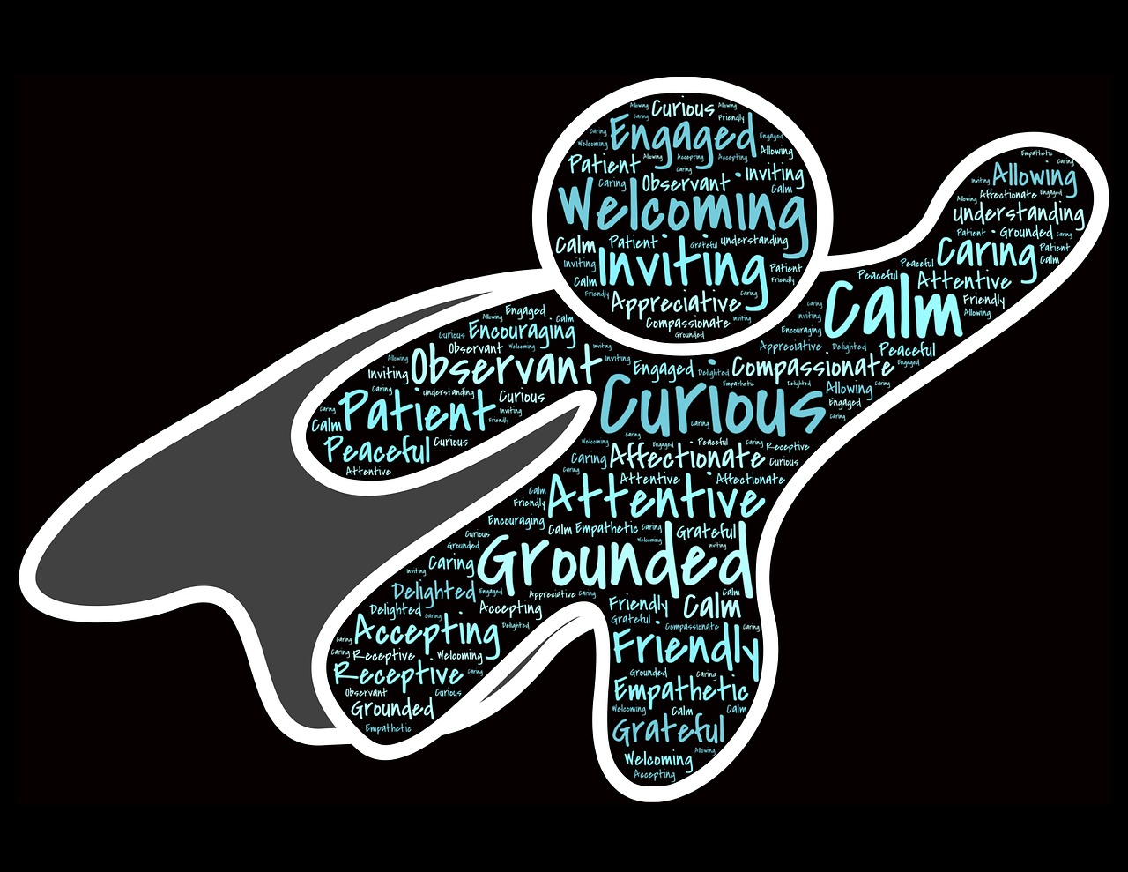

WHO ARE YOUR SCHOOL-BASED HELPERS?
TEACHERS
SCHOOL COUNSELORS
SCHOOL NURSE
PRINCIPAL
SCHOOL SOCIAL WORKERS
VICE-PRINCIPAL
SUPERVISORS
SCHOOL PSYCHOLOGIST
EDUCATORS THAT YOU TRUST
Notes:
Who are your school based helpers?
You have many school-based helpers who are amazing helpers, understand how young people's behavior and mental well-being might impact their ability to be successful in school. You are encouraged to speak to the helper that you are most comfortable with.
We have… [teacher should read all school-based helpers on the slide, saving School Counselors for last]
School Counselors work with young people and their families to make sure that they know how to manage their emotions, develop coping skills, and navigate difficult times. School Counselors are ready to talk with you and help you through this scary and uncertain time.

Slide 33
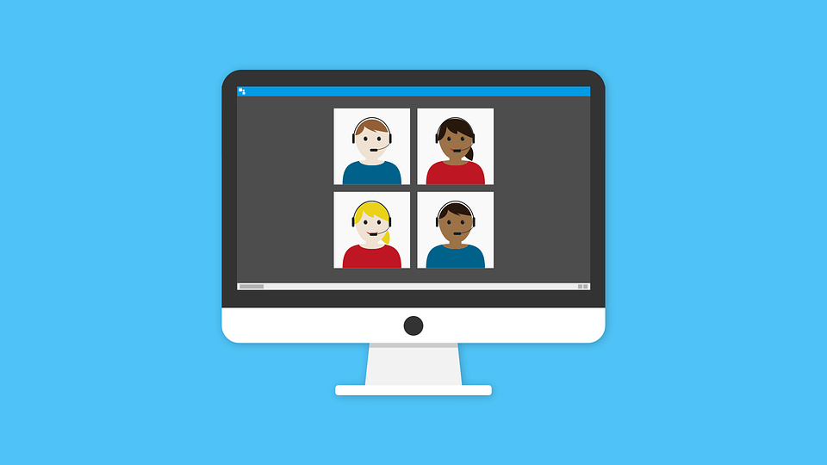
HOW TO REACH YOUR SCHOOL COUNSELOR
Talk To My Counselor
School Counselor Directory
Notes:
In a virtual world, like we said earlier, we cannot just walk into our counselor’s office anymore. An appointment can be made with your school counselor virtually by clicking the “Talk to My Counselor” link. If you don’t know who your counselor is, you may look at the “School Counselor Directory” link and locate your school. Or, you can always ask a teacher to help you get connected.

Slide 34

HOW TO REACH OTHER SCHOOL-BASED HELPERS
Visit the Paterson Public School Website
http://www.paterson.k12.nj.us/
Paterson Email address and ppsstaff.org email address
Office Tel. Numbers and/or Work Mobile
Google Classroom
Notes:
Students can find school-based information by visiting the Paterson Public School website http://www.paterson.k12.nj.us/ and searching for their school under the “Schools” tab.
Every Paterson Public School worker has a Paterson.k12.nj.us email and a ppsstaff.org.
Google classrooms will be essential in communicating with your helpers.

Slide 35
Do you have a school based helper you feel comfortable talking to about school and personal issues?
ⓘ Start presenting to display the poll results on this slide.
Notes:
Here is our final poll question (read question aloud). Please take the time to enter your response.
📣 This is Slido interaction slide, please don't delete it.
✅ Click on 'Present with Slido' and the poll will launch automatically when you get to this slide.

Slide 36
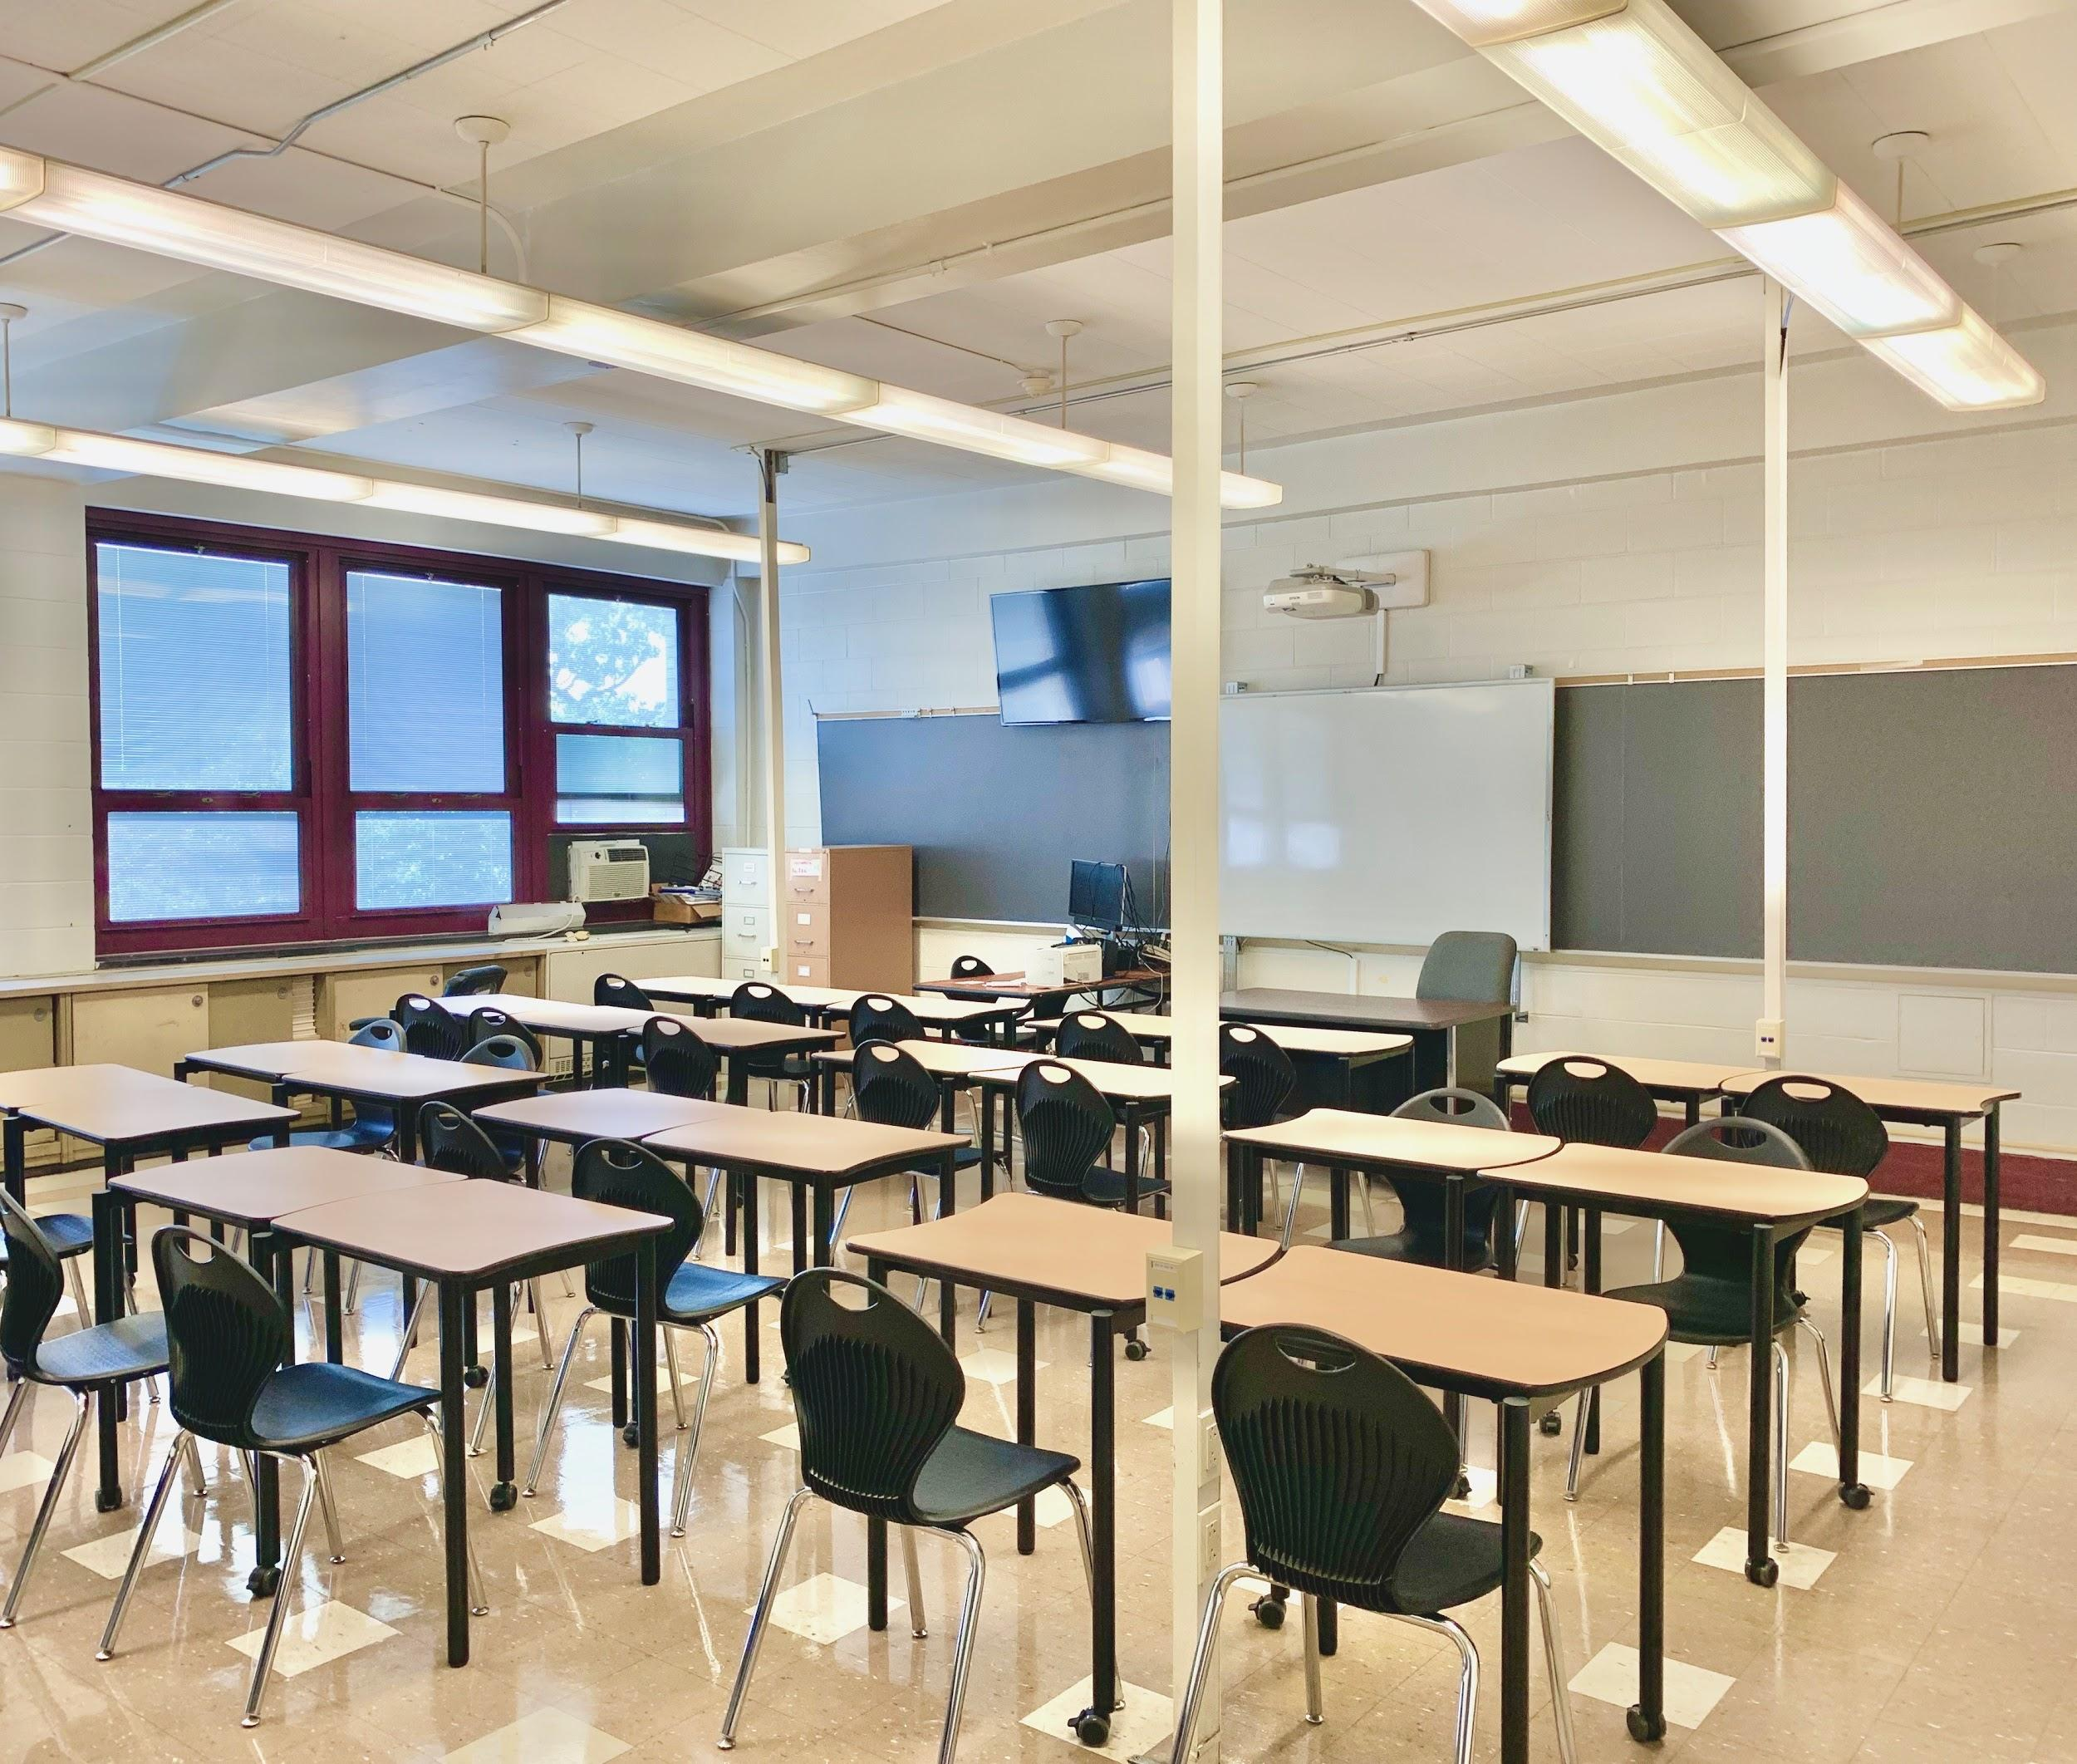
Whether you are here…...
Notes:
[Teacher should read slide text]

Slide 37
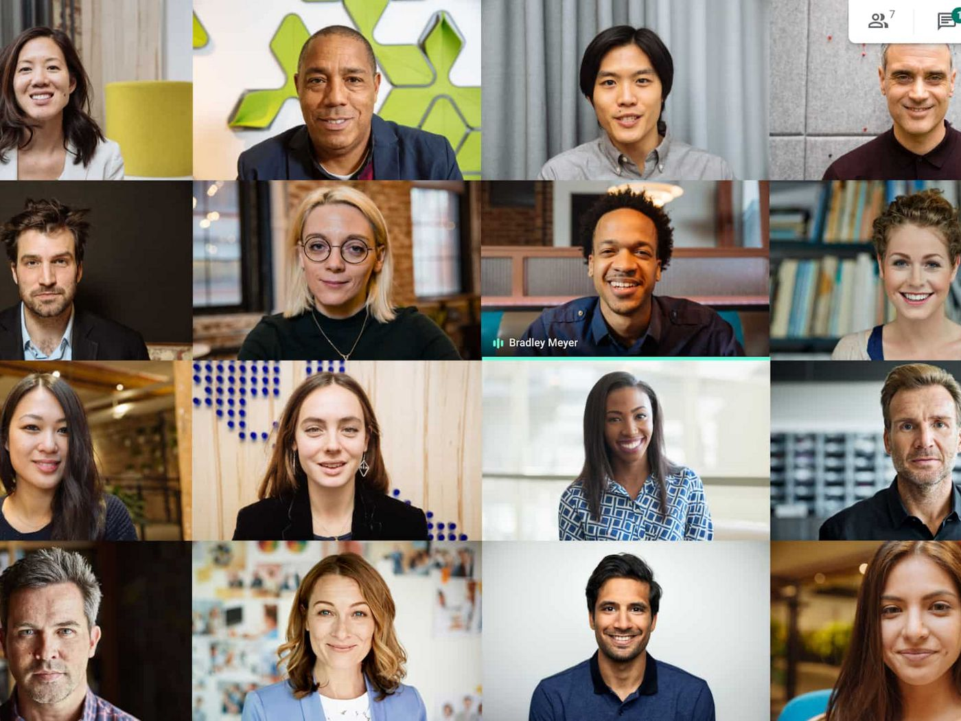
Or if you are here…...
Notes:
[Teacher should read slide text]

Slide 38

We are here for you.. anywhere!
Notes:
[Teacher should read slide text]

Slide 39
References
Love is respect. (2017) Dating abuse statistics.
https://www.loveisrespect.org/resources/dating-violence-statistics/
McClure, B. M. [Lessons for SEL]. (March 26, 2020). SEL Lesson Relationships. [video]. You tube.
https://www.youtube.com/watch?v=WP1wxft4j8A
McClure, B. M. [Lessons for SEL]. (June 5, 2020). What is social emotional learning (SEL)? [video]
You tube. https://www.youtube.com/watch?v=87zTsJ_Fxhc&feature=emb_title
National Institute of Mental Health. (2020). The teen brain: 7 things to know.
https://www.nimh.nih.gov/health/publications/the-teen-brain-7-things-to-know/index.shtml

