Slide 1
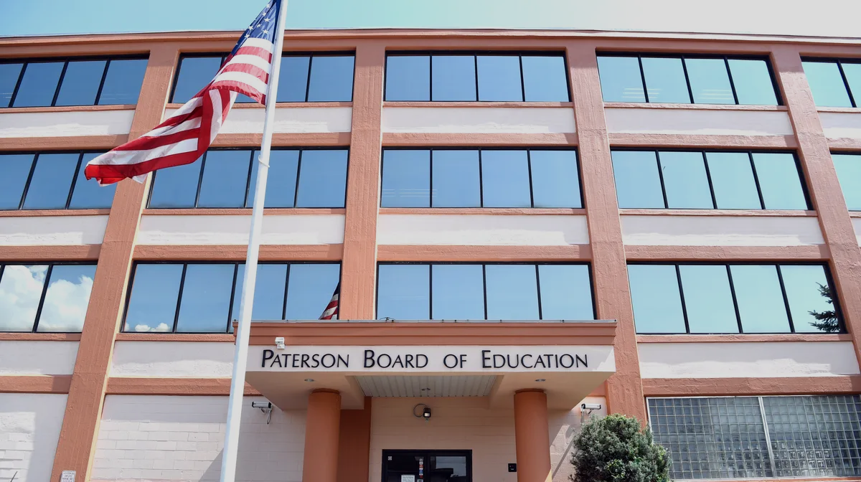







Welcome Back Paterson Public School Students!
WE ARE ALL IN THIS TOGETHER

Slide 2

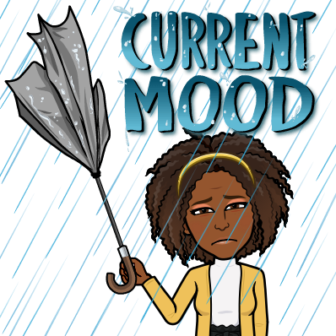
We know you might be nervous about coming back…
We are nervous too!
We Are Stronger Than We Know!
Notes:
This school year will look and feel different. We should always remember that our goals will remain the same, no matter how our first day of school looks. Our goal will always be for our last day in June 2021 to be filled with success and growth!

Slide 3
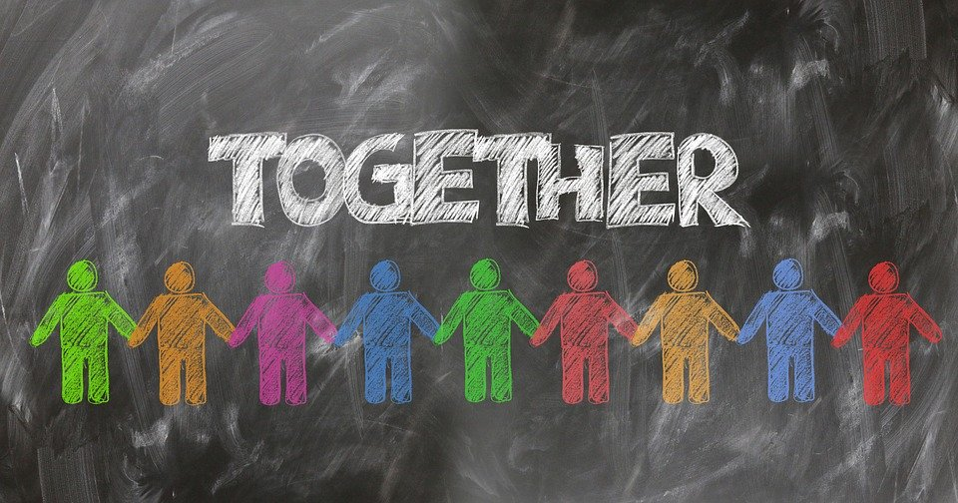
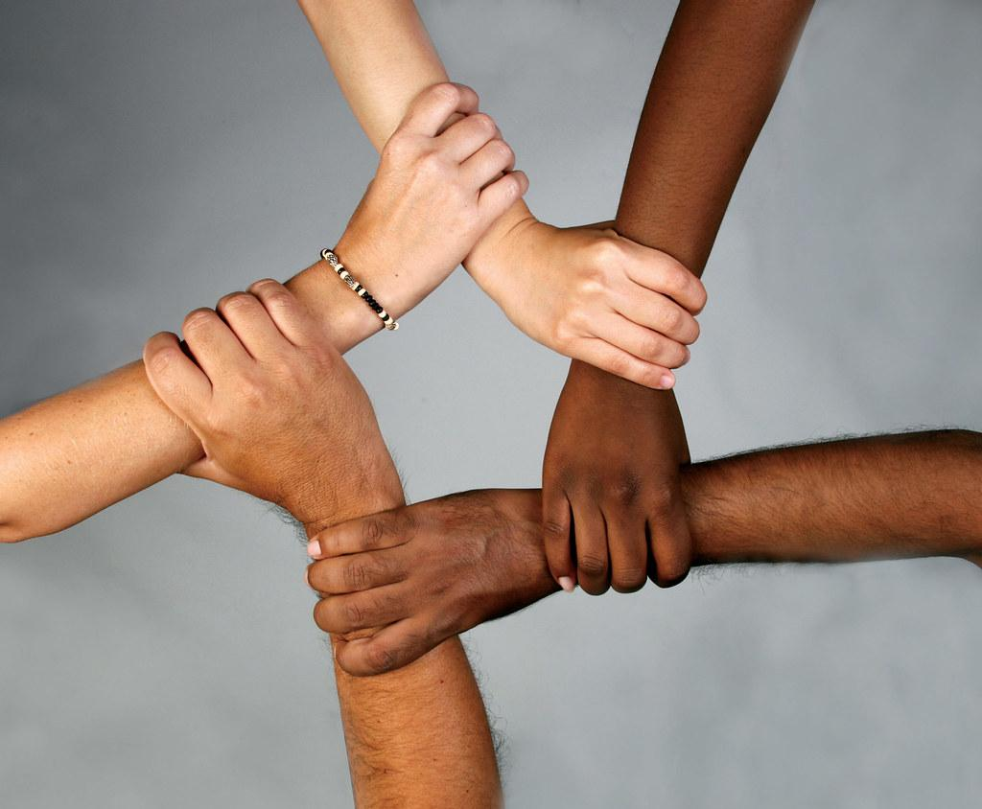
YOU ARE
NOT ALONE
WE ARE IN THIS TOGETHER
LOOK FOR THE HELPERS
Feeling Lost
Extremely sad
Lonely
Confused
Then you
may need
to talk to a
HELPER
“Always look for the helpers. If you look for the helper... you will know that there is hope” Mister Rogers
Notes:
Many young people, all over the World, are experiencing very similar fears, confusions, anger, sadness and loneliness, which can be a scary thing.
Many young people may have a hard time understanding their emotions.
As students, you may be trying to adjust to learning remotely from home or struggle with how different it will look and feel when in your school building.
Being disconnected from friends and the warmth of your teachers can be very hard.
If you are feeling lost, extremely sad, lonely, or even confused, then you may need to talk to a helper.
Lets see who they are! (click next slide)

Slide 4


School Counselors
Principals
&
Vice Principals
Teachers
School
Nurse
Supervisors
School Social Worker
School Psychologist
As Helpers, we will guide you through these difficult times. We will help you collect the tools to adjust to our new school life. We will provide school-wide
SOCIAL EMOTIONAL LEARNING
to help you achieve your highest potential.
Notes:
There are alot of people who are here and want to help you! We see teachers on this list so you all know that you can come to me for any help you need. You may also feel more comfortable with another adult you know.
Lets see who we know.
(pose to class)
-Who is the principal at our school?
-Who is the school counselor?
-etc
(if students do not know the answers to the question, teachers should provide the answer and ask them to repeat it)

Slide 5


Today, we are going to discuss social emotional learning and how focusing on five key competencies will help you do well in school and life.
What is social emotional learning or SEL?
Notes:
While we are learning in school, we also learn to think about our own emotions and the world around us, like the people we love. When we learn about ourselves, we can tell people what makes us happy, sad, mad, or tired.
Can anyone tell me one thing that makes them happy?
What about sad?
(Teacher should reflect responses back to students and also ask the class if anybody else has felt like what was shared)
This type of learning is called Social Emotional Learning. We will call it SEL!
(Teacher should ask students: “can you say SEL?”
Upon response, ask them to repeat it one more time)
Okay, now that we can say SEL. Let’s find out what it is!
(click to next slide)

Slide 6
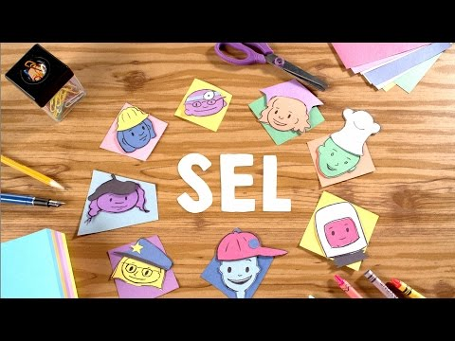

Slide 7

The 5 Competencies of
Social Emotional Learning
Self-Awareness
Self-Management
Social Awareness
Relationship Skills
Responsible Decision-Making
Notes:
The video taught us that SEL can help us be better people. We can have better grades, less behavior problems, better relationships with our friends and family. And most important - a better relationship with ourselves! There are five different areas that we grow in when we learn through SEL. Let’s find out about them together!

Slide 8
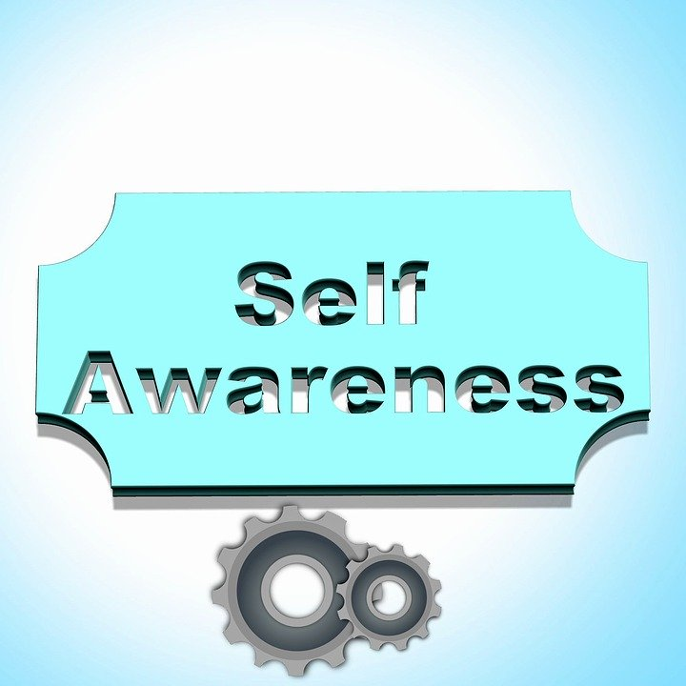
Competency #1

Slide 9
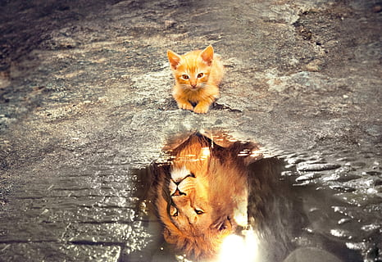
Understanding one’s emotions, feelings, thoughts, and values, and how this influences our behavior. It also includes evaluating our strengths and areas for improvement.
Notes:
First, we have to be self-aware. We need to know and understand how we feel and what we think. Pretend one of your friends pushed you while you both were playing tag and you really don’t like being pushed. How would you feel? (allow some student responses.. highlight those who say mad or angry). So, if we were angry/mad, some other things could happen. Your face may turn red or you feel hot. You may be making a fist with your hand. With this example, we know know the feeling inside our mind about being angry can also be seen outside too.
We also need to understand how our emotions and thoughts change our behavior. If we think of the same example of the student above who was pushed by a friend and felt mad, that feeling of mad might make you do something you would not do or didn’t ever do before. Maybe you push your friend back. Maybe you had a hard time thinking. What are some things we can do to feel better when we are mad?
(allow students to provide answers)
Some other things we can do is speak to the school counselor or other adult, draw, or write in a journal.
Knowing your strengths is knowing what you are good at. For example, I think I am good teacher, I care alot about my students. Think of some of the things you are good at. What makes you special? We need to believe in ourselves.
And believing in yourself means just that... Knowing that you can do something and one day you might surprise yourself. Maybe you’re really good at drawing. So you start making a book of all your drawings and you believe one day it will be in a bookstore.
Which brings us to the last one - being in control of your future. This is your life! And you choose what you want to do when you grow up. Maybe you want to be a doctor. You can! And just remember, there are plenty of people to help you along the way if you need it!

Slide 10
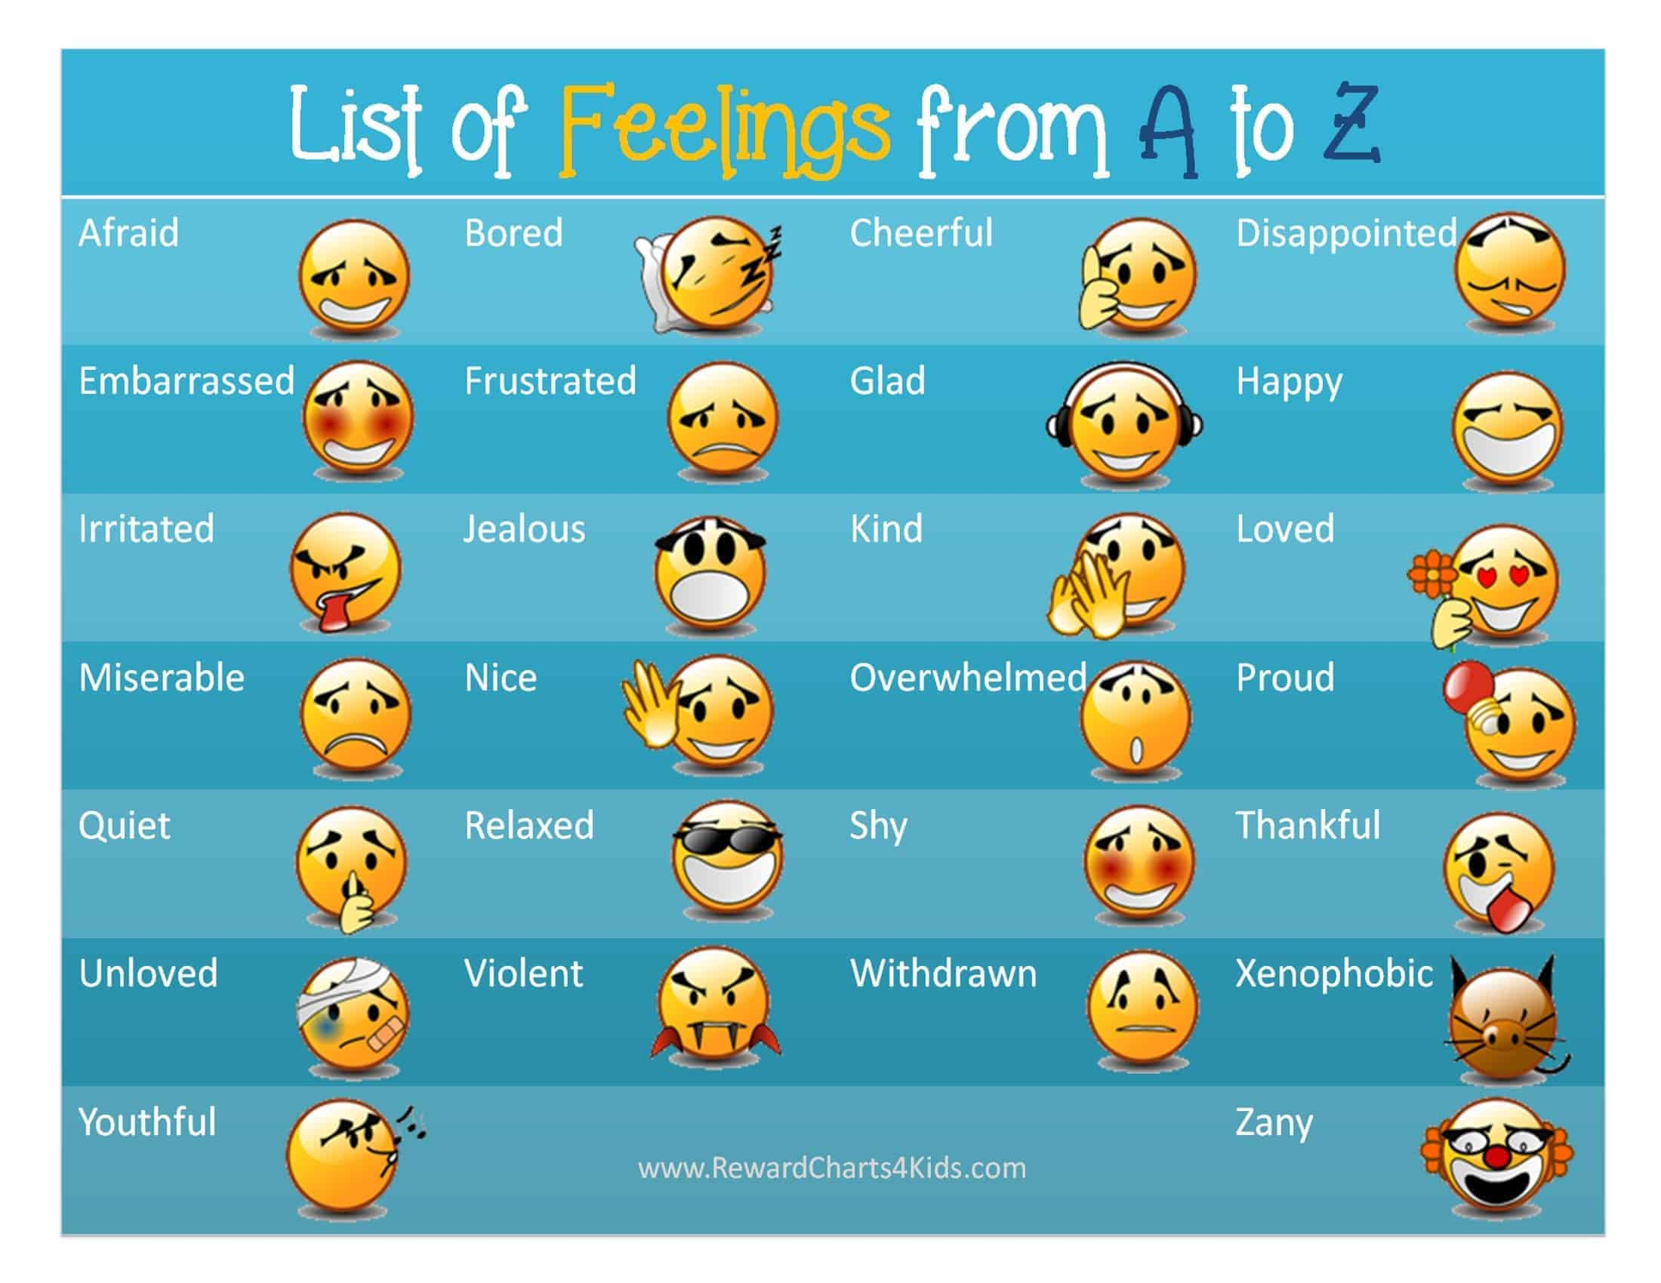
Knowing your feelings?
Understanding
your emotions?
SHY
EXCITED
RELAXED
SADNESS
AFRAID
STRESS
CONFUSED
ANXIOUS
EMBARRASSED
CONFIDENT
DISAPPOINTED
HAPPINESS
FEAR
LOVE
PROUD
DISGUST
JEALOUS
SURPRISE
BORED
ANGER
Notes:
Earlier we mentioned an example of anger and being mad. There are so many other emotions we can feel. (Teacher should highlight a few from the list. Pose a question to class: who can give me an example of when they felt _________. Allow a few responses).
Let’s watch a video to help us to become more self-aware.
(click to next slide)

Slide 11
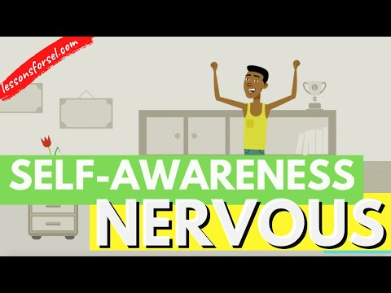

Slide 12


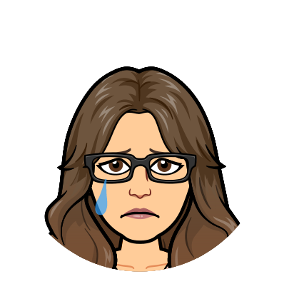
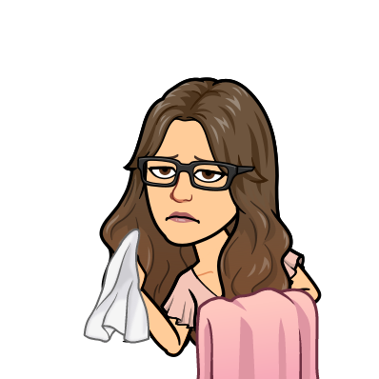
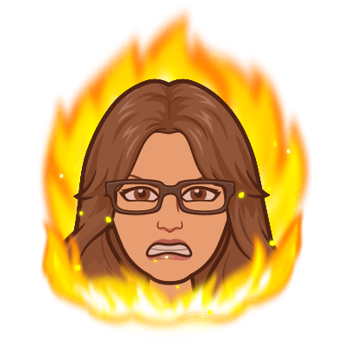
How am I feeling today?
What activities do I enjoy?
Am I ready to learn?
What situations make me feel terrible, and what do they have in common?
Happy
Angry
Sad
Sick
Notes:
Sometimes children can identify emotions by being aware of their physical being or body signals. For example, clenched fists could indicate anger, while sweaty palms could feeling nervous..
Write down on some paper (or Google Chat) how you are feeling today. Maybe even draw it!

Slide 13

When you are able to identify your emotions,
you will also be better capable of managing your behavior.

Slide 14
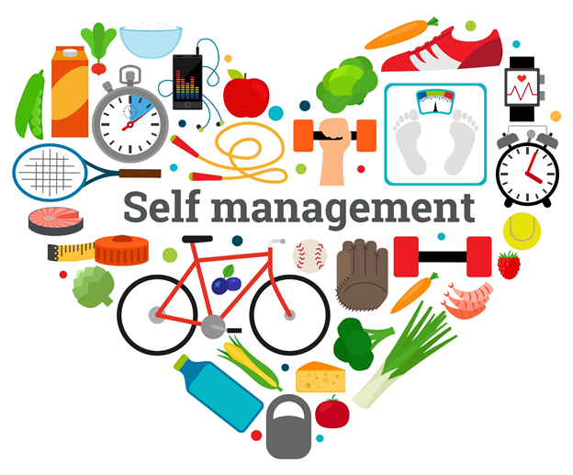
Competency #2

Slide 15


Self Management
The ability to successfully manage one’s emotions, thoughts, and behaviors in different situations. The ability to set and work toward personal and academic goals.
Notes:
Now that we know how to identify our emotions, let’s talk about how to manage them, making us the best version of us we can be!
We have to control those emotions we learned about and the thoughts and reactions we have when those emotions happen to us so we can stay calm. Listen to this example: “My teacher asked me to answer a math problem but I was really nervous and said no. I heard a classmate laugh and I got really angry. I wanted to throw a chair at him. I asked my teacher if I can get a drink of water to calm down.” Sometimes taking a break for a minute will help you feel alot better!
If we can identify what makes us feel stressed or just not ourselves, we can calm ourselves pretty well! Listen to this example: “Math is hard for me. I felt butterflies in my tummy during class. My heart starts racing and sometimes i have a hard time thinking. My teacher helps me relax by letting me get a drink of water and walk around the hallway 2 times. I also have a squishy ball that I play with.” It is okay to feel this way! There are tons of things we can do to feel better in a not so happy situation. You can always reach out to someone you trust, like me or your school counselor, to talk about other things you can try.
We should do what is right, even if you do not feel like doing it. You may not enjoy having to do schoolwork all the time but you do it because you know it will help you in the future. Getting your education will help you to achieve your goals!
Keeping your things in order, together clean and easily found will help you feel less stressed. It is easier to know where you put one of your toys then having to look all over your room for it. Something as simple as keeping your room organized and clean can make your mind feel happy and peaceful.
Last, plan for something you want, and work very hard to get it. If you are having a hard time in class but want to do well, you might show you are working hard by getting extra help from your teachers. You may promise to study harder. If you have a goal, you can achieve it. By using these skills, we can learn self-control.
Let’s watch a video to learn more!
(click to next slide)

Slide 16
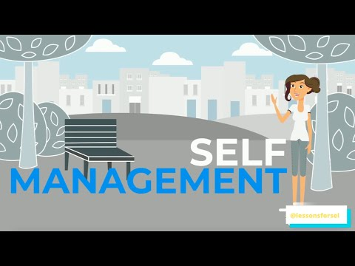

Slide 17



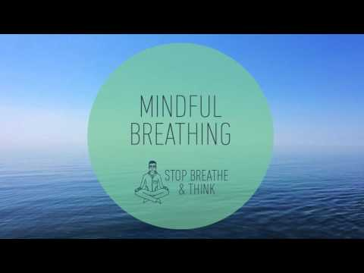
WHAT WILL YOU DO THE NEXT TIME YOU FEEL STRESSED?
Meditation
YOGA
Drawing
Journaling
Notes:
It is very important to control our emotions. It allows us to control and regulate our behavior. Just because we don’t feel “normal,” it doesn’t give us permission to act out against people. For example, it is perfectly OK to feel angry, but it is NOT OK to hit or cause pain. Try coping techniques to de-escalate and self-regulate.
Stress and Anxiety are normal feelings that we might experience every day in school, at home, or with our friends. It can be hard and make you feel sad, worried, and afraid. It can stop us from finishing our work and reaching our goals. It can make us act and feel out of control. It can even make us feel bad about ourselves. It can create very bad thoughts. BUT DO NOT WORRY!
Understanding what makes us stressed and anxious can help us manage our feelings. We learn how to accept, grow stronger and face our fears.
Let’s try a mindful breathing activity to re-center ourselves
[click to play video]

Slide 18
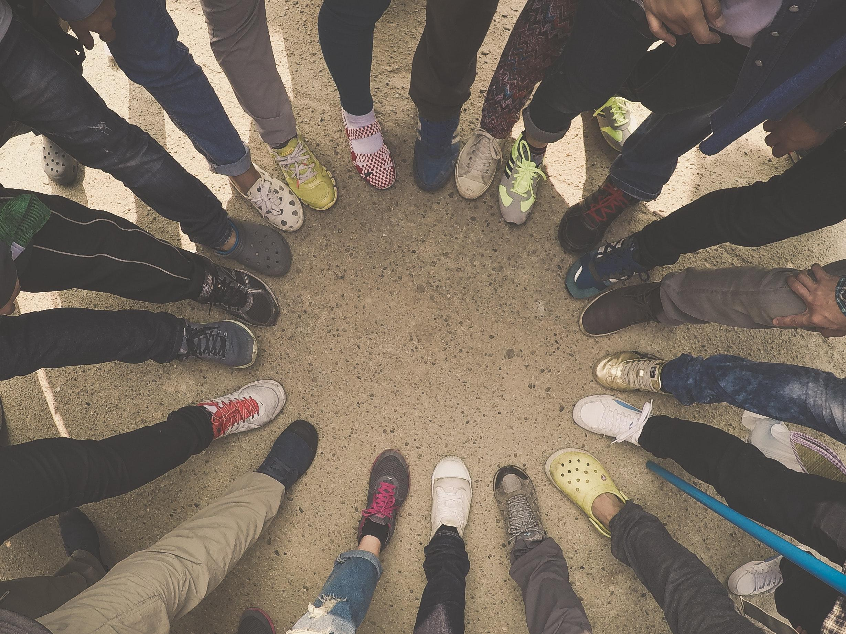
Competency #3
Social Awareness
“Put yourself in someone else’s shoes”

Slide 19
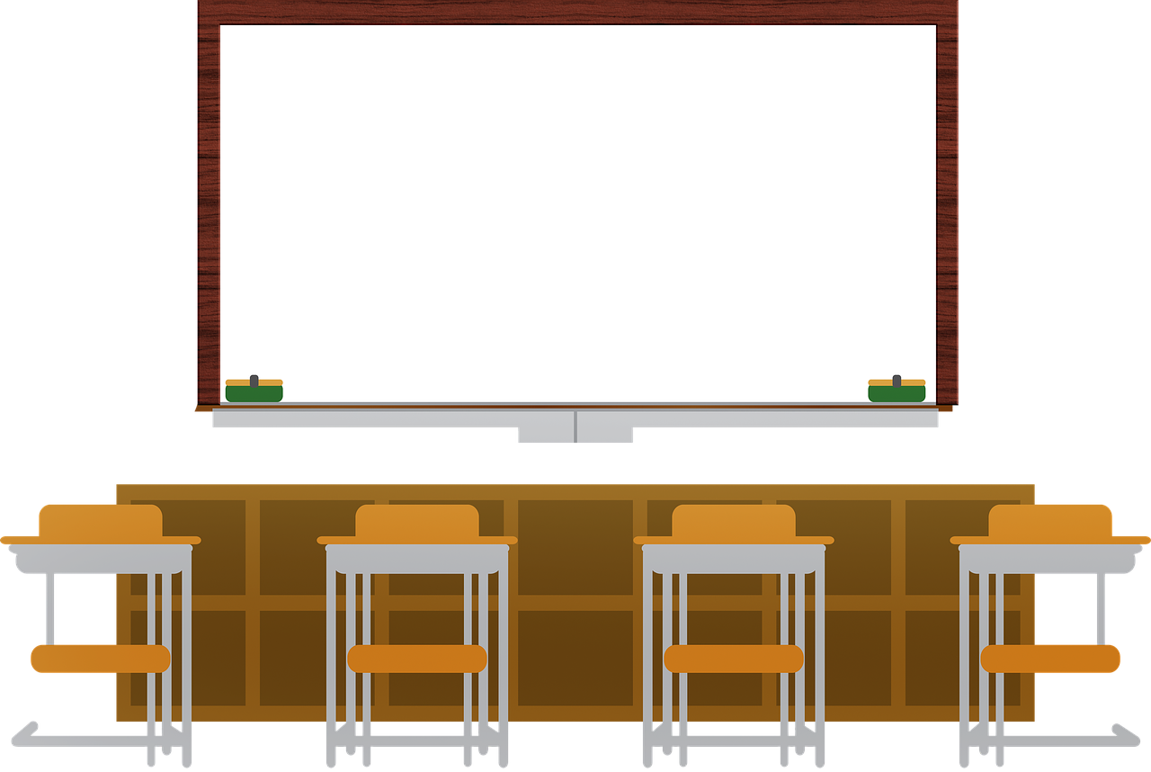
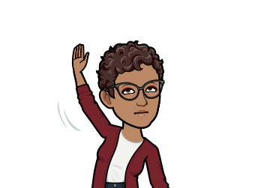

Social Awareness - helps you to understand the emotions, feelings, experiences, of others. It includes understanding individuals of different religions, cultures, ages, abilities.
Why it matters? You will be able to have positive relationships with those around you.
Notes:
Understanding how someone else might feel is important as we meet more people. You want to be able to understand that everyone is different and special in their own way.
Showing respect and love to all people from every part of the world. Let’s listen to this example other students experienced. “There is a new student in class and she came from a different Country. She even speaks a different language. During recess, me and my best friend wanted to play with her. She is still learning english so we used our hands to wave hi and smiled at her. We also pointed to the swings and she started to play with us. It was so much fun.”
We can become more aware by learning about other people and their cultures. Here’s a student example: “My best friend was born in a different Country but has a long time living in New Jersey. She speaks a different language with her family. She has different color skin, color eyes, and hair than me but we have so many other things in common. We love the same type of music and tv shows. We enjoy playing games and drawing.” Just because we are different in our culture, does not mean we cannot have amazing friendships with them. Everyone has something positive to offer, and we should consider ourselves lucky to find someone we share interests with.
Just because someone feels different than we do doesn’t make them right or wrong. For example, you may love the color blue and think its the best in the world and your friend may think green is the best color in the world. You can accept that your friend loves green and you love blue and that is OK!
Being aware of what others are feeling through what they are saying and how they are behaving is important, Pretend your friend who loves green showed you their notebook and you said it was ugly because it was green. You noticed that your friend’s got upset. Your friend left the classroom without permission and got yelled at by the teacher.” At this point, you may feel bad. You can be more socially aware by seeing what you did and saying sorry.
Putting yourself in other people’s shoes teaches empathy. Imagine if your friend had called your new notebook ugly. You would feel bad. You may have reacted just as they did. We should always do our best to understand the many people around us and respect and accept the differences we see and not make fun of someone for it.
Let’s watch a video that can show us how are differences are beautiful… and how it is a good thing!
(click to next slide)

Slide 20
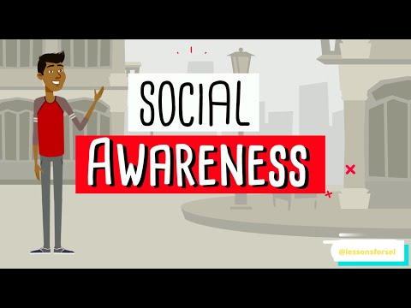

Slide 21
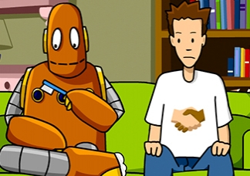
Skills that improve social awareness...
Identifying social cues to determine how someone else might be feeling.
Empathizing with others shows you are able to put yourself in n someone else’s shoes.
Predicting and understanding your friend’s feelings and reactions.
Acceptance of others from different culture, race or ethnic group.
Notes:
[Teacher should first read slide] Then pose the following about the photo….
What do you see here?
Do they look like they are communicating?
Would you give a robot a toothbrush?
Can you recognize how he must be feeling given a gift he does not understand?
How might he respond?

Slide 22
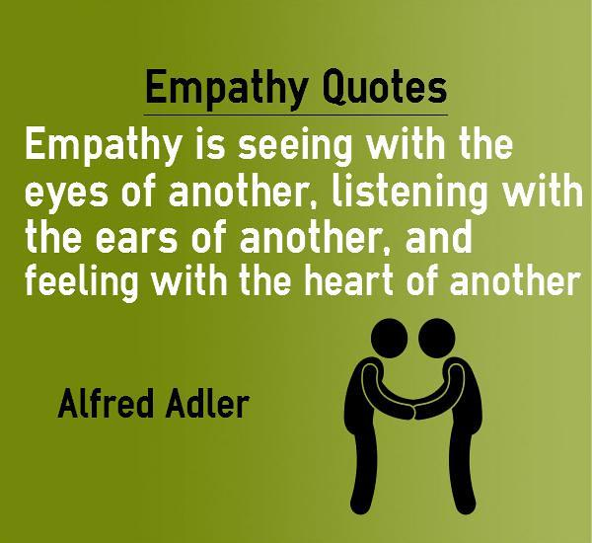
WHAT IS EMPATHY?
Notes:
Empathy allows people to build social connections with others. By understanding what people are thinking and feeling, people are able to respond appropriately in social situations whether it is at school, at home, at a friend’s house or in the community.
Let’s see what it means to have empathy.
(click to next slide)

Slide 23
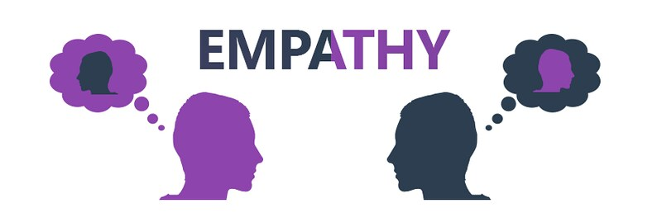
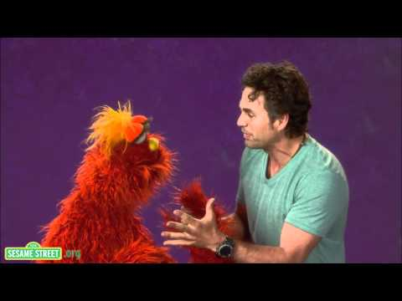

Slide 24

Competency #4
Relationship Skills

Slide 25
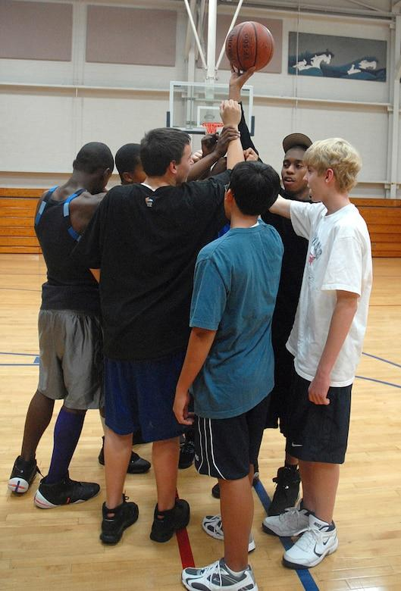

The ability to establish and maintain healthy and rewarding relationships with diverse individuals and groups.
Notes:
Having relationship skills is all about being able to work together, share ideas, listen without interrupting and letting everyone have a chance to be their best! Being able to do this will allow for healthy relationships all around you! But how do we build our skills? Let’s find out..
(click to next slide)

Slide 26
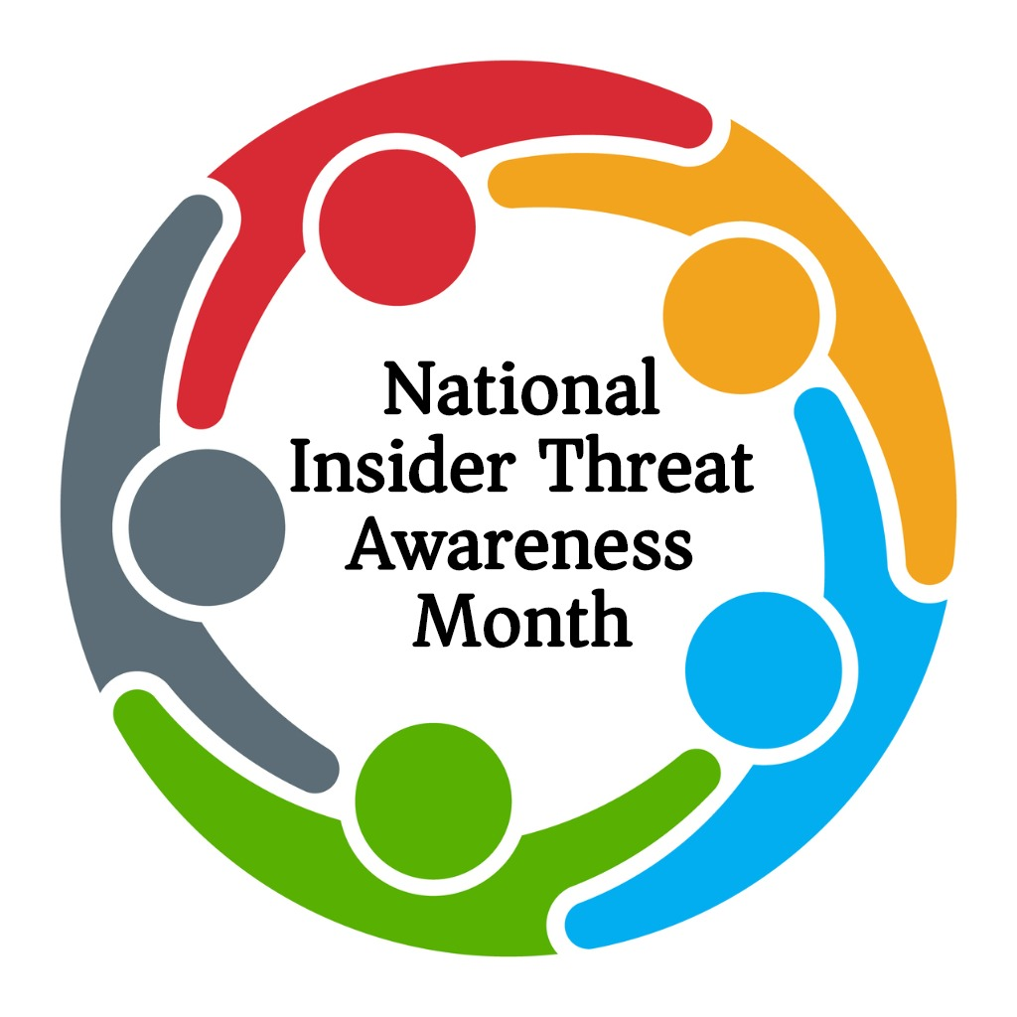
HOW DO WE BUILD ON OUR
RELATIONSHIP SKILLS?
WORK ON CONFLICT IN A POSITIVE WAY
SPEAKING IN ASSERTIVE AND RESPECTFUL WAYS
BEING KIND
RESPECTFUL
UNDERSTANDING
INCLUDING ALL NO MATTER COLOR, RACE, RELIGION, OR DISABILITY.
COMMUNICATE CLEARLY
ACCEPTING AND FIXING MISTAKES
INCLUDE OTHERS
LEARNING TO AGREE TO DISAGREE. COMPROMISING
LISTENING WHEN OTHERS SPEAK AND NOT INTERRUPTING
POSITIVE
GROUP WORK
BEING ABLE TO FORGIVE AND KNOWING WHEN TO SAY SORRY
Notes:
(Teacher should highlight some important points on this slide and allow students to share what works for them)

Slide 27
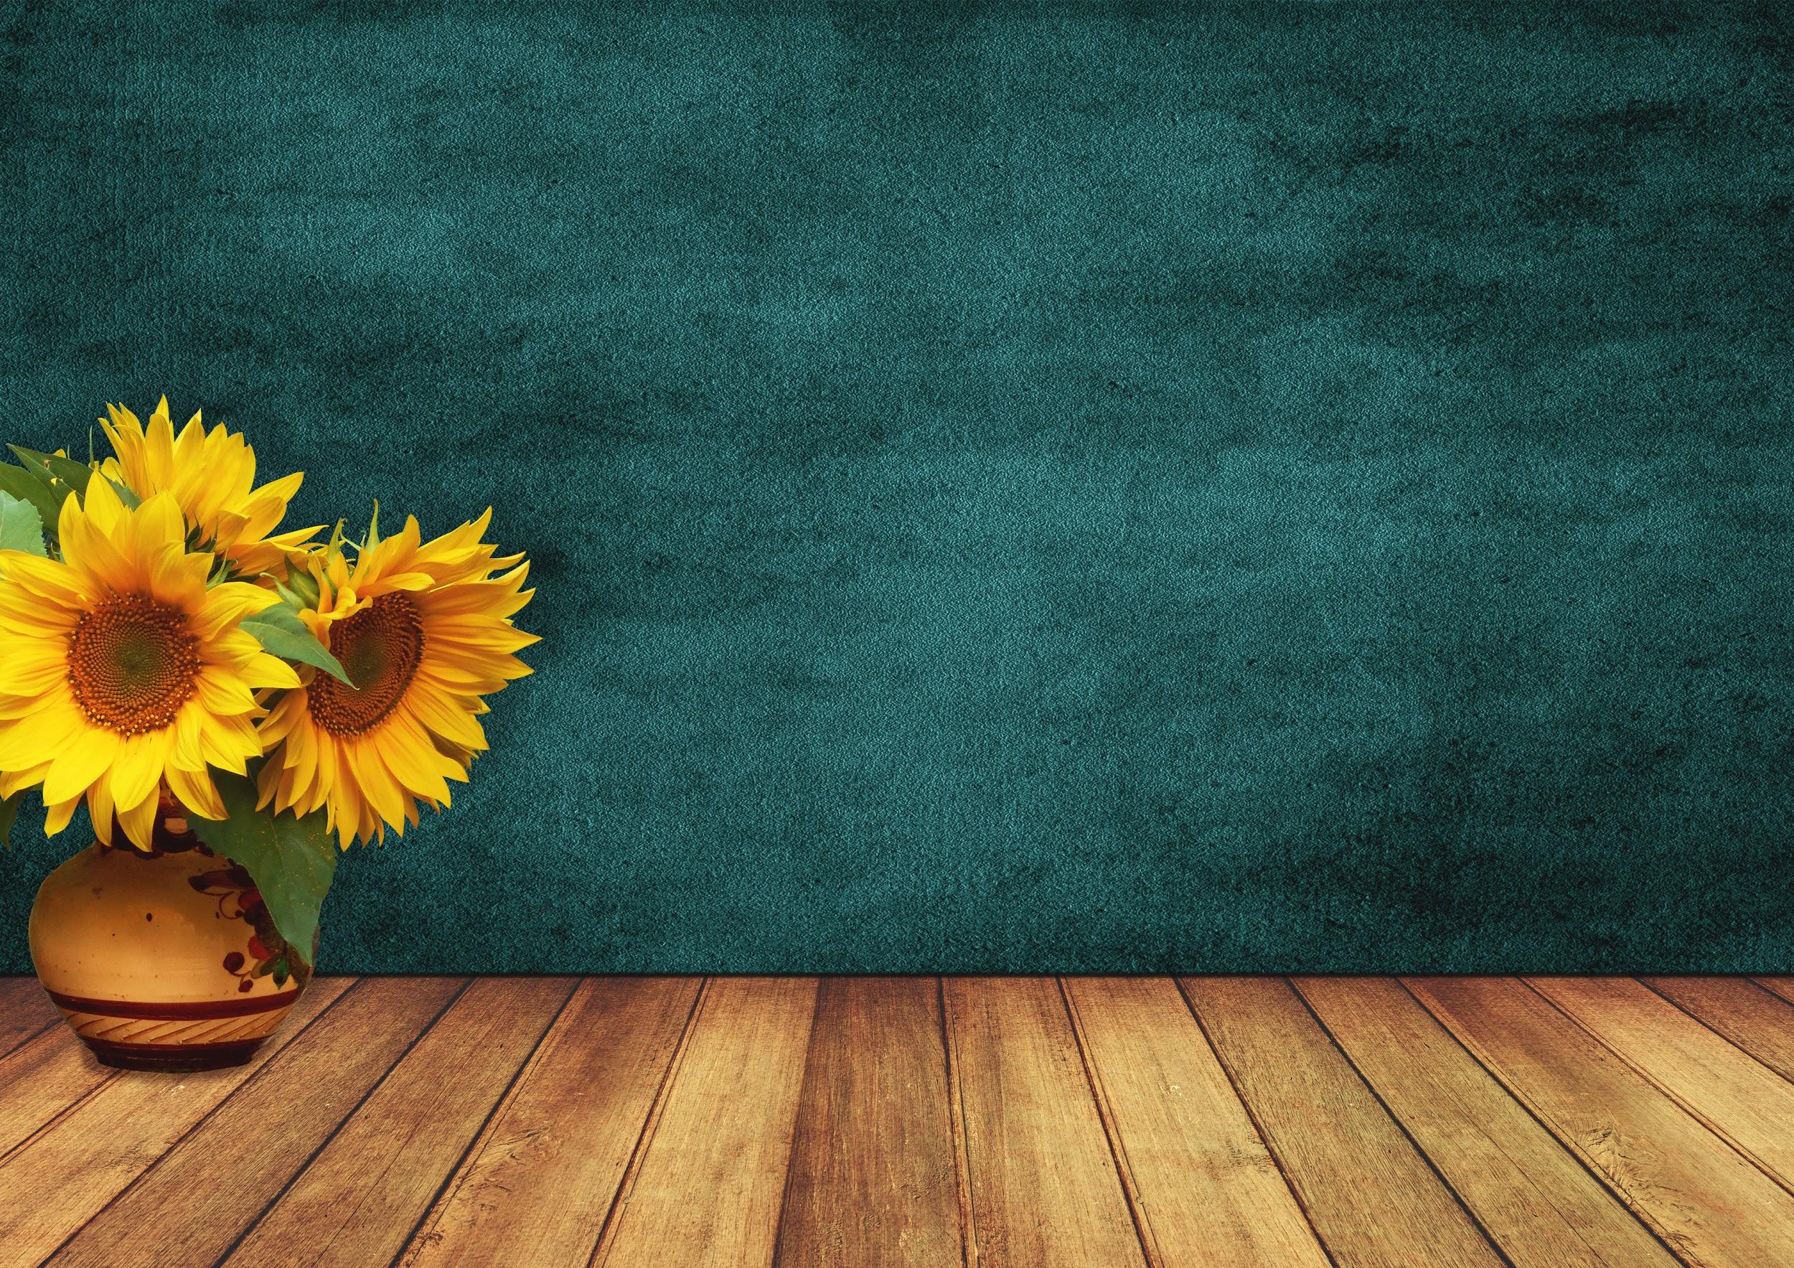

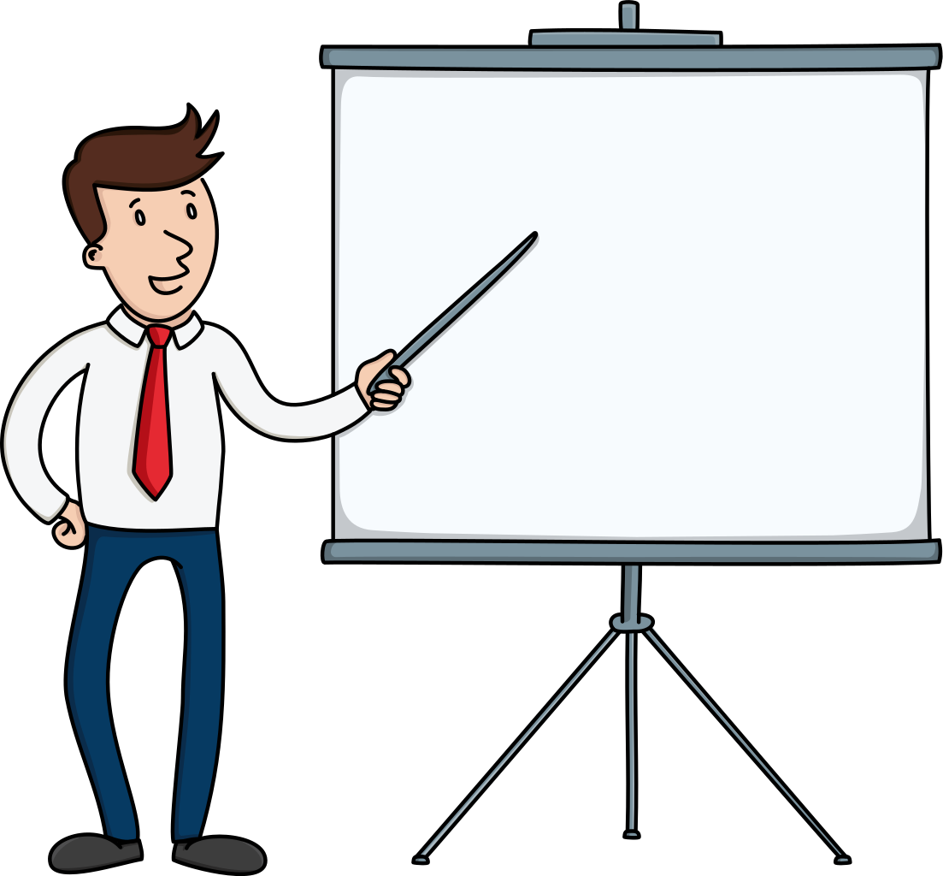
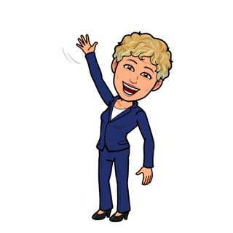
Communication….
Practicing Good Listening Skills is an important part of communication
Communication is very important when avoiding conflicts, expressing your feelings and asking for help.
What is an
important part of Communication?
Notes:
Communication is very important factor in relationship building. Communication is key to avoiding conflicts, expressing your feelings, and asking for help. Communication help can become successful both in the classroom and outside the classroom.
Let’s watch a short video to show us what it means to use communication to build healthy relationships.
(click to next slide)

Slide 28
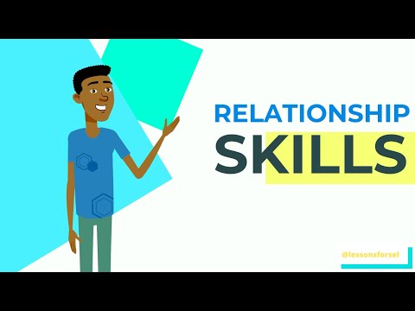

Slide 29


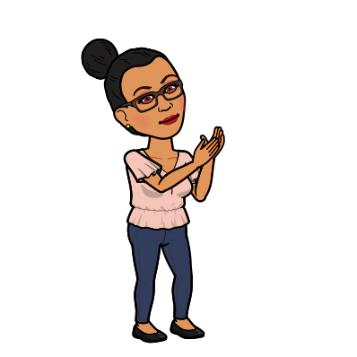



At school, it is important to build healthy relationships with your friends and find people you can talk to when you are upset or need help
Notes:
Read slide.
Remember the helpers we discussed earlier? Who were the people in school that can help you.
Students should name a few. If not, the answers are below:
School Counselor. Teachers. School Nurse. School Social Worker. School Psychologist. Principal. Vice Principal. Supervisors.
You have many school- based helpers who are amazing helpers, understand how young people's behavior and mental well-being might impact their ability to be successful in school. You are encouraged to speak to the helper that you are most comfortable with.
Always consider your School Counselor as one of your helpers. School Counselors work with young people and their families to make sure that they know how to manage their emotions, develop coping skills, and navigate difficult times. School Counselors are ready to talk with you and help you through this and any uncertain times.

Slide 30

Competency #5
Responsible Decision Making Skills

Slide 31
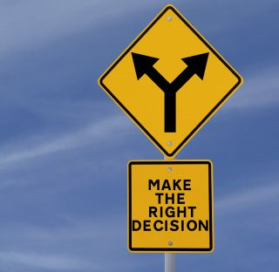
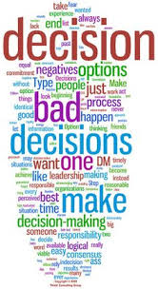
Responsible decision-making means gathering information to make decisions.
Notes:
The final area of SEL is responsible decision making. This means that we know how to make the right choices for how you personally and socially behave. You understand what is right and what is wrong. And it is important that you practice those beliefs every day.
Knowing when there is danger and what to do if you feel unsafe is part decision making. A responsible decision during a time where you feel unsafe would be to tell an adult.
It is also responsible to know and follow the rules to keep you and others safe. Not only is your safety important, but all of our feelings of safety matter. Rules are created to help us, not hurt us. And we should practice respect and acceptance of the rules.
Being in control of making choices to complete goals and promises made shows how responsible you can be. If you make a promise to yourself that you will try and do better and make choices about your own goals, keep it. The reward that you will feel after sticking with it and working hard to stay on track will let you experience a very happy emotion and give you confidence.
Always be smart when making your choices. We must be able to recognize when our choices cause pain and injury to others. We must accept this is a wrong way to act.
Making responsible decisions means asking yourself if this is the right thing to do. When you make a good decision, chances are positive things will happen. If something negative happens, then you should consider making a different choice. Always think about the consequences of your decision before making a choice. Let’s listen to a real life example of an issue and then talk about what we might do…
(click to next slide)

Slide 32
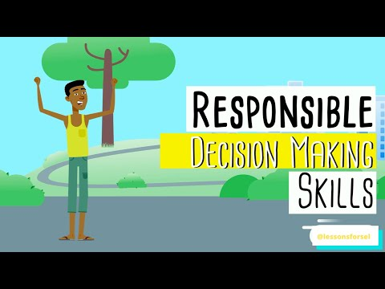

Slide 33

Responsible Decision-Making happens when...
Decisions are made after you have considered ethical standards, safety concerns, social norms, evaluation of consequences, and the well-being of self and others.
You should feel good about the decisions you make and typically expect a positive outcome.
Notes:
Ask the students to reflect on the video.

Slide 34
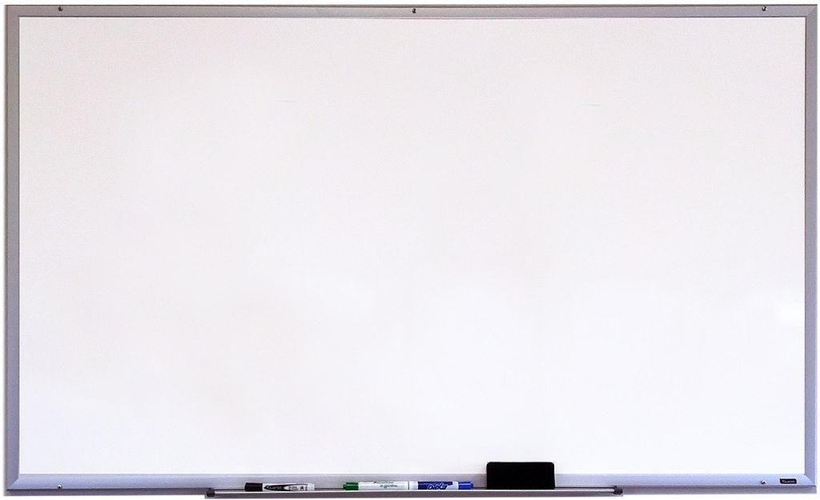
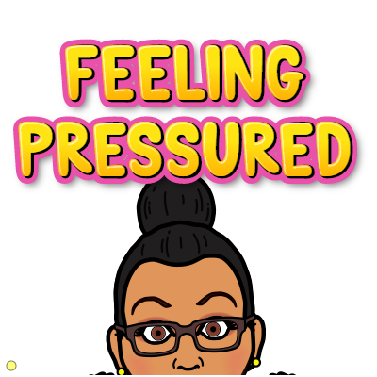
At times, your peers may influence your decisions. You may want to make a decision in order to impress your friends or not to feel embarrassed.
Bottom line...
Think first, weigh your options, and then decide.
Notes:
Ask students if they have even felt peer pressure?
Have they ever made decisions, really not wanting to, based on the fear of what their friends might think or say?.

Slide 35

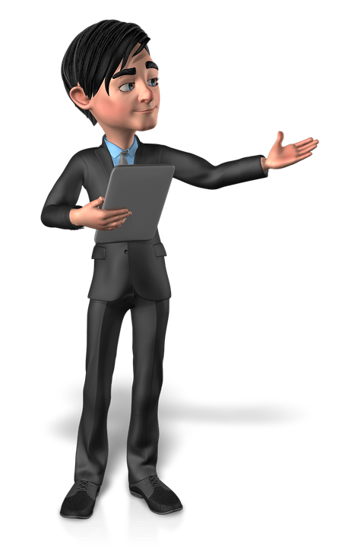


When it comes time to make a decision you need to follow these simple steps.
Identify the decision to be made
Consider possible options
Evaluate your choices
Make a decision
Reflect on your decision and make a different choice if you did not receive the outcome you expected
Notes:
Remind them that they are in control of their actions, decisions, and behaviors.

Slide 36
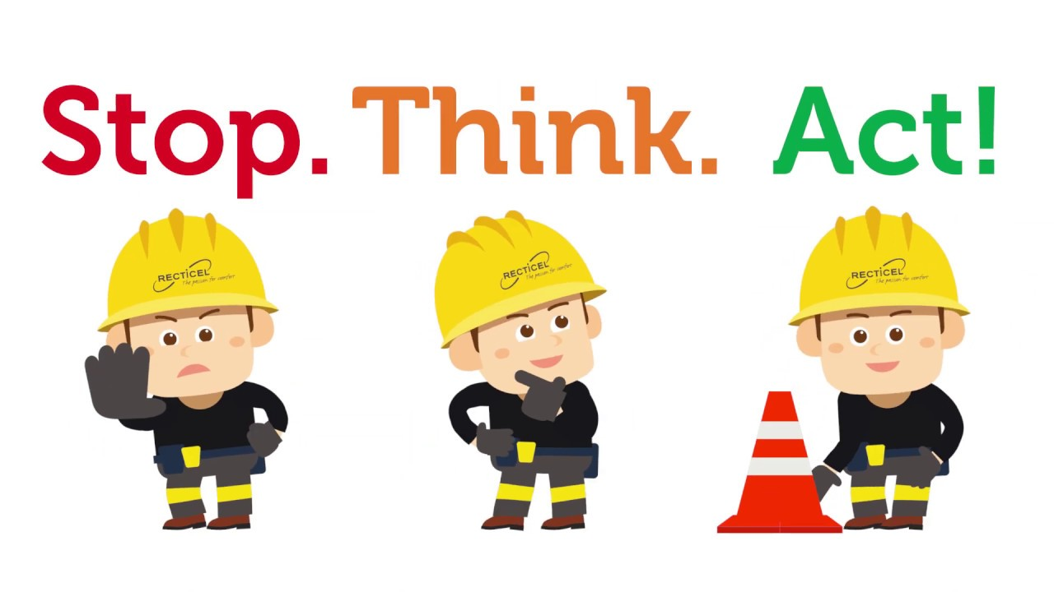
What have we learned about
SOCIAL EMOTIONAL LEARNING
KNOW AND UNDERSTAND YOUR FEELINGS AND EMOTIONS
WE ARE ALL DIFFERENT
AND THE SAME.
WE ARE ALL FROM
THE HUMAN RACE.
ALWAYS REMEMBER
I CAN, AND I WILL!
BE KIND,
BE RESPECTFUL,
BE UNDERSTANDING
FIND YOUR HELPERS
Notes:
What have we learned about SEL? We learned to identify and understand our feelings and emotions.. That we must be kind, be respectful and be understanding of ourselves and others.. And even though we may be different, we are very much the same too!
When using SEL, remember: Stop. Think. Act.
We use our self-management skills to STOP, so we can get hold of our emotions, thoughts, and behaviors to avoid doing something we may feel bad about later
We use our self-awareness to THINK about how you are feeling about a situation
We use our self-management skills to ACT on your decision or ask for help
Always remember to find your helpers… your school counselor is a great person to speak to about your feelings and emotions. Let’s learn how to reach them remotely!
(click to next slide)

Slide 37
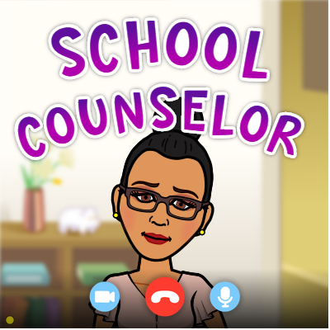
HOW TO REACH YOUR SCHOOL COUNSELOR
Talk To My Counselor
School Counselor Directory
Notes:
You may request to speak to your counselor online by clicking the site link and filling out the short form. An alert will go to the counseling department and they will tell your school counselor to contact you as soon as possible. If you do not know who your school counselor is, you may look for your school in the directory list. Just know that help is here when you need it!

Slide 38

FINDING OTHER SCHOOL HELPERS
Visit the Paterson Public School Website
http://www.paterson.k12.nj.us/
Paterson Email address and ppsstaff.org Email
Office Tel. Numbers and/or Work Mobile
Google Classroom
Notes:
Students can find school-based information by visiting the Paterson Public School website http://www.paterson.k12.nj.us/ and searching for their school under the “Schools” tab.
Every Paterson Public School worker has a Paterson.k12.nj.us email and a ppsstaff.org.
Google classrooms will be essential in communicating with your helpers.

Slide 39

WE ARE HERE FOR YOU!
At Paterson Public School,
we are ALL aiming and working on
A Promising Tomorrow
Because you matter to us.
and
TOGETHER WE CAN!
Notes:
Emphasize on the fact that there are multiple helpers in the district.
Virtual learning can be a very shocking experience for students that can exacerbate feeling and emotions from minor/normal to catastrophic thinking.
Please feel free to provide students with the contacts information provided via google classroom.

Slide 40

Notes:
Social Emotional Learning will be embedded in the day to day activities and learning for all students’.

Slide 41
Additional Activities and Videos
McClure, B. M. [Lessons for SEL]. (2020, April 21). Can You “Name That Emotion”? Social
Emotional Learning Video Lesson/Gameshow Social Awareness. YouTube. https://www.youtube.com/watch?v=v-vbDrGk-Xc&feature=emb_logo
Overcoming Obstacles. (2020). Life Skills Curriculum for Elementary, Middle, and High School-Fre
Now and Forever. Retrieved from: https://www.overcomingobstacles.org/

Slide 42
References
Committee for Children. (2016, August 1). Social-Emotional Learning: What Is SEL and Why SEL Matters. YouTube.
https://www.youtube.com/watch?v=ikehX9o1JbI&feature=emb_logo
McClure, B. M. [Lessons for SEL]. (2020, March 26). SEL Lesson Relationships. [video]. YouTube.
https://www.youtube.com/watch?v=WP1wxft4j8A
McClure, B. M. [Lessons for SEL]. (2020, April, 1). Social Emotional Learning Video Lessons-Self-Management
Week 3. YouTube. https://www.youtube.com/watch?time_continue=5&v=zSjCjOmnz-4&feature=emb_logo
McClure, B. M. [Lessons for SEL]. (2020, May 11). Social Emotional Learning Video Lesson: Understanding
Nervousness. YouTube. https://www.youtube.com/watch?time_continue=1&v=hraP3xqV3ys&feature=emb_logo
McClure, B. M. [Lessons for SEL]. (2020, May 12). Social Emotional Learning Video Lesson Week 9: Social Awareness!
YouTube. https://www.youtube.com/watch?time_continue=9&v=reM8uQVqgoM&feature=emb_logo
McClure, B. M. [Lessons for SEL]. (2020, May 15). Social Emotional Learning Video Lessons: Week 9-Making Good
Choices. YouTube. https://www.youtube.com/watch?v=8upPvRMGg6w&feature=emb_logo

