Slide 1

WE’VE GOT YOU COVERED
HOW DEEP IS YOUR WELL-NESS?

Slide 2
CHALYCE GLOVER
CMGLOVER@PPSSTAFF.ORG
SCHOOL-BASED MENTAL HEALTH COUNSELOR,
INTERVENTION & REFERRAL SPECIALIST
🙞
TAMISHA MCKOY
TMCKOY@PPSSTAFF.ORG
DIRECTOR OF GUIDANCE & COUNSELING K12
🙞
LAUREL OLSON
LOLSON@PPSSTAFF.ORG
SUPERVISOR OF STUDENT ASSISTANCE
🙞
JAIRUS THOMPSON
JTHOMPSON@PPSSTAFF.ORG
SCHOOL-BASED SUPERVISOR OF GUIDANCE
INTRODUCTIONS
Notes:
McKoy
The collaborators for this presentation were....
Ms. Chalyce Glover, School Based Mental Health Counselor and Intervention & Referral Specialist at GFA
Yours truly, Tamisha McKoy, Director of Guidance & Counseling
Ms. Laurel Olsen…
And Mr. Jarius Thompson...

Slide 3



WELCOME
Adult Self-Care Practices; Mental Wellness &
Social-Emotional Learning
JUST AS RESEARCH POINTS TO THE IMPORTANCE OF STUDENTS' SEL; STUDIES SHOW THAT FOCUSING ON THE SOCIAL-EMOTIONAL DEVELOPMENT OF ADULTS CAN LEAD TO POSITIVE OUTCOMES FOR STUDENTS.
  PROMOTING STUDENTS SEL STARTS WITH ADULTS
  RESEARCH SHOWS THAT SEL LEADS TO GREATER ACADEMIC ACHIEVEMENT, BETTER MENTAL HEALTH, AND CAREER SUCCESS
Are you attending to your self-care and social-emotional development as an educator ?
Notes:
McKoy
Welcome to the 2020 Administrator’s Institute. We are privileged to explore the topic of Adult Self-Care Practices; Mental Wellness & Social-Emotional Learning.
A published article, Educators’ social and emotional skills vital to learning states, “TEACHERS WITH STRONG SEL COMPETENCIES HAVE MORE POSITIVE RELATIONSHIPS WITH STUDENTS, MANAGE THEIR CLASSROOMS MORE EFFECTIVELY, AND IMPLEMENT SEL ACTIVITIES TARGETED TO STUDENTS WITH GREATER FIDELITY. STUDENTS LEARN FROM THE WAY TEACHERS MANAGE FRUSTRATION, MAINTAIN CONTROL OF THEMSELVES AND THE CLASSROOM, STAY FOCUSED IN THE FACE OF DISTRACTIONS, AND SHIFT TACTICS WHEN NEEDED.”
JONES ET AL., EDUCATORS SOCIAL AND EMOTIONAL SKILLS VITAL TO LEARNING, 2013
That said, I make the argument that promoting SEL starts with adults...
ARE YOU ATTENDING TO YOUR SELF-CARE AND SOCIAL-EMOTIONAL DEVELOPMENT? I INVITE YOU TO BECOME TRANSPARENT & REFLECTIVE AS WE EXPLORE THESE TENETS FURTHER.
HTTPS://EAB.COM/INSIGHTS/BLOGS/DISTRICT-LEADERSHIP/IMPROVE-TEACHER-WELLBEING/

Slide 4
OBJECTIVES
TO UTILIZE THE CASEL COMPETENCIES IN CONJUNCTION WITH THE 8 DIMENSIONS OF WELLNESS TO DEVELOP A PERSONAL AND SCHOOL COMMUNITY CLIMATE OF HEALTH & WHOLENESS
TO DEEPEN OUR UNDERSTANDING OF THE IMPORTANCE OF SELF-CARE AND MENTAL WELLNESS BY DEVELOPING SUSTAINABLE SELF-CARE PRACTICES
TO PROVIDE TOOLS TO SUPPORT YOU AND YOUR STUDENT’S SOCIAL-EMOTIONAL AND MENTAL WELL-BEING
TO ENCOURAGE MORE COGNIZANT, INTENTIONAL USAGE OF SOCIAL-EMOTIONAL LEARNING TECHNIQUES AND STRATEGIES WITH YOUR STUDENTS
Notes:
McKoy
Today’s purpose is to obtain tangible & practical resources that will serve as a catalyst for educating the whole child.
Goals are general intentions toward the attainment of something. While objectives are precise actions for the accomplishment of a specific task....Goals may be set for a long term but, objectives may rest within a goal and can be acquired in a short amount of time.
Our ultimate, joint goal is to become a SEL District. A district where the very essence of Social Emotional Learning and Mental Wellness becomes an organic process. Right, it’s not isolated activities, it’s not push-in or pull-out from a School Counselor, it’s woven into the fabric of our daily operations and instructional practices.
Our objectives are:
To utilize the CASEL Competencies in conjunction with the 8 Dimensions of Wellness
To deepen our understanding of the importance of self-care & mental wellness
To provide tools and resources that support adults on their journey to becoming more whole, practice self-care AND
To encourage intentionality as it relates to the implementation of SEL Competencies & Indicators
At this time, Ms. Chalyce Glover will take us on a journey of exploration through the 8 Dimensions of Wellness. Before Ms. Glover begins, we would like to know how are you feeling today, in this moment?

Slide 5
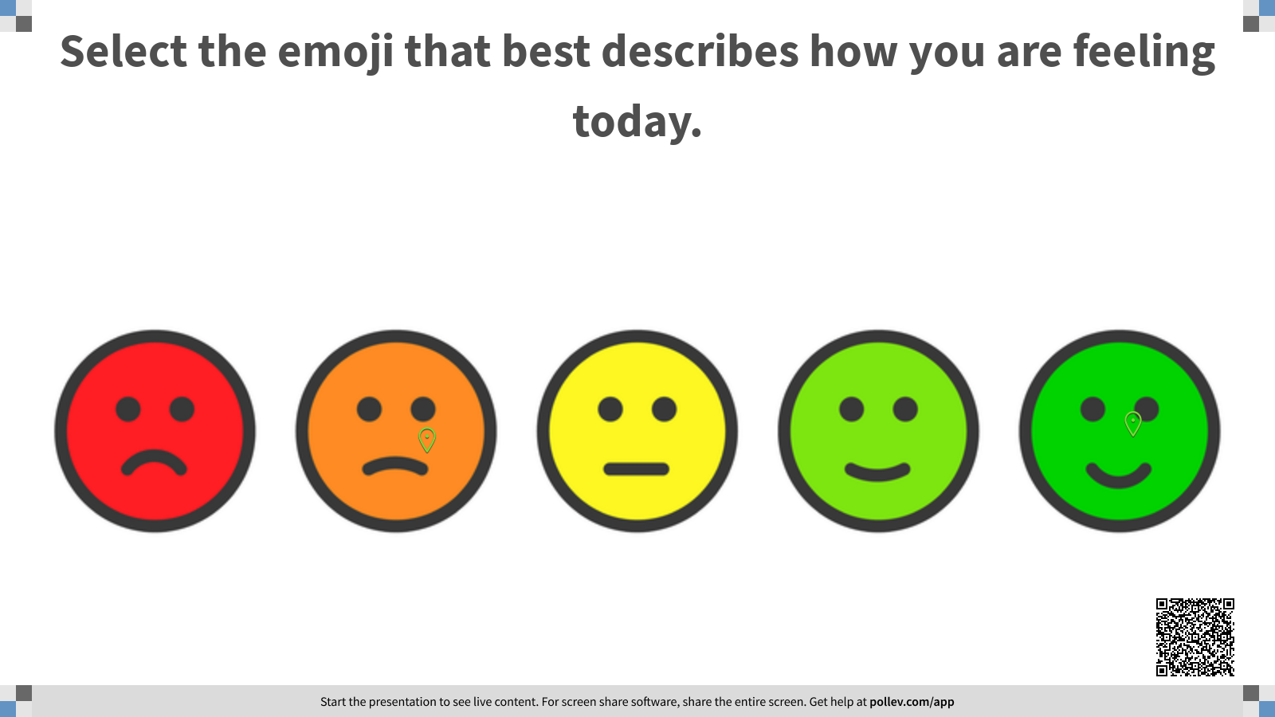
Notes:
McKoy
If you will, please search the extension at the top of the slide and select the emoji that best describes how you feel.
Please search pollev.com/tamishamckoy298 and select the emoji that best describes your present state of feeling
Ms. Glover….

Slide 6
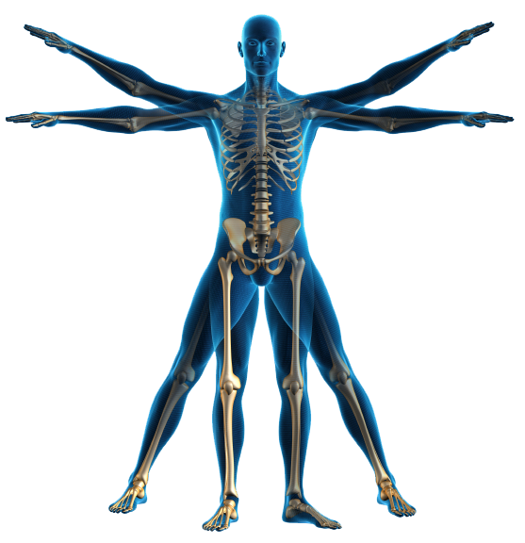
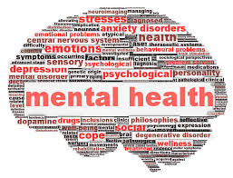
MENTAL WELLNESS
VS.
MENTAL ILLNESS
“MENTAL HEALTH” AND “MENTAL ILLNESS” ARE INCREASINGLY BEING USED AS IF THEY MEAN THE SAME THING, BUT THEY DO NOT.
EVERYONE HAS MENTAL HEALTH, JUST LIKE EVERYONE HAS HEALTH.
Notes:
Glover
Comment if necessary on the outcome of the poll.
Just as we are not immune to physical health problems, people are not immune to mental and emotional deficiencies and declines.
As the World Health Organization famously says, “There is no health without mental health.”
When we talk about mental health, we’re talking about our mental well-being: our emotions, our thoughts and feelings, our ability to solve problems and overcome difficulties, our social connections, and our understanding of the world around us.
Mental health is not simply the absence of mental illness but also encompasses social, emotional, and behavioral health and the ability to cope healthily with life’s challenges.
Health is: the CONDITION OF BEING OF SOUND BODY WITH EMPHASIS ON FREEDOM FROM PAIN AND DISEASE.
WELLNESS IS: A MULTI-DIMENSIONAL STATE OF WELL-BEING, A HOLISTIC APPROACH TO LIFE THAT ENCOMPASSES PHYSICAL, EMOTIONAL, INTELLECTUAL, SPIRITUAL, SOCIAL, ENVIRONMENTAL, AND OCCUPATIONAL as well as FINANCIAL aspects. We will explore these aspect a bit more in the following slides.

Slide 7

WHAT IS WELLNESS?
WELLNESS IS A CONSCIOUS, DELIBERATE PROCESS THAT REQUIRES A PERSON BECOME AWARE OF AND MAKE CHOICES FOR A MORE SATISFYING LIFESTYLE
THE PATHWAY TO WELLNESS IS A DEEPLY PERSONAL AND UNIQUE PROCESS OF REGAINING BALANCE WHEN ONE EXPERIENCES ILLNESS, CRISIS, AND/OR TRAUMA.
Notes:
Glover
According to Swarbrick, Wellness is not the absence of disease, illness, and stress but the presence of: Purpose in life; Active involvement in satisfying work and play. Joyful relationships; A healthy body and a living environment of Happiness
Dunn, H.L. (1961). High-Level Wellness, Beatty Press: Arlington, VA
Self care is a vital part of maintaining good health and a vibrant life. It’s a way of living that incorporates behaviors that help you to be refreshed, that allow you to replenish your personal motivation, and grow as a person. Wellness is an interactive process of becoming aware of and practicing healthy choices to create a more successful and balanced lifestyle.
Wellness is A direction in which by its nature, moves us toward a more proactive, responsible and healthier existence.
The integration of the body, mind, and spirit.
The loving acceptance of ourselves today and the exciting free search for who we choose to become tomorrow.
Choice living; a compilation of the daily decisions we make that lead us to that person we choose to become.
Wellness is the framework that you can use to organize, understand, and balance your own growth and development. Everything you do, every decision you make, every thought you think, and every attitude and belief you hold fits into this framework made up of the following eight basic concepts:
How deep is your WELL-ness
https://www.ferris.edu/RSS/eccc/tools/wellness.htm
We will go through the eight dimensions of health.
1 Swarbrick, M. (March 1997). A wellness model for clients. Mental Health Special Interest Section Quarterly, 20, 1-4.
2 Swarbrick, M. (2006). A wellness approach. Psychiatric Rehabilitation Journal, 29, (4)
3 Swarbrick, M. (2009). A wellness and recovery model for state hospitals. Occupational Therapy in Mental Health, (25),

Slide 8
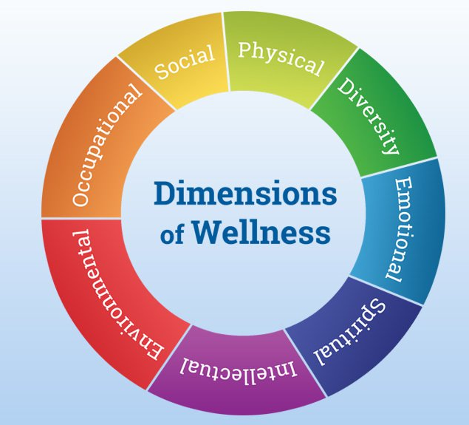
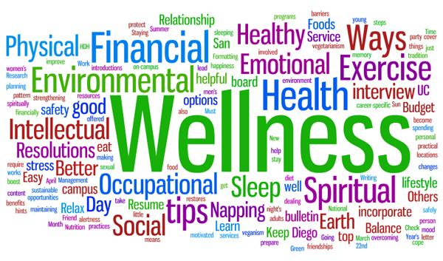
EIGHT DIMENSIONS OF WELLNESS
Notes:
Glover

Slide 9

WHAT IS ADULT SEL?
ADULT SEL IS THE PROCESS OF HELPING EDUCATORS BUILD THEIR EXPERTISE AND SKILLS TO LEAD SOCIAL EMOTIONAL LEARNING INITIATIVES. IT ALSO INVOLVES CULTIVATING ADULTS’ OWN SOCIAL AND EMOTIONAL COMPETENCIES.
ADULTS SHOULD:
  POSITIVELY MODEL PROSOCIAL BEHAVIORS, LABEL EMOTIONS, AND DEMONSTRATE EMPATHY, POSITIVE RELATIONSHIPS, SOCIAL AWARENESS, AND SELF-AWARENESS TO STUDENTS
  PARTICIPATE IN SELF-CARE PRACTICES TO COPE WITH STRESS AND MANAGE THEIR OWN EMOTIONS
  RECEIVE ENVIRONMENTAL SUPPORT AND LEADERSHIP INVESTMENT TO CULTIVATE THEIR OWN SEL SKILLS TO FEEL SUPPORTED, EMPOWERED AND VALUED
Notes:
McKoy
One of the concepts that will be reiterated in this presentation is that Social Emotional Learning start with Adults. Adult SEL is when staff have regular opportunities to cultivate their own social emotional & cultural competence, collaborate with one another, build trusting relationships and maintain a strong community. ​
Today, you are taking an opportunity to invest into your own SEL. There are various contextual factors, inside and outside the school building, that influence teachers' Social Emotional Competence.
These factors include co-teacher support, principal and district leadership, school climate and norms, school district values, in-service opportunities, community culture, and the operational demands of the job.
A teacher's overall well-being and efficacy as well as factors such as friendships, spousal relations, and degrees of stress in a teacher's personal life might also affect their performance of social and emotional abilities in the classroom.
​Wayne Dyer has a famous quote that says, “we can't give away what we don't have.” The following video will allow you to see and hopefully grasp the connection between SEL and academic achievement.​

Slide 10

WHAT IS SEL?
https://www.youtube.com/watch?v=4YxyAcV9QXc&t=2s
Notes:
https://www.youtube.com/watch?v=4YxyAcV9QXc&t=2s

Slide 11
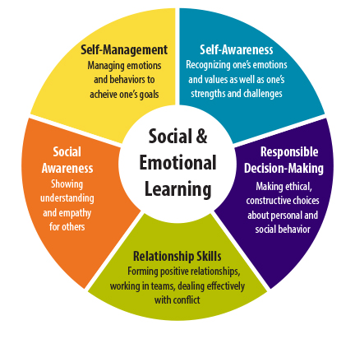
SOCIAL-EMOTIONAL LEARNING WHEEL
Notes:
McKoy
As the video states, SEL creates conditions that support learning.
The CASEL model of Social Emotional Learning covers five broad areas of social-emotional learning: ​
1. Self-Management has everything to do with recognizing and managing one’s emotions and self-efficacy. ​
2. Self-Awareness is taking time to recognizing one's feelings, values, strengths, biases and areas where growth is needed.​
3. Responsible Decision Making entails making ethical and moral decisions as it relates to one's personal and interpersonal interactions​
4. Relationship Skills, it’s one's ability to form and maintain positive relationships in your personal and professional life.​
5. Social Awareness is the ability to understand a diverse group of people, their situation and demonstrate empathy as well as social and ethical norms for behavior​
​The next two slides break down indicators that fall under these 5 competencies. The indicators measure non-academic traits and skills such as "grit" and "self confidence".

Slide 12
SOCIAL AND EMOTIONAL LEARNING (SEL) COMPETENCIES
RESPONSIBLE
DECISION-MAKING
SOCIAL AWARENESS
SELF-AWARENESS
The ability to take the perspective of and empathize with others, including those from diverse backgrounds and cultures. The ability to understand social and ethical norms for behavior and to recognize family, school, and community resources and supports.
PERSPECTIVE-TAKING
EMPATHY
APPRECIATING DIVERSITY
RESPECT FOR OTHERS
The ability to make constructive choices about personal behavior and social interactions based on ethical standards, safety concerns, and social norms. The realistic evaluation of the consequences of various actions, and a consideration of the wellbeing of oneself and others.
IDENTIFYING PROBLEMS
ANALYZING SITUATIONS
SOLVING PROBLEMS
EVALUATING
REFLECTING
ETHICAL RESPONSIBILITY
The ability to accurately recognize one’s own emotions, thoughts, and values and how they influence behavior. The ability to accurately assess one’s strengths and limitations, with a well-grounded sense of confidence, optimism, and a “growth mindset.”
IDENTIFYING EMOTIONS
ACCURATE SELF-PERCEPTION
RECOGNIZING STRENGTHS
SELF-CONFIDENCE
SELF-EFFICACY
Notes:
McKoy
SEL Indicators are not the same as measures of school climate, which may look at how students, educators, and sometimes parents experience their school environment.
Please take a moment to read the indicators listed.

Slide 13
SOCIAL AND EMOTIONAL LEARNING (SEL) COMPETENCIES CONT.
SELF-MANAGEMENT
RELATIONSHIP SKILLS
The ability to successfully regulate one’s emotions, thoughts, and behaviors in different situations — effectively managing stress, controlling impulses, and motivating oneself. The ability to set and work toward personal and academic goals.
IMPULSE CONTROL
STRESS MANAGEMENT
SELF-DISCIPLINE
SELF-MOTIVATION
GOAL SETTING
ORGANIZATIONAL SKILLS
The ability to establish and maintain healthy and rewarding relationships with diverse individuals and groups. The ability to communicate clearly, listen well, cooperate with others, resist inappropriate social pressure, negotiate conflict constructively, and seek and offer help when needed.
COMMUNICATION
SOCIAL ENGAGEMENT
RELATIONSHIP BUILDING
TEAMWORK
Notes:
McKoy
Now that we have a general understanding of (SEL), Social Emotional Learning, the 5 competencies and indicators. Let’s take a deeper dive into (SEC), Social Emotional Competence.

Slide 14
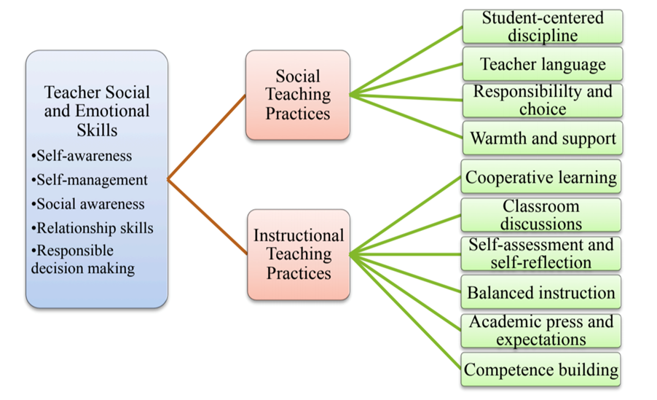
Notes:
McKoy
Educators must understand how best to implement the most effective strategies to promote students’ development of SEL competencies. We must understand how to build and improve our Social Emotional Learning, because teachers’ social and emotional competencies directly affect how they interact with students on both social and instructional constructs.
This tools takes 10 teaching practices, divides them into two types of teaching approaches; those that focus on Social Teaching Practices and Instructional Teaching Practices. To implement these practices successfully, teachers must strengthen their own social and emotional skills. For one to model and encourage positive student interactions, teachers themselves need the social and emotional skills required to communicate effectively with students and to handle stressful situations that can and will occur in the classroom and beyond.
Teachers who are socially and emotionally competent develop supportive relationships with students, create activities that build on the strengths of students, and help students develop the basic social and emotional skills necessary to participate in the classroom.
Source: https://www.gtlcenter.org/products-resources/self-assessing-social-and-emotional-instruction-and-competencies-tool-teachers

Slide 15
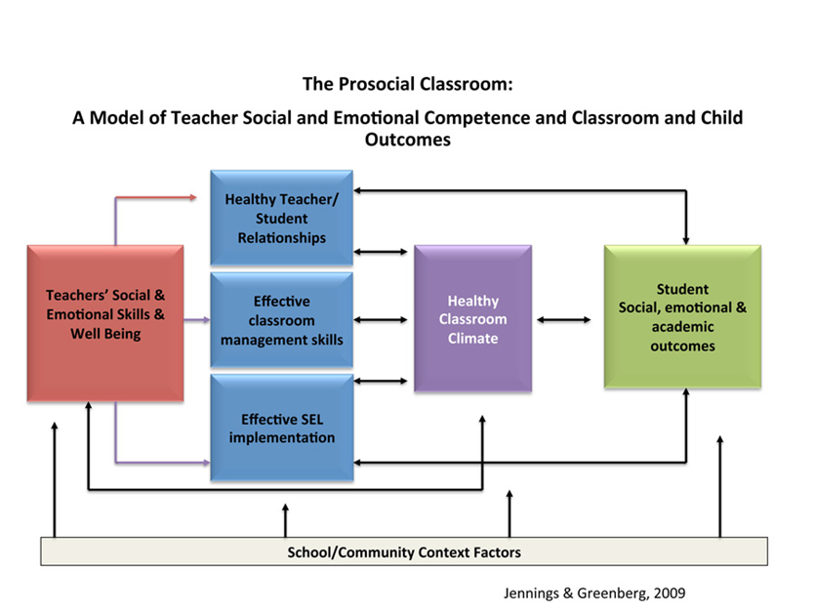
Notes:
McKoy
Let’s take a learning walk through a SEL rich classroom.
A Prosocial classroom is a model of teacher social and emotional competence that has a direct correlation on the classroom environment and student outcomes. The figure suggests that teachers’ social emotional-competence and wellbeing affect three categories; the relationships they form with students, their classroom management style, and their ability to implement SEL practices.
In addition, the authors conceptualize a transactional relationship between these three aspects of the model and the outcome of a healthy classroom climate. In turn, a healthy classroom climate directly contributes to students' social, emotional, and academic outcomes.
I think we can all agree that improvements in classroom climate may reinforce a teacher's enjoyment of teaching, efficacy, and commitment to the profession. Thereby, creating a positive feedback loop that may prevent teacher burnout.
Jennings, P.A., & Frank, J.L. (2017). Inservice preparation for educators. In Handbook of Social and Emotional Learning Research and Practice(pp. 422-437). New York, NY: The Guilford Press.

Slide 16
Social Emotional Competencies
Self Awareness
8 Areas of Wellness
Social Awareness
Self-Management
Social
  Social Awareness
  Self-Awareness
Diversity
  Social Awareness
  Relationship Skills
Physical
  Relationship Skills
  Self Management
Emotional
  Self-Awareness
  Self-Management
Spiritual
  Self-Management
  Self Awareness
Intellectual
  Responsible Decision Making
  Self-Awareness
Occupational
  Responsible Decision making
  Self-Awareness
Environmental
  Social Awareness
  Relationship Skills
Relationship Skills
Responsible Decision making
Notes:
Glover
Combined: each area of wellness includes a particular social emotional competency

Slide 17
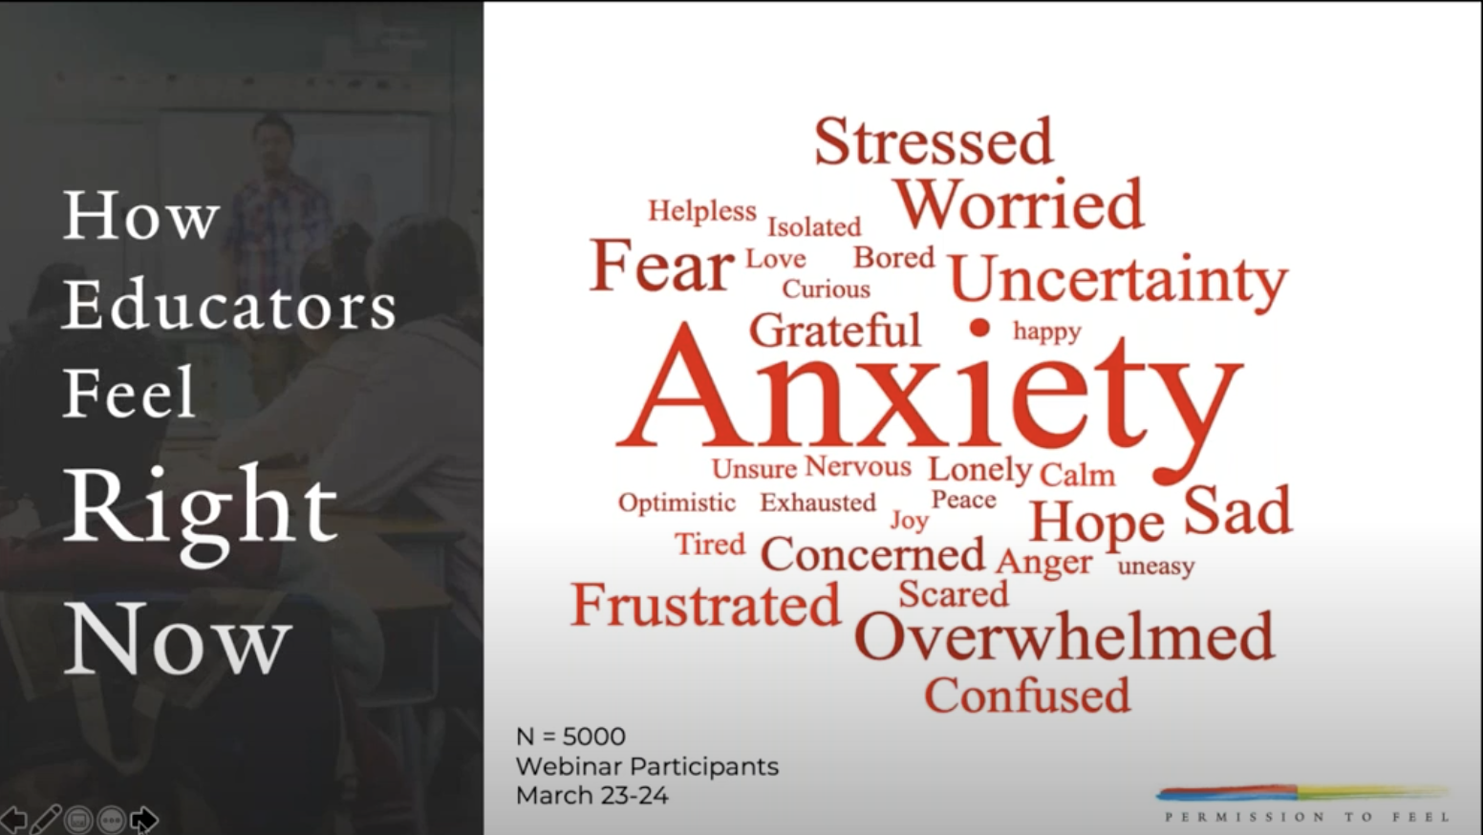
EMOTIONAL
THE CAPACITY TO MANAGE ONE'S FEELINGS AND THE REALISTIC ASSESSMENT OF ONE'S LIMITATIONS, AND ABILITY TO COPE EFFECTIVELY WITH STRESS. TOLERANCE, AND THE AWARENESS OF AND ACCEPTANCE OF A WIDE RANGE OF FEELINGS IN YOURSELF AND OTHERS. THE ABILITY TO LIVE AND WORK INDEPENDENTLY WHILE REALIZING THE IMPORTANCE OF SEEKING AND APPRECIATING THE SUPPORT AND ASSISTANCE OF OTHERS.
Notes:
Glover
Paying attention to your emotions is an important part of emotional wellness, self-care and self-awareness. Your feelings and emotions are often connected to your thoughts. If you notice that you are anxious, concerned or worried, then it may be a good practice to identify your thoughts. If you are having negative thoughts about what may be happening, it has the potential to result in negative feelings and emotions...which in turn leads to behaviors that may not be appropriate. Emotional wellness is the ability to cope effectively with stress; be aware of, tolerate and accept the wide range of feelings in yourself and others.

Slide 18
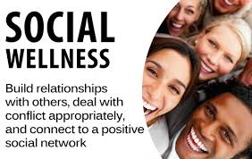
SOCIAL
THE SOCIAL DIMENSION ENCOURAGES CONTRIBUTING TO THE ENVIRONMENT AND COMMUNITY AND EMPHASIZES THE INTERDEPENDENCE BETWEEN YOU, OTHERS, AND NATURE.
Notes:
Glover
Establishing and maintaining better communication with those around you. Enhancing personal relationships, important friendships, and building a better living space and community.
And not through social media. We are more connected and more isolated. Facebook is only one form of socialization. It is interfacing not interaction.

Slide 19

SPIRITUAL
A BROAD CONCEPT THAT REPRESENTS ONE'S PERSONAL BELIEFS AND VALUES. OUR SPIRITUAL DIMENSION RECOGNIZES OUR SEARCH FOR MEANING AND PURPOSE IN BEING 'HUMAN’ AND OUR EXISTENCE. IT INCLUDES THE DEVELOPMENT OF A DEEP APPRECIATION FOR FORCES THAT EXIST IN THE UNIVERSE
Notes:
Glover
Explore, respect, and incorporate personal values, beliefs, awareness of a being or' force’ that transcends the material life and gives a sense of connectedness to the universe. Link and connect with cultural, religious and/or spiritual traditions which enhance self identity. That is a part of spiritual wellness. The concept of spiritual wellness has more to do with the search for purpose and meaning and our human existence.

Slide 20

OCCUPATIONAL
THE OPPORTUNITY TO PARTICIPATE IN ACTIVITIES THAT ARE MEANINGFUL, REWARDING AND IN LINE WITH PERSONAL VALUES, INTERESTS AND BELIEFS
PERSONAL SATISFACTION AND ENRICHMENT IN ONE'S LIFE IS DERIVED FROM PARTICIPATION IN WORK AND VOLUNTEER ACTIVITY
Notes:
Glover
It’s about How we handle major tasks at work or school and meaningful roles in our lives. “Burnout syndrome” has been recognized for the first time as an official medical diagnosis with its own diagnostic criterion. World Health Organization
https://nypost.com/2019/05/28/world-health-organization-now-considers-burnout-a-condition/
WHO’s International Classification of Diseases 11th edition (ICD), which categorizes diseases for diagnosis by health care professionals and determines coverage by health insurers, was published on Saturday ending more than four decades of debate among experts over how to define this stress disorder.
The new diagnosis is defined as a “syndrome conceptualized as resulting from chronic workplace stress that has not been successfully managed. It is characterized by three dimensions: 1) feelings of energy depletion or exhaustion; 2) increased mental distance from one’s job, or feelings of negativism or cynicism related to one’s job; and 3) reduced professional efficacy. Burnout refers specifically to phenomena in the occupational context and should not be applied to describe experiences in other areas of life.”

Slide 21
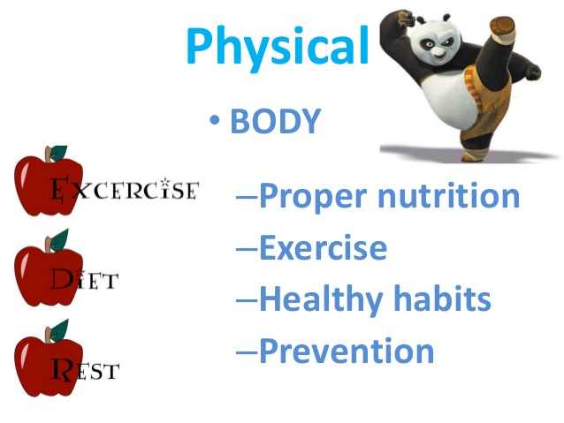
PHYSICAL
ADDRESSING COMORBID MEDICAL AND ADDICTIVE DISORDERS. TAKING PERSONAL RESPONSIBILITY AND CARE FOR MINOR AND MAJOR ILLNESSES AND KNOWING WHEN PROFESSIONAL MEDICAL ATTENTION IS NEEDED.
INVOLVES ATTENDING TO THE BODY WITH EXERCISE, PROPER NUTRITION & REST
Notes:
Glover
You only have one body. Keeping your body in motion with Exercise is healthy. Paying attention to the foods that you put into your body to fuel it is all about a balanced nutrition. An now that we are working from home, ensuring balance between work and recreational activities is critical to your overall physical wellness.

Slide 22

INTELLECTUAL
INTELLECTUAL WELLNESS IS ABOUT ENGAGING THE INDIVIDUAL IN CREATIVE AND STIMULATING MENTAL ACTIVITIES TO EXPAND THEIR KNOWLEDGE AND SKILLS AND HELP THEM DISCOVER THE POTENTIAL FOR SHARING THEIR GIFTS WITH OTHERS
AN INTELLECTUALLY WELL PERSON: CHERISHES MENTAL GROWTH AND STIMULATION
Notes:
Glover
Recognizing creative abilities and finding ways to expand your knowledge and skills while discovering the potential for sharing those gifts with others. Spending time pursuing personal interests, reading books, magazines, and newspapers to keep current on issues and ideas. This increases our capacity for problem solving and reasoning, creativity, insight, These are pillars within the responsible decision making and social awareness areas of SEL as well.

Slide 23
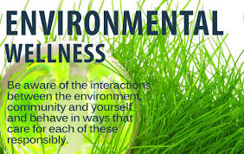
ENVIRONMENTAL
THE ENVIRONMENT INCLUDES OUR LIVING, LEARNING AND WORKING SPACES AND THE LARGER COMMUNITIES WHERE WE PARTICIPATE AS CITIZENS
FINDING PLEASANT, STIMULATING ENVIRONMENTS THAT SUPPORT PHYSICAL, SOCIAL, AND EMOTIONAL WELL-BEING
PLACES THAT PROMOTE LEARNING, CONTEMPLATION AND RELAXATION
Notes:
Glover
Environmental wellness includes protecting the earth and its resources
It is the ability to recognize our own responsibility for the quality of air, the water and the land that surrounds us. It is the ability to make a positive impact on the quality of our environment in our homes and communities
Some ideas include:
Conserving water and other natural resources
Reducing, reusing and recycling
Minimize your exposure to chemicals; use more natural items.
Our connection to the earth, nature and the animal kingdom is important. It contributes to the ability to feel relaxed in a safe, clean environment with access to clean air, food and water. In densely populated and iron jungles where there are very little vegetation and little sun because of large buildings and skyscrapers it is good to recognize the impact for your overall health and our students as well as the environmental well-being of the neighborhoods where we work and live.

Slide 24
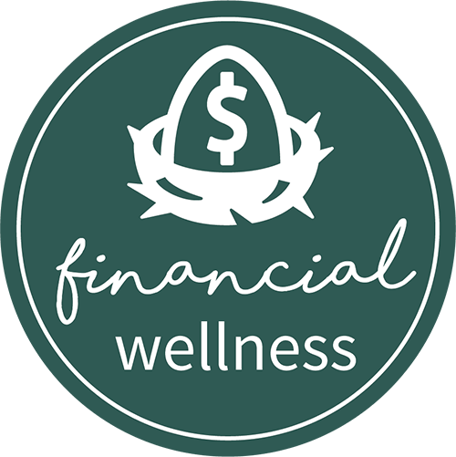
FINANCIAL
INVOLVES THE ABILITY TO HAVE FINANCIAL RESOURCES TO MEET PRACTICAL NEEDS, AND A SENSE OF CONTROL AND KNOWLEDGE ABOUT PERSONAL FINANCES
INDICATORS OF FINANCIAL WELLNESS MAY INCLUDE INCOME, DEBT, SAVINGS AND ASPECTS OF FINANCIAL CAPABILITY SUCH AS KNOWLEDGE OF FINANCIAL PRODUCTS AND SERVICES, PLANNING AND STAYING ON BUDGET
Notes:
Glover
Financial Wellness is having Satisfaction with current and future financial situations. Refers to the objective perceptions and subjective indicators of individuals’ personal financial status.

Slide 25
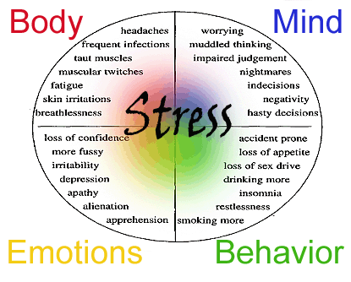
5 THINGS YOU SHOULD KNOW ABOUT STRESS
STRESS AFFECTS EVERY PART AND ASPECT OF YOUR BODY
STRESS AFFECTS EVERYONE
NOT ALL STRESS IS BAD
LONG-TERM STRESS (TOXIC STRESS) CAN HARM YOUR HEALTH
YOU CAN MANAGE & REDUCE YOUR STRESS LEVELS
Notes:
Glover
A stressor may be a one time or short term occurrence, or it can be an occurrence that keeps happening over a long period of time.
1. Examples of stress include: ◉ Routine stress related to the pressures of work, school, family, and other daily responsibilities ◉ Stress brought about by a sudden negative change, such as losing a job, divorce, or illness ◉ Traumatic stress experienced in an event like a major accident, war, assault, or a natural disaster where people may be in danger of being seriously hurt or killed. People who experience traumatic stress often experience temporary symptoms of mental illness, but most recover naturally soon after
Stress can motivate people to prepare or perform, like when they need to take a test or interview for a new job.
With chronic stress, those same life-saving responses in your body can suppress immune, digestive, sleep, and reproductive systems, which may cause them to stop working normally. Different people may feel stress in different ways. For example, some people experience mainly digestive symptoms, while others may have headaches, sleeplessness, sadness, anger or irritability. Over time, continued strain on your body from routine stress may contribute to serious health problems, such as heart disease, high blood pressure, diabetes, and other illnesses, as well as mental disorders like depression or anxiety.
See SHEET UNDER NUMBER 4
Seek help from, peer support, support and professional support if needed but stay in community and talk about it.
Toxic stress occurs when life’s demands consistently outpace our ability to cope with those demands. Being in a constant state of vigilance is what separates toxic stress from normal everyday stress.
Traumatic stress can also lead to increased use of health and mental health services and increased involvement with the child welfare and juvenile justice systems.
Stress symptoms can affect your body, your thoughts and feelings, and your behavior:
Mayo Clinic- https://www.mayoclinic.org/healthy-lifestyle/stress-management/in-depth/stress-symptoms/art-20050987
Signs of toxic stress include but are not limited to : Obesity, inflammation, poor digestion, fatigue and headaches, mood swings and poor energy, skin irritation and rashes and immune dysfunction.

Slide 26
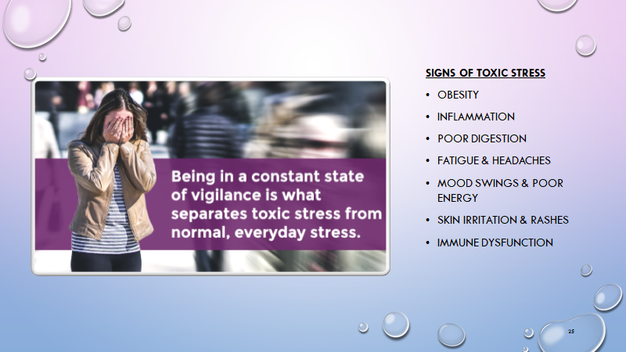
Notes:
Glover
Change this info
Toxic stress occurs when life’s demands consistently outpace our ability to cope with those demands.
Traumatic stress can also lead to increased use of health and mental health services and increased involvement with the child welfare and juvenile justice systems.
Stress symptoms can affect your body, your thoughts and feelings, and your behavior:
Mayo Clinic- https://www.mayoclinic.org/healthy-lifestyle/stress-management/in-depth/stress-symptoms/art-20050987

Slide 27




STRESS DEEPLY AFFECTS EDUCATORS AND STUDENTS
Teacher's job satisfaction, job turnover and student outcomes are all impacted by stress.
Teachers who are mandated to teach SEL but did not attend to and cultivate their own practices worsened their student's SEL Skills.
However, teachers who developed their own SEL skills not only improved their own well-being but also improved the social-emotional and academic development of their students
Students learn SEL skills better when educators effective model these practices
Effective management and practice of SEL skills can positively influence student-teacher relationships, improve classroom management and improve overall school climate.
Notes:
McKoy
Stress deeply affects educators and students.
It’s no secret that teachers have heavy workloads, high stress levels and a significant risk of compassion fatigue. The coronavirus pandemic is magnifying each of these factors. It is clear that teachers need support. Educators are adjusting to new ways of teaching, connecting with students, balancing work and home life in the same space and facing uncertainty around what’s to come.
I submit to you, that now more than ever before, teachers need to practice social emotional skills and self-care. Becoming more intentional with these practices will minimize the negative effects of stress.
https://www.panoramaed.com/blog/comprehensive-guide-adult-sel#what-is-adult-sel
https://eab.com/insights/blogs/district-leadership/improve-teacher-wellbeing/

Slide 28
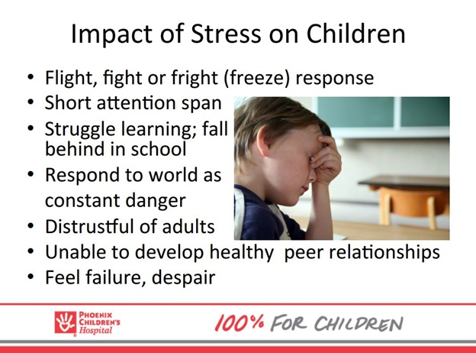
SOCIAL-EMOTIONAL
RELATIONSHIPS
Notes:
McKoy
The fight, flight, or freeze response is housed in the brain's amygdala at the base of the brain (the brain's fear center). Stress activates this area. The main objective of the amygdala is to determine very quickly whether a certain situation, context or person presents a threat or danger. It is always on much like a smoke detector. When this fear center interprets a situation as threatening, its smoke sensors are activated. The amygdala is often hyper-activated in those suffering from post-traumatic symptoms like many of us, our colleagues and students. The practice of SEL for both adults and students will significantly decrease this hyper-arousal.
At this time, I would like to introduce you to Mr. Jensen. While watching, try to identify how Mr. Jensen is modeling SEL in his approach to a hyperactive student.

Slide 29

MR. JENSEN'S SEL SKILLS
https://www.youtube.com/watch?v=4p5286T_kn0

Slide 30

HOW TO STRENGTHEN ADULT SEL TO IMPROVE MENTAL WELLNESS, SELF-EFFICACY AND LEARNING OUTCOMES
REFLECT REGULARLY TO DEEPEN YOUR UNDERSTANDING OF YOUR OWN EMOTIONS, THOUGHTS AND VALUES
OBSERVE AND NAME YOUR OWN EMOTIONS IN FRONT OF STUDENTS
PRIORITIZE RELATIONSHIP BUILDING
PRACTICE SELF-CARE
ENGAGE IN VULNERABLE, HONEST COMMUNICATION WITH PEERS TO BUILD NETWORKS OF CARING SUPPORT
Notes:
McKoy
Teachers' self-efficacy, namely teachers' beliefs in their ability to effectively handle the tasks, obligations, and challenges related to their professional duties, play a key role in influencing important academic outcomes like achievement, motivation and well-being in the working environment. Mr. Jensen was not the best in the world, but the best for the world.
Cultivating mindfulness and working to improve your mental wellness will truly benefit – not just you, but your students as well. You are encouraged to take a moment to identify your energy, observe your emotions and share with your students. Connect with colleagues and build networks of support.
The following video will explain the benefits further.

Slide 31
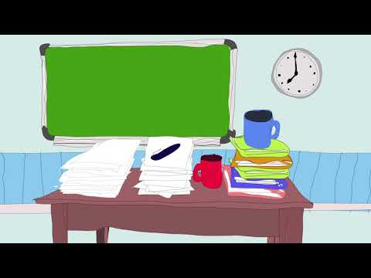
MINDFULNESS & SELF-CARE
https://www.youtube.com/watch?v=Rjc57hXNcwI

Slide 32
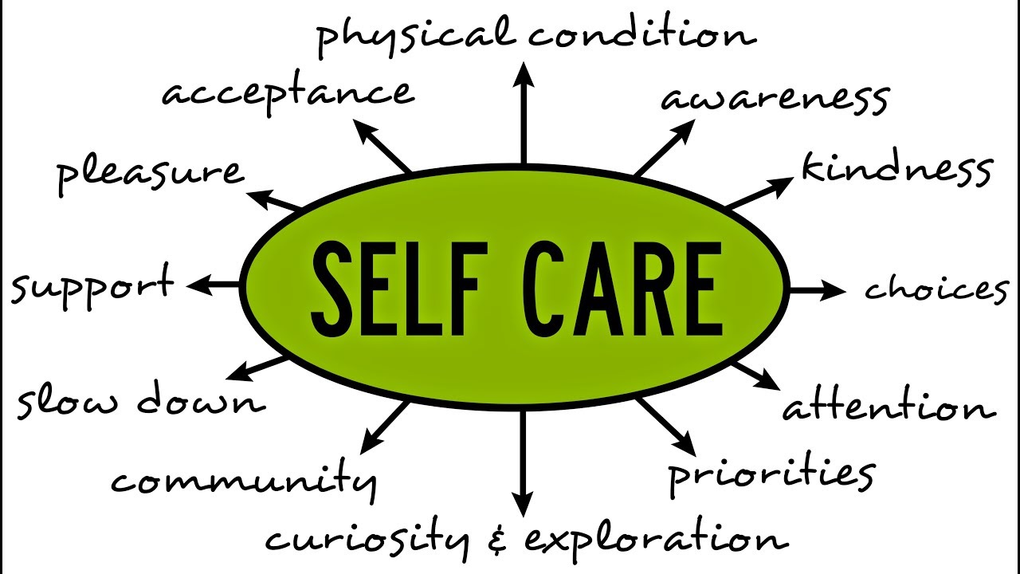
Notes:
Glover
Self-care can be described as attitudes and actions that contribute to happiness, balance and well-being. Not advocating selfishness. Sometimes caring for ourselves can feel like Selfishness.

Slide 33
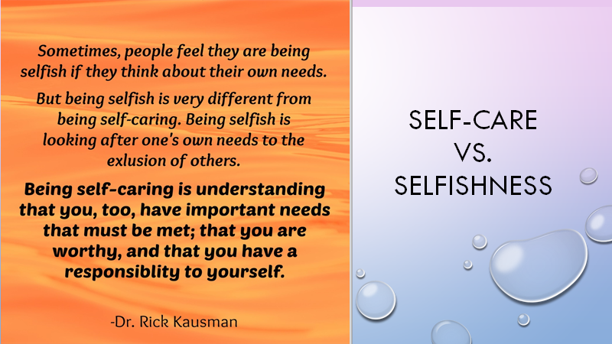
Notes:
Glover
Teaching and educating others is the role of a caregiver's. By definition a caregiver is a person who is responsible for the physical care and emotional support of someone who is unable to do so for themselves. Only when we first help ourselves can we effectively help others. Caring for yourself is one of the most important—and one of the most often forgotten—things you can do as a caregiver. When your needs are taken care of, the person you care for will benefit, too. Self Care is about being gentle with yourself. It is about taking care of you so that your tank is full enough to care for others.

Slide 34
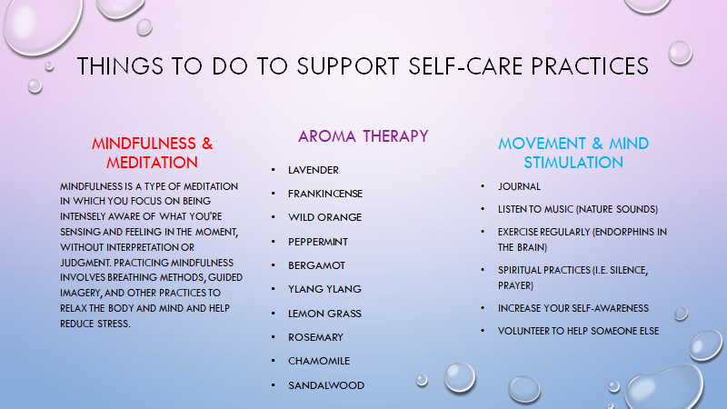
Notes:
Glover
What are the benefits of meditation?
Meditation has been studied in many clinical trials. The overall evidence supports the effectiveness of meditation for various conditions, including:
Stress
Anxiety
Pain
Depression
Insomnia
High blood pressure (hypertension)
BENEFITS:
IMPROVES ATTENTION
DEVELOPS EMOTIONAL REGULATION
ADAPTABILITY & AWARENESS
BUILDS COMPASSION & EMPATHY
CALMING & SELF-REGULATION
RESILIENCE
Next, we will present a short video that will introduce you to the healing benefits of a brief meditation.

Slide 35
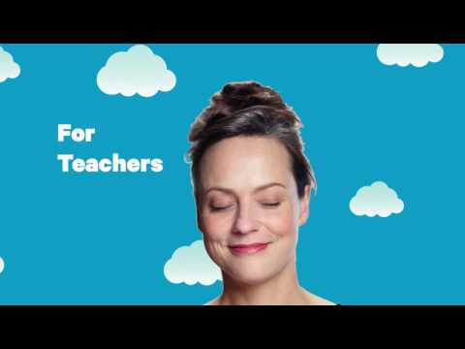
MEDITATION
https://www.youtube.com/watch?v=6CCEYJ82rl4

Slide 36
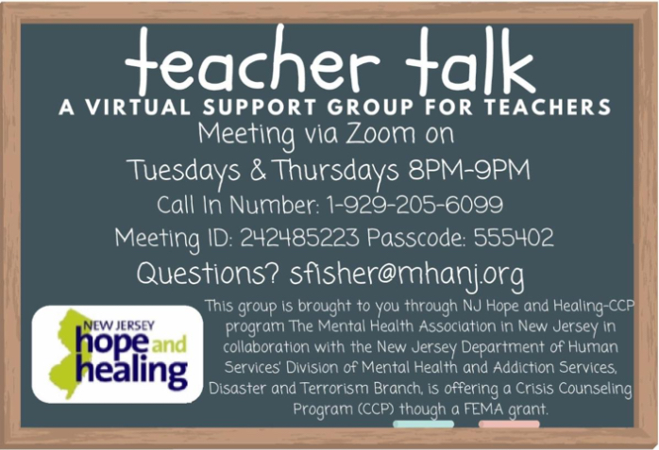
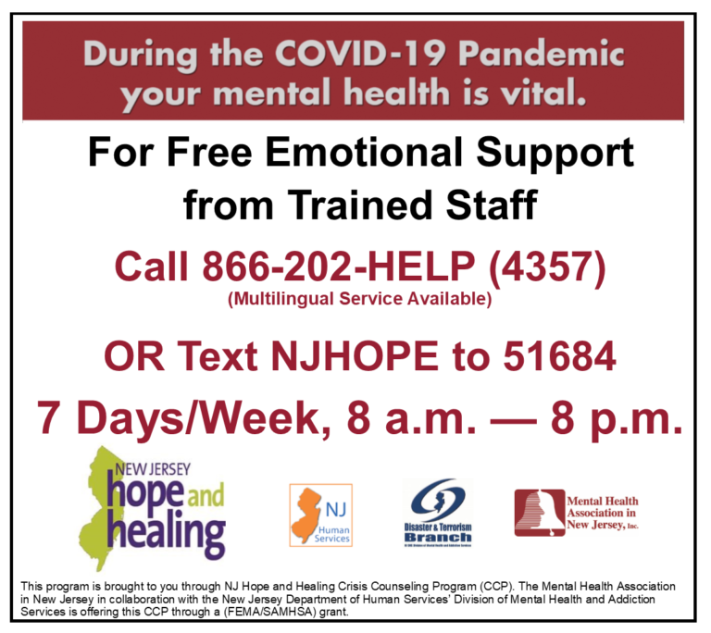
https://www.mhanj.org/njhope/
Notes:
Glover
In addition to meditation, many feel supported when sharing their feelings with others that have similar backgrounds. The Mental Health Association in New Jersey, in collaboration with the New Jersey Department of Human Services' Division of Mental Health and Addiction Services, offers emotional support groups, like Teacher Talk, and individual counseling from trained staff. These services are 100% free. For additional support groups or more information about these wellness-driven services, you may visit www.mhanj.org/njhope.

Slide 37
RESOURCES
PANORAMA'S ADULT SEL TOOLKIT (INCLUDES AN ADULT SEL SELF-ASSESSMENT)
THE PANORAMA SOCIAL-EMOTIONAL LEARNING SURVEY
HOW TO LEAD ADULT SEL IN SCHOOL DISTRICTS: 4 EXPERTS SHARE BEST PRACTICES AND TIPS
SUPPORTING STUDENTS WITH A HISTORY OF TRAUMA: HTTPS://ATTACHMENT.EAB.COM/WP-CONTENT/UPLOADS/2019/05/1E459F776A13410E8EEEB633B375E570.PDF#PAGE=13
HTTPS://EAB.COM/RESEARCH/STRATEGY/RESOURCE-CENTER/SUPPORT-YOUR-K-12-SCHOOL-THROUGH-THE-CORONAVIRUS-CRISIS/?X_ID=%7B%7BLEAD.SFDC%20ID:DEFAULT=%7D%7DU0026AMP;UTM_SOURCE=BANNERU0026AMP;UTM_MEDIUM=ADVERTISINGU0026AMP;UTM_CAMPAIGN=CORONAVIRUSU0026AMP;UTM_CONTENT=HOMEPAGEBANNER
HTTPS://WWW.MAYOCLINIC.ORG/HEALTHY-LIFESTYLE/CONSUMER-HEALTH/IN-DEPTH/MINDFULNESS-EXERCISES/ART-20046356
Notes:
Glover
The next two slides contain resources for youHere are some resources for you.

Slide 38
RESOURCES
INSPIRE EDUCATORS, STRENGTHEN COMMUNITIES (VIA SECOND STEP)
3 SELF-CARE TIPS FOR TEACHERS AND EDUCATORS (VIA COMMITTEE FOR CHILDREN)
SOCIAL-EMOTIONAL LEARNING: IT STARTS WITH ADULTS (VIA COMMITTEE FOR CHILDREN)
SCHOOL LEADERS’ ROLE IN EMPOWERING TEACHERS THROUGH SEL (VIA NASBE)
SEL FOR ADULTS (VIA ASCD)
STRENGTHEN ADULT SOCIAL, EMOTIONAL, AND CULTURAL COMPETENCE (VIA CASEL)
SEL TRENDS BRIEF: STRENGTHENING ADULT SEL (VIA CASEL)
5 SOCIAL-EMOTIONAL LEARNING LESSONS FOR ADULTS (VIA EDUTOPIA)
Notes:
Glover
More Resources

Slide 39


EXIT TICKET
HTTPS://FORMS.GLE/RBVEU5TRFNBJA7RS8
Notes:
Glover
We have an exit ticket for you. Please click the link and provide your feedback
https://forms.gle/rBVEU5TRfNBJa7rs8
Copy and paste the link into the chat box to finish the exit ticket.
Questions will go there.

Slide 40

THANK YOU FOR ALL YOUR COMMITMENT AND
HARD WORK
LET'S STAY HEALTHY TOGETHER.
Notes:
Glover & McKoy

