Slide 1
ELE PROPOSED REGULATIONS and the LOOK ACT
Parent Outreach

Slide 2
What is the LOOK Act?
The Language Opportunities for Our Kids Act is designed to improve the education of English learners (ELs) and other students.
November 22, 2017: Governor Baker signs the Language Opportunity for Our Kids (LOOK) Act.

Slide 3
What are Acts, Laws, and Regulations?
ACTS are laws or changes to laws made by a group of lawmakers (legislators).
LAWS are rules made by the government of a town, state, country.
REGULATIONS are official rules to help carry out laws.

Slide 4
Proposed LOOK Act Regulations
English Learner Parent Advisory Councils (603 CMR 14.09)
English Learner Programs (603 CMR 14.04)
Bilingual Education Endorsement (603 CMR 7.14 and 7.15)
State Seal of Biliteracy (603 CMR 31.07)
Notes:
In the next several minutes, I’m going to present to you four areas of regulations (regulations are rules, guidelines, or instructions). These are the four.

Slide 5
1- English Learner Parent Advisory Councils (ELPAC) (603 CMR 14.09)
Districts that require an EL Parent Advisory Council are those with 100 or more English learners or where English learners comprise 5% of the student body
Schools that require an EL Parent Advisory Council are those that have ELE programs and are underperforming or chronically underperforming.
The council shall receive assistance from the ELE Director or other appropriate school personnel as designated by the Superintendent.
5%
Notes:
Districts assistance includes translations and interpreters, and the law specifically calls out the Director

Slide 6
Examples of ELPAC Duties
Create by-laws (rules) regarding officers and operational procedures
Advise the school district, school committee, and board of trustees on matters related to English learners
Meet regularly with school or district leaders to participate in the planning and development of programs to improve educational opportunities for English learners
Notes:
Second area of regulations are the Parent Advisory Councils regulations. (Nothing really new)
Regulations require EL PACs in districts and schools that have: 100 ELs or 5% of student body; also underperforming and chronically underperforming schools with ELE programs.
Also, the regulations reference the LOOK Act duties EL PAC members would participate in including advising districts in matters pertaining to ELs

Slide 7
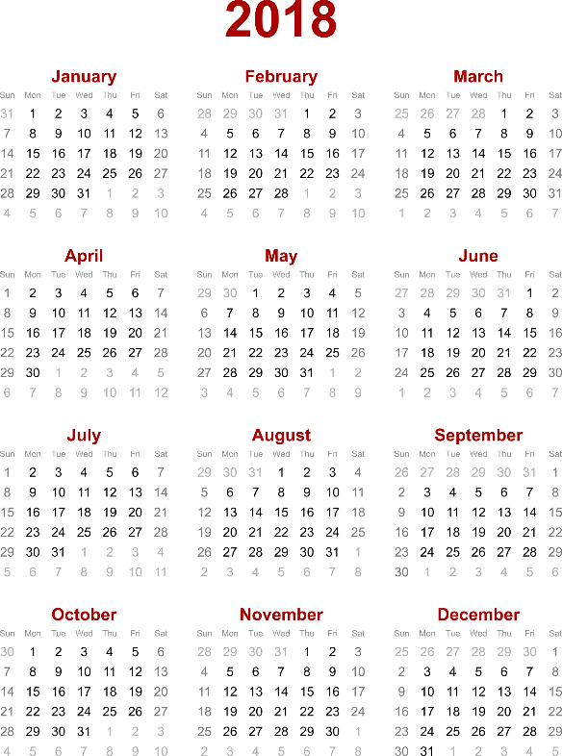
Examples of ELPAC Duties
Advise the district on any new ELE programs before they are submitted for approval
Participate in the review of district and school improvement plans as they relate to English learners
Meet at least annually with the school committee or school council

Slide 8
2- English Learner Programs (603 CMR 14.04)
Proposed regulations establish the process that districts and the Department would use when a district applies to offer a new Sheltered English Immersion (SEI) program OR an alternative English learner education program.
Proposed regulations also specify the process a district would follow when a parent/guardian requests to enroll or transfer an English learner into an English learner education program offered by the district.
1
2
3
Notes:
First set of Regulations mostly center around the review of new ELE programs by the Department. (Nothing really new here)
Context: 1. Prior to the LOOK Act parental waivers were required for students to attend a bilingual program.
Now with the LOOK Act and these new regulations districts will be allowed to run any ELE program without waivers, provided that they follow a specified process which includes a Departmental review of the required information indicated in the statute and the regulations.
2. There are also related provisions on how districts handle parental requests to enroll or transfer their child to a different ELE program offered by the district.

Slide 9
Review Process for New ELE Programs Requirements: LOOK Act
Districts that wish to operate a new SEI or alternative ELE program must submit information required to the Department.
The Department has 90 days to review the information submitted and notify the district in writing whether the program fails to meet federal and state law requirements.
There are two possible outcomes based on the Department’s review:
The district can begin the proposed program.
If required, the district will have 30 days to submit a revised proposal incorporating the feedback to bring the program into compliance.
The Department will then review the revised proposal and determine whether the district can start implementing the program.

Slide 10
Parental Requests for an ELE Program
A parent can request to enroll or transfer their student into another ELE program in the district. This is ultimately the Superintendent’s decision.
Parents of 20 or more students may request the implementation of a new ELE district program. This is ultimately the Superintendent’s decision.
Districts must respond within 90 days after receiving the request and provide:
a plan for implementation of the requested program; or
a denial of the request, in writing, including an explanation of the denial.
Notes:
The school district had 20 days to respond to requests to enroll or transfer to another ELE program.

Slide 11
3- Bilingual Education Endorsement: Proposed Regulations (603 CMR 7.14 and 7.15)
Proposed regulations clarify the requirements to earn a Bilingual Education endorsement.
Proposed regulations specify which educators will need the SEI or Bilingual Education endorsements.
Proposed regulations allow the Commissioner to issue a one-year waiver of the Bilingual Education Endorsement requirements under certain circumstances.
Notes:
Third area of regulations are the Bilingual Education Endorsement regulations.
This endorsement covers all bilingual programs with ELs including TBE and TWI.
Who is required to have the bilingual endorsement? The only group of teachers in a bilingual program who would be required to hold the Bilingual Education Endorsement are core content teachers (specifically Math, Soc. St., Science) who teach in a language other than English and have ELs.
Also, the regulations establishes the requirements for the endorsement and allows for provisions such as the waiver in cases where districts have been unable to find a candidate with the Bilingual Endorsement.

Slide 12
4- State Seal of Biliteracy: Proposed Regulations (603 CMR 31.07)
Proposed regulations describe the process and criteria for earning the State Seal of Biliteracy.
Seal of Biliteracy Proposed Criteria
Meets all graduation requirements.
Demonstrates a high level of proficiency in English as measured by MCAS.
Demonstrates a high level of proficiency in a foreign language by attaining a minimum score on a nationally recognized and readily available assessment or an alternative evidence method established by the Department.
Notes:
Fourth area of regulations is the State Seal of Biliteracy regulations
As a reminder the State Seal of Biliteracy is voluntary for districts.
If asked:
Department to annually publish the list of approved assessments and the acceptable minimum scores or levels.
Districts that award the Seal maintains a record of the list of students and assessment results AND sends the names of students that earned the Seal to the Department.

Slide 13
For Comments, please see the information below:
For Comments, please see the information below:
Written comments on the proposed amendments may be submitted by mail to: Sibel Hughes, OELAAA, Department of Elementary and Secondary Education, 75 Pleasant Street, Malden, MA 02148; by fax to: 781-338-3395; or by email to: LOOKAct@doe.mass.edu.
The following link may also be used to submit public comment on the proposed revisions: Proposed Amendments to English Learner Education Regulations: Public Comment Survey. The deadline for submission of public comment is Friday, May 18, 2018. The Board is expected to vote on the proposed amendments to the regulations at its regular monthly meeting scheduled for June 26, 2018.

Slide 14
THANK YOU
Office of English Language Acquisition and Academic Achievement
781.338.3538
el@doe.mass.edu
www.doe.mass.edu
75 Pleasant Street, Malden, MA 02148

