Slide 1

CENTRAL OFFICE DIRECTORS & STAFF
AREAS OF RESPONSIBILITY
2024-2025

Slide 2
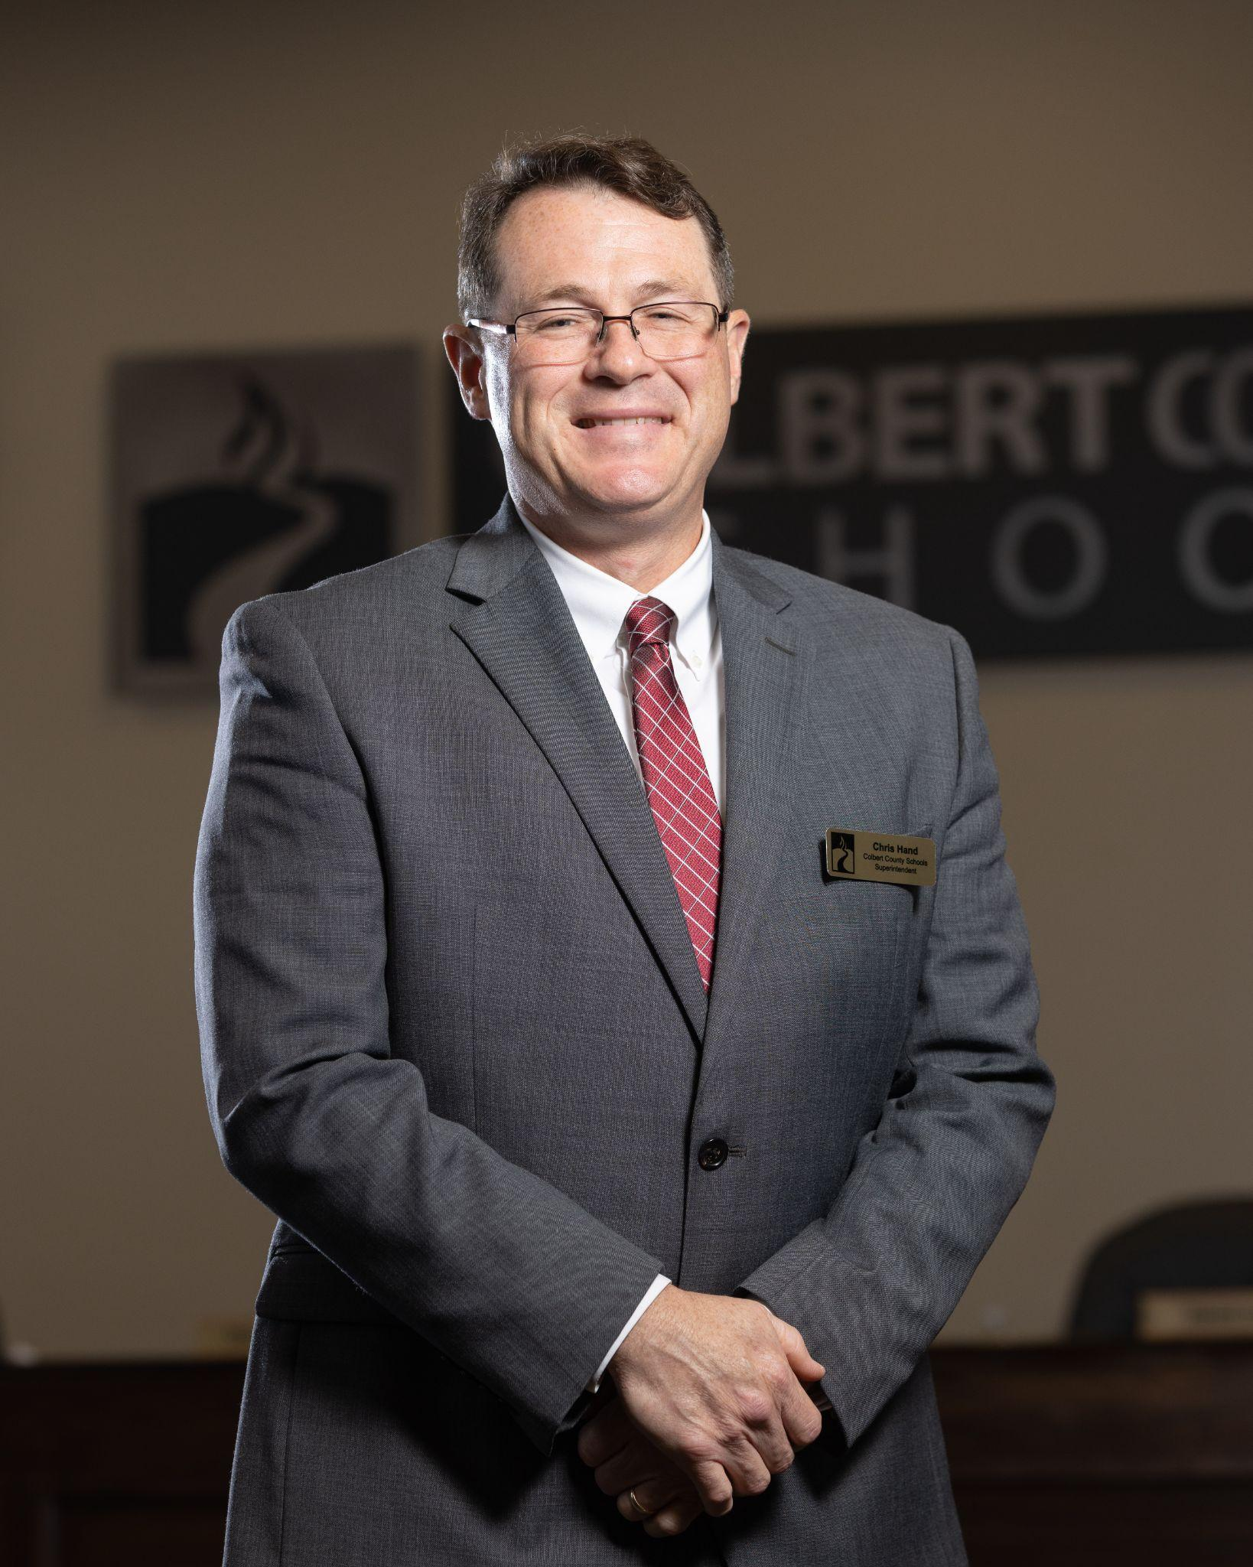
CHRIS HAND
SUPERINTENDENT
chand@colbertk12.org
256 386 8565 Ext 1211

Slide 3
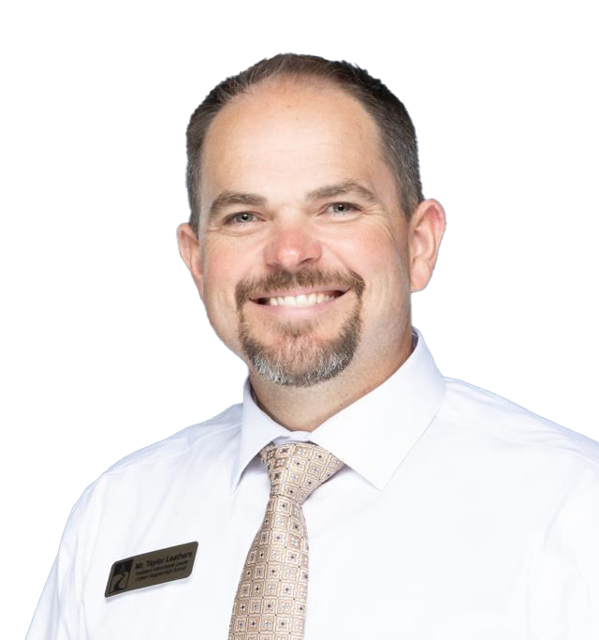
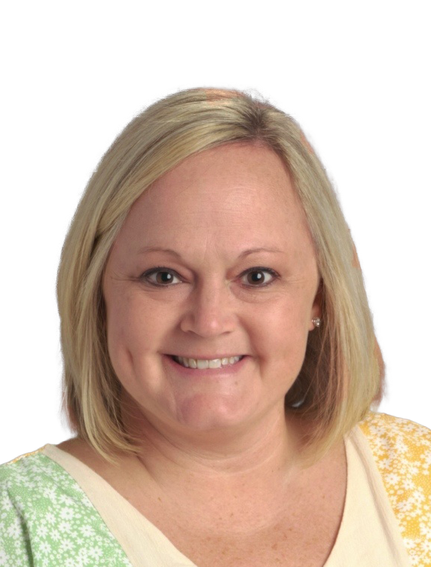
OFFICE OF SUPERINTENDENT
Assistant Superintendent Taylor Leathers tleathers@colbertk12.org 256 386 8565 Ext 1229
PROGRAM AREAS KEY CONTACT
Board Policy & Procedures
School Counselors
Capital Planning
Student Handbooks & School Calendar
 | Admin Assistant to Superintendent Chrissy Denton cdenton@colbertk12.org 256 386 8565 Ext 1212
 | PROGRAM AREAS KEY CONTACT
 | Teacher Certification | Background Checks | Board Meeting Minutes
 | New Employees | Substitutes | Education Directory & AIM

Slide 4
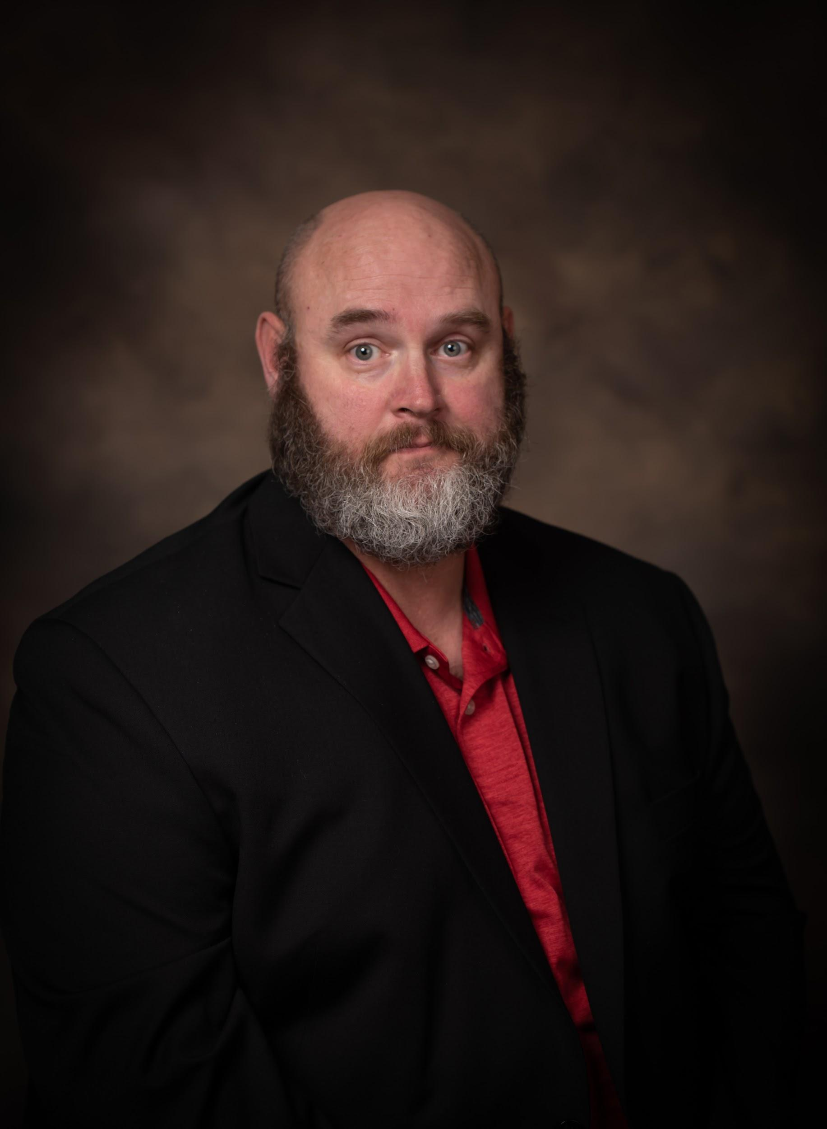
WADE TURBERVILLE
DIRECTOR OF TRANSPORTATION
PROGRAM AREA | KEY CONTACT
Transportation | Wade Turberville Ext 1264
Transportation Secretary | Sarah Sparks Ext 1263
Bus Shop Assistant | Brandi Logan Ext 1252
Bus Shop | Kenneth Franks Ext 1265
dturberville@colbertk12.org
256 386 8565 Ext 1264

Slide 5
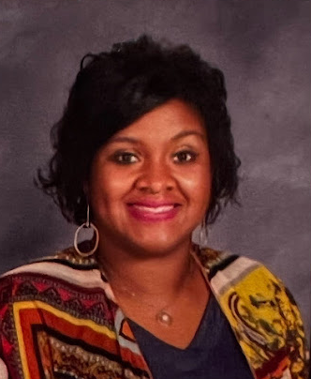
TIFFANI FUQUA
DIRECTOR OF FEDERAL PROGRAMS
PROGRAM AREA | KEY CONTACT
Federal Programs | Tiffani Fuqua Ext 1228
Pre-K & 21st Century | Brooke Cunningham Ext 1263
Safety & Security Officer | Brad Counce Ext 1208
Nursing & Health Services | Tonia Klyce Ext 1217
English Language Learners | Ashley Harris Ext 1263
Homeless Population & Student Mental Health Coordinator | Emily Counce Ext 1215
tfuqua@colbertk12.org
256 386 8565 Ext 1228

Slide 6
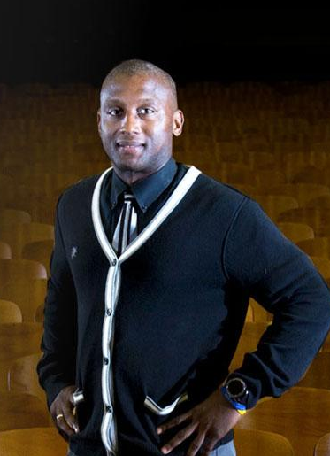
DR. FRED ABERNATHY
DIRECTOR OF SPECIAL EDUCATION & 504 COORDINATOR
PROGRAM AREA | KEY CONTACT
Special Education | Dr. Fred Abernathy Ext 1238
Section 504 | Dr. Fred Abernathy Ext 1238
Occupational Therapy | Anna Underwood Ext 1232
Caseload & Parent Inquiries | Brooke Cunningham Ext 1244
Homebound Facilitator | Destin Gargis Ext 1237
IEPs, Classroom SPED Teachers | Nathan Fuller Ext 1250
Speech Therapy | Savannah Latham Ext 1224 Judd Franks Ext 1220 Hannah Lolley Ext 1242
fabernathy@colbert.k12.org
256 386 8565 Ext 1238

Slide 7
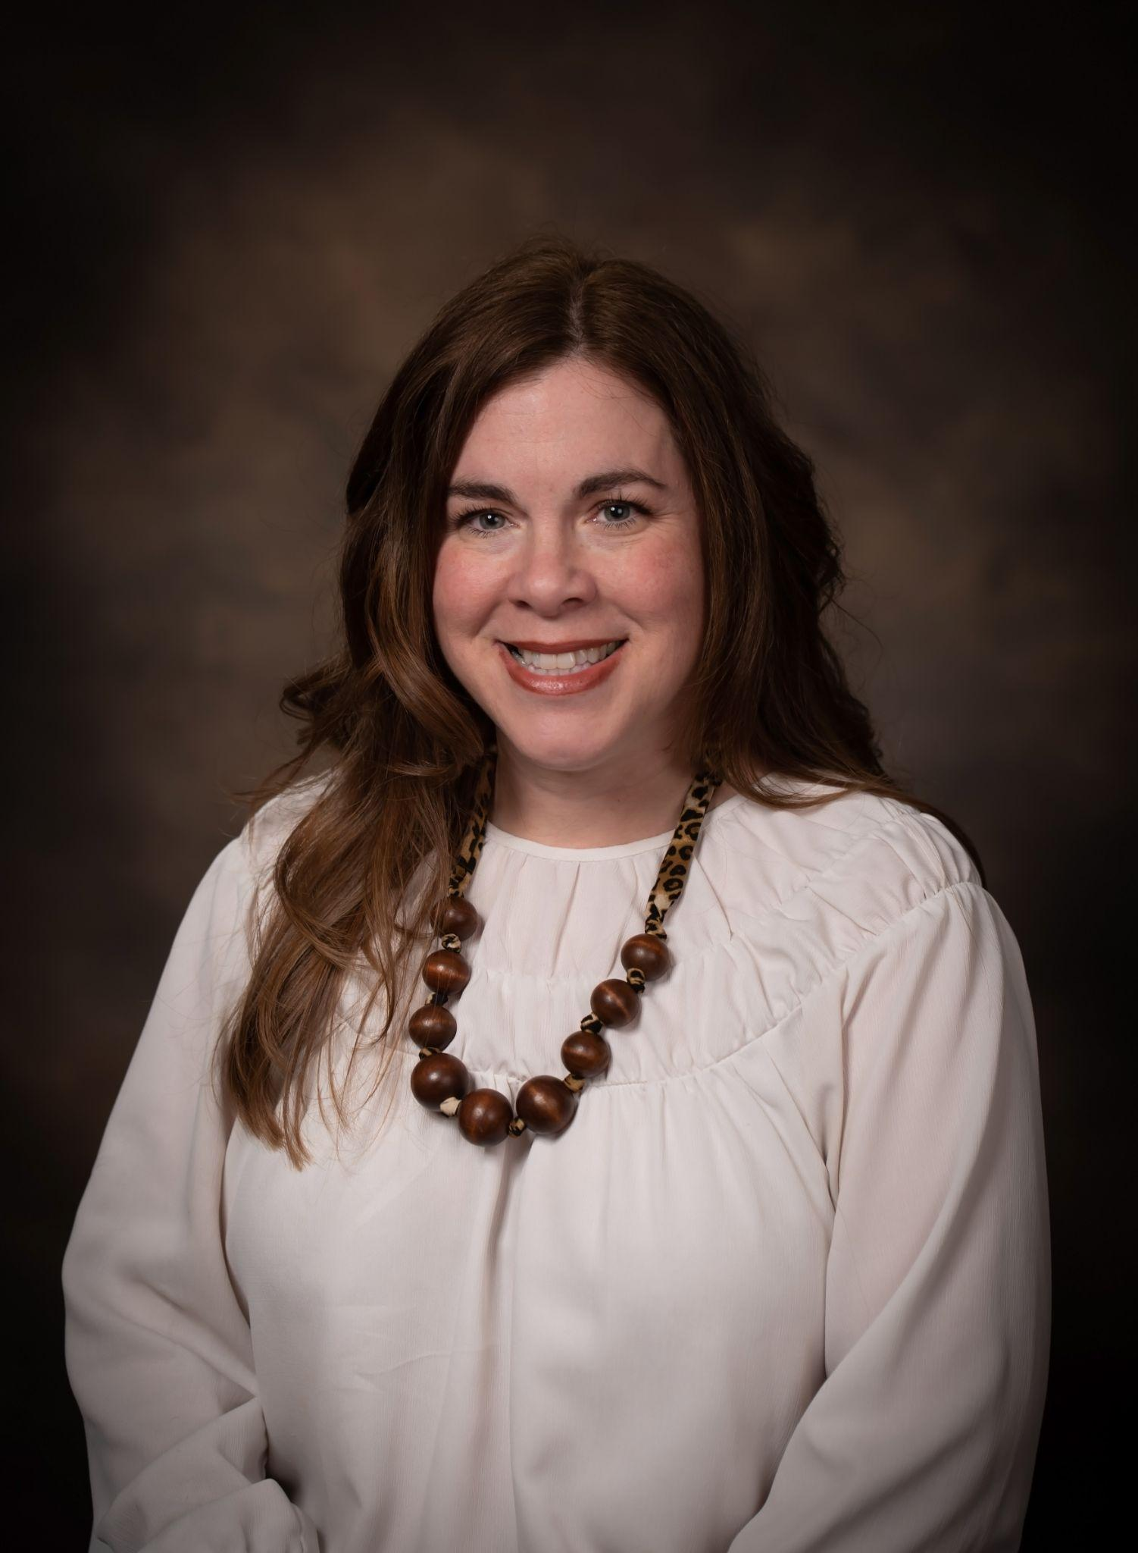
EMILEY CRISLER
DIRECTOR OF CAREER & TECHNICAL EDUCATION
PROGRAM AREA | KEY CONTACT
Career & Technical Education | Emiley Crisler Ext 1624
Dual Enrollment | Emiley Crisler Ext 1624
Career Coach | Lattoria Jones Ext 1213
4 Year Plans | Lattoria Jones Ext 1213
Pre-Apprenticeship | Emiley Crisler Ext 1624
Work-Based Learning | Emiley Crisler Ext 1624
ecrisler@colbertk12.org
256 386 8565 Ext 1624

Slide 8
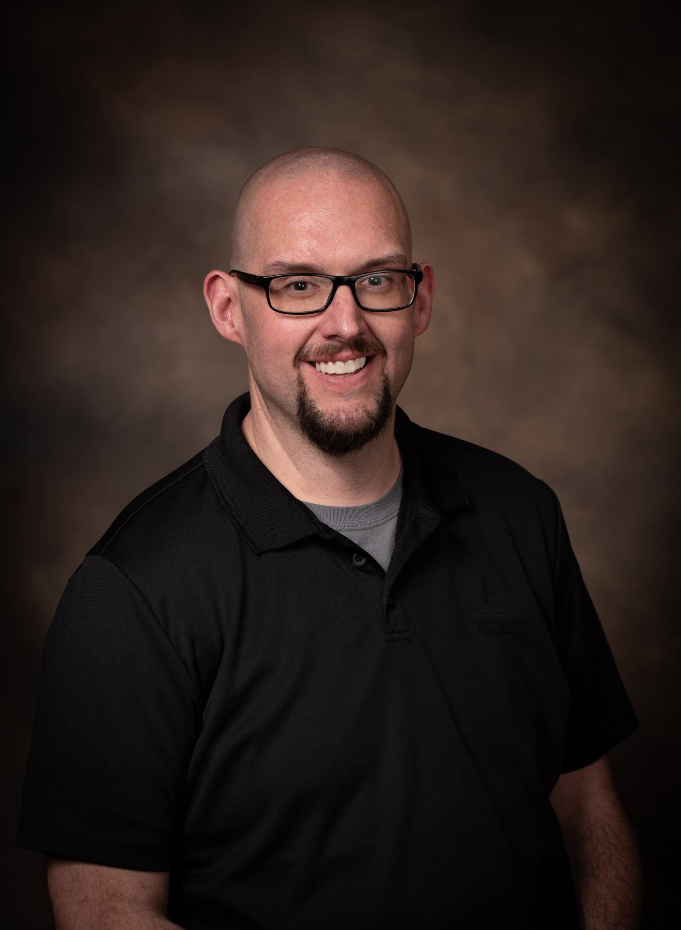
MATTHEW OSBORN
EXECUTIVE DIRECTOR OF TECHNOLOGY
PROGRAM AREA | KEY CONTACT
PowerSchool | Tennille Sullivan Ext 1246
Textbooks | Matt Osborn Ext 1204
Devices, Hardware, & Work Orders | Shawn Sullivan Ext 1206
Network & Internet Outages | Louis Delbert Ext 1205
District Website & Mass Notification | Matt Osborn Ext 1204
Telephone Systems | Louis Delbert Ext 1205
Student Accounts & Access | Michael Pellitteri Ext 1207
Technology Purchases & Inventory | Michael Pellitteri Ext 1207
mosborn@colbertk12.org
256 386 8565 Ext 1204

Slide 9
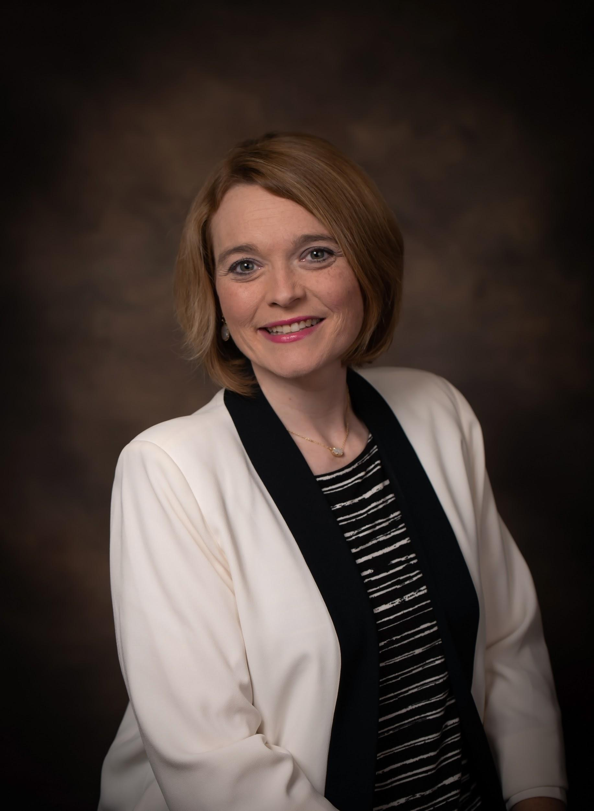
DR. KATIE DALRYMPLE
DIRECTOR OF CURRICULUM & ASSESSMENT
PROGRAM AREA | KEY CONTACT
State & Common Assessments | Dr. Katie Dalrymple Ext 1241
Pacing Guides | Jessica Fuller Ext 1243
Numeracy Act & Math Coaches | Dr. Katie Dalrymple Ext 1241
New Teacher Mentoring | Dr. Katie Dalrymple Ext 1241
Secondary Instructional Support | Jessica Fuller Ext 1509
Literacy Act & Reading Specialists | Local Reading Specialists
Elementary & Secondary Curriculum & Instructional Programs | Dr. Katie Dalrymple Ext 1241
kdalrymple@cobertk12.org
256 386 8565 Ext 1241

Slide 10
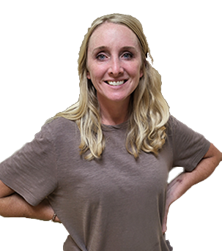
JAMIE AUSTIN
DIRECTOR OF CNP
PROGRAM AREA | KEY CONTACT
School CNP Staff | Jamie Austin Ext 1514
School Cafeteria Managers | Jamie Austin Ext 1514
School Cafeteria Accounts Payable | Chastity Howard Ext 1515
School Menu Planning | Jamie Austin Ext 1514
jaustin@colbertk12.org
256 386 8565 Ext 1514

Slide 11
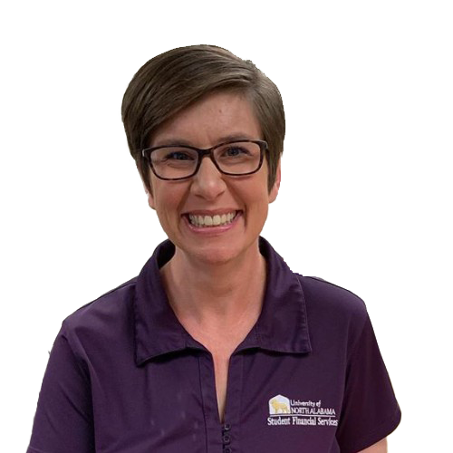
SHAUNA JAMES
CHIEF SCHOOL FINANCIAL OFFICER
PROGRAM AREA | KEY CONTACT
Local School Accounting | Shauna James Ext 1230
FMLA, Worker’s Comp, etc. | Angela Puckett Ext 1221
Accounts Payable | Christina Turberville Ext 1214
District & School Budgets | Shauna James Ext 1230
Financial Reporting & Audits | Shauna James Ext 1230
Bids & Procurement | Shauna James Ext 1230
Payroll, PEEHIP, & RSA | Angela Puckett EXT 1221
HR, Onboarding | Erica Jacques EXT 1210
sjames2@colbertk12.org
256 386 8565 Ext 1230

Slide 12
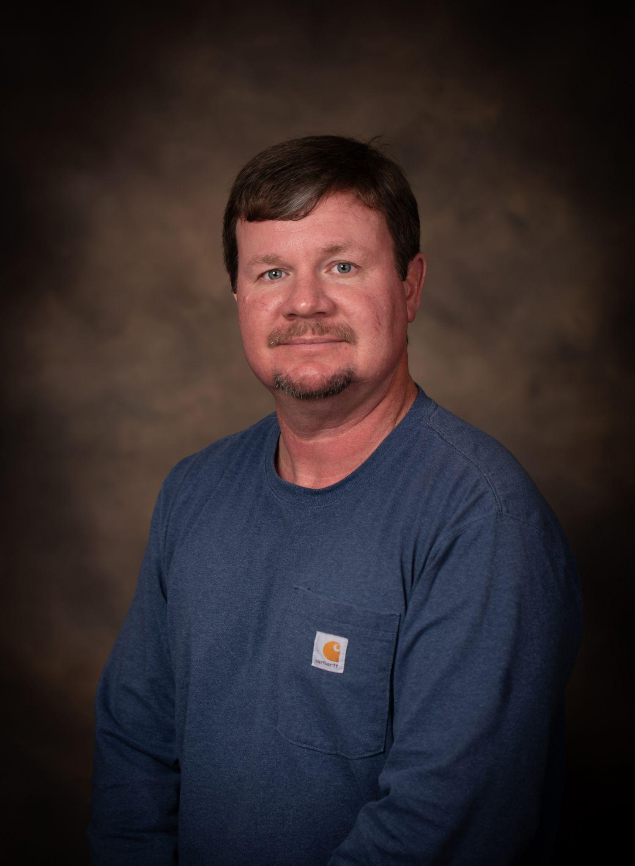
ALLEN HYDE
DIRECTOR OF MAINTENANCE
PROGRAM AREAS
HVAC
Electrical
Maintenance Work Orders
Plumbing
School Custodians
ahyde@colbertk12.org
256 386 8565 Ext 1271

Slide 13
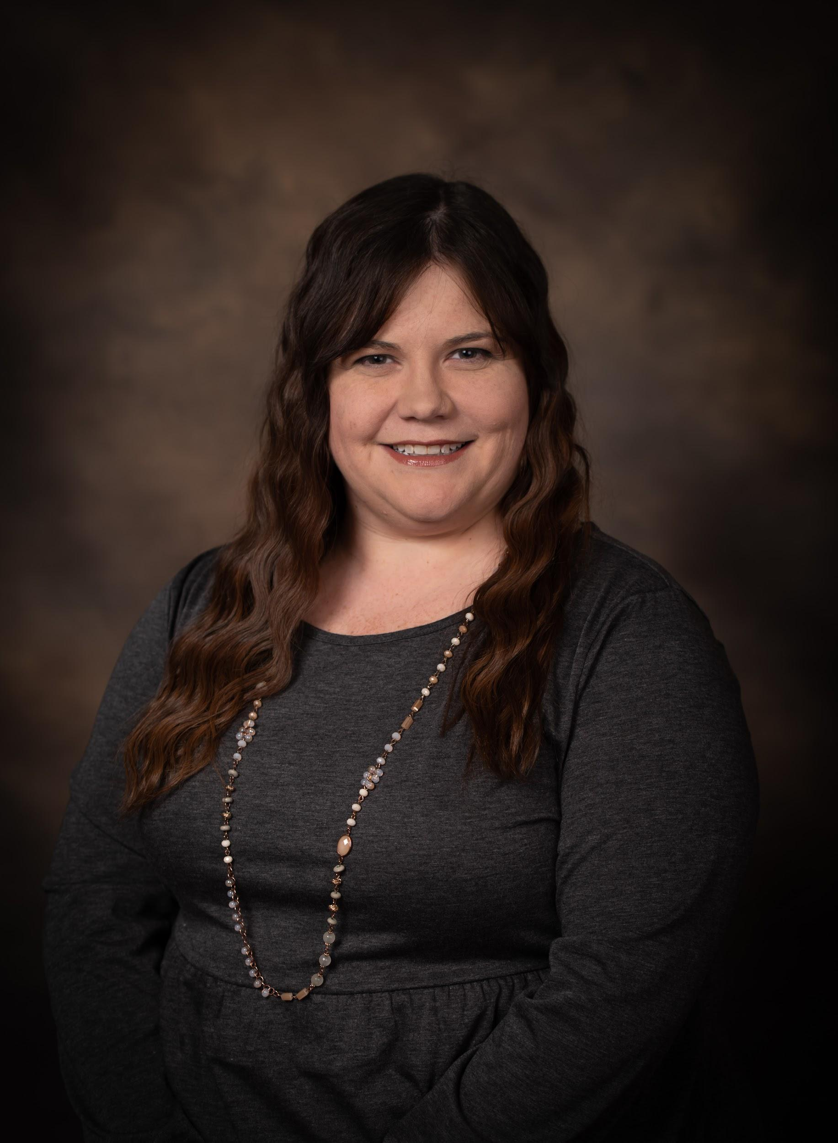
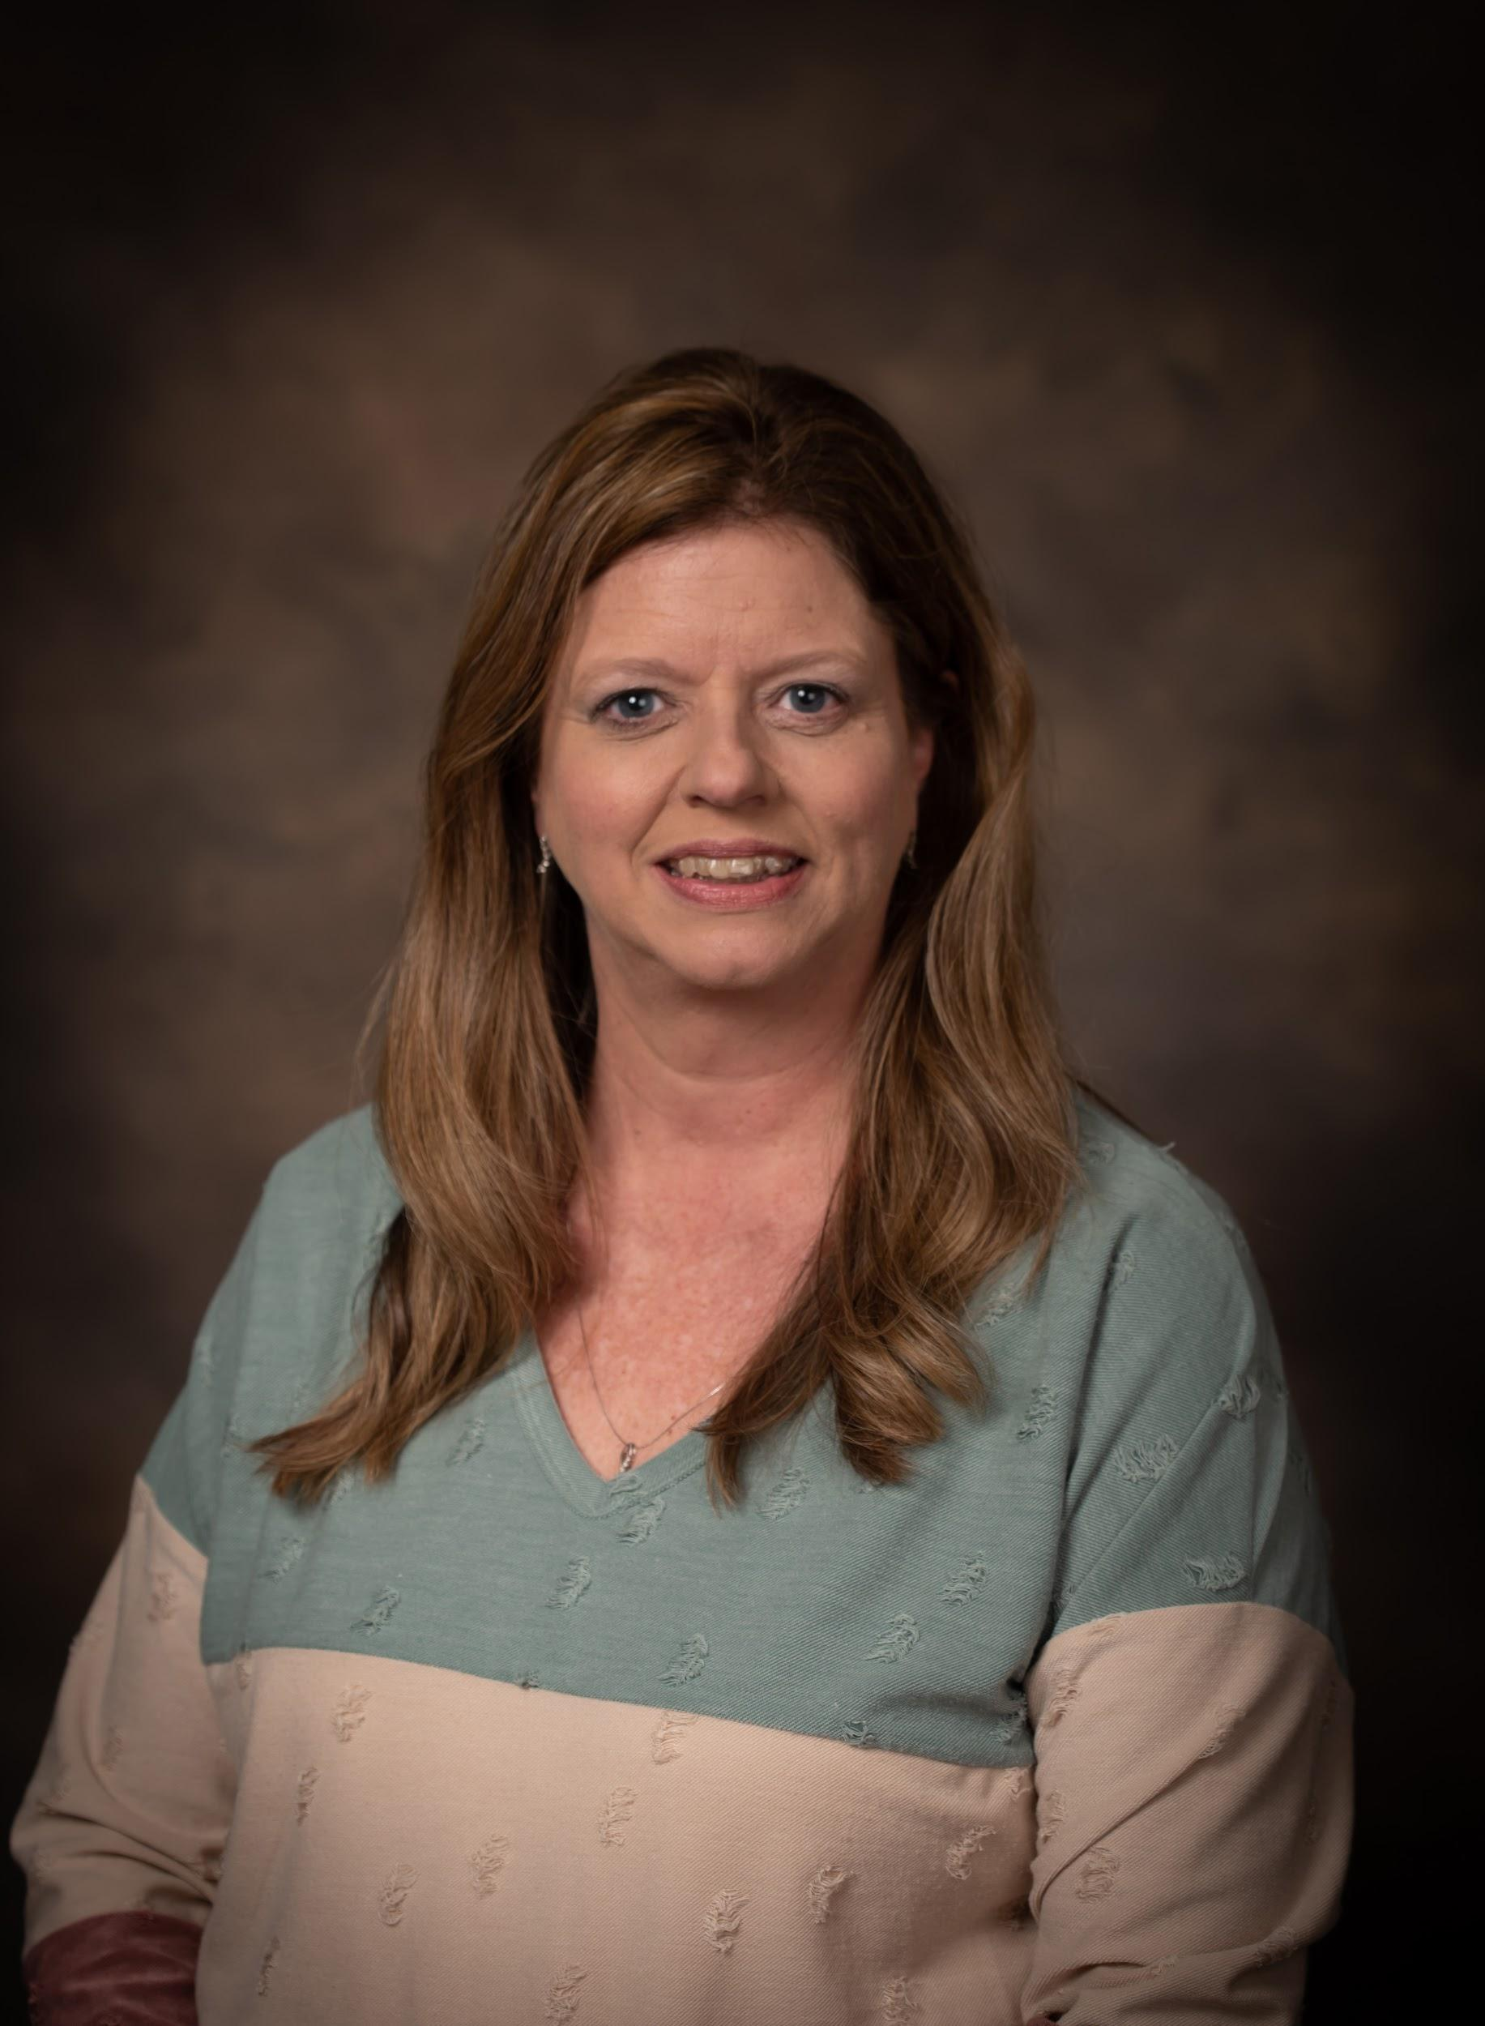
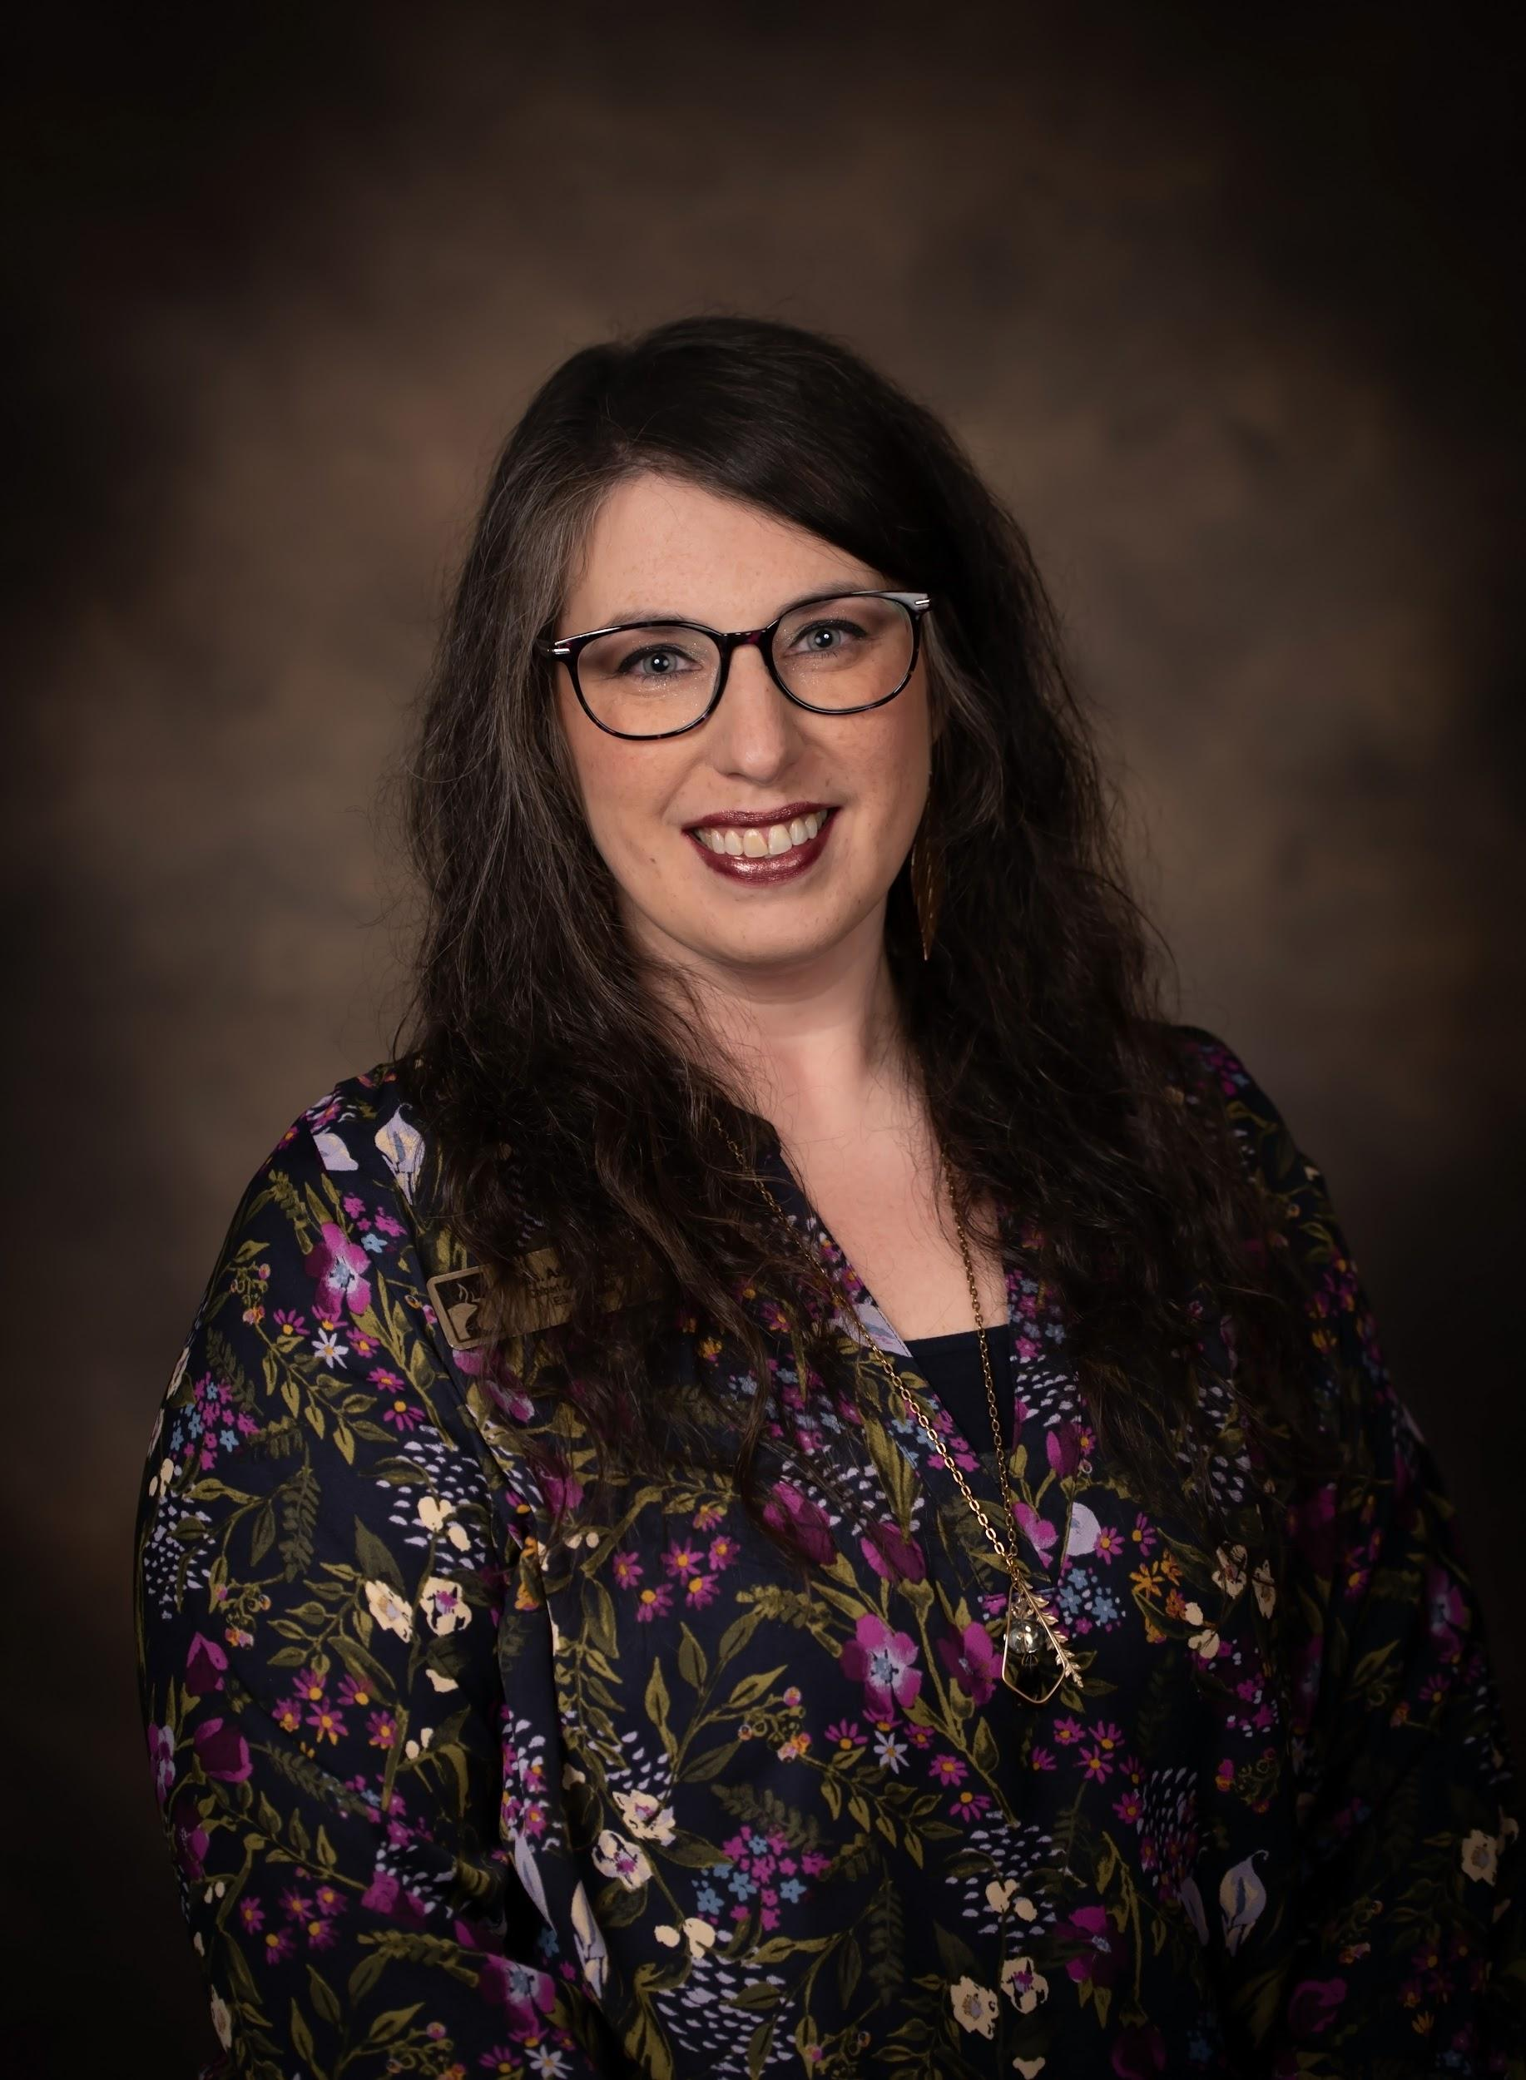
FEDERAL PROGRAMS SUPPORT STAFF
Brooke Cunningham
Fed Programs Secretary
bcunningham@colbertk12.org
256 386 8565 Ext 1227
Emily Counce
Mental Health & Homeless
Ashley Harris
EL Facilitator
Emily Counce
Mental Health Services Coord.
ecounce@colbertk12.org
256 386 8565 Ext 1215
Ashley Harris
ESL Facilitator
aharris@colbertk12.org
Itinerant

Slide 14
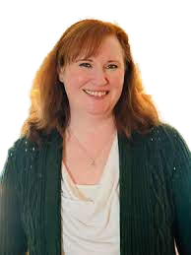
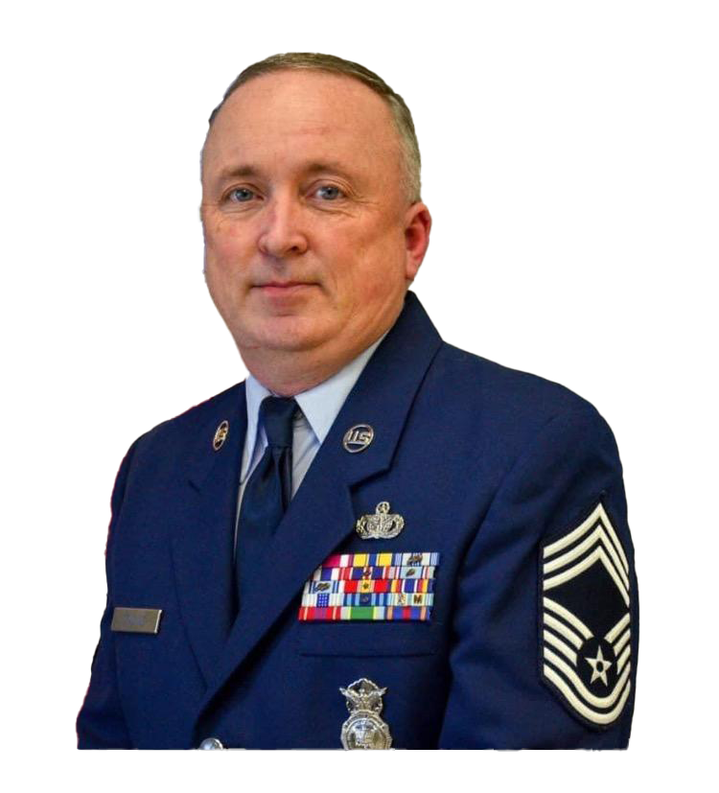
SAFETY & SECURITY, STUDENT HEALTH
Leatonia Klyce
District Lead Nurse
lklyce@colbertk12.org
256 386 8565 Ext 1217
Brad Counce
District Safety & Security Coordinator
bcounce@colbertk12.org
256 386 8565 Ext 1208

Slide 15
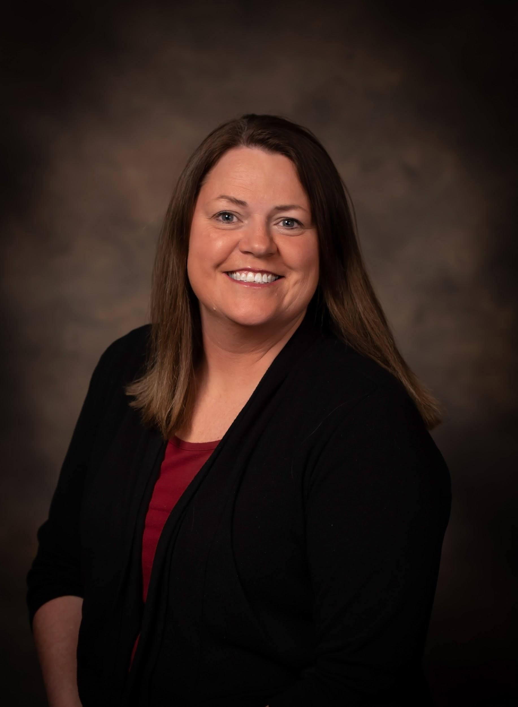
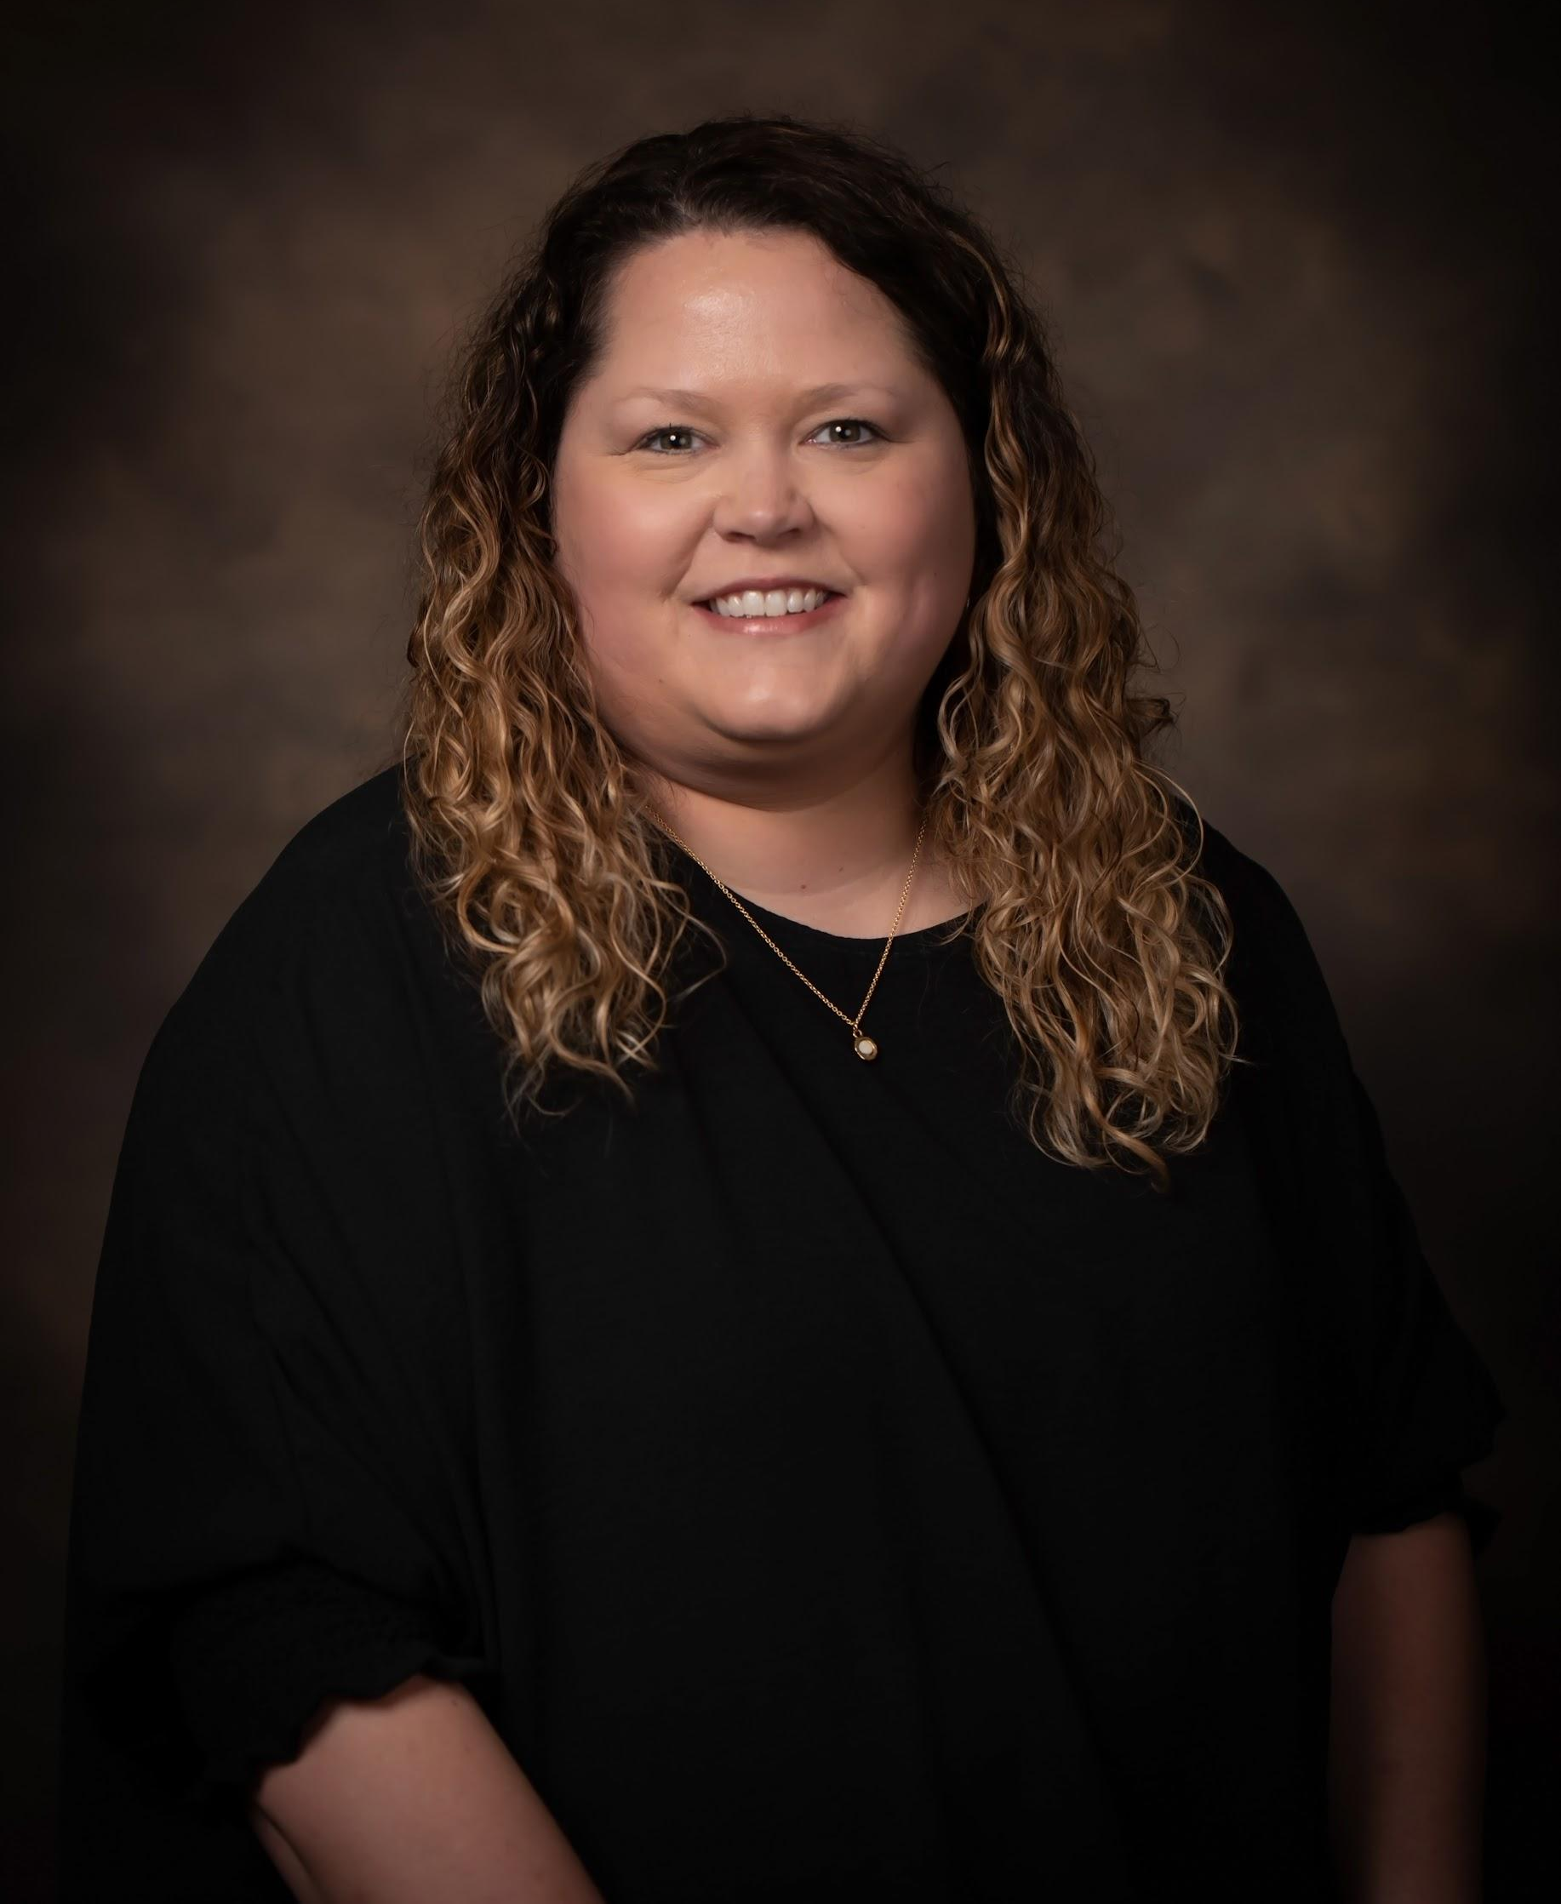
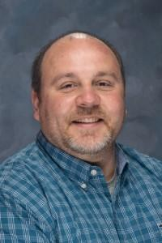
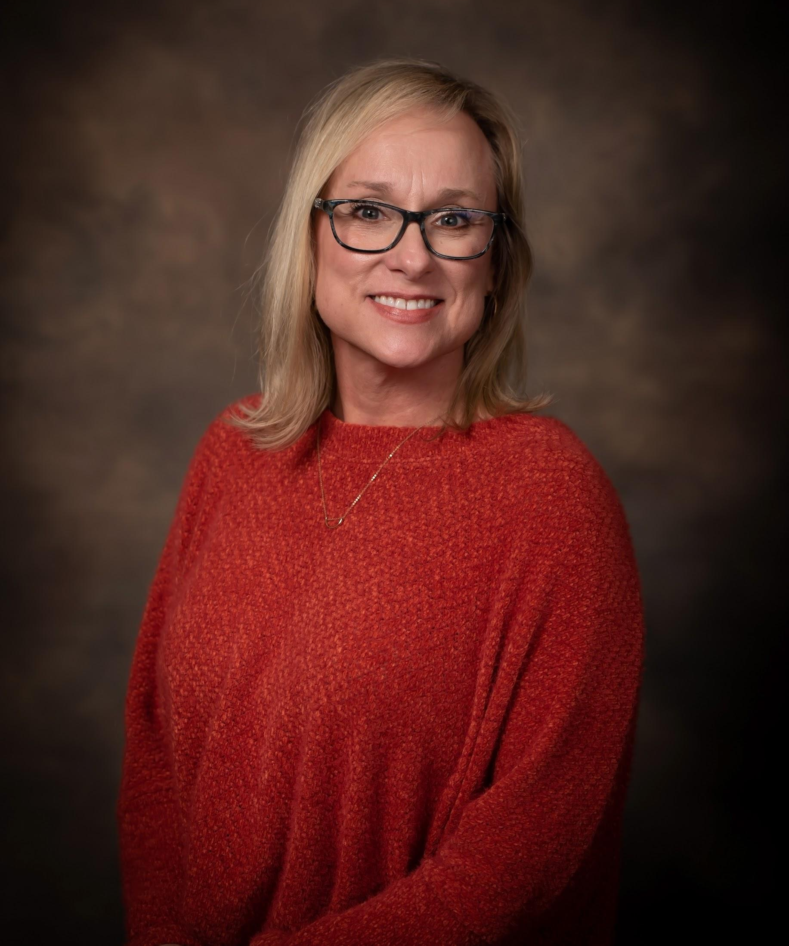
SPECIAL EDUCATION SUPPORT STAFF
Destin Gargis
Homebound Facilitator
dgargis@colbertk12.org
256 386 8565 Ext 1237
Emily Counce
Mental Health & Homeless
Brooke Cunningham
SPED Secretary
bcunningham2@colbertk12.org
256 386 8565 Ext 1244
Nathan Fuller
SPED Administrator
nfuller@colbertk12.org
256 386 8565 Ext 1250
Anna Underwood
Occupational Therapy
aunderwood@colbertk12.org
256 386 8565 Ext 1232
Destin Gargis
IEP/Homebound
Brooke Cunningham
Secretary
Anna Underwood
Occupational Therapy

Slide 16
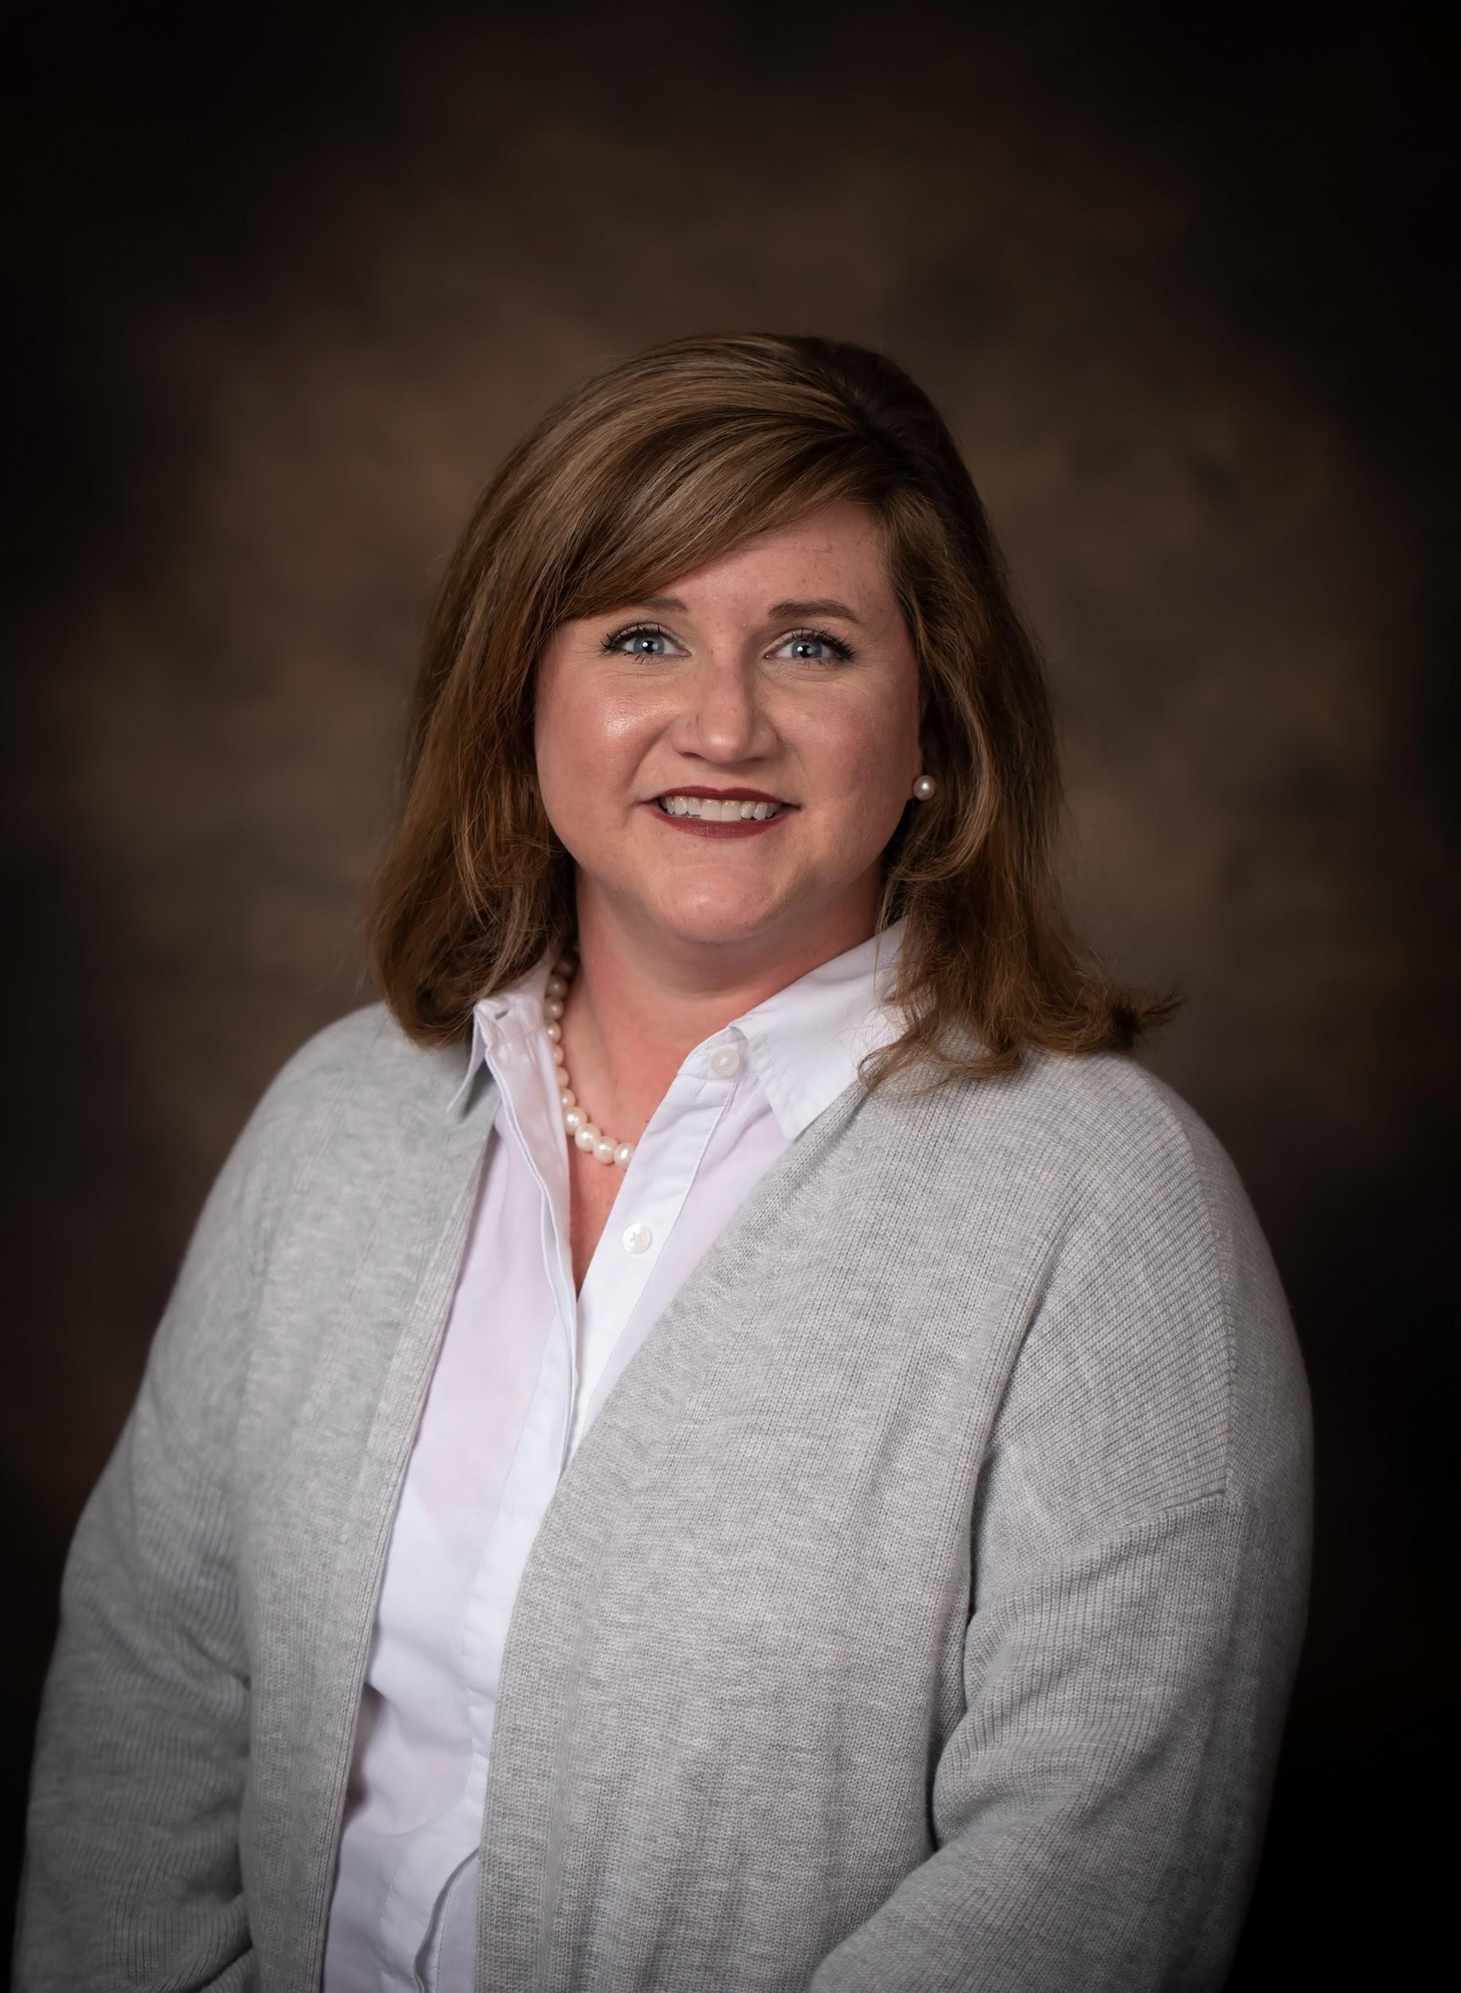
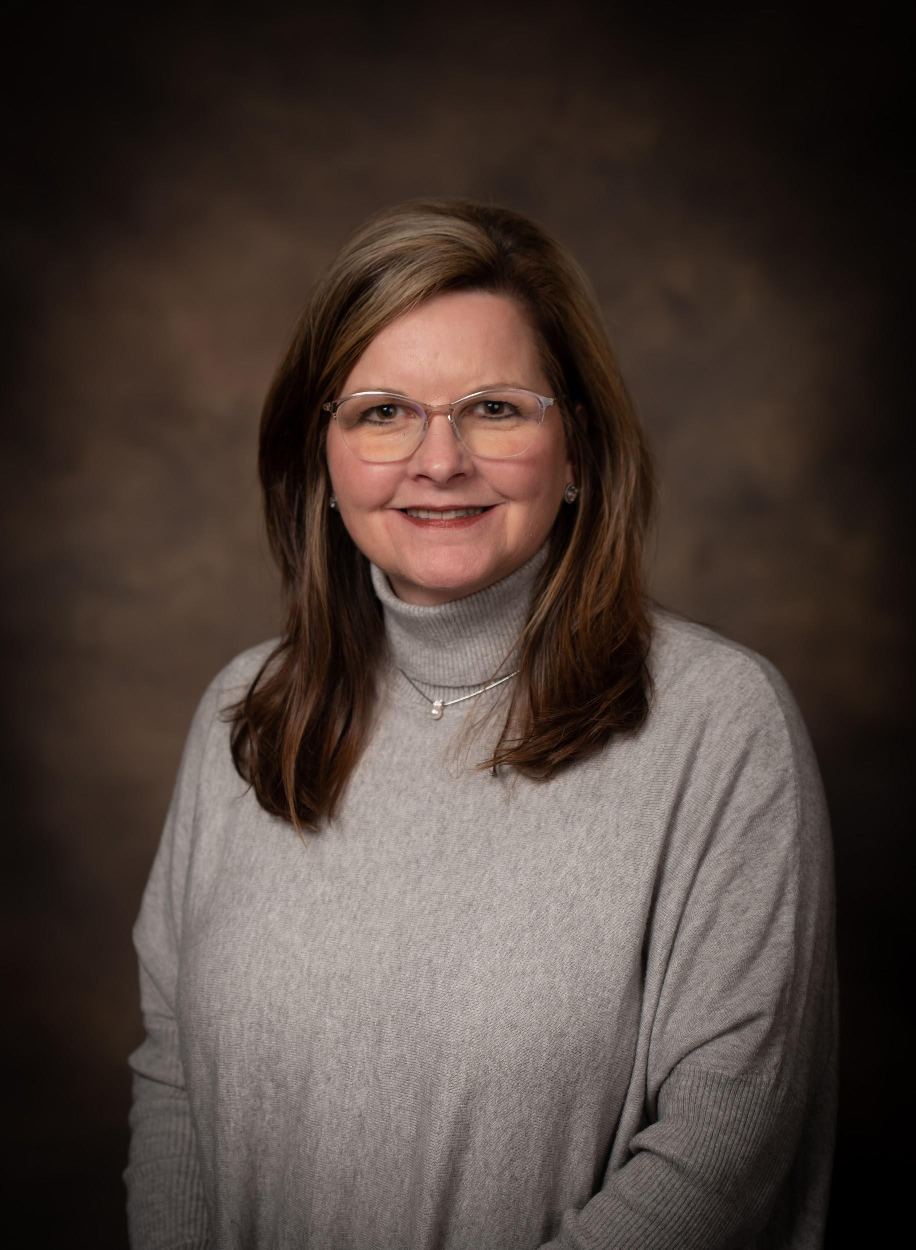
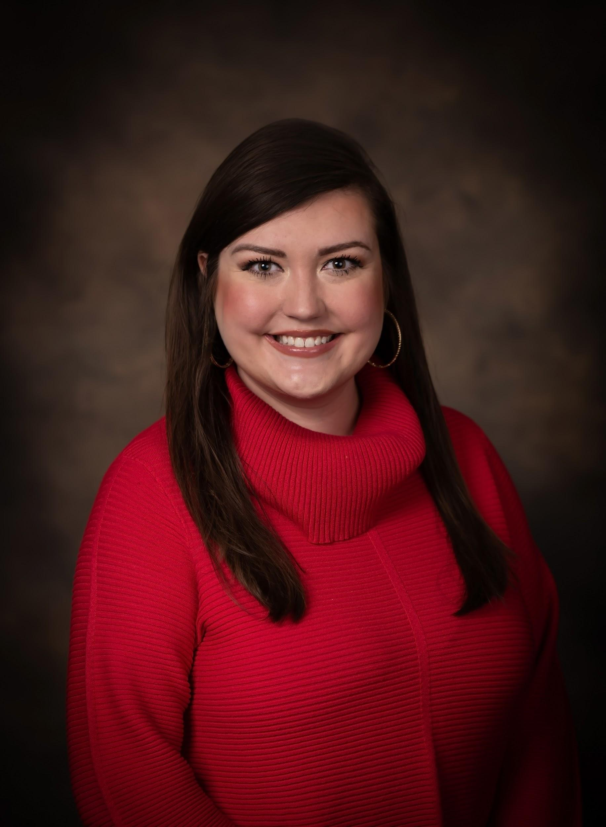
SPECIAL EDUCATION SUPPORT STAFF
Emily Counce
Mental Health & Homeless
Ashley Harris
EL Facilitator
Amanda Parker
Gifted Teacher
aparker@colbertk12.org
NWSCC Gifted Room
Michelle Reaves
Gifted Teacher
mreaves@colbertk12.org
NWSCC Gifted Room
Savannah Latham
Speech
Amanda Parker
Gifted
Michele Reaves
Gifted
Savannah Latham
Speech
slatham@colbertk12.org
256 386 8565 Ext 1224

Slide 17
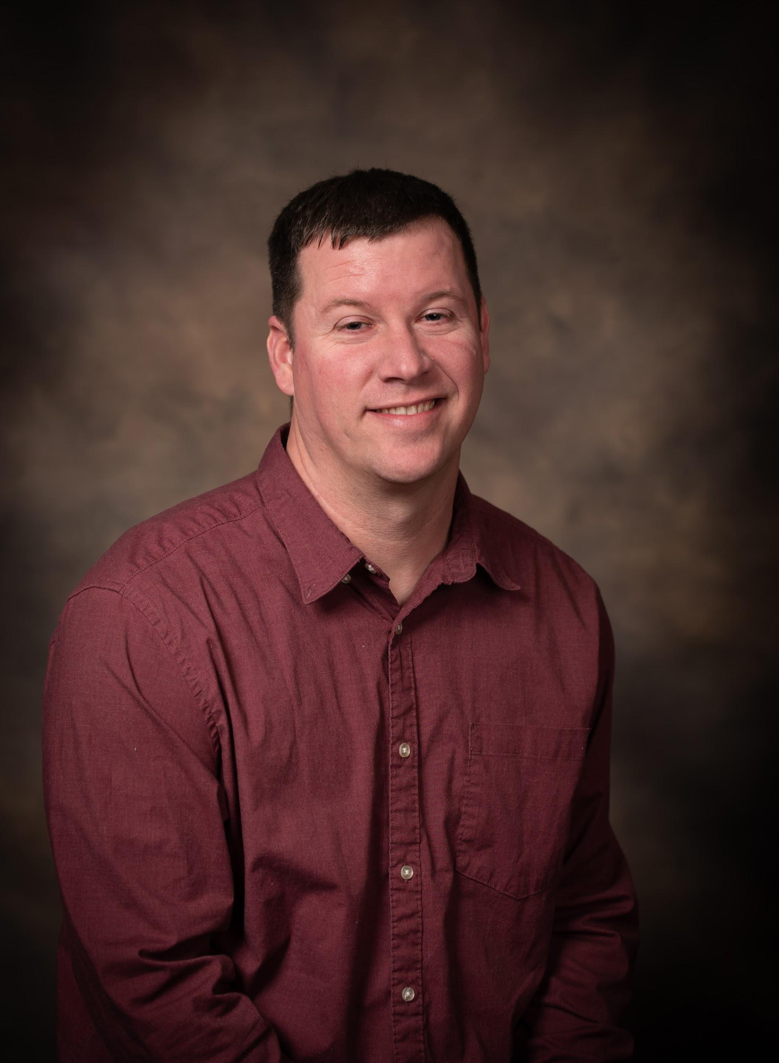
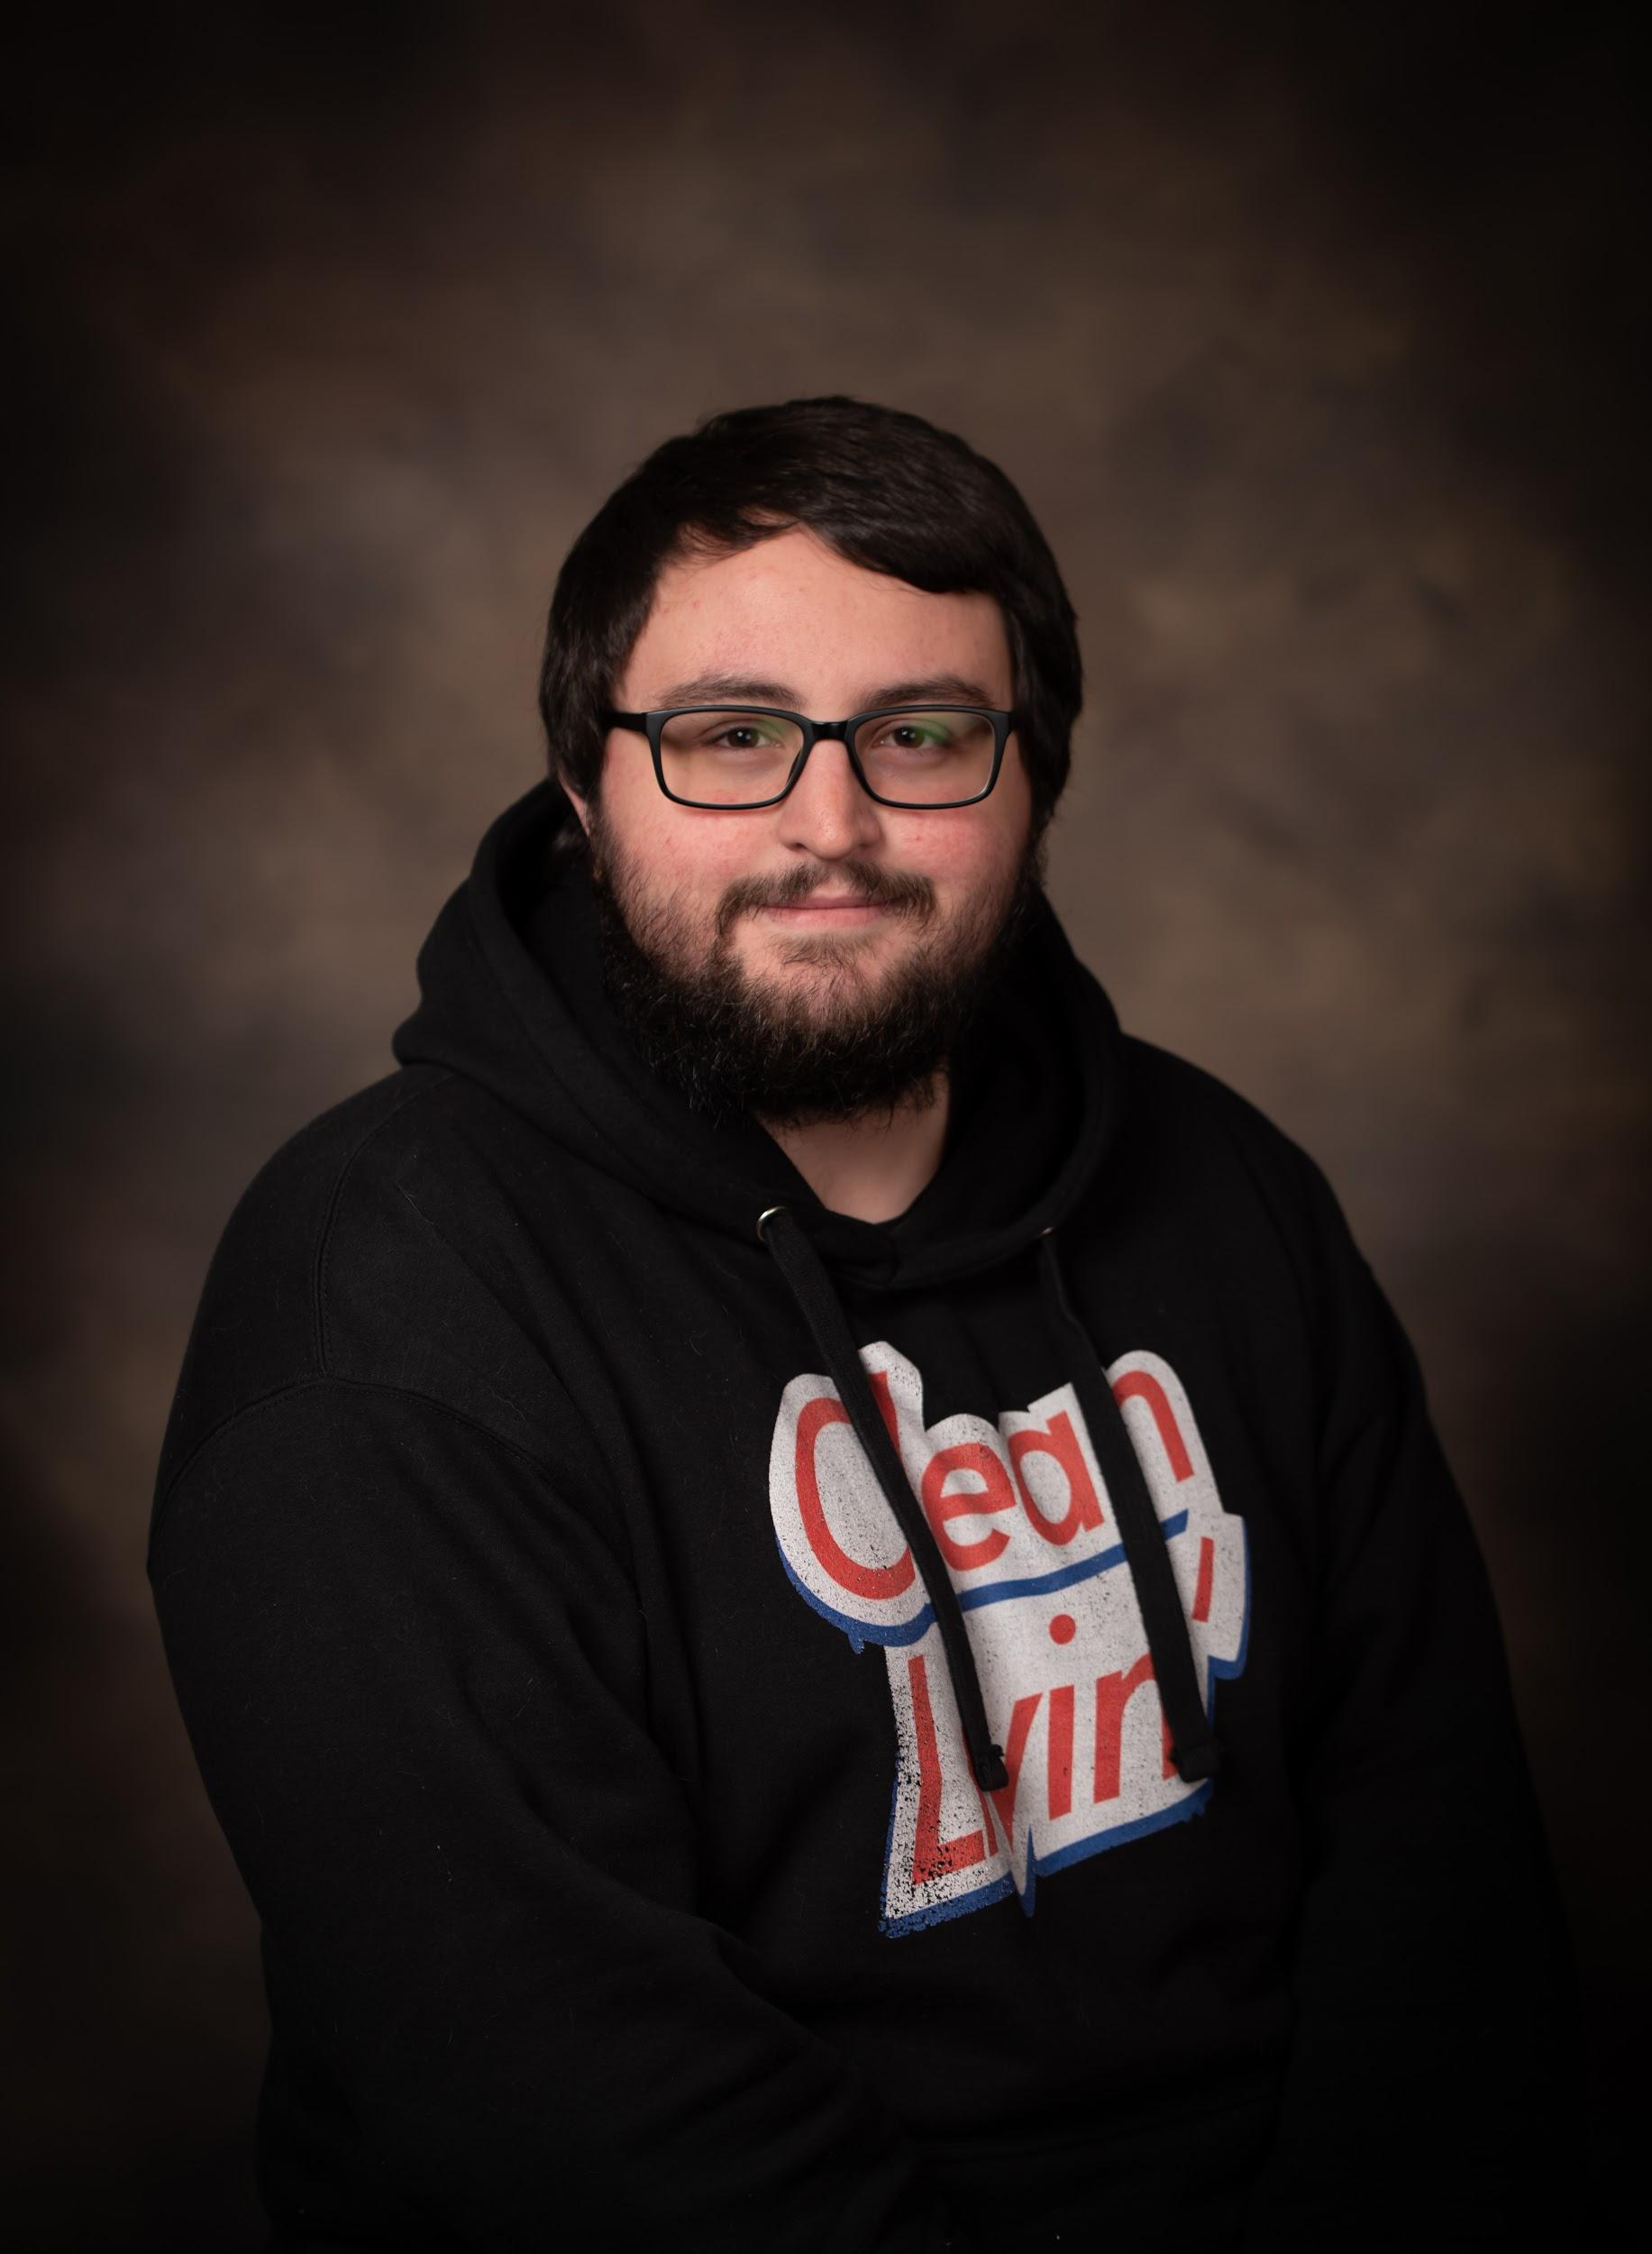
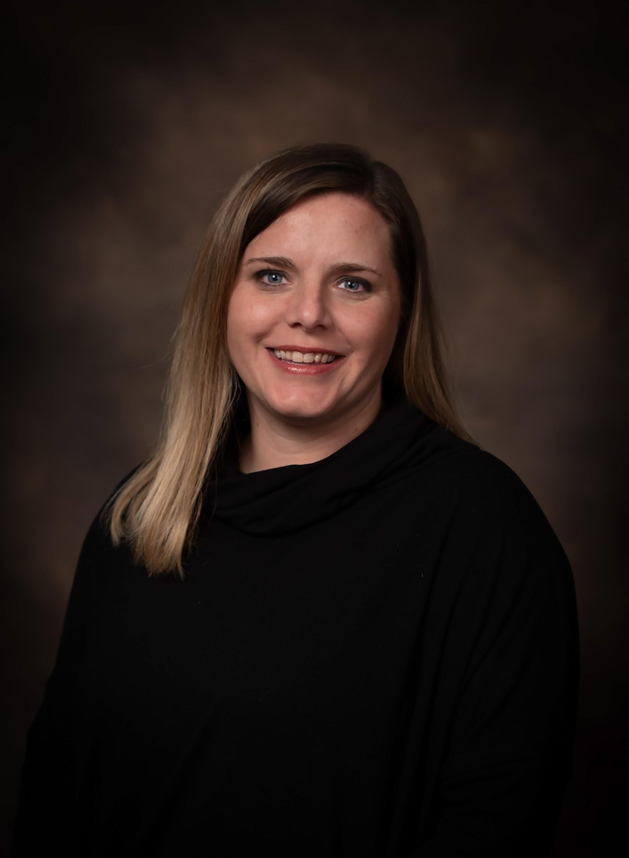
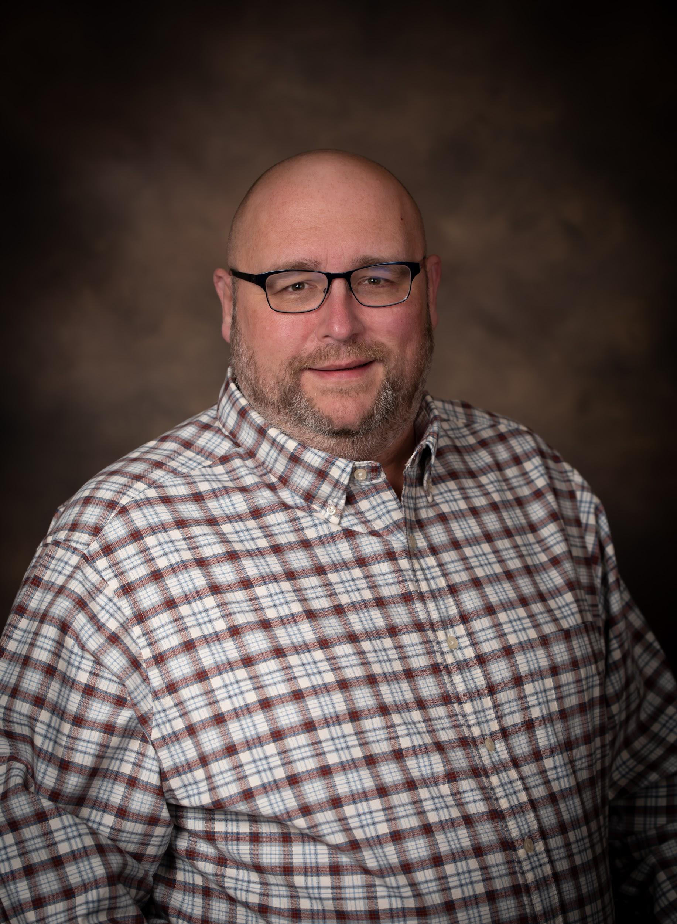
TECHNOLOGY SUPPORT STAFF
Ashley Harris
EL Facilitator
Shawn Sullivan
Helpdesk & Chromebooks
ssullivan@colbertk12.org
256 386 8565 Ext 1206
Michael Pellitteri
Purchases & Software
mpellitteri@colbertk12.org
256 386 8565 Ext 1207
Tennille Sullivan
PowerSchool/District Counselor tsullivan@colbertk12.org
256 386 8565 Ext 1246
Savannah Latham
Speech
Amanda Parker
Gifted
Michele Reaves
Gifted
Louis Delbert
Network Administrator
ldelbert@colbertk12.org
256 386 8565 Ext 1205
Shawn Sullivan
HelpDesk & Chromebooks
Michael Pellitteri
Software, Programs, & Purchasing
Louis Delbert
Network Administrator

Slide 18
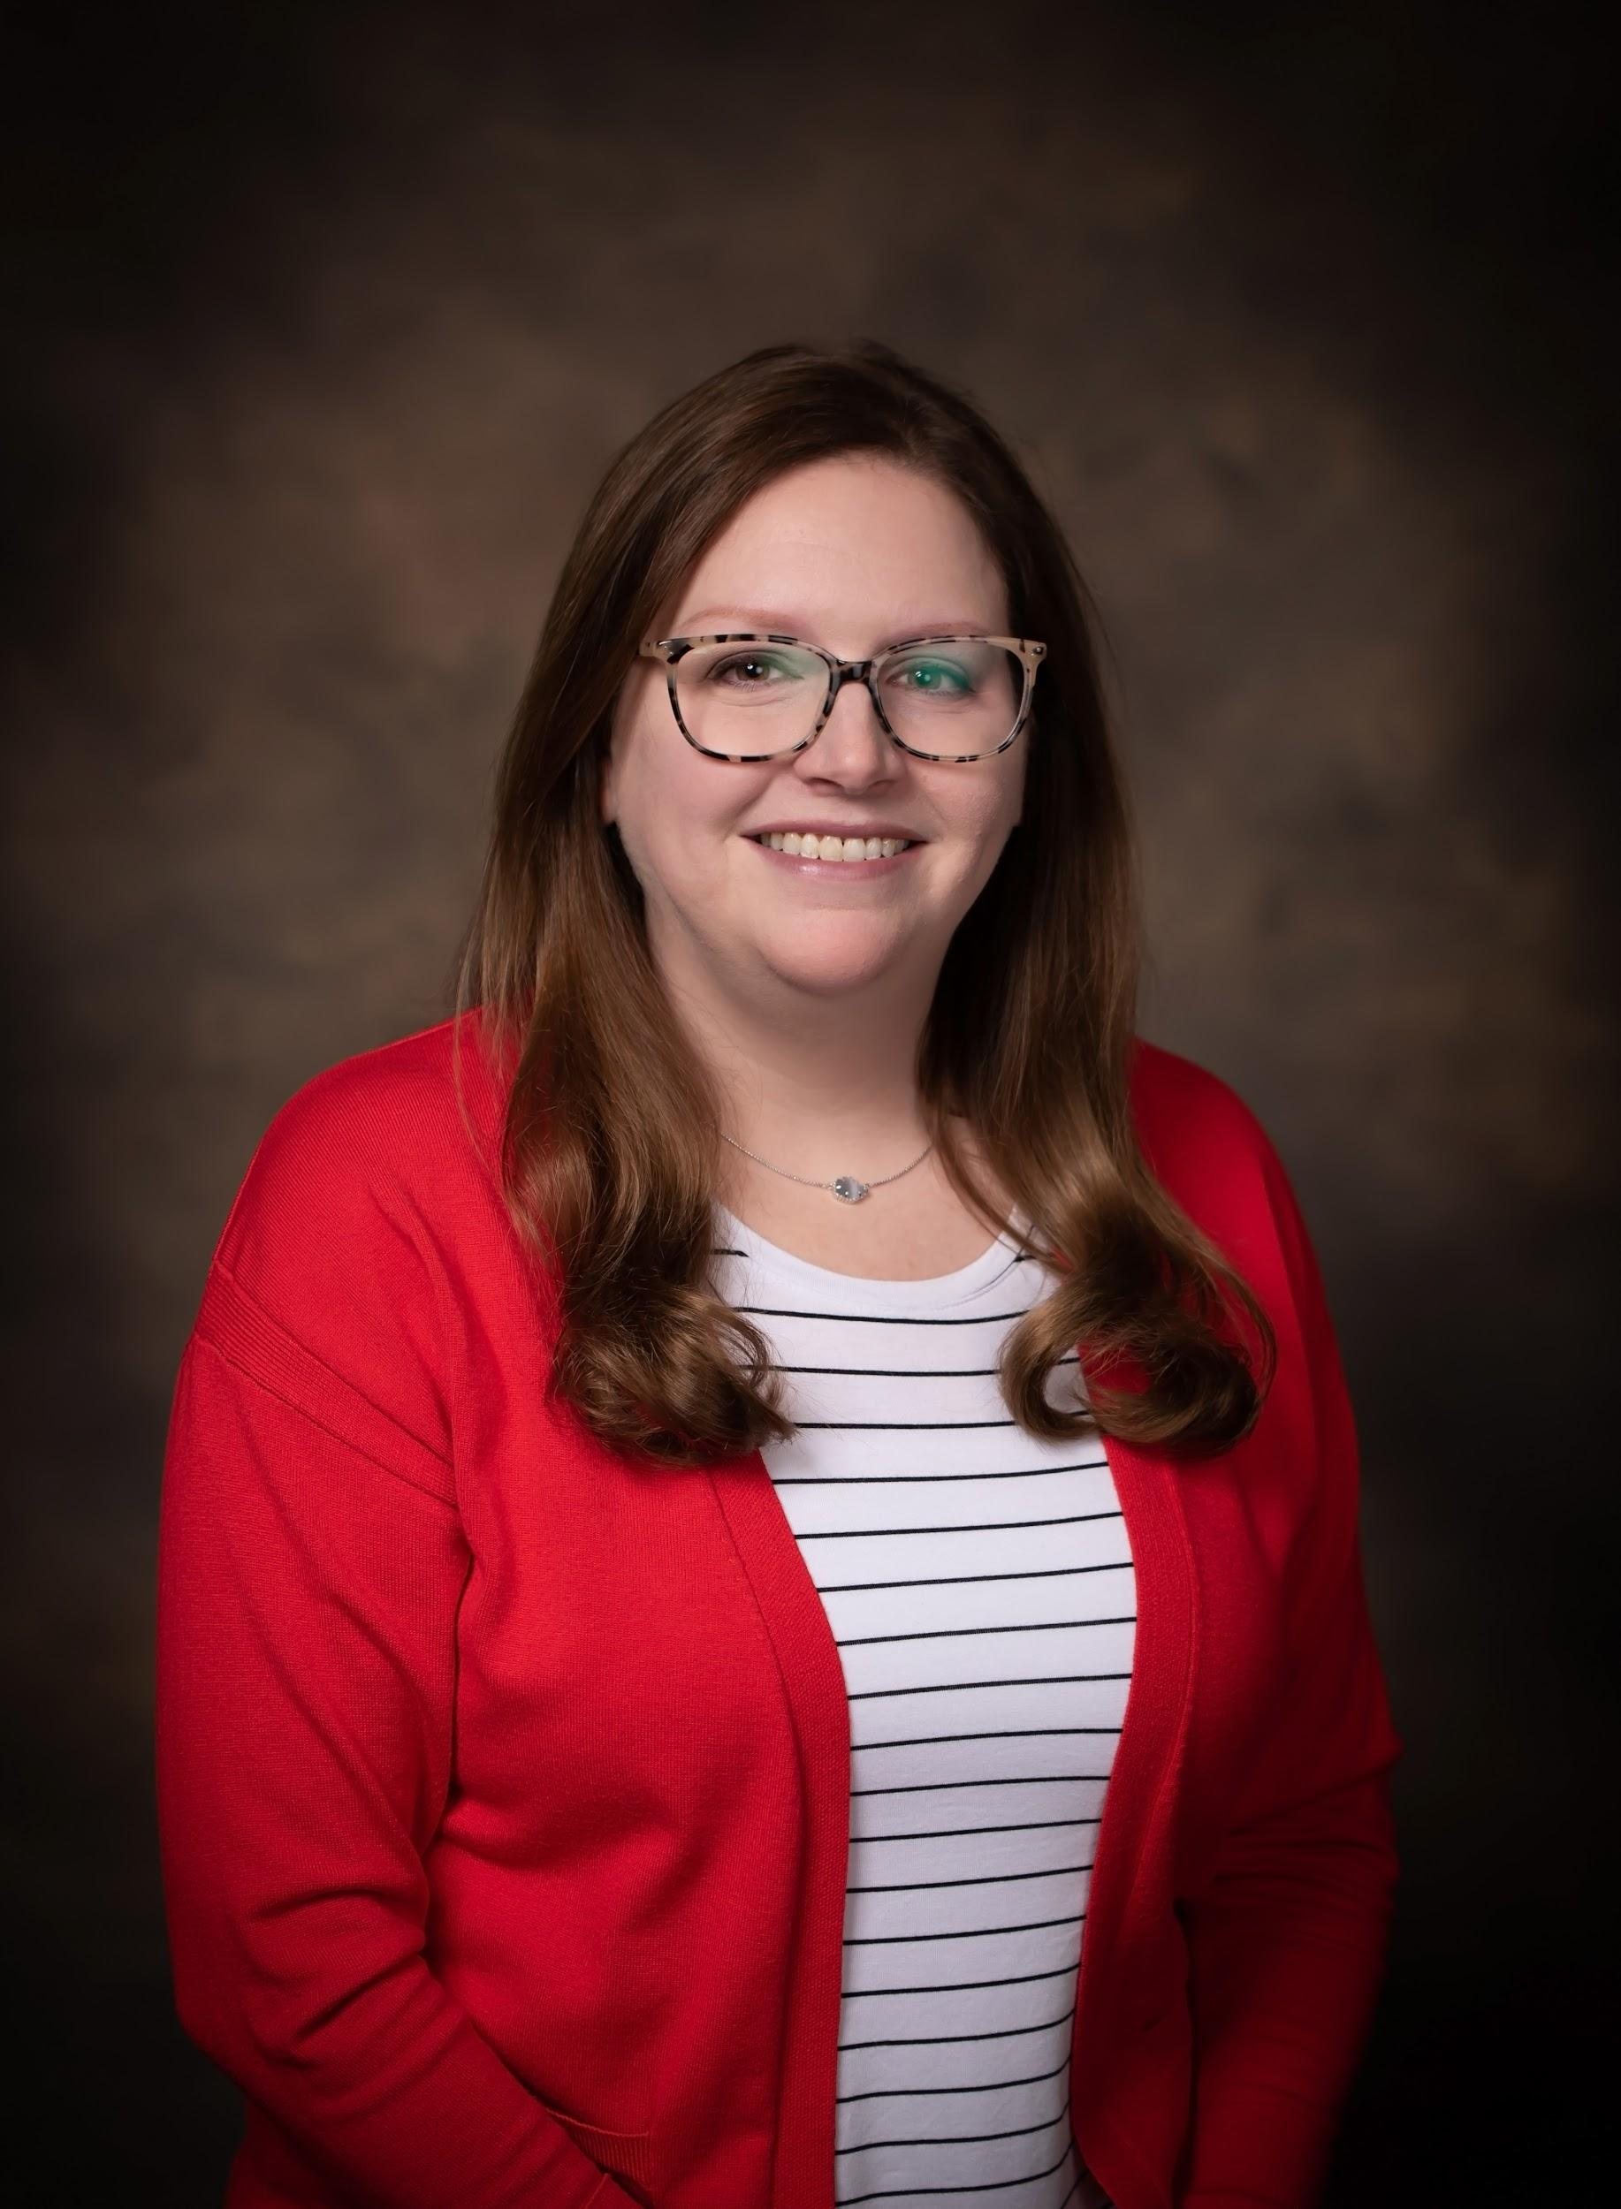
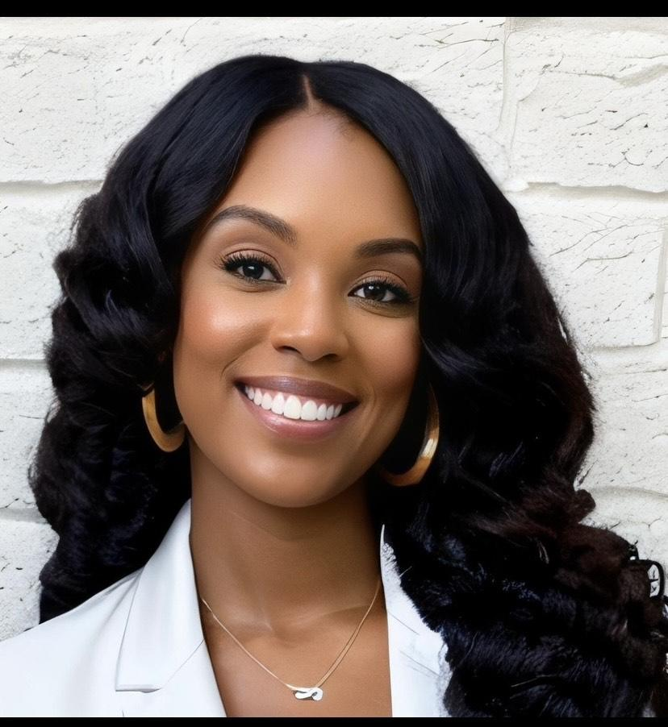
INSTRUCTIONAL & STUDENT SUPPORT
Ashley Harris
EL Facilitator
Jessica Fuller
Secondary Instructional Coach
jfuller@colbertk12.org
256 386 8565 Ext 1243
Savannah Latham
Speech
Amanda Parker
Gifted
Michele Reaves
Gifted
Lattoria Jones
Career Coach
ljones@colbertk12.org
256 386 8565 Ext 1213
Jessica Fuller
Secondary Instructional
Courtney Snipes
Elementary Math Coach
Tennille Sullivan
Career Coach

Slide 19
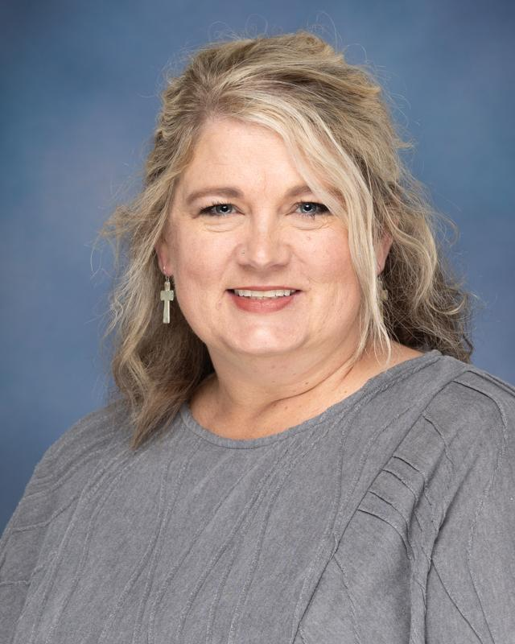
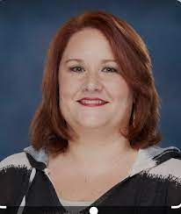
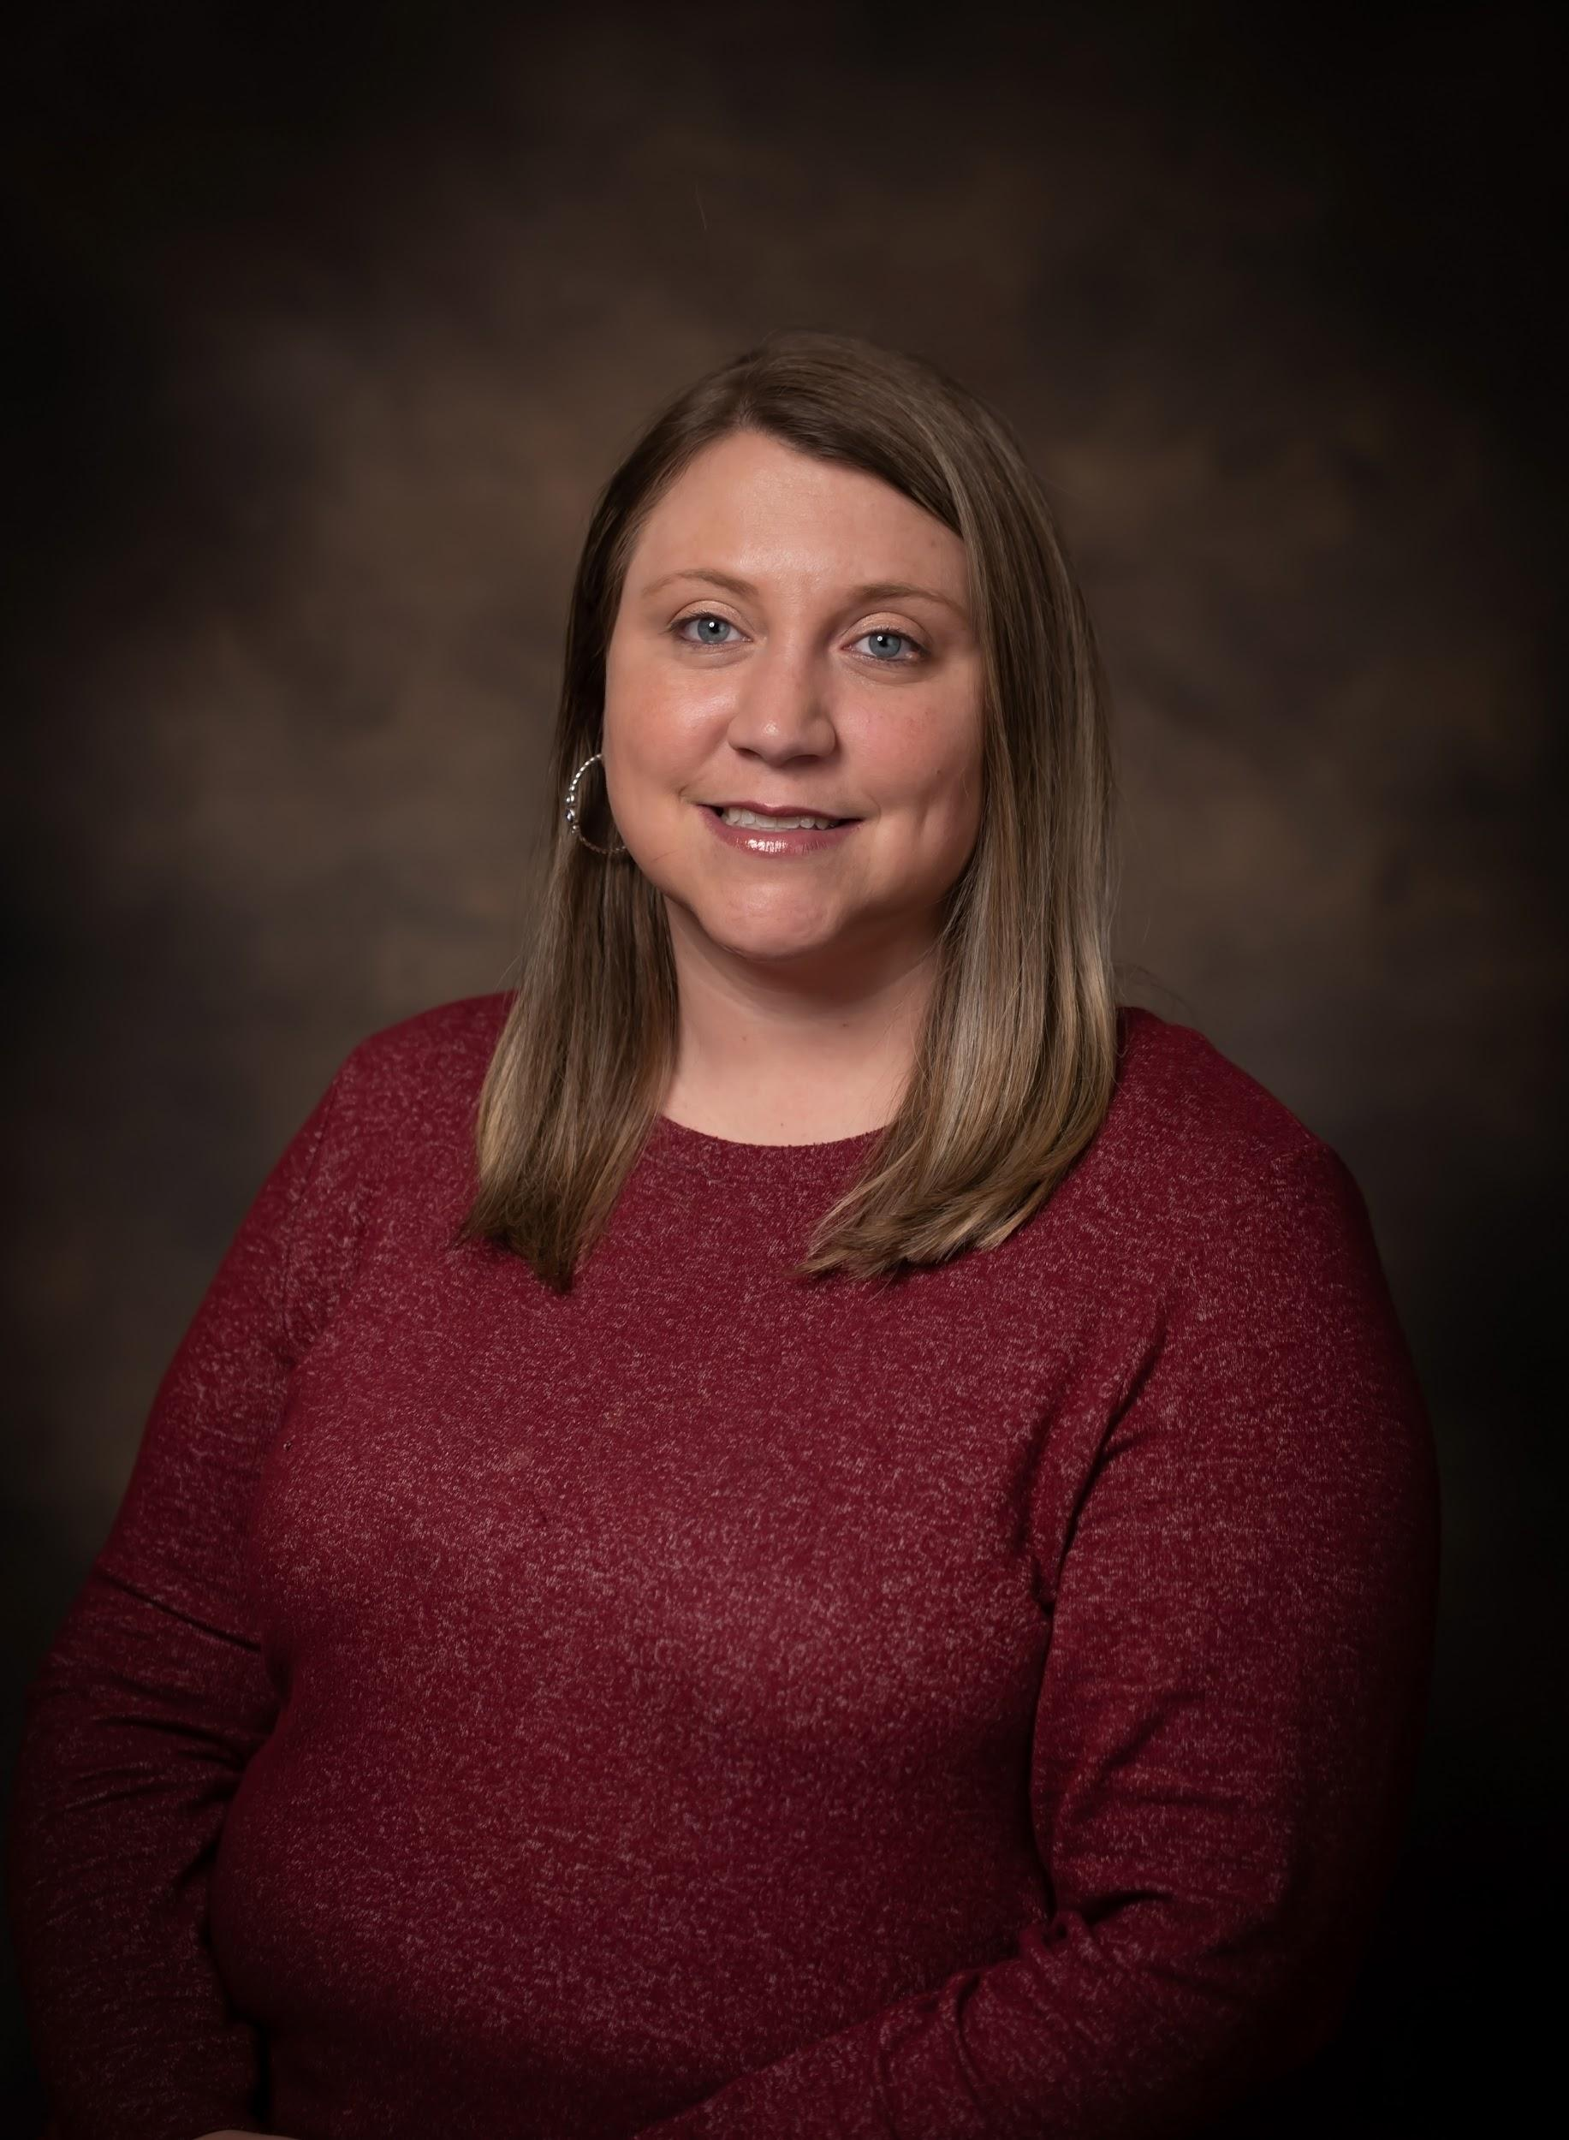
BUSINESS OFFICE
Ashley Harris
EL Facilitator
Erica Jacques
Employee Benefits Specialist
ejacques@colbertk12.org
256 386 8565 Ext 1210
Christina Turberville
Accounts Payable Specialist
cturberville@colbertk12.org
256 386 8565 Ext 1214
Savannah Latham
Speech
Amanda Parker
Gifted
Michele Reaves
Gifted
Angela Puckett
Payroll Specialist
apuckett@colbertk12.org
256 386 8565 Ext 1221
Jessica Fuller
Secondary Instructional
Courtney Snipes
Elementary Math Coach
Tennille Sullivan
Career Coach
Kathy Howard
Payroll/HR
Angela Puckett
Accounts Payable

Slide 20
ADDITIONAL DISTRICT PERSONNEL
PHOTOS COMING SOON
Tommy Buckner
CLASS Administrator
tbuckner@colbertk12.org
256 386 8565 Ext 1616
Chastity Howard
CNP Supervisor
choward@colbertk12.org
Itinerant
Shelly Hopkins
Alternative School & Virtual
shopkins@colbertk12.org
256 386 8565 Ext 1617
Chris Black
Elementary Alternative Services
cblack@colbertk12.org
256 383 6471 Ext 1801

Slide 21
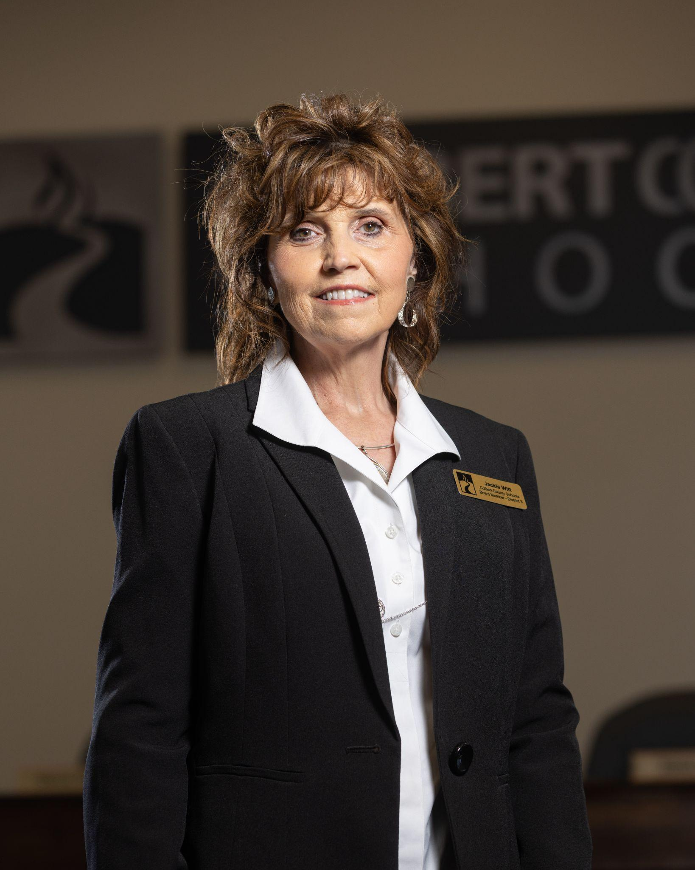
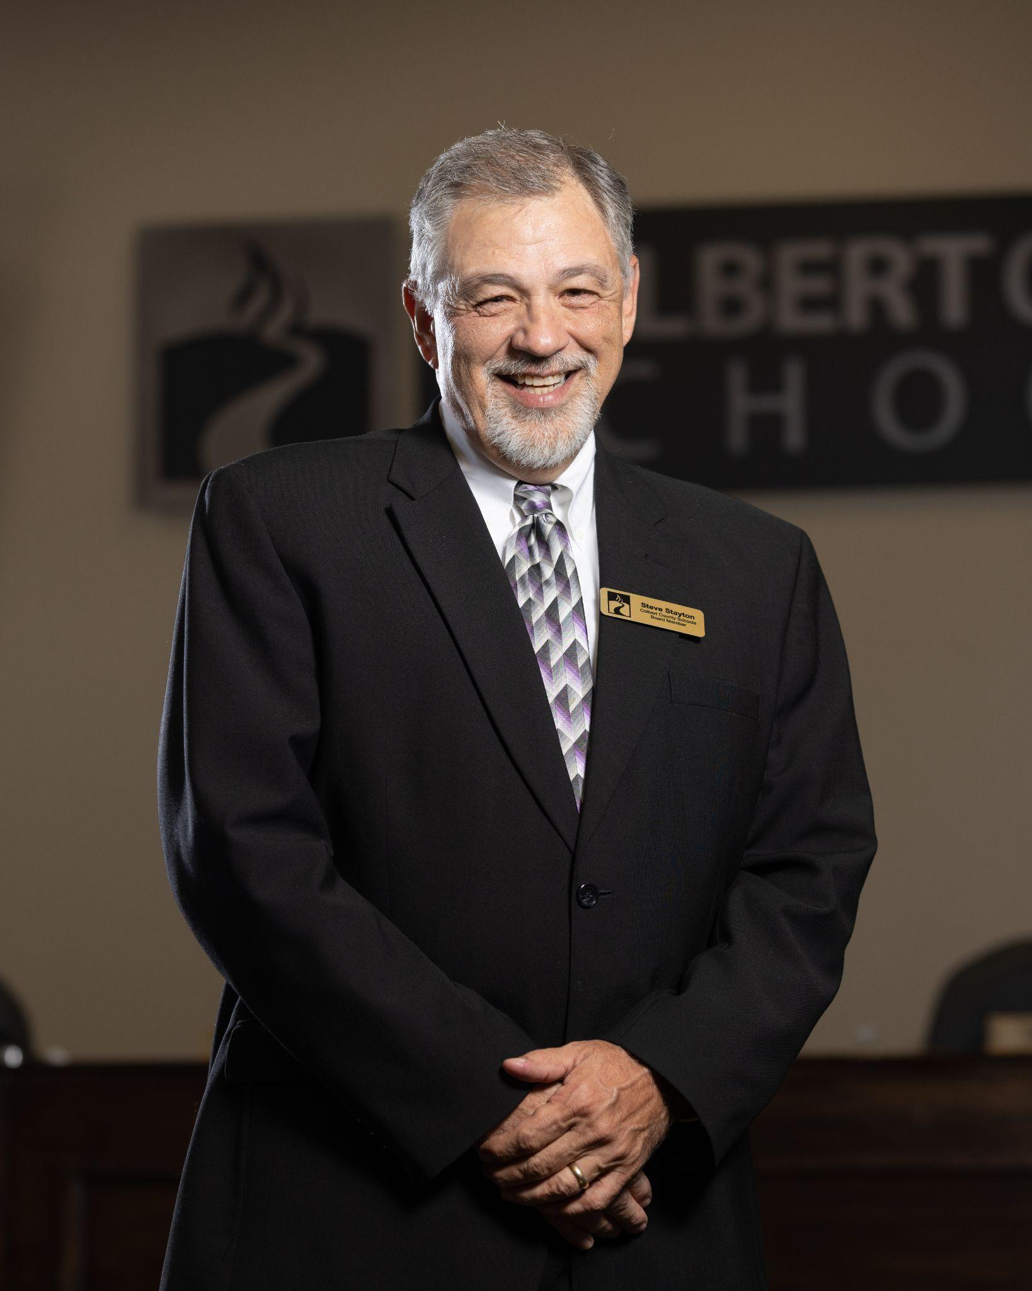
BOARD OF EDUCATION
Current Board President
Jackie Witt - District 3
jwitt@colbertk12.org
Current Vice-President
Steve Stayton - District 6
sstayton@colbertk12.org

Slide 22
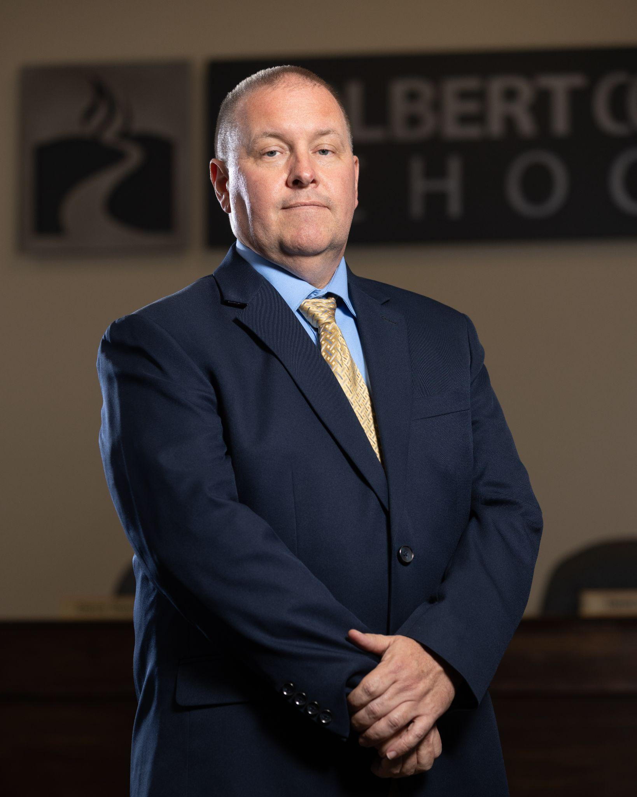
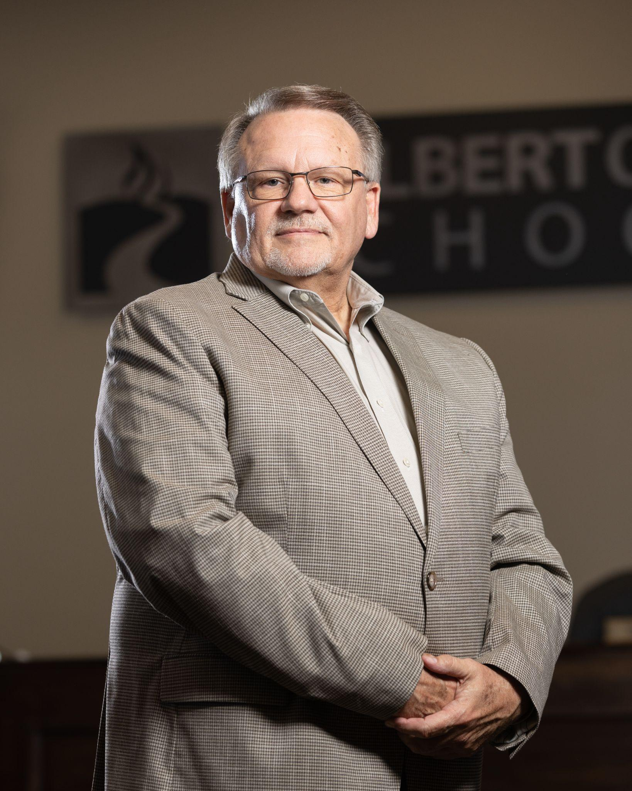
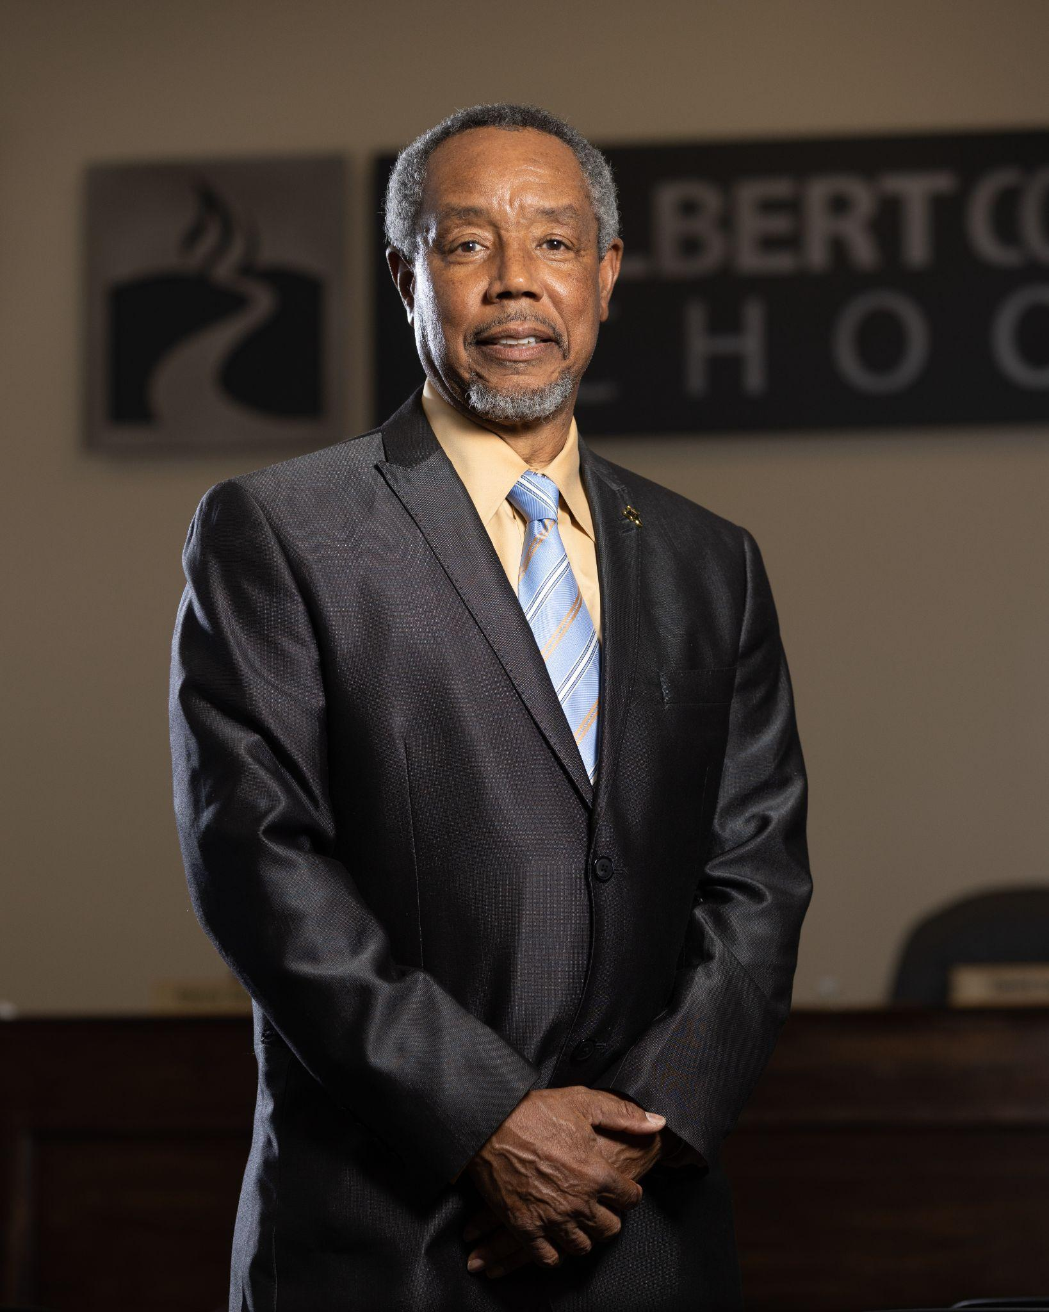
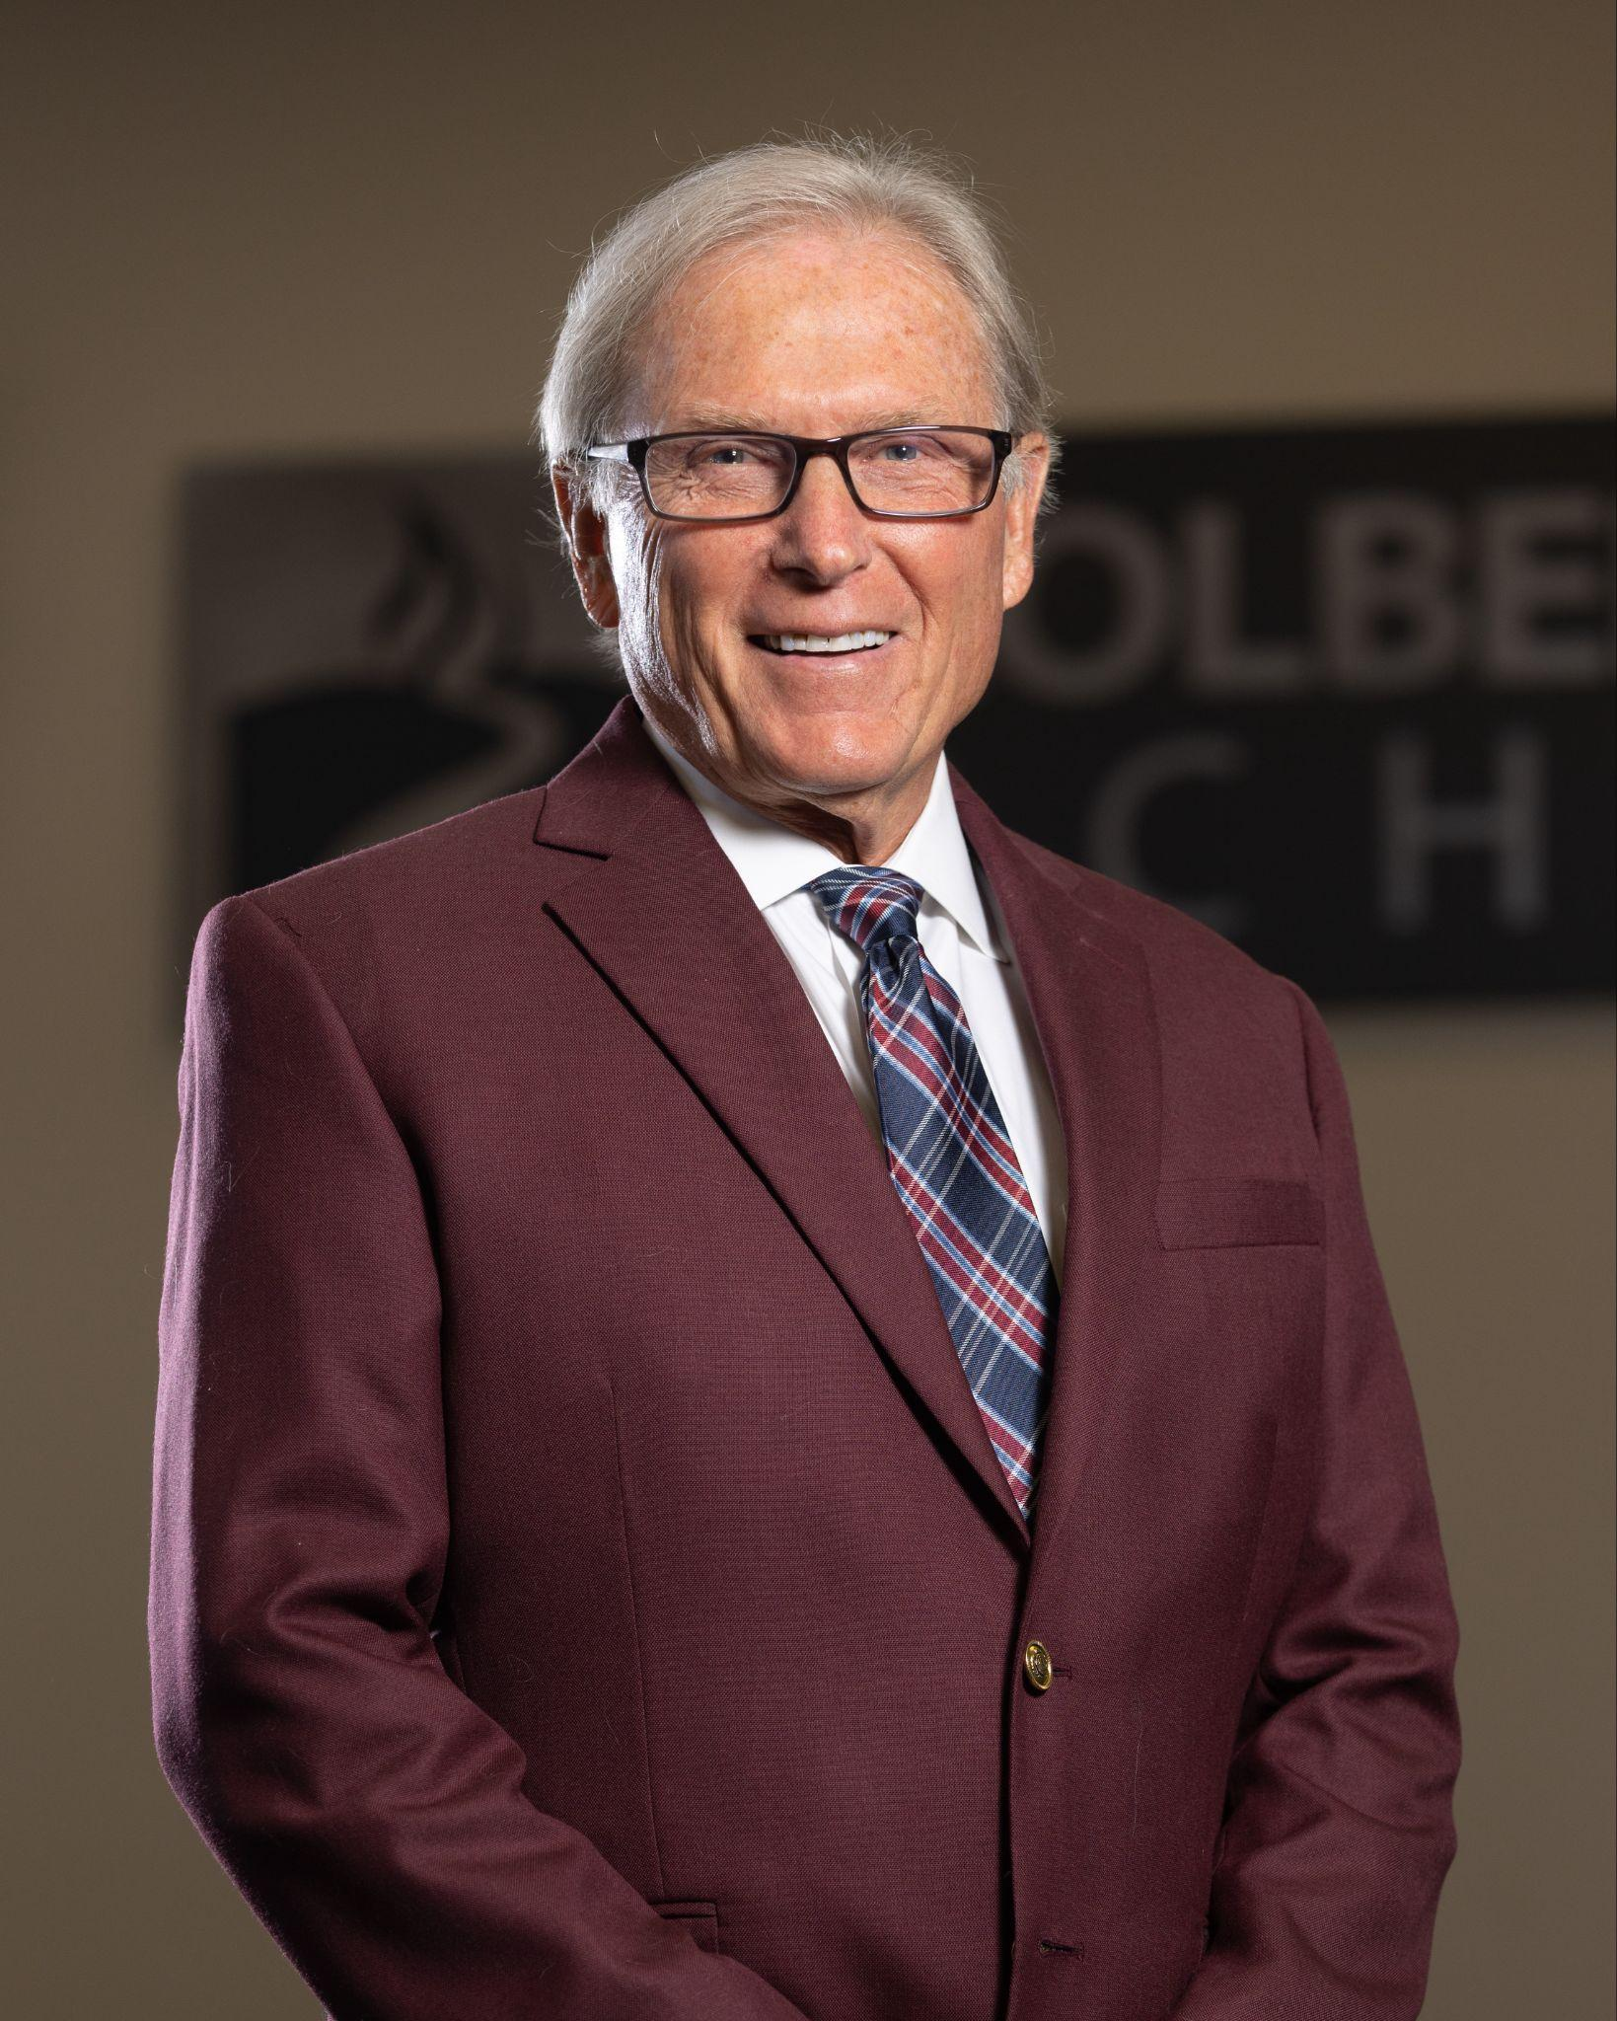
BOARD OF EDUCATION
Jarrod Johnson
District 1
jjohnson@colbertk12.org
David Yarber
District 2
dyarber@colbertk12.org
Thomas Burgess
District 4
tburgess@colbertk12.org
Ricky Saint
District 5
rsaint@colbertk12.org

