Slide 1
Measure BB Bond
21st Century Classroom Improvements
October 24, 2024

Slide 2
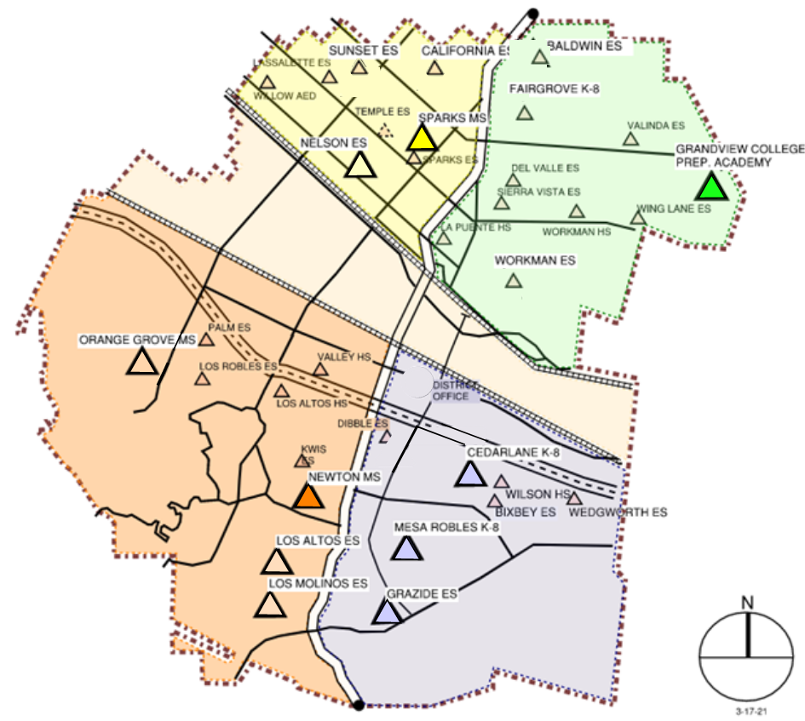
HLPUSD MEASURE BB - SUMMARY SCHOOLS IN PROGRESS
IN PROGRESS
CONSTRUCTION
Los Altos HS
Wilson HS
BIDS OPENED 9/24/2024
California ES
Baldwin ES
Grazide ES
Los Molinos ES
AT DSA FOR REVIEW
Kwis ES
Lassalette ES
Fairgrove K-8
Palm ES
Valinda ES
Sierra Vista MS
IN DESIGN
Orange Grove MS
Sparks ES
Wing Lane ES
Valley Alternative
COMPLETED
Nelson ES
Los Altos ES
Workman ES
Mesa Robles K-8
Cedarlane K-8
Sparks MS
Newton MS
Grandview MS
Stimson EC
Workman HS
La Puente HS
STIMSON

Slide 3
PHASE B PROGRESS
1. Baldwin ES Construction Documents Anticipated Start Date November 11, 2024
2. California ES Construction Documents Anticipated Start Date November 11, 2024
3. Los Molinos ES Construction Documents Anticipated Start Date November 11, 2024
Interim Housing Los Altos ES (Tentative)
4. Grazide ES Construction Documents Anticipated Start Date November 11, 2024
Interim Housing Bixby ES (Tentative)
Anticipated Construction Start Fall of 2024
5. Kwis ES Construction Documents At DSA for Plan Review Back Check 10/28/2024
6. Lassalette ES Construction Documents At DSA for Plan Review Back Check 10/28/2024
Anticipated Construction Start New Year of 2025
7. Palm ES Construction Documents At DSA for Plan Review Submitted 10/8/2024
Interim Housing Los Robles (Tentative)
8. Valinda ES Construction Documents At DSA for Plan Review Submitted 10/8/2024
Anticipated Construction Start Spring of 2025
9. Fairgrove K-8 Construction Documents At DSA for Plan Review Submitted 8/12/2024
Interim Housing Del Valle (Tentative)
10. Orange Grove MS Construction Documents Schematic Design
Anticipated Construction Start Summer of 2025
11. Sierra Vista Construction Documents Design Development District Reviewed 8/2/2024
12. Sparks ES Construction Documents Design Development District Reviewed 8/2/2024
Interim Housing Sunset (Tentative)
Anticipated Construction Start Summer -Fall of 2025
13. Wing Lane ES Construction Documents Design Development District Reviewed 9/17/2024
14. Valley Alternative Construction Documents Design Development District Reviewed 9/17/2024
Anticipated Construction Start Fall of 2025

Slide 4
HIGH SCHOOL REFRESH PROJECTS

Slide 5
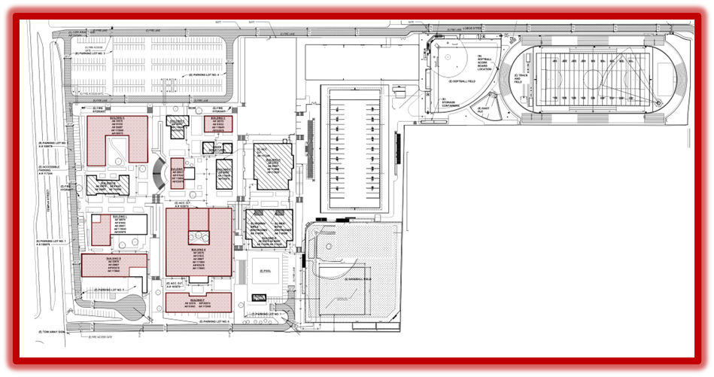
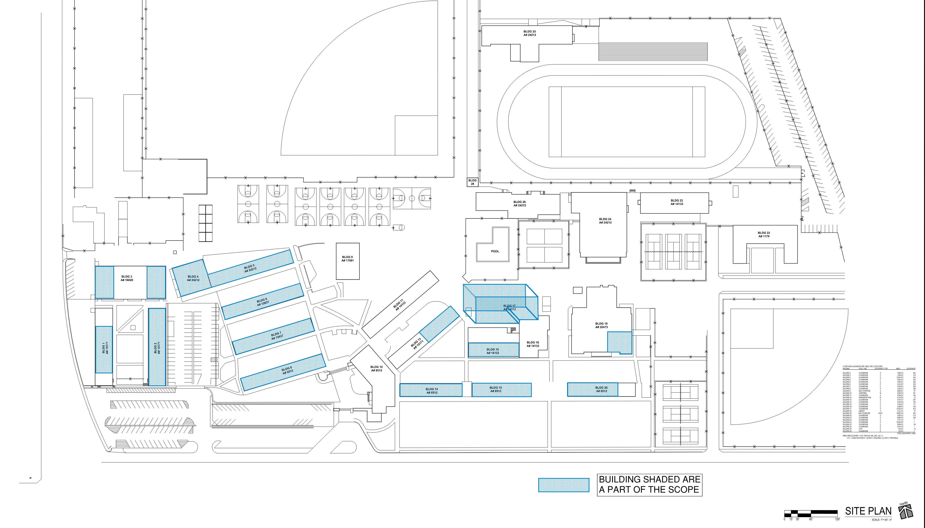
HIGH SCHOOL REFRESH GROUP 1
WORKMAN HIGH SCHOOL
43 CLASSROOMS
LA PUENTE HIGH SCHOOL
55 CLASSROOMS
SCHOOL | START DATE | ANTICIPATED COMPLETION DATE
WORKMAN HS | 1/16/2024 | 9/13/2024 COMPLETED
LA PUENTE HS | 1/16/2024 | 10/18/2024 COMPLETED

Slide 6
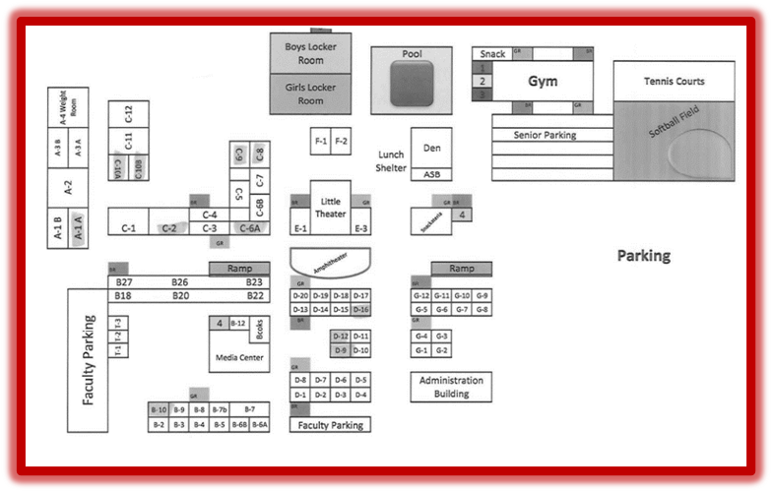
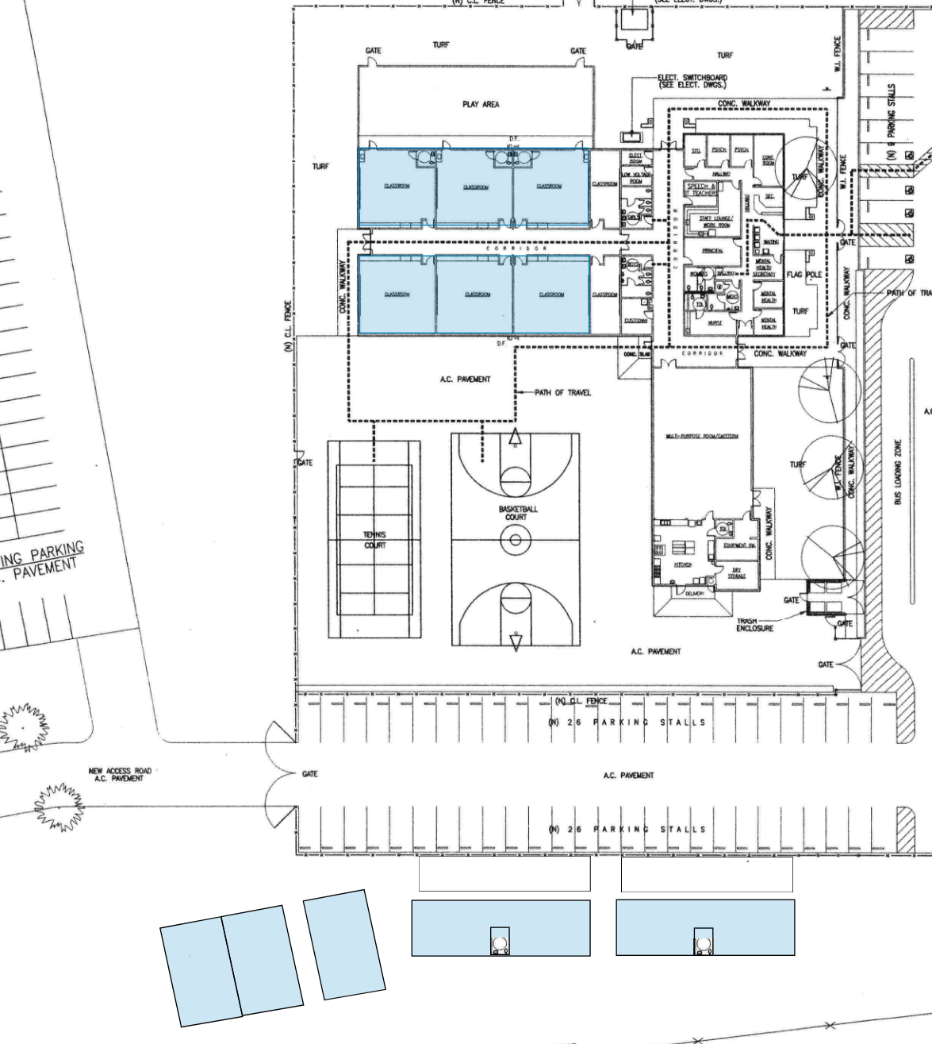
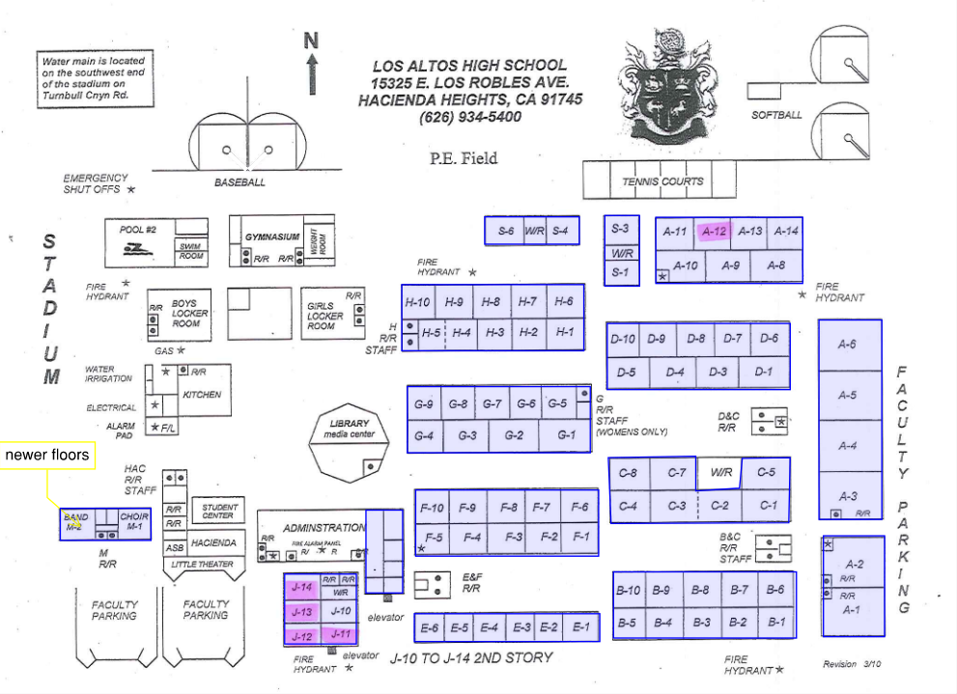
HIGH SCHOOL REFRESH GROUP 2
WILSON HIGH SCHOOL
59 CLASSROOMS
STIMSON LEARNING CENTER
10 CLASSROOMS
LOS ALTOS HIGH SCHOOL
69 CLASSROOMS
SCHOOL | START DATE | ANTICIPATED COMPLETION DATE
WILSON HS | 3/4/2024 | 2/21/2025
LOS ALTOS HS | 3/4/2024 | 4/18/2025
STIMSON EC | 7/1/2024 | 7/31/24 Completed

Slide 7
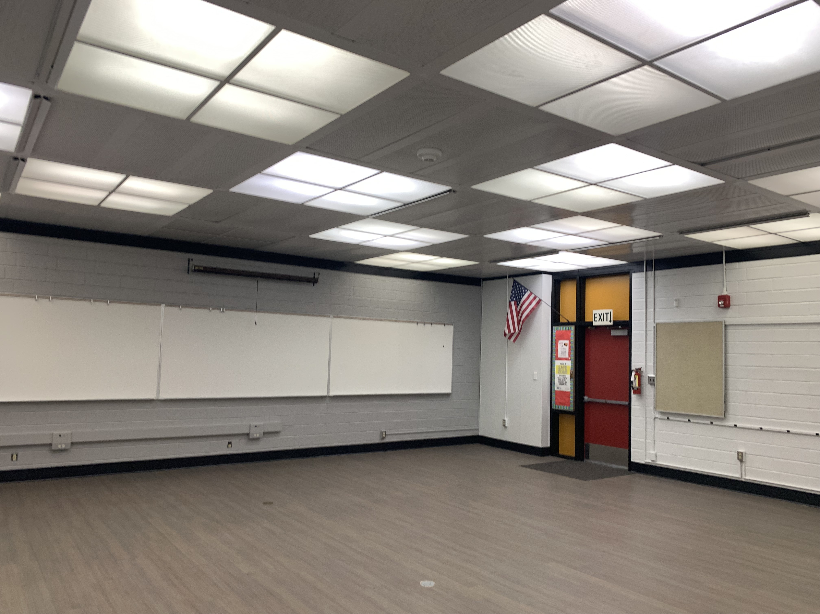
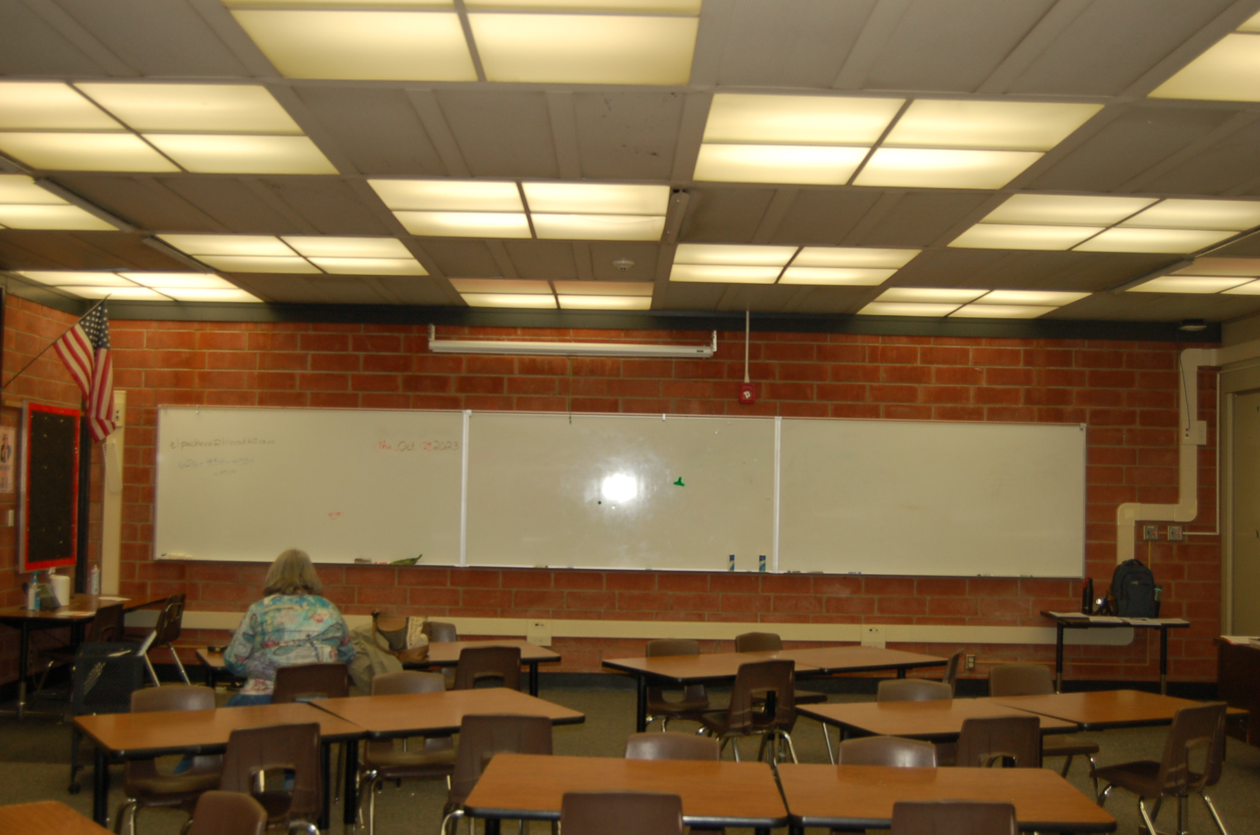
REFRESH GROUP 2
Wilson HS Phase 2
Classroom B-7 Before
and After
After
Before

Slide 8
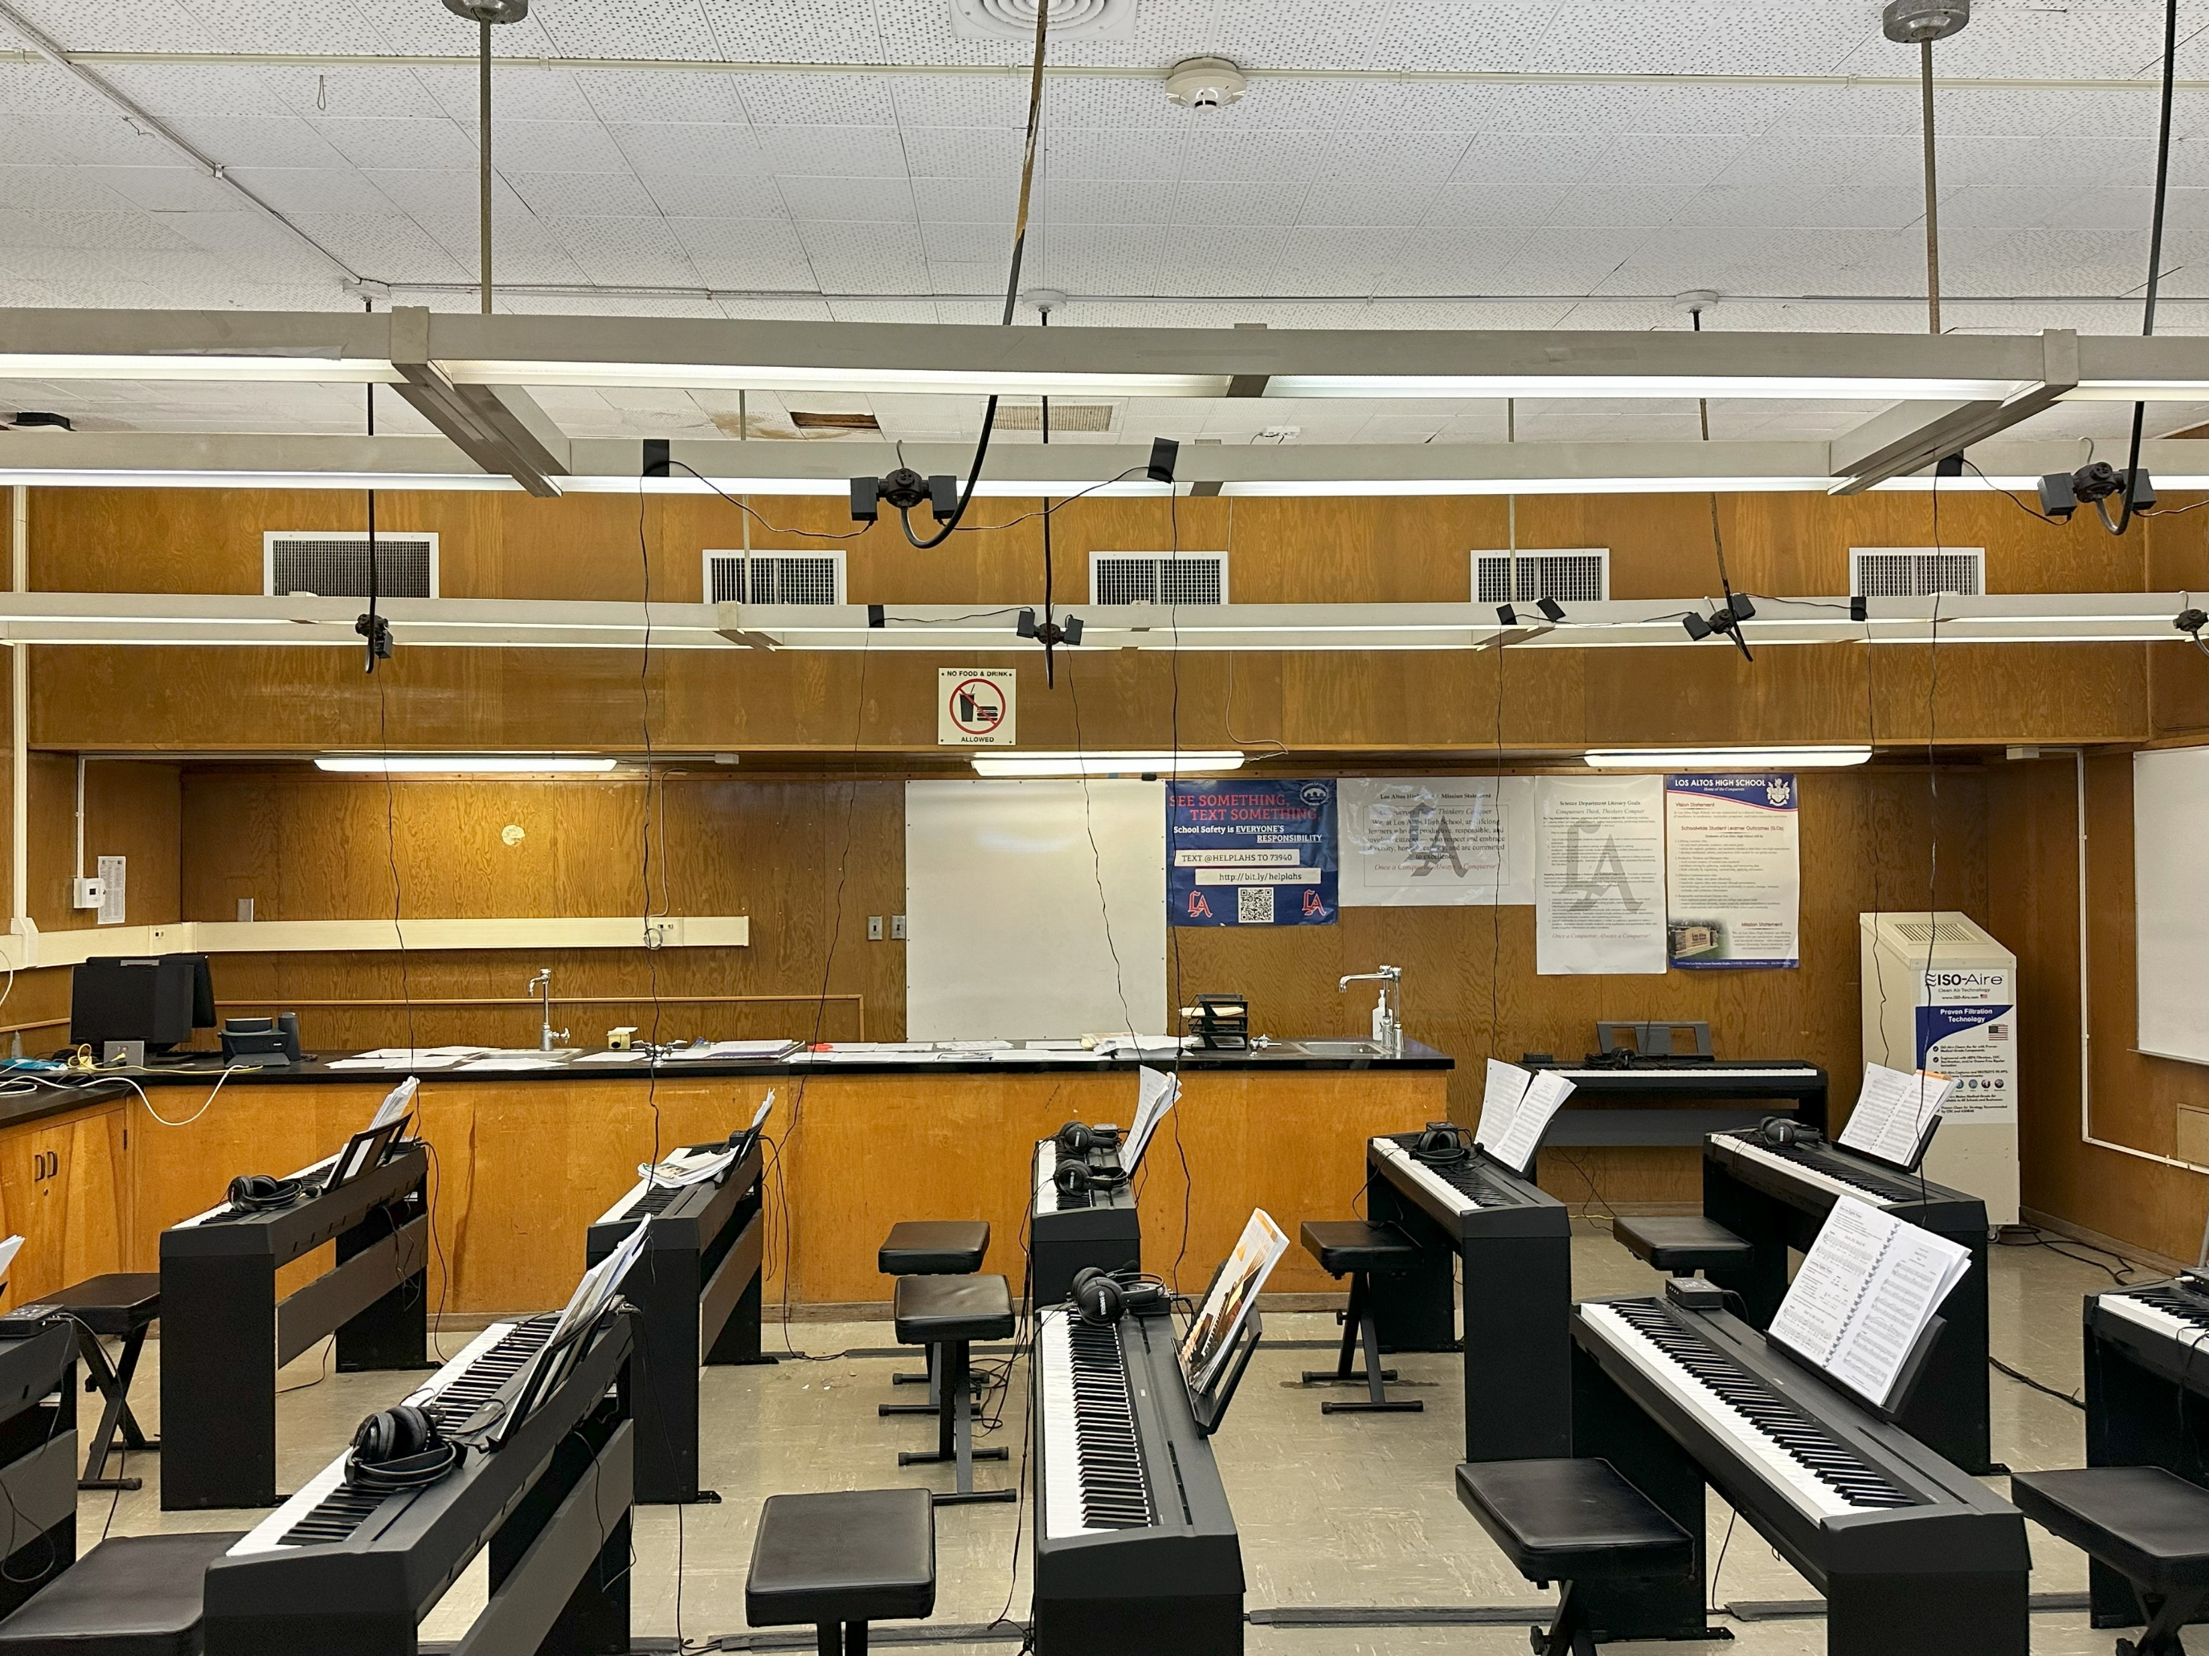
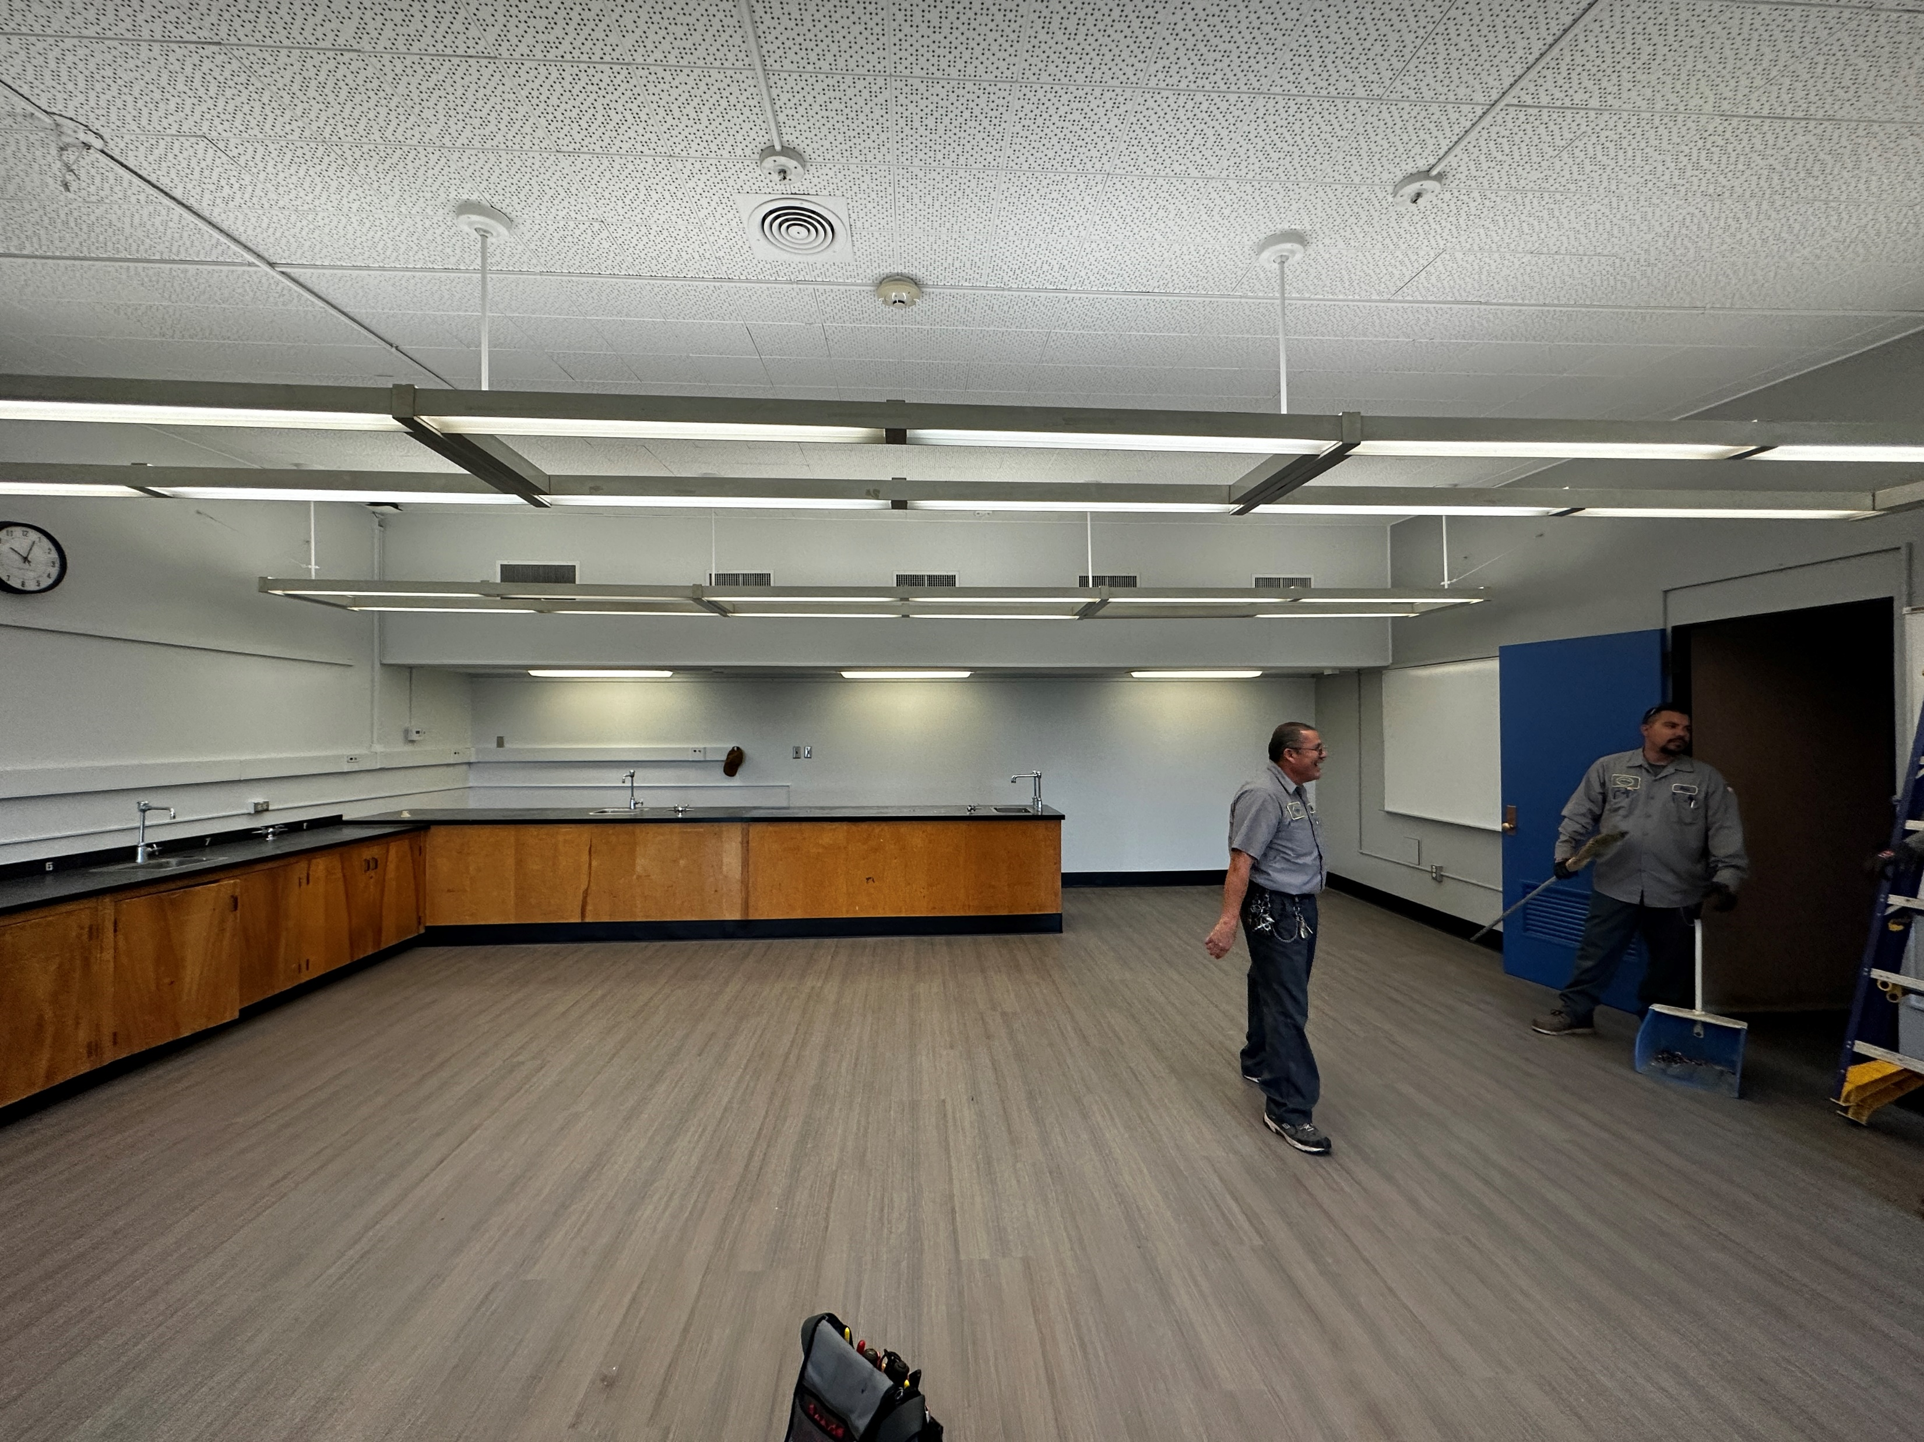
REFRESH GROUP 2
Los Altos HS Phase 4 Classroom C-8.
Before
After
After

Slide 9
QUESTIONS

