Slide 1
GHC 2024-25
Coffee Chat with Administration - 8th Grade

Slide 2
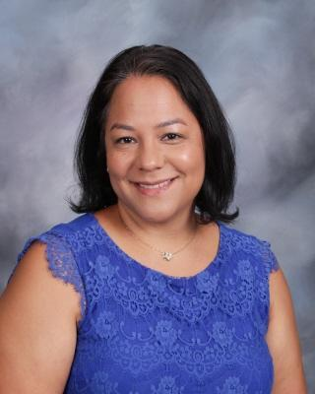
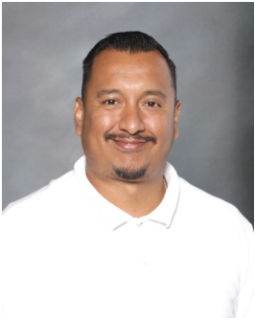
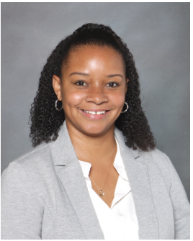
ADMINISTRATION
Chief Academic Officer/Interim Director
Dr. DaCosta
Interim Assistant Administrative Director:
Mrs. Rodriguez
Assistant Administrative Director:
Mrs. Alfred
Assistant Administrative Director:
Mr. Alvarado
Notes:
Jana -- Welcome speech
Victoria -- Introduction

Slide 3
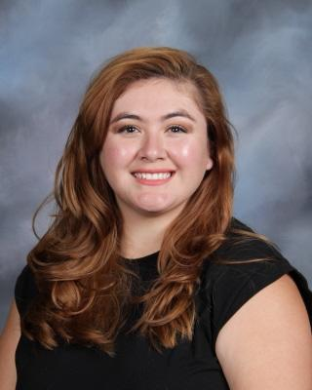
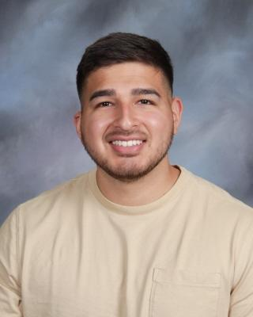
Social-Emotional, Behavior and Mental Health Support Staff
Ms. Bernal,
School Counselor
giovanabernal@ghctk12.com
Mr. Rodriguez,
Intervention Coordinator
stevenrodriguez@ghctk12.com
Ms. Cordero,
School Psychologist
ingridcordero@ghctk12.com
Mr. Berenson
Dean of Student Life
justinberenson@ghctk12.com

Slide 4
GHC 2024-25
Community Engagement/Outreach
Bonnee Lallouz

Slide 5
GHC 2024-25
Attendance

Slide 6
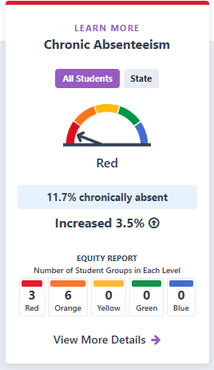
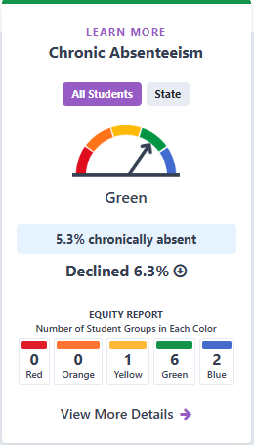
2023
2024

Slide 7
Attendance Policy: Terminology
Tardy: Arriving late after the scheduled start time for class.
Unexcused Absence: Missing more than 30 minutes of class without a valid excuse.
Truancy: Absence without a valid excuse for 3 days in a school year or tardy/absence of more than 30 minutes on 3 occasions.
Habitual Truant: 5 unexcused absences or tardies in a school year.
Chronic Truant: Missing 10% of school days without a valid excuse.

Slide 8
Middle School Unexcused Absences
Following is an outline of the attendance plan for students in Grades 6-8:
Students who are absent 15 or more times from a class will have their grade reduced by one (1) letter grade.
The school will make every effort to notify parents of troublesome attendance patterns; however, it is the student's responsibility to maintain satisfactory attendance.
The fifteen-day absence policy includes excused/unexcused absences.

Slide 9
Verification of Absence
Students are expected to bring a written excuse signed by the parent to the TK-8 Office within one day after returning to school in order to clear his/her absences. Medical absences of five days or more require a doctor’s note to be excused. All excused absences are still counted as an absence from school and will be subject to the attendance policy.
Students with verified excused absences may be allowed to submit make-up work for credit.
Any unexcused absence is treated as a truancy. Teachers are not required to provide opportunities for students to complete missed work or tests for unexcused absences. A parent conference may be required.

Slide 10
Tardy and Absence Consequences
Tardy Consequences
○ 1st & 2nd tardy: Warning.
○ 3rd tardy: Call or letter sent home.
○ 4th tardy: Parent conference.
○ 5th tardy: Administrative intervention.
Unexcused Absences:
○ 3 Unexcused Absences: Truant - Email
○ 5 Unexcused Absences: Habitually Truant - Email and Meeting
○ Anything beyond 5 absences and equaling 10% of Year: Contract
○ Absences beyond Contract: Consequence List

Slide 11
Attendance Contract: Consequence List
Parent/guardian to attend school with the child for one day
Student retention for grades TK-5
After school detention program
Required school counseling
Loss of field trip privileges
Loss of school store privileges
Loss of school event, such as 5th and 8th grade commencement
Loss of extra-curricular privileges, such as after school theater, sports, elective enrichment.
Mandatory Saturday school
Voluntarily agree to enroll in GHC Independent Study - Loss of in-person seat
with priority to enroll in-person in the next grade level given space is available.]
Required remediation plan as set by the SART
Notification to the County District Attorney
Involuntary Removal

Slide 12
GHC 2024-25
Behavior Expectations

Slide 13
STANDARDS OF STUDENT BEHAVIOR
All students are expected to:
Attend school regularly and punctually; and remain on the school grounds
Complete all class work and homework assignments and maintain satisfactory marks.
Maintain a good attitude towards teachers, administrative directors, other staff members, and fellow students and comply with all reasonable requests from adult staff members.
Resolve conflicts or personal problems with the assistance of a staff member.
Bring necessary supplies and materials to classes daily, such as notebook, pencil, Chromebook, textbooks, and physical education clothing.
Conduct oneself aligned with our IB Learner Profile.

Slide 14
Progressive Discipline PBIS
Behavior Matrix of Expected Behaviors following Be Safe, Be Respectful, Be Responsible
Behavior Expectations (tour) at the beginning of the school year
Expected Behaviors are explained and modeled in each area of the campus by counseling, campus aides and administration
Expectations defined and clearly posted in all areas of campus
Scotty Buck given by support staff to students
Drawing each Friday during schoolwide SEL
6 Students are chosen each week and receive front of the line privileges for pizza lunch

Slide 15
Behavior Discipline
Minor Behavior Problems defined as electronic violation, dresscode, inappropriate language, classroom disruption, Property Misuse
Possible Consequences, warning, phone call home, seat change, redirection
Major Behavior defined as Abusive Language, Fighting, Bullying, Harassment, Student Conflict, Theft, Leaving class without permission
Possible consequences counseling warning, redirection, Parent, student, Restorative Practice (research paper) Dean conference, Reassignment, Suspension

Slide 16
GHC 2024-25
8th Grade Expectations
Ronda Alfred

Slide 17
Important Dates
December 16 - 20th - Final Exams for 8th grade
January 24th - Deadline to opt out of IB
February 14th - 8th Grade Field trip Museum of Tolerance
March 11th - 8th Grade Panoramic Picture
March 21th - Middle School Spring Dance at Highlander Hall
April 28th - May 9th - CAASPP Testing
May(TBD) - Jr. Grad night @ Magic Mountain
May 27th - 30th - Finals week & culmination rehearsals
May 30th - 8th Grade Culmination
June 30th - July 18th - STA at High School campus

Slide 18
Finals Exam Absences
Students must be in attendance during final exams. Students will not be able to take final exams before or after the scheduled final exam date and period.
Students who are absent must receive a zero on the final exam unless an approved incomplete has been authorized. Final exam appeal forms are available from the TK-8 Office and online.
Incompletes are approved for family or medical emergencies (documentation is required). Early vacation plans are not emergencies.
Students who are absent (due to illness) on the day of their final will be given a zero on the final exam and a grade of incomplete in the class.
Students have six weeks from the first day of the new semester to make-up the Incomplete. Failure to do so will result in a grade of fail.

Slide 19
8th Grade Culmination
Student has three (3) or more U’s (Unsatisfactory) marks in citizenship on the Progress/Report Card leading up to Culmination or Culminating activity.
Student must clear all obligations including Redirections, Chromebook & textbook return, cafeteria charges, and library charges, if applicable.
Frequent or serious violations of any school rule(s) resulting in an office referral can disqualify a student from participation in the culmination ceremony and other 8th grade activities.
All students are subject to the attendance policy which can be referenced on page 17 of the GHC Student Planner.

Slide 20
High School (Essentials to note)
STA Summer Transition Academy 2025: June 30 - July 18
Attendance Policy at the High School: 15 Day Drop/Fail
Multiple Opportunities to engage in clubs and sports: Some tryouts happen in the spring and summer for the fall sports

Slide 21
THANK YOU!
All Content Property of Granada Hills Charter. All Rights Reserved

