Slide 1
^{8th} Grade Science District Benchmark Data Review
Reporting Categories 1 & 2

Slide 2
STAAR Science Resources
2024-2025 Transition Year
Assessed Curriculum
Blueprints
Beginning Spring 2026
Middle School (6-8) administered in grade 8

Slide 3
Assessed Curriculum

Slide 4
TEKS
Old TEKS | Before 2024–2025 | New TEKS | Implemented in 2024–2025
8.6A | demonstrate and calculate how unbalanced forces change the speed or direction of an object’s motion; Readiness | 8.7A | calculate and analyze how the acceleration of an object is dependent upon the net force acting on the object and the mass of the object using Newton's Second Law of Motion; Readiness
 |  | 6.7B | calculate the net force on an object in a horizontal or vertical direction using diagrams and determine if the forces are balanced or unbalanced Readiness
8.6C | investigate and describe applications of Newton's three laws of motion such as in vehicle restraints, sports activities, amusement park rides, Earth's tectonic activities, and rocket launches Readiness | 8.7B | investigate and describe how Newton's three laws of motion act simultaneously within systems such as in vehicle restraints, sports activities, amusement park rides, Earth's tectonic activities, and rocket launches. Readiness

Slide 5
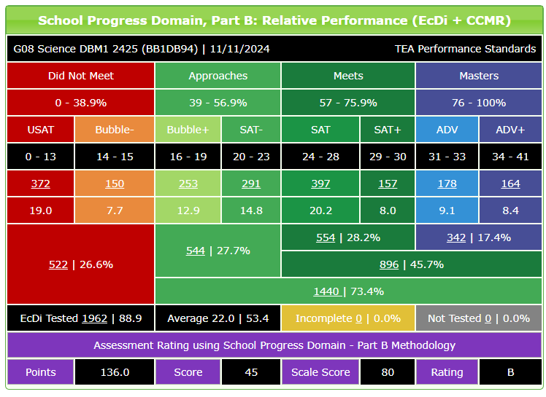
Grade 8 Science DBM1 Results

Slide 6
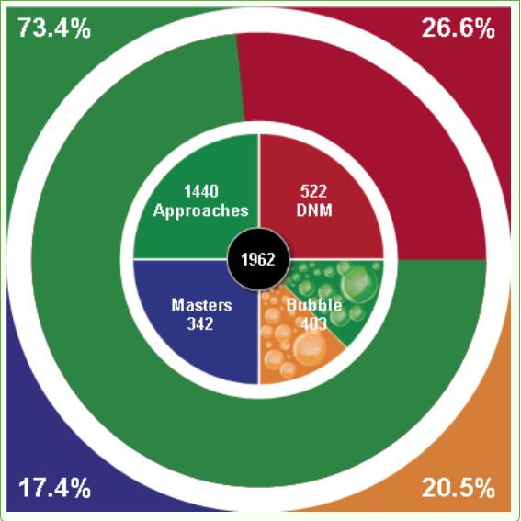
Grade 8 Science DBM1 Results
2024 DBM1
73.4% Approaches
45.7% Meets
17.4% Masters
2023 DBM1
79.6% Approaches
53.3% Meets
15.1% Masters

Slide 7
Lowest TEKS
7.07C - measure, record, and interpret an object's motion using distance-time graphs
6.08B - describe how energy is conserved through transfers and transformations in systems such as electrical circuits, food webs, amusement park rides, or photosynthesis
8.07B – investigate and describe how Newton's three laws of motion act simultaneously within systems such as in vehicle restraints, sports activities, amusement park rides, Earth's tectonic activities, and rocket launches
7.07A – calculate average speed using distance and time measurements from investigations
7.06C - distinguish between physical and chemical changes in matter

Slide 8
MS Science Assessed TEKS Frequency Chart RCs 1&2
MS Science Assessed TEKS Frequency Chart
TEKS Clusters |  | STAAR |  |  |  |  | TOTAL Streamline | 2021 | 2025
subclusters | Student Expectations (SEs) | 2019 | 2021 | 2022 | 2023 | 2024 |  | Student Expectations (SEs) | SEs
Properties of Atoms
Structure of Atoms | 8.5(A) 8.5(B) | 3 | 2 | 4 | 4 | 4 | 17
Periodic Table | 8.5(C) 6.6(A) | 2 | 3 | 3 | 2 | 2 | 12 | 6.6C | 8 4
Chemical Formulas, Equations, and Reactions
Chemical Formulas | 8.5(D) | 2 | 1 | 1 | 1 | 1 | 6 | 7.6B | 6
Chemical Reactions | 8.5(E) 7.6(A) | 2 | 3 | 2 | 2 | 2 | 11 | 8.6E 7.6C | 10 3
Density | 6.6(B) | 1 | 1 | NT | 1 | NT | 3
Force, Motion, and Energy
Force | 8.6(A) | 3 | 3 | 2 | 2 | 2 | 12 | 8.7A 6.7B | 12
Motion | 8.6(C) 8.6(B) 6.8(C) 6.8(D) | 4 | 4 | 5 | 5 | 4 | 14 | 8.7B 7.7A 7.7C | 10 4 4
Energy | 6.8(A) 6.9(C) | 2 | 2 | 2 | 2 | 2 | 10 | 6.8A 6.8B | 5 5

Slide 9
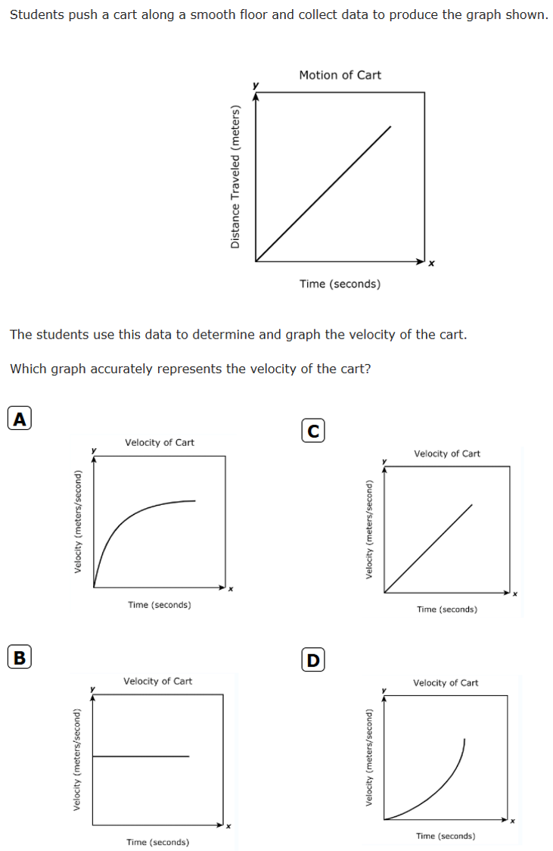
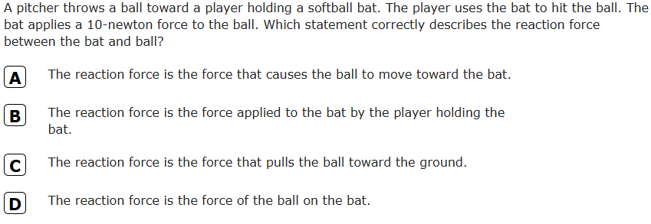
Assessed Items

Slide 10
Important to Note
TEKS assessed on the DBM1 which covers RC 1 and RC 2, only covers 35% of the assessed TEKS on the 2025 STAAR.​
63% of the assessed TEKS on the 2025 STAAR are 6th and 7th grade specific TEKS.​
 | RC1 | RC2 | RC3 | RC4 | Total
8th | 1 | 2 | 5 | 5 | 13
7th | 3 | 2 | 4 | 4 | 13
6th | 1 | 3 | 2 | 3 | 9
 | 14% | 20% | 31% | 34% | 35

Slide 11
Next Steps
Analyze campus TEKS results on the DBM1 which covers RC 1 and RC 2, to identify which TEKS ones need reviewing and which ones need reteaching.​
Include TEKS such as, TEKS 7.07C, in an intensive reteaching during STAAR Review which begins March 28, 2025 according to the district's scope and sequence.​
Review the scope and sequence to determine if adjustments are needed, based on campus needs, to ensure frequently assessed TEKS are allotted ample time.
Include providing a hands-on opportunity not only to collect data but convert the data into graphs to analyze and interpret.​
Ensure science teachers have the time needed to complete instruction on RC3 and RC4. Minimize time students are pulled out of their science classes.

Slide 12
Labs and Demos

Slide 13
Resources
McGraw-Hill (primary resource including science equipment, materials and supplies
EduSmart
Lowman
ProgressLearning
Science Cutups

Slide 14
2026 STAAR 8 Science Assessed Curriculum

