Slide 1
Eastern Lebanon County School District 2023-24 Preliminary Budget
Julia Vicente, Superintendent
Michael Miller, Business Manager
Educating for Excellence

Slide 2
Key Question to Answer Tonight
Can we (expect to) balance the 2023-24 budget without exceeding the Act 1 Adjusted Index of 4.9%?
If so, committee should move forward resolution of “to not increase its tax rate above the Act 1 Index of 4.9% for the 2023-24 fiscal(budget) year.”

Slide 3
Act 1 2023-24 Data & Timelines
2023-24 adjusted (est.) index set at 4.9%, base 4.1%
Current millage rate is 16.7620 mills
Max Millage increase to index is .8213, a total rate of 17.5833
2022 Assessment currently at $1,745,606,905
Max additional revenue to index = $1,421,853 at 98.5% collection
Timeline per Act 1
January 26, 2023 – Deadline for Adopting opt – out resolution (not to exceed Adjusted Act 1 Index)
May 31, 2023 – Deadline for Adopting Proposed Final Budget
June 30, 2023 – Deadline for Adopting Final Budget

Slide 4
2023-24 Preliminary Budget

Slide 5
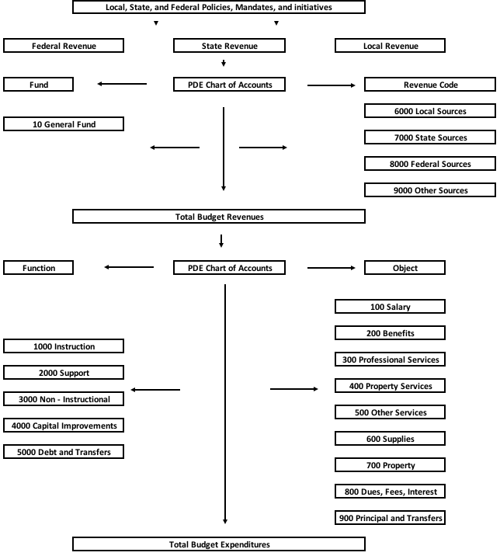
PA School Budget Flowchart
Revenue
Side
Expenditure
Side

Slide 6
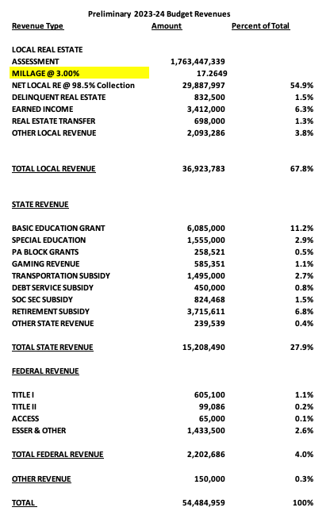

Slide 7
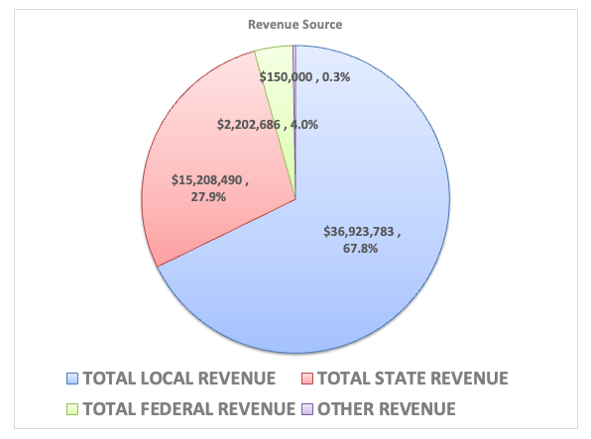

Slide 8
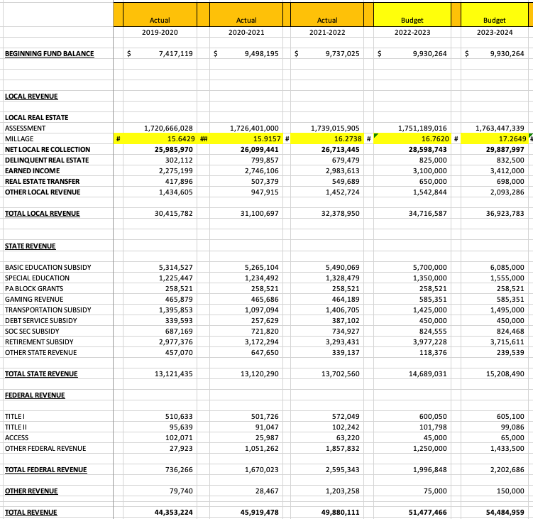
Five Years Revenues

Slide 9
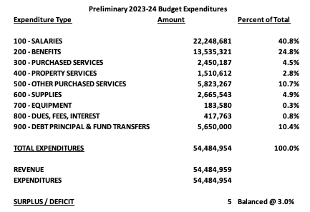

Slide 10
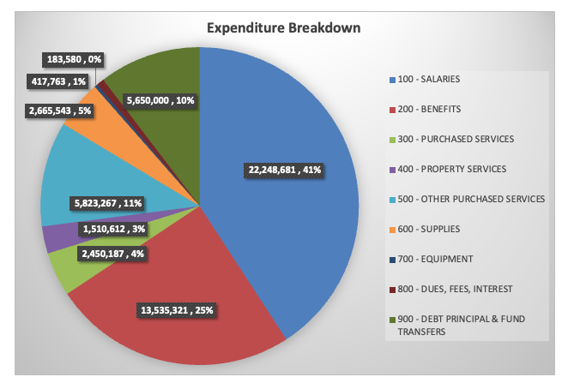

Slide 11
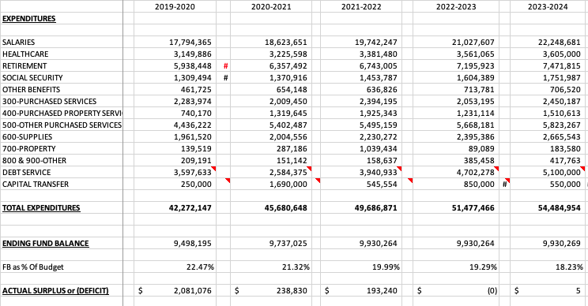
Five Years Expenditures

Slide 12
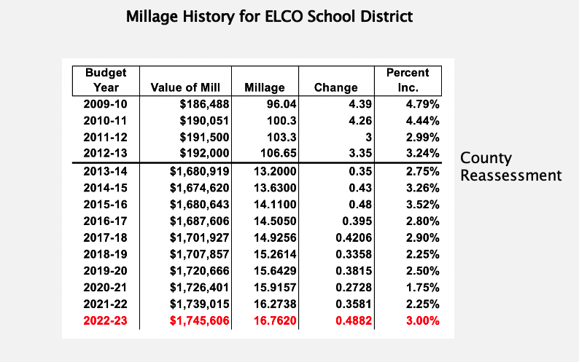

Slide 13
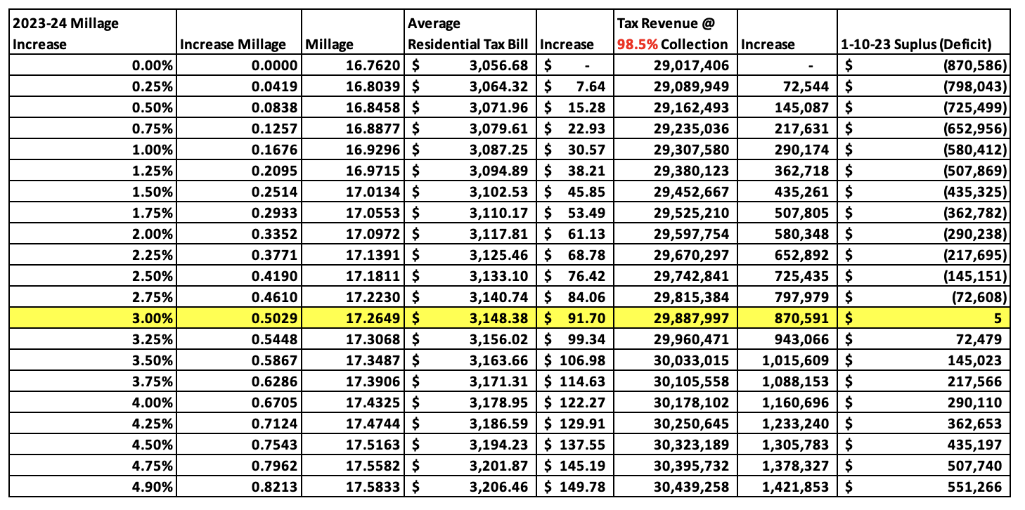
Tax Rate Menu Slide

Slide 14
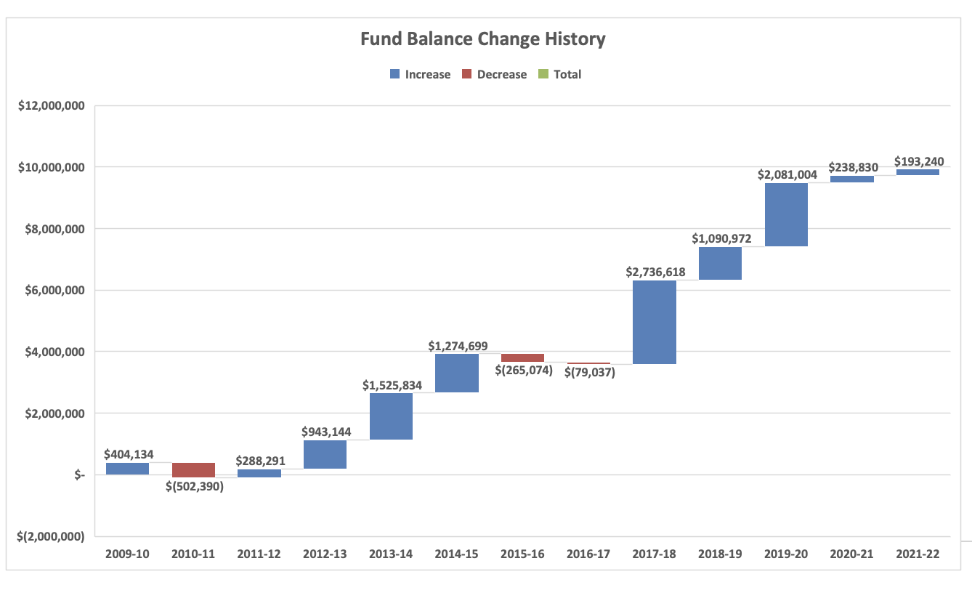
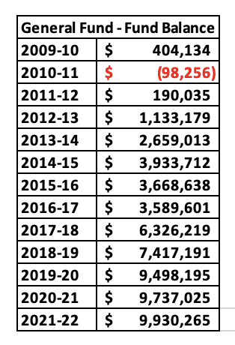
13 Year Fund Balance History for ELCO School District

Slide 15
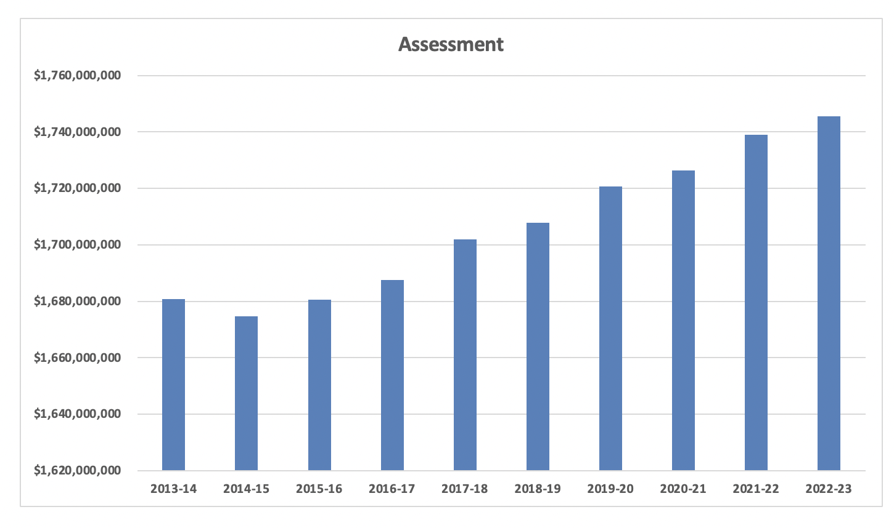
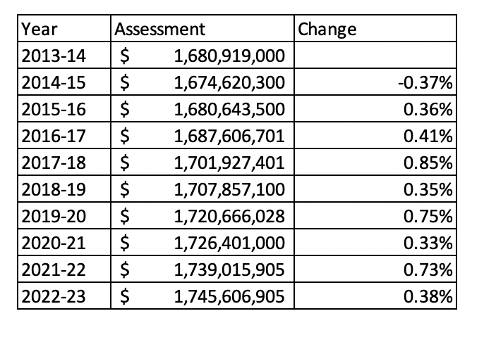
Assessment History for ELCO School District

Slide 16
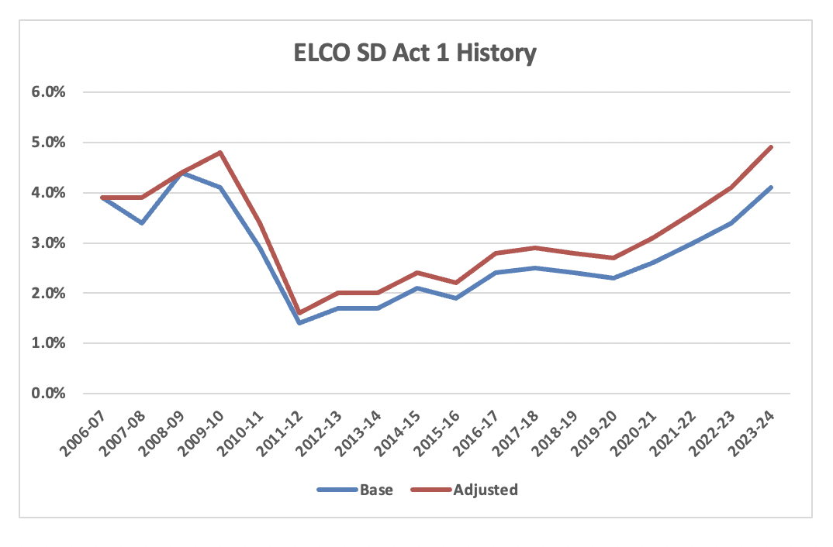

Slide 17
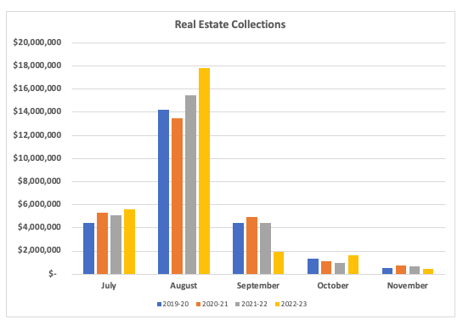
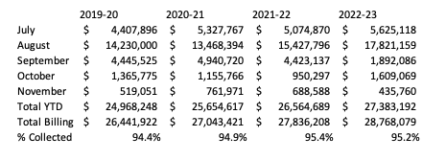
RE Collections

Slide 18
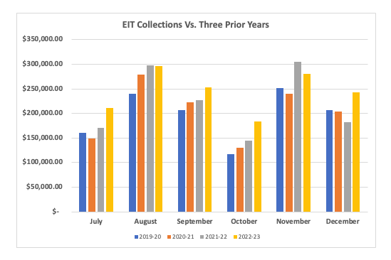
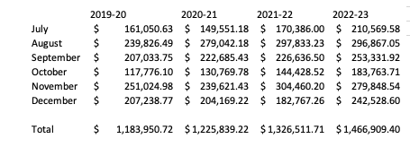
EIT Collections
Encouraging for 2023-24 Budget

Slide 19
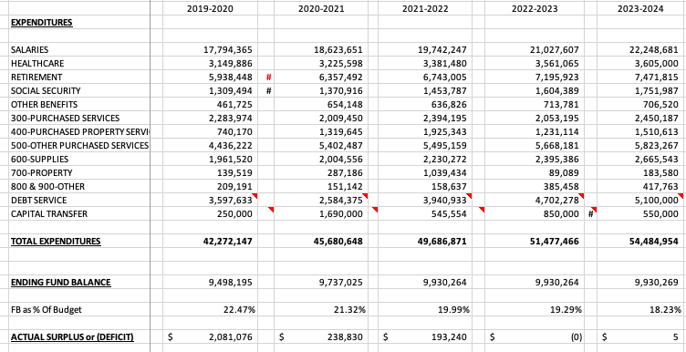
Fiscal Cliff Begins 2023-24 Budget

Slide 20
New Items in the Preliminary Budget
IS Autism Support Program (1 Teacher, 2 Paras)
2 MS learning support teachers to support teaming model
New Apple iPad lease for cycle refresh
HS project debt service being budgeted
First year of new CBA
Support Staff competitive market adjustments

Slide 21
Major Cost Drivers
Charter Schools
Salaries
PSERS
Healthcare
Debt

Slide 22
Charter Schools – Improving Trends
2022-23 budget was $1,425,000 for around 100 students
2023-24 budget set at $1,445,000
No Charter relief expected from Legislature

Slide 23
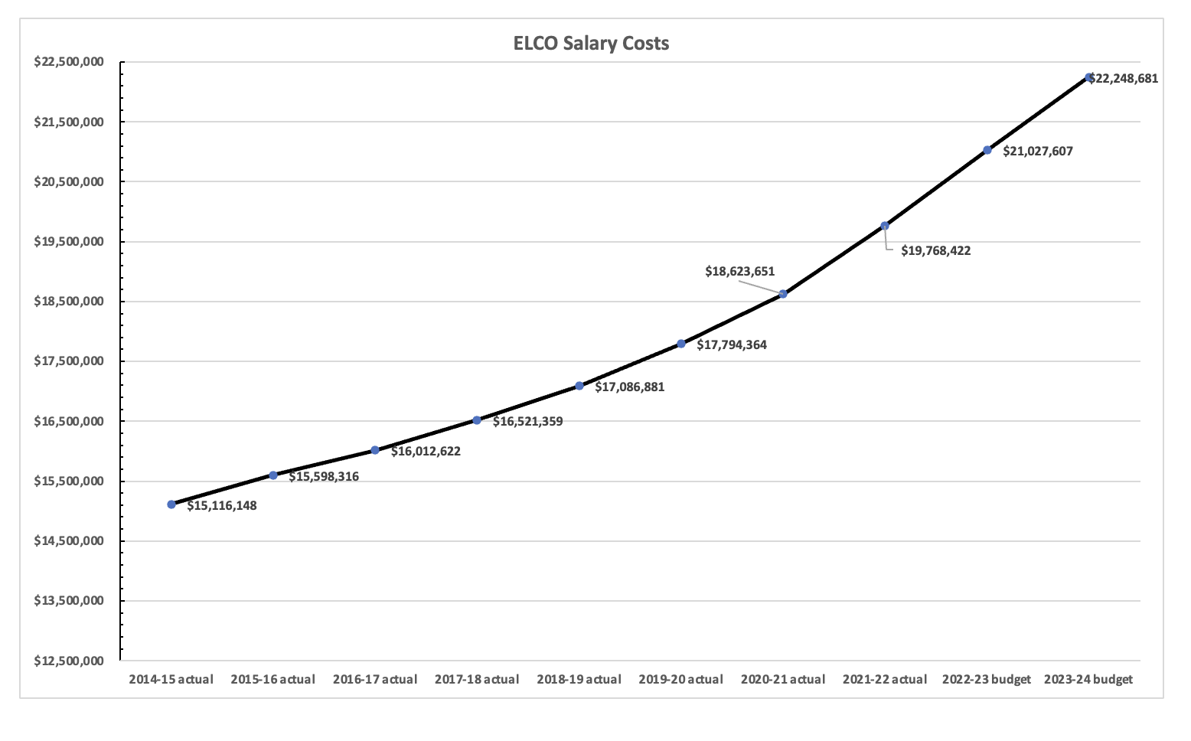

Slide 24
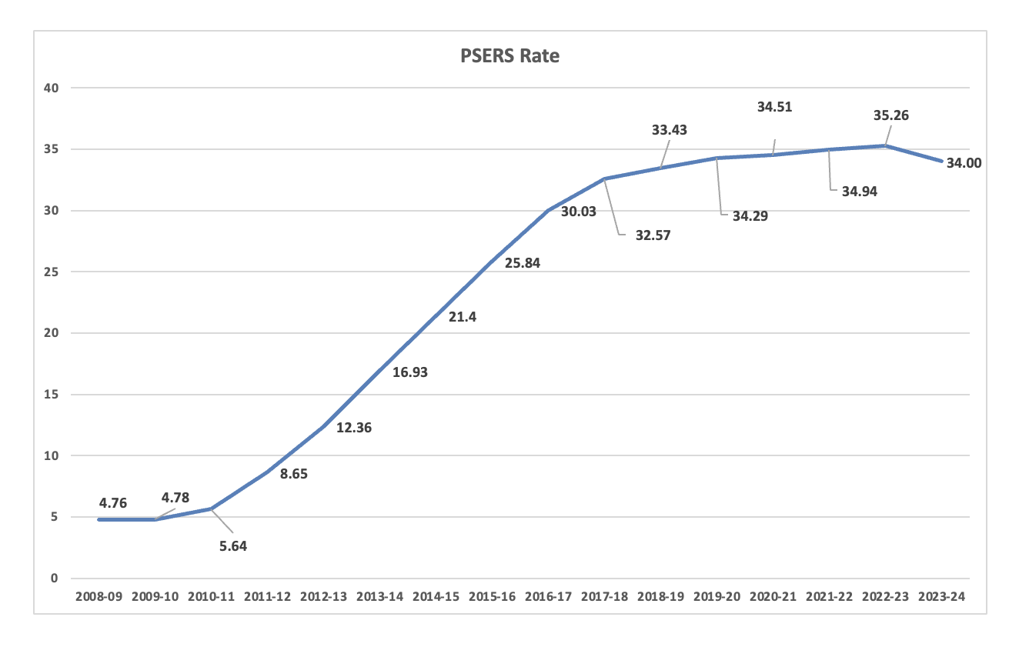
PSERS – Employer Rate
Past service debt makes up more than 80%
of the 2023-24 employer rate, would be 7-8%
without the unfunded liability
-PSERS

Slide 25
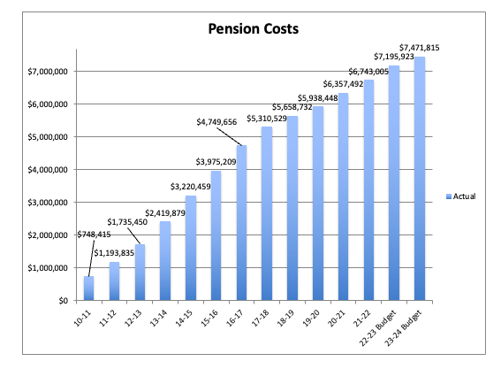
Retirement Cost History

Slide 26
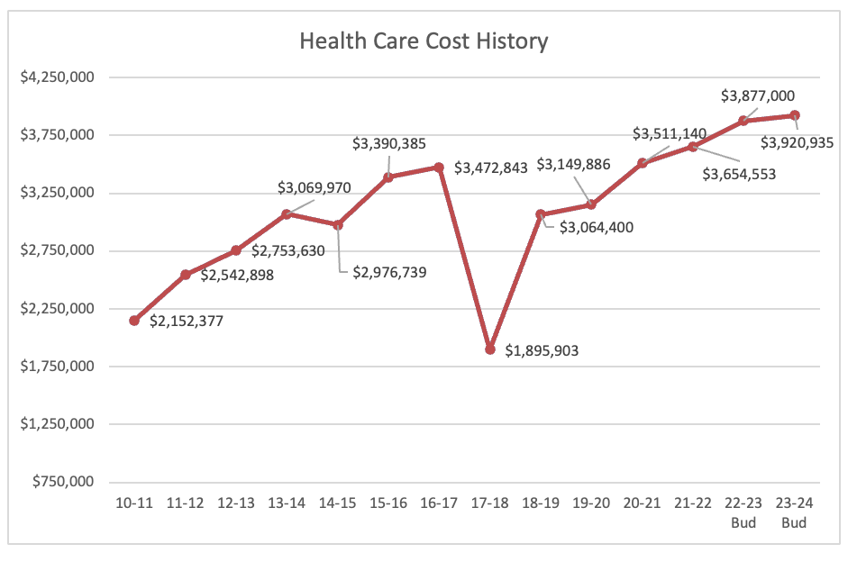
Health Care Cost History
US Employers expect health care costs to increase by 6.5% in 2022, according to the 2022 Global Medical Trends Survey by Willis Towers Watson (NASDAQ: WLTW).
Includes Dental and Vision

Slide 27
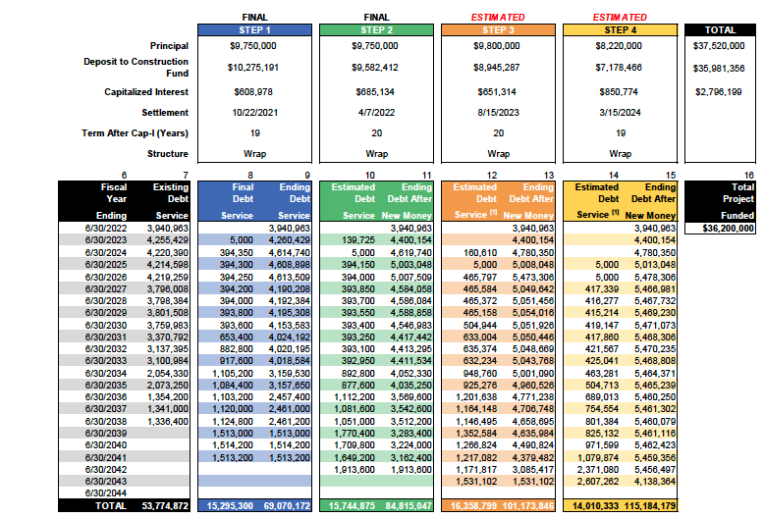
Debt Update – Principal & Interest

Slide 28
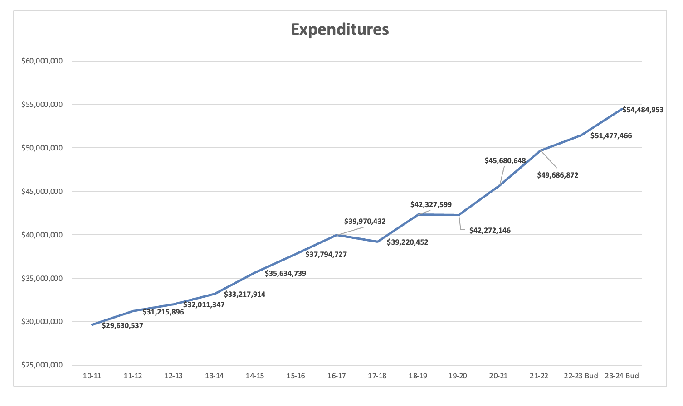
Total Expenditure History

Slide 29
Key Question to Answer Tonight
Can we (expect to) balance the 2023-24 budget without exceeding the Act 1 Adjusted Index of 4.9%?
If so, committee should move forward resolution of “to not increase its tax rate above the Act 1 Index of 4.9% for the 2023-24 fiscal(budget) year.”

Slide 30
Questions?

