Slide 1
Eastern Lebanon County School District 2023-24 Proposed Final Budget
Julia Vicente, Superintendent
Michael Miller, Business Manager
Educating for Excellence

Slide 2
Act 1 2023-24 Data & Timelines
2023-24 adjusted index set at 5.0%, base 4.1%
Current millage rate is 16.7620 mills
Max Millage increase to index is .8381, a total rate of 17.6001
2022 Assessment currently at $1,751,189,016
Max additional revenue to index = $1,452,706 at 98.5% collection
Timeline per Act 1
January 17, 2023 – Date of adoption of opt – out resolution (not to exceed Adjusted Act 1 Index)
May 31, 2023 – Deadline for Adopting Proposed Final Budget
June 30, 2023 – Deadline for Adopting Final Budget

Slide 3
2023-24 Proposed Final Budget

Slide 4
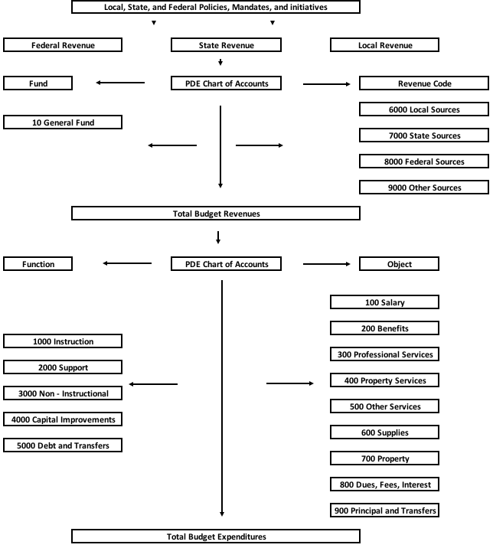
PA School Budget Flowchart
Revenue
Side
Expenditure
Side

Slide 5
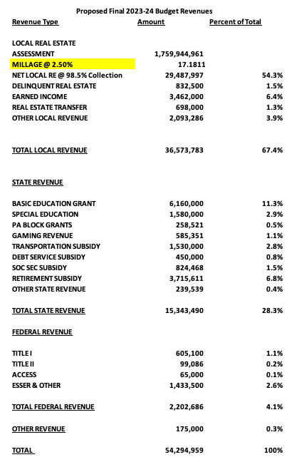

Slide 6
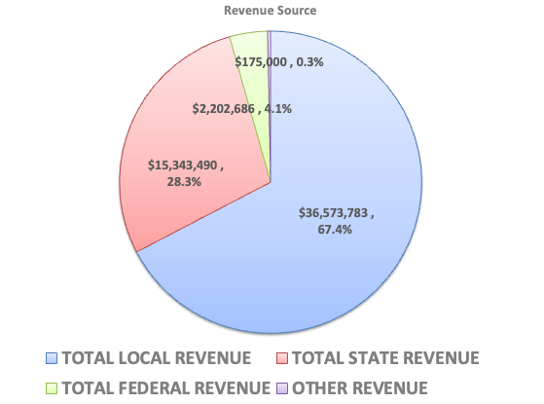

Slide 7
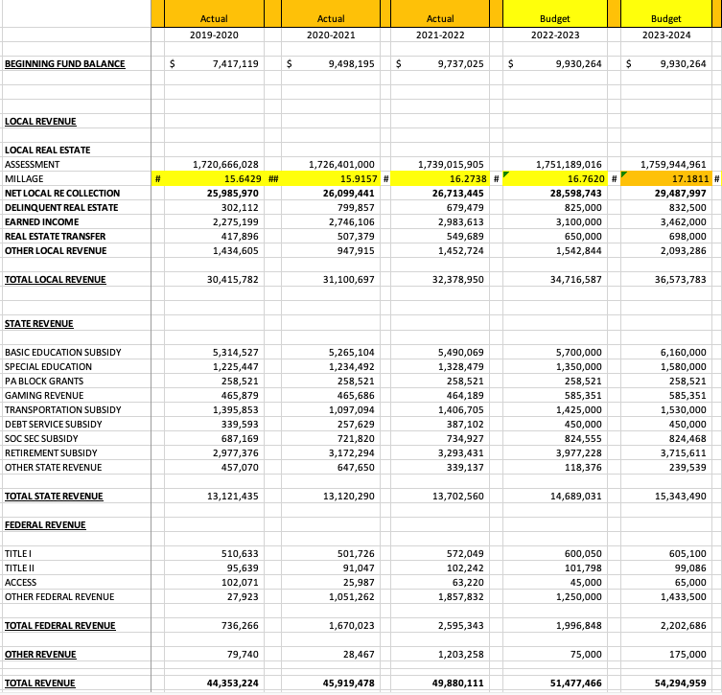
Five Years Revenues

Slide 8
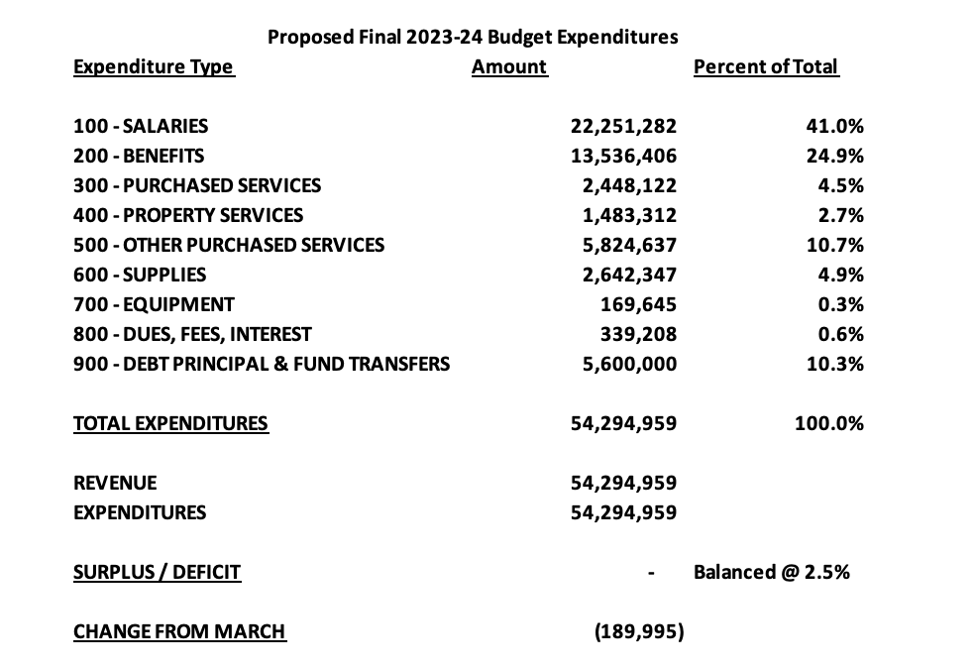

Slide 9
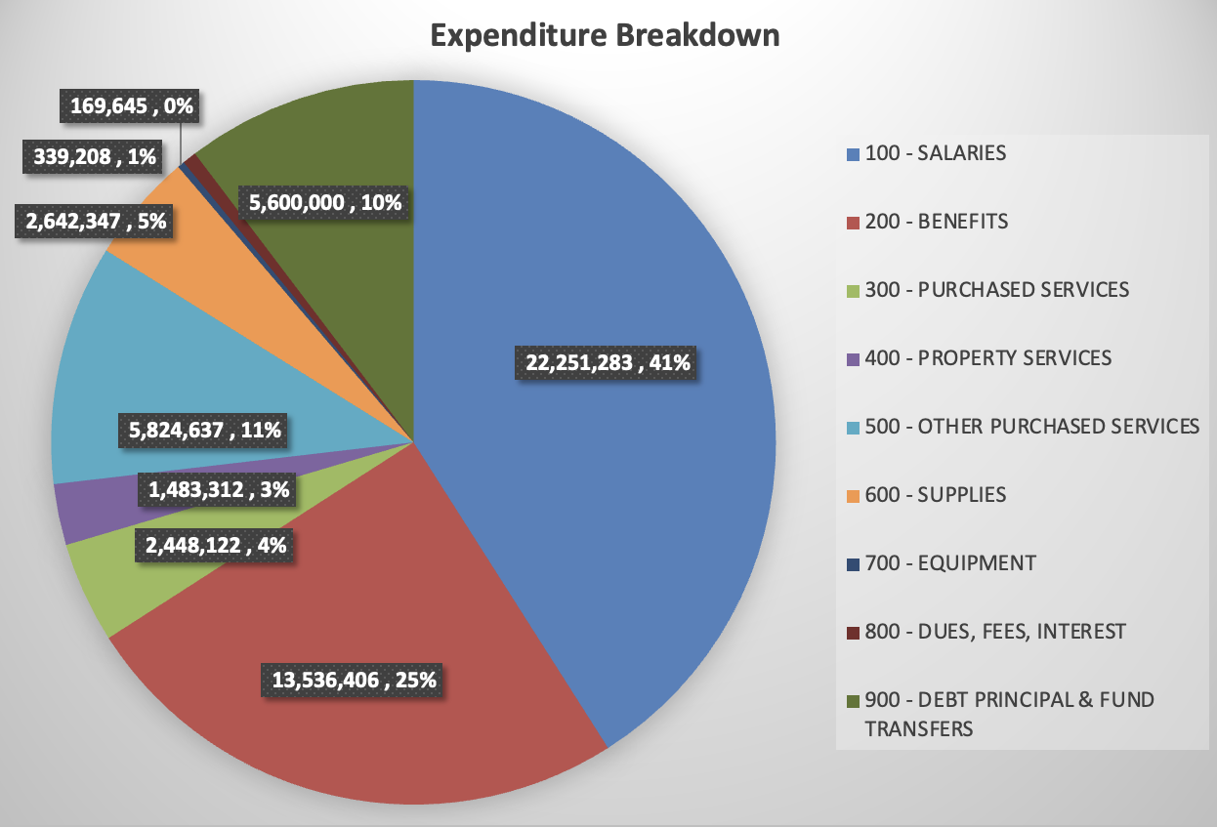

Slide 10
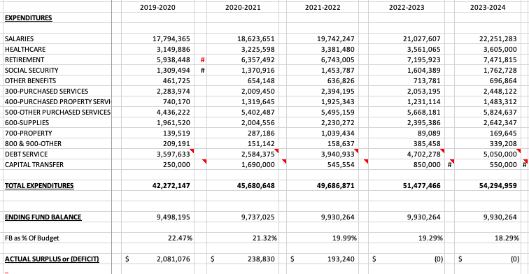
Five Years Expenditures

Slide 11
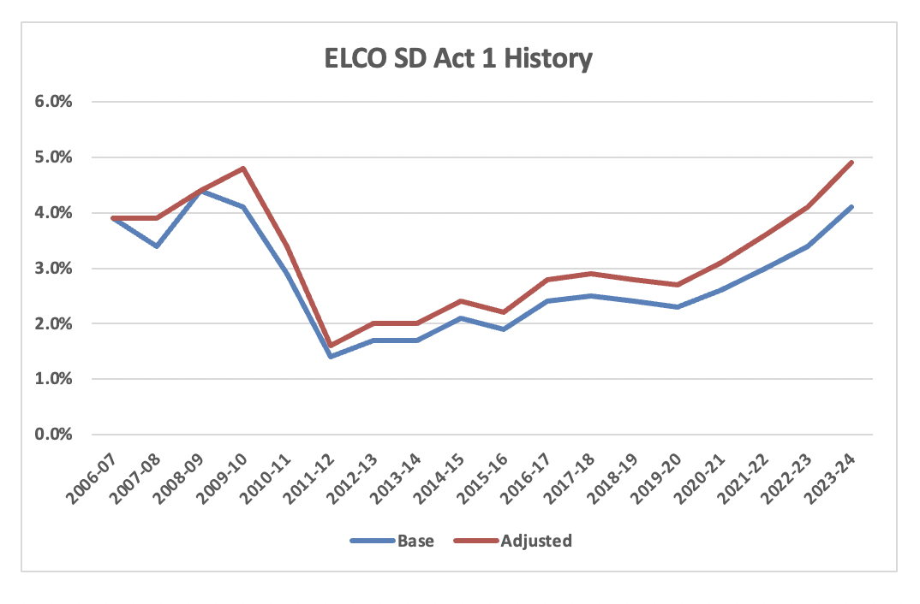

Slide 13
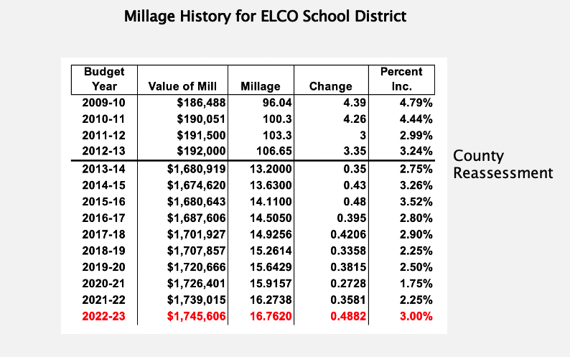

Slide 14
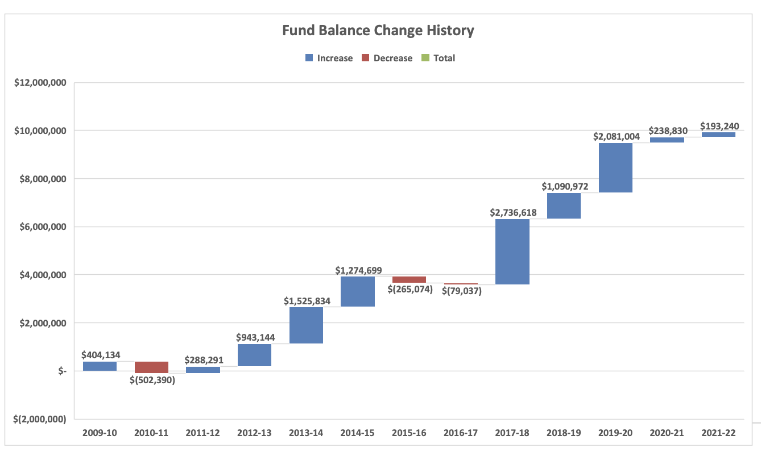
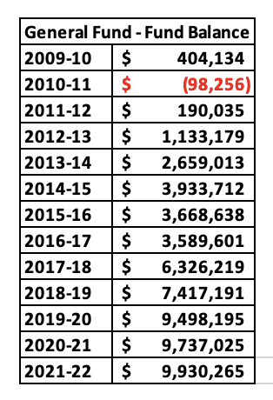
13 Year Fund Balance History for ELCO School District

Slide 15
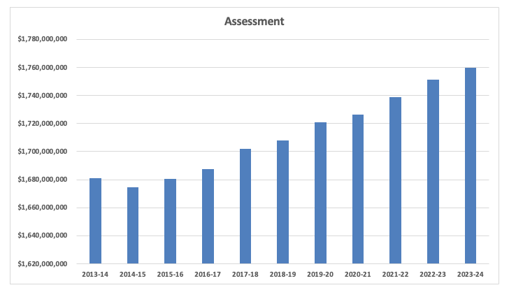
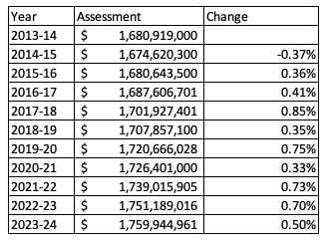
Assessment History for ELCO School District

Slide 16
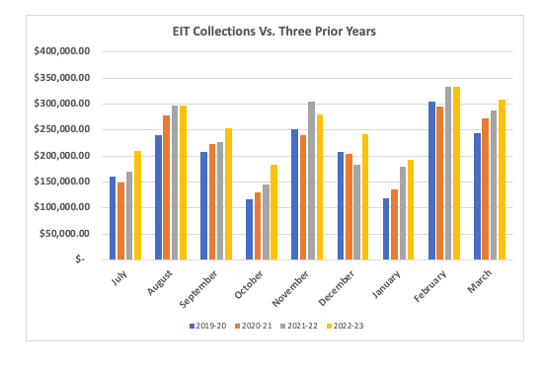
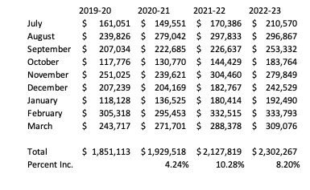
EIT Collections
By Budget Year
Encouraging for 2023-24 Budget

Slide 17
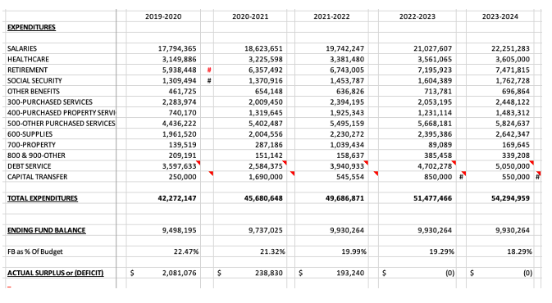
Fiscal Cliff Begins 2023-24 Budget

Slide 18
District Staffing Plan

Slide 20
Staffing Plan
2. Set Instructional Priorities = Strategic Plan Goals

Slide 21
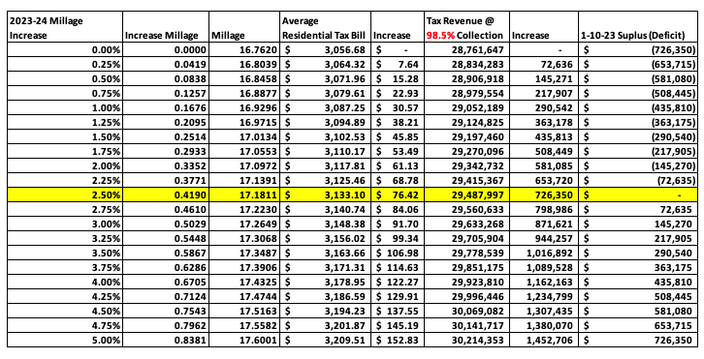
Tax Rate Menu Slide

Slide 22
Major Cost Drivers
Charter Schools
Salaries
PSERS
Healthcare
Debt

Slide 23
Charter Schools – Improving Trends
2022-23 budget was $1,425,000 for around 100 students
2023-24 budget set at $1,445,000
No Charter relief expected from Legislature

Slide 24
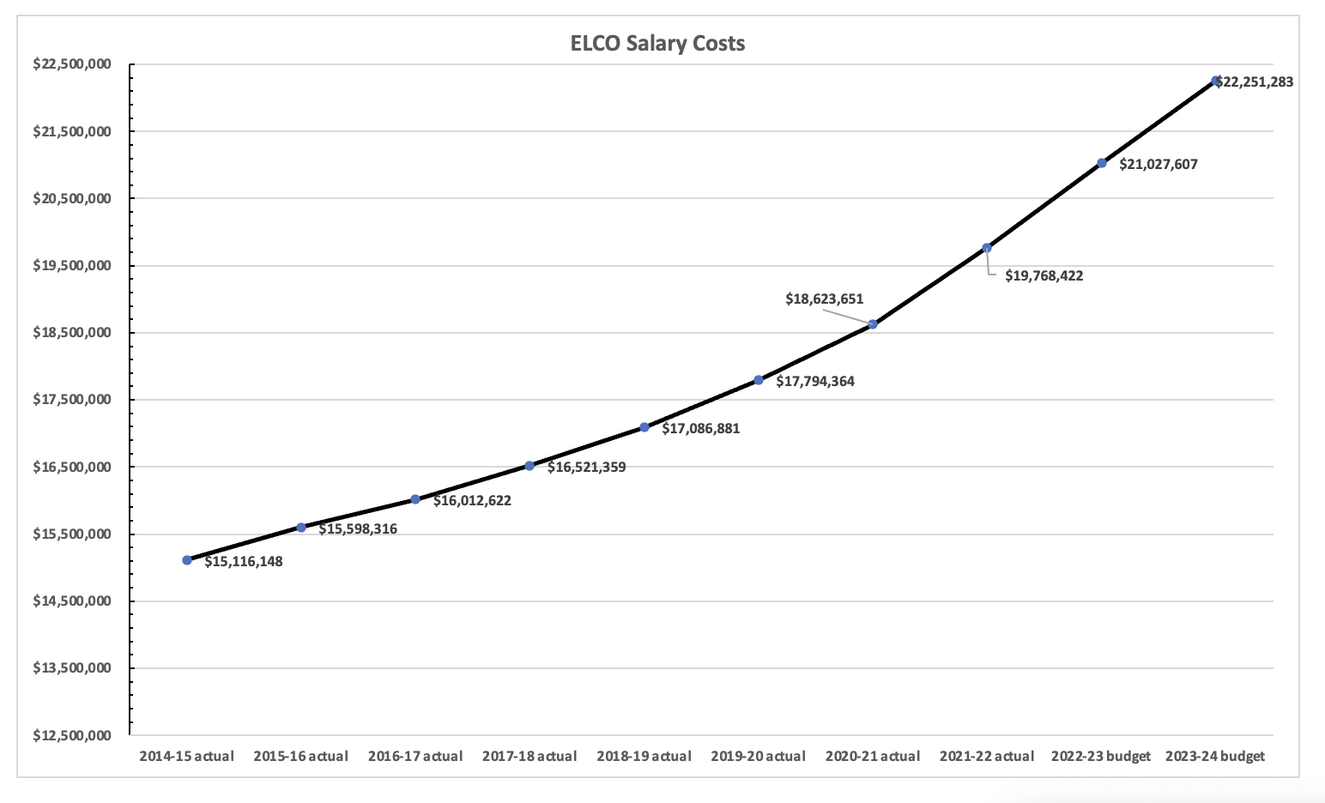

Slide 25
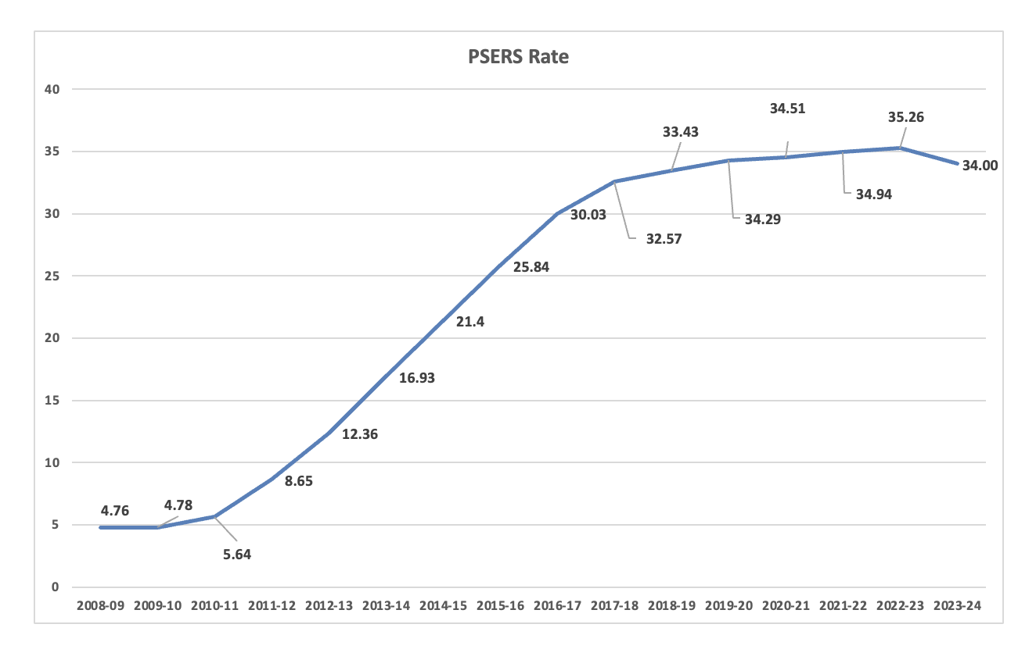
PSERS – Employer Rate
Past service debt makes up more than 80%
of the 2023-24 employer rate, would be 7-8%
without the unfunded liability
-PSERS

Slide 26
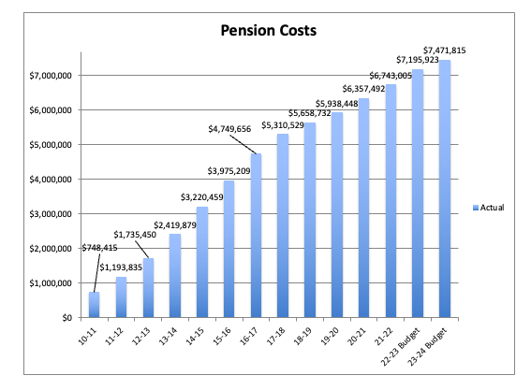
Retirement Cost History

Slide 27
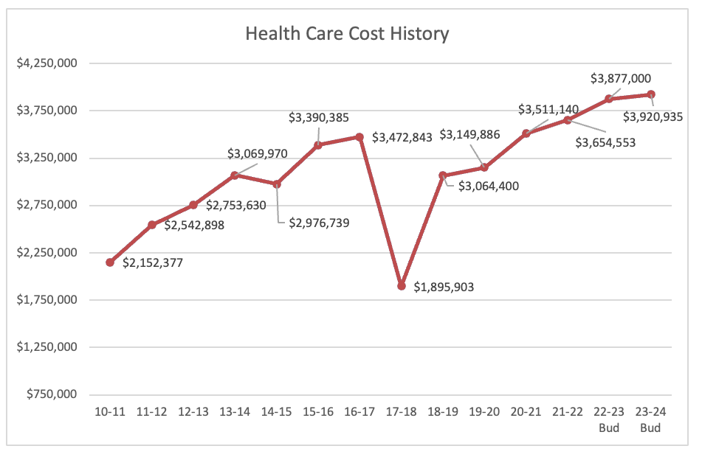
Health Care Cost History
US Employers expect health care costs to increase by 6.5% in 2022, according to the 2022 Global Medical Trends Survey by Willis Towers Watson (NASDAQ: WLTW).
Includes Dental and Vision

Slide 28
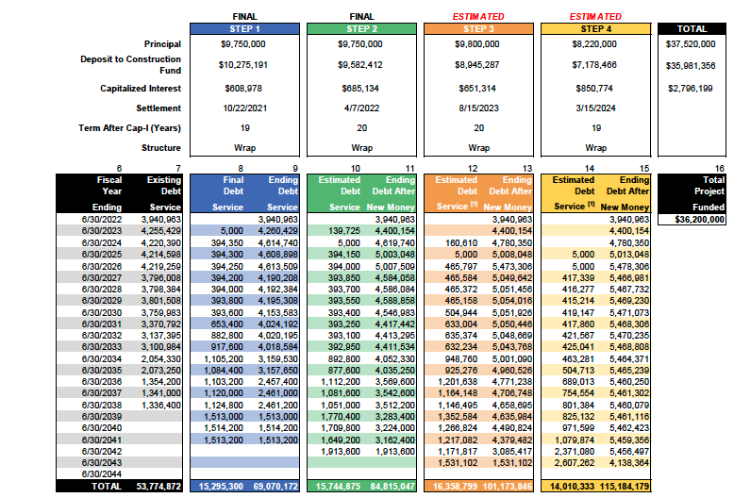
Debt Update – Principal & Interest

Slide 29
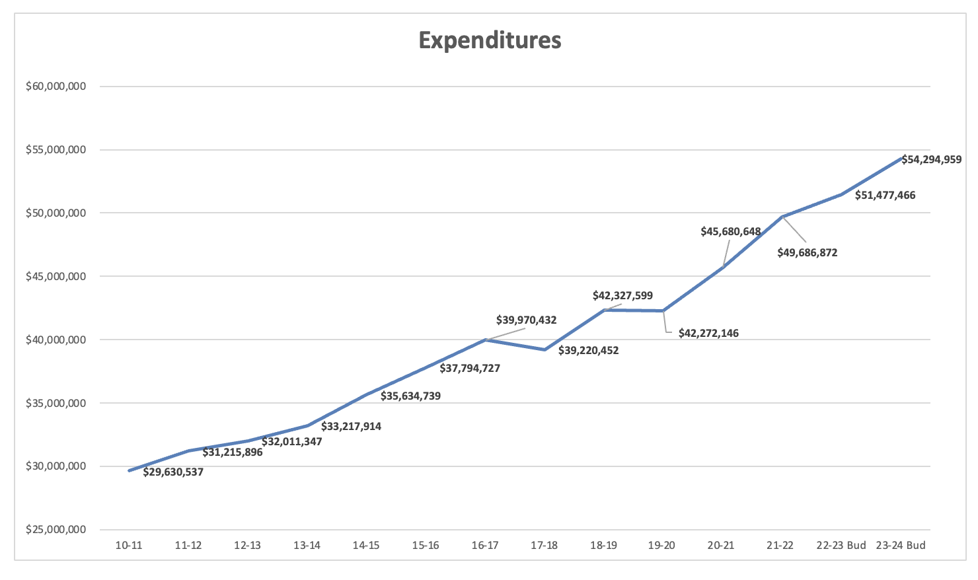
Total Expenditure History

Slide 30
Final Slide

