Slide 1
Cause and Effect p. 197-205, Common Places “The Butterfly Circus”

Slide 2
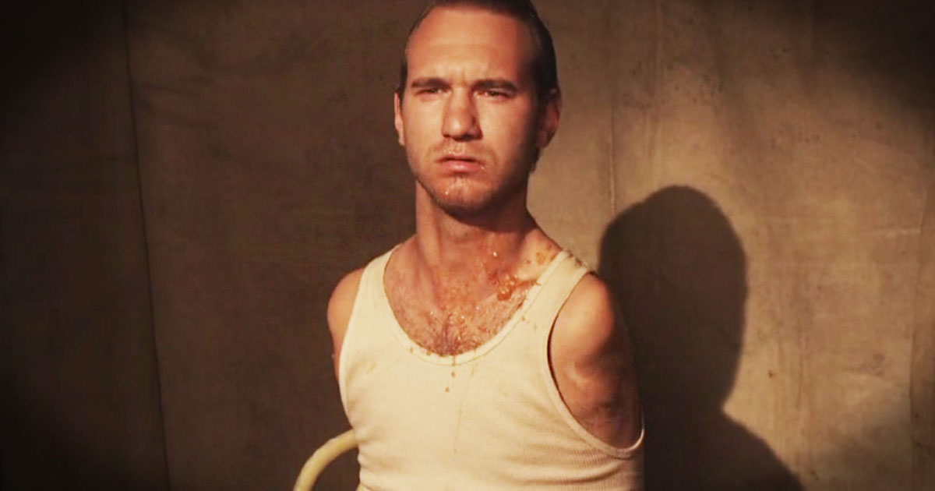
The Butterfly Circus Key Points in Cause and Effect
Will has been degraded by his current circus as a man “Cursed from Birth.”
Will Meets Mendez.
Mendez shows Will compassion.
This motivates Will to run away to the Butterfly
Circus (BC).
There, Will finds his people.
They treat him with respect and dignity.
No one feels sorry for him.
Will wants to find his act, but the BC refuses to have
a sideshow.
Mendez gives him a harsh pep talk.
Will asks for help crossing the river, but Mendez refuses.
Will learns he can get up by himself after falling.
Excited, Will then falls into the water and almost drowns.
Will learns he can swim.
Will find his act.
Will is now an inspiration and no longer a joke.

Slide 3
Cause
Effect
Cause
Cause
Several causes have the same effect.
A

Slide 4
Effect
Cause
Effect
Effect
B
One cause can have a number of effect.

Slide 5
Cause
Effect
Effect
Effect
In the domino effect, a cause can start a chain of events.
C

Slide 6
Key Words for the Cause and Effect Pattern p. 197, Common Places
These key words MUST be used in your Cause and Effect Essays (not all of them, of course).
as a result
at last
because of
cause
consequently
effect
for that reason
if…then
since
so
therefore
thus
Example: Mendez showed Will compassion. As a result, Will ran away to join Mendez’s circus.
Example: Will had always been mistreated as a freak in a sideshow. For that reason, he did not know how to react when Mendez showed him kindness, and Will spit in his face.
When Will learned he could swim, he found his act at last.

Slide 7
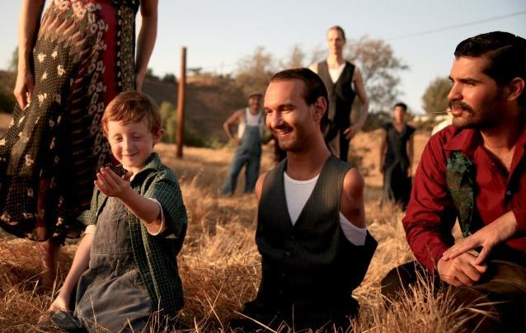
Criteria and Instructions for this Writing Opportunity: The Butterfly Circus Cause and Effect Essay
In a paragraph of 400-500 words, identify and explain a cause and effect relationship from the short film, The Butterfly Circus.

Slide 8
Introduction:
Give us a brief summary or background of
The Butterfly Circus film. The reader needs to
know basic information including plot and
major characters before they can go on the
journey. If you just start out about how Will ran
away, nobody will understand what that even
means unless they read about Will and his situation in this Introduction.
After the background, you slowly start angling toward your cause and effect thesis statement based on whatever CAUSE AND EFFECT MODEL you chose.
Thesis Example: Because people mistreated Will at the Freak Show, he ran away to join The Butterfly Circus, he was respected there, and he discovered he was more than just a limbless man.

Slide 9
Body 1, Body 2, and Body 3 Thesis Example: Because people mistreated Will at the Freak Show, he ran away to join The Butterfly Circus, he was respected there, and he discovered he was more than just a limbless man.
Body 1:
Explore your first point: Show us how Will was mistreated. What happened to him at his old circus? Then discuss how this treatment impacted him to do something about it—the beginning of cause and effect in is life. Transition into Body 2’s idea:
Body 2:
Show the places in the film where Will was shown respect by his new companions even when it meant they weren’t going to overprotect him even though he was limbless. Transition to Body 3’s idea:
Body 3:
Talk about how he struggled to belong at first. Talk about how nobody pitied him. Talk about how he wanted desperately to find his act. Show us how almost drowning led him to learn he could swim thus finding his act and becoming an inspiration to others instead of a joke. Close Body 3.

Slide 10
Conclusion
Remember, the conclusion simply reviews and closes.
Remember, this is not a summary of the movie. The rules of Cause and Effect are very clear.
Yes, you may google the movie if you need a little help with things like character names, plot, etc., but you should NOT plagiarize from these Web sites. If Blackboard detects any plagiarism, your paper will be given a zero.
See sample Cause and Effect essay on p. 200 of Common Places: “Sit with us.”

Slide 11
Due Dates:
The essay is due both to Blackboard and in your packets by the start of class on: _______________
Only your FINAL DRAFT will be uploaded to Blackboard.
Packets must include:
Final Draft
Draft with penciled self-revisions
Your Cause and Effect Model (p. 199)
Pre-writing/Brainstorming ideas (can be done on same page as Cause and Effect Model)
Grammarly Report
Please go to the Writing Center or come see me for help or with questions

