Slide 1
HB5 College Prep Course MyOpenMath

Slide 2
Signing Up for MyOpenMath.com
Notes:
Please note, it takes a few days to be verified. Take that into account when setting up your course.

Slide 3
Signing Up for MyOpenMath

Slide 4
Signing Up for MyOpenMath
Select…
Provide a website
Send an email
Upload a school ID

Slide 5
Signing Up for MyOpenMath

Slide 6
Copying HB5 Course Shell

Slide 7
Copying HB5 Course Shell

Slide 8
Copying HB5 Course Shell
Enter course ID: 76384

Slide 9
Copying HB5 Course Shell
Enrollment key: Math

Slide 10
Copying HB5 Course Shell
Optional: Enrollment key protects your course by only allowing those with the key to enroll into your course. When students register for your course they will be asked for the course ID and enrollment key if you created one.

Slide 11
Copying HB5 Course Shell
Don’t forget to make the course available to students by checking the box.

Slide 12
Copying HB5 Course Shell

Slide 13
Accessing HB5 Course

Slide 14
Setting Up HB5 Course
Use the gear to change view date and other settings.
Notes:
You can switch between views.
Don’t forget to change view and due dates on all items. Use the gear to get to Settings.

Slide 15
Setting Up HB5 Course
To add your syllabus, click “Add An Item…” Then, “Add Inline Text.”
Use the Attachment feature to upload your document.

Slide 16
HB5 Course Set Up
Check availability dates.
Notes:
Student Course Overview goes through the steps needed to complete the course content.
Notebook matches the newest version that goes along with the OER textbook.

Slide 17
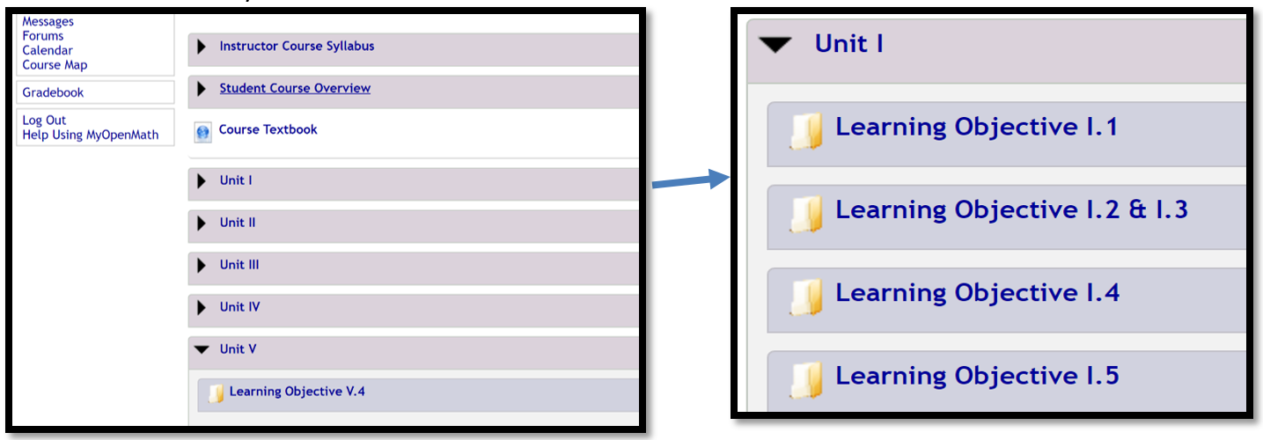
HB5 Course Set Up
Notes:
Each Unit and Learning Objective matches the OER Student Notebook and Frameworks Student Learning Objectives.

Slide 18
HB5 Course Set Up

Slide 19
HB5 Course Set Up
Use the gear to view all assignment settings.
Notes:
Don’t forget to update homework dates and other settings.

