Slide 1

Texas

Slide 2
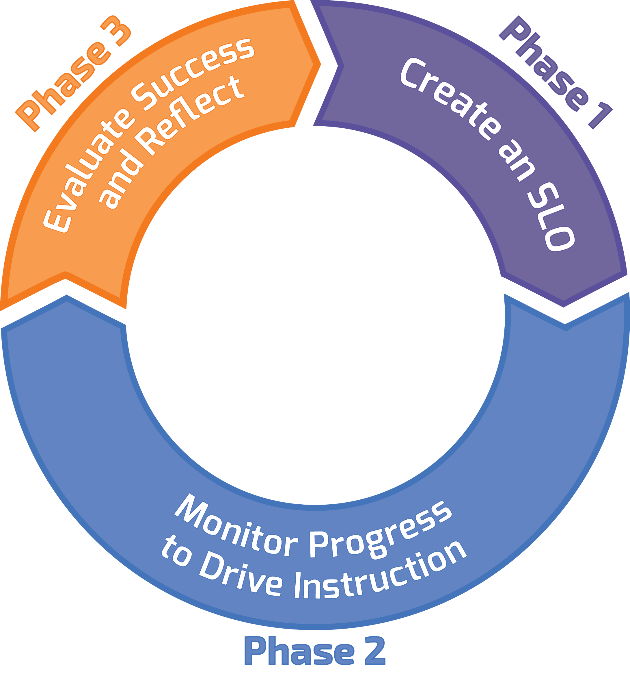
Three Phase Process
Notes:
“This is how the thinking about the SLO process is organized. The beginning is crafting an SLO and where most of the creation and work on the actual SLO is captured. Then you move into monitoring and adjusting instruction, and finally, reflecting on outcomes. What is learned in this cycle plays into how one might adjust instruction and SLOs in the future.
The proportions in the diagram are intentional – most of the time should be spent on monitoring progress and drive improvement in instruction.
Of the Big 6 questions – 4 will occur in the first phase. So – there is some front loading of work here – but it is a continuous process – it does not end once the SLO is written.”
Click to next slide…

Slide 3
SLOs are...
A means to teacher growth (reflect, assess,
adjust, and develop over time)
A concentrated look at instructional impact on student learning
Focused on one foundational skill in one subject area with one class
A way to inform potential instructional goals in a teacher’s GSPD plans
Evidence-based
Notes:
“SLOs are about a teacher’s instructional growth – focusing on supporting teachers in their development of deliberate, evidence-based thinking as they plan and deliver instruction, monitor and assess learning, and adjust and refine practice to meet the learning needs of the actual students in their classrooms.”
“In order to promote that teacher growth, the SLO process allows for teachers to take a concentrated look at their instructional impact through a foundational skill and allows the teacher to reflect on their decisions and their effectiveness while still allowing for adjustments for an improved student outcome.”
“The value of the SLO process is the distilled focus it allows so that teachers and appraisers can filter through the otherwise noisy school year to really hone in on the teacher’s choices and practice. Trying to draw conclusions about practice when wrestling with an entire course worth of learning can be very difficult. Using the foundational skill as the lens really helps both the teacher and appraiser discuss and reflect on what worked and didn’t work, with results that feed into the teacher’s growth and development.”
“SLOs are evidence based and this is intended to be a counterpoint to the previous slide that says SLOs are not mathematical or mathematically precise. While that’s true, the impression that determinations in SLOs (where students are, where they should be, where they actually land, etc.) are willy-nilly is also not a true statement. The entire point of all of this is to develop more thoughtful, deliberate, and evidenced-based approach to teaching.
Although SLOs deal with estimation and aren’t designed to come up with a magical growth number or teacher effectiveness number, they are certainly evidence-based in that teachers are constantly pointing to evidence to justify their rational decisions.”
Click to next slide…

Slide 4
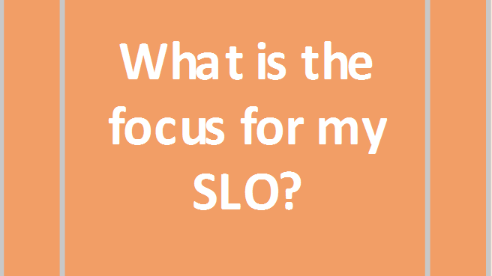
Notes:
“Let’s start with step 1. What is the focus for my SLO?”
Click to next slide…

Slide 5
SLO Skill Statement
The skill statement is a description of what students should be able to do with the foundational skill by the end of the course/year.
It is about your personal teaching growth.
Notes:
“The first thing we do in the SLO process is to determine our focus for the SLO. The Skill Statement is a description of what students should be able to do with the foundational skill by the end of the course/year.”
Click to next slide…

Slide 6

Probing Question
Notes
Pg. 2
What is the difference between a foundational skill and TEKS?
Notes:
Notes & Reflections: Page 2 BOTTOM
“Take 1 minute to reflect on this questions silent and solo. Then we will prompt you to talk with your table.”
After silent solo time:
“Now take 1 ½ to share your thoughts with your group.”
Debrief the conversation with the group.
See next slide the next slide to lock in the answers for the characteristics of foundational skills.
Click to next slide…

Slide 7
Foundational Skills
Are the most important skills students develop in the course.
Can impact not just this course but other courses both this year and beyond.
Persist throughout the course.
Will be found in multiple TEKS.
Notes:
“Here is what we came up with as the characteristics of foundational skills for the SLO process. ”
Make sure to acknowledge which ones the participants hit themselves and then highlight any characteristics that weren’t mentioned in the debrief.
Click to next slide…

Slide 8
The foundational skill focus should represent a balance between being valuable for teacher growth and being important for students both in the current course but in other courses beyond this year.
If there are multiple, competing skills that appear to be equally important, teachers should consider which of those foundational skills they feel they teach less effectively.

Slide 9

Foundational Skills
analyzing text
communicating ideas
using multiple representations
developing vocabulary
comprehending & connecting text
formulating questions & hypotheses
Notes:
The action verb anchors the “what” to the “how” as teachers consider the SLO Skill Focus Statement.

Slide 10
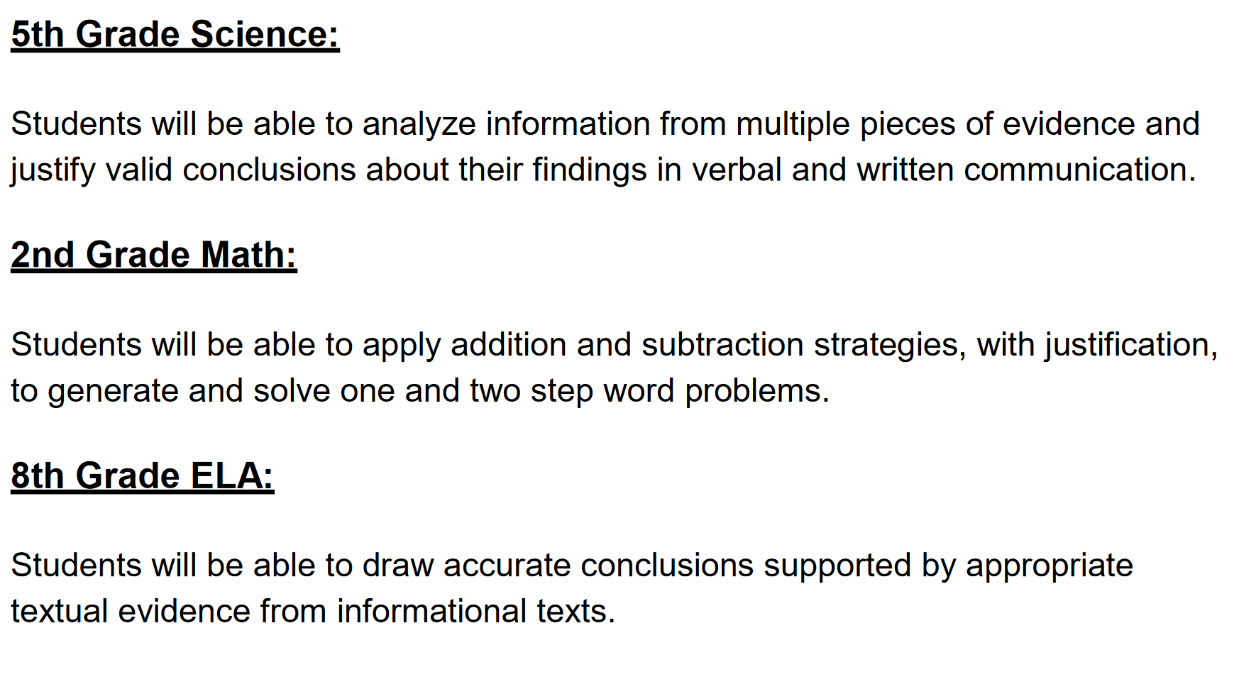

Slide 11
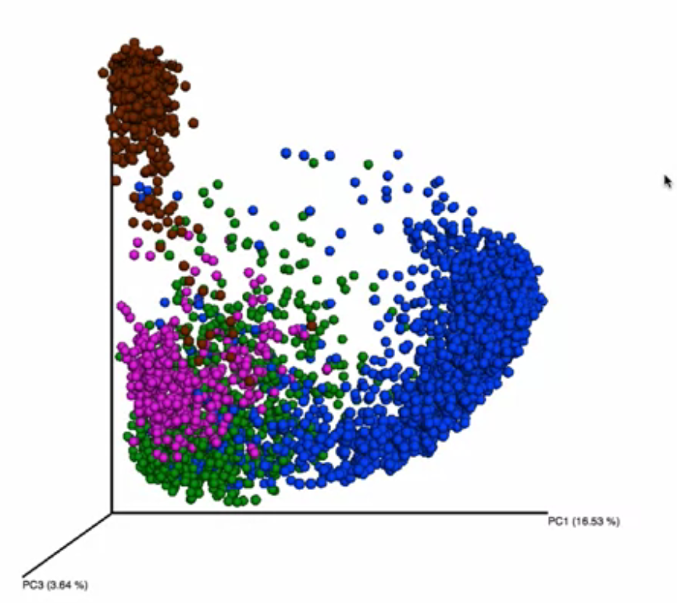
SLO examplars…
Students will analyze text using academic language to communicate verbally or in writing to communicate their strategies in problem solving.
Students will practice using scientific terminology to improve problem solving and context clues skills.
Students will be able to use perspective properly in an artistic drawing.
Is your SLO…
meaningful?
manageable?
measurable?
Notes:
This slide shows examples of SLOs that we analyzed to answer the question, “Is your SLO meaningful? manageable? measurable?

Slide 12
SLO Skill Statement Success Criteria
Manual
Pg. 29
1) Represents a foundational skill that is specific to the content area
2) Persists throughout the course
3) Measurable through a demonstration of student skill
4) Focus on it will improve the teacher’s practice (teacher dependent)
5) The skills captured are clearly defined and appropriately focused (teacher dependent)
Notes:
Manual: Page 29
Make sure to acknowledge which ones the participants hit themselves and then highlight any criteria that weren’t mentioned in the debrief.
“We want to spend a little time on #4 and #5 and the concept of ‘teacher dependent’. This is a phrase that we’ll see throughout the training today, and it signals that for a particular success criteria, whether or not it is met is going to depend on the teacher and his or her context.
When it comes to teacher practice, the focus on one particular foundational skill may be very beneficial for one teacher and much less beneficial for another. It depends on that individual teacher’s strengths and struggles in teaching the skill in question.
When it comes to a clear focus, it really depends on a teacher’s ability to unpack his or her view of what the statement is truly capturing. If a teacher is able to clearly explain and make a compelling case for a statement, regardless of how simplistic or complex it may read, then that would likely be a good skill statement for that teacher. Conversely, if a statement seems very clear on its face but the teacher is unable to explain key parts of the statement, then the focus may need more attention.”
If participants are uncertain about “teacher dependent”, let them know that we’ll come back to this with concrete examples during practice, which begins on the next slide.
Click to next slide…

Slide 13
SLO Skill Focus Statement
Students will show steady growth in oral reading fluency in appropriately leveled text.
Estela | Rheala | Fatima | Martha
fluency experiences | phonics | phonics | vowel digraphs
timed passages buddy reading | direct instruction centers intervention | reading with expression | games poems Johnny Can Spell
phonics | spelling | modeling read-alouds | building background
writing | speaking | comprehension | vocabulary
Notes:
This example shows how Grade 2 teachers shared the unique needs of their individual classes during a PLC anchored to the SLO Skill Focus Statement they determined as a common focus.
The “red” highlights the area and specifics teachers landed on for their SLO work content & pedagogy).

Slide 14


Thinking about my SLO with a partner discuss how the statement stacks up to the success criteria.

Slide 15
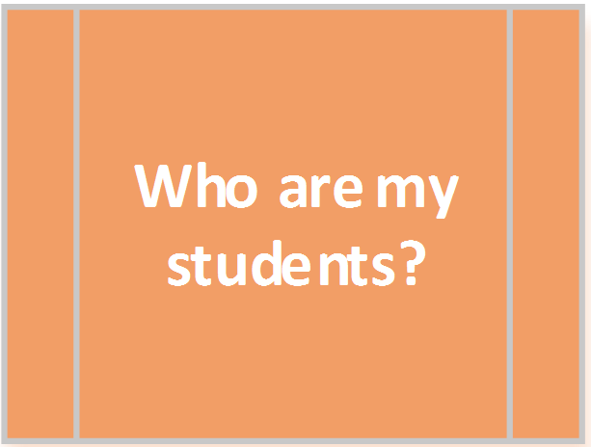
Notes:
“Now moving on to Step 2 and our next question: Who are my students?”

Slide 16
Initial Skill Profile
An Initial Skill Profile (ISP) captures:
Where students are in relation to the skill statement at the beginning of the course
The different levels of student skill
What is “typical” for the teacher’s classroom
Notes:
“The Initial Skill Profile is the tool teachers will use to capture the range of student skills they expect to see as students begin the course. As this last bullet indicates, the Initial Skill Profile is about what the teacher expects to see based on the teacher’s experience.
What one teacher typically sees with beginning of the year student skill in her classroom isn’t necessarily the same as another teacher typically sees. Student background knowledge and skill varies from hallway to hallway and campus to campus, and the Initial Skill Profile is intended to capture a teacher’s unique context.”

Slide 17
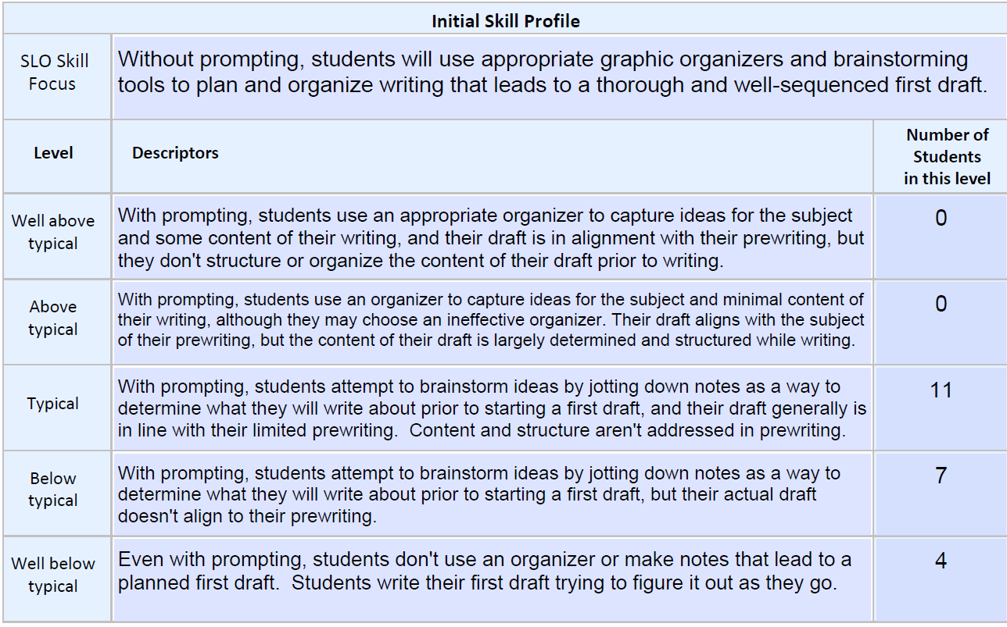
ISP Structure
Manual
Pp. 5
2
4
1
5
3
Notes:
“This is where the teacher builds out the Initial Skill Profile (ISP). The teacher is separating out the 5 levels of students based on where they think the students will be.
The 5 levels include Well Below Typical, Below Typical, Typical, Above Typical, and Well Above Typical. It is important to understand that Typical in this process means who typically walks in the room. The skill set of a typical student in an AP class may be vastly different than a student in a regular class, however “typical” would be used to describe what the typical skill level of the student walking into your classroom.
So for the ISP, the teacher would ask: What do you ASSUME your students can do as it relates to the SLO skill statement itself?
The goal here is to describe typical students, high performing students, and low performing students as they are likely to appear on the first day of class. The teacher wants to describe what he or she expects the skill levels would look like of these students.
What do you think they will they be able to do as it relates to your SLO statement? What skills to do you think they will possess? What level of learning are they bringing?
The issue of new teachers will undoubtedly arise. Two suggestions here: 1. Review TEKS from EOY previous grade – these should indicate what should students know and be able to do in the area of focus, and 2) Ask other teachers.”
Just a note for presenters: Sometimes those folks who are rubric driven get caught up in thinking that it should be the same at the beginning of the year and the end of the year. If that should happen just remind them of the purpose of the ISP. The purpose is to describe the skills they think students will have prior to ever being taught by the teacher.

Slide 18
Success Criteria
Manual
Pg. 29
1) Articulates skills for the beginning of the year
2) Differentiates between levels
3) Descriptors align to skill statement (potentially through subskills)
4) Can be assessed through in multiple ways
5) Specific to the teacher’s experience and expectations (teacher dependent)
Notes:
Make sure to acknowledge which ones the participants hit themselves and then highlight any criteria that weren’t mentioned in the debrief.
“For #5, remember that the ISP is about what the teacher expects to see in his or her classroom. This means that, like with the teacher dependent success criteria in the skill statement, an appraiser will need to determine if the teacher’s ISP is about right based on that teacher’s experience and expectations.”

Slide 19
ISP Practice
Work with a partner to review what you wrote down:
Descriptions for your 5 levels.
Use the success criteria and the exemplar ISPs to help you.
Notes:
Notes & Reflections: Page 4 BOTTOM
Manual: Pages 5-10
See below for sample responses to potential gaps for ISPs 1-2.
Directions:
Using the Non-Exemplar ISP Examples (Page 5- 10 of the Teacher Orientation Manual), have participants read through the first 2 ISPs. For this practice session, assign one ISP to each table group. Read the directions from the slide.
Give participants approximately 3 minutes total to identify gaps.
Have light whole-group share out (one share out for each ISP) lasting no more than 2 minutes.
Sample Gaps:
7th grade science – differentiation between levels (below typical and well below seems like a massive drop); alignment to skill statement (graphic displays not present – is that intentional?)
Culinary arts – alignment to skill statement (why are STAAR results pertinent?); differentiation (well above and above seem like a large leap; typical seems like it could be higher level than above typical).

Slide 20
Who are my students?
There are two different parts in this section in order to clarify:
  What I expect or assume my students will be able to do with this skill statement; and
  What my students are actually able to do
This ensures that we adjust our planning to fit the needs of the students we have, not the ones we thought we’d have.
Notes:
Now we are on the second part of this question. I have fleshed out what I think my students skills will be, it’s time that I see what my students can really do as it relates to my SLO.
This part of the process is testing to see if your initial assumptions are correct about what students can do. Classes vary from year to year. Essentially, here, you are testing out your assumptions. This ensures that when you are planning, it is with clarity about the kids in your class this year. Now that we have our ISP fleshed out, let’s see how we can effectively map our students to our ISP.”

Slide 21
Who are my students?
We collect data about our current students’ skill level in order to assess current level of learning and map to the Initial Skill Profile.
Notes:
“This begins the second part of Step 2. Now the teacher has created their ISP on the students who they think will be in their class. So now it is time to collect data so that they can actually map the students to their ISP based on where the students really are.
The ISP itself can be written prior to students arrival. Once that is fleshed out and the students arrive, it can take up to 3-4 weeks to really get to know students. This is where the teacher can use various types of data to determine the individual student skill level is again as it relates to the SLO skill statement.
This will likely be a mix of formal and informal data. The goal here is that teachers are already getting to know their students through many methods. SLOs are designed to complement that process not create extra assessments.
Caution - if teachers are using an assessment already created, remember that, although it may contain 30 question, only the questions related to the SLO would be viable to use.”
“Think about 2 different types of data you might use for the ISPs we just reviewed or for the last class you taught.”
THE KEY IS TO USE MULTIPLE DATA SOURCES
Suggestions might include:
Grade 7 math:
Early quizzes (only using the questions focused on the SLO or sub skills)
Having students explain the process or concept tied to the SLO
Exit tickets
Any diagnostic tests given by the school/district
Grade 6 STAAR results for CURRENT students ONLY IF results can be mapped specifically to the skill in question.
Grade 5 Art:
Early student work – perhaps giving a task that is directly tied to the issue of interest – here it is perspective
A vocabulary quiz using the words that the teacher has focused on in the SLO
Knowledge from previous experience with these students
HS Culinary Arts:
Survey of students’ experiences and interests
Early student work on a simple cooking task – perhaps assessed using a rubric similar to what would be used to judge the end product
STAAR results were on the ISP – but should they be? Do STAAR results tell you a student’s skill in culinary arts?

Slide 22
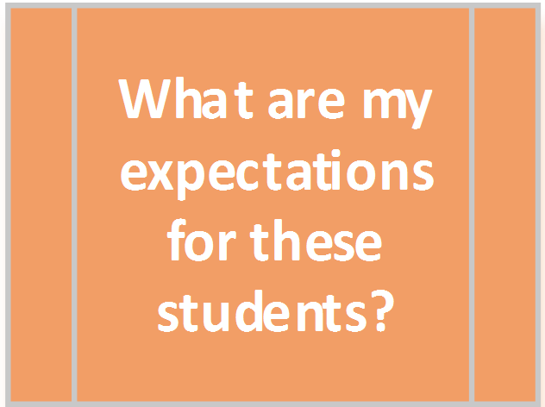
Notes:
“We are ready for Step 3. So far we have determined our focus for the year through our Skill Statement , looked at what skills we thought students would have in relation to our Skill Statement by writing our ISP, and then mapped where our students actually were in relation to the ISP. Now it’s time to decide where we think our students can go with this SLO.”

Slide 23
Targeted Skill Profiles (TSP)
The Initial Skill Profile (ISP) captures students as they arrive in your class prior to your instruction.
The Targeted Skill Profile (TSP) describes what you expect of students at the end of the SLO.
They are NOT the same.
Notes:
“There are big differences between the Initial Skill Profile and the Targeted Skill Profile. Teachers should not create a single profile and use it for both. This is a temptation many folks have – write it and just have students move up one level for growth.
The ISP is really about what students can do before ever really having any instruction from the teacher. That is the purpose it serves and essentially after you have used it and are ready to build your TSP, the ISP is no longer is important as it has fulfilled its purpose.
The TSP is designed to capture, now that you know these students, how far can they grow after a year of your instruction.
The skills students exhibit on day one should be different (as this would be prior to your instruction and given that the teaching will either build on a recursive skill or be brand new content) than they will be at the end.”

Slide 24
Targeted Skill Profiles
The Targeted Skill Profile captures where your students should be at the end of the SLO.
  Targeted Skill Profiles (TSP):
Are a means for considering long term goals for students
Are based on the distribution of skills seen in the students that you have in the class
Describe what skill level your students should display at the end of the course
Notes:
“This is the step where the teacher is going to build a Targeted Skill Profile (TSP). The teacher has spent 3-4 weeks getting to know their students. The teacher knows the students’ skills as it relates to the SLO statement and the teacher is really getting know the whole child…..how they have performed, their attendance record, how they learn and respond, etc. At this point, the teacher is able to say that: I can see how far I can push them after a year of my instruction.
While a TSP is similar in structure to your ISP, note that the purpose is completely different. The teacher uses an ISP to really find out who is in your classroom, a TSP is really the road map to growing all of your students.
And now -- as the teacher begins to think of how far they can take their class, the teacher would want to put at ‘typical’ – a description that would fit your goals for the largest group of students at the end of the year.
The teacher wants to build a TSP with the goal of a bell curve. This may seem counterintuitive to some – but the teacher should always have your highest and lowest students in addition where “most” students will land.
This allows for the teacher to push and grow students in a way that allows them to focus on the skills that they gain in an honest, realistic way while still pursuing those high expectations of all students without expecting all students to reach the same outcome level. If you have students who are two grade levels behind in performance – the profile should reflect that.
Similarly, if the teacher has students who are well above grade level – the skills selected and the skill profile should reflect a higher expectation of performance.
So the targeted student skill profile is based squarely on the students in the class. Based on where these students started, what are reasonable goals by the end of the year.
It is perfectly fine for someone to be rated Typical on the ISP and Typical on the TSP. It is still growth because the profiles are different—and the description would be of a higher, more sophisticated level of performance on the TSP.”

Slide 25
Success Criteria
Manual
Pg. 30
1) Articulates skills for the end of the year
2) Differentiates between levels
3) Descriptors align to skill statement
4) Can be assessed in multiple ways
5) Targets are specific to the students in the teacher’s class (teacher dependent)
6) Reflects high, yet reasonable, expectations for student growth (teacher dependent)
Notes:
“Here are the success criteria for a TSP.” Discuss how there is growth when being rated within the same descriptor (level)
Read the slide
“For #6, just like we’ve seen with other ‘teacher dependent’ success criteria throughout the day, high expectations for growth will be dependent on the teacher’s classroom. High expectations for a classroom that entered already with a high level of skill will not be the same as high expectations for a classroom that entered multiple years below grade level. High expectations must be present, but the end of year skills that reflect those high expectations will vary from classroom to classroom.”

Slide 26
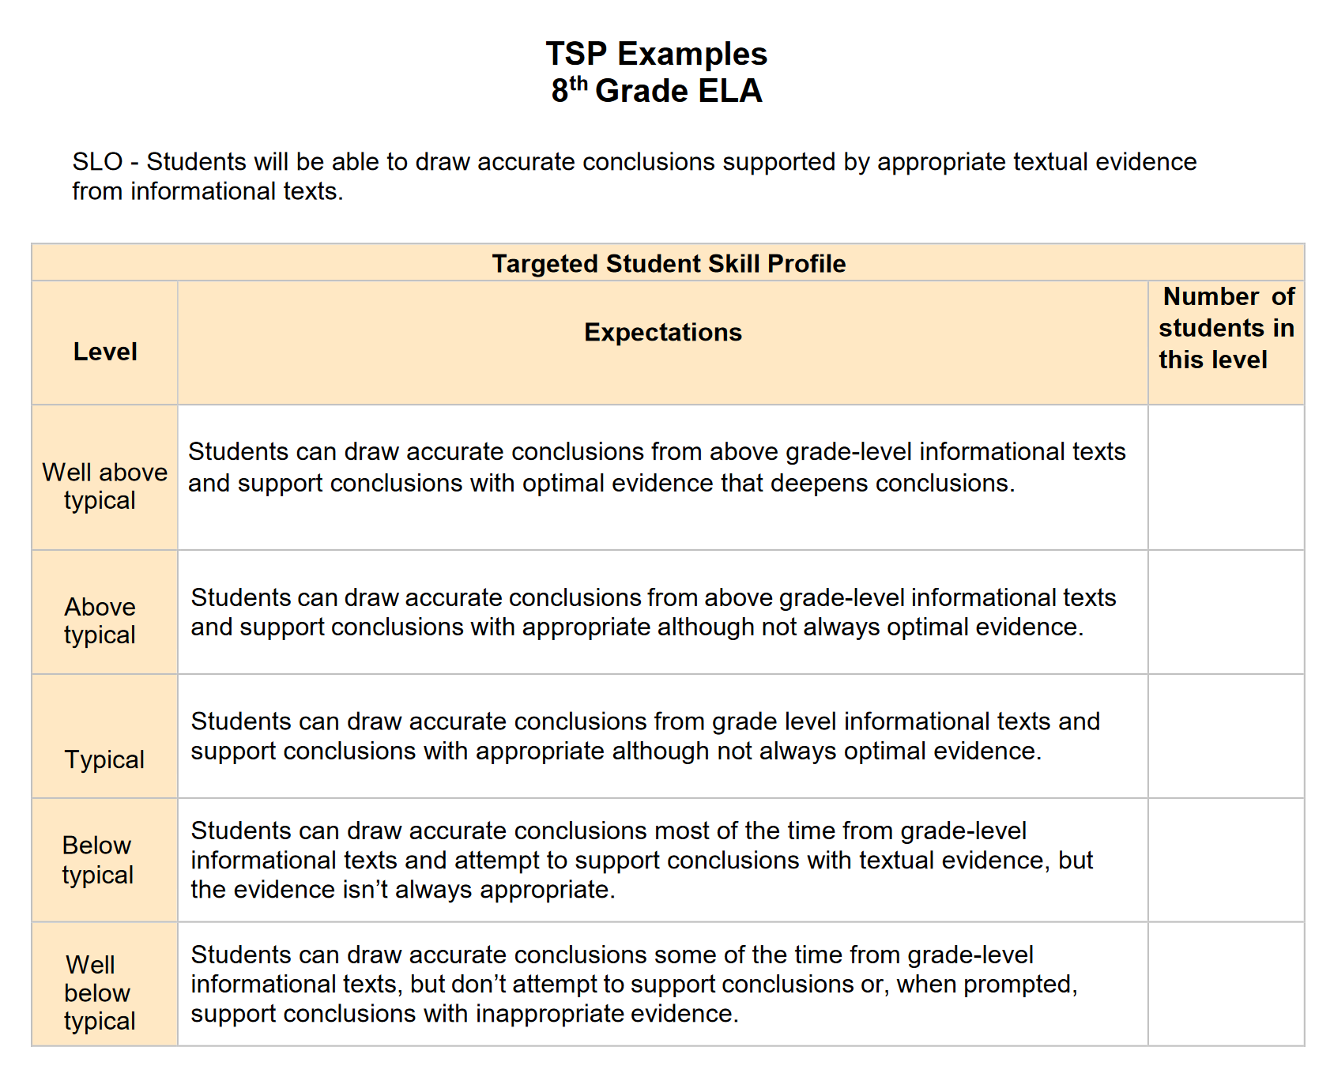

Slide 27
TSP Practice
Notes
Pg. 6
Manual
Pp. 13-14
Review your Target goals for students:
Are they high but reasonable goals for each of the 5 levels of students.
Use the success criteria to help you.
Notes:
Notes & Reflections: Page 6 TOP
Manual:
TSPs: Pages 13-14
ISPs (corresponding): Pages 7-10
See below for sample responses to potential gaps for TSPs 1-2.
Directions:
Using the Non-Exemplar TSP Examples (Page 11- 16 of the Teacher Orientation Manual), have participants read through the first 2 TSPs. For this practice session, assign one TSP to each table group. Note to participants that they will need to use the Improved ISPs in their materials for this exercise so that the issues with TSPs aren’t really about issues with flawed ISPs.
Read the directions from the slide.
Give participants approximately 3 minutes total to identify gaps.
Have light whole-group share out (one share out for each TSP) lasting no more than 2 minutes.
Sample Gaps:
7th grade science – reflects high expectation (does well below typical from ISP to TSP reflect reasonable growth?); differentiation (gap between below typical and well below typical seems large); assessable (how will the teacher reconcile all those subcomponents in the levels – how do you bring all of those together in measurement)
Culinary Arts – high expectations (well below seems like a very low bar at the end of the course); descriptors align to skill statement (table presentation pops in and out of the descriptors)

Slide 28
What are my expectations for these students? (Growth Plan)
Teachers will set an individual target for each student
Use status in the ISP plus other data (attendance, grades in related classes, learning designations, etc.) to determine expected level at the end of the course
Expectations should be high yet reasonable
Notes:
“After you have written the targets on the TSP, it is time to set individual targets for your students as to how far your think you can push them in relation to this skill.
Again, this is not a precise process – rather it is based on the your best judgment based on the knowledge gained on each student. Remember, it is NOT a subtraction problem. It is perfectly fine for a student to be typical on the initial with a goal of typical on the targeted.
Targets can and should be differentiated based on the student's present level of skill and other information that the teacher may have about student. This could include previous performance levels, information that would impact performance such as an IEP, attendance, motivation, etc.”

Slide 29
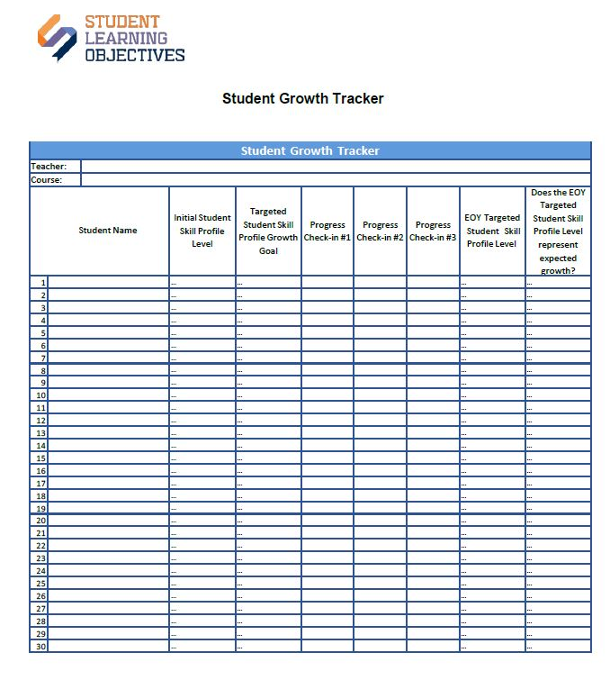
Student Growth Tracker
Notes:
Materials: Student Growth Tracker (Page 22 of the Teacher Orientation Manual)
“The Student Growth Tracker will be a place where the teacher and administrator can watch the data form over time. This can aide in discussions with teams and appraisers. It simply catches snapshots of progress for students at multiple points so trends can be seen and discussions about changes or flatlines can be had to determine the best course of action.”
Excel format worksheet
Enter student’s starting point on an individual basis
Record progress check-ins
Can add columns to this sheet if desired
Will return to record end-of-year level of learning
Key record to track progress

Slide 30
What are my expectations for these students?
Table discussion:
What should a teacher think about when planning for end-of-year SLO assessments?
The assessments are aligned in content and rigor with the skill statement
Multiple assessments are being used
Notes:
“We have now set individual targets for each student and now we have to figure out who will we know if they have gained these skills at the end of the year?
Alignment is the key. The goal is for teachers to talk and plan for how they determine what assessments may help them best see the application side of the SLO statement. Having the end in mind when planning and preparing for multiple data to capture progress will help teachers be intentional and thoughtful about checking for progress and the types of assessment that will be the most beneficial.”
“I want you to think of ways that these courses might best capture the focus of the valuable assessment throughout the year”
Examples could be:
High school choir – would need a rubric to assess performance at the concert. Might want to ask if the choir director can do that in real time as he or she is also directing the choir. It would be difficult. Could have multiple raters (possibly colleagues from other schools); they could trade off. Or there might be a need to record the performance.
Kindergarten – phonemic awareness; there are many vendor-based assessments such as DIBELS and PALS that measure this. They are usually used as screening devices, so district would have to determine if that was possible. What is “that” here? If using them is possible? Please clarify.
MS PE - they might use a fitnessgram, which is a nationally developed assessment with age level norms. Or the teacher could develop a measure of their own based on specific skills of focus. For example, if they were teaching gymnastics and fitness via ability to perform various routines, there could be a rubric to assess performance levels.

Slide 31

Notes:
“Now we are ready to move into our 4th step. How will I guide these students toward growth?”

Slide 32
Probing Question
Notes
Pg. 6
The teacher knows:
Where the students started
Where the students should finish
How to determine if they got there
How will teachers guide these students toward growth?
Notes:
Notes & Reflections: Page 6 BOTTOM
“If we know where the students started, where they should end and how you will measure it. What do you still need to focus on in this process? “
Let the group talk for 1 minute and then share out.
“We want to think about how we can guide them to that end. Our teachers should have an idea of how they approach guiding students and some of the things they should think through when planning.”

Slide 33
Planning for Growth
Teachers should be ready to discuss:
How do you differentiate instruction?
How will you monitor progress?
How will you collaborate with colleagues?
Notes:
“This may not be comprehensive list, but we want to make sure that teachers do these things and are actively thinking about the supports that need to be in place to help address the varying needs of their students and plan for monitoring the progress of students to help inform what instructional practices are or aren’t working.
Talking with colleagues is something that needs to be planned and counted on for their own learning. These are important parts of the process that should be discussed. Teachers don’t need to write down a plan differentiating for the entire year, but rather have thoughtful reflections to share regarding their approach.”

Slide 34
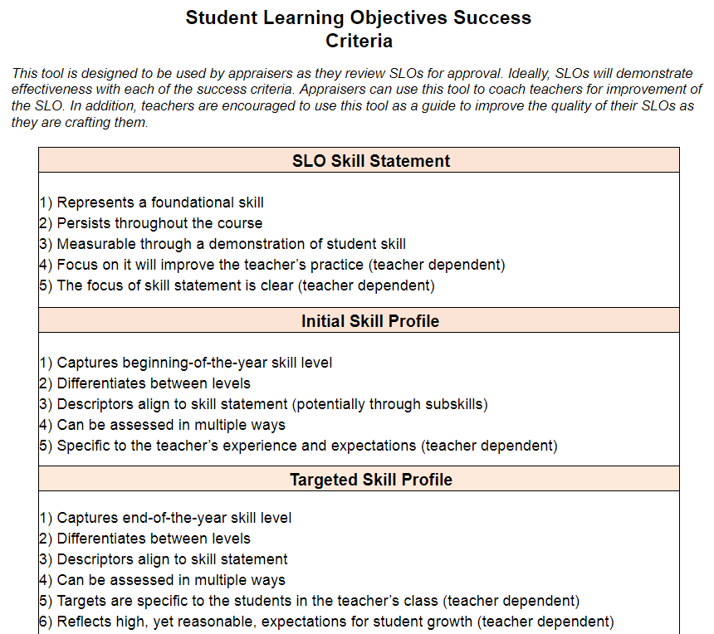
Review Success Criteria Document
Notes:
“This tool captures the Success Criteria we’ve already listed out throughout the day. Teachers and appraisers can use this tool as they work through crafting and providing feedback to SLOs.”
Give participants a minute to look over the tool. (Page 29 of the Teacher Orientation Manual)

Slide 35
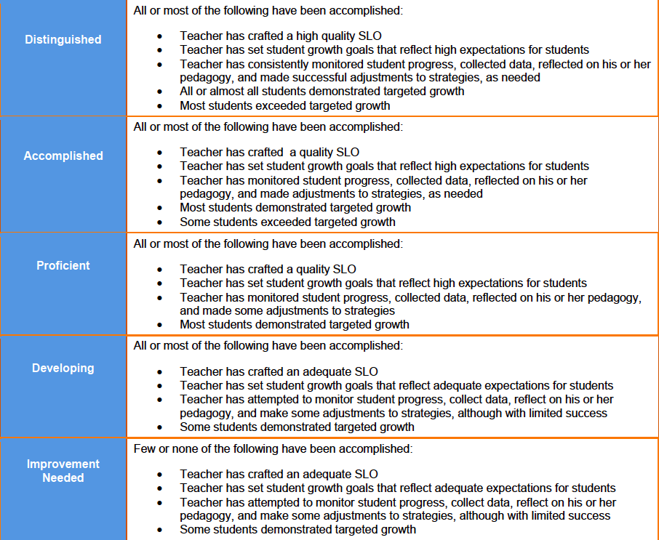
Review SLO with appraiser for approval
SLO Rating Rubric
Notes:
Walk participants through the SLO rubric. (Page 30 of the Teacher Orientation Manual)
“In your book behind the forms you will see the SLO Rating Rubric. This rubric is designed to apply holistic scoring that uses a “preponderance of evidence” standard similar to what is used in T-TESS.
A majority of the criteria are based on teacher behavior because:
Administrators want to incentivize teacher engagement in the process…remember the process is the value and the rating is the least important part.
Teacher behaviors captured are those behaviors that should lead to growth - focus on the fundamentals (practice), the results (growth) take care of themselves.
Preponderance of evidence allows the appraiser to apply context to rating. For example, half of the students don’t hit growth targets, but that’s because the teacher set targets that were too lofty. That’s okay - we’d rather have high goals that aren’t reached than low goals that are (it’s about pushing students). In that instance, the appraiser wouldn’t need to overly penalize the teacher for students not reaching growth targets.”

Slide 36
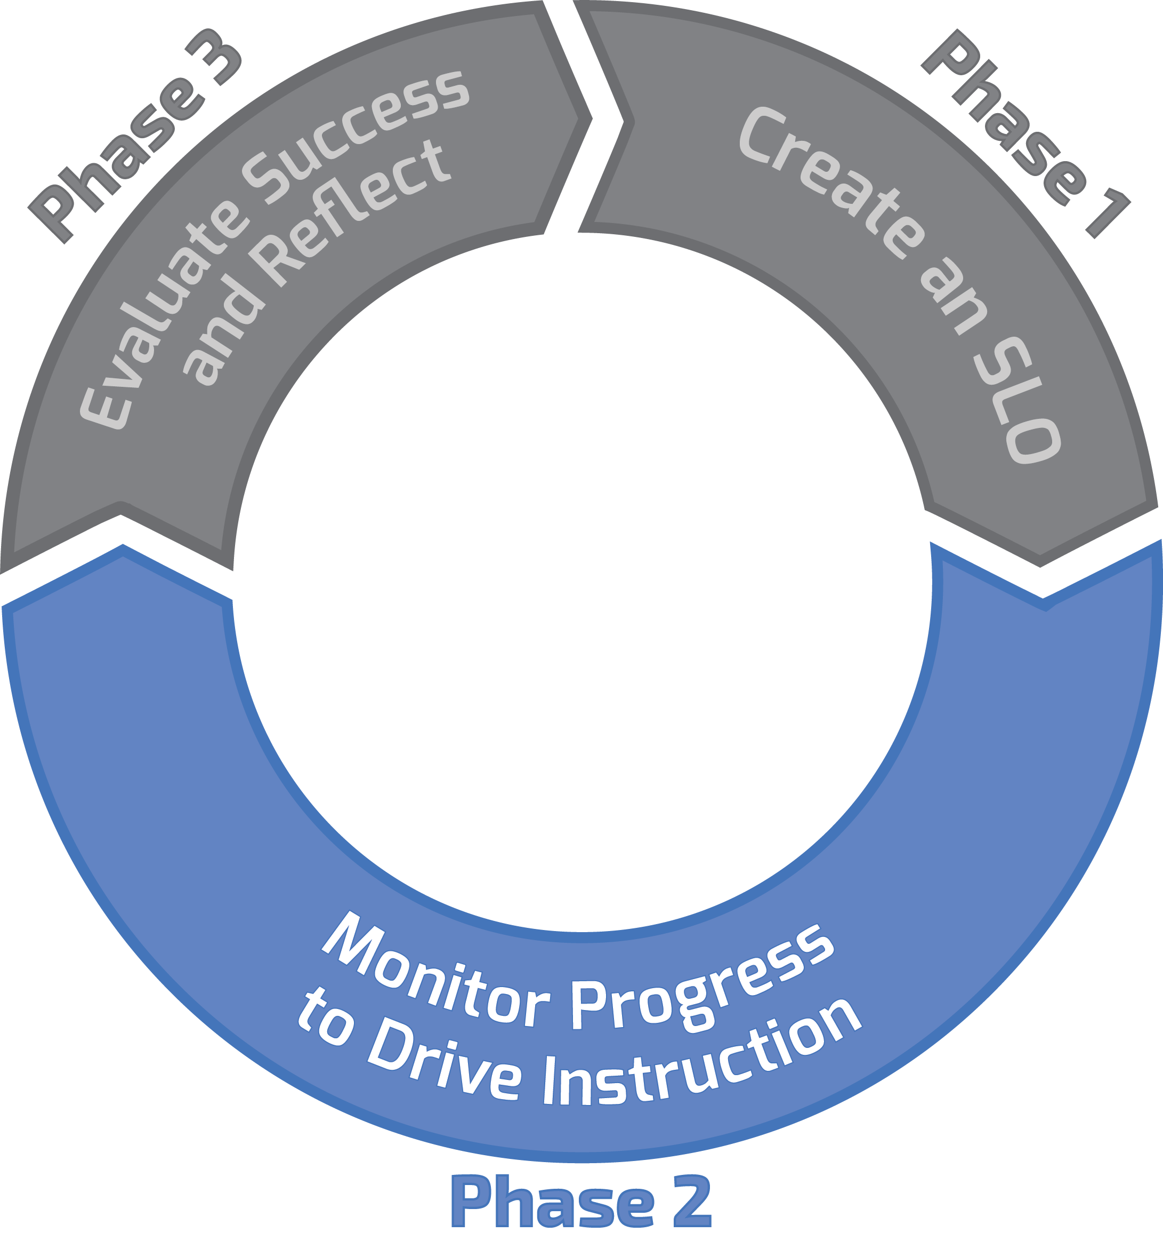
Three Phase Process
Notes:
“Now, we will focus on Phase 2- which is about monitoring progress to drive instruction. Note that this covers most of the SLO interval. It is the longest part of the process where you are implementing what you created in Phase 1.”

Slide 37
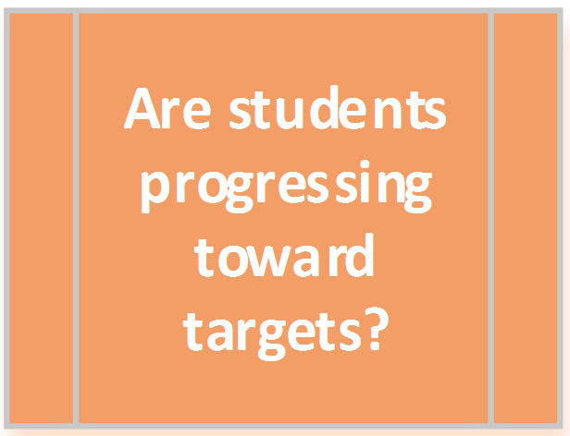
Notes:
“Here we are at our 5th question. Are students progressing toward their targets?”

Slide 38
Teaching Loop
Plan
Instruct
Assess
Analyze
Adjust
1. What do we do when students aren’t learning?
2. How do we reteach?
3. How do we alter pedagogy?
Notes:
“Here is our teaching loop. After teachers have planned their SLO from the focus to the ending points, this loop is what we focus on for most of the year.
Teachers simply teach and use this as a guide. Adjust is generally the most difficult part - what do we do when students aren’t learning? How do we reteach, how do we alter pedagogy?
This loop shouldn’t be once every six weeks, you want this to be much tighter and continuous. It should happen all the time. We want to be sure we are responsively adjusting our teaching to match how students are learning. This loop is designed to ensure we are intentional about our practice.”

Slide 39
Phase 2 Processes
Mid-point conferences with appraisers
Main points of the check-in:
Are students on track to meet targets?
What adjustments have been made?
What adjustments still need to be made?
What additional support can be provided to the teacher?
Notes:
“Keep in mind that the goal of the whole evaluation system is providing feedback and support to help teachers become more effective. This could fold nicely into a post-conference situation or other meetings already scheduled.
(For those who are in an off-year for evaluation – this meeting could be between the teacher and the department chair). Note that the evaluation plan still requires goal setting, PD planning, and addressing student growth even in non-evaluation years. Therefore, SLOs will still be done in those years.
This is a key opportunity to meet that objective. Appraisers can help teachers reflect on their own progress and talk through potential improvements to practice. This will also be a chance to identify any additional professional development that might support progress.
The midpoint conference should be seen as conversation with equal exchange of ideas and mutual support.“

Slide 40
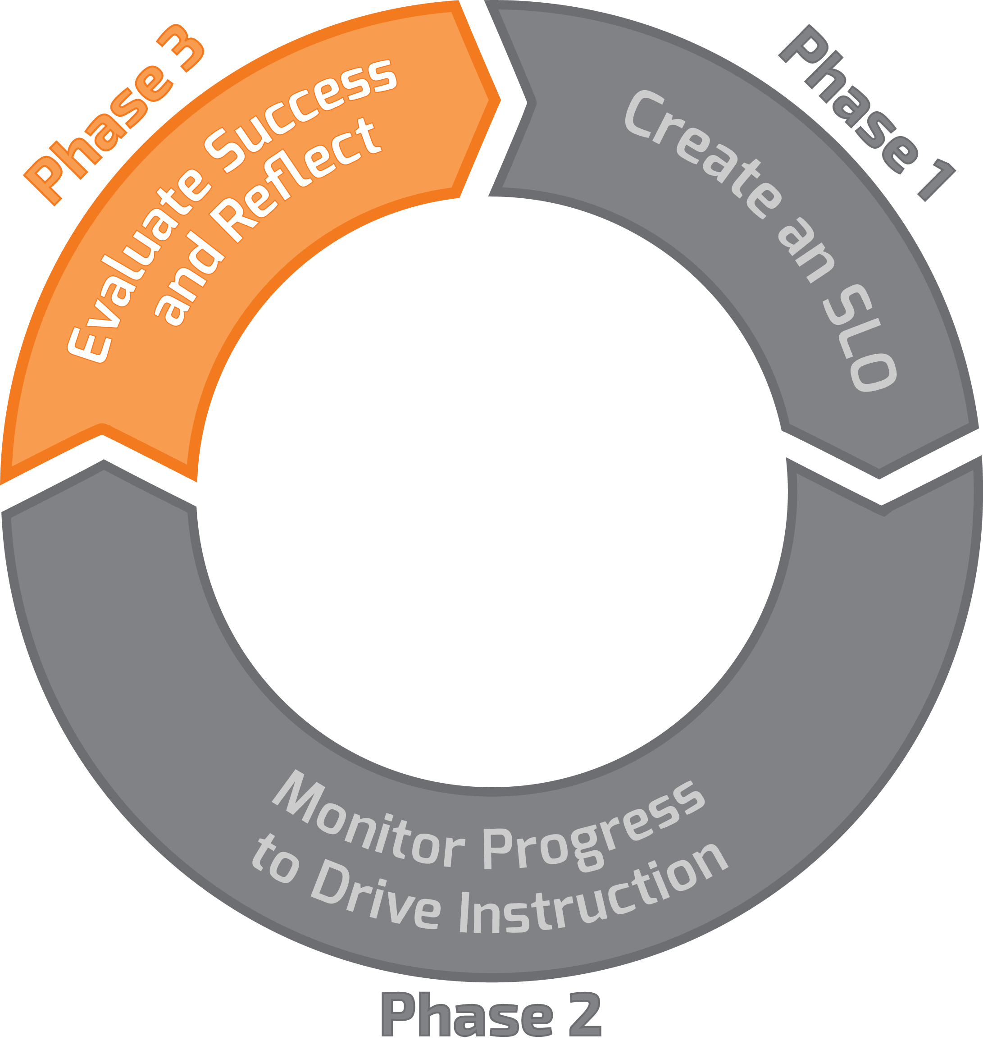
Three Phase Process
Notes:
“Now we are ready to move to the last part of the process. Phase 3 -Evaluating Success and Reflecting on outcomes is the final phase in the cycle.”

Slide 41
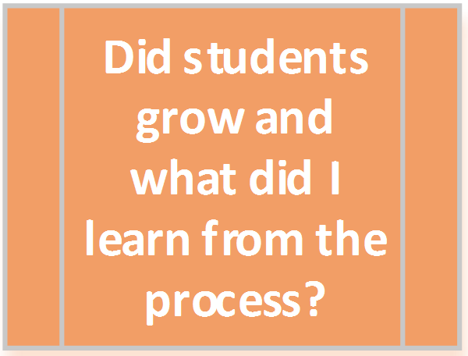
Notes:
“Here we are at Question 6. This is at the end of the process for the year. Did the students grow and what did I learn from the process?”

Slide 42
Reflection and Close-Out
Teachers should assess the end-of-year student skill level
Teachers record students’ end-of-year skill level on the Student Growth Tracker and complete EOY Reflection in advance of EOY Conference
The SLO EOY close out should occur during the TTESS EOY conference
Notes:
“Teachers will administer the measures they identified as evidence of SLO outcomes near the end of the SLO interval. They record those scores on the growth tracker – keeping in mind that scores are reported in the targeted skill profile levels. Multiple measures are not just okay, they will lead to more accurate estimates of student learning.
Once the teachers have recorded and reflected on their year, they should schedule a conference with their appraiser.”

Slide 43
Check for Understanding
Areas you feel good about?
Concerns?
Questions?
Notes:
Have participants write post-it notes for each of these categories (as they see fit) and have them place their sticky notes on either chart paper or a white board where you have “Good” for what they feel good about, “Concerns” for what concerns they have, and “Support” for what additional support they’d like from their campus, district, or ESC.

Slide 44
Student Learning Objectives
SLOs are about teacher growth.
When teachers grow, students benefit.
When students benefit, students grow.
When students grow, teachers benefit, too.

Slide 45
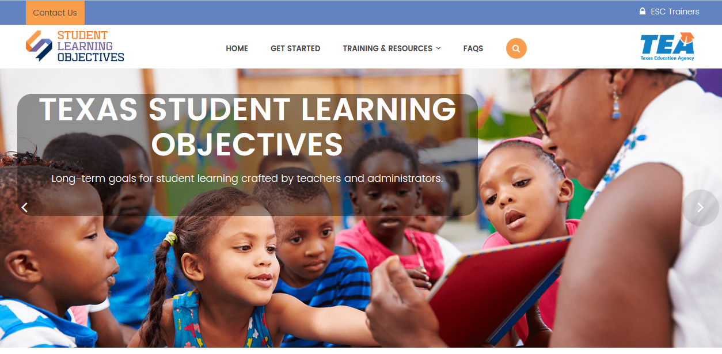
Supporting documents can be found at:
https://TexasSLO.org/

Slide 46
THANK YOU!
Jeffrey Strom
  jstrom@esc19.net

