Slide 1
TEKS Resource System: Mathematics
Presented by
ESC Region 19
Mathematics
Please log in to:
www.teksresourcesystem.net
Notes:
Assist participants accessing TRS website

Slide 2
News To Know…
8:00-3:30
Mathematics
Notes:
Housekeeping info
Take care of yourself
Step outside to take care of personal family and business matters
We will honor your start and end time
Give scheduled lunch time, in case they have to make plans

Slide 3
Goals for Today
Study the IFD to plan instruction
TEKS Study
Use the Assessment Creator to generate a unit exam
Outline day-by-day instruction for a unit
Connections to T-TESS
PLANNING DIMENSION 1.1- Standards and Alignment
PLANNING DIMENSION 1.2 – Data and Assessment
PLANNING DIMENSION 1.3 – Knowledge of Students
PLANNING DIMENSION 1.4- Activities
What is your personal goal for today?
Notes:
Help participants make a connection from the planning with TRS and T-TESS
1.1 The teacher designs clear, well-organized, sequential lessons that reflect best practices, align with standards and are appropriate for diverse learners.
1.2 The teacher uses formal and informal methods to measure student progress, then manages and analyzes student data to inform instruction.
1.3 Through knowledge of the students and proven practices, the teacher ensures high levels of learning, social-emotional development and achievement for all students.
1.4 The teacher plans engaging, flexible lessons that encourage higher-order thinking, persistence and achievement.

Slide 4
Tell Me Something New!
“About yourself”
or
“About using your curriculum”
And
share your personal goal.

Slide 5
TEKS RS Components
Please Choose an upcoming unit for todays planning.
Components
1. TVD
TEKS Verification Document
2. VAD
Vertical Alignment Document
3. YAG
Year at Glance
4. IFD
Instructional Focus Document
5. TCD/ETCD
TEKS Clarification Document
Enhanced TEKS Clarification Document
6. Resources
Content documents
Notes:
Refer to the At-A-Glance handout, front and back page.
Participant will engage in an Expert Gallery Walk, And rotate between 5 stations--About 10-12 minutes each station.
Experts: share everything and anything you know about the component, give ideas on how to use it for instruction

Slide 6
Connections
Instruction
Curriculum
study
study
compile
Assessment

Slide 7
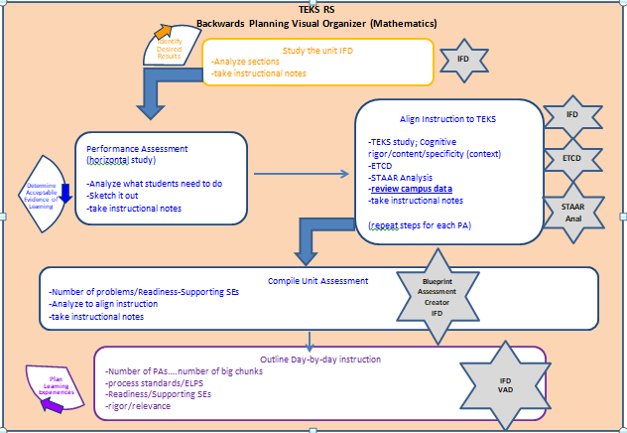
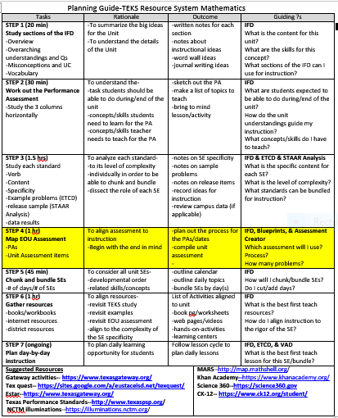

Slide 9
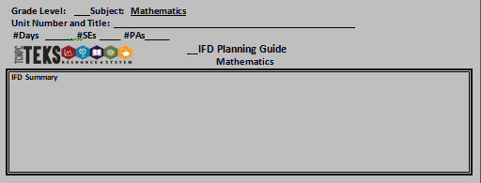
Step 1

Slide 10
Step 2

Slide 11
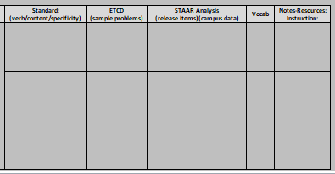
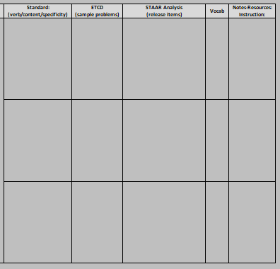
Step 3

Slide 12
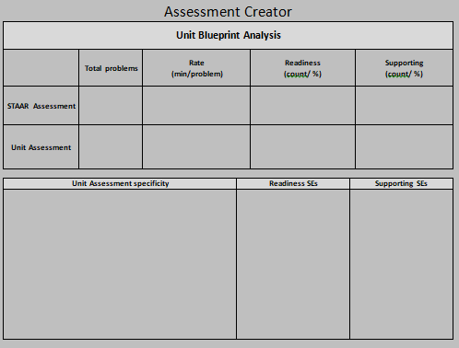
Step 4

Slide 13
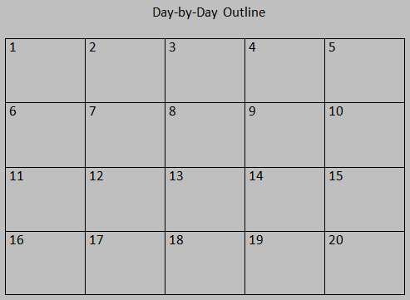
Step 5

Slide 14
Step 6

Slide 15
Step 7

Slide 16
Let’s Get Started!
Notes:
Return to slide #8 and proceed as time allows.

Slide 17
Thank You!
Jeff Strom
915-780-5339
jstrom@esc19.net
3-2-1 Reflection
What 3 main ideas did you learn from TEKS RS?
What 2 lesson planning ideas will you explore further?
What is 1 question you may still have?

