Slide 1
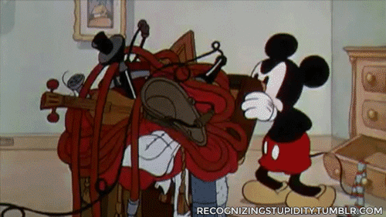
Unpacking the Standards and Building Assessments
Welcome! Please log in to the TEKS Resource System
Notes:
*Note to presenter:
The notes throughout this presentation are intended as a guide for the presenter to achieve consistency. Whether you are experienced or new, this serves as support when presenting concepts of the TEKS Resource System.
Most presenters will use the system online when presenting, use these slides as needed.

Slide 2
Welcome!
First time users:
Username: full district email address Password: check your district email If this is not available, click “Forgot password” link to receive a new email.
As you are making yourselves comfortable, please log in to the TEKS Resource System: 1. Open up the web page: www.teksresourcesystem.net
2. Log onto TEKS Resource System.
Please VERIFY your account with the follow–up email you will receive the first time you log on.
Notes:
Suggested Time: 15-20 minutes - DISPLAY BEFORE PRESENTATION BEGINS
Notes:
Have this slide showing as participants are walking in.
If a participant does not have his/her login credentials:
Have them click on “Forgot Password” and it should send them the information to their email - note that this may take between 5 - 10 minutes.
If the above doesn’t work, contact the district technology administrator so that they can reset the password or create account
If the above two bullets don’t work, use the DEMO account information:
region19basic@teks.net PW: tcmpc OR
region19campus@teks.net PW: tcmpc
Walk around the room to help participants log in
Talking Points:
Please log in to the TEKS Resource System at your earliest convenience.
Materials Needed:
Participants need a device (laptop, tablet, phone, etc…)
Provide the Wi-Fi Password as needed (guest111 - if you are at the ESC)

Slide 3
Objectives
Understanding the Backward Design model by Wiggins and McTighe
Explore standard bundling as it pertains to the TEKS Resource System
Unpack the standards to study the cognitive rigor, context and content of student expectations.
Learn to create assessments using the Assessment Creator and build assessments for the upcoming unit of study
Notes:
Suggested Time: 15-20 minutes - DISPLAY BEFORE PRESENTATION BEGINS
Notes:
Our objectives today revolve around unpacking the standards via the Instructional Focus Document (IFD) and the Performance Assessments (PA)s within the IFD.
Talking Points:
Today our objectives will really focus on understanding the standards within our units. So we will unpack the standards by focusing on one unit at a time. We will also spend some time learning how to create an assessment and we will give you time to build our assessments as needed.
Materials Needed:
Participants need a device (laptop, tablet, phone, etc…)
Provide the Wi-Fi Password as needed (guest111 - if you are at the ESC)

Slide 4
Backward Design Model
Stage 1: Identify Desired Results
Stage 2: Determine Acceptable Evidence of Learning
Stage 3: Plan Learning Experiences
Stage 1
Stage 2
Stage 3
Notes:
Suggested Time: 5 minutes
Notes: Understanding by Design is a book written by Grant Wiggins and Jay McTighe that offers a framework for designing courses and content units called “Backward Design.” Instructors typically approach course design in a “forward design” manner, meaning they consider the learning activities (how to teach the content), develop assessments around their learning activities, then attempt to draw connections to the learning goals of the course. In contrast, the backward design approach has instructors consider the learning goals of the course first. These learning goals embody the knowledge and skills instructors want their students to have learned when they leave the course. Once the learning goals have been established, the second stage involves consideration of assessment. The backward design framework suggests that instructors should consider these overarching learning goals and how students will be assessed prior to consideration of how to teach the content. For this reason, backward design is considered a much more intentional approach to course design than traditional methods of design.
Talking Points:
The backward design model for planning is based on the book “Understanding by Design” by Grant Wiggins and Jay McTighe.
The basic premise of this framework is that rather than beginning our planning with the activities, we begin our work by identifying the learning goals, which embody the knowledge and skills we want our students to have learned at the end of the unit or course. This is stage 1
After establishing our goals or desired results, we consider the assessment, the demonstration of acquired learning. This is Stage 2
Lastly, Stage 3 involves designing those activities that are directly aligned with the assessment and goals already established

Slide 5
Backward Design for Planning
Stage 1
Stage 2
Stage 3
Stage 1: Identify Desired Results
What should the students know and be able to do after this unit?
Stage 2: Determine Acceptable Evidence of Learning
How will students demonstrate what they know and can do?
Stage 3: Plan Learning Experiences
What learning experiences are needed to equip students with the knowledge and skills?
Notes:
Suggested Time: 5 minutes
Notes (repeat info from last slide): Understanding by Design is a book written by Grant Wiggins and Jay McTighe that offers a framework for designing courses and content units called “Backward Design.” Instructors typically approach course design in a “forward design” manner, meaning they consider the learning activities (how to teach the content), develop assessments around their learning activities, then attempt to draw connections to the learning goals of the course. In contrast, the backward design approach has instructors consider the learning goals of the course first. These learning goals embody the knowledge and skills instructors want their students to have learned when they leave the course. Once the learning goals have been established, the second stage involves consideration of assessment. The backward design framework suggests that instructors should consider these overarching learning goals and how students will be assessed prior to consideration of how to teach the content. For this reason, backward design is considered a much more intentional approach to course design than traditional methods of design.
Talking Points:
So as we go through each stage, there are some questions that can begin to frame our thinking about each of the units of study that we will work with today.
During stage 1, I would ask: What should the students know and be able to do by the end of this unit?
During stage 2, How will students demonstrate what they know and can do?
During Stage 3, what learning experiences are needed to equip students with the knowledge and skills?
Today, we will spend the morning focusing on Stage 1 and the afternoon we will focus on Stage 2. As we go through the day, we may spend some time sharing activities for planning or you may get some ideas – however we will not spend time working on the planning. Once you have broken down the standards – you will see how the activities will fit in and that lesson planning will come much easier and will be better aligned.

Slide 6
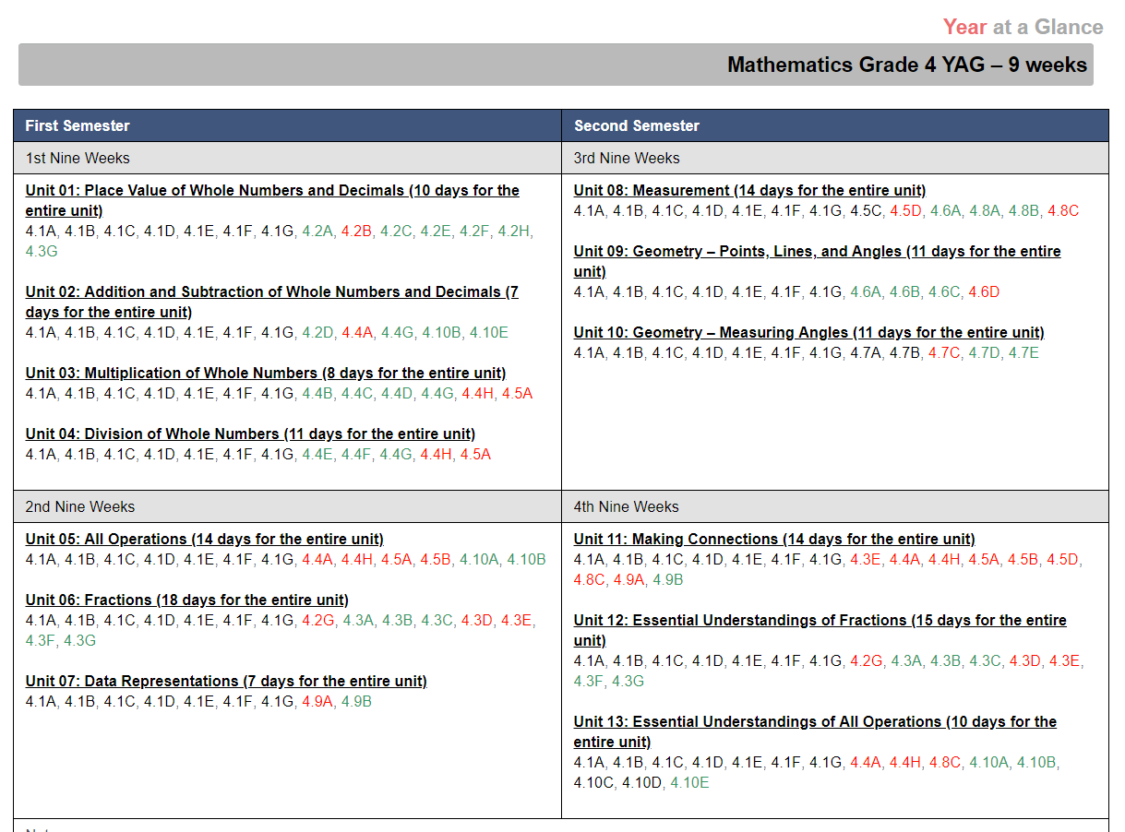
TEKS Resource System Structure
TEA – Standards
Year at a Glance (YAG)
Instructional Focus Document (IFD)
Performance Assessment (PA)
Thematic Units of Study
Notes:
Suggested Time: 5 minutes
Notes: This slide is intended to have a quick discussion of the structure/rationale of how units are structured within TEKS Resource System
Talking Points:
When we go to TEA and we find our standards, they are all organized alphanumerically – but obviously that is not how we teach – gong down the list of standards
TEKS Resource System takes these standards and organizes them in thematic units of study that you see clearly in the Year at A Glance
However, remember that we do not plan from the Year at a Glance, this is a quick look document for the entire year. Notice that this year the standards are color coded for readiness and supporting (tested grade levels only)
If you click on the unit title in the YAG, this will take you to the Instructional Focus Document (IFD) – which is the document we use to plan. Today we will use the IFD to work on Stage 1 and break down the standards of one unit in our grade level and subject area.
Before we get started, let’s take a few minutes to review some of the sections of the IFD, especially those that we will be focusing on for today’s session. (NOTE TO PRESENTER: You may skip the next section if your audience is very well versed with the sections of the IFD)

Slide 7
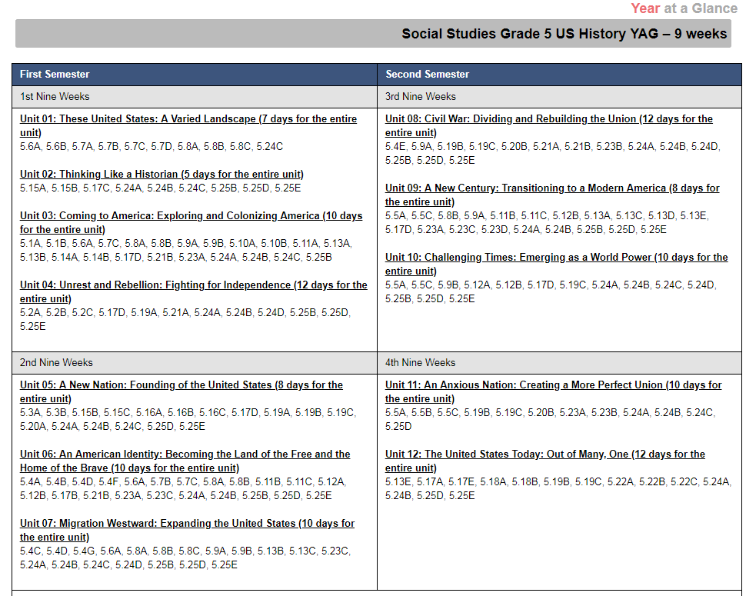
TEKS Resource System Structure
TEA – Standards
Year at a Glance (YAG)
Instructional Focus Document (IFD)
Performance Assessment (PA)
Thematic Units of Study
Notes:
Suggested Time: 5 minutes
Notes: This slide is intended to have a quick discussion of the structure/rationale of how units are structured within TEKS Resource System
Talking Points:
When we go to TEA and we find our standards, they are all organized alphanumerically – but obviously that is not how we teach – gong down the list of standards
TEKS Resource System takes these standards and organizes them in thematic units of study that you see clearly in the Year at A Glance
However, remember that we do not plan from the Year at a Glance, this is a quick look document for the entire year. Notice that this year the standards are color coded for readiness and supporting (tested grade levels only)
If you click on the unit title in the YAG, this will take you to the Instructional Focus Document (IFD) – which is the document we use to plan. Today we will use the IFD to work on Stage 1 and break down the standards of one unit in our grade level and subject area.
Before we get started, let’s take a few minutes to review some of the sections of the IFD, especially those that we will be focusing on for today’s session. (NOTE TO PRESENTER: You may skip the next section if your audience is very well versed with the sections of the IFD)

Slide 8
Instructional Focus Document: A Review
Overview
Overarching Understandings and Questions
Performance Assessments
Notes:
Suggested Time: 5 minutes
Notes: This section is intended to give participants a review of the sections within the IFD that we will be focusing on during the day. If your audience is already familiar with the IFD sections, you may skip/hide these next few slides.
Talking Points:
Today we will be using the IFD quite a bit to break down the standards, so we will take a few minutes to make sure we all know where to find information within the IFD.

Slide 9
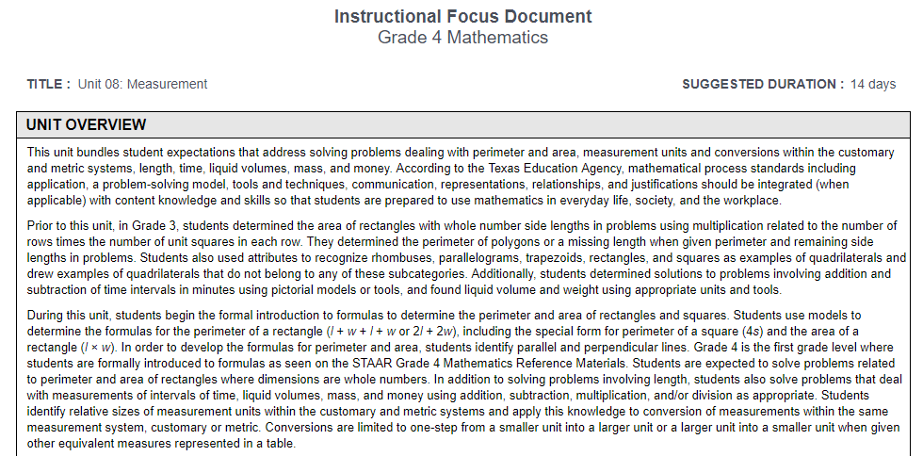
IFD - Review
Notes:
Suggested Time: 5 minutes
Notes: We are reviewing this section of the IFD, our goal is to identify the sections. Participants and presenter will analyze and breakdown (read) the information at a later time.
Talking Points:
When we open an IFD, the first thing you will see is the grade level and content area as well as the title of the unit and the suggested number of days. This number is based on a 45 minute period block and the assumption that you do the performance assessments. That said, this is a suggestion – your classroom may need a few more days or less days to teach these concepts.
You will also find the Unit Overview at the top of the IFD. This section gives you information about the big ideas and/or goals for this unit. You will find the “prior to this unit,” “during this unit,” and “after this unit” information to help support your instruction.
In Science, the structure of the overview is a little different. You see the “during this unit” first. You will also see standards that correlate to this topic that the students learned in previous units or grade levels (and some connections to mathematics as well).

Slide 10
IFD - Review
Notes:
Suggested Time: 5 minutes
Notes: We are reviewing this section of the IFD, our goal is to identify the sections. Participants and presenter will analyze and breakdown (read) the information at a later time.
Talking Points:
When we open an IFD, the first thing you will see is the grade level and content area as well as the title of the unit and the suggested number of days. This number is based on a 45 minute period block and the assumption that you do the performance assessments. That said, this is a suggestion – your classroom may need a few more days or less days to teach these concepts.
You will also find the Unit Overview at the top of the IFD. This section gives you information about the big ideas and/or goals for this unit. You will find the “prior to this unit,” “during this unit,” and “after this unit” information to help support your instruction.
In Science, the structure of the overview is a little different. You see the “during this unit” first. You will also see standards that correlate to this topic that the students learned in previous units or grade levels (and some connections to mathematics as well).

Slide 11
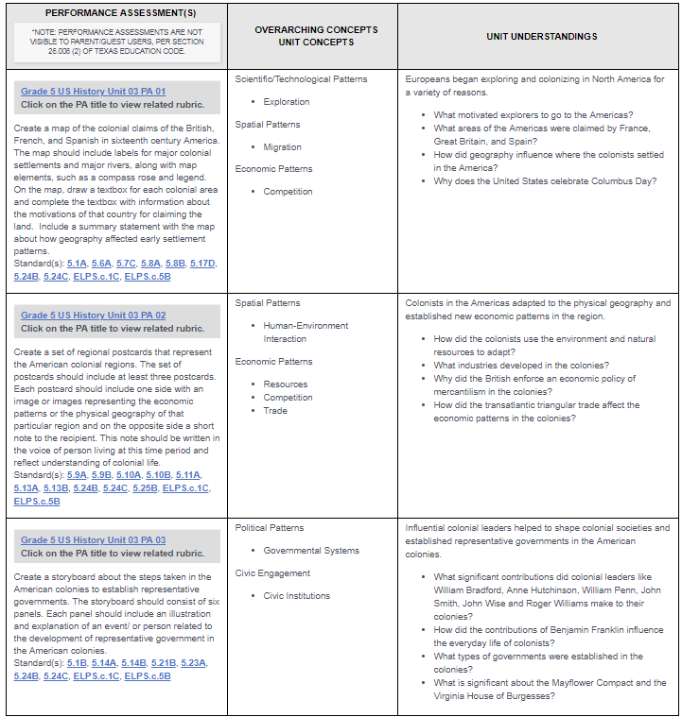
IFD - Review
Notes:
Suggested Time: 5 minutes
Notes: We are reviewing this section of the IFD, our goal is to identify the sections. Participants and presenter will analyze and breakdown (read) the information at a later time.
Talking Points:
The next section has overarching understandings and questions. These are sometimes used as the essential question because these are the connections to outside the four walls of the classroom – why is this important to me in life?
Then we also have the Performance Assessments. We will come back to these in a few minutes. The number of PAs in a unit varies, these are the “checkpoints” within a unit. There are sometimes a lot of standards to cover in one unit so TRS chunks the standards into smaller bites. The PAs if you notice are tasks that the students do – they demonstrate evidence of learning via something they do or create – they are not quizzes or tests.
If we read this section, it’s easier to understand if we begin with the last column – the unit understandings. If we look at this column and say: if the students understand “this” (point to the third column) in the context of “this” (point to the middle column) then they are able to DO “this” (point to the first column).
Each PA has a rubric to use and you will see the standards, bundled standards, that are associated with this PA and Unit Understandings.

Slide 12
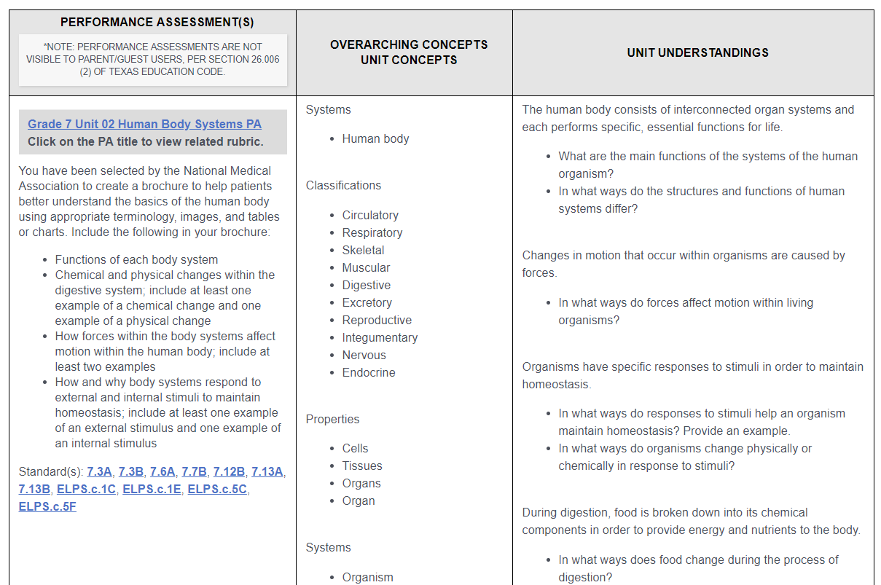
IFD - Review
Notes:
Suggested Time: 5 minutes
Notes: We are reviewing this section of the IFD, our goal is to identify the sections. Participants and presenter will analyze and breakdown (read) the information at a later time.
Talking Points:
The next section has overarching understandings and questions. These are sometimes used as the essential question because these are the connections to outside the four walls of the classroom – why is this important to me in life?
Then we also have the Performance Assessments. We will come back to these in a few minutes. The number of PAs in a unit varies, these are the “checkpoints” within a unit. There are sometimes a lot of standards to cover in one unit so TRS chunks the standards into smaller bites. The PAs if you notice are tasks that the students do – they demonstrate evidence of learning via something they do or create – they are not quizzes or tests.
If we read this section, it’s easier to understand if we begin with the last column – the unit understandings. If we look at this column and say: if the students understand “this” (point to the third column) in the context of “this” (point to the middle column) then they are able to DO “this” (point to the first column).
Each PA has a rubric to use and you will see the standards, bundled standards, that are associated with this PA and Unit Understandings.

Slide 13
IFD - Review
Notes:
Suggested Time: 5 minutes
Notes: We are reviewing this section of the IFD, our goal is to identify the sections. Participants and presenter will analyze and breakdown (read) the information at a later time.
Talking Points:
The next section has overarching understandings and questions. These are sometimes used as the essential question because these are the connections to outside the four walls of the classroom – why is this important to me in life?
Then we also have the Performance Assessments. We will come back to these in a few minutes. The number of PAs in a unit varies, these are the “checkpoints” within a unit. There are sometimes a lot of standards to cover in one unit so TRS chunks the standards into smaller bites. The PAs if you notice are tasks that the students do – they demonstrate evidence of learning via something they do or create – they are not quizzes or tests.
If we read this section, it’s easier to understand if we begin with the last column – the unit understandings. If we look at this column and say: if the students understand “this” (point to the third column) in the context of “this” (point to the middle column) then they are able to DO “this” (point to the first column).
Each PA has a rubric to use and you will see the standards, bundled standards, that are associated with this PA and Unit Understandings.

Slide 14
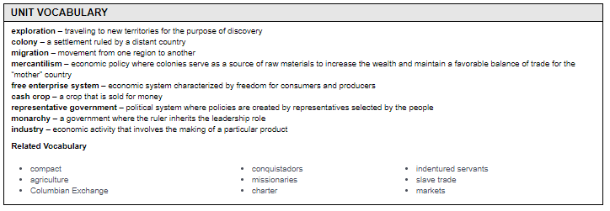
IFD - Review
Notes:
Suggested Time: 5 minutes
Notes: We are reviewing this section of the IFD, our goal is to identify the sections. Participants and presenter will analyze and breakdown (read) the information at a later time.
Talking Points:
The next section has misconceptions and underdeveloped concepts that may have been identified. It’s important to review these when planning so that we make a note of some things we may need to emphasize.
The next section contains key unit vocabulary as well as possible related vocabulary

Slide 15
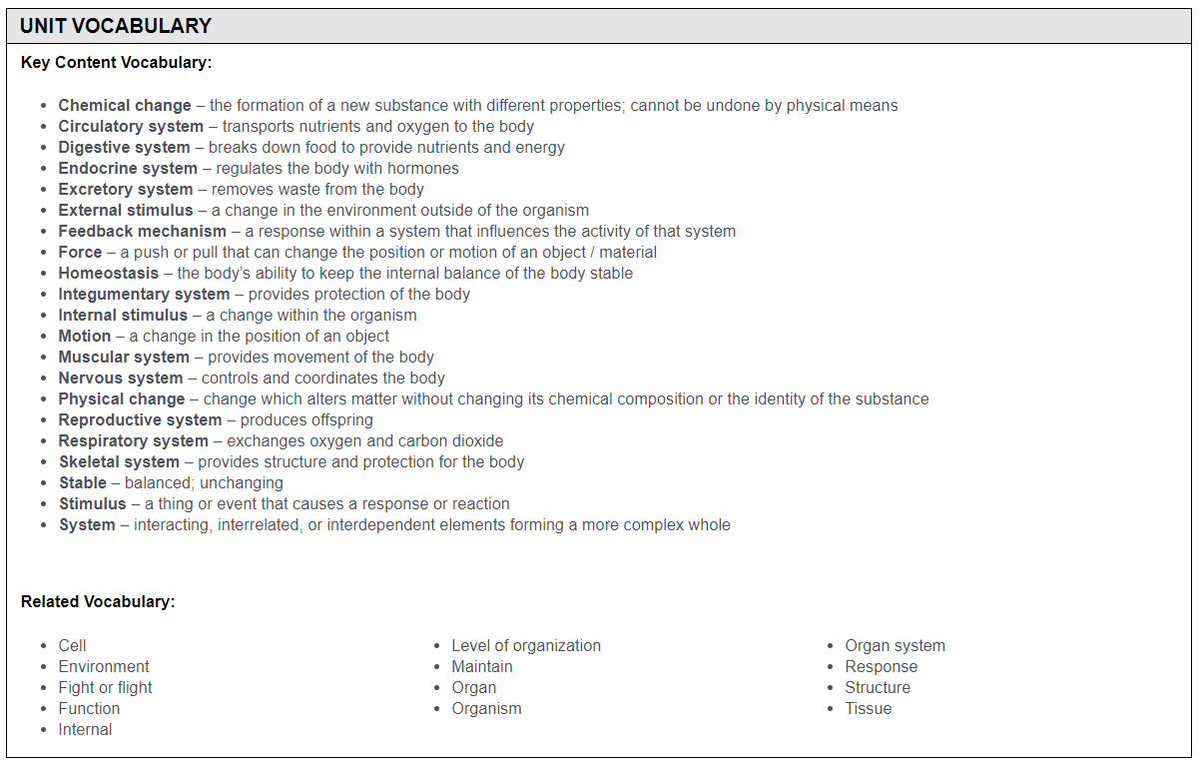
IFD - Review
Notes:
Suggested Time: 5 minutes
Notes: We are reviewing this section of the IFD, our goal is to identify the sections. Participants and presenter will analyze and breakdown (read) the information at a later time.
Talking Points:
The next section has misconceptions and underdeveloped concepts that may have been identified. It’s important to review these when planning so that we make a note of some things we may need to emphasize.
The next section contains key unit vocabulary as well as possible related vocabulary

Slide 16
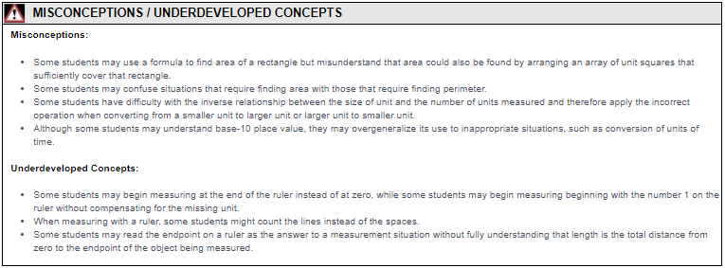
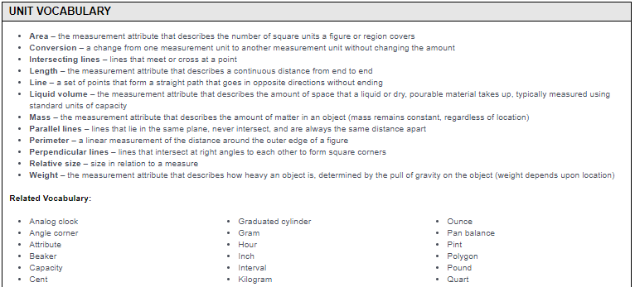
IFD - Review
Notes:
Suggested Time: 5 minutes
Notes: We are reviewing this section of the IFD, our goal is to identify the sections. Participants and presenter will analyze and breakdown (read) the information at a later time.
Talking Points:
The next section has misconceptions and underdeveloped concepts that may have been identified. It’s important to review these when planning so that we make a note of some things we may need to emphasize.
The next section contains key unit vocabulary as well as possible related vocabulary

Slide 17
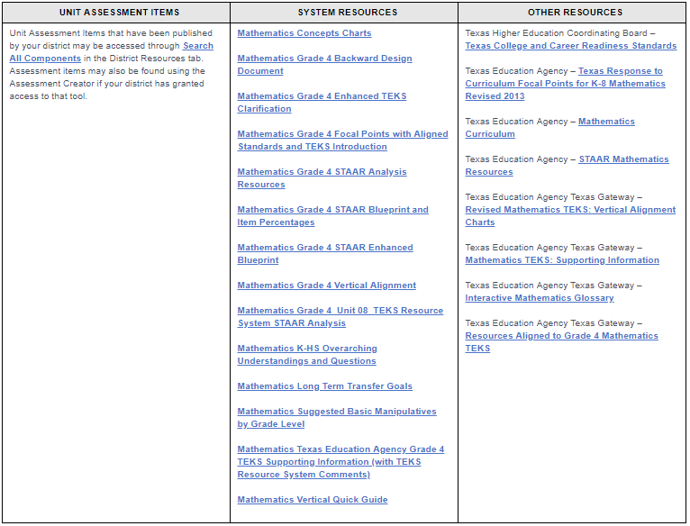
IFD - Review
Notes:
Suggested Time: 5 minutes
Notes: We are reviewing this section of the IFD, our goal is to identify the sections. Participants and presenter will analyze and breakdown (read) the information at a later time.
Talking Points:
Then we will see three columns, unit assessment items, system resources, and other resources. The unit assessment items link takes you to the assessment creator where you can create an assessment. We will navigate to that section in the afternoon. The middle column has related resources for this unit or standards addressed within this unit. All of the resources listed here can also be found when you do a “quick search” for your content and grade level – there’s a folder that says “Resources.” Lastly, other resources can have links to outside resources such as the Texas Gateway or TEA
In ELAR/SLAR, you will also find the Instructional Components Chart. This shows all the standards within this unit that are addressed but they are organized by word study, reading and writing – following the balanced literacy model. You’ll see here what are some of the ongoing TEKS that support the learning of this unit

Slide 18
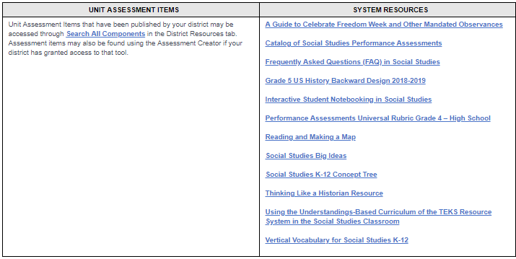
IFD - Review
Notes:
Suggested Time: 5 minutes
Notes: We are reviewing this section of the IFD, our goal is to identify the sections. Participants and presenter will analyze and breakdown (read) the information at a later time.
Talking Points:
Then we will see three columns, unit assessment items, system resources, and other resources. The unit assessment items link takes you to the assessment creator where you can create an assessment. We will navigate to that section in the afternoon. The middle column has related resources for this unit or standards addressed within this unit. All of the resources listed here can also be found when you do a “quick search” for your content and grade level – there’s a folder that says “Resources.” Lastly, other resources can have links to outside resources such as the Texas Gateway or TEA
In ELAR/SLAR, you will also find the Instructional Components Chart. This shows all the standards within this unit that are addressed but they are organized by word study, reading and writing – following the balanced literacy model. You’ll see here what are some of the ongoing TEKS that support the learning of this unit

Slide 19
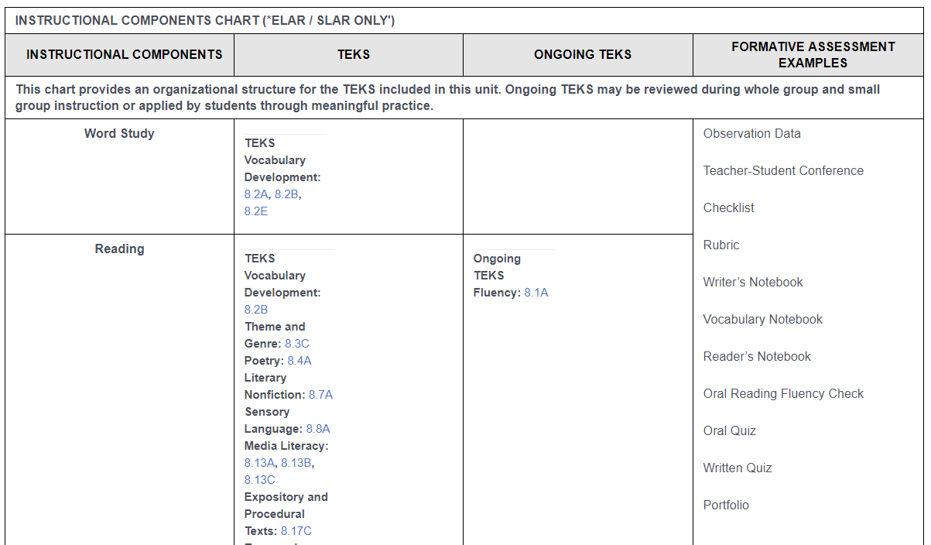
IFD - Review
Notes:
Suggested Time: 5 minutes
Notes: We are reviewing this section of the IFD, our goal is to identify the sections. Participants and presenter will analyze and breakdown (read) the information at a later time.
Talking Points:
Then we will see three columns, unit assessment items, system resources, and other resources. The unit assessment items link takes you to the assessment creator where you can create an assessment. We will navigate to that section in the afternoon. The middle column has related resources for this unit or standards addressed within this unit. All of the resources listed here can also be found when you do a “quick search” for your content and grade level – there’s a folder that says “Resources.” Lastly, other resources can have links to outside resources such as the Texas Gateway or TEA
In ELAR/SLAR, you will also find the Instructional Components Chart. This shows all the standards within this unit that are addressed but they are organized by word study, reading and writing – following the balanced literacy model. You’ll see here what are some of the ongoing TEKS that support the learning of this unit

Slide 20
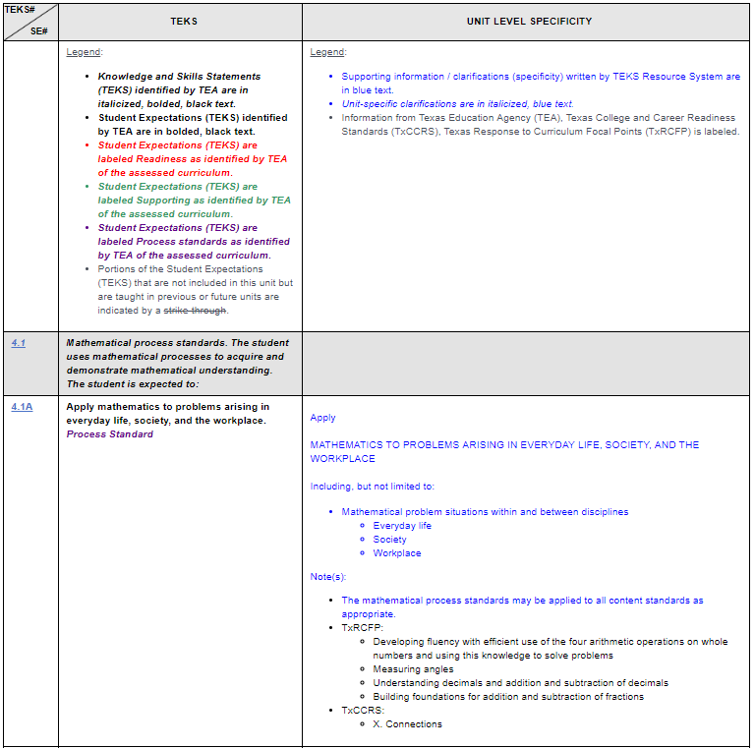
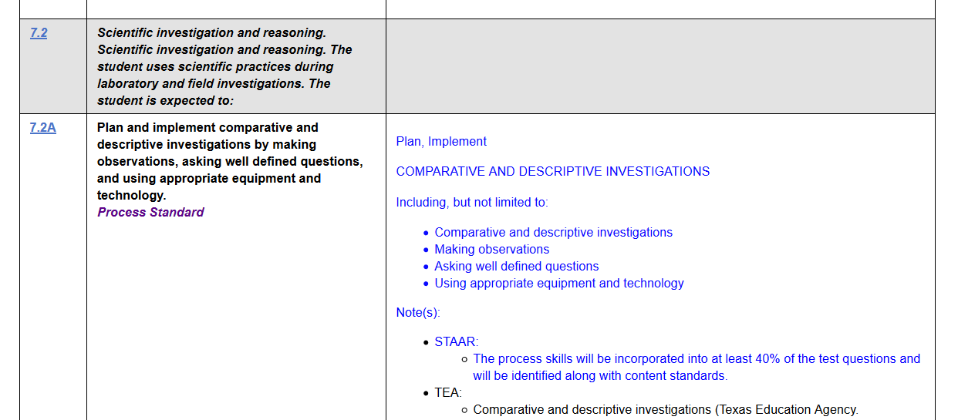
IFD - Review
Notes:
Suggested Time: 5 minutes
Notes: We are reviewing this section of the IFD, our goal is to identify the sections. Participants and presenter will analyze and breakdown (read) the information at a later time.
Talking Points:
Lastly, you will find the standards at the bottom of the IFD with the specificity. These are the standards addressed in this unit. We will navigate to this section as well to help us unpack the standards.
This document is a long document and it may be overwhelming to seek and find the standards or information you’re looking for quickly. One quick way to find what you’re searching for is by using the “Find” function on your device. Once in the document, hit your “CTRL + F” keys or Mac “CMD + F” This opens a small window either at the top or bottom of your screen and you type what you’re searching for there to find it quickly (it’s highlighted).

Slide 21
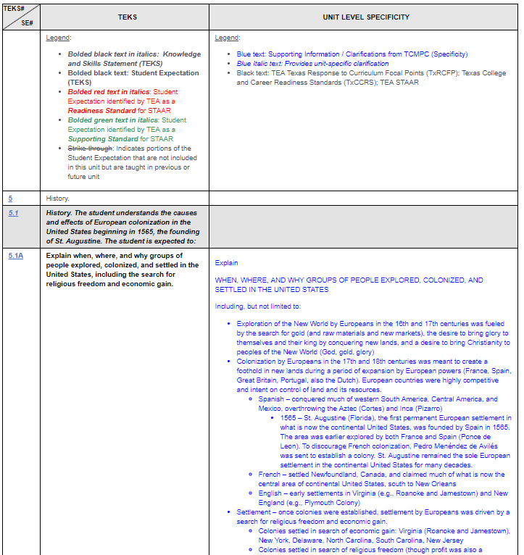
IFD - Review
Notes:
Suggested Time: 5 minutes
Notes: We are reviewing this section of the IFD, our goal is to identify the sections. Participants and presenter will analyze and breakdown (read) the information at a later time.
Talking Points:
Lastly, you will find the standards at the bottom of the IFD with the specificity. These are the standards addressed in this unit. We will navigate to this section as well to help us unpack the standards.
This document is a long document and it may be overwhelming to seek and find the standards or information you’re looking for quickly. One quick way to find what you’re searching for is by using the “Find” function on your device. Once in the document, hit your “CTRL + F” keys or Mac “CMD + F” This opens a small window either at the top or bottom of your screen and you type what you’re searching for there to find it quickly (it’s highlighted).

Slide 22
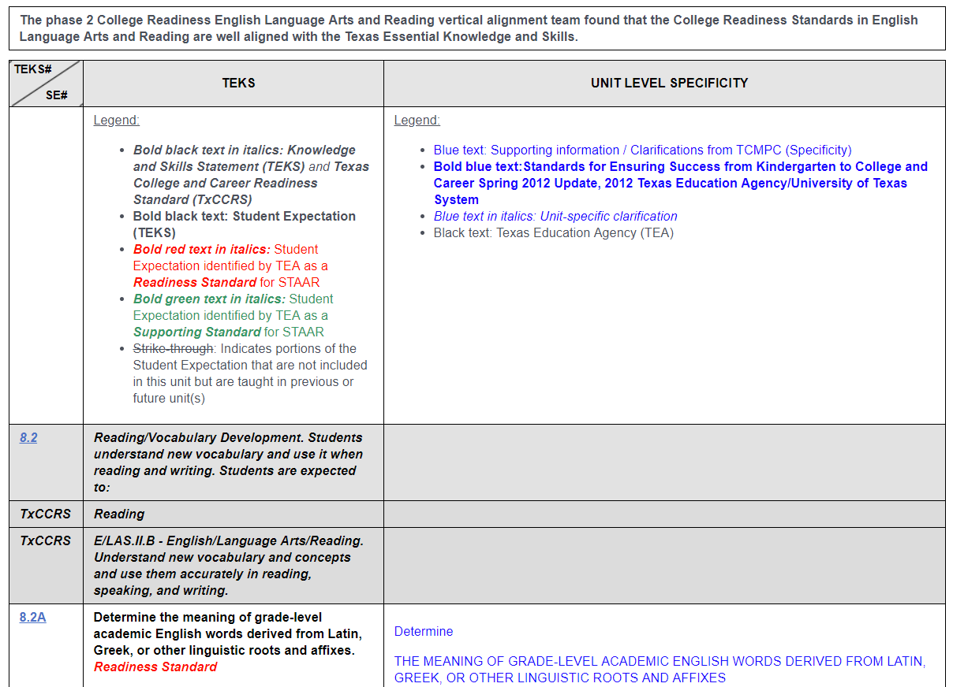
IFD - Review
Notes:
Suggested Time: 5 minutes
Notes: We are reviewing this section of the IFD, our goal is to identify the sections. Participants and presenter will analyze and breakdown (read) the information at a later time.
Talking Points:
Lastly, you will find the standards at the bottom of the IFD with the specificity. These are the standards addressed in this unit. We will navigate to this section as well to help us unpack the standards.
This document is a long document and it may be overwhelming to seek and find the standards or information you’re looking for quickly. One quick way to find what you’re searching for is by using the “Find” function on your device. Once in the document, hit your “CTRL + F” keys or Mac “CMD + F” This opens a small window either at the top or bottom of your screen and you type what you’re searching for there to find it quickly (it’s highlighted).

Slide 23
IFD – Review: Your Turn!
Select an IFD to work on today
Log in to the TEKS Resource System
Select a grade level for your content area - Click Search
Click on “Instructional Focus Document” OR Find it in the YAG
Select a unit of study
Review your IFD
Find the title, suggested number of days and unit overview
Find the performance assessments (unit understandings and overarching concepts)
Find the specificity for the standards
Notes:
Suggested Time: 5 minutes
Notes: We are reviewing this section of the IFD, our goal is to identify the sections. Participants and presenter will analyze and breakdown (read) the information at a later time.
Talking Points:
Now that you’ve see the different sections of the IFD, spend some time selecting the IFD you want to work with for the morning and identify the sections listed here. We will do more work with them – for now just make sure you can find them quickly

Slide 24
Backward Design Model Stage 1: Identify Desired Results
What is the goal of this unit?
What will students understand?
What will students know and be able to do?
Stage 1
What should the students know and be able to do after this unit?
Notes:
Suggested Time: 5 minutes
Notes: Today’s session is focused on breaking down the standards – stage 1 of the backward design. Even though many of the conversations will lead us to discuss specific activities, the focus is not the activities. So we will break down the standards – in our examples – using the performance assessments. Some may like to go directly to the bottom of the IFD and break down the standards and “bundle” on their own (not the way TRS bundles in the PAs) and that’s ok too. But for our examples, we will be using the performance assessments
Talking Points:
We will begin by looking at our stage 1 of the backward design model: identify desired results. Remember the question here is what should the students know and be able to do after this unit?

Slide 25
What is the goal of this unit?
The goal of each unit is the enduring understandings found in the Overview sections of the IFD.
Notes:
Suggested Time: 5 minutes
Notes: This slide is the transition/beginning of the backward design stage 1. We will need to establish a goal or goals for the unit. What follows are examples per content area. Hide those examples that are not of your content area.
Talking Points:
We begin stage 1 by identifying the goal or purpose of a particular unit. I can find this information in the IFD by looking at the overview section (remember this is at the very top). I will need to read the overview and determine: what are the big ideas that the students will need to learn from this unit?

Slide 26
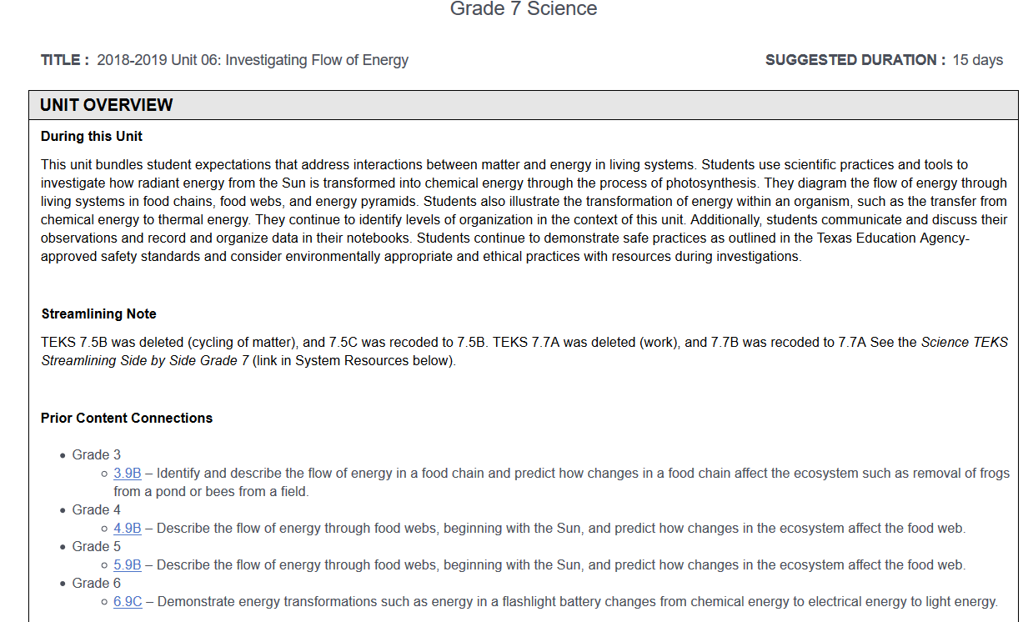
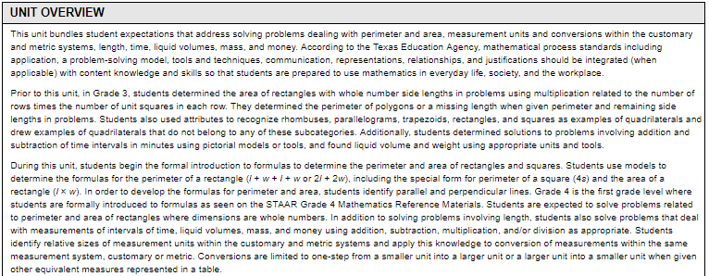
Example
Summarizing and forming an overview
Different organizational patterns
Logical connections within multiple, similar, or different genres
Notes:
Suggested Time: 5 minutes
Notes: This is an example of 7th grade science, unit 2. After reading the “during this unit” section, I gathered the main ideas that the students will learn about.
Talking Points:
After reading the “during this unit” section, I gathered the main ideas that the students will learn about. During the unit, students will: (read the bullets). So everything that I do during this unit will have to center around these core ideas

Slide 27
ELAR Example: 7th Grade Unit 3
Summarizing and forming an overview
Different organizational patterns
Logical connections within multiple, similar, or different genres
Notes:
Suggested Time: 5 minutes
Notes: This is an example of 7th grade science, unit 2. After reading the “during this unit” section, I gathered the main ideas that the students will learn about.
Talking Points:
After reading the “during this unit” section, I gathered the main ideas that the students will learn about. During the unit, students will: (read the bullets). So everything that I do during this unit will have to center around these core ideas

Slide 28
Social Studies Example: 5th Grade Unit 3
About exploration and colonization of North America.
The colonization of the Americas resulted in changes in global trade patterns and new settlement patterns.
Establishment of British colonies in North America first steps toward eventual creation of United States.
Notes:
Suggested Time: 5 minutes
Notes: This is an example of 7th grade science, unit 2. After reading the “during this unit” section, I gathered the main ideas that the students will learn about.
Talking Points:
After reading the “during this unit” section, I gathered the main ideas that the students will learn about. During the unit, students will: (read the bullets). So everything that I do during this unit will have to center around these core ideas

Slide 29
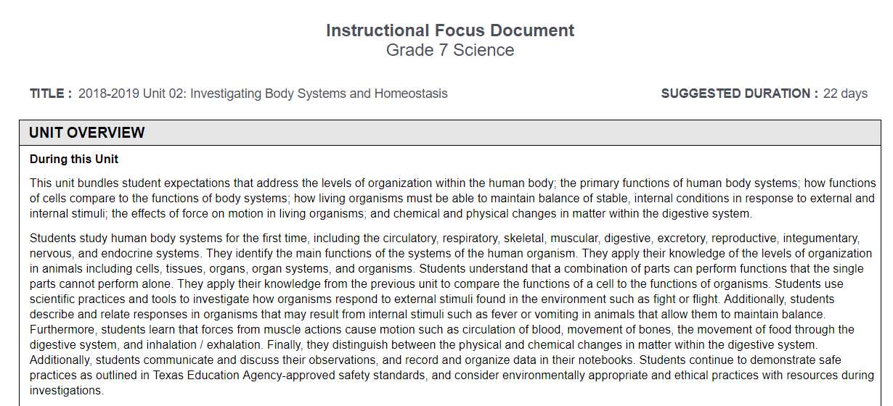
Science Example: 7th Grade Unit 2
Levels of organization within the human body
Living organisms must be able to maintain balance of stable, internal conditions in response to external and internal stimuli
Effects of force on motion in living organisms
Chemical and physical changes in matter within the digestive system
Notes:
Suggested Time: 5 minutes
Notes: This is an example of 7th grade science, unit 2. After reading the “during this unit” section, I gathered the main ideas that the students will learn about.
Talking Points:
After reading the “during this unit” section, I gathered the main ideas that the students will learn about. During the unit, students will: (read the bullets). So everything that I do during this unit will have to center around these core ideas

Slide 30
Your Turn!
Big ideas of the unit
Using the unit overview you’ve chosen, identify the big ideas for your unit.
Circle map
Notes:
Suggested Time: 5 minutes
Notes: The participants will complete a circle map of the unit understandings per PA. This is the beginning of analyzing or breaking down the standards. We need to establish a purpose or a goal/target to make connections between those targets and the standards.
Talking Points:
(Have teachers identify the big blocks of understandings for their unit)

Slide 31
What will students know and be able to do?
Standards bundled within a unit are organized into smaller chunks or unit understandings.
Unit understandings get assessed through the Performance Assessment.
PAs are not lessons, they are checkpoints within a unit.
Number of PAs is dependent upon information that has been chunked conceptually.
Bundling of Standards
Option #1
Bundling of Standards
Option #2
Notes:
Suggested Time: 5 minutes
Notes: The participants will complete a circle map of the unit understandings per PA. The IFD already bundles the standards into smaller chunks. However, teachers can bundle the standards however they see fit, after breaking them down. They can choose either way that works for them.
Talking Points:
Breaking down the standards is the same process for all. We will need to identify the cognitive rigor and the content/context in which the standards are address for this unit.
The IFD has performance assessments that already bundle the standards into smaller chunks. However, you might choose to break down/analyze the standards then re-bundle in a way that makes sense
For the purposes of our session today, we will use the PAs already bundled standards to breakdown the standards

Slide 32
Breaking Down the Standards
What are the unit understandings associated with the performance assessment? (Big Ideas)
What are the standards addressed in the performance assessment?
What is the cognitive rigor and content for the standard?
What are some notes/vocabulary/background knowledge/misconceptions that I need to address?
Using a Performance Assessment
Notes:
Suggested Time: 5 minutes
Notes: The participants will complete a circle map of the unit understandings per PA. The IFD already bundles the standards into smaller chunks. However, teachers can bundle the standards however they see fit, after breaking them down. They can choose either way that works for them.
Talking Points:
Breaking down the standards is the same process for all. We will need to identify the cognitive rigor and the content/context in which the standards are address for this unit.
The IFD has performance assessments that already bundle the standards into smaller chunks. However, you might choose to break down/analyze the standards then re-bundle in a way that makes sense
For the purposes of our session today, we will use the PAs already bundled standards to breakdown the standards. The questions we want to ask are:
Read the bullets

Slide 33
Performance Assessments: Unit Understandings
The unit understandings associated with the performance assessment are aligned with the “Big Ideas” identified in the overview.
Identify a “Big Idea” and the standards that are associated with it.
Review the specificity for these standards (bottom of IFD) and make notes as appropriate.
Cognitive Rigor – verb
Content
Add notes/vocabulary/misconceptions as needed
Notes:
Suggested Time: 5 minutes
Notes: The participants will complete a circle map of the unit understandings per PA. We have already identified the “Big Ideas” of the unit. You should have a sample of this already prepared. The Science sample prepared in the next slide uses the following format:
What is one of the big ideas found in the overview? (white rectangle)
What unit understanding correlates with the big idea? (this unit has only one PA, so we break the unit understandings further and use one of the ideas)
What standards correlate with the big ideas/unit understandings? (unit only has one PA so only certain standards apply to this big idea)
What is the cognitive rigor of the standards? Content? (circle, underline) – have participants look at the specificity at the bottom of the IFD – don’t forget to mention the strike-throughs
Are there any notes/vocabulary/misconceptions that apply to this big idea/concept?
Talking Points:
Breaking down the standards is the same process for all. We will need to identify the cognitive rigor and the content/context in which the standards are address for this unit.
As we look at our sample IFD, we have already identified the big ideas from the overview. Now we are going to take a deeper look at the standards and we will begin with the PA. As we look at the PA, remember that these are tasks that the students complete to demonstrate understanding and mastery for the bundled standards listed. However, we will not look at the actual task just yet. Lets look at the rest of the information in the same line as the PA – let’s begin with the unit understandings (go online and analyze)
How many PAs do we have for this unit?
What are the unit understandings? How do they relate to the overview big ideas?
If there is only one PA, find the standards on the bottom of the IFD. What is the cognitive rigor? (verb) What is the content?
In the vocabulary section, are there vocabulary words that directly correlate to these standards (per bundle)?
Are there any misconceptions that directly align to this big idea/concept?
Materials:
Presenter’s sample (begin a circle map of your selected unit/PA/unit understanding)

Slide 34
Activities?
4.5C Use models to determine the formulas for perimeter of a rectangle (l + w + l+ w or 2l +2w), including the special form for perimeter of a square (4s) and the area of a rectangle (l x w).
Vocabulary:
Measurement
Related Vocabulary:
Analog time
Start time
4.6A Identify points, lines, line segments, rays, angles, and perpendicular and parallel lines.
Measurment
4.5D Solve problems related to perimeter and area of rectangles where dimensions are whole numbers.
(Unit 8) Determine and use the formulas for area and perimeter.
4.8A Identify relative sizes of measurement units within the customary and metric systems.
4.8B Convert measurements within the same measurement system, customary or metric, from a smaller unit into a larger unit or a larger unit into a smaller unit when given other equivalent measures represented in a table.
Notes:
Suggested Time: 5 minutes
Notes: This is a Science completed sample. You may want to create your own content sample and add here so we can all use it. This is after they have completed the steps in the previous slide. This slide is animated to show certain items at a time.
Talking Points:
Here is a completed sample
We identified our big idea from the overview paragraph
We connected this idea with one of the unit understandings
We summarized the standards relating to this idea/concept
We identified vocabulary and misconceptions to watch out for in relationship to this big idea/unit understanding
We are not doing activities just yet, but by purposefully identifying the verb and the content, we have a pretty good idea of the types of activities that the students can engage in. I am responsible as an educator to create opportunities for the students to identify the main function of systems in a human body, of recognizing levels of organization in animals and to use models to represent these concepts.
Materials:
Presenter’s sample (begin a circle map of your selected unit/PA/unit understanding)

Slide 35
Activities?
7.10A Evaluate a summary of the original text for accuracy of the main ideas, supporting details, and overall meaning.
7.10D Synthesize and make logical connections between ideas within a text and across multiple texts representing similar or different genres, support with text evidence.
7.10C Use different organizational patterns as guides for summarizing and forming an overview of different kinds of expository text.
Vocabulary:
summarize
Related Vocabulary:
Structures
interpretation
Structure to organize information and communicate meaning.
Authors choose structure to organize information and communicate meaning.
Notes:
Suggested Time: 5 minutes
Notes: This is a Science completed sample. You may want to create your own content sample and add here so we can all use it. This is after they have completed the steps in the previous slide. This slide is animated to show certain items at a time.
Talking Points:
Here is a completed sample
We identified our big idea from the overview paragraph
We connected this idea with one of the unit understandings
We summarized the standards relating to this idea/concept
We identified vocabulary and misconceptions to watch out for in relationship to this big idea/unit understanding
We are not doing activities just yet, but by purposefully identifying the verb and the content, we have a pretty good idea of the types of activities that the students can engage in. I am responsible as an educator to create opportunities for the students to identify the main function of systems in a human body, of recognizing levels of organization in animals and to use models to represent these concepts.
Materials:
Presenter’s sample (begin a circle map of your selected unit/PA/unit understanding)

Slide 36
Activities?
5.1A Explain when, where, and why groups of people explored, colonized, and settled in the United States
5.6A Apply geographic tools to construct and interpret maps.
5.7C Locate on a map important political features
Vocabulary:
exploration, colony, migration, mercantilism, free enterprise system, cash crop, representative government, monarchy, industry
Related Vocabulary
Compact, agriculture, Columbian Exchange, conquistadors, missionaries, charter, indentured servants, slave trade, markets
Europeans began exploring and colonizing in North America for a variety of reasons.
Europeans began exploring and colonizing in North America
5.8A Identify and describe the types of settlement and patterns of land use in the United States.
Notes:
Suggested Time: 5 minutes
Notes: This is a Science completed sample. You may want to create your own content sample and add here so we can all use it. This is after they have completed the steps in the previous slide. This slide is animated to show certain items at a time.
Talking Points:
Here is a completed sample
We identified our big idea from the overview paragraph
We connected this idea with one of the unit understandings
We summarized the standards relating to this idea/concept
We identified vocabulary and misconceptions to watch out for in relationship to this big idea/unit understanding
We are not doing activities just yet, but by purposefully identifying the verb and the content, we have a pretty good idea of the types of activities that the students can engage in. I am responsible as an educator to create opportunities for the students to identify the main function of systems in a human body, of recognizing levels of organization in animals and to use models to represent these concepts.
Materials:
Presenter’s sample (begin a circle map of your selected unit/PA/unit understanding)

Slide 37
Vocabulary:
Circulatory, digestive, endocrine, excretory, integumentary, muscular, nervous, respiratory, skeletal systems, system, homeostasis
Misconceptions:
body systems are interrelated, correct functioning depends on and influences homeostasis in another
Other animals have similar structures and functions (body systems)
7.3B Use models to represent aspects of natural world
Activities?
7.12B Identify main function of systems in a human body
Note: last time students see before STARR (8); foundation for Biology
7.12C Recognize levels of organization in animals
Note: foundation for Biology
Interconnected Organ Systems
Big Idea: Levels of organization within the human body
Notes:
Suggested Time: 5 minutes
Notes: This is a Science completed sample. You may want to create your own content sample and add here so we can all use it. This is after they have completed the steps in the previous slide. This slide is animated to show certain items at a time.
Talking Points:
Here is a completed sample
We identified our big idea from the overview paragraph
We connected this idea with one of the unit understandings
We summarized the standards relating to this idea/concept
We identified vocabulary and misconceptions to watch out for in relationship to this big idea/unit understanding
We are not doing activities just yet, but by purposefully identifying the verb and the content, we have a pretty good idea of the types of activities that the students can engage in. I am responsible as an educator to create opportunities for the students to identify the main function of systems in a human body, of recognizing levels of organization in animals and to use models to represent these concepts.
Materials:
Presenter’s sample (begin a circle map of your selected unit/PA/unit understanding)

Slide 38
Vocabulary:
Misconceptions:
Activities?
STANDARD #1
STANDARD #2
STANDARD #3
PA #1 UNIT UNDERSTANDING
Big Idea:
Your Turn!
Notes:
Suggested Time: 40 minutes
Notes: Give participants time to develop the circle map of at least two other PAs or Unit understandings. You may want to create your sample on a chart paper to leave for your participants to see. It may also be helpful for participants to see the questions (slide 19) as they are working – this can be a handout or card for them to have at their tables to refer to.
Talking Points:
Now it’s your turn! You will have the next few minutes to complete at least two other PAs or unit understandings – same process that I worked on earlier
Materials:
Presenter’s sample (completed)
Chart paper/markers for the participants – they can do two circle maps per chart paper if you’d like.

Slide 39
Vocabulary:
Misconceptions:
Activities?
STANDARD #1
STANDARD #2
STANDARD #3
PA #1 UNIT UNDERSTANDING
Big Idea:
Your Turn!
Notes:
Suggested Time: 40 minutes
Notes: Give participants time to develop the circle map of at least two other PAs or Unit understandings. You may want to create your sample on a chart paper to leave for your participants to see. It may also be helpful for participants to see the questions (slide 19) as they are working – this can be a handout or card for them to have at their tables to refer to.
Talking Points:
Now it’s your turn! You will have the next few minutes to complete at least two other PAs or unit understandings – same process that I worked on earlier
Materials:
Presenter’s sample (completed)
Chart paper/markers for the participants – they can do two circle maps per chart paper if you’d like.

Slide 40
Gallery Walk!
We will rotate teams every 5 minutes.
Spokesperson will stay with the poster and share with visiting teams the following:
Content/Grade Level/Unit
“Aha” moments your team had as a result of the standards study
How might you adjust your instruction as a result of the work you did today?
Select one person from your team to be the spokesperson
Notes:
Suggested Time: 40 minutes
Notes: Gallery walk is dependent upon the number of teams/units. Some participants may have worked together as a team and some people may have worked as individuals.
Talking Points:
Let’s share our work! (Read slide)
Materials:
Presenter’s sample (completed)
Participants’ completed work

Slide 41
Good work unpacking the standards!
Questions?

Slide 42
Unpacking the Standards and Building Assessments
Backward Design Stage 2

Slide 43
Backward Design for Planning
Stage 1
Stage 2
Stage 3
Stage 1: Identify Desired Results
What should the students know and be able to do after this unit?
Stage 2: Determine Acceptable Evidence of Learning
How will students demonstrate what they know and can do?
Stage 3: Plan Learning Experiences
What learning experiences are needed to equip students with the knowledge and skills?
Notes:
Suggested Time: 5 minutes – EMPHASIZE STAGE 2 (This is the Intro)
Notes (repeat info from last slide): Understanding by Design is a book written by Grant Wiggins and Jay McTighe that offers a framework for designing courses and content units called “Backward Design.” Instructors typically approach course design in a “forward design” manner, meaning they consider the learning activities (how to teach the content), develop assessments around their learning activities, then attempt to draw connections to the learning goals of the course. In contrast, the backward design approach has instructors consider the learning goals of the course first. These learning goals embody the knowledge and skills instructors want their students to have learned when they leave the course. Once the learning goals have been established, the second stage involves consideration of assessment. The backward design framework suggests that instructors should consider these overarching learning goals and how students will be assessed prior to consideration of how to teach the content. For this reason, backward design is considered a much more intentional approach to course design than traditional methods of design.
Talking Points:
So as we go through each stage, there are some questions that can begin to frame our thinking about each of the units of study that we will work with today.
During stage 1, I would ask: What should the students know and be able to do by the end of this unit?
During stage 2, How will students demonstrate what they know and can do?
During Stage 3, what learning experiences are needed to equip students with the knowledge and skills?
Today, we will spend the morning focusing on Stage 1 and the afternoon we will focus on Stage 2. As we go through the day, we may spend some time sharing activities for planning or you may get some ideas – however we will not spend time working on the planning. Once you have broken down the standards – you will see how the activities will fit in and that lesson planning will come much easier and will be better aligned.

Slide 44
Assessment
Formative & Summative Assessment
Formative | Summative
Performance Assessment | Performance Assessment
Guiding Questions | Assessment Creator Items
Formative Spiral Items
Notes:
Suggested Time: 5 minutes
Notes (repeat info from last slide): Different assessment supports within the TEKS Resource System
Talking Points:
Assessment can be formative or summative. Within the TEKS Resource System, I have different supports to assess the students.
What is the difference between formative and summative assessment? (Discussion)
TRS has Performance Assessments that can be both formative and summative. The PAs are a way of assessing learning for a unit in chunks – in this manner it is formative. The PA can be broken down into smaller tasks that can be completed over a period of time – in this manner it is formative. However, the PA can be a task the students do after learning experiences have taken place over a period of time, in this manner it can be summative.
Formative assessments do not have to be formal/paper-pencil type of tests all the time. The teacher can simply observe mastery or understanding of the student. Science content resources include guiding questions that can be used to scaffold information for students and assess progress – in this manner it is formative assessment
In the assessment creator, we have items that have been build for each of the units. You may have several questions for one standard to chose from. It is not recommended to select all questions for a unit and administer to the students – you should choose those questions carefully – but more on that later

Slide 45
Formative Assessment
Performance Assessments
Guide Questions
Formative Spiral Items
What are they?
Where are they located?
How can they help me assess student progress?
Notes:
Suggested Time: 5 minutes
Notes: Formative assessment is the assessment that allows us to check-in whether our students are making progress toward a target. This can be formal or informal. Answer the questions for each of the formative assessment bullets.
Talking Points:
Within the TEKS Resource System, I can use the Performance Assessments, the Science Guiding Questions and the Formative Spiral Item questions to assess formatively.
Performance Assessments
Tasks that act as checkpoints within the unit to assess student progress – they are bite-sized concept assessments within a unit (standards are bundled by performance assessments)
Located within the IFD
PA tasks assess content mastery at the level or cognitive rigor of the standard. It assesses a bundle of students at a time – not a single standard
Guide Questions
Scaffolds for student understanding
Science Resources
Guided questions allow science teachers to scaffold content for students and meet the students where they are in terms of understanding concepts – this is how I can identify gaps
Formative Spiral Items
Questions to spiral-in concepts previously taught
Within the assessment creator
Questions are aligned to the cognitive rigor of the standards and allows for spiraling in content from previously taught units

Slide 46
Performance Assessments: Discussion
As I examine the Performance Assessment tasks for my grade level and content area:
What kind of tasks are the students being asked to complete?
If I compare the tasks with the standard breakdown (completed earlier) – does it align?
If I don’t like this task – what else can I ask the students to do instead to demonstrate this level of content and cognitive rigor?
If I want to raise the rigor, what can my students do instead?
How can I embed technology?
Notes:
Suggested Time: 5 minutes
Notes: This slide is intended to provide a few questions to discuss as you take participants through analyzing the performance assessments
Talking Points:
Read the questions and discuss with the participants.

Slide 47
Summative Assessment
Performance Assessments
Assessment Creator Items
What are they?
Where are they located?
How can they help me assess student progress?
Notes:
Suggested Time: 5 minutes
Notes: Summative assessment is the assessment that is comprehensive of several concepts. This is usually the culmination of a concept taught or a unit or a lesson. Answer the questions for each of the formative assessment bullets.
Talking Points:
Within the TEKS Resource System, I can use the Performance Assessments, and the Assessment creator items for summative assessments. We will take a look at each of these and discuss how I can use them for summative assessment
Performance Assessments
Tasks that act as checkpoints within the unit to assess student progress after they have been exposed or familiarized with the content. These could be the assessment for the culmination of a group of standards being taught.
Located within the IFD
PA tasks assess content mastery at the level or cognitive rigor of the standard. It assesses a bundle of students at a time – not a single standard
Assessment Creator Items
Item bank of questions aligned to standards for a particular unit
In the assessment creator
At the end of a unit I can use the assessment creator items to build an assessment and gather data to adjust instruction as needed

Slide 48
Assessment Creator
Click on the District Resources
Click on Assessment Creator
Review creating an assessment
Formative Spiral Items
Unit Assessment Items
Notes:
Suggested Time: 5 minutes
Notes: This slide is intended to give instructions to the participants – however, the presenter may choose to use the live website for demo.
Talking Points:
Let’s find the unit items for our sample unit: Science 7th grade, Unit 2

Slide 49
Discussion
As I examine formative spiral items
What types of questions/tasks will the students respond to?
As I examine the unit assessment items
How can I determine which questions I will use for the assessment?
Notes:
Suggested Time: 5 minutes
Notes: This slide is intended as a discussion starter for analyzing the different type of items in the assessment creator.
Talking Points:
Let’s find the unit items for our sample unit: Science 7th grade, Unit 2

Slide 50
Assessment Creator
Tips and Tricks
Notes:
Suggested Time: 5 minutes
Notes: This slide is intended as a discussion to share tips regarding the assessment creator. See examples below, feel free to add your own as needed
Talking Points:
When building an assessment, you may want to use the same naming convention to keep your assessments organized.
You can either create your assessment on TRS or on Eduphoria or DMAC, but you do not have to build on every platform. You can search by item in Eduphoria by searching “unit2” or whatever unit number you’re looking for – no spaces, no capital letters.

Slide 51
Your Turn!
Create an assessment:
Formative Spiral Items OR
Unit Assessment Items
What is your rationale for choosing those questions?
How will your instruction change/be impacted now that you know the type of questions you will be using to assess student knowledge?
BE READY TO SHARE
Create an assessment

Slide 52
Backward Design for Planning
Stage 1
Stage 2
Stage 3
Stage 1: Identify Desired Results
What should the students know and be able to do after this unit?
Stage 2: Determine Acceptable Evidence of Learning
How will students demonstrate what they know and can do?
Stage 3: Plan Learning Experiences
What learning experiences are needed to equip students with the knowledge and skills?
Notes:
Suggested Time: 5 minutes – EMPHASIZE STAGE 2 (This is the Intro)
Notes: This slide is intended to wrap up the session
Talking Points:
Today we began by looking at the backward design for planning, and we focused on Stage 1 and Stage 2. Stage 3 is really looking at the learning experiences, the activities of day-to-day instruction. Now that we have spent our time in breaking down the standards and determining the acceptable evidence of learning – the next step is planning those activities which should be aligned to the standards. By breaking down the standards, we know exactly what vocabulary, misconceptions, background knowledge our students need to be successful. By analyzing the evidence of learning, we are better prepared for designing activities that will allow students to have enough practice with the content and stimuli that they will see in the assessment. Of course, when we plan using the TEKS resource system, we plan an entire unit at a time, not a week at a time. Today we will stop at stage 2, we have another session that focuses strictly on stage 3 (share date and time).

Slide 53
Thanks!
Any questions?
Ernesto Herrera
eherrera@esc19.net
Jeff Strom
jstrom@esc19.net
Notes:
Don’t forget to add your presenter names and emails on this slide.
The slides that follow have the screenshots of the upcoming trainings. You can show all or only the first one and the one with your content area.

Slide 54
Thanks!
Any questions?
Veronica T. Hernandez
vhernandez@esc19.net
Jeff Strom
jstrom@esc19.net
Evaluation/Feedback
https://goo.gl/Jhc1wF
Notes:
Don’t forget to add your presenter names and emails on this slide.
The slides that follow have the screenshots of the upcoming trainings. You can show all or only the first one and the one with your content area.

Slide 55
Thanks!
Any questions?
Yoscelina Hernandez
yhernandez2@esc19.net
Roxanne Hackney
rhackney@esc19.net
Evaluation/Feedback
https://goo.gl/Jhc1wF
Notes:
Don’t forget to add your presenter names and emails on this slide.
The slides that follow have the screenshots of the upcoming trainings. You can show all or only the first one and the one with your content area.

Slide 61
THIS IS THE END!!!

