Slide 1

Proficiency Based Learning at NMHS Making a Difference!
Northfield Middle & High School – January 7, 2019

Slide 2


Proficiency-Based Learning
Proficiency-Based Learning (PBL) is any system of academic instruction, assessment, and reporting that is based on learners demonstrating proficiency in knowledge, skills, and abilities they are expected to learn before progressing to the next level or challenge. Proficiency-based learning may also be referred to as mastery or competency-based learning.

Slide 3
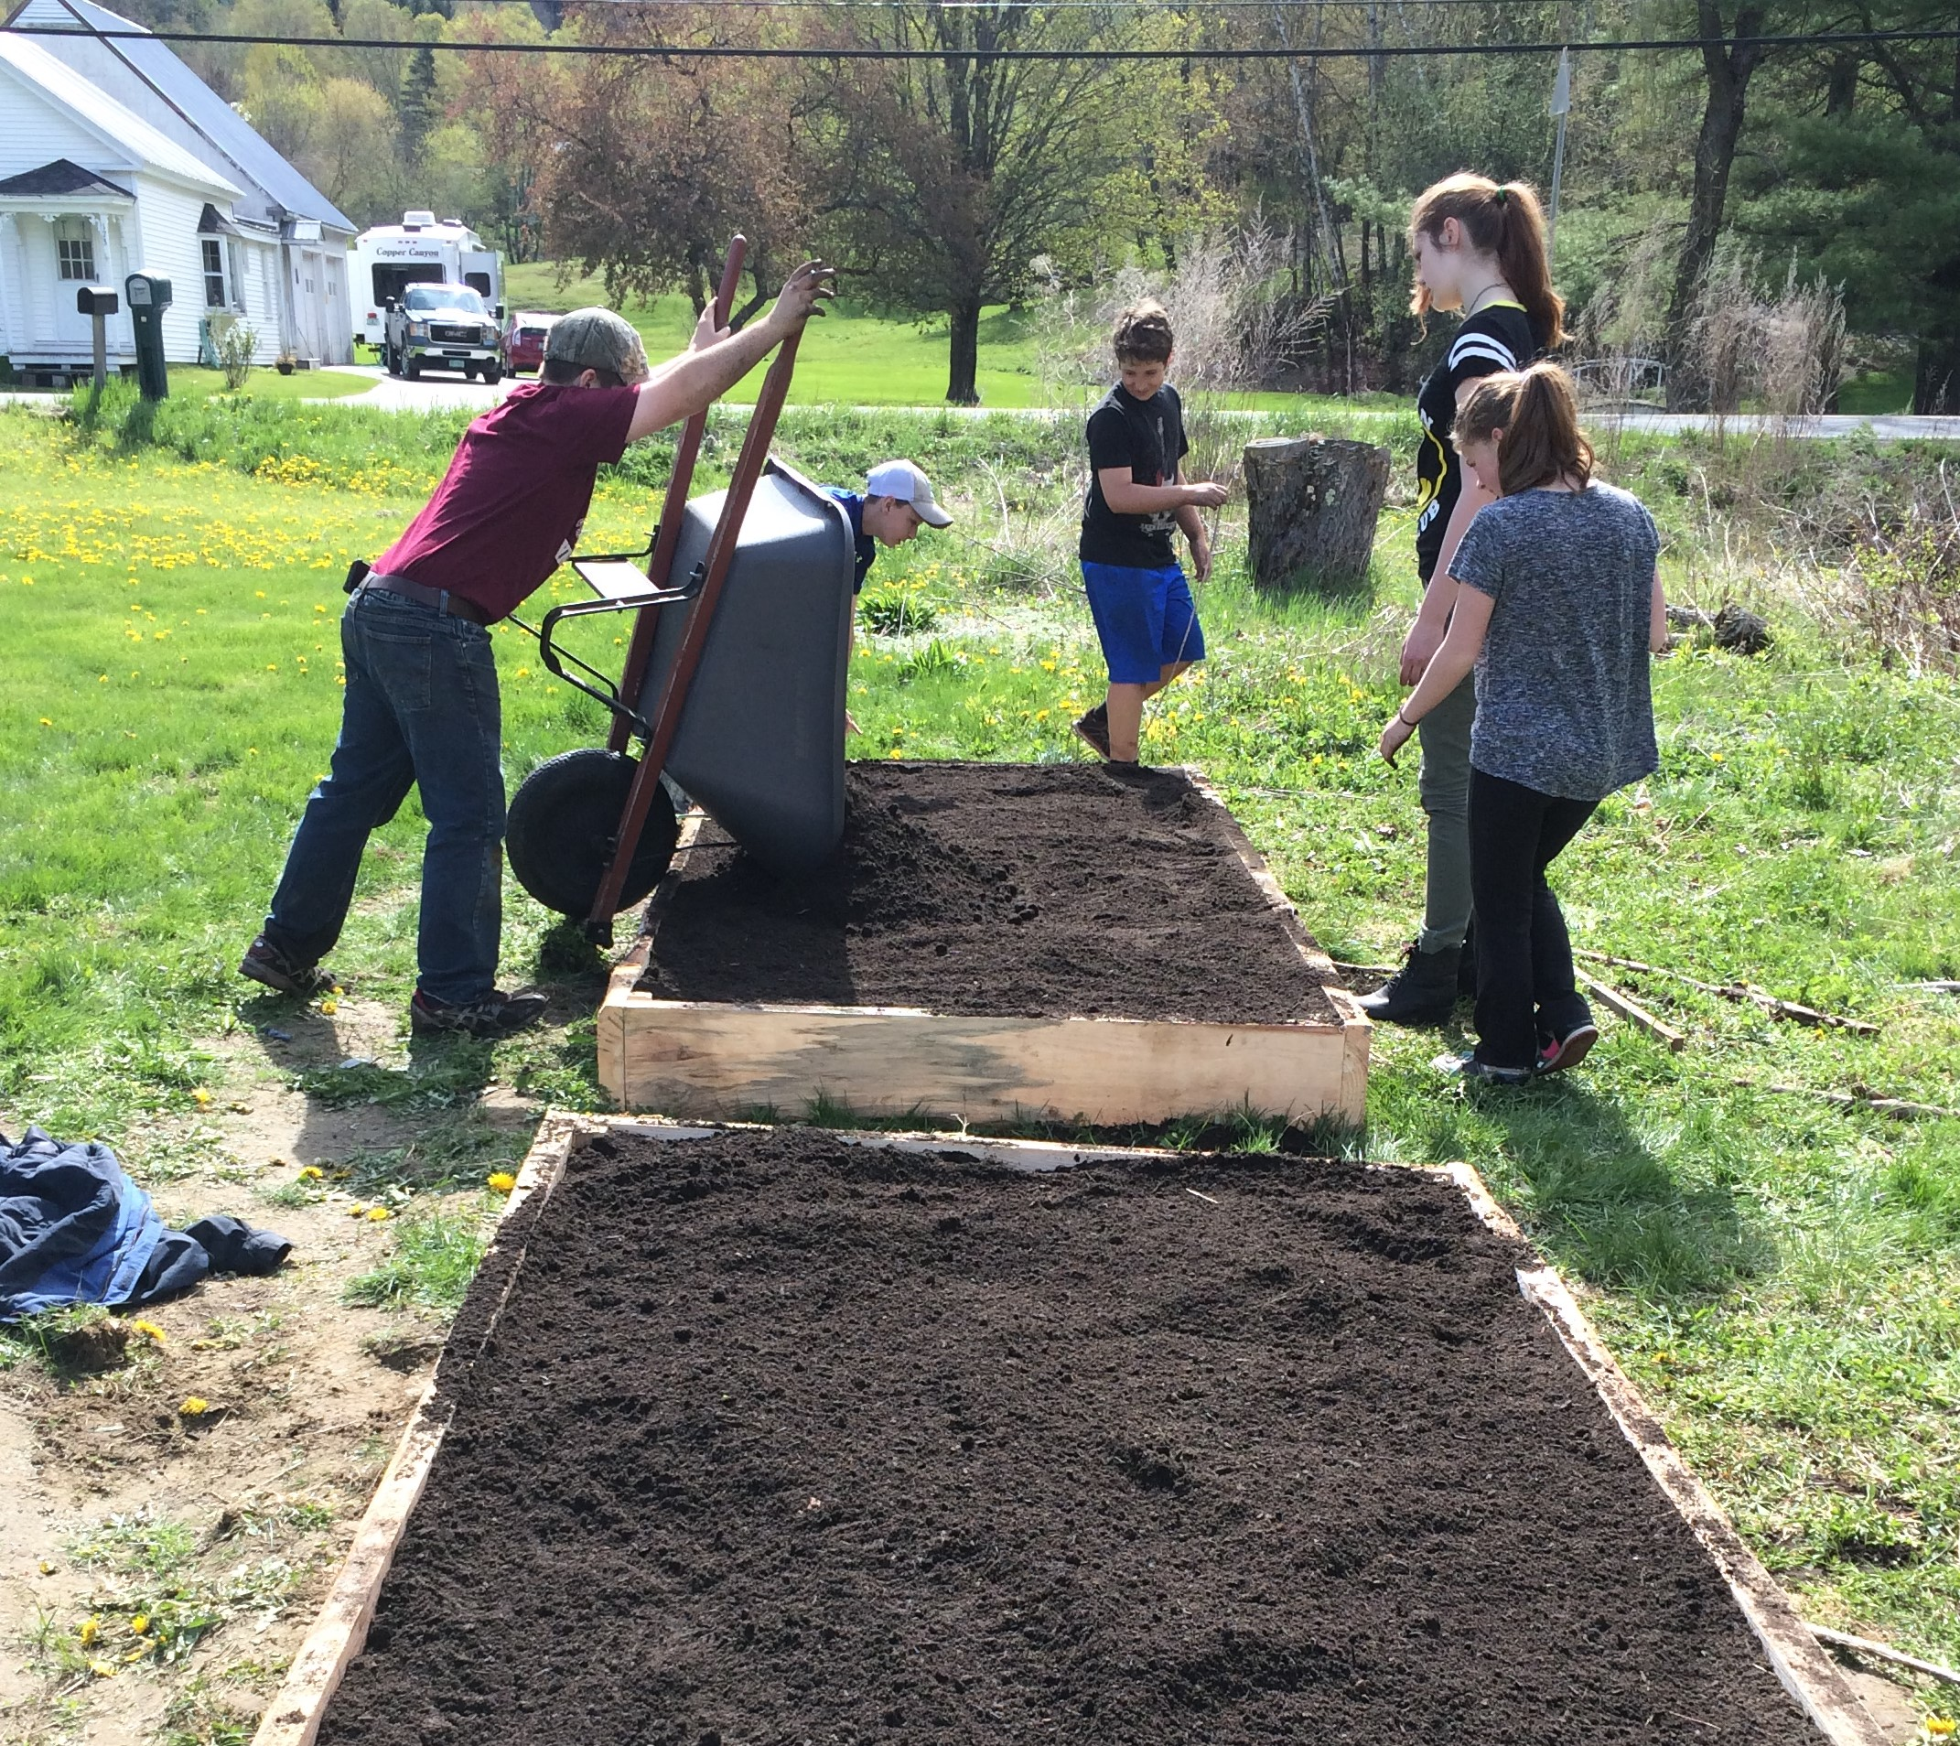

CVSU’s Guide To: Personalized and Proficiency Based Learning
Proficiency-Based Learning
Continued

Slide 4

 | Habits of Success Graduation Proficiency: Engaged Learner (Critical Thinking)
Performance Indicator | Task Specific Learning Targets (What it looks like, and what I will need to do) |  | Evidence of Learning (What I will use to show proficiency)
Synthesis and Application Synthesizes information from a variety of sources and experiences into new understanding; applies knowledge and skills. | I can learn about Proficiency Based Education by active listening, note taking, and participating in group discussions and/or asking questions. I can understand the reasons for the switch, the difference between Formative and Summative Assessments, and have a basic foundation for supporting my son and/or daughter. |  | Presentation notes Close read of CVSU’s Guide to Personalized and Proficiency Based Learning Analysis of example assessments PBGR understanding self-assessment Record of discussion with student or teacher.
Beginning | Approaching | Proficient |  | Exemplary
Selecting new information and generating new understandings. Collects information from different sources and experiences. | Analyze new information into new understanding. Integrates new knowledge and skills from different sources and experiences. | Synthesizes new information into new understanding. Integrates new knowledge and skills from a variety of sources and experiences. |  | Student can independently synthesize new information into a deeper understanding and apply knowledge and skills to new learning.

Slide 5
 | Habits of Success Graduation Proficiency: Engaged Learner (Critical Thinking)
Performance Indicator | Task Specific Learning Targets (What it looks like, and what I will need to do) |  | Evidence of Learning (What I will use to show proficiency)
Synthesis and Application Synthesizes information from a variety of sources and experiences into new understanding; applies knowledge and skills. | I can learn about Proficiency Based Education by active listening, note taking, and participating in group discussions and/or asking questions. I can understand the reasons for the switch, the difference between Formative and Summative Assessments, and have a basic foundation for supporting my son and/or daughter. |  | Presentation notes Close read of CVSU’s Guide to Personalized and Proficiency Based Learning Analysis of example assessments PBGR understanding self-assessment Record of discussion with student or teacher.
Beginning | Approaching | Proficient |  | Exemplary
Selecting new information and generating new understandings. Collects information from different sources and experiences. | Analyze new information into new understanding. Integrates new knowledge and skills from different sources and experiences. | Synthesizes new information into new understanding. Integrates new knowledge and skills from a variety of sources and experiences. |  | Student can independently synthesize new information into a deeper understanding and apply knowledge and skills to new learning.

Slide 6
 | Habits of Success Graduation Proficiency: Engaged Learner (Critical Thinking)
Performance Indicator | Task Specific Learning Targets (What it looks like, and what I will need to do) |  | Evidence of Learning (What I will use to show proficiency)
Synthesis and Application Synthesizes information from a variety of sources and experiences into new understanding; applies knowledge and skills. | I can learn about Proficiency Based Education by active listening, note taking, and participating in group discussions and/or asking questions. I can understand the reasons for the switch, the difference between Formative and Summative Assessments, and have a basic foundation for supporting my son and/or daughter. |  | Presentation notes Close read of CVSU’s Guide to Personalized and Proficiency Based Learning Analysis of example assessments PBGR understanding self-assessment Record of discussion with student or teacher.
Beginning | Approaching | Proficient |  | Exemplary
Selecting new information and generating new understandings. Collects information from different sources and experiences. | Analyze new information into new understanding. Integrates new knowledge and skills from different sources and experiences. | Synthesizes new information into new understanding. Integrates new knowledge and skills from a variety of sources and experiences. |  | Student can independently synthesize new information into a deeper understanding and apply knowledge and skills to new learning.

Slide 7
 | Habits of Success Graduation Proficiency: Engaged Learner (Critical Thinking)
Performance Indicator | Task Specific Learning Targets (What it looks like, and what I will need to do) |  | Evidence of Learning (What I will use to show proficiency)
Synthesis and Application Synthesizes information from a variety of sources and experiences into new understanding; applies knowledge and skills. | I can learn about Proficiency Based Education by active listening, note taking, and participating in group discussions and/or asking questions. I can understand the reasons for the switch, the difference between Formative and Summative Assessments, and have a basic foundation for supporting my son and/or daughter. |  | Presentation notes Close read of CVSU’s Guide to Personalized and Proficiency Based Learning Analysis of example assessments PBGR understanding self-assessment Record of discussion with student or teacher.
Beginning | Approaching | Proficient |  | Exemplary
Selecting new information and generating new understandings. Collects information from different sources and experiences. | Analyze new information into new understanding. Integrates new knowledge and skills from different sources and experiences. | Synthesizes new information into new understanding. Integrates new knowledge and skills from a variety of sources and experiences. |  | Student can independently synthesize new information into a deeper understanding and apply knowledge and skills to new learning.

Slide 8
 | Habits of Success Graduation Proficiency: Engaged Learner (Critical Thinking)
Performance Indicator | Task Specific Learning Targets (What it looks like, and what I will need to do) |  | Evidence of Learning (What I will use to show proficiency)
Synthesis and Application Synthesizes information from a variety of sources and experiences into new understanding; applies knowledge and skills. | I can learn about Proficiency Based Education by active listening, note taking, and participating in group discussions and/or asking questions. I can understand the reasons for the switch, the difference between Formative and Summative Assessments, and have a basic foundation for supporting my son and/or daughter. |  | Presentation notes Close read of CVSU’s Guide to Personalized and Proficiency Based Learning Analysis of example assessments PBGR understanding self-assessment Record of discussion with student or teacher.
Beginning | Approaching | Proficient |  | Exemplary
Selecting new information and generating new understandings. Collects information from different sources and experiences. | Analyze new information into new understanding. Integrates new knowledge and skills from different sources and experiences. | Synthesizes new information into new understanding. Integrates new knowledge and skills from a variety of sources and experiences. |  | Student can independently synthesize new information into a deeper understanding and apply knowledge and skills to new learning.

Slide 9
 | Habits of Success Graduation Proficiency: Engaged Learner (Critical Thinking)
Performance Indicator | Task Specific Learning Targets (What it looks like, and what I will need to do) |  | Evidence of Learning (What I will use to show proficiency)
Synthesis and Application Synthesizes information from a variety of sources and experiences into new understanding; applies knowledge and skills. | I can learn about Proficiency Based Education by active listening, note taking, and participating in group discussions and/or asking questions. I can understand the reasons for the switch, the difference between Formative and Summative Assessments, and have a basic foundation for supporting my son and/or daughter. |  | Presentation notes Close read of CVSU’s Guide to Personalized and Proficiency Based Learning Analysis of example assessments PBGR understanding self-assessment Record of discussion with student or teacher.
Beginning | Approaching | Proficient |  | Exemplary
Selecting new information and generating new understandings. Collects information from different sources and experiences. | Analyze new information into new understanding. Integrates new knowledge and skills from different sources and experiences. | Synthesizes new information into new understanding. Integrates new knowledge and skills from a variety of sources and experiences. |  | Student can independently synthesize new information into a deeper understanding and apply knowledge and skills to new learning.

Slide 10
 | Habits of Success Graduation Proficiency: Engaged Learner (Critical Thinking)
Performance Indicator | Task Specific Learning Targets (What it looks like, and what I will need to do) |  | Evidence of Learning (What I will use to show proficiency)
Synthesis and Application Synthesizes information from a variety of sources and experiences into new understanding; applies knowledge and skills. | I can learn about Proficiency Based Education by active listening, note taking, and participating in group discussions and/or asking questions. I can understand the reasons for the switch, the difference between Formative and Summative Assessments, and have a basic foundation for supporting my son and/or daughter. |  | Presentation notes Close read of CVSU’s Guide to Personalized and Proficiency Based Learning Analysis of example assessments PBGR understanding self-assessment Record of discussion with student or teacher.
Beginning | Approaching | Proficient |  | Exemplary
Selecting new information and generating new understandings. Collects information from different sources and experiences. | Analyze new information into new understanding. Integrates new knowledge and skills from different sources and experiences. | Synthesizes new information into new understanding. Integrates new knowledge and skills from a variety of sources and experiences. |  | Student can independently synthesize new information into a deeper understanding and apply knowledge and skills to new learning.

Slide 11
 | Habits of Success Graduation Proficiency: Engaged Learner (Critical Thinking)
Performance Indicator | Task Specific Learning Targets (What it looks like, and what I will need to do) |  | Evidence of Learning (What I will use to show proficiency)
Synthesis and Application Synthesizes information from a variety of sources and experiences into new understanding; applies knowledge and skills. | I can learn about Proficiency Based Education by active listening, note taking, and participating in group discussions and/or asking questions. I can understand the reasons for the switch, the difference between Formative and Summative Assessments, and have a basic foundation for supporting my son and/or daughter. |  | Presentation notes Close read of CVSU’s Guide to Personalized and Proficiency Based Learning Analysis of example assessments PBGR understanding self-assessment Record of discussion with student or teacher.
Beginning | Approaching | Proficient |  | Exemplary
Selecting new information and generating new understandings. Collects information from different sources and experiences. | Analyze new information into new understanding. Integrates new knowledge and skills from different sources and experiences. | Synthesizes new information into new understanding. Integrates new knowledge and skills from a variety of sources and experiences. |  | Student can independently synthesize new information into a deeper understanding and apply knowledge and skills to new learning.

Slide 12
 | Habits of Success Graduation Proficiency: Engaged Learner (Critical Thinking)
Performance Indicator | Task Specific Learning Targets (What it looks like, and what I will need to do) |  | Evidence of Learning (What I will use to show proficiency)
Synthesis and Application Synthesizes information from a variety of sources and experiences into new understanding; applies knowledge and skills. | I can learn about Proficiency Based Education by active listening, note taking, and participating in group discussions and/or asking questions. I can understand the reasons for the switch, the difference between Formative and Summative Assessments, and have a basic foundation for supporting my son and/or daughter. |  | Presentation notes Close read of CVSU’s Guide to Personalized and Proficiency Based Learning Analysis of example assessments PBGR understanding self-assessment Record of discussion with student or teacher.
Beginning | Approaching | Proficient |  | Exemplary
Selecting new information and generating new understandings. Collects information from different sources and experiences. | Analyze new information into new understanding. Integrates new knowledge and skills from different sources and experiences. | Synthesizes new information into new understanding. Integrates new knowledge and skills from a variety of sources and experiences. |  | Student can independently synthesize new information into a deeper understanding and apply knowledge and skills to new learning.

Slide 13

Proficiency-Based Reporting
Proficiency-Based Learning
Continued
Proficiency-based reporting systems require:
clear expectations for what will be learned;
a shared understanding of the depth of learning necessary to demonstrate proficiency;
strategies for documenting and reporting learning over time;
a transparent method of communicating with learners, parents, and guardians where learners are along a continuum;
and opportunities, when necessary, for learners to retake assessments in order to progress towards proficiency.

Slide 14
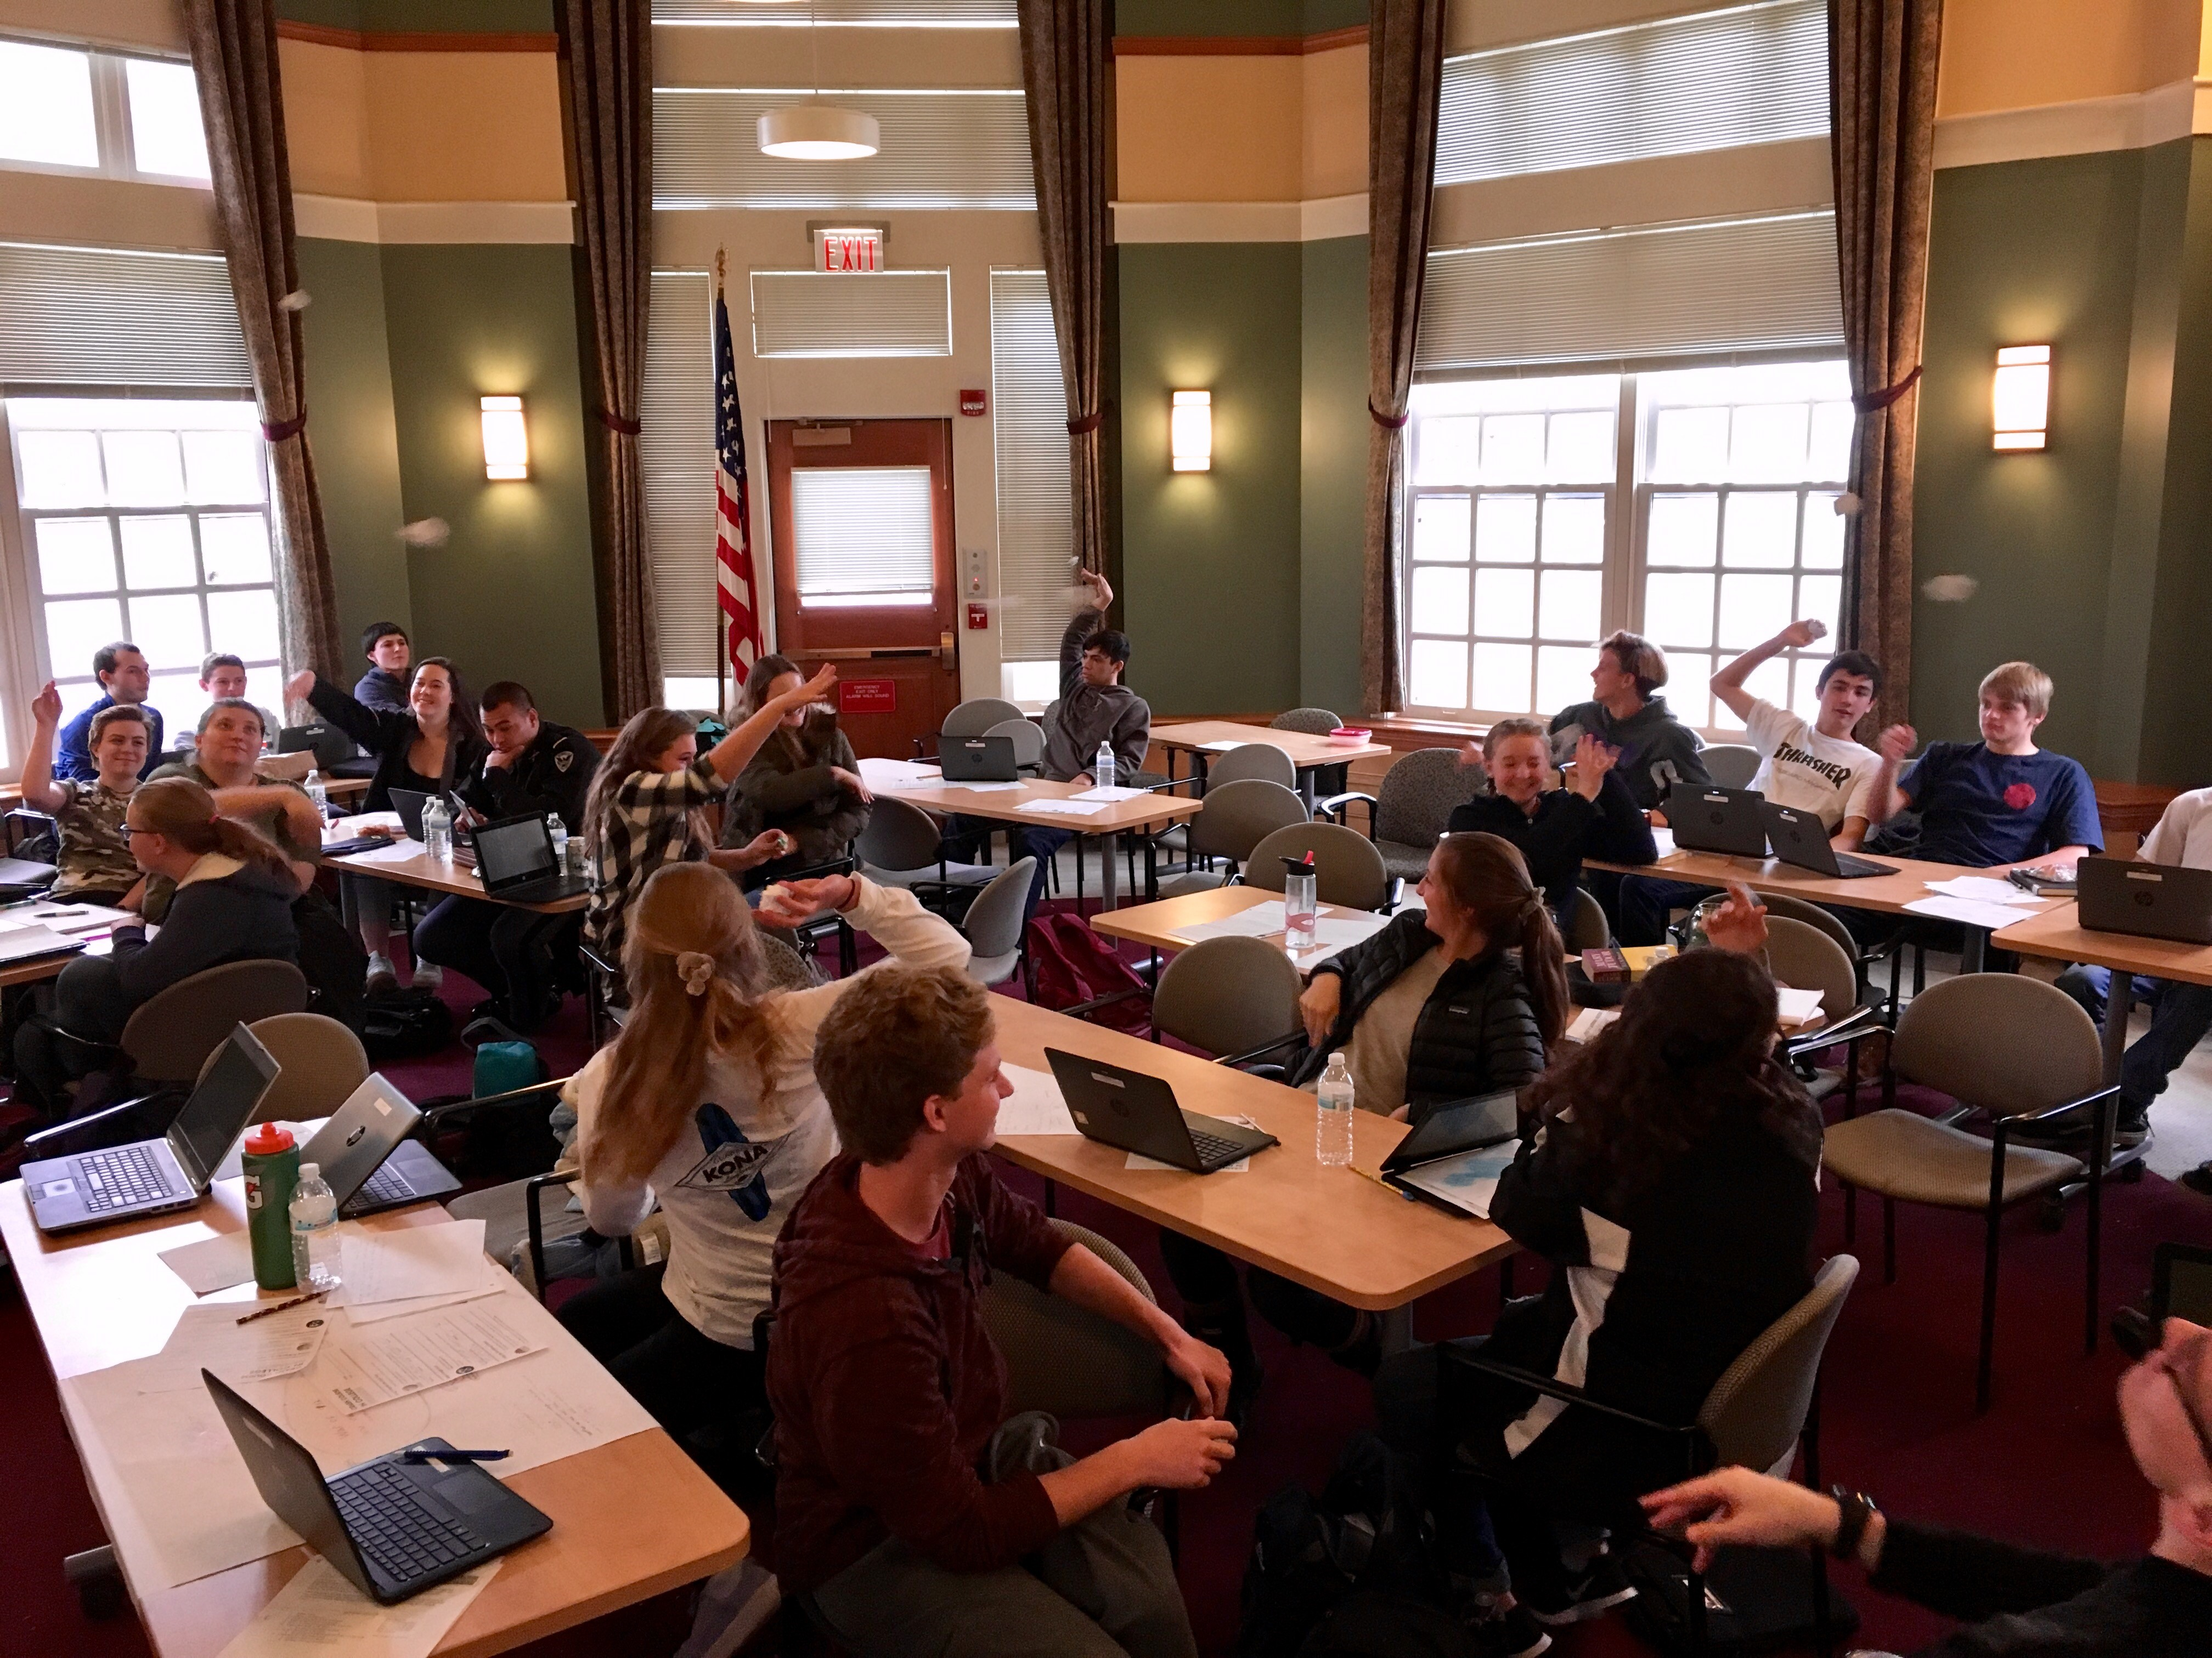
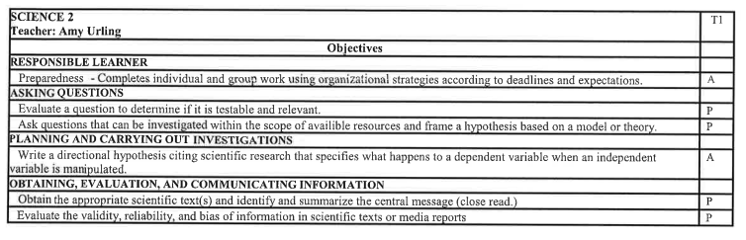
Proficiency Based Report Cards
Proficiency-Based Learning
Continued

Slide 15

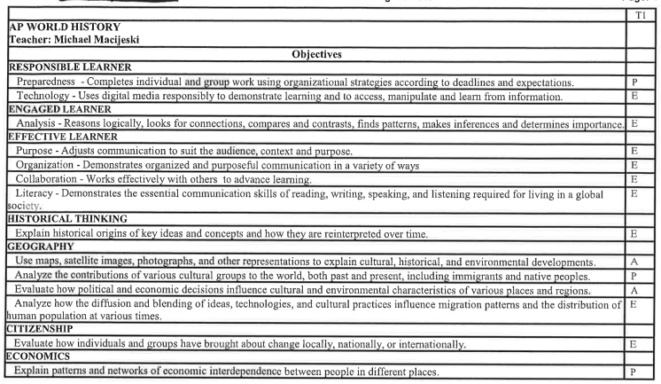
Habits of Success and Content Specific Performance Indicators
Proficiency Based Report Cards Continued

Slide 16

Proficiency Based Grading and Scoring Scales
Student progress on Formative Assessments will be in various forms of feedback to indicate where a student is tracking in a particular indicator
Students will be given scores on their Summative Assessments in the form of B, A, P or E.
B = Beginning
A = Approaching
P = Proficient
E = Exemplary
Middle School students may receive a DP (= Developmentally Proficient) if they are performing where they should be for that grade year.
For example, a student in sixth grade may only be expected to be at Beginning for that Performance Indicator and their Term Grade will be given as DP
What will “grades” look like?

Slide 17
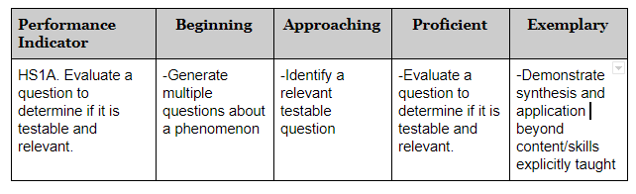
Habits of Success and Content Specific Performance Indicators - Science
Proficiency Based Report Cards Continued

Slide 18
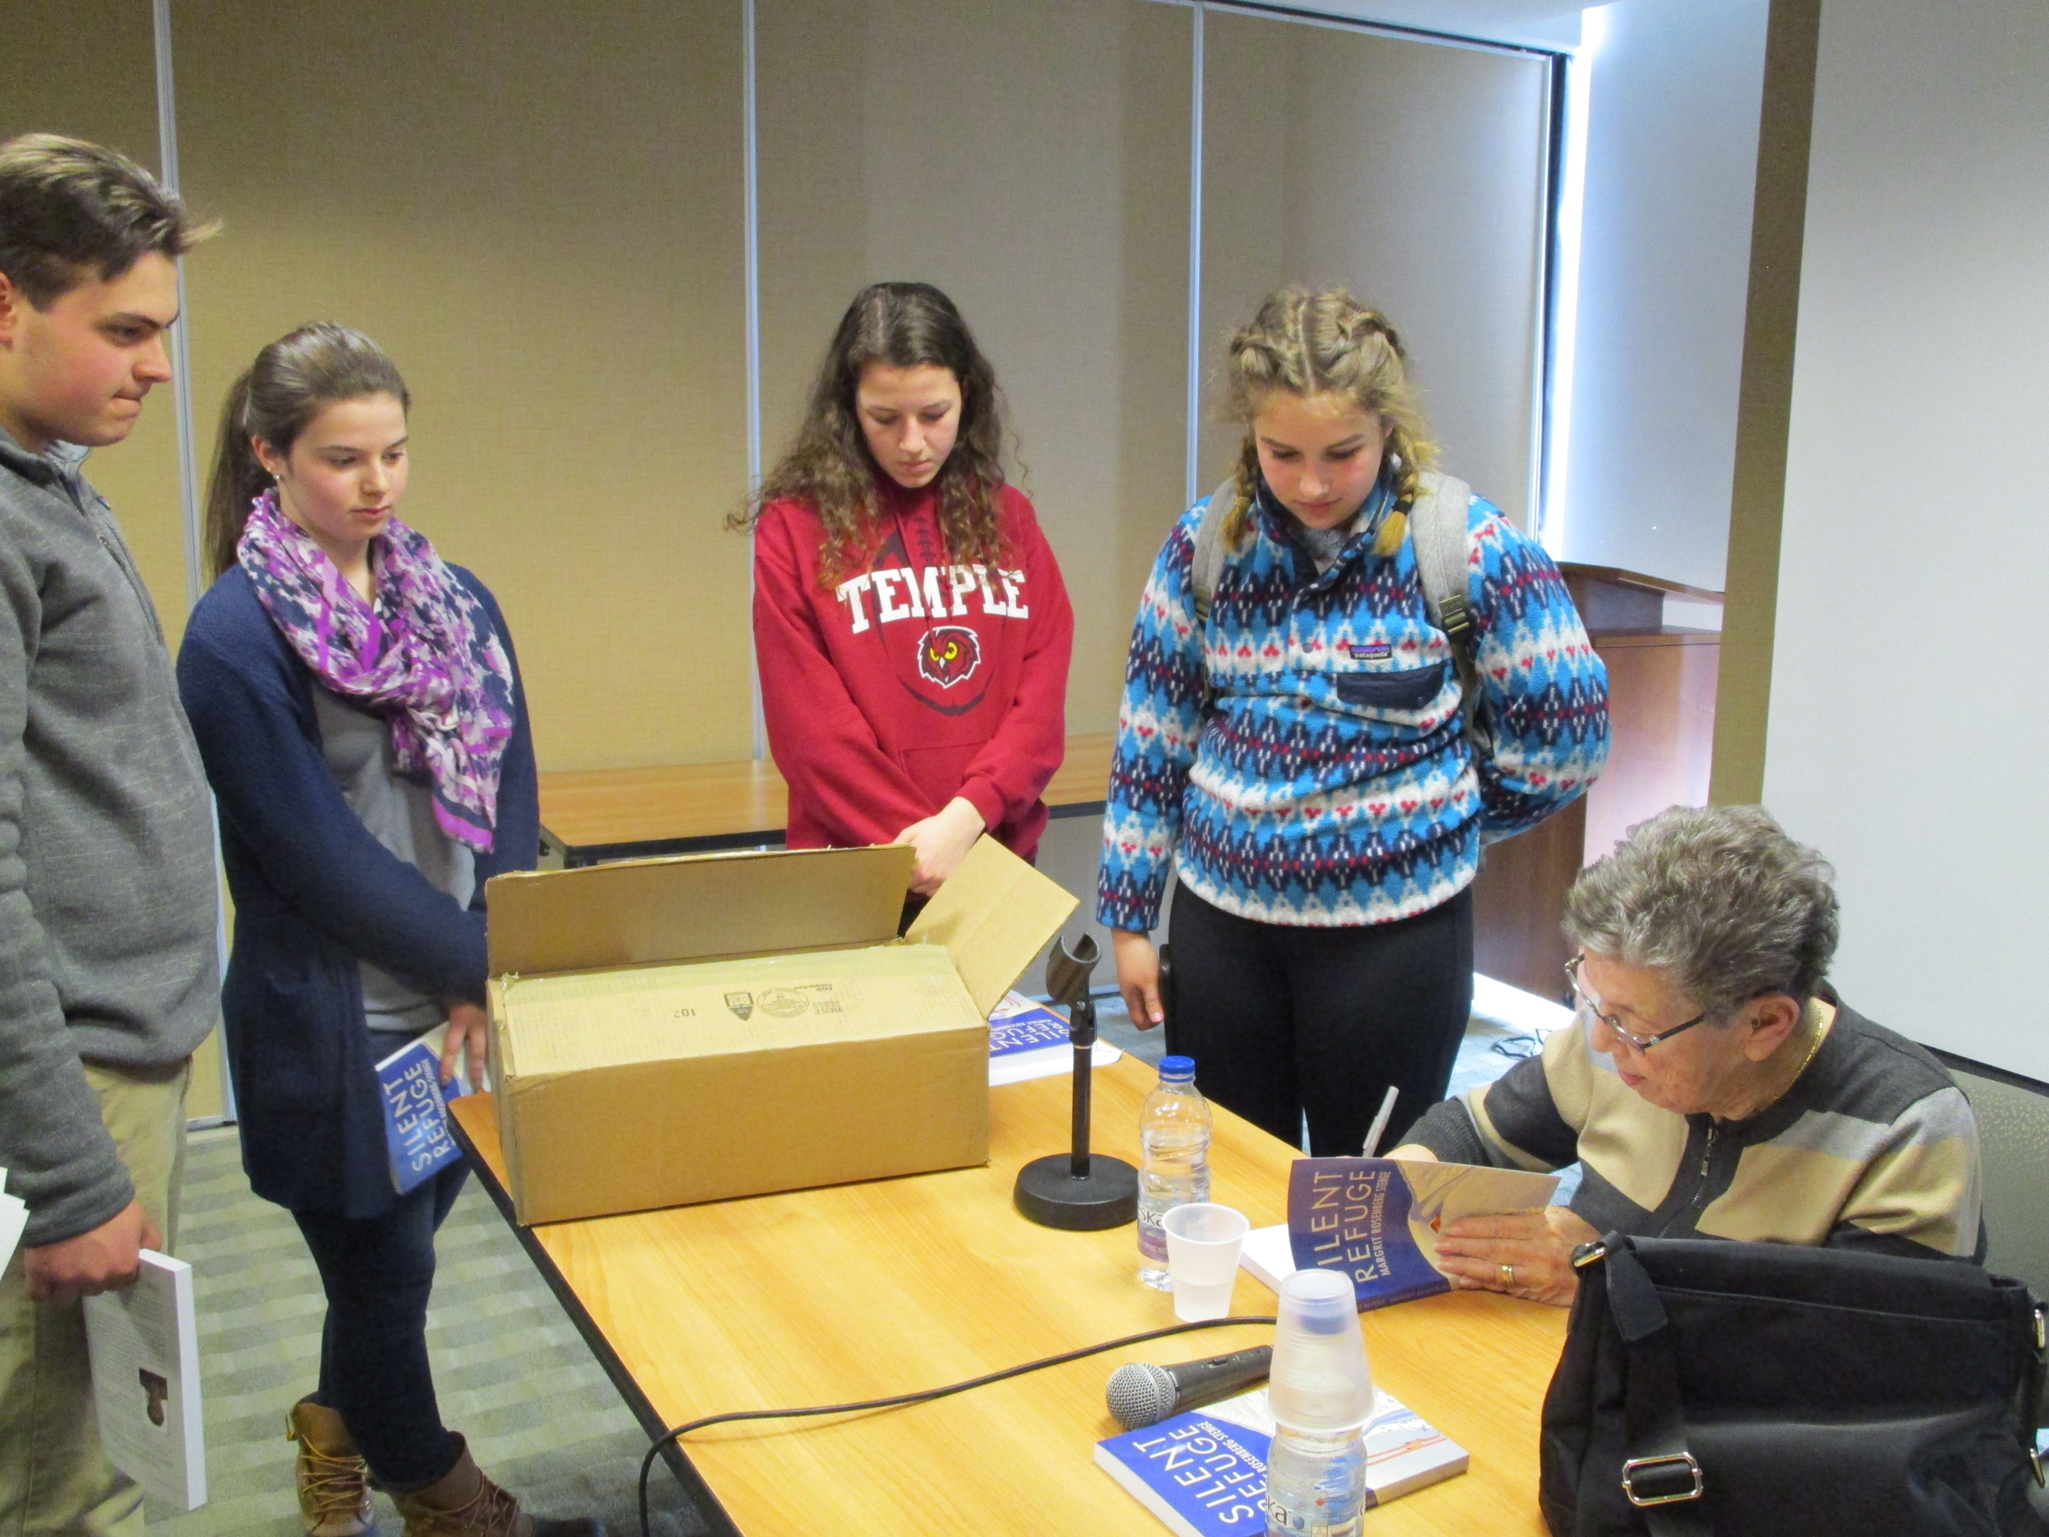
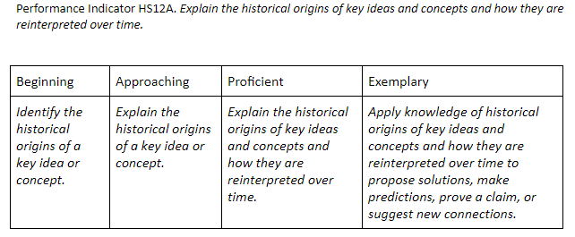
Scoring Criteria and Scoring Scales – Global Studies
What does my “score” look like and how do I know what it means?

Slide 19
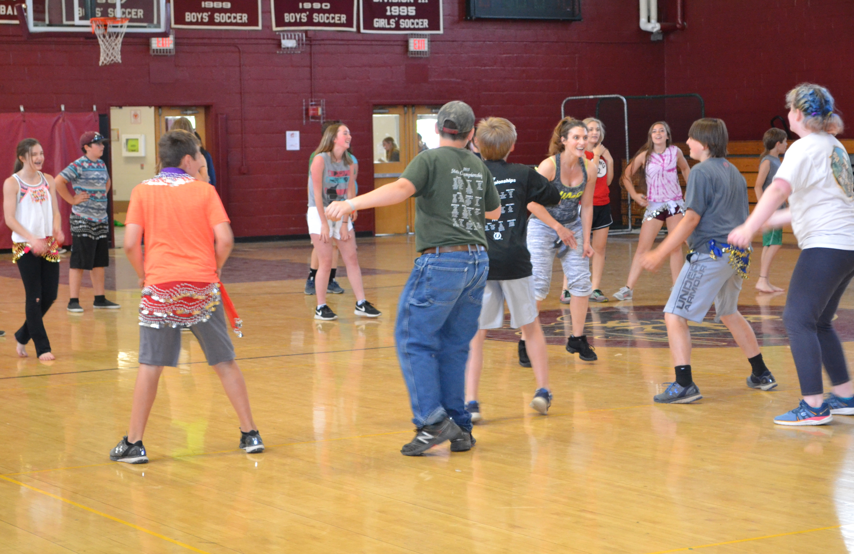
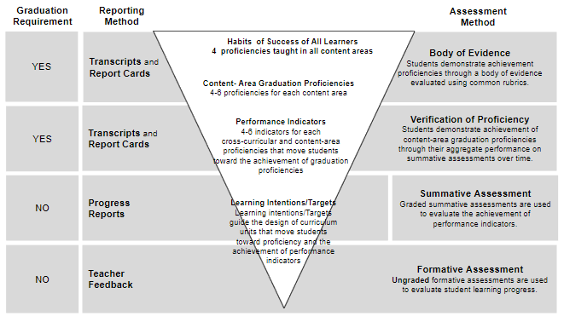
Proficiency Based Learning
Derived from existing content area standards (CCSS, NGSS, etc…).
Performance Indicators are used to assess whether or not a student has met the Graduation Proficiency associated with those indicators.
These are not items in a checklist to determine proficiency, they are used to inform determinations of student proficiency.
Central Vermont SU

Slide 20
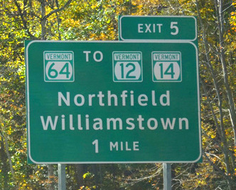
Conclusion
Thank you for coming!
We will be having more parent nights to continue to inform the community about Proficiency Based Learning
Stay tuned for the next evening!

