Slide 1
Proficiency Based Learning at NMHS Making a Difference!
Northfield Middle & High School – October 24, 2018

Slide 2
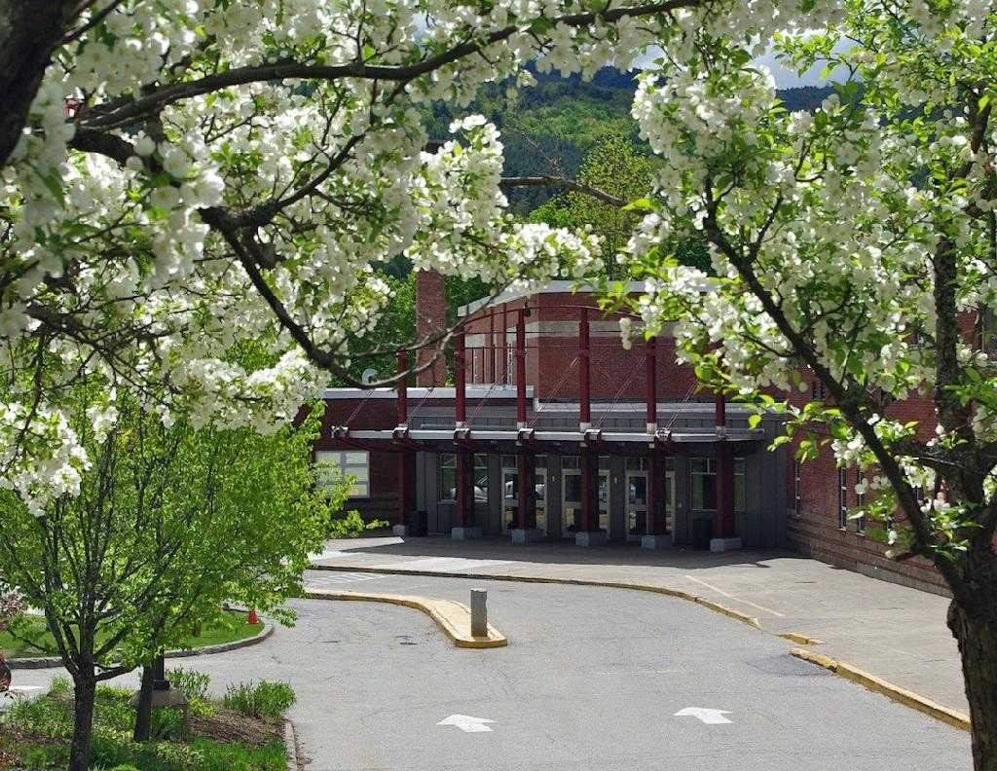
VT Education Quality Standards
State Board Rule 2000 – adopted Dec. 17, 2013
The purpose of these rules is to ensure that all students in Vermont public schools are afforded educational opportunities that are substantially equal in quality, and enable them to achieve or exceed the standards approved by the State Board of Education.

Slide 3
Graduation Requirements
VT ED Quality Standards Continued
A student meets the requirement for graduation when the student demonstrates evidence of proficiency in the stated curriculum content.
Local graduation policy must define proficiency-based graduation requirements based on standards adopted by the State Board of Education.
Schools may or may not use credits for the purpose of demonstrating proficiency.
When used, credits must specify the proficiencies demonstrated in order to attain that credit.

Slide 4
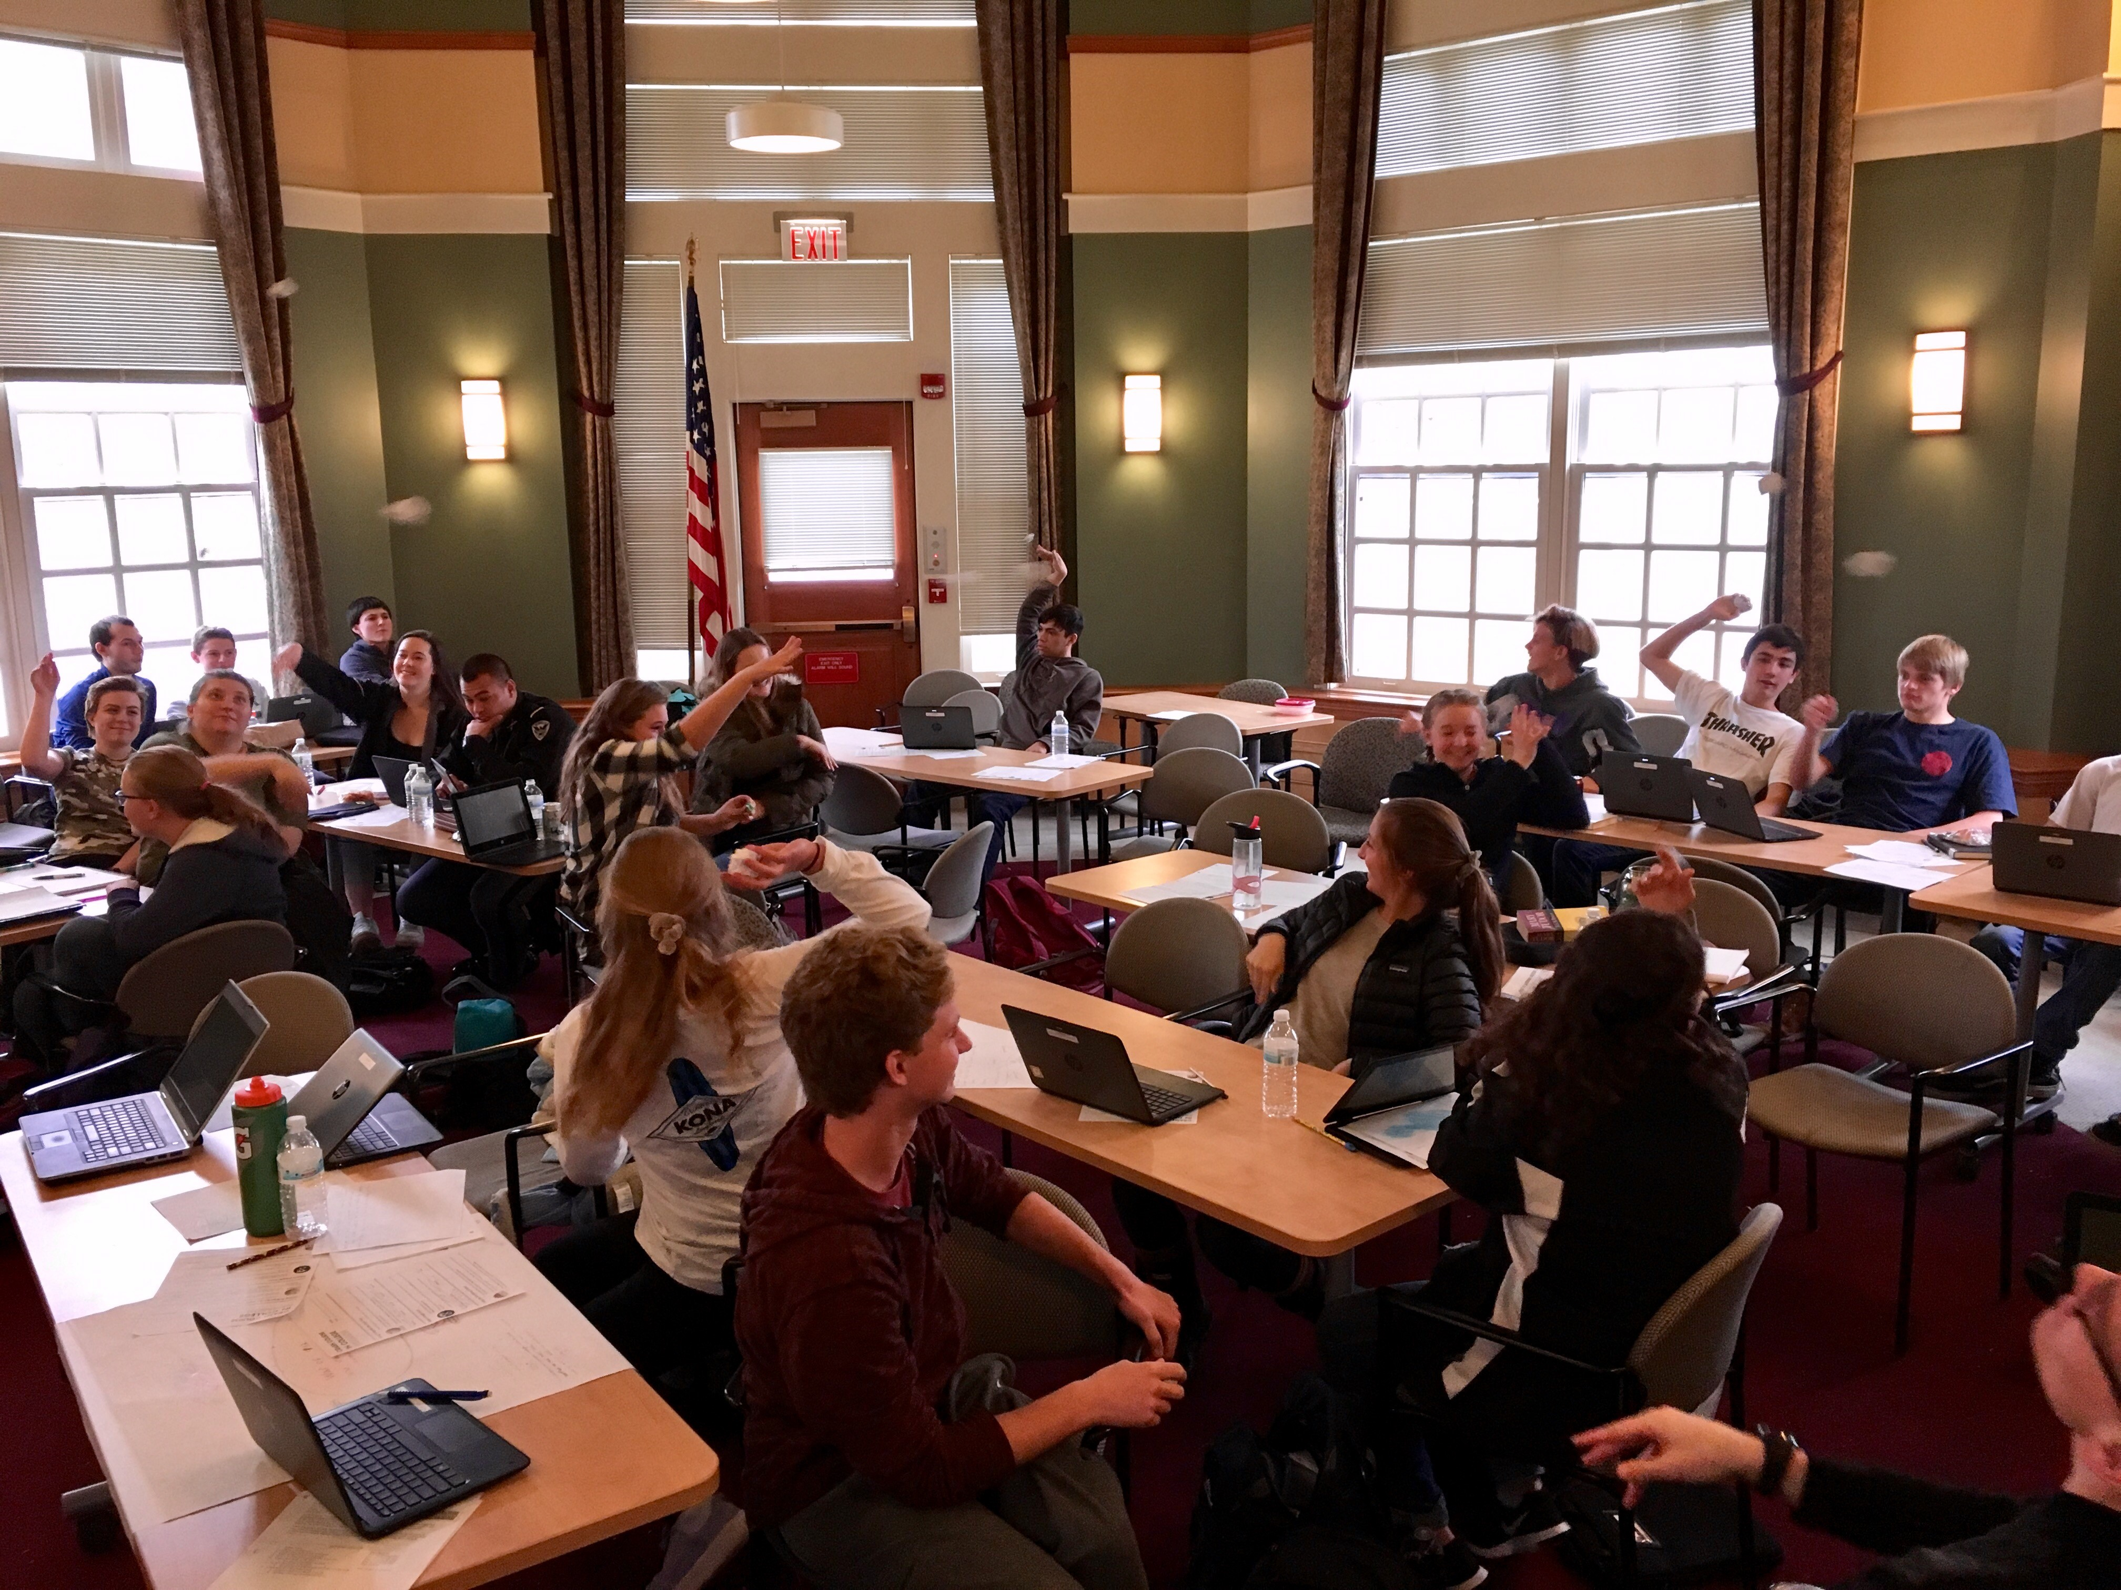
Proficiency Based Graduation Requirements
What is a PBGR?
The locally-delineated set of content knowledge and skills that have been determined to qualify a student for earning a high school diploma.
Students earn their diploma by demonstrating mastery of skills and content through teacher-designed assessments, written papers, presentations, portfolios projects, or other venues.

Slide 5
Performance Indicators
Derived from existing content area standards (CCSS, NGSS, etc…).
Performance Indicators are used to assess whether or not a student has met the Graduation Proficiency associated with those indicators.
These are not items in a checklist to determine proficiency, they are used to inform determinations of student proficiency.
What is a PI?

Slide 6
Scoring in Traditional System

Slide 7
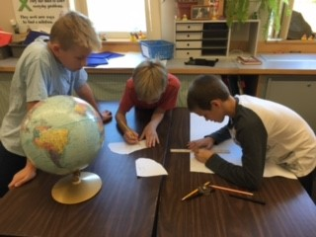
Scoring in a Proficiency Based System

Slide 8
Proficiency Based Grading and Scoring Scales
Student progress on Formative Assessments will be in various forms of feedback to indicate where a student is tracking in a particular indicator
Students will be given scores on their Summative Assessments in the form of B, A, P or E.
B = Beginning
A = Approaching
P = Proficient
E = Exemplary
Middle School students may receive a DP (= Developmentally Proficient) if they are performing where they should be for that grade year.
For example, a student in sixth grade may only be expected to be at Beginning for that Performance Indicator and their Term Grade will be given as DP
What will “grades” look like?

Slide 9
Tyler Portal
Log into your students Tyler Portal
Select the Schedule Tile
Next to the Course Title, select the “+” symbol, then select “Assignments”
You should now see all Formative and Summative
How do I monitor progress?

Slide 10
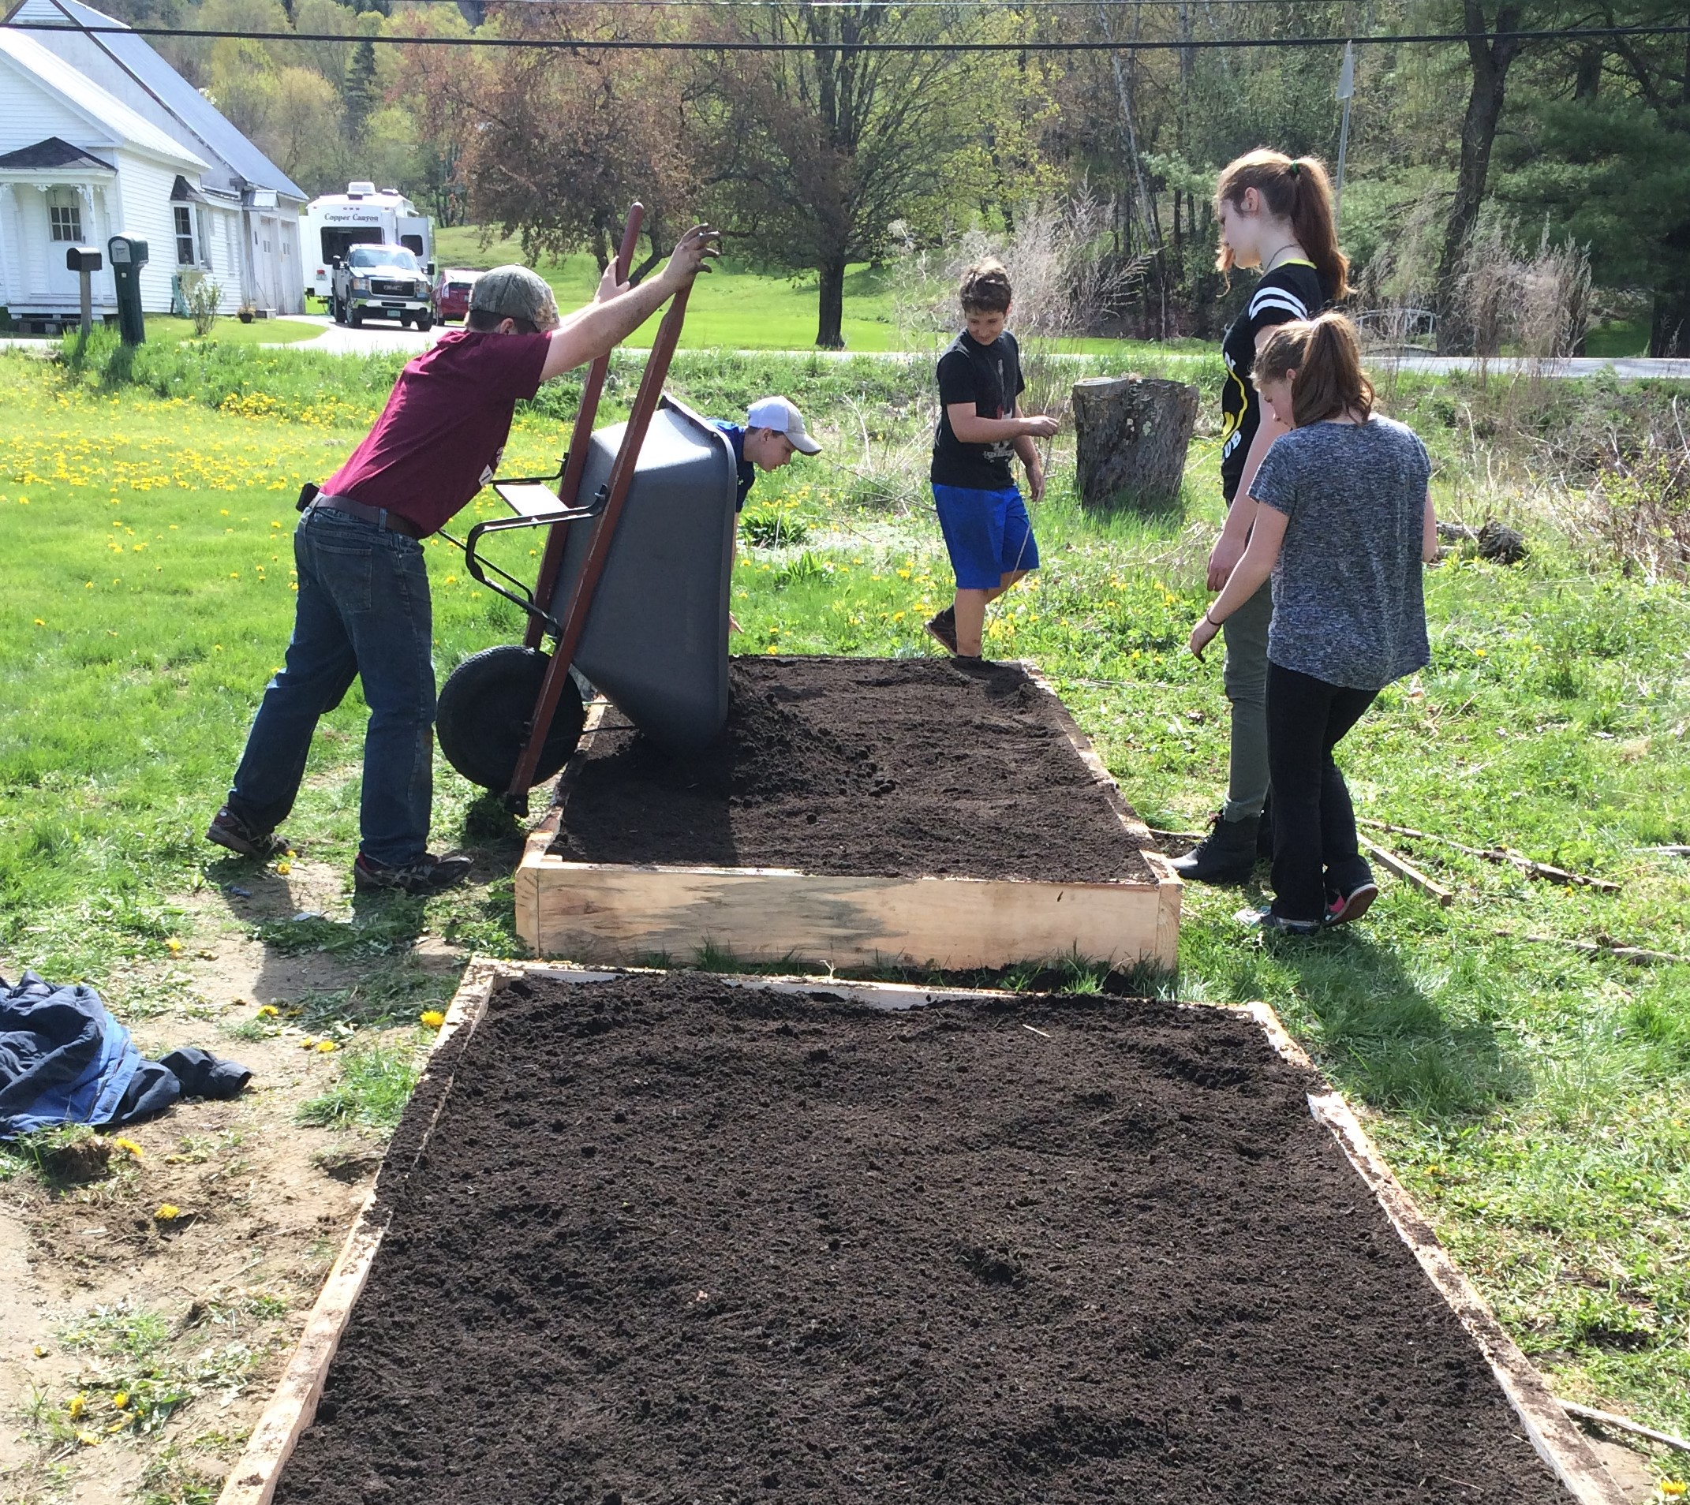
“Grades” are given by Performance Indicator
Is there an overall course grade?
Students are assessed on each Performance Indicator, each PBGR has 3-5 indicators that must be met at a Proficient level in order to meet graduation requirements
Scores for each Performance Indicator can be found by checking progress through Tyler
Term ending “grades” that end up on a report card, the Grades tile in Tyler, are the final assessment for that term for each Performance Indicator

Slide 11
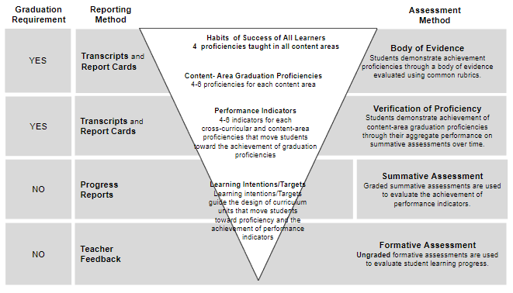
Proficiency Based Learning
Derived from existing content area standards (CCSS, NGSS, etc…).
Performance Indicators are used to assess whether or not a student has met the Graduation Proficiency associated with those indicators.
These are not items in a checklist to determine proficiency, they are used to inform determinations of student proficiency.
Central Vermont SU

Slide 12
Habits of Success, PBGR’s, Performance Indicators, Learning Targets
Habits of Success for all learner, the Transferrable Skills that CVSU has identified as graduation requirements
Habits of Success and PBGR/PI’s for Visual Arts
What does this look like in a class?

Slide 13
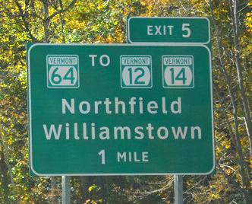
Conclusion
Thank you for coming!
We will be having more parent nights to continue to inform the community about Proficiency Based Learning
Stay tuned for the next evening
We have some laptops available if you would like to log in and have us help you navigate
The Portal will be fully live this Weekend!

