Slide 1
One Vision, One Mission, One Team
J.P. ODOM ACADEMY MIDDLE SCHOOL

Slide 2
Student Schedule Requirements
The ODOM EXPERIENCE
ELAR
Math
Social Studies
Science
Electives (4)

Slide 3
CURRICULUM GUIDELINES
ELAR Pegasus (7th Grade Curriculum)
Math Pegasus (8th Grade Curriculum)
Social Studies Pegasus (7th Grade Curriculum)
Science Pegasus(8th Grade Curriculum)

Slide 4
Language Arts
Level | 6th Grade | 7th Grade | 8th Grade | 9th Grade
On-Level | Lang Arts 6 STAAR Reading 6 | Lang Arts 7 STAAR Reading 7 | Lang Arts 8 STAAR Reading 8 | English I English I EOC
Honors | Lang Arts 6 H STAAR Reading 6 | Lang Arts 7 H STAAR Reading 7 | Lang Arts 8 H STAAR Reading 8 | English I Pre-AP Eng I EOC
Pegasus | Lang Arts 6 Peg STAAR ELAR 7 | Lang Arts 7 Peg STAAR Reading 8 | English I Pre-AP Eng I EOC | English II Pre-AP Eng II EOC

Slide 5
Social Studies
Level | 6th Grade | 7th Grade | 8th Grade | 9th Grade
On-Level | Soc Stud 6 | Soc Stud 7 | Soc Stud 8 STAAR Soc Stud 8 | World Geography
Honors | Soc Stud 6 H | Soc Stud 7 H | Soc Stud 8 H STAAR Soc Stud 8 | Pre-Advanced World Geography
Pegasus | Soc Stud 6 Peg | Soc Stud 7 Peg STAAR Soc Stud 8 | Pre Advanced World Geography | US History US Hist EOC

Slide 6
Math
Level | 6th Grade | 7th Grade | 8th Grade | 9th Grade
On-Level | Math 6 STAAR Reading 6 | Math 7 STAAR Reading 7 | Pre-Algebra STAAR Reading 8 | Algebra I Algebra I EOC
Honors | Math 6 H STAAR Math 6 | Pre-Algebra STAAR Math 8 | Algebra I Pre-AP Alg I EOC | Advanced Geom
Pegasus | Math 6 Peg STAAR Math 8 | Algebra I Pre-AP Alg I EOC | Advanced Geom | Advanced Algebra II

Slide 7
Science
Level | 6th Grade | 7th Grade | 8th Grade | 9th Grade
On-Level | Science 6 | Science 7 | Science 8 STAAR Science 8 | Biology I Biology I EOC
Honors | Science 6 H | Science 7 H STAAR Science 8 | IPC | Biology I Pre-AP
Pegasus | Science 6 Peg STAAR Science 8 | IPC | Biology I Biology EOC | Chemistry Pre-AP

Slide 8
Elective Category Options
Theatre Arts
Physical Education
Fine Arts
Dance

Slide 9
Potential Earned High School Credit
Pegasus- 6 core high school credits are possible to obtain
● English I ** (1 credit)
● Algebra I** (1 credit)
● Integrated Physics and Chemistry (IPC)** (1 credit)
● Geometry** (1credit)
● Biology** (1credit)
● World Geometry** (1 credit)

Slide 10
Potential Earned High School Credit
Pegasus*** and Honors**- 5 high school elective credits are possible to obtain
● Spanish 1** (1 credit)
● Spanish II***(1 credit)
● Art I** (1 credit)
● Business Information Management I***(1 credit)
● Touch System Data Entry ** (.5 credit)

Slide 11
Potential Earned High School Credit
Students who have successfully completed a high school credit course in middle school receive the appropriate units of high school credit and grade points. High school courses taken in middle school will be included on a student’s transcript and count in the grade point average (GPA).
Grade Level | Classification | Credits
9 | Freshman | 0 – 5.5
10 | Sophomore | 6 – 11.5
11 | Junior | 12 – 17.5
12 | Senior | 18 +

Slide 12
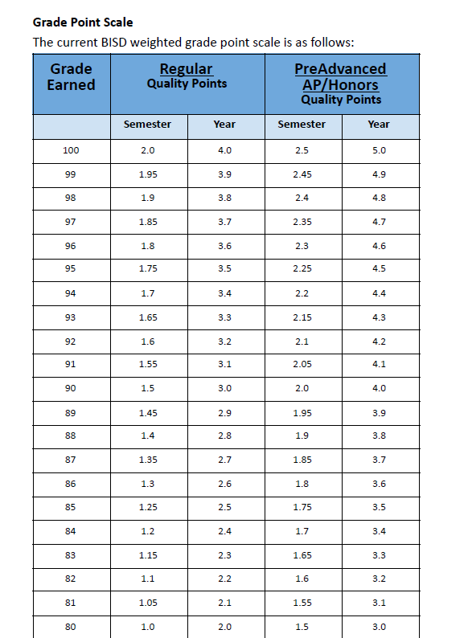

Slide 13
Any Questions You May Think Of……
Email:
Eric Lathan elathan@bmtisd.com
Peyton Jones pjones2@bmtisd.com
Answers will also be updated on our FAQ on our webpage.

