Slide 1
My School Bucks
Create Invoice

Slide 2
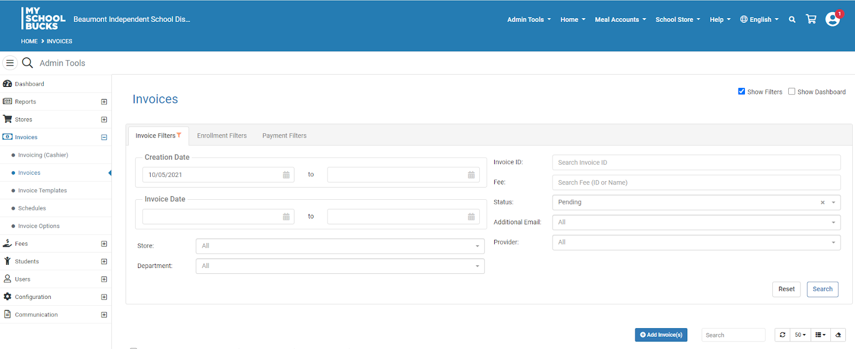
Under Admin Tools, click Invoices > Invoices
This will take you to the Invoices screen.
Click the blue +Add Invoice(s) button. You will be routed to the Create Invoice screen.
Invoices can be created in MSB to invoice (bill) students/parents for specific items. Once the invoice is created, an email will be sent to the parent of the student (Note: the parent has to have a MSB account in order to receive the email).

Slide 3
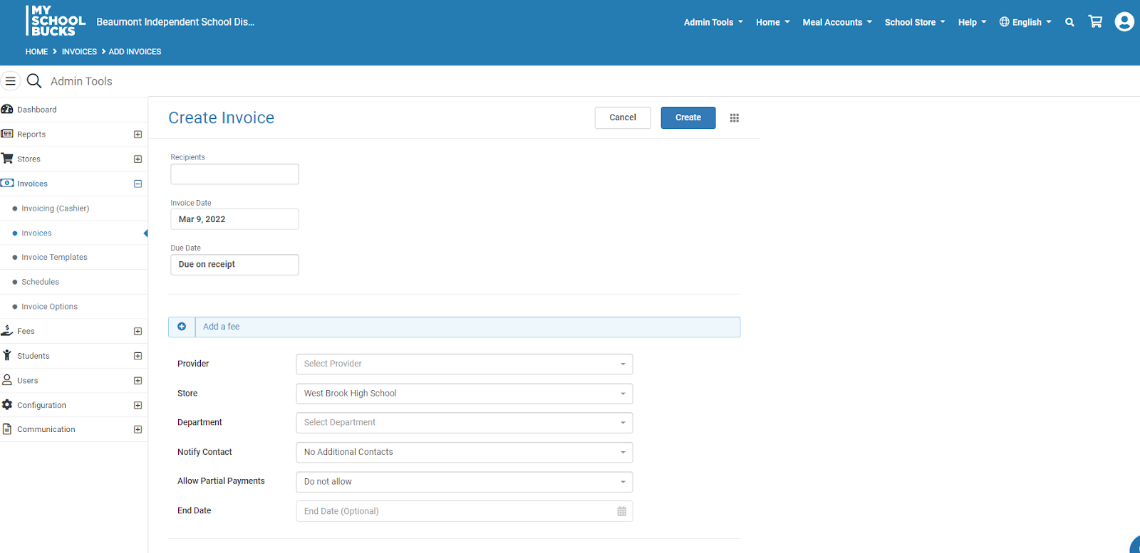
Select the Provider > Invoices
Select your school Store(Campus)
Select Allow or Do Not Allow Partial Payments
Click inside the Recipient box. This will take you to the Recipients screen.

Slide 4
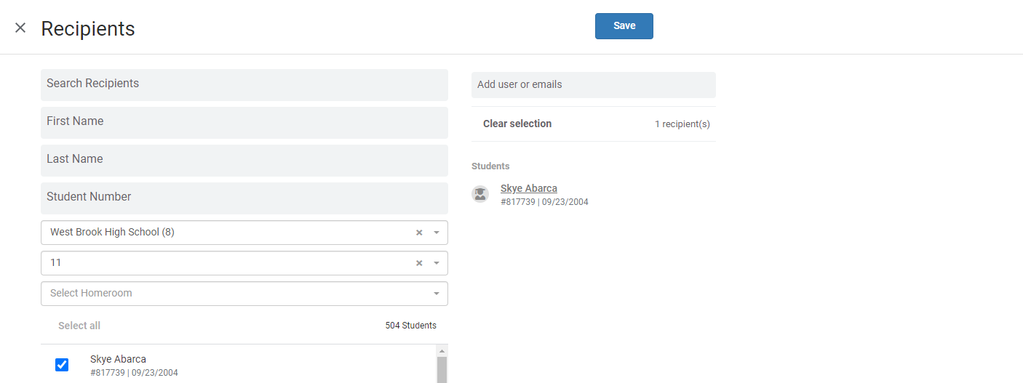
Select the School and Grade (this will narrow your search options).
Select the student – suggestion: select one student per invoice for tracking purposes.
The students name will appear on the right.
Enter an email if you have this information.
Click Save. You will be routed back to the Create Invoice screen

Slide 5
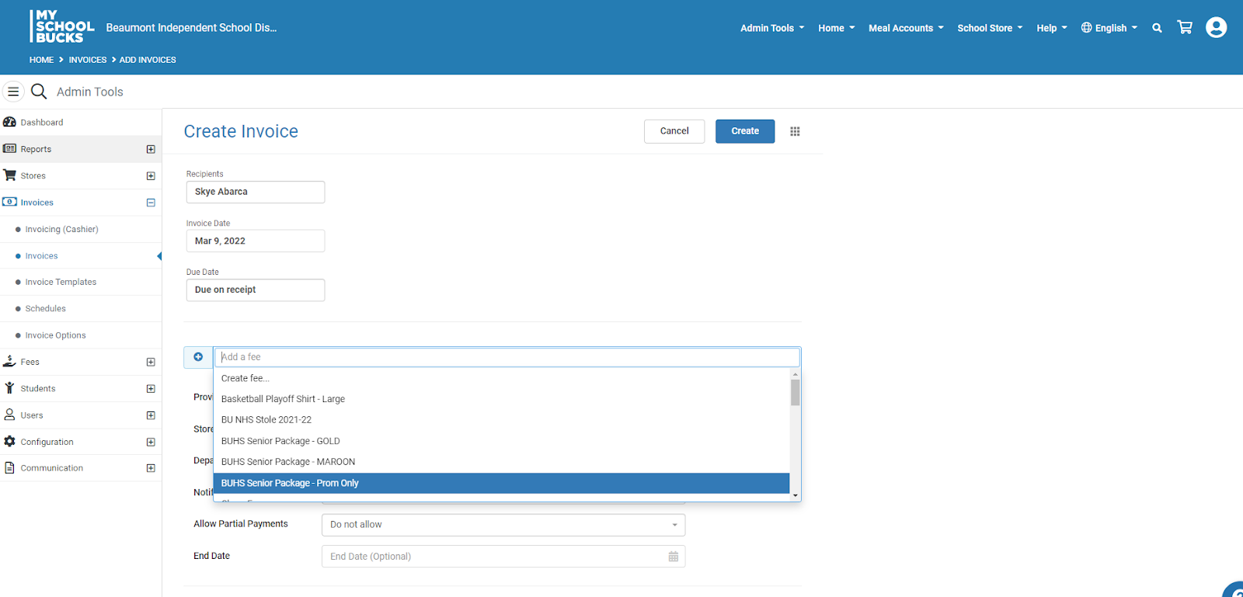
Click on Create Fee.
You will then get a pop-up box.

Slide 6
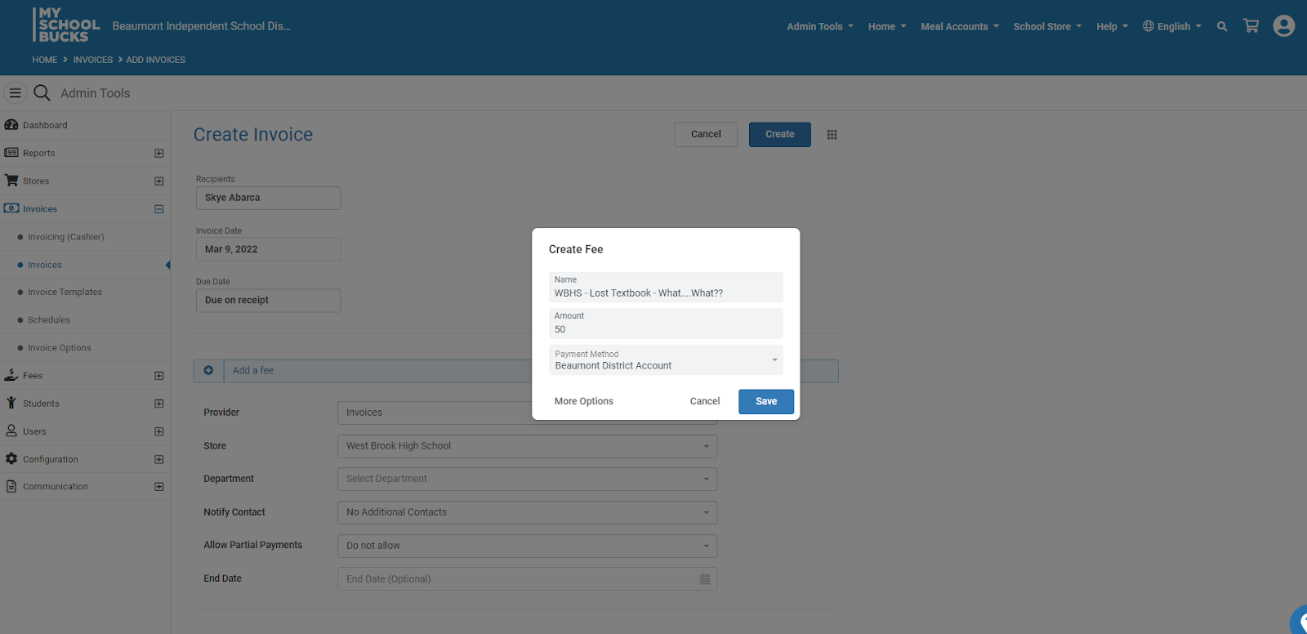
After selecting Create Fee, you will get a pop-up box (see above).
Name your fee (i.e. book name and serial number, cell phone fine, etc.).
Enter amount owed.
Payment Method is always Beaumont District Account.
Click More Options

Slide 7
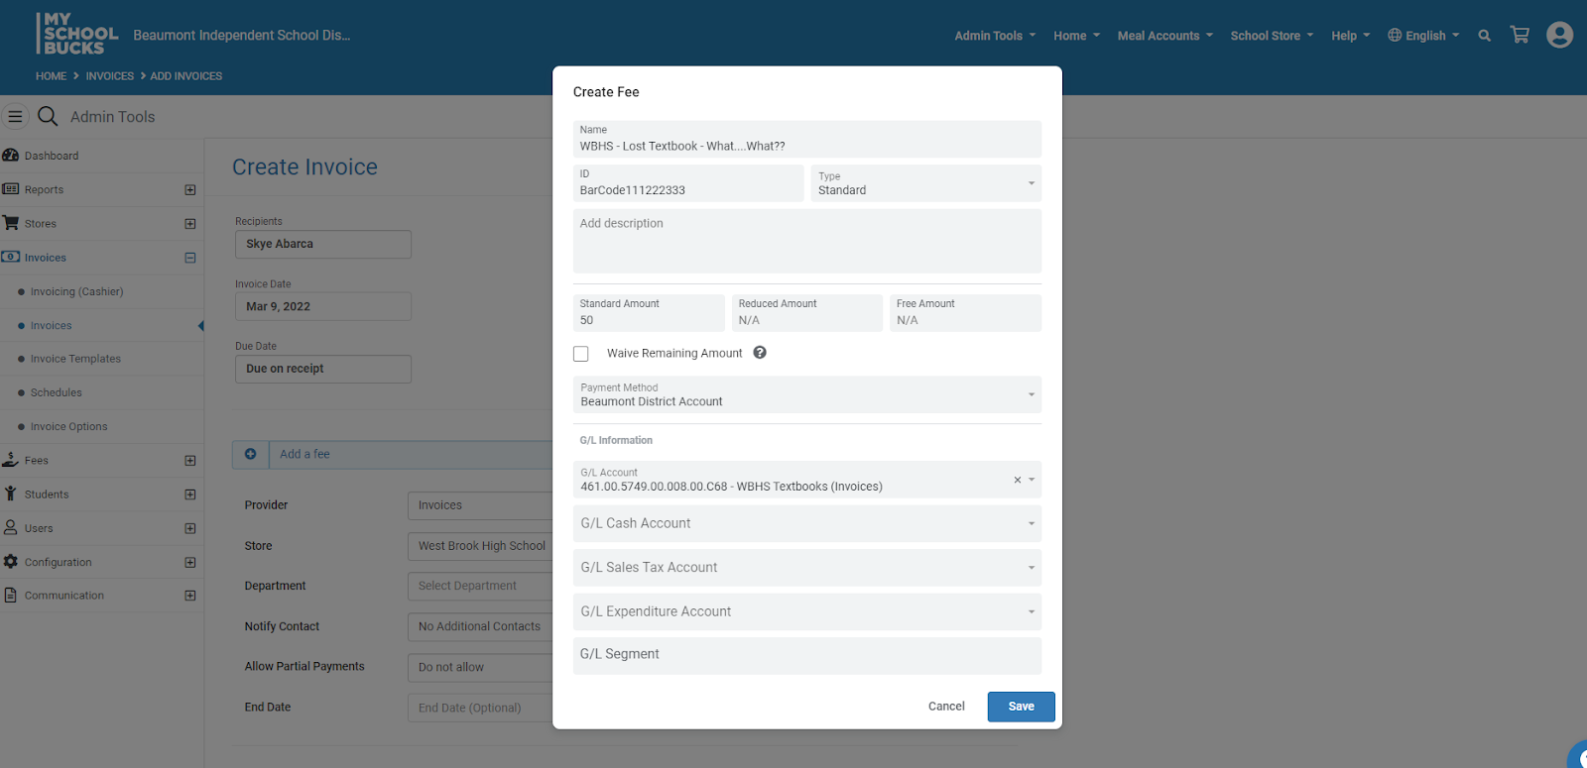
After clicking on More Options, you will get the pop-up above.
For additional tracking, enter any information you want on your MSB report in the ID box.
Note that the name, amount, and ID information will print on your MSB reports.
Also note that you can enter a description. This information will display on the invoice, but not print on your MSB reports.
Use the drop down to add your G/L Account number. The G/L Account number is needed to ensure monies are deposited to the correct activity fund account. If you do not see you account number, contact the Activity Funds Office.
After adding the G/L Account, click the blue Save button.
This will route you back to the Create Invoice screen.

Slide 8
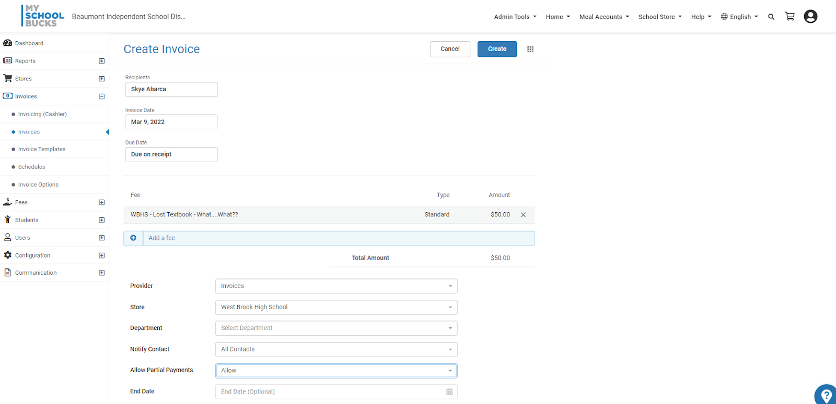
Click the blue Create button to generate the invoice.
Click Skip – majority of invoices are a custom name for tracking purposes.

Slide 9
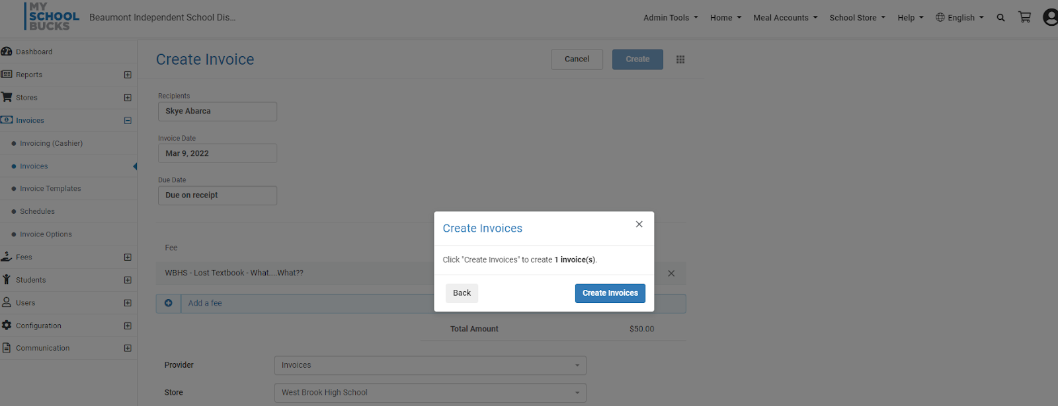
After clicking Skip, you will get the pop-up above.
Click the blue Create invoices button.

Slide 10
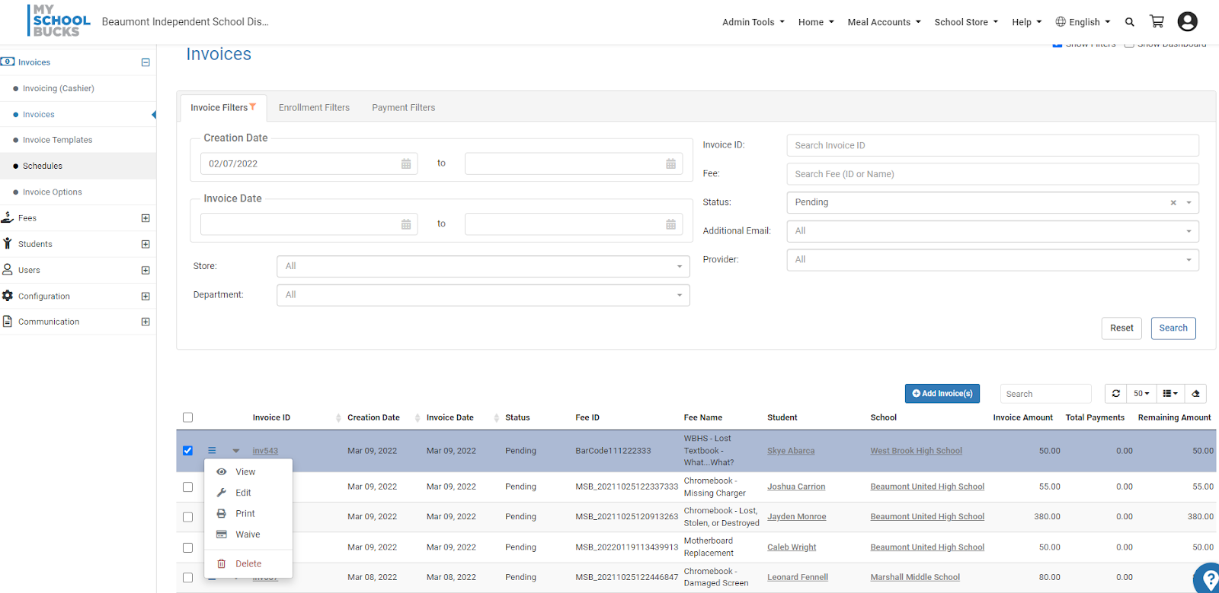
After clicking the Create button, you will be routed back to the Invoices screen.
At the top of the screen in green, it is noted that 1 – invoice(s) added successfully.
At the bottom of the screen, invoices created will be listed.
You will see the invoice amount, total payments, and remaining balance (if you choose to allow partial payments). The Status will remain pending until the remaining amount is zero.
To make changes or to view the invoice, check the Actions option (three blue horizontal lines).
The invoice can also be printed and a copy provided to the student/parent.
If the parent has a MSB account, an email will be sent to the email address on the account.

Slide 11
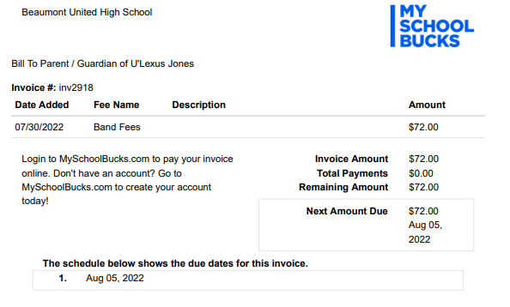
Invoice
Example

Slide 12
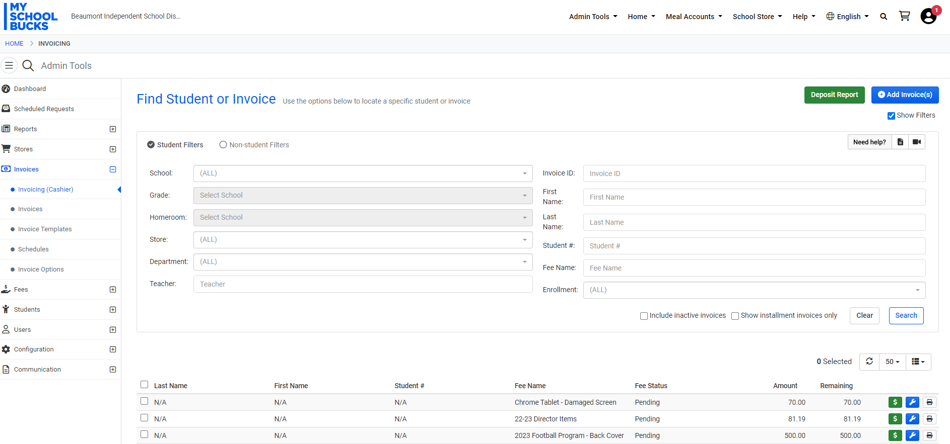
Use the Invoicing (Cashier) for and cash payments received.
Click the green Dollar Sign to be routed to the Payment Options screen.

Slide 13
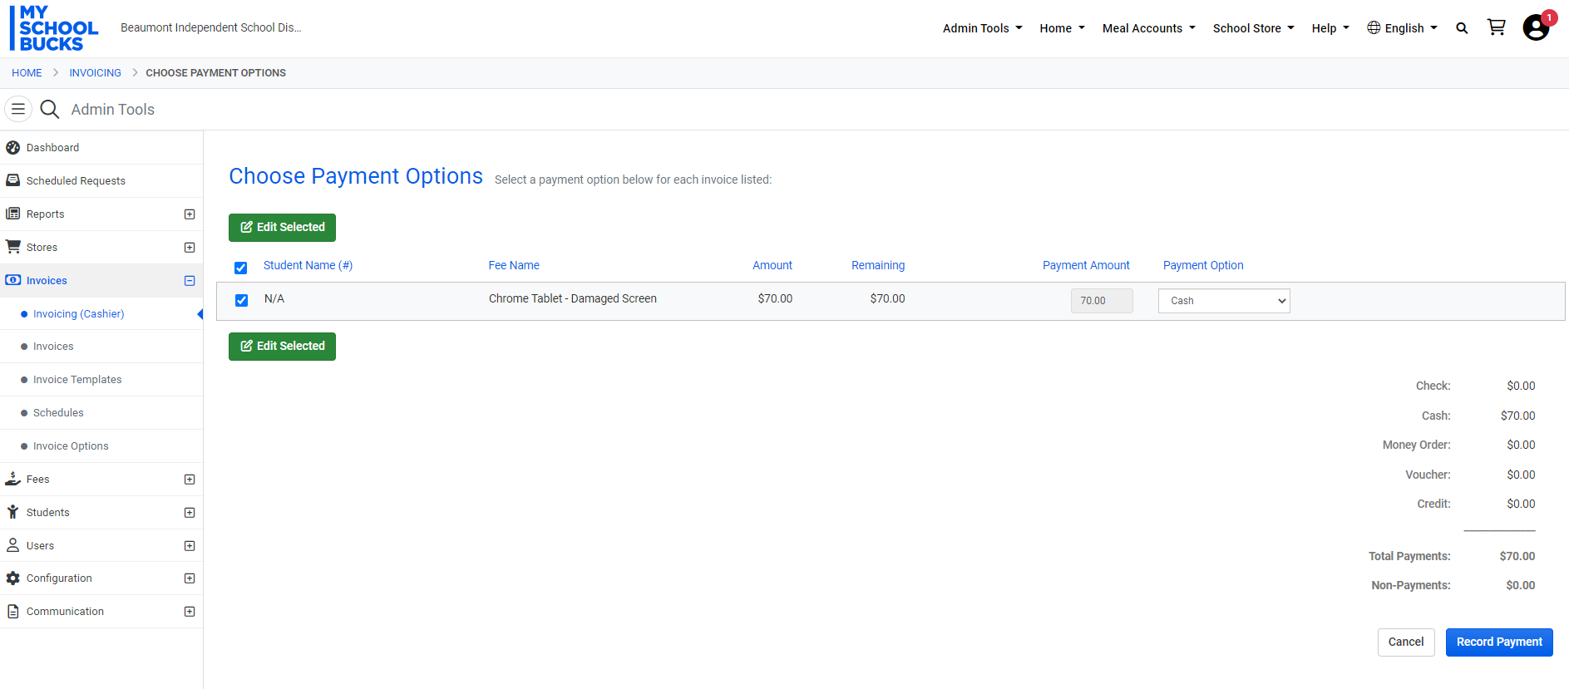
Enter the amount paid.
This option is to record cash payments in MSB and remove the invoice from the invoice list (if the payment is made in full).
Cash handling procedures are to be followed to record the payment in TEAMS and make the bank deposit.
Click the blue Record Payment button.

