Slide 1
My School Bucks (MSB)
Navigating the MSB Site

Slide 2
Utilize myschoolbucks.com to access the My School Bucks website. Click on the blue Log In button.

Slide 3
Sign in using your log in or create a new account.
User account notes:
- Secretary/bookkeepers are set up as Campus Administrators and can see all campus products, can create invoices, and run reports.
- Parents need to add all their students to their household in order to see the products at their student’s campus.
- Students need to add themselves in their household on their account to be able to access products at their campus.
- Anyone signing in as a guest will only see products that are offered district-wide.

Slide 4
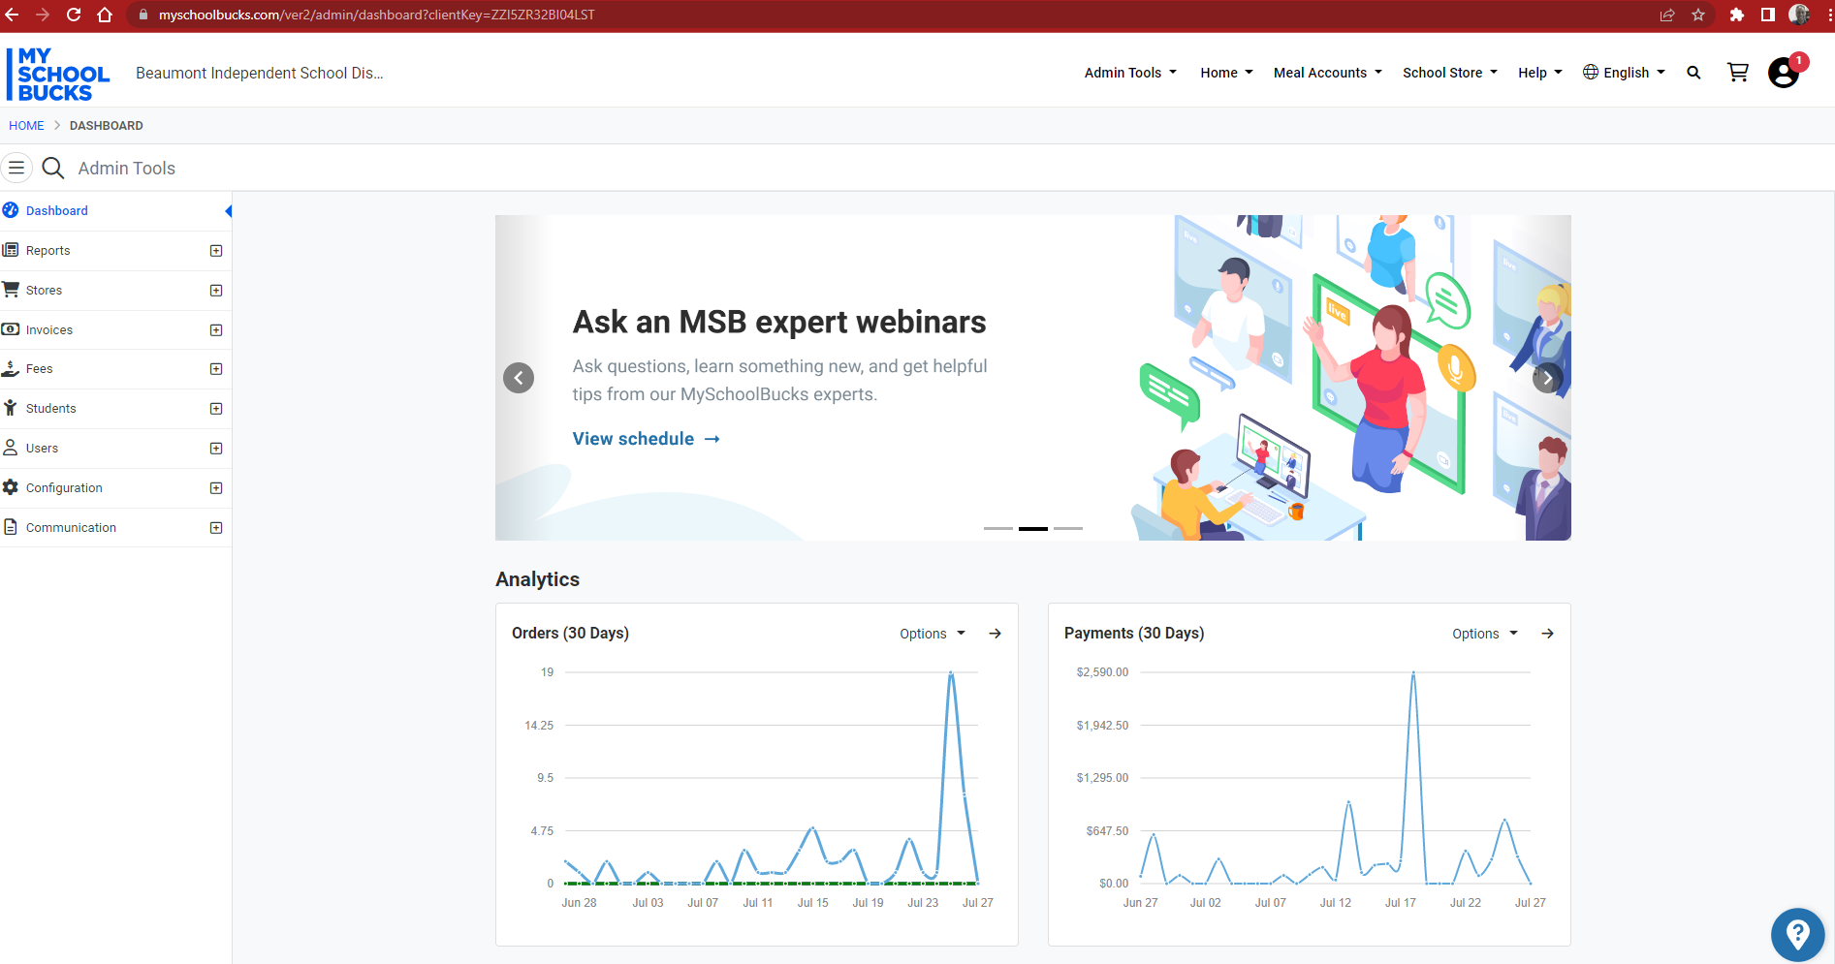
Secretary/bookkeepers as administrators will have access to ‘admin tools’ in MSB.
Use Admin Tools to navigate in MSB
Under Admin Tools, Campus Administrators will use the Reports, Stores (Products), and Invoices options.

Slide 5
Reports: Admin tools > Reports > payment > Payment report (detail)
You will use this option to run reports on products for sponsors and for financial reporting.
Reference the ‘Reports” procedures for running reports.

Slide 6
Products: Admin tools > Stores > Products
This is where the products created for your campus are listed.
Currently, the Activity Funds Office will create new products in MSB. Use the SAF 109 New Product/Update Product Request Form to request new products.
The sponsor of a product/fundraiser will complete the form and turn it in to the campus secretary/bookkeeper who will then forward it to the Activity Funds Office.
Parents that have an account set up with a student at your campus will be able to see the items (dependent on how the product is set up) and be able to make online purchases.
Depending on your user role, your campus will be the only option, or you will need to select a Store (campus) to narrow your search.

Slide 7
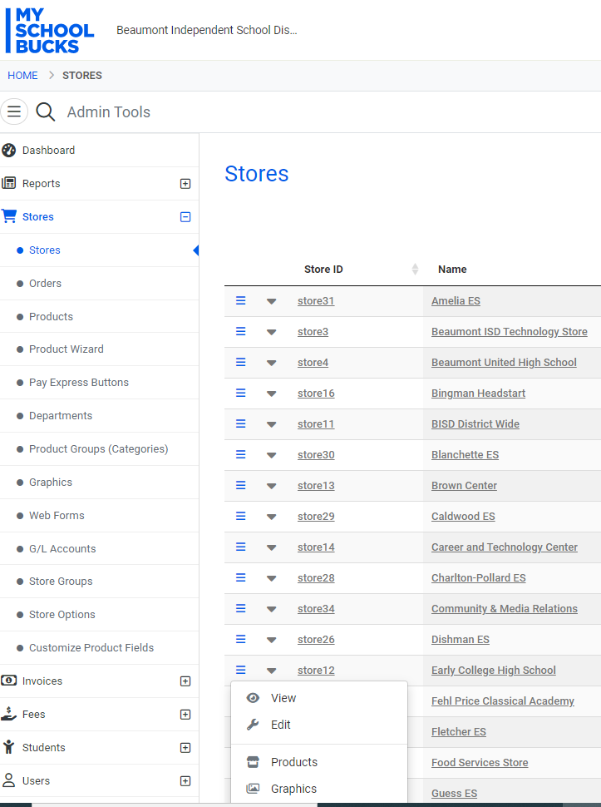
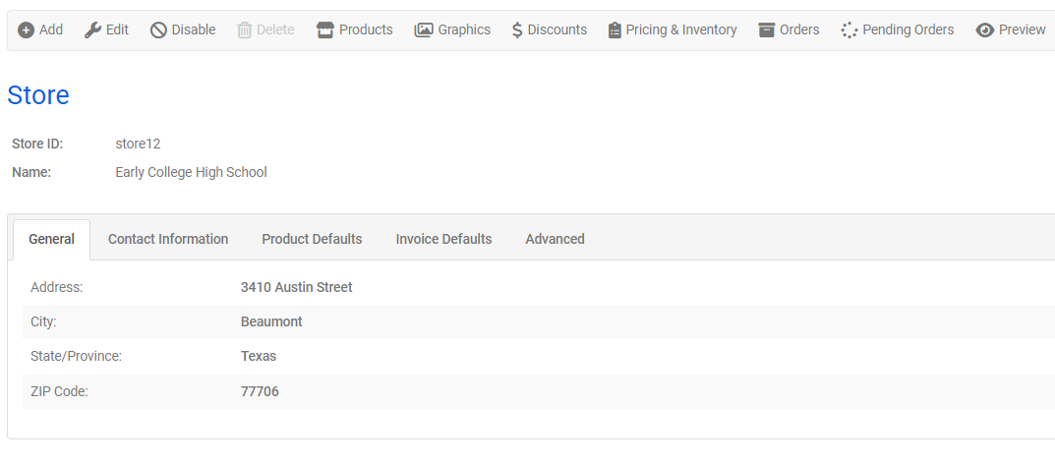
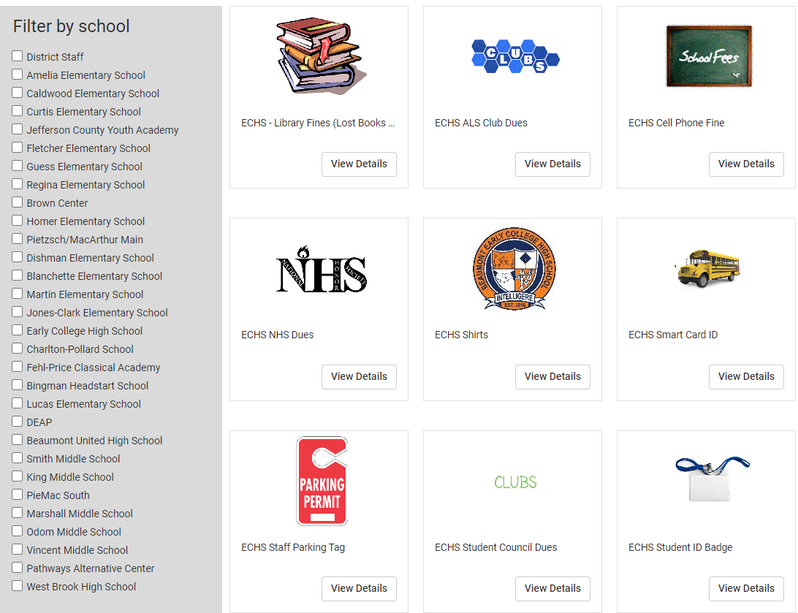
View your MSB Store (what the purchasers sees):
The Products created for the campus will be displayed.
Go to Admin Tools > Stores > Stores
Click the Preview button
Use the Filter by Category to narrow search
Click the Menu icon and click View

Slide 8
Invoices: admin tools > invoices > invoices
The Invoice option allows you to directly invoice parents/students.
Reference the ‘Create Invoice’ procedures for invoicing parents/students.
Invoices created will be listed at the bottom of the screen.

