Slide 1
My School Bucks (MSB)
Reports

Slide 2
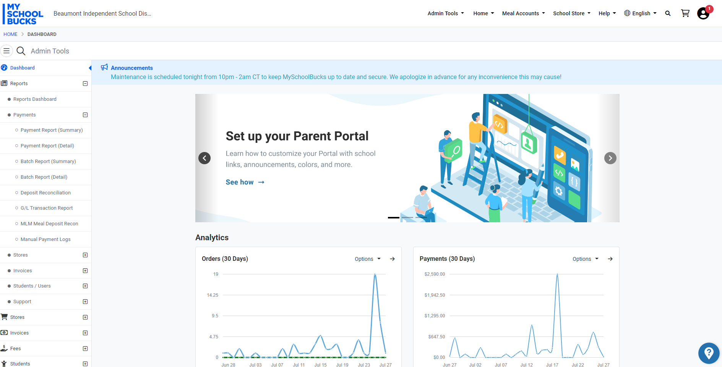
Reports: Admin Tools > Reports > Payment Report (Details)
Click on Payment Detail Report

Slide 3
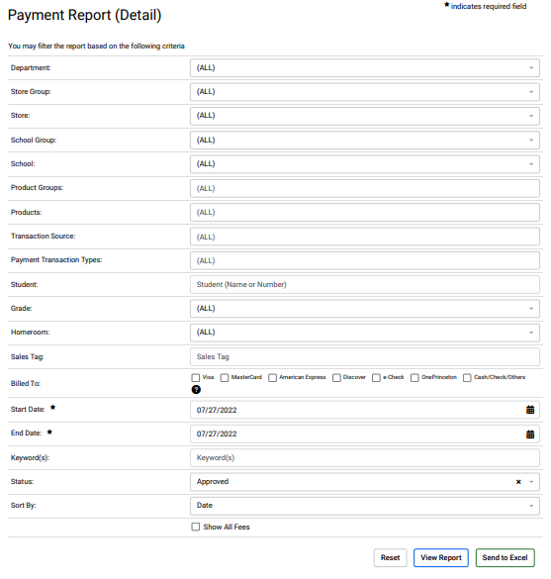
Reports:
Admin Tools > Reports > Payment Report (Details)
Enter the following information before submitting:
Select your Store (campus)
Product Groups (Categories) are setup to assist in isolating specific products. Select a product group to limit the amount of data in your report.
Click all to capture all methods of payments.
Suggestion:
- Date Range: Use for financial reporting or to provide information for a specific event.
- Specific Dates: Use when processing sales for purchasers. For example, you may need a daily report to make sure students receive parking tags in a timely manner.
Enter a date range or one specific date.
Click to view report (see slide 7 for example)
Click to download report (see slide 8 for example)

Slide 4
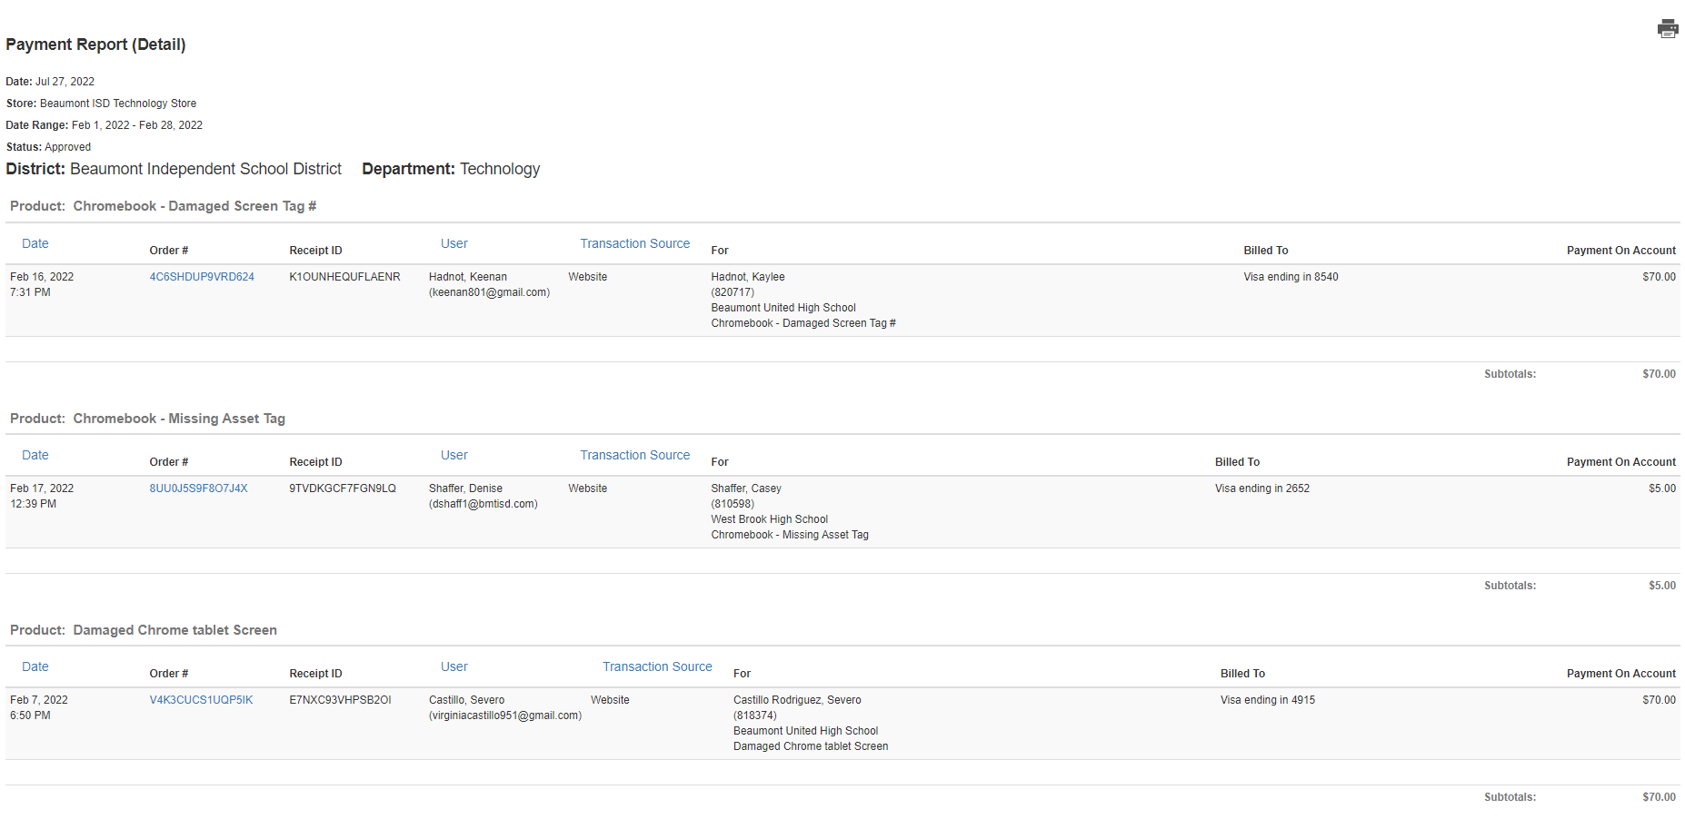
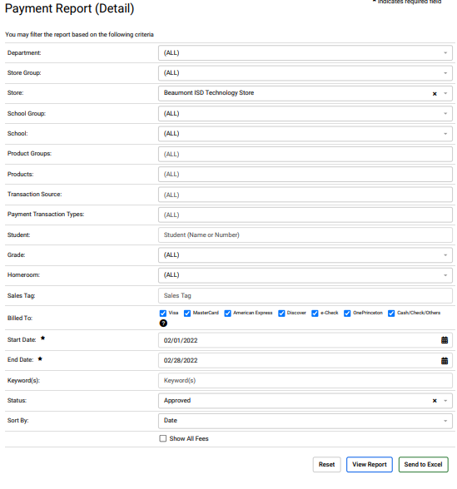
Sample Report Run
Results when you select ‘View Report’
Click to Print

Slide 5
Print this report for sponsors for sales information and to use for financial reporting in Eduphoria.
Sample Excel Download
Results when you download to Excel. You can delete columns you do not need as well as sort and sum data results.

Slide 6
Sample report capturing data from a Web Form included in Product set up in MSB

