Slide 1
Activity Funds Training Business Office/Activity Funds Office
2023-2024 School Year

Slide 2
Introduction
Training materials will include an overview of:
Cash Receipts Fundraising
Deposits Online Payments
Donations Staff/Student Incentives
Purchasing Campus Fines
Requisitions (Purchase Orders) Refunds
Check Requests
Transfers
Sponsor Responsibilities
Bookkeeper Responsibilities

Slide 3
Cash Receipts Section 2 of the Centralized Activity Funds Procedures Manual (CAFPM)
As Secretary/Bookkeepers, you are to provide TEAMS receipts to anyone bringing you money. The only time you are writing physical receipts is when your are away from your computer or your access to TEAMS is down.
Sponsors turning in money are to complete and turn in the Money Collected Internal Deposit Slip SAF 102 with the money and the yellow receipt copies (or the Tabulation for Money Collected SAF 103). This form is used by the Secretary/Bookkeeper to verify the money turned in.
Do not create a batch (click the “Submit” button) for every receipt you enter. When you complete entering individual receipt information in the Campus Cash Receipt screen, Click “Add and Print Receipt”. Keep entering receipts throughout the day.
At the bottom of the screen, you will see the “Cash Receipt List” which lists all the receipts entered for the day. At the end of the day, click the “Submit” button in the top right corner of the screen; print your batch receipt. You will then make your deposit. The amount of cash/checks received will equal your batch total (one batch/one deposit).
Make sure not to include any money that is not a part of the batch submitted.
Some days, you may have very large deposits. In those cases, you can you can have multiple deposits in one day; however, the rule of one batch/one deposit still applies.
Refer to Section 2 of the CAFPM for details on Cash Receipts.

Slide 4
Deposits Section 3 of the Centralized Activity Funds Procedures Manual (CAFPM)
Deposits are to equal your batch in TEAMS.
Enter and add receipts in TEAMS timely; make timely deposits.
Deposits in excess of $20.00 are to be made daily.
At the end of the day, Submit your batch and print your batch receipt.
Prepare your deposit.
Cash is secured in the tamper proof section of the deposit bag.
Checks and deposit slip are placed in the bottom section of the deposit bag (clear bags) or the back section (white bags).
Remember to include white and yellow deposit slip copies.
Record deposits on the Bank Deposit Pickup Log SAF 125. Make sure deposits are picked up by the mail couriers timely.
Towards the end of the month, close out batches and make deposits in the month the money was received.
Refer to Section 3 of the CAFPM for deposit details

Slide 5
Donations Section 1 of the Centralized Activity Funds Procedures Manual (CAFPM)
Donations are reported monthly to the Board.
Monetary Donations
Make a copy of the check.
Complete the Monetary Donation form (SAF 121).
Forward the SAF 121 and the check to the CFO’s Office.
Keep a copies of the check and SAF 121 in your daily files.
Non-Monetary Donations
Complete the Record of Donated Items form (SAF 122) in its entirety.
Estimated values must be provided.
Forward a copy to the Activity Funds Office.

Slide 6
Purchasing – Requisitions Section 4 of the Centralized Activity Funds Procedures Manual (CAFPM)
Requisitions are not process out of Student Activity (865) Funds.
Requisitions are required on Campus Activity (461) Funds – exceptions are subscriptions, membership fees, renewal notices, entry/contests fees, registration fees, payments for non-employee judges/game officials. These are processed as check requests.
Note – requisitions are entered in TEAMS. A requisition is considered approved when a Purchase Order (PO) number is generated.
Attach your quote and a completed SAF 104 as support in TEAMS.
Requisitions are required prior to receiving products and services. Products and services purchased and received without a PO number are considered unauthorized purchases.
Refer to Section 4 of the CAFPM for details on Purchasing.

Slide 7
Purchasing – Check Requests Section 4 of the Centralized Activity Funds Procedures Manual (CAFPM)
Check request are processed for all Student Activity (865) fund requests. You do not requisition out of Student 865 accounts.
Reference the second bullet on the previous slide for a list of checks requests that can be entered using Campus (461) funds.
Attach an invoice or quote with a completed SAF 104 as your support in TEAMS.
Note – in the majority of cases, items have already been received and an invoice sent from the vendor. Check requests are to be entered within two (2) days of receipt of the invoice to ensure vendors are paid timely. Non-timely payments impacts the creditability of the district and in turn affects the purchasing options of all campuses and departments.
Refer to Section 4 of the CAFPM for details on Purchasing

Slide 8
Transfers Section 4 of the Centralized Activity Funds Procedures Manual (CAFPM)
When moving money within the District, check requests and requisitions are not needed; instead, a transfer is processed.
Use the Transfer Request Form SAF 115 for the following:
Transfers between your campus accounts.
Payments to other campuses or departments for fees or services from your activity accounts.
The BISD Internal Transfer form is used when:
Making payment to other departments using non-activity fund accounts.

Slide 9
Sponsor Responsibilities Section 7 of the Centralized Activity Funds Procedures Manual (CAFPM)
Required Forms
SAF 116 – Conflict of Interest form
SAF 113 – Responsibilities of Faculty Sponsors of Student Groups
SAF 118 Sponsor Checklist – read and initial
SAF 126 Club Authorization Form – Student clubs only
Activity Fund Financial Training
Complete E-course in Eduphoria
Provide copy of certificate.
Fundraising
Fundraiser Approval and Fundraiser Financial Reports.
The approval form needs to be submitted by the sponsor prior to the start of a fundraiser. Principal needs to approve.
The financial report needs to be completed by the sponsor within 5 days after the end of the fundraiser.
Documentation
Sponsors are to keep records of club activities and by-laws which includes voting decisions of the club members.
Sponsor are responsible for all deposits and ensuring all invoices for products and services are paid.
See Section 7 of the CAFPM for details.

Slide 10
Bookkeeper Responsibilities Section 8 of the Centralized Activity Funds Procedures Manual (CAFPM)
Activity Fund Financial Training
All employees that handle cash at your campus are required to complete the training in Eduphoria; including secretaries/bookkeepers and principals.
Fundraising Calendar
Fundraisers should be documented on the campus calendar to assist in tracking activities and cash receipts.
Sponsor Training
Secretaries/bookkeepers coordinate sponsor training with the Activity Funds Office.
Monthly Report of Account Transactions
Secretaries/bookkeepers, principals, and sponsors are to receive these reports.
See page 8-2 in the CAFPM for instructions on setting up and updating emails.
Dormant Accounts/Negative Balances
Campus and Student are to be reviewed periodically. Negative balances need to be resolved and account balances with no activity for 24 months should be transferred.
Documentation/Record Keeping
Activity Fund records are to be maintained in your daily files and filed away at the end of each school year.
See Section 8 of the CAFPM for details.

Slide 11
Fundraising Section 5 of the Centralized Activity Funds Procedures Manual (CAFPM)
All fundraisers are to be entered in Eduphoria by the sponsor and approved by the principal.
Fundraisers are to be for a specific purpose and the money used for that purpose.
Money collected should be turned in daily with support documentation:
Yellow receipt copies or the SAF 103 Tabulation of Money Collected.
Completed Money Collected Internal Deposit Slip SAF 102
For Library Book Fairs, a daily receipt should be printed at the end of the day.
The Fundraiser Financial Report should be entered in Eduphoria within 5 days after the end of the fundraiser.
Any discrepancies should be reported to the principal and resolved.
Crowdfunding
Board Policy CDC – Other Revenues: Gifts and Solicitations states-
“An employee may solicit web-based donations of money or items for use by the employee in fulfilling his or her professional responsibilities or for the District’s use, including “crowdfunding”. However, an employee shall obtain prior approval from the employee’s supervisor before using the name or image of the District, a campus, or any student.”
Follow District fundraising procedures

Slide 12
Online Payments My School Bucks (MSB)/Hometown Ticketing (HTT)
In an effort to decrease the amount of cash received at the campus, My School Bucks and Hometown Ticketing are available for processing credit card payments.
My School Bucks may be used to collect club membership fees, uniform fees, yearbooks, testing fees, parking permits, cell phone fines, library fines, lost book fines, fundraising items, etc.
Hometown Ticketing is used for ticketed events (sports events, dances, etc.)
Procedures are on the District website: Bmtisd.com >Departments >Business & Finance >Activity Funds

Slide 13
Staff and Student incentives Section 1 of the Centralized Activity Funds Procedures Manual (CAFPM)
Incentive – refers to a ‘reward’ for performing an activity, achieving a milestone, or some other form of recognition. Note, an incentive is not a gift.
Campus Activity 461 Funds may be used to purchase ‘allowable’ staff and student incentives. For staff, make certain every staff member has an opportunity to receive the award.
Student Activity 865 Funds can be used to purchase any reasonable student incentive. Although these funds belong to the student group, all purchases shall b approved by the student club members.
Note: No cash, clothing (shirts, shoes, hats, socks, etc.) loans, payment of personal living expenses (utility bills, groceries, medical bills, etc.) can be purchased for District employees. IRS law requires that the cost of these items be included on an employee’s W-2, therefore, these items are not allowed.

Slide 14
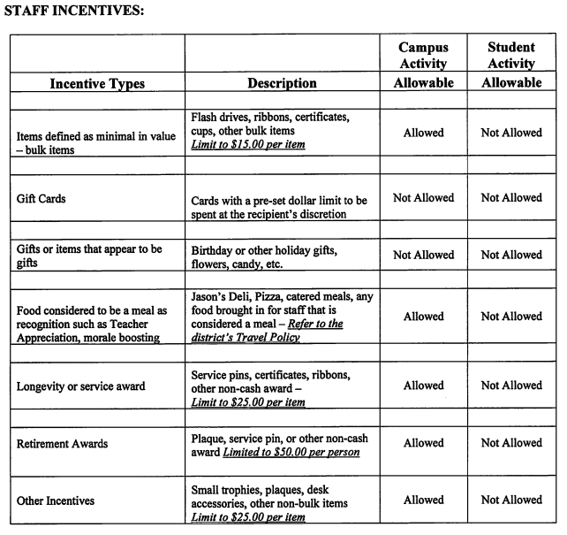

Slide 15
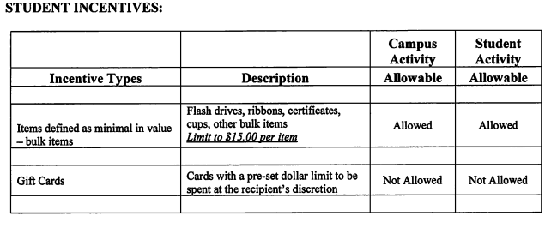
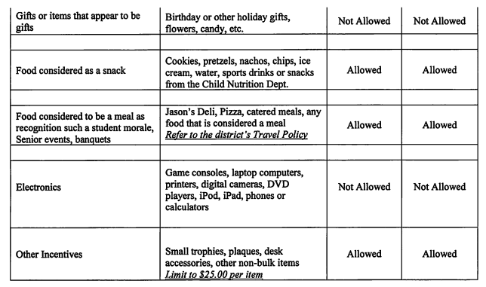

Slide 16
Campus Fines Section 1 of the Centralized Activity Funds Procedures Manual (CAFPM)
Reminder, the following fines are to be collected:
Lost Textbooks
Students that lose textbooks are required to pay the fine which is deposited in the Campus C68 Account
Lost Library Books
Students that lose library books are required to pay the fine which is deposited in the Campus C32 Account
Chromebook Fines
Students that lose or damage Chromebooks are required to pay the fine which is deposited in the Campus C71 Account
Smart Card Fines
Students that lose smart cards (bus ID) are required to pay the fine which is deposited in the Campus C58 Account

Slide 17
Refunds Section 4 of the Centralized Activity Funds Procedures Manual (CAFPM)
Reminder – the refund process starts at the campus. Please do not have the parents call the Activity Funds Office.
BISD Receipt Payments
For refunds where a BISD receipt was written, obtain a copy of the receipt, complete an SAF 104, and enter it in TEAMS as a non-employee reimbursement.
My School Bucks Payments
For my school bucks (MSB) refund requests, obtain information from the purchaser (student name and ID number, amount paid, payment date, event). Email the information to the activity funds office to verify payment in MSB. A refund request will be entered in MSB.
If a refund cannot be entered in MSB, the Activity Funds Office will contact the bookkeeper and a non-employee reimbursement request will need to be entered as outlined above.

Slide 18
Questions?
Contact
Geri Russell x5083
Activity Funds office

