Slide 1

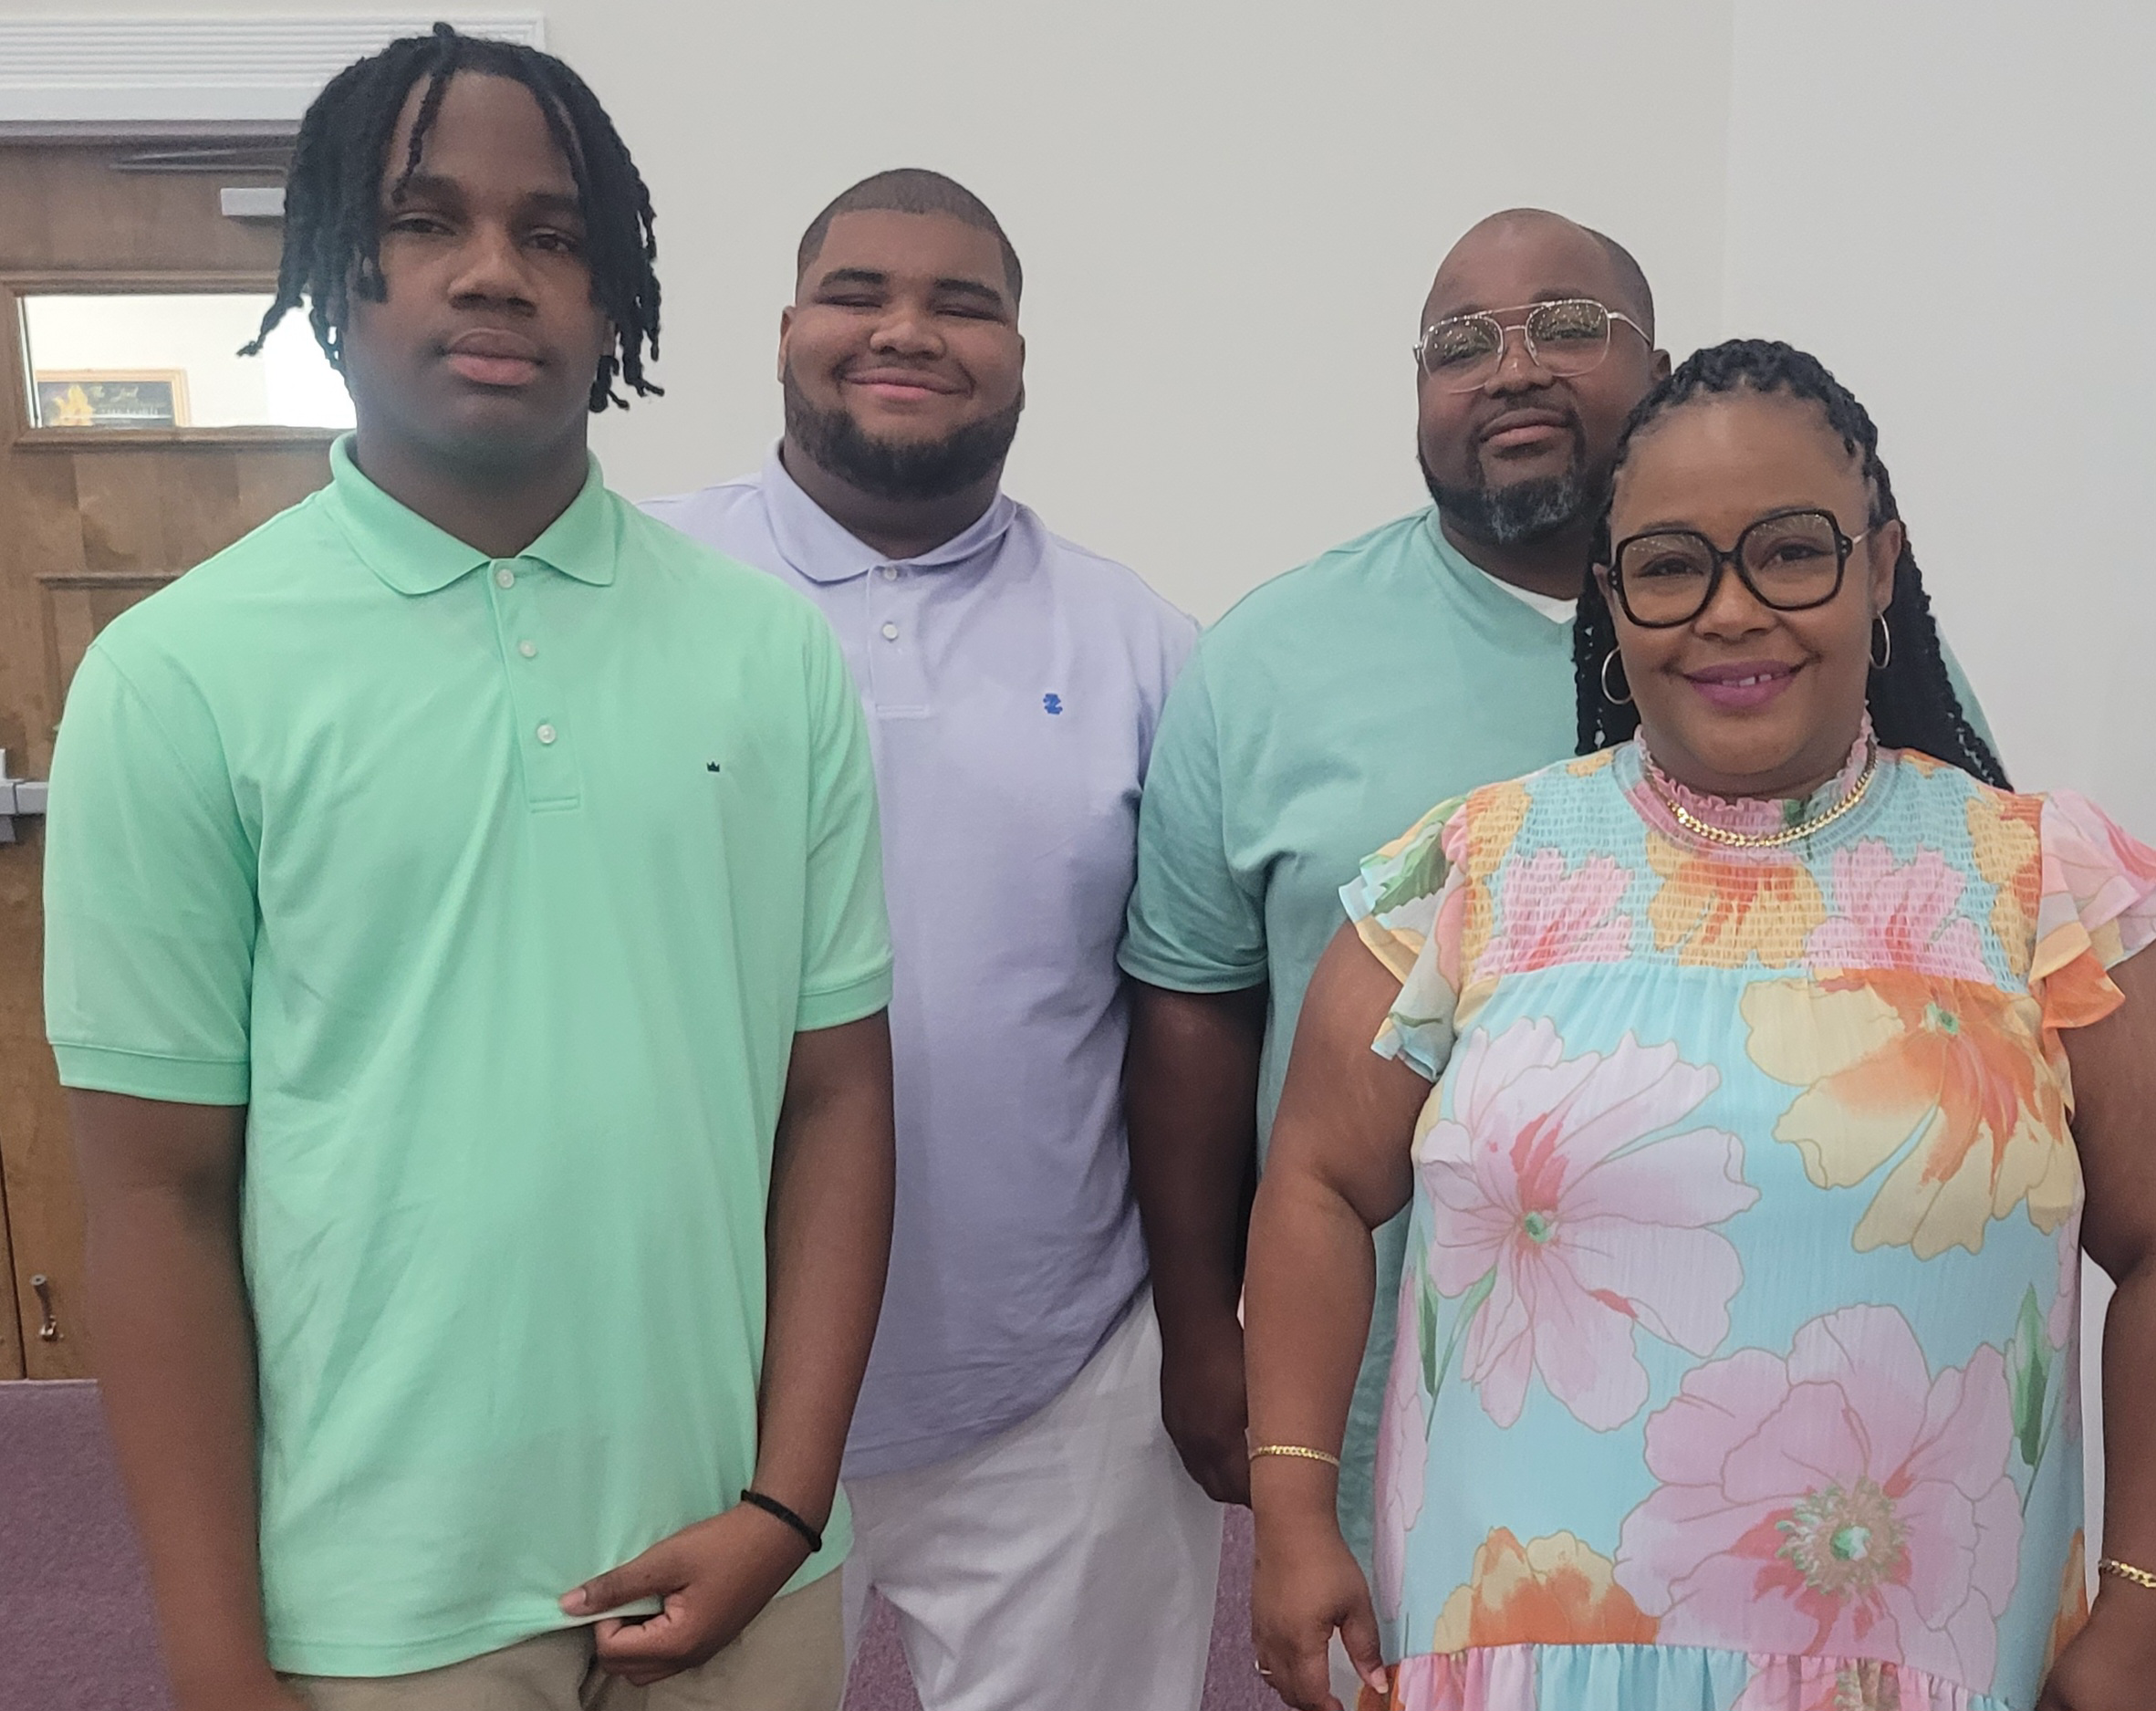
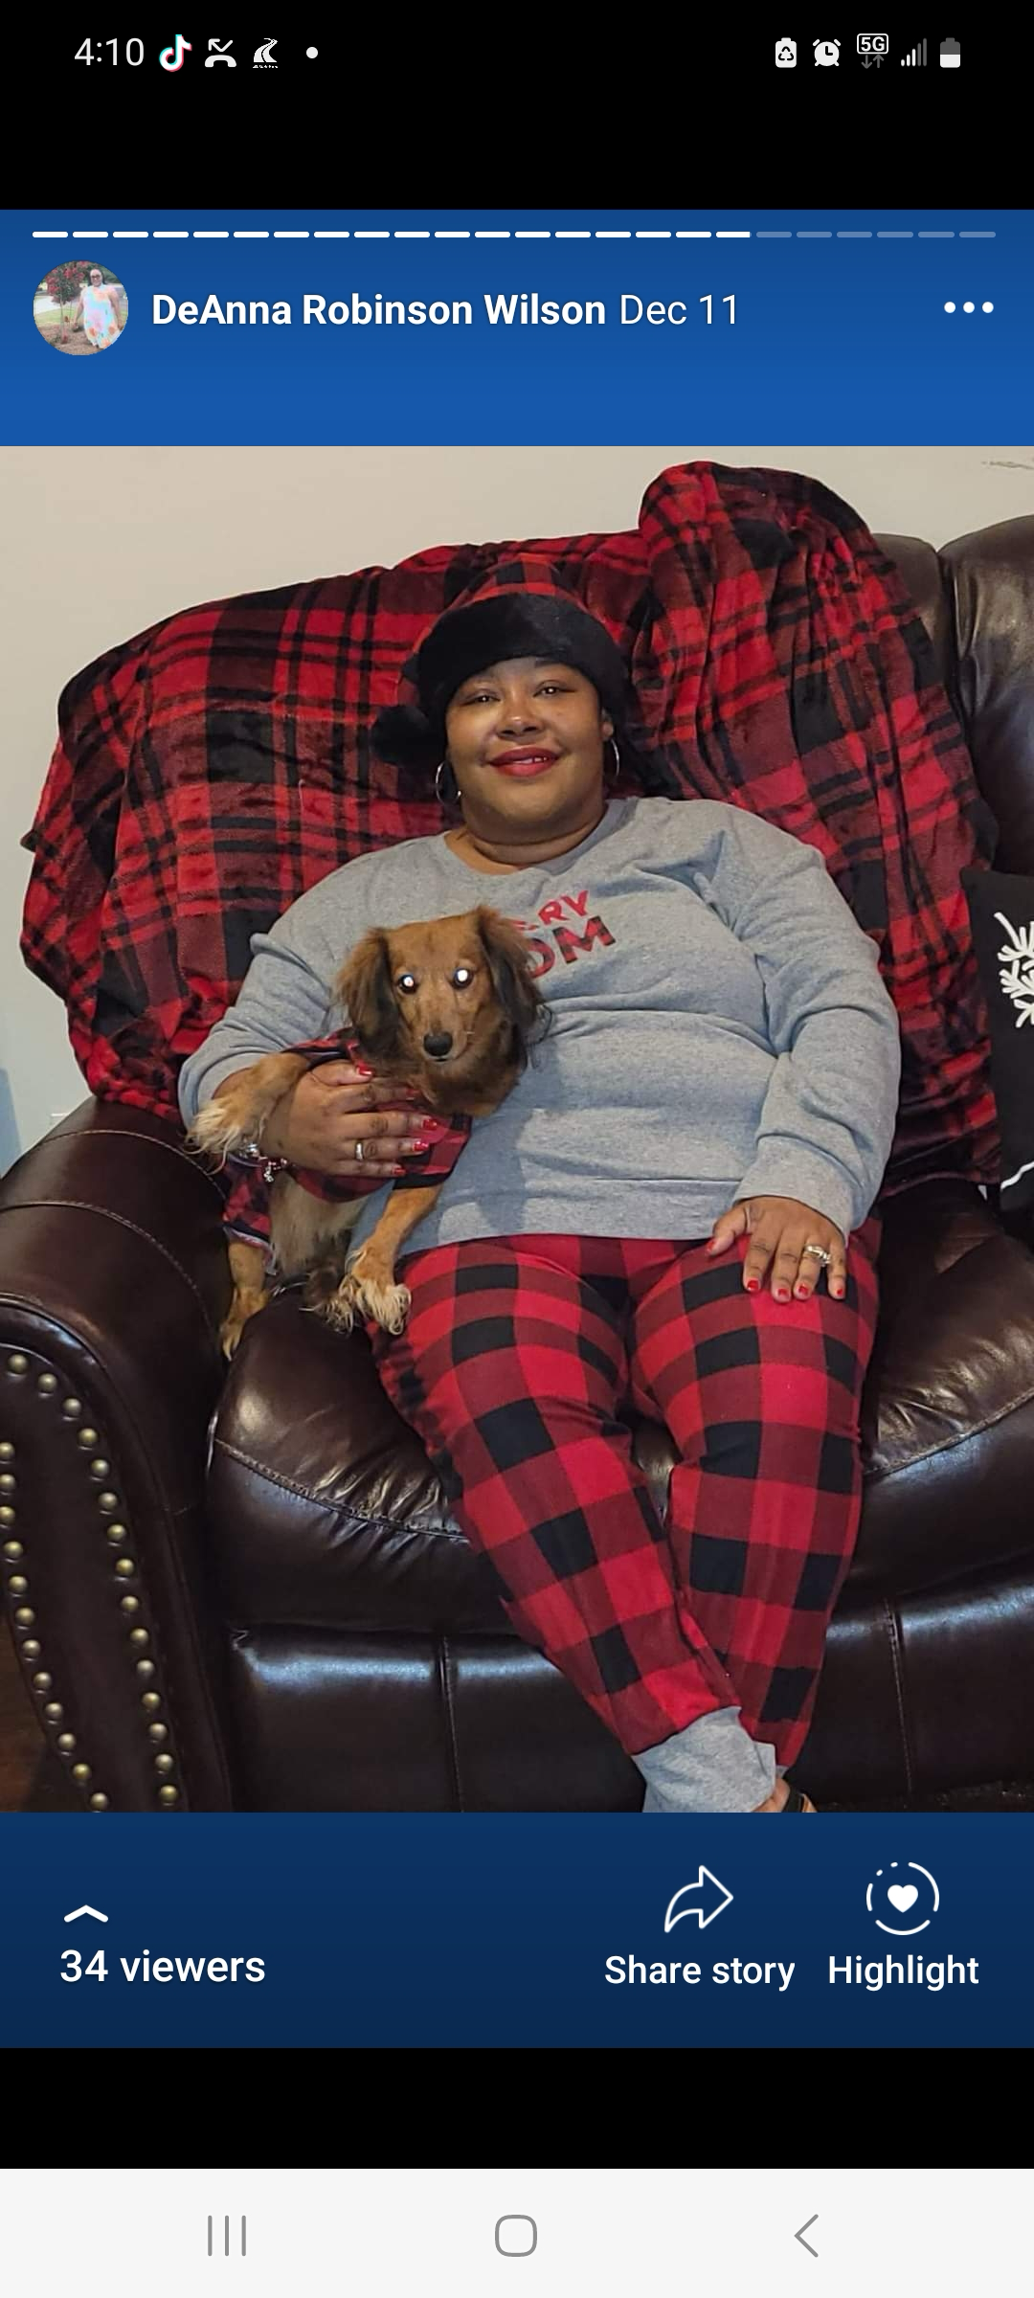













Meet Mrs. Wilson
3rd grade ELA, Reading, & Writing
Welcome to 3rd!
I am so excited to be your language arts, reading, & writing teacher this year! This is my 4th year teaching at Mannsdale Upper. I earned my teaching Degree at Mississippi State University. I also have a Master’s degree in Administration and Supervision from Jackson State University and a Specialist Degree from Arkansas State University. My husband Nate and I are high-school sweethearts and are the proud parents of two young men, Isaiah (20) and Noah (16). Rocky, our 10-year-old dachshund is the baby of the family.
Things I love
Things I love
dwilson@madison-schools.com
Remind:Text @hullwilson to 81010

