Slide 1
High School Planning
Jana Lanier
Creekside Middle School
8th Grade Counselor
322-6155 Ext. 38920

Slide 2
Middle School Credits for Promotion
3 Language Arts
3 Math
3 Social Studies…with career planning component
3 Science
Cannot go to high school without the 12 credits…

Slide 3
High School Credits in Middle School Algebra I and Geometry
Algebra 1 & Geometry– All students enrolled in Algebra 1 & Geometry must take the EOC.
Results constitute 30% of the final course grade and calculated into their high school GPA
The student MUST pass the Algebra 1 EOC to graduate from high school (Level 3) or earn a concordant score on Geometry, PERT, SAT, or ACT.

Slide 4
High School Credits in Middle School~Spanish I
Students taking Spanish I will receive a high school credit and a grade that will be calculated into their high school GPA.
Not a weighted grade
Option to switch to middle school credit now.
World language is not a graduation requirement, but most universities require two consecutive years for admission. It is also required for Bright Futures.

Slide 5
HIGH SCHOOL CREDITs in middle School - dit
DIT – Digital Information Technology
Students taking DIT will receive a high school credit and a grade that will be calculated into their high school GPA
Not a weighted grade
Option to switch into middle school credit now

Slide 6
High School Registration
Teacher Recommendations from 8th grade and test scores
Student will pick Electives.
Each high school typically offers an Orientation Night.
Counselors will visit middle school
Students follow an academic track
Information to be sent home/address should be updated
Usually occurs around the middle/end of February.

Slide 7
Upcoming High School Nights
Spruce Creek High School
Academy Night – Jan. 15
Atlantic High School
Rising Shark Parent Night – Jan 23rd 5:30 – 7:00 pm
New Smyrna Beach High School
Sneak Peak – Jan. 16
Registration – Feb. 19
Mainland HS – Buc Extravaganza Jan. 14th

Slide 8
Current Graduation Requirements for 8th graders…always subject to change
Subject | Credits
English | 4 Credits with ELA Courses
Math | 4 with Alg* and Geo*
Science | 3 with Biology* and Phy Science
Social Studies | 3 with WH, AH*, Gov & Econ
Fine and Performing Art | 1 (Course Code Directory)
Physical Education | 1 PE and Personal Fitness
Electives | 7.5
Financial Literacy (grade req) | .5
**EOC worth 30% of final grade

Slide 9
Special High School Programs
*Career Academies
*International Baccalaureate (IB)
*AICE
Dual Enrollment
*all require an application through Parent Portal – if you need an access code, please email me.

Slide 10
HIGH SCHOOL SHOWCASE EVENT
Thursday, December 12, 2024
5:30pm – 7:30pm
Volusia County Fairgrounds, Deland, FL
Speak with Academy Students and Teachers!
Applications available on FOCUS Parent Portal from December 13, 2024 through January 31, 2025

Slide 11
What is an Academy?
Typically replaces one elective class a year
Small learning community that combines core classes with a career focus.
Provides unique learning opportunities through business, hands-on learning, career shadowing, and internships.
You get real world skills.
You must apply for an academy…due January 31
*You can still take honors, advanced placement, and dual enrollment courses.

Slide 12
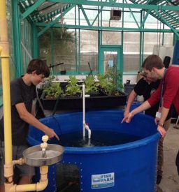
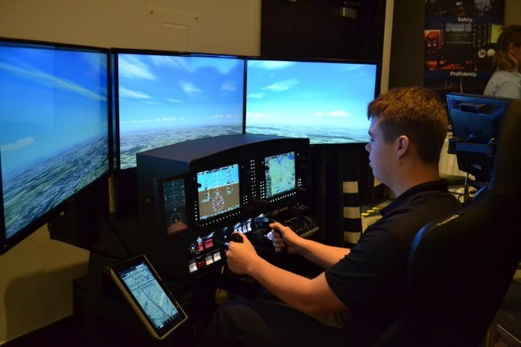
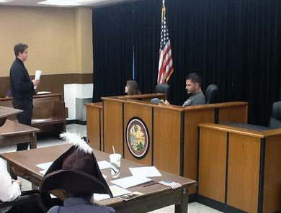
Atlantic High school
Career Academies | Careers
Law & Government | Lawyer; Police Officer; City Manager
Technology, Engineering, Science & Aeronautics | Aerospace Engineer; Astronaut; Research Physician; Biologist
Aquaculture, Environmental & Marine Science | Fish & Wildlife Manager; Marine Biologist; Ecologist
Principles of Teaching | Educational Administrator Teacher, Preschool Teacher, Tutor
*Game & Simulation | 3D Game Programmer; Technical Animator; Simulation Software Engineer

Slide 13
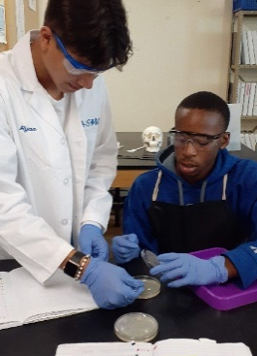
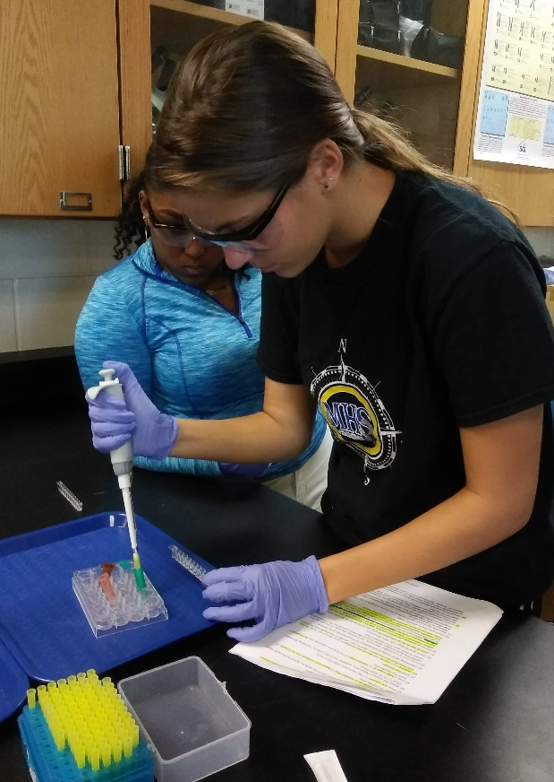
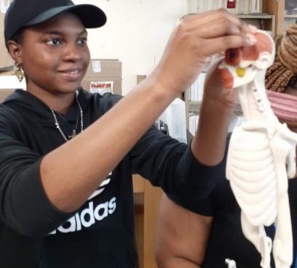
Mainland HIGH school
Career Academies | Careers
Scientific Inquiry & Medicine | Athletic Trainer; Physician; Nurse; Physical Therapist; Physician’s Assistant; Biomedical & Lab Sciences
Entrepreneurship & Marketing | Market Research Analysts & Marketing Specialists, Marketing Managers
*Criminal Justice | Police Officer; Federal Agent; Wildlife Officer; Forensics Investigator; Court Personnel; Lawyer; Corrections Officer; Victim Advocate

Slide 14
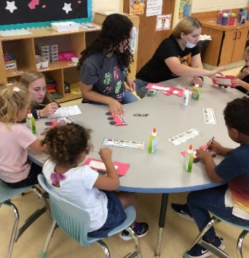
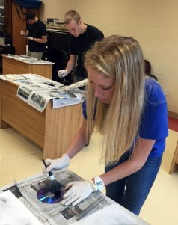
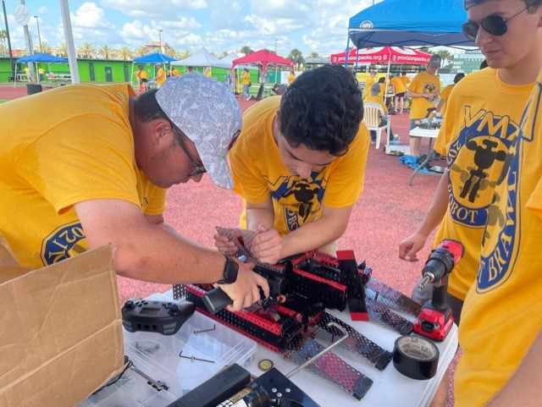
New Smyrna beach high school
Career Academies | Careers
Engineering | Environmental Engineer; Mechanical Engineer; Nuclear Engineer
Education | Childcare Workers; Preschool Teachers; Preschool Administrators; Teachers
Medical | Physician; Nurse; Physical Therapist; Medical Assistant
Agriscience – Animal Sciences & Services | Biological Technicians, Farmer, Rancher, and other Agricultural Managers
Criminal Justice | Police Officer; Federal Agent; Wildlife Officer; Forensics Investigator; Court Personnel; Lawyer; Corrections Officer; Victim Advocate
Culinary Arts | Chef & Head Cook, Food Service Manager General & Operations Manager

Slide 15
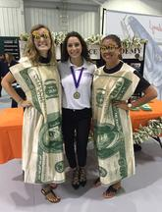
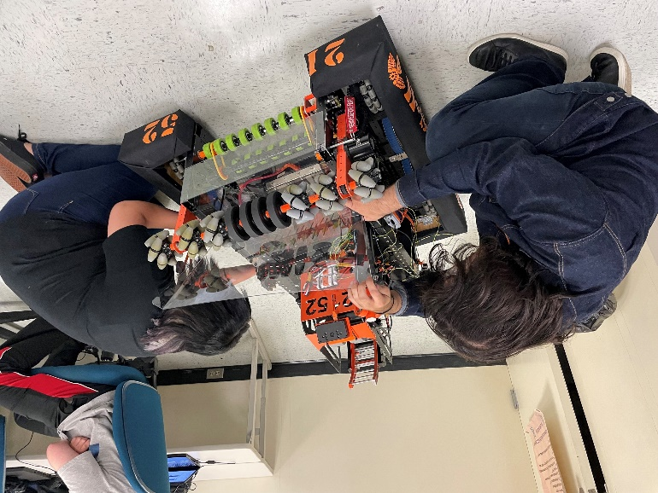
Spruce Creek High school
Career Academies | Careers
Finance | Banker; Stockbroker; Bank Teller; Accountant; Financial Planner
Information Technology & Robotics | 3D Game Programmer; Robotics Engineer; Game Designer
*Health Science | Physician; Nurse; Physical Therapist; Occupational Therapist; Medical Assistant
Promotional Design & Management | Fashion Designers, Advertising & Promotional Managers

Slide 16
International Baccalaureate (IB)
Spruce Creek High School
Information and applications (different from the past)
December - January of 8th grade year
Parent Portal Application
Will look at grades and standardizes test scores
The high school will ask your current 8th grade teachers for recommendations…mainly ELA and Math
Algebra 1 Required in 8th Grade
Spanish Not Required in 8th Grade
One Time To Apply - Deadline in January

Slide 17
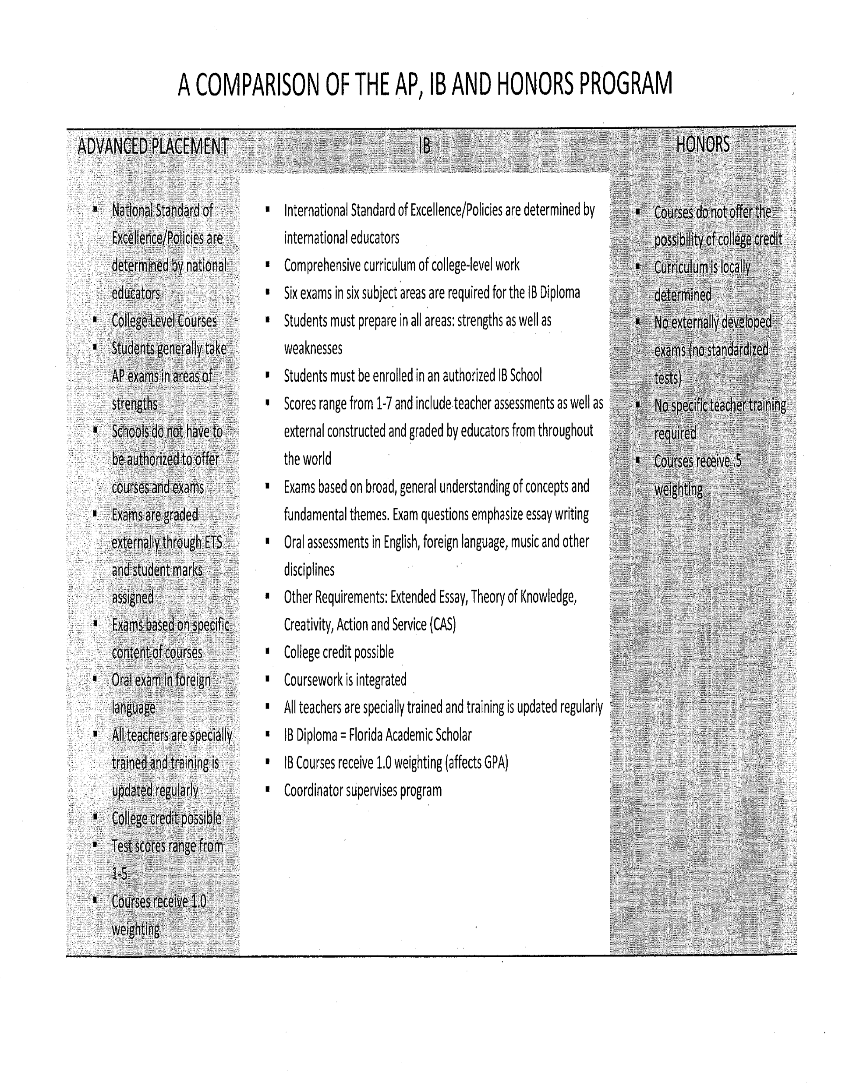

Slide 18
CamBridge Aice
Flexible curriculum – Student chooses based on interest
Future predictor of college success – Rigor, Critical thinking
GPA points – Pre-AICE classes are weighted the same as Honors classes and AICE classes are weighted the same as AP and IB
Earn college credit
Bright Futures - If the student earns the AICE diploma AND put in 100 hours of community service, you are guaranteed the top level of Bright Futures award, no matter what your SAT or ACT scores are (the minimum score is waived)
AICE offered at NSBHS, Atlantic, Mainland and Seabreeze

Slide 19
Career Academy/Cambridge/IB Application Timeline School Recruitment & Application Procedures 2024‐2025
February 13, 2025 to February 25, 2025:
CAREER ACADEMY/CAMBRIDGE/IB
DECLARATION OF INTENT:
1. February 13, 2025: School Messenger notification sent to parents regarding the program of choice Declaration of Intent deadline.
2. By February 25, 2025 ‐ DEADLINE
for program of choice Declaration of Intent
To CONFIRM a seat in one (1) program of choice,
parents must communicate the Declaration of Intent
through the FOCUS Parent Portal.

Slide 20
AVID Program
Advancement Via Individual Determination
Participating students must commit themselves to improvement
Available at Creek (as of right now)
Application and interview process required – applications in the spring.
Rigorous program that focuses on academic “survival skills” and college prep
Average/above average state test scores
Must take at least 1 honors class—compatible with AP/IB/DE
AVID class will be an elective class – organization, study skills, time management, group tutorials, career research, college visits, character development, relationship building
Ask HS counselor during registration process

Slide 21
Dual Enrollment with Daytona State College
Must have a high school credit on your transcript
Must have required GPA (typically 3.0)
Must have a qualifying PERT score – offered in February and April at Creekside to students that qualify
Must have good attendance
Must have good discipline record
See county website for Dual Enrollment Guide

Slide 22
Questions?
Career Connection website
https://www.vcsedu.org/cte
Call or email Mrs. Lanier
jlanier@volusia.k12.fl.us
322-6155 Ext. 38920
Bulletin board in 8th grade building
Check your email regularly
Individual high school websites

