Slide 1
Comprehensive District Educational Planning (CDEP)
Tuesday, November 19, 2024

Slide 2
Welcome and Opening activity

Slide 3
WALLKILL CENTRAL SCHOOL DISTRICT COMPREHENSIVE SCHOOL COUNSELING PLAN
2024-2025

Slide 4
WALLKILL CENTRAL SCHOOL DISTRICT COMPREHENSIVE SCHOOL COUNSELING PLAN
Committee Members: Mr. Latino, Mr. Derisse, Mr. Nace, Mrs. Reid-Apronti, Ms. Sinacori, Mrs. Terralavoro, Mrs. Veach, Mrs. Trozzi (staff/parent/community member), Mrs. Tejeda (staff/parent/community member), Mrs. Wager (MS teacher/parent/community member), Mr. Frisbie (board member/parent/community member), Mr. White (Asst. Superintendent), Mrs. Rounds (Asst. Superintendent), Mr. Redmond (MS Principal), Mr. Brown (ES Principal), Mr. Masopust (HS Principal)

Slide 5
Progress on 2023-24 SY School Counseling Program Goals
The school counselors collected and evaluated data for each goal on the 2023-2024 School Counseling Plan. The data was reviewed and informed the decisions when developing the goals for the 2024-2025 school year.
Goals that were not met for the 2023-2024 school year were discussed and a plan was developed to meet the new goals in the 2024-2025 school year.
Goals that were met were evaluated, discussed and determined if they needed to continue to be a goal.

Slide 6
School Counseling Program Goals for Students in Grades K – 6
Goal 1: By the end of the school year, 83% of K-6 students who have attended our After School AIS program will have increased their SGP on our STAR assessments by 15 points.
Goal 2: By the end of the year, 95% of sixth grade students will be exposed to a college and career readiness opportunities, involving community partners.
Goal 3: The percentage of students who are absent for more than 18 days will decrease by 2% by the end of the school year. (Note our absentee rate for the 2023-24 school year was 15.16%)
Goal 4: At least 95% of families with students in Grade 6 who are meeting for 504 reviews will have direct communication and access to middle school counselors as they meet for their child’s annual review.

Slide 7
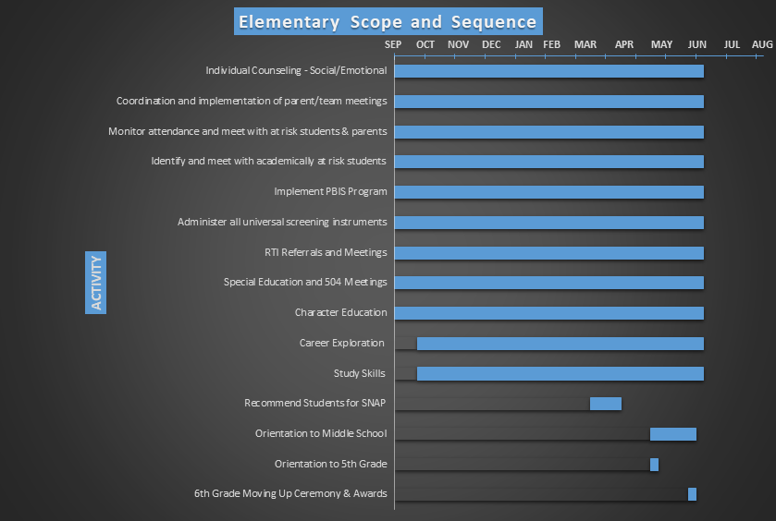

Slide 8
Guidance Plan
John G. Borden Middle School

Slide 9
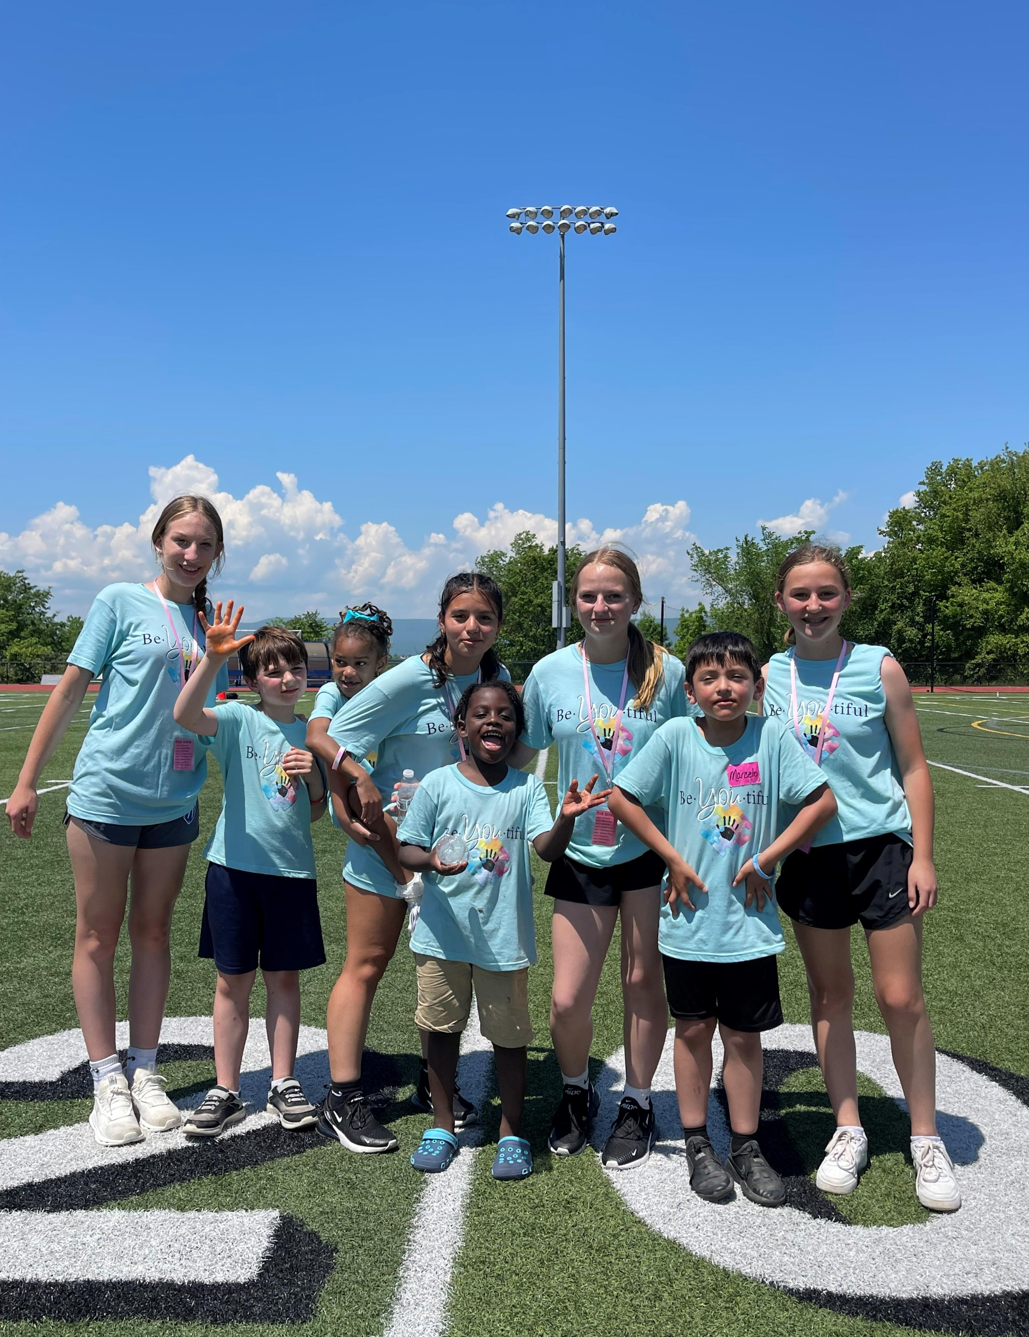
2023-2024 Middle School Guidance Plan in Review
Goal 1:
Percentage of students who are Chronically Absent (18 days or more) will decrease by 15%.
Strategy:
Attendance Data Monitored Quarterly
Plan to Communicate Absence Information to Families
Review:
Student’s classified as Chronically Absent decreased by 14.6%.

Slide 10
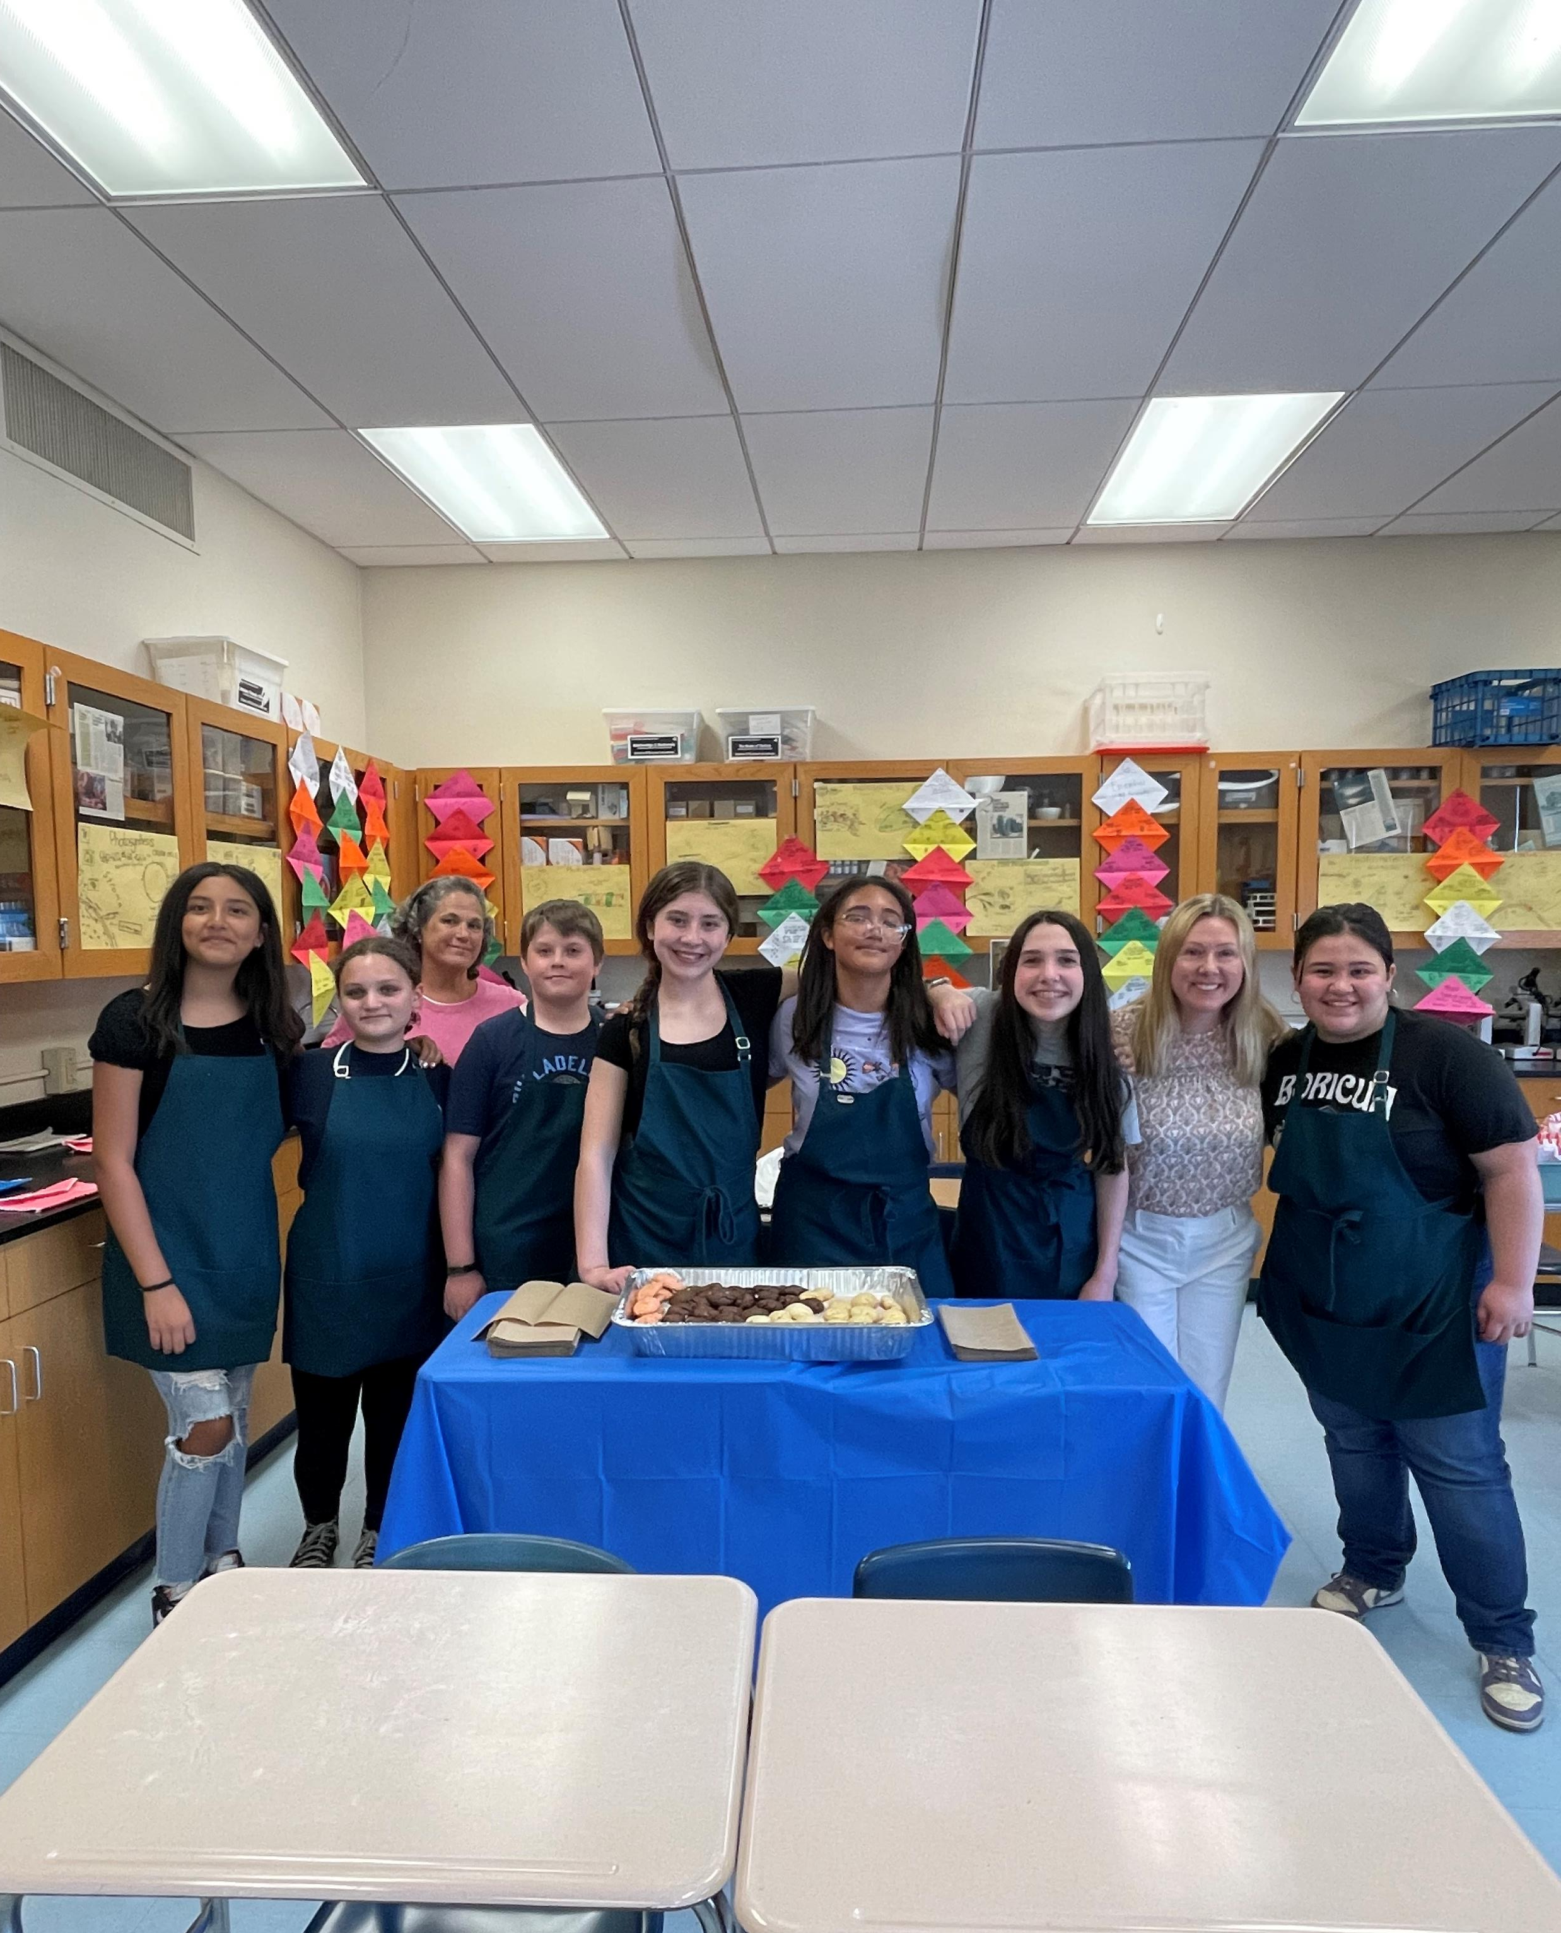
2023-2024 Middle School Guidance Plan in Review
Goal 2:
95% of Students will Utilize the PBIS “Check-in” System.
Strategy:
Utilize the PBIS “Check-in” System to Identify Students in Need of Support
Review:
JGBMS utilized a building created model for identifying and checking in with students in need of support

Slide 11
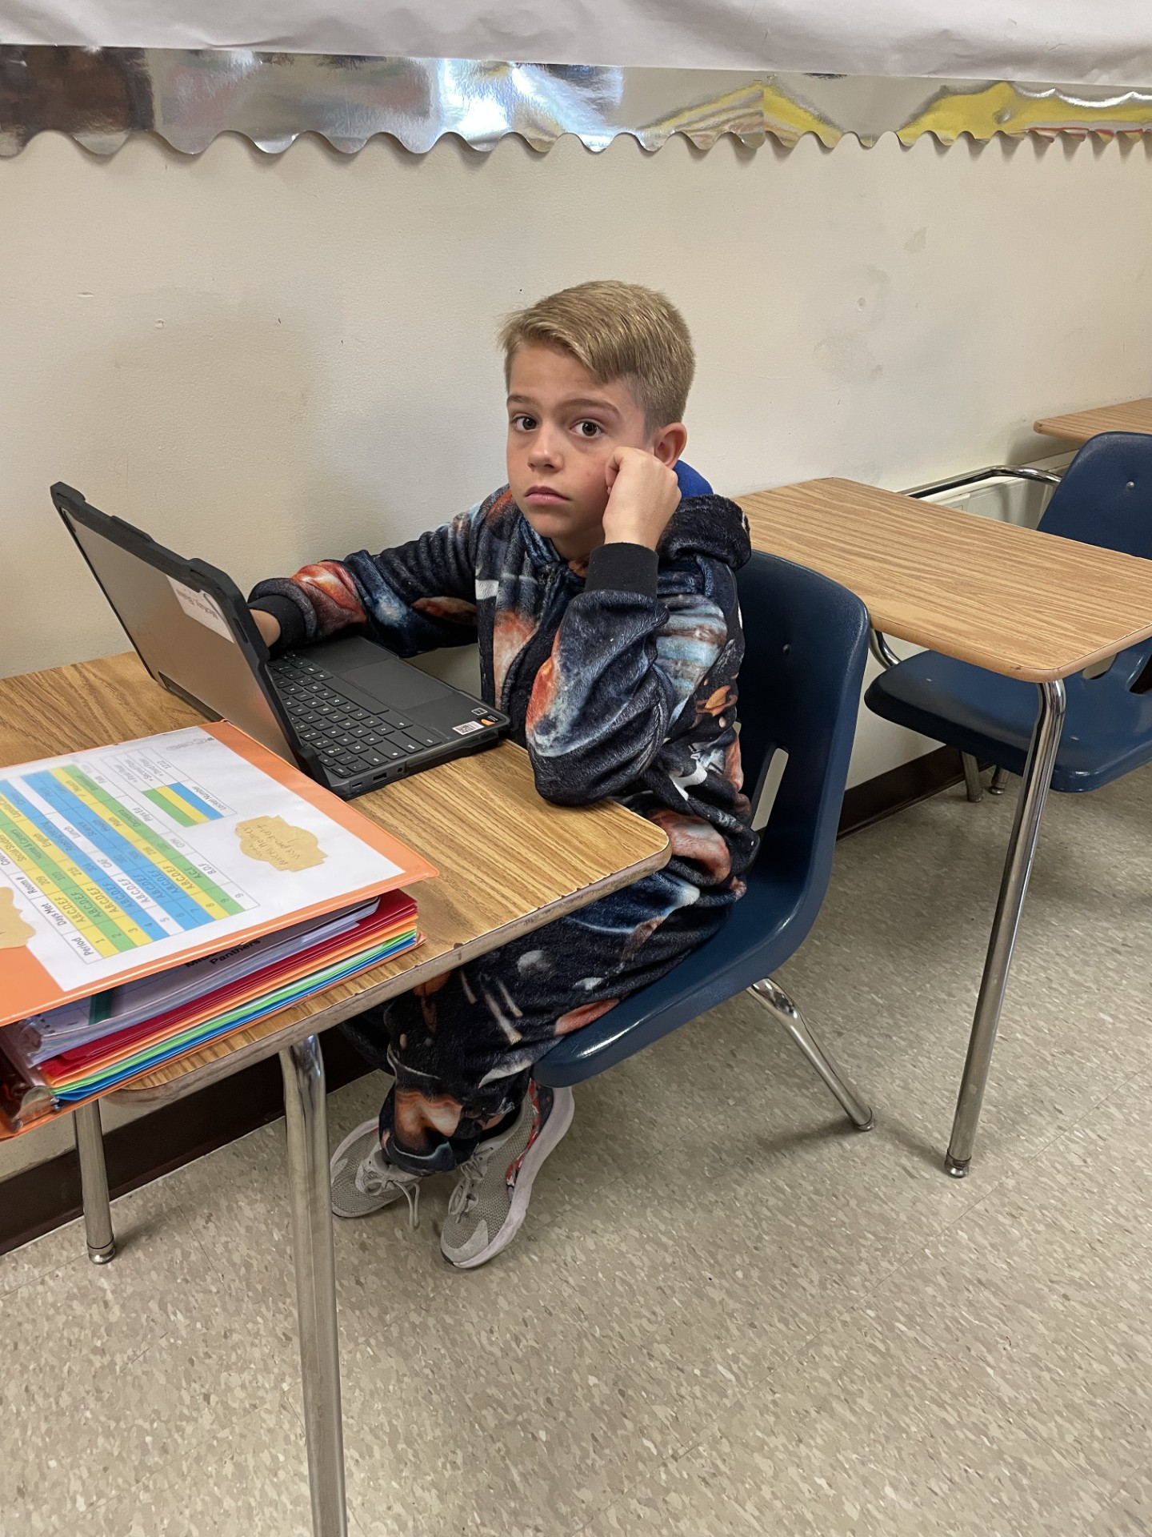
2023-2024 Middle School Guidance Plan in Review
Goal 3:
Decrease the Number of At-Risk Students (Failed More than One Core Subject) after Two Quarters by 20% by the End of the Year.
Strategy:
Review Quarterly Report Cards
Identified Students will Meet with Guidance Counselors
Team Meetings
Review:
Students Identified as At-Risk from Quarter 2 to Quarter 4 Increased by 4.7%.

Slide 12
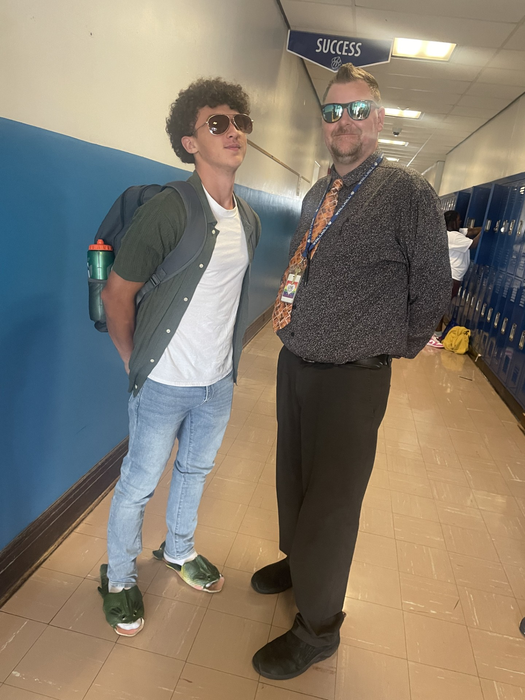
2024-2025 Middle School Guidance Plan
Goal 1:
Percentage of students who are Chronically Absent (18 days or more) will decrease by 3%.
Chronic Absenteeism dropped to 24.6% last year from when it was 28.6% from the 2022-2023 school year.
Strategy:
Attendance Data Monitored every 5 Weeks.
Formalized Plan to Communicate Absence Information to Families.

Slide 13
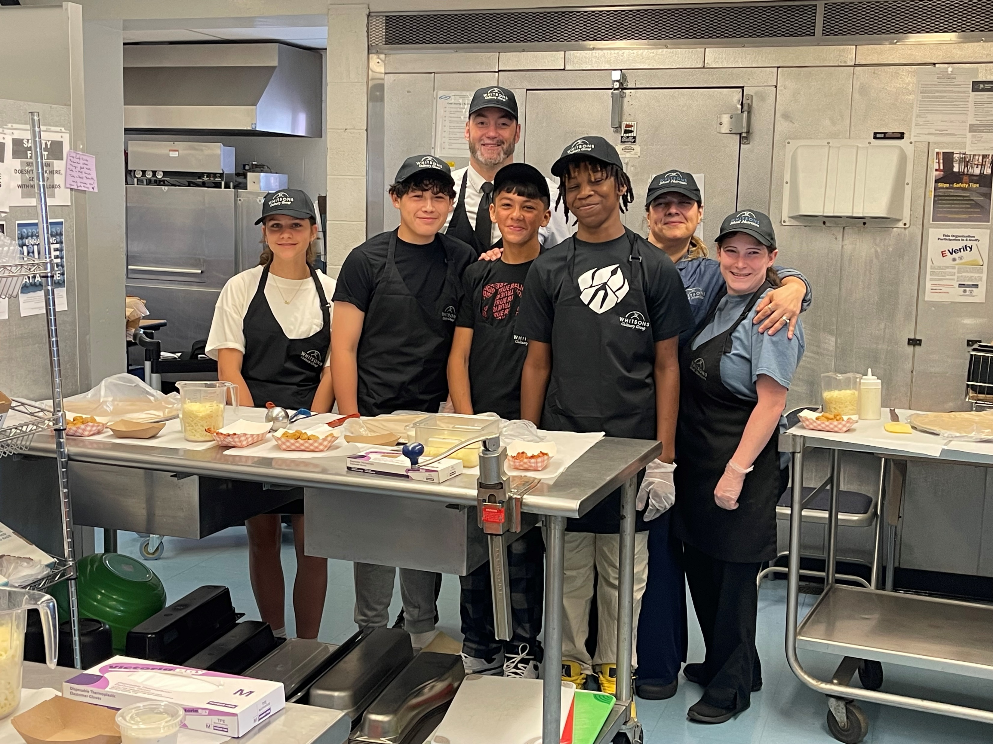
2024-2025 Middle School Guidance Plan
Goal 2:
95% of Students will be Exposed to AT LEAST Two College and Career Readiness Opportunities involving Community Partners.
Strategy:
Connect with Community Partners to Arrange Site Visits and to Invite Community Partners to Engage Students in Learning Opportunities about Careers.

Slide 14
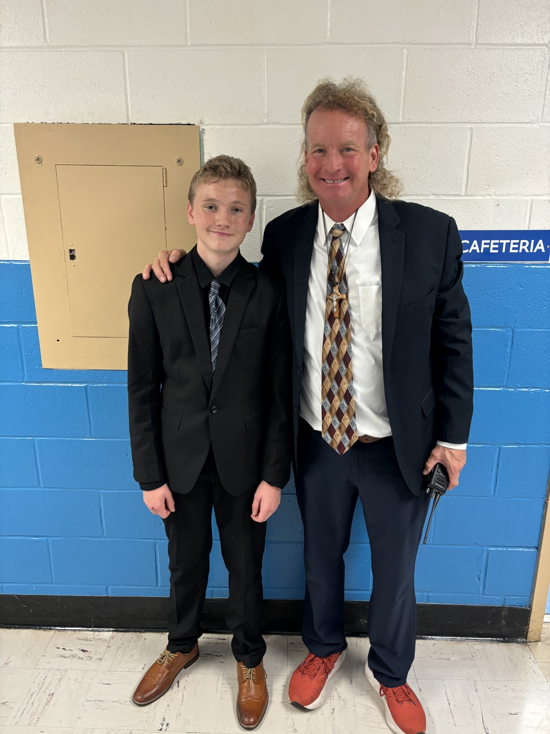
2024-2025 Middle School Guidance Plan
Goal 3:
Decrease the Number of At-Risk Students (Failed More than One Core Subject) after Two Quarters by 15% by the End of the Year.
Strategy:
Review Quarterly Report Cards
Identified Students will Meet with Guidance Counselors
Team Meetings
Utilize Teacher Professional Periods for Support, After School AIS and Homework Lab

Slide 15
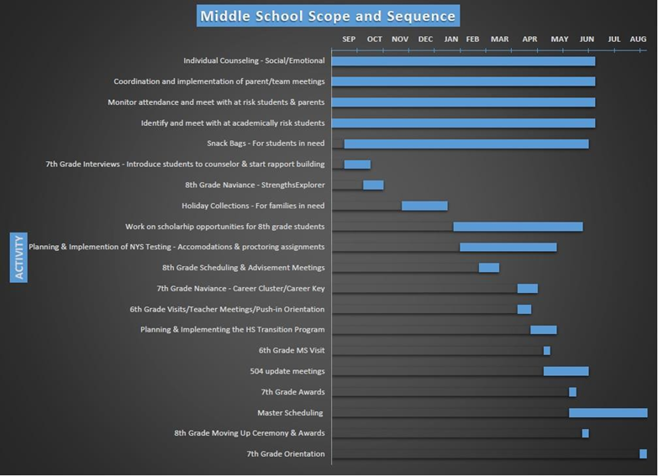

Slide 16
Wallkill Senior High School Counseling Action Plan
2024-2025 School year

Slide 17
Goal 1: 100% of students attending the Wallkill Central School District will be able to identify a post-secondary goal upon graduation.
2024-2025 High School Guidance Plan
Regular Meetings with Senior Students
Student Survey in Senior Classes on Naviance
Concrete Planning
2023-2024 Goal: Was met with 100% Success. We rolled the same goal out for 2024-2025

Slide 18
Goal 2: At least 96% of ninth graders will have earned at least four credits by the end of summer school.
2024-2025 High School Guidance Plan
School Tool Reports (Report cards, progress reports, attendance records, transcripts)
Failure notices
Summer School data
Attendance
Quarterly failure meetings
Parent-teacher conferences
APEX Credit Recovery
National Honor Society Peer Tutoring
2023-2024 Goal: Set at 95%. Goal was met, so we increased our goal for 2024-2025 to 96%

Slide 19
Goal #3 At least 85% of freshman, 75% of sophomores, and 70% of juniors will complete grade appropriate activities (see scope and sequence chart) through Naviance, that are designed to help make informed decisions when selecting courses and creating post-secondary plans.
2024-2025 High School Guidance Plan
Naviance Classroom lessons
Achieveworks Personality Assessment, Resume Builder, Career Interest Profiler, College and Scholarship Search)
Data collected from Naviance
Attendance
2023-2024 Goal: Was partially met, but we redesigned our goal this year based on changes to activities offered to different grades

Slide 20
Goal #4 The percentage of students who are absent for more than 18 days will decrease by 3% by the end of the school year.
2024-2025 High School Guidance Plan
Data collected from SchoolTool Attendance Reports
Parent Contact
Team Meetings
Home Visits
Collaboration with Social Workers, administration, teachers, nurse, attendance office
Attendance Letters
2023-2024 Goal: Reduce chronic absenteeism by 3%.

Slide 21
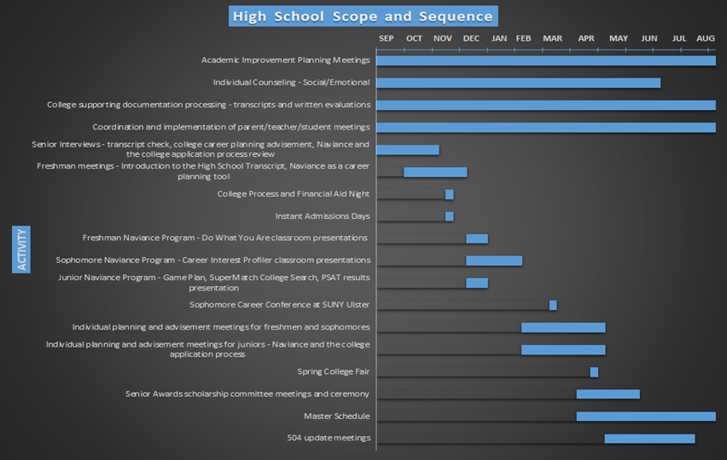

Slide 23
Multi-Tiered System of Support (MTSS)
Continued Development of Practices and Procedures – Update November 2024

Slide 24
Pilot New Tier 1 Intervention Bank in K-8 buildings
A committee made up of members from each building met for two days in July to build upon the Tier 1 Intervention Bank. Denise Alterio facilitated this work with the committee
Additional overview of the process took place
The current Intervention Bank was reviewed as were Evidence Based Practices from various resources
Sample Progress Monitoring Tools were reviewed
The committee created a comprehensive Intervention Bank by subject area and skill deficit
The committee created one Progress Monitoring Tool that can be used for any skill/goal as well as several tools specific to certain skills

Slide 25
Sharing Resources
Denise Alterio met with Elementary and Middle School Principals to review the Tier 1 Intervention Bank
Denise Alterio has been meeting with grade-level teams to present an update and review of the MTSS process as well as the Intervention Bank and Progress Monitoring Tools.
The Tier 1 Intervention Bank and Progress Monitoring Tools are easily accessible for teachers in the Elementary Resources Teams

Slide 26
Next Steps
Teachers in all four buildings are encouraged to begin utilizing the Tier 1 Intervention Bank this year when referring student for MTSS
Buildings are rolling out the process with ongoing support from the principals
If questions arise or a teacher needs support in the process an MTSS meeting can be called to review data with the team and decide on next steps in intervention.

Slide 27
District Curriculum Updates
Implemented this year (2024-2025)
Spanish 6, American Sign Language 3 and Financial Literacy
Writing Benchmarks and writing scope and sequence
Vocabulary Morphology Lessons for grades 4, 5 and 6
Supports:
BOCES Itinerant Science support for high school, middle school and elementary
ELA consultant for K-8 grade level support for MTSS, how to use instructional data and coaching days
Educational consultant supporting vocabulary and morphology implementation for grades 4, 5 and 6
Trainings
Orton-Gillingham Training for kindergarten and grade 1 classroom teachers
Learning A-Z for K-6 teachers
Canva – Instructional Technology platform training for K-8 teachers
Barbara Curiale working with middle school English AIS and Reading teachers on vocabulary development.
Math consultant working with elementary schools on building math fluency

Slide 28
Wallkill Central School District New York State Assessment Data 2023-2024

Slide 29
2024 ELA Proficiency Comparison – District-Wide
Grade(s) | 2023 vs. 2024 |  | District vs. Ulster County
 | 2023 | 2024 | WCSD ’24 | UC ‘24
3 | 47% | 49% | 49% | 40%
4 | 44% | 38% | 38% | 34%
5 | 31% | 36% | 36% | 35%
6 | 46% | 39% | 39% | 32%
7 | 45% | 41% | 41% | 40%
*8 | 45% | 48% | 48% | 42%
* Includes out of district placements
At or Above 2023 District Average
At or Above 2024 County Average
Below 2024 County Average

Slide 30
2024 Grade Band ELA Proficiency Comparison – District-Wide*
Grade(s) | 2023 vs. 2024 |  | District vs. Ulster County
 | 2023 | 2024 | WCSD ’24 | UC ‘24
3-6 | 42% | 41% | 41% | 35%
*7-8 | 45% | 45% | 45% | 41%
*3-8 | 43% | 42% | 42% | 37%
* Includes out of district placements
At or Above 2023 District Average
At or Above 2024 County Average
Below 2024 County Average

Slide 31
2024 ELA Local County Comparison
Grade | Wallkill | Ulster County | Orange County | Dutchess County | Sullivan County
3 | 49% | 40% | 35% | 40% | 25%
4 | 38% | 34% | 38% | 45% | 27%
5 | 36% | 35% | 38% | 41% | 23%
6 | 39% | 32% | 37% | 45% | 28%
7 | 41% | 40% | 41% | 45% | 30%
8 | 48% | 42% | 44% | 47% | 32%
3-6 | 41% | 35% | 37% | 43% | 26%
7-8 | 45% | 41% | 42% | 48% | 31%
3-8 | 42% | 37% | 39% | 45% | 27%
1st
T-2nd
3rd
2nd
T-2nd
1st
2nd
2nd
2nd

Slide 32
ELA NOT Tested comparison –District
District-Wide
Grade(s) | Percent Not Tested
 | 2023 | 2024
3 | 31% | 28%
4 | 35% | 41%
5 | 46% | 41%
6 | 42% | 44%
7 | 36% | 42%
8 | 57% | 54%
Grade(s) | Percent Not Tested
 | 2023 | 2024
3-6 | 39% | 38%
7-8 | 47% | 48%
3-8 | 42% | 42%

Slide 33
2024 Math State Assessment – District-Wide
Grade(s) | 2023 vs. 2024 |  | District vs. Ulster County
 | 2023 | 2024 | WCSD ’24 | UC ‘24
3 | 57% | 64% | 64% | 51%
4 | 56% | 51% | 51% | 41%
5 | 32% | 27% | 27% | 35%
6 | 53% | 52% | 52% | 36%
7 | 63% | 66% | 66% | 49%
*8 | 36% | 43% | 43% | 33%
* Does not include students that took Algebra 1 Regents Exam
At or Above 2023 District Average
At or Above 2024 County Average
Below 2024 County Average

Slide 34
2024 Grade Band Math State Assessment – District-Wide
Grade(s) | 2023 vs. 2024 |  | District vs. Ulster County
 | 2023 | 2024 | WCSD ’24 | UC ‘24
3-6 | 50% | 49% | 49% | 41%
*7-8 | 55% | 58% | 58% | 42%
*3-8 | 51% | 51% | 51% | 41%
* Does not include students that took Algebra 1 Regents Exam
At or Above 2023 District Average
At or Above 2024 County Average
Below 2024 County Average

Slide 35
2024 Math Local County Comparison
Grade | Wallkill | Ulster County | Orange County | Dutchess County | Sullivan County
3 | 64% | 51% | 49% | 49% | 34%
4 | 51% | 41% | 53% | 56% | 35%
5 | 27% | 35% | 43% | 49% | 28%
6 | 52% | 36% | 43% | 52% | 27%
7 | 66% | 49% | 50% | 53% | 37%
8 | 43% | 33% | 31% | 31% | 16%
3-6 | 49% | 41% | 47% | 51% | 31%
*7-8 | 58% | 42% | 41% | 44% | 28%
*3-8 | 51% | 41% | 45% | 49% | 30%
1st
3rd
5th
T-1st
1st
1st
2nd
1st
1st
* Does not include students that took Algebra 1 Regents Exam

Slide 36
Math NOT Tested comparison – District
District-Wide
Grade(s) | Percent Not Tested
 | 2023 | 2024
3 | 31% | 28%
4 | 35% | 40%
5 | 46% | 43%
6 | 42% | 41%
7 | 38% | 41%
*8 | 55% | 58%
Grade(s) | Percent Not Tested
 | 2023 | 2024
3-6 | 40% | 38%
*7-8 | 46% | 49%
*3-8 | 42% | 41%
*Does not include students that took Algebra 1 Regents Exam

Slide 37
2024 NYS Science Exam - Grades 5 & 8
*County Proficiency Comparison – Grade 5
Wallkill | Ulster
39% | 31%
*County Proficiency Comparison – Grade 8
Wallkill | Ulster
29% | 30%
*Includes out of district placements
Special Note: Grade 5 Exam was new for 2024

Slide 38
WCSD Regents Performance Summary (June Exams only)
Assessment | 2022-2023 % of students’ scores between 65-100 | 2023-2024 % of students’ scores between 65-100
**Algebra 1 | 86% | 78%
Geometry | 84% | 84%
Algebra 2 | 93% | 96%
English | 90% | 93%
Global History | 87% | 88%
U.S. History | 89% | 94%
*Living Environment | 77% | 78%
Earth Science | 89% | 80%
Chemistry | 93% | 82%
Physics | 71% | 88%
* MS Advanced students included
** New Exam 2024 & MS Advanced students included
At or Above 2023 WCSD %
Below 2023 WCSD %

Slide 39
WCSD Regents Performance vs. Ulster County (June Exams only)
Assessment | 2023-2024 WSHS Proficiency Rate | 2023-2024 Ulster County Proficiency Rate
**Algebra 1 | 78% | 65%
Geometry | 84% | 76%
Algebra 2 | 96% | 93%
English | 93% | 76%
Global History | 88% | 80%
U.S. History | 94% | 86%
*Living Environment | 78% | 72%
Earth Science | 80% | 74%
Chemistry | 82% | 76%
Physics | 88% | 83%
* MS Advanced students included
** New Exam 2024 & MS Advanced students included
At or Above 2023 UC %
Below 2023 UC %

Slide 40
Wallkill Senior High School Graduation Rates
Class of 2020 (Cohort of 2016) | Class of 2021 (Cohort of 2017) | Class of 2022 (Cohort of 2018) | Class of 2023 (Cohort of 2019) | Class of 2024 (Cohort of 2020)
94.0% | 92.3% | 95.4% | 93.6% | 92.8%
Wallkill Senior High School Only

Slide 41
Wallkill Senior High School Special Education Graduation Rates
Class of 2020 (Cohort of 2016) | Class of 2021 (Cohort of 2017) | Class of 2022 (Cohort of 2018) | Class of 2023 (Cohort of 2019) | Class of 2024 (Cohort of 2020)
80.0% | 75.0% | 85.2% | 83.3% | 81.8%
Wallkill Senior High School only

