Slide 1
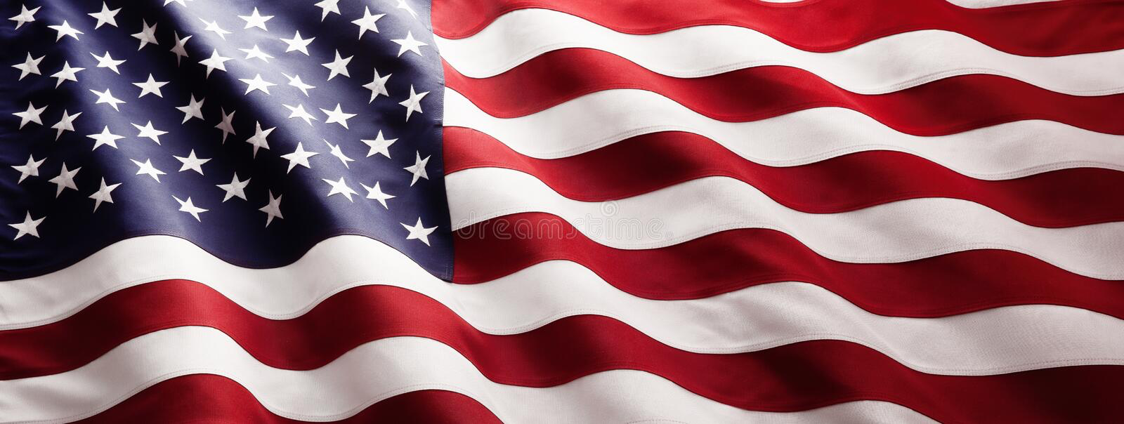
Honoring Our Veterans
Notes:
Make sure computer volume is at 84.

Slide 2
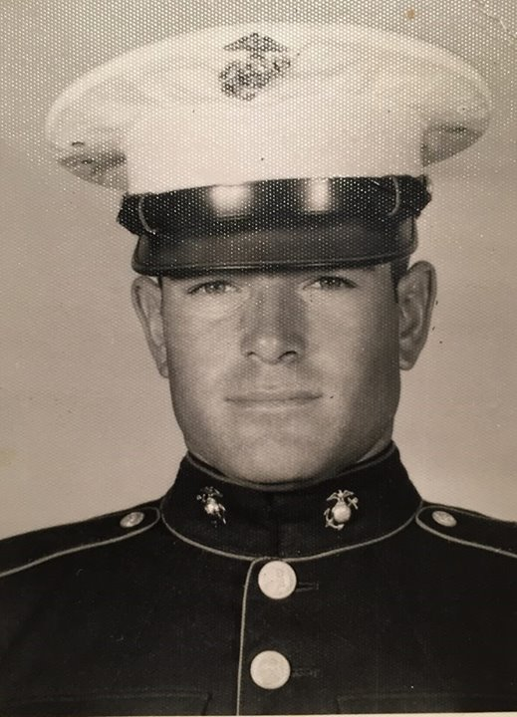
PVC L. Allen Jagneaux
Marine Corps
Father
of
Mrs. Whitman
Notes:
“This Land is Your Land” at 3/4 volume

Slide 3
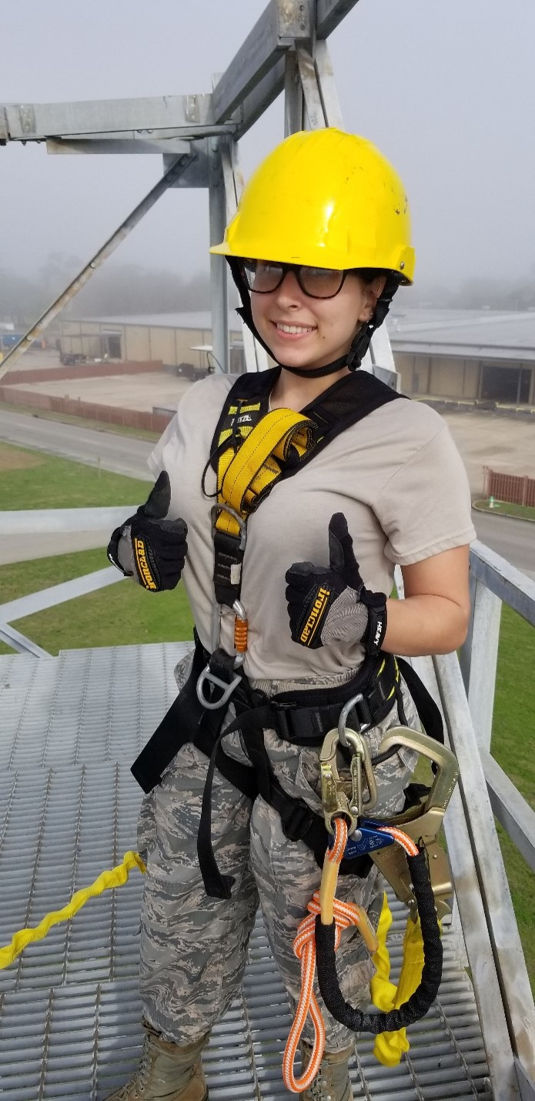
Kylie DeBarge
Staff Sergeant
Air Force National Guard
Daughter-in-law
of
Mrs. Whitman

Slide 4
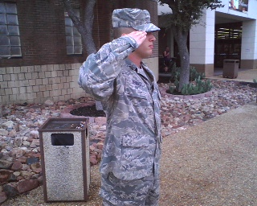
Ethan DeBarge
Technical Sergeant
Air Force
National Guard
Son
of
Mrs. Whitman

Slide 5
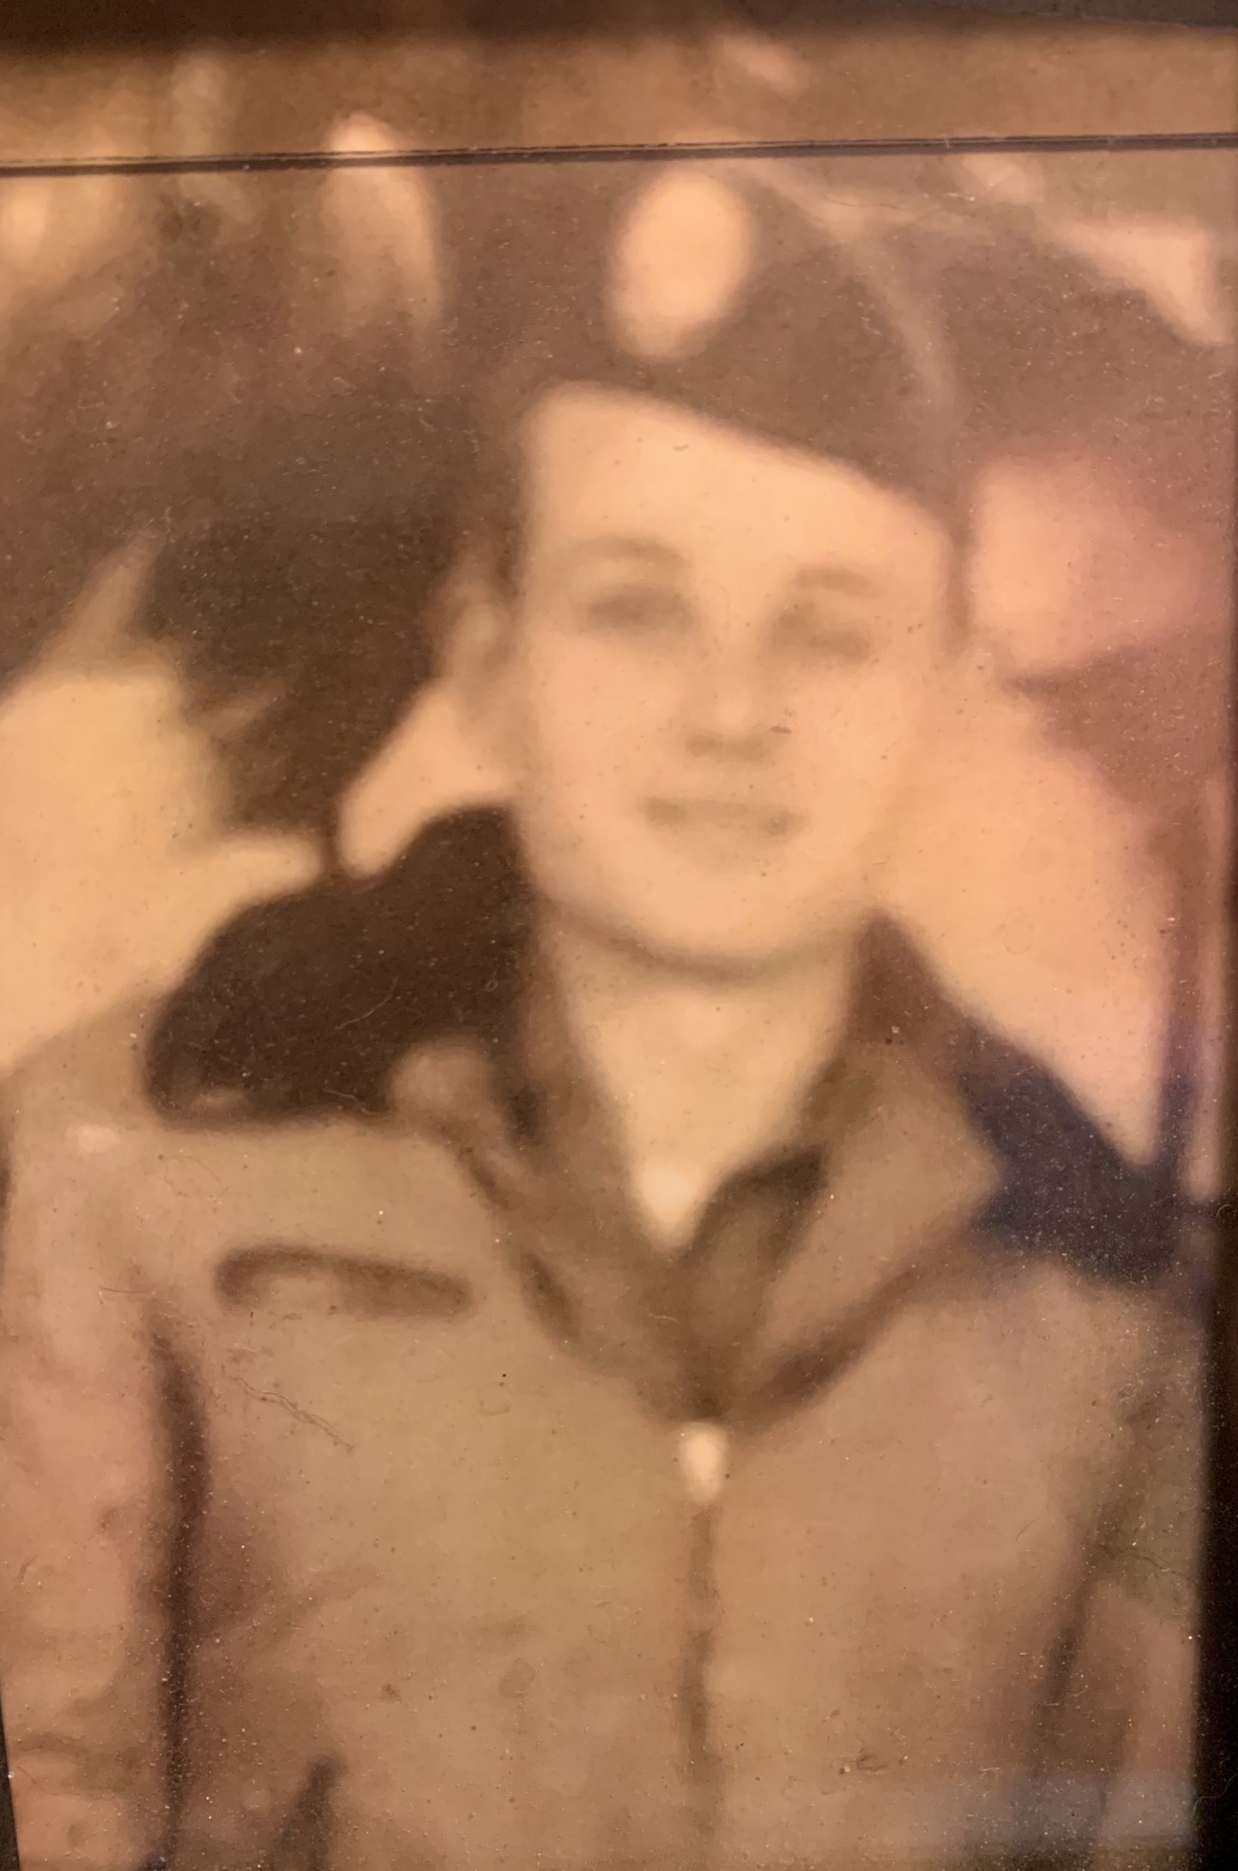
Arthur Corley
Army
Great, Great Grandfather
of
Chesney & Claydon Richardson

Slide 6
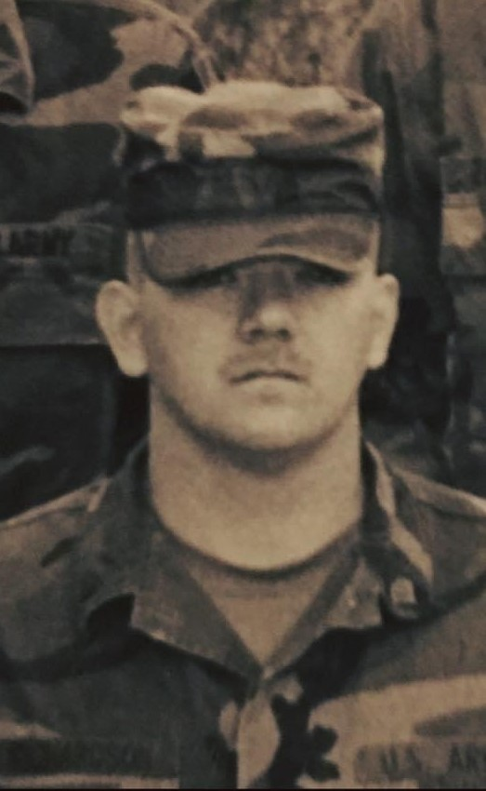
Craig Richardson
Army
Grandfather
of
Chesney & Claydon Richardson

Slide 7
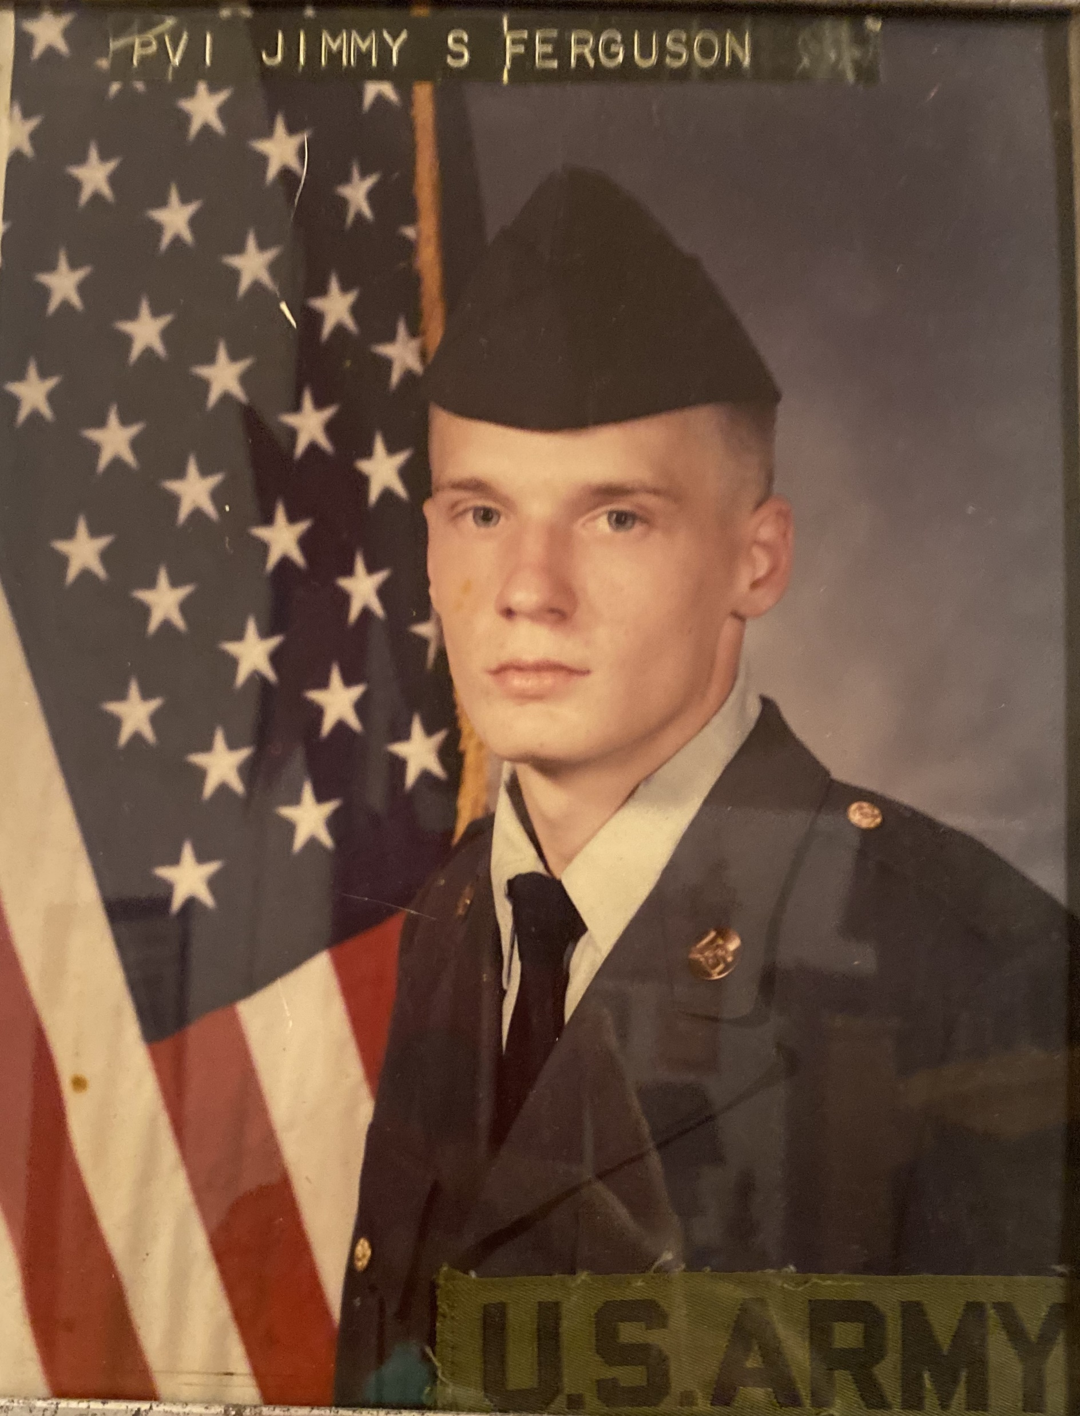
Jimmy S. Ferguson
Army
Grandfather
of
Chesney & Claydon Richardson

Slide 8
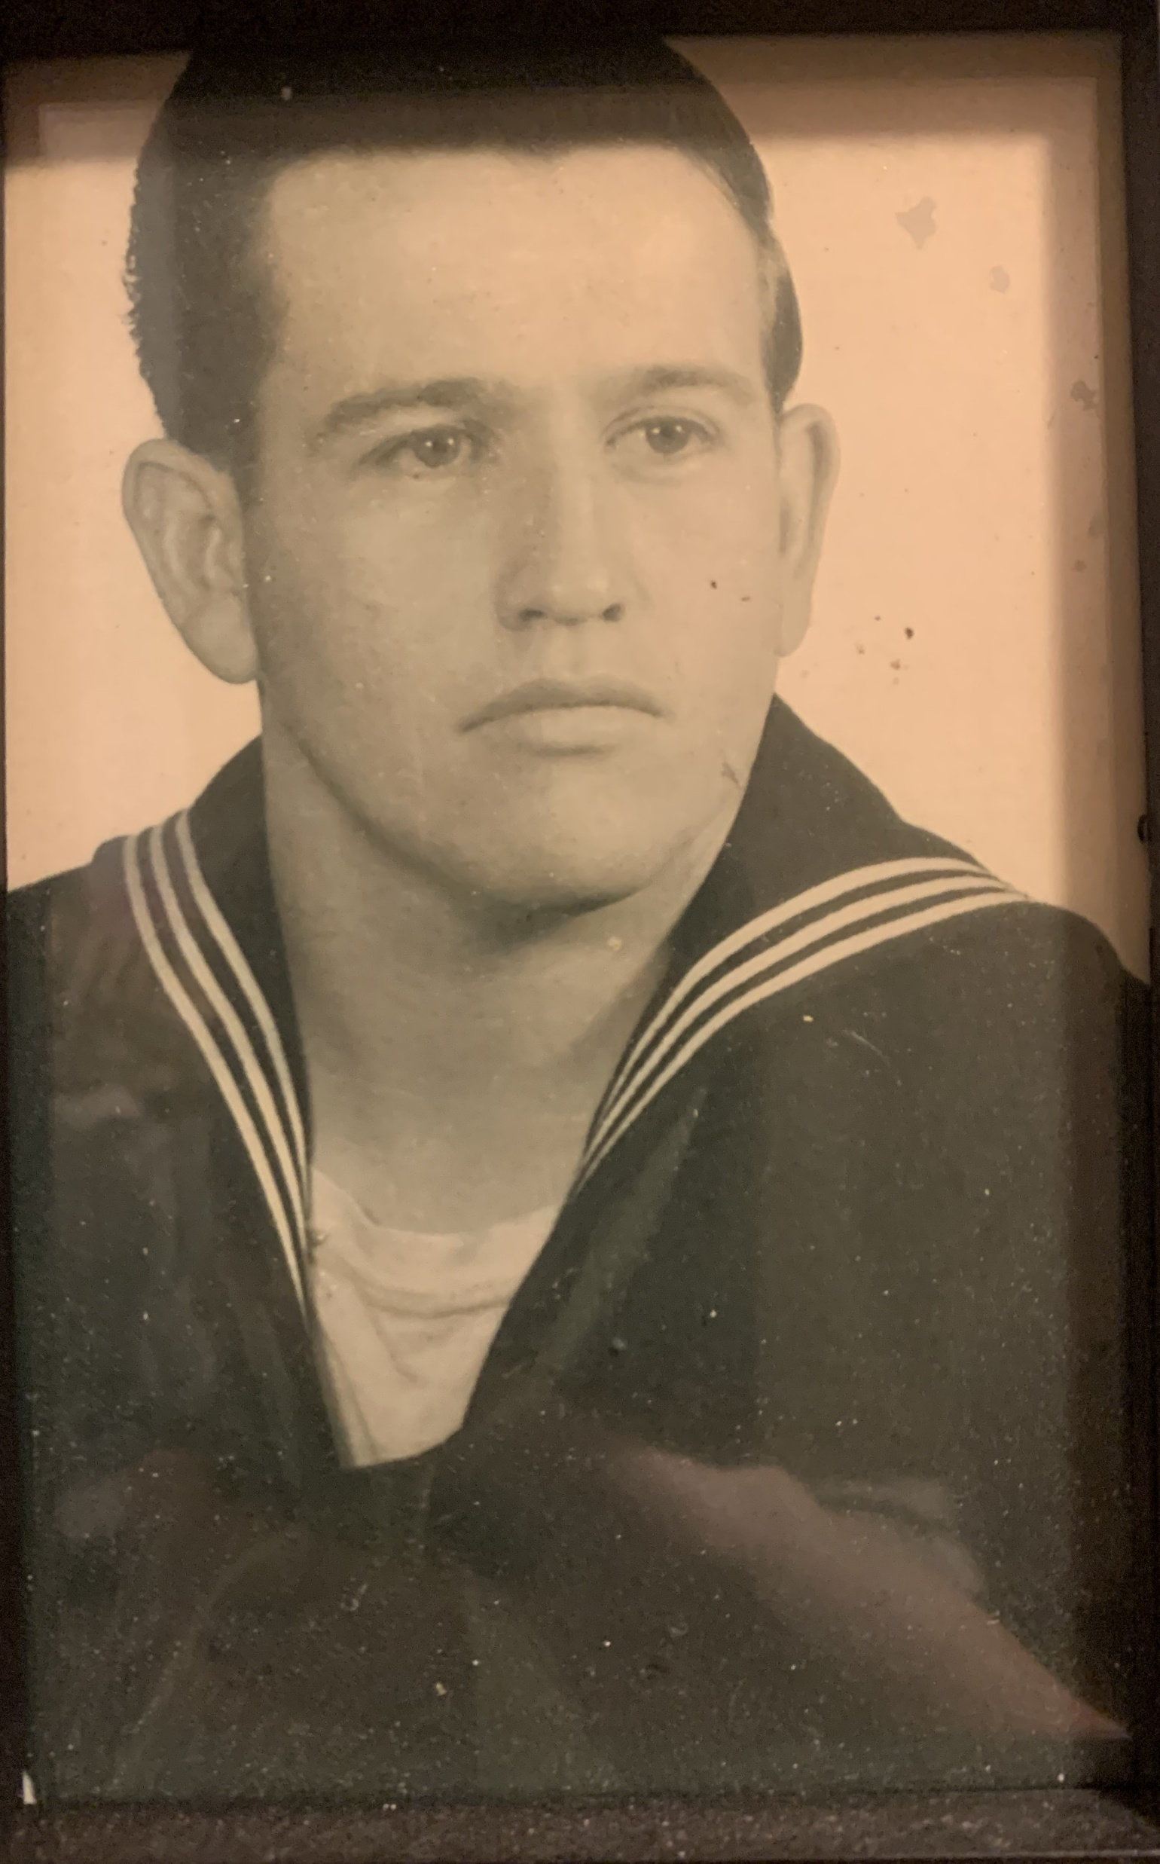
Walt Roberson
Navy
Great Grandfather
of
Chesney & Claydon Richardson

Slide 9
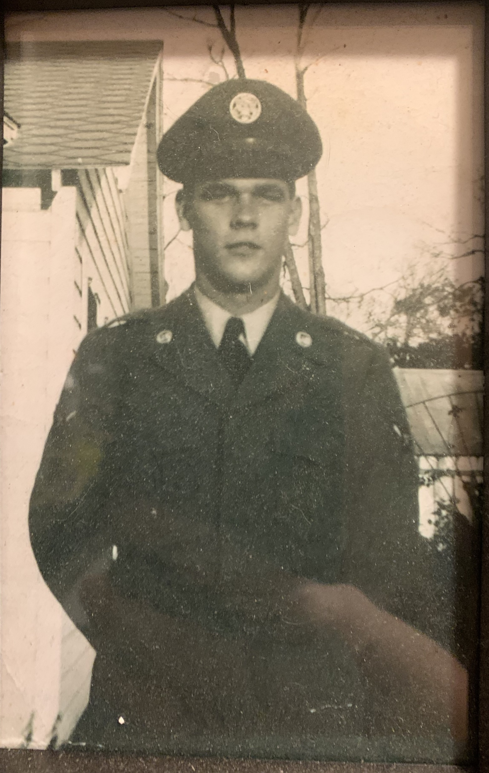
Jim Saxton
Air Force
Great Grandfather
of
Chesney & Claydon Richardson

Slide 10
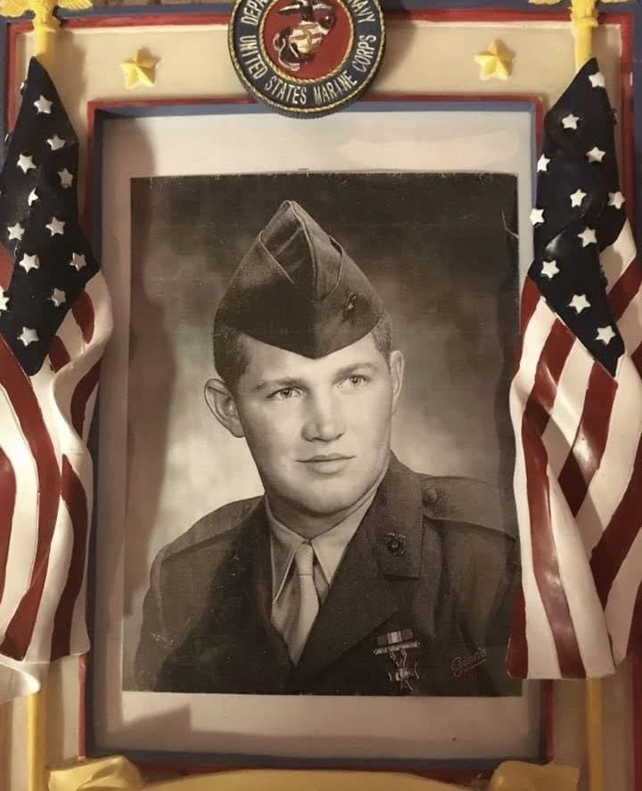
Charles Broussard
Marines
Grandfather
of
Colt Oliver

Slide 11
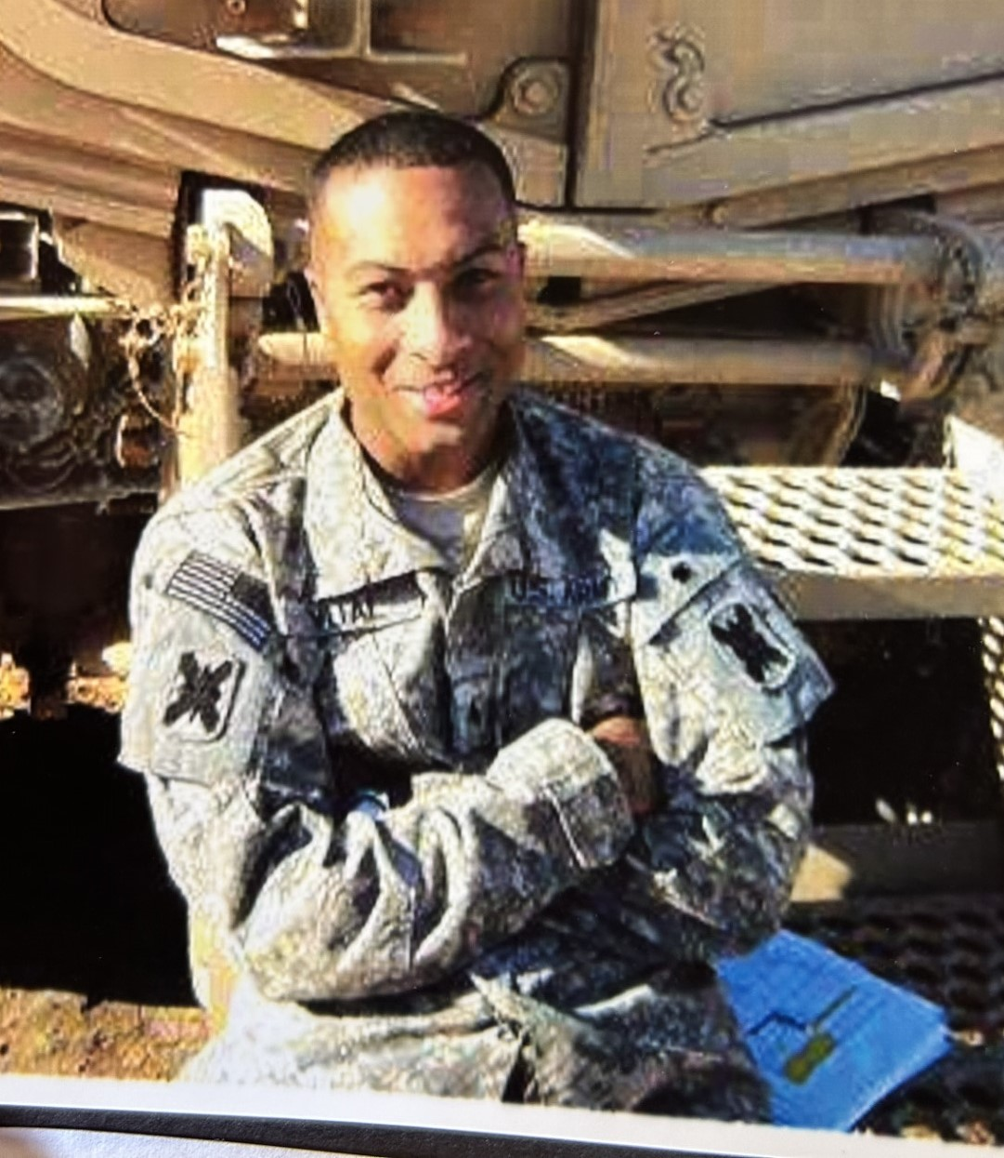
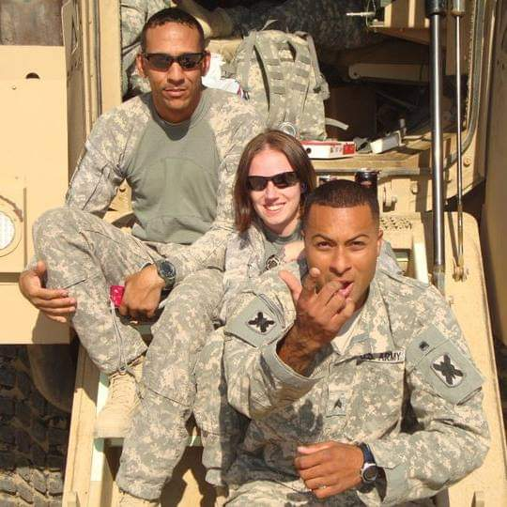
Cody Vital
Army
E-5 Sargeant
Father
of
Jayden & Lane
Vital

Slide 12
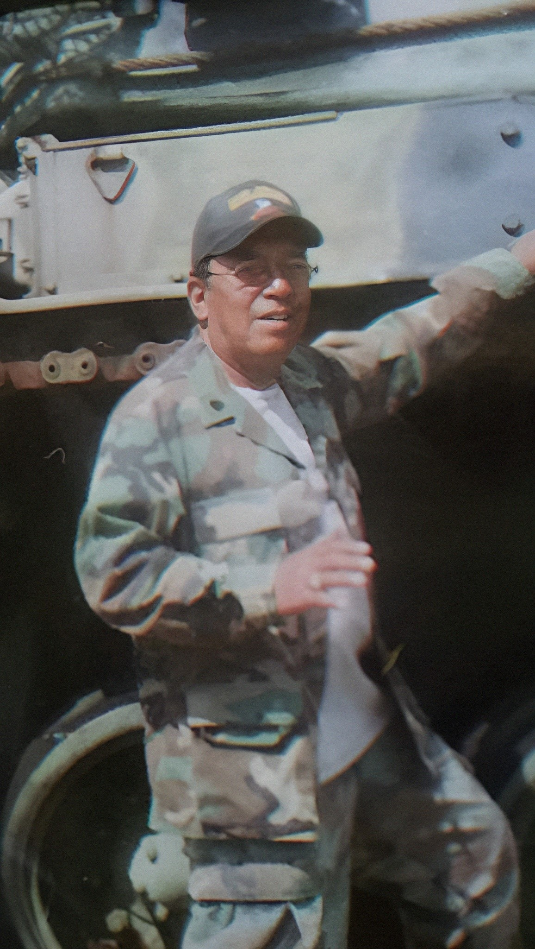
James Simon
Army
PV 2
Grandfather
of
Jayden and Lane Vital

Slide 13
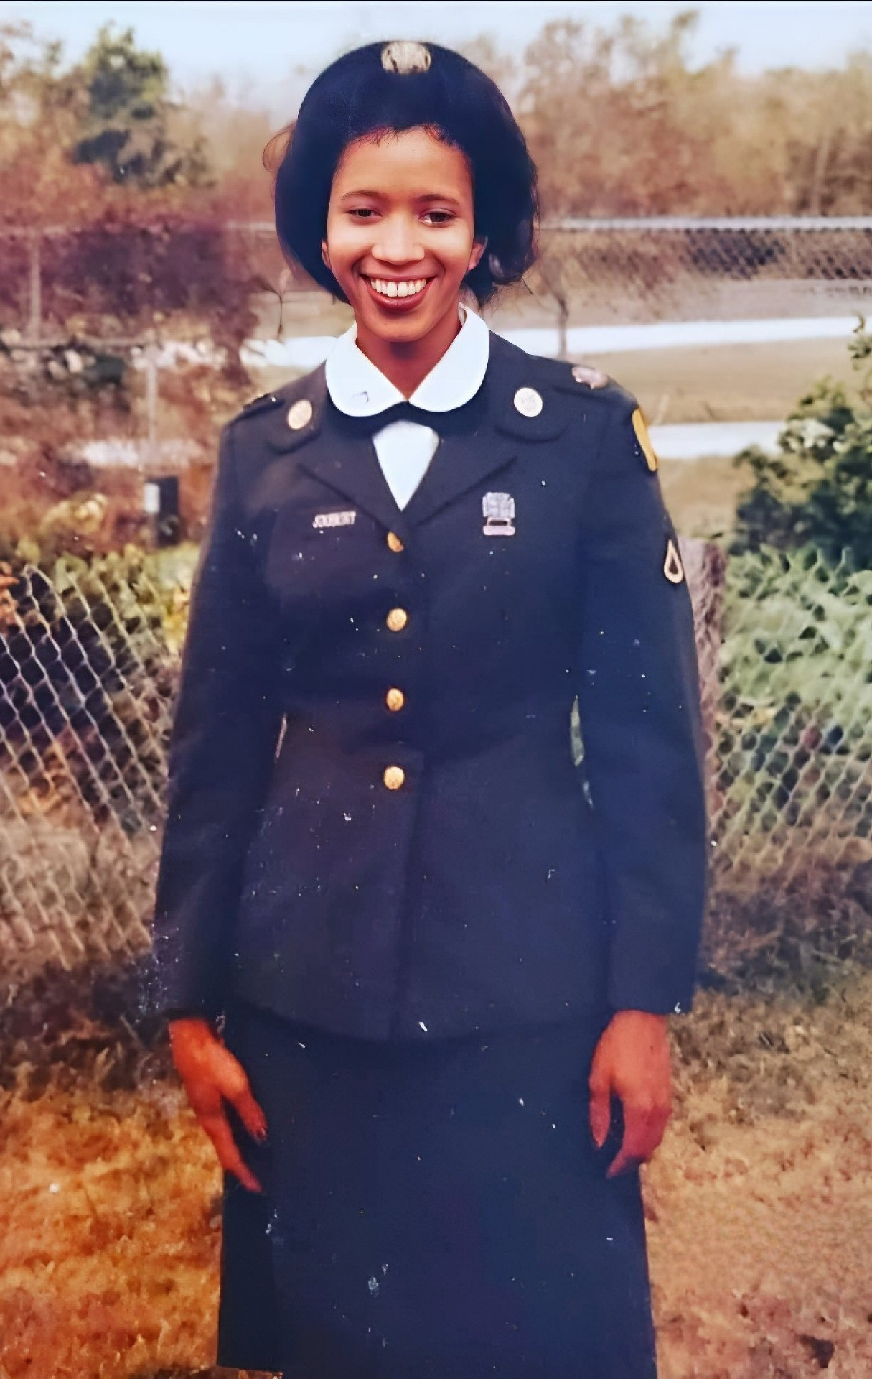
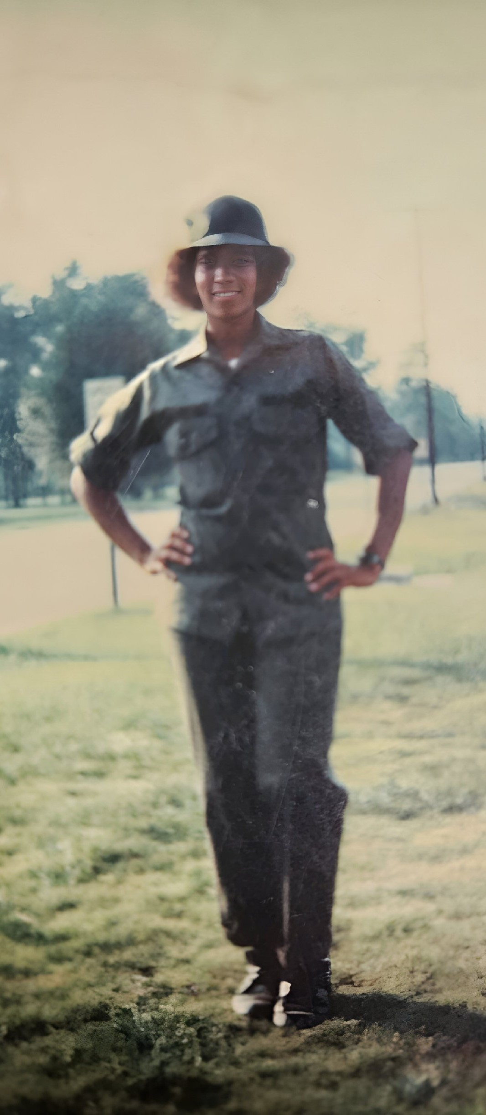
Stephanie Joubert
Army
Specialist 4
Grandmother
of
Jayden and Lane Vital

Slide 14
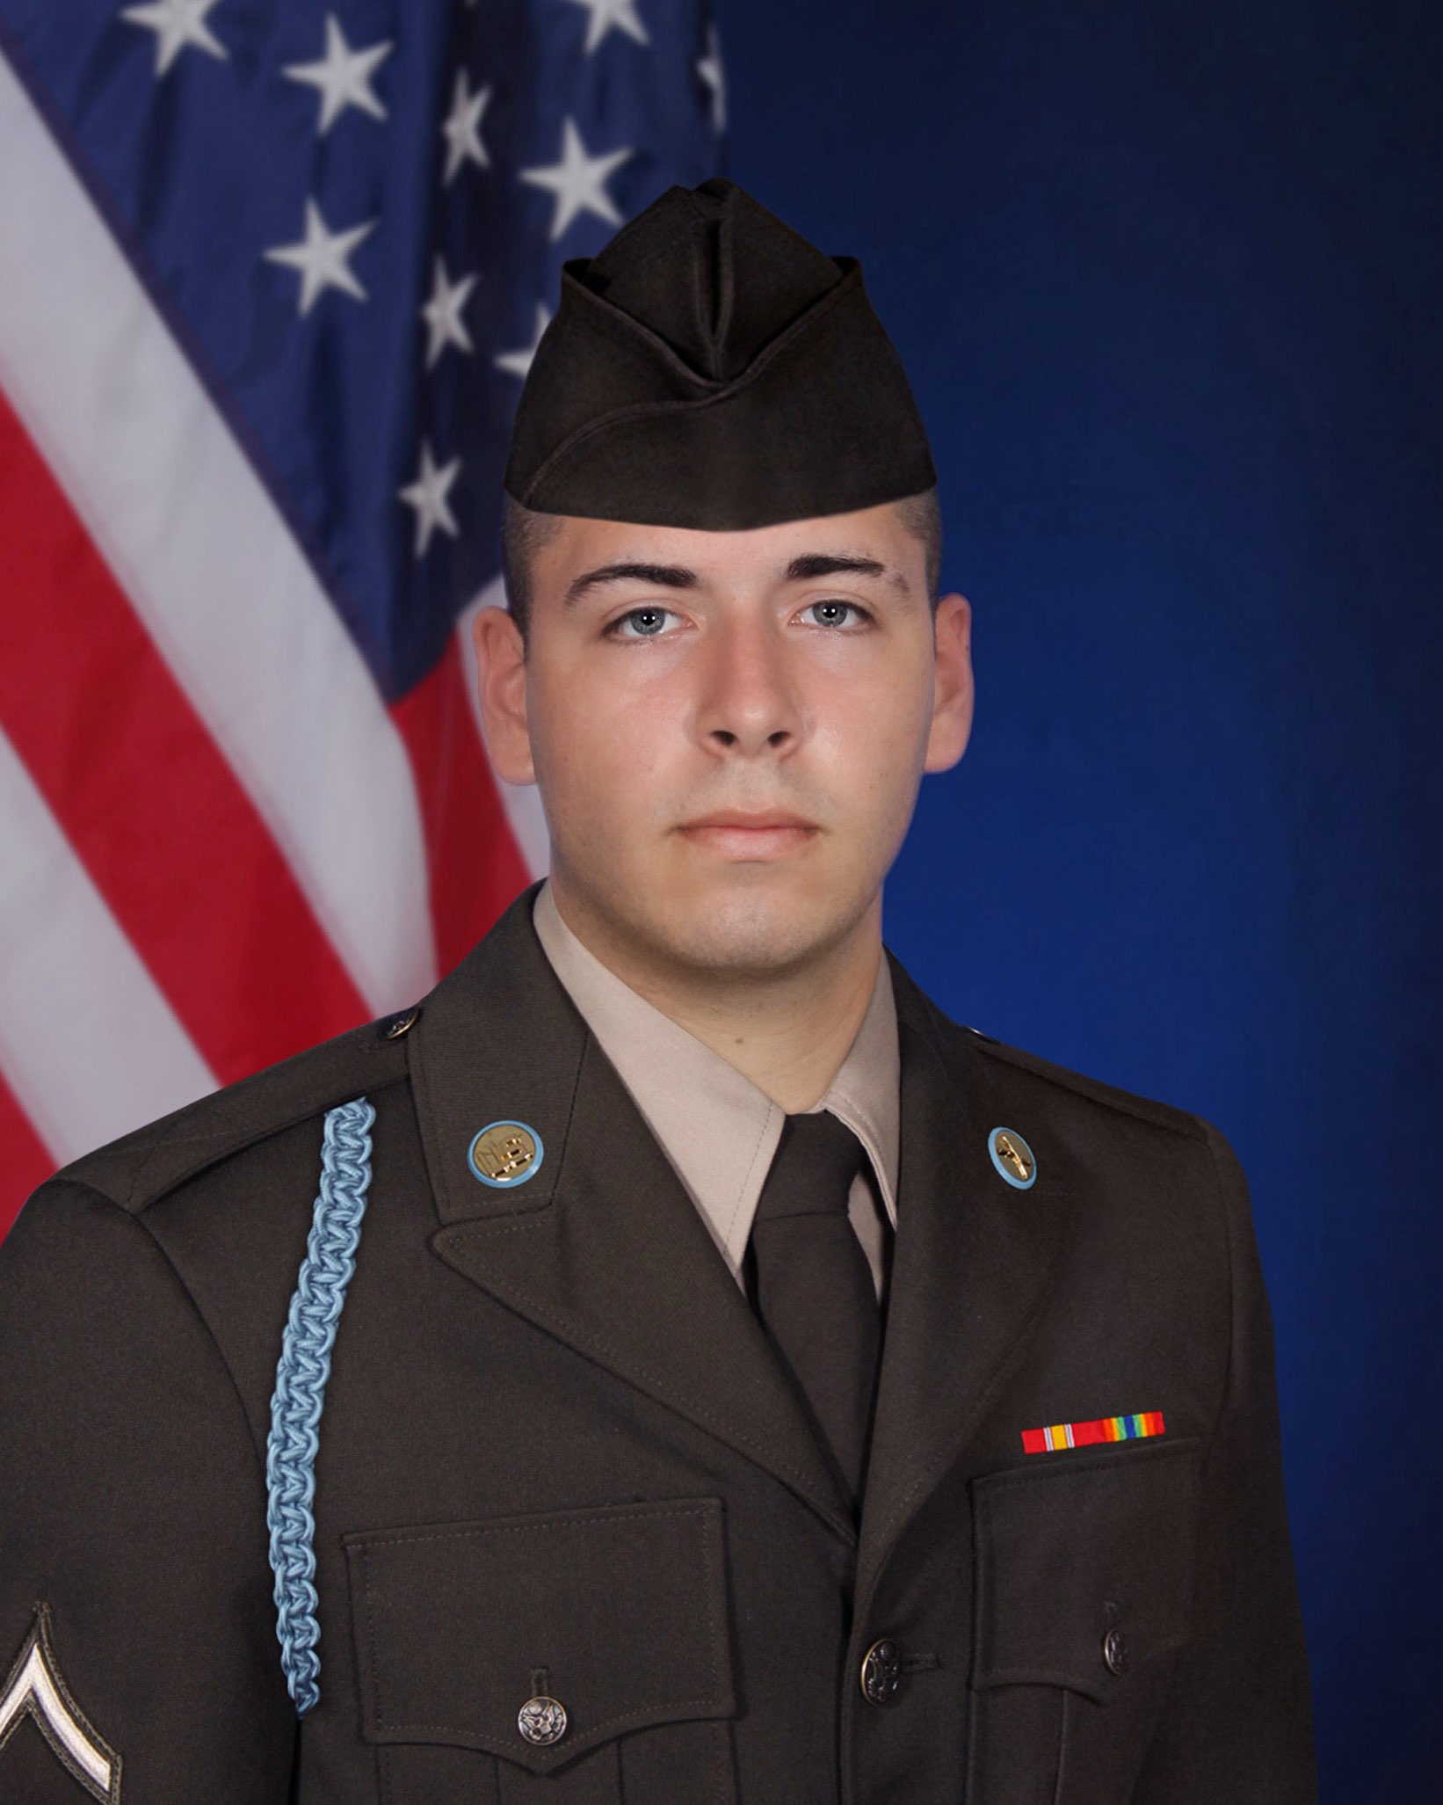
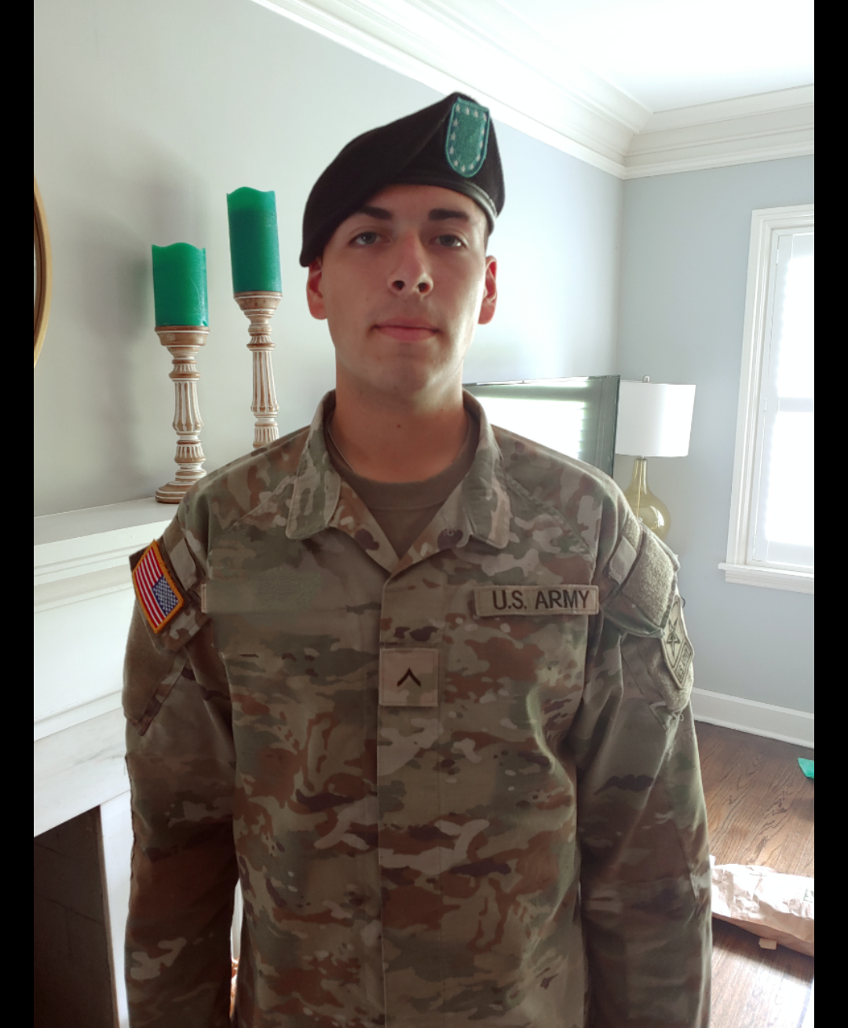
Cory English
Army
Grandson
of
Mrs. Medina

Slide 15
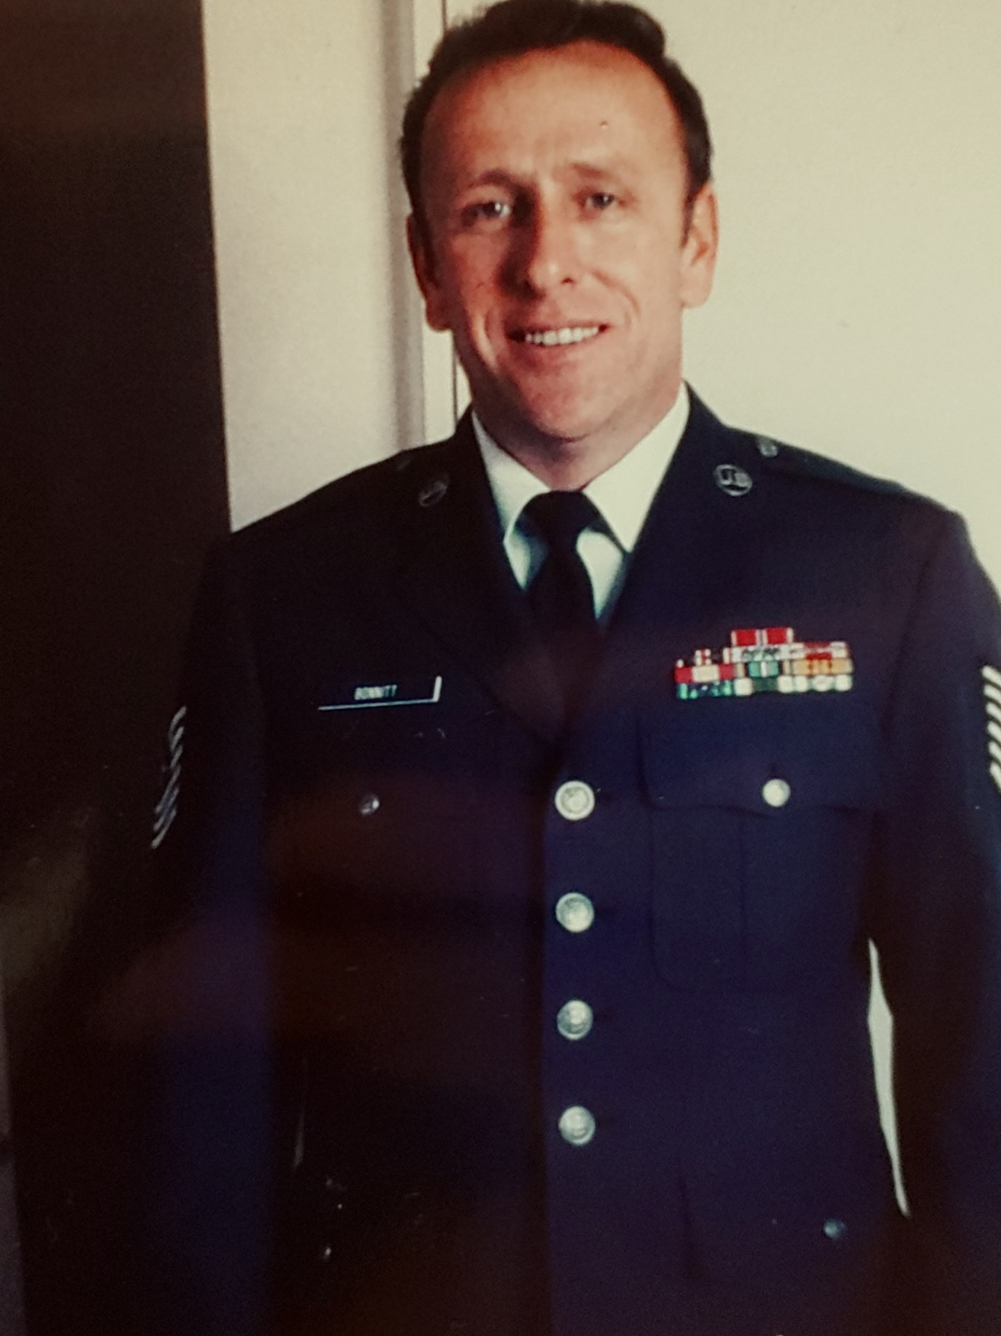
M.Sgt. Brad Bonnitt
Air Force
Father
of
Mrs. Medina

Slide 16
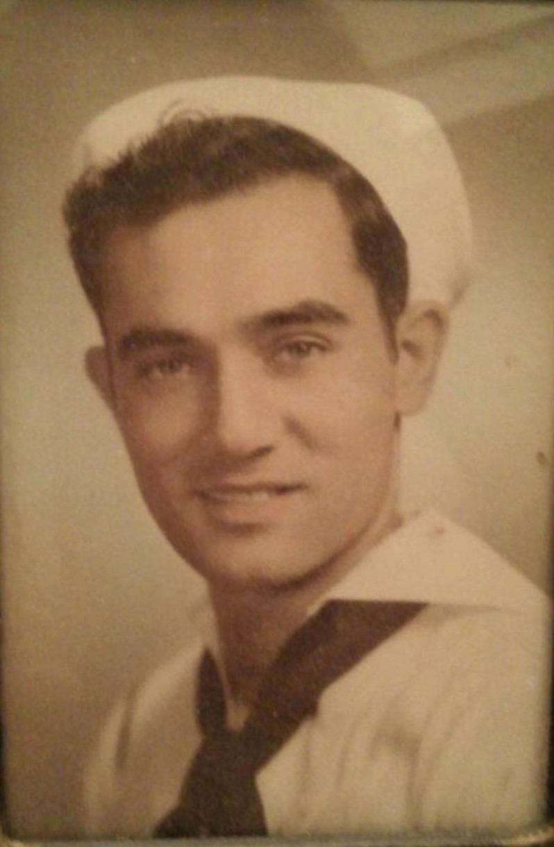
Floyd Linscomb
Coast Guard
Great Grandfather
of
DarleeFaye Linscomb

Slide 17
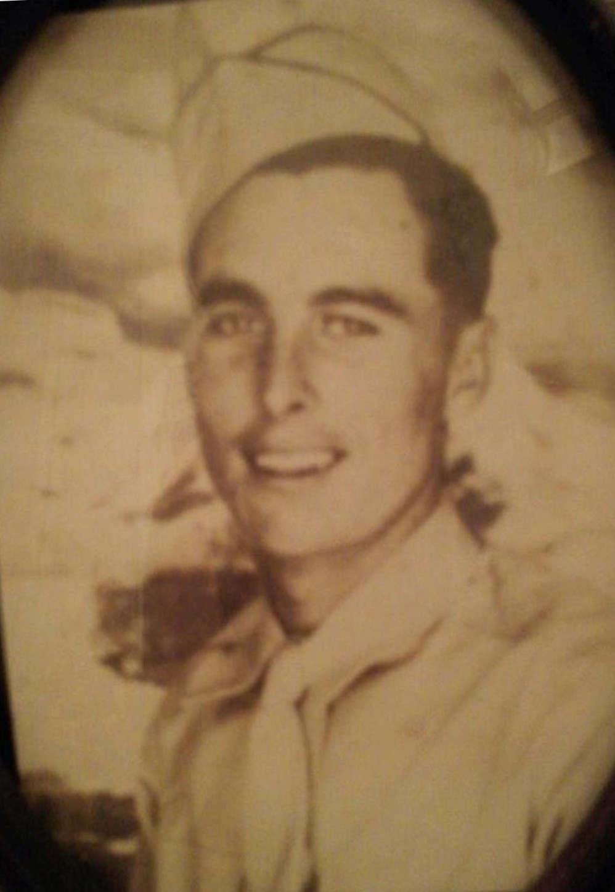
Luther Hashaw
Army
Great Grandfather
of
DarleeFaye Linscomb

Slide 18
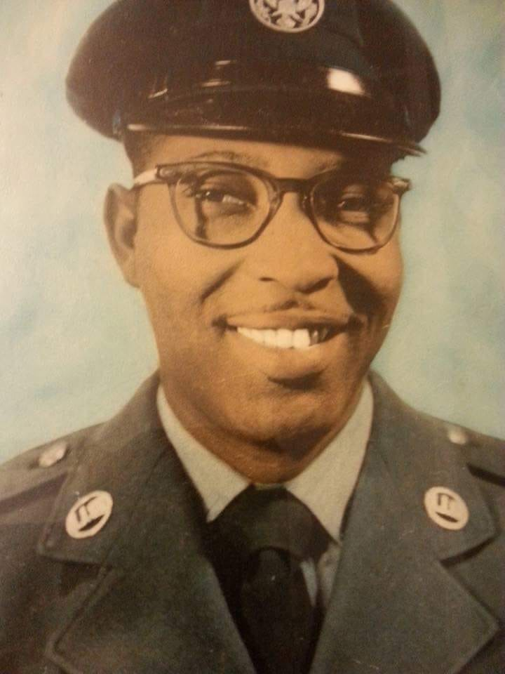
Herbert Johnson
Air Force
Grandfather
of
Karder & Kassian Davis

Slide 19
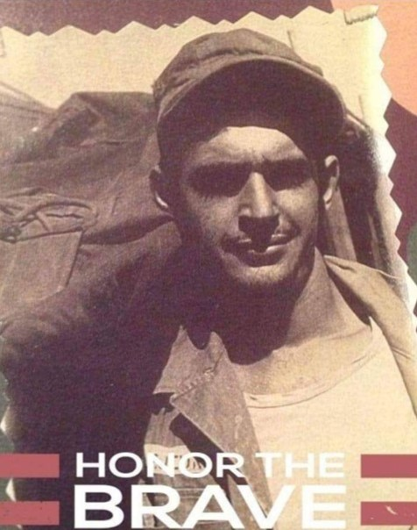
Joseph S. LeJeune
Army
Korean War
Great Grandfather
of
Harmony Ware

Slide 20
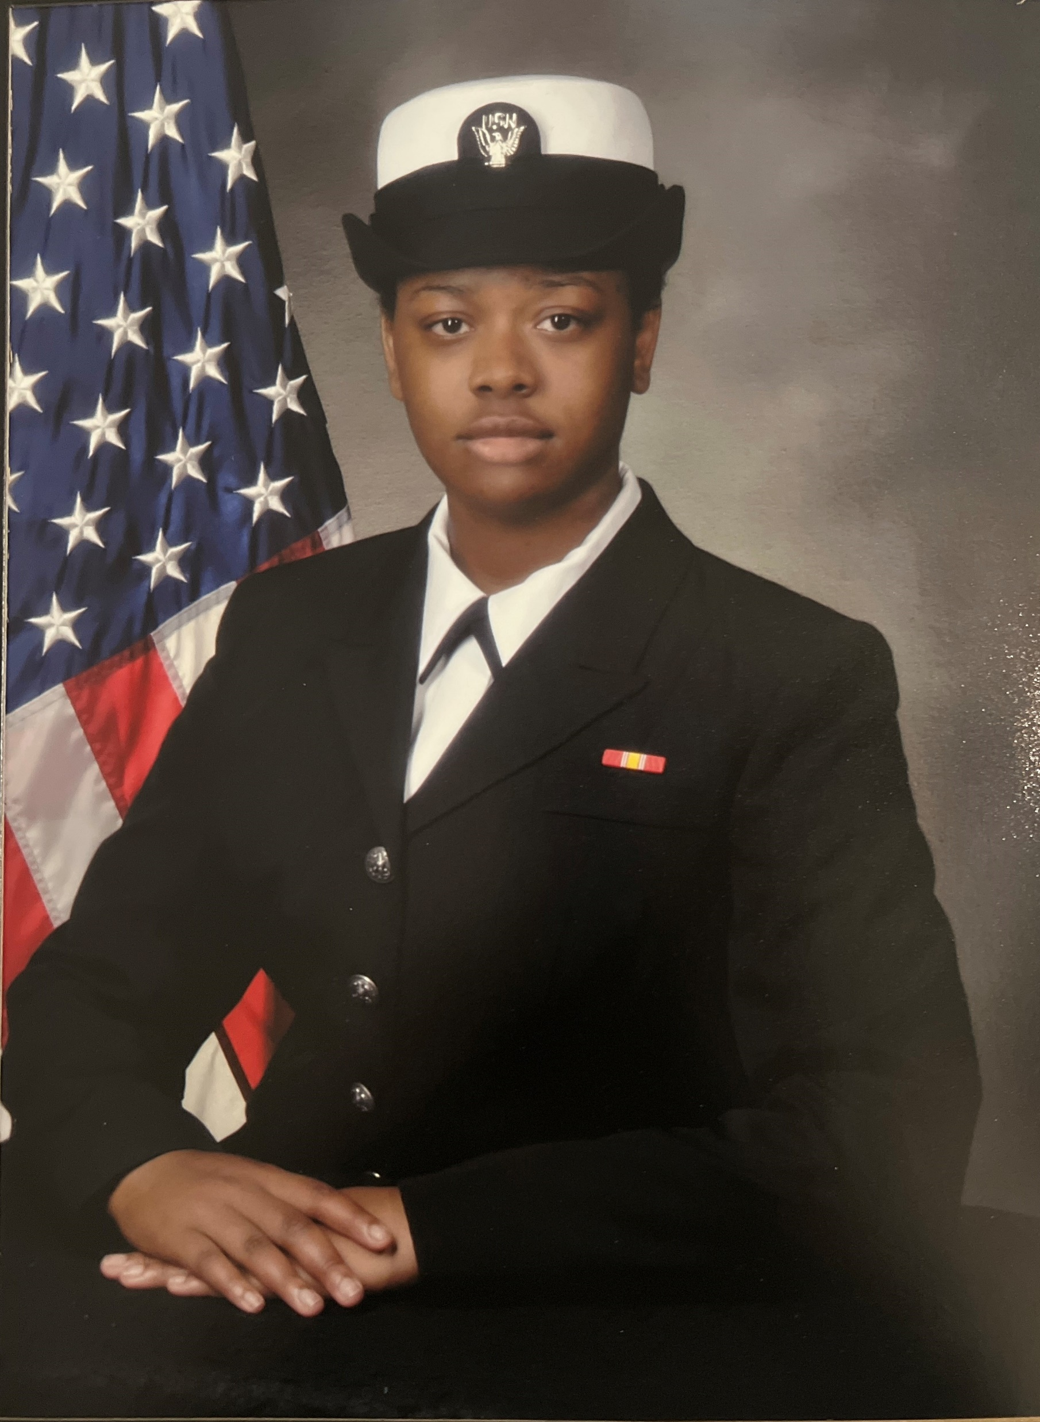
Kaylen Prescott
Mother
of
D’Laysia & Jaxson Prescott

Slide 21
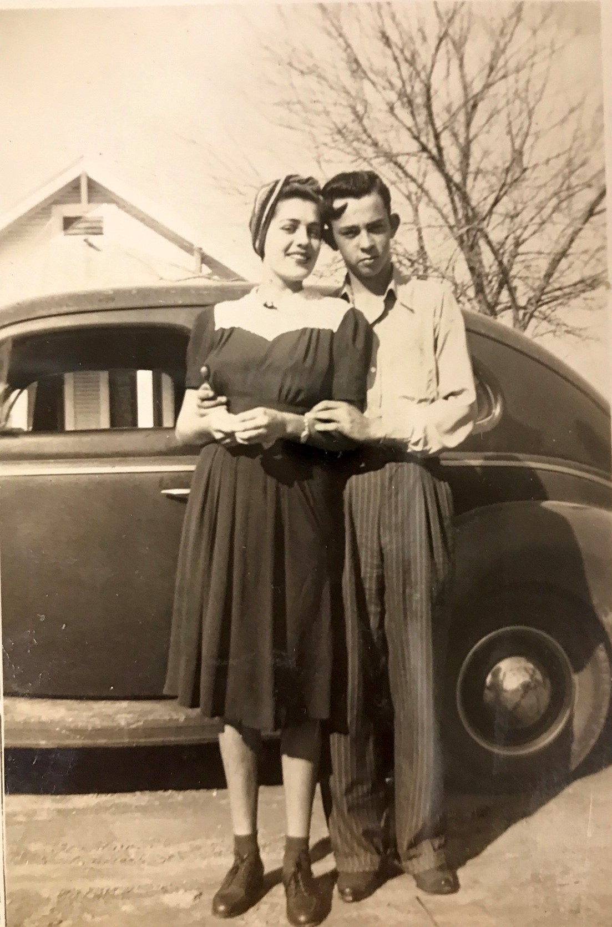
Melvin A. Coleman
Army
World War II
Grandfather
Of
Mrs. Clair
Great Grandfather
of
Rowen Beatty
&
Rhett Renfrow

Slide 22
Jared Breaux
Air Force
Cousin
of
Mrs. Clair

Slide 23
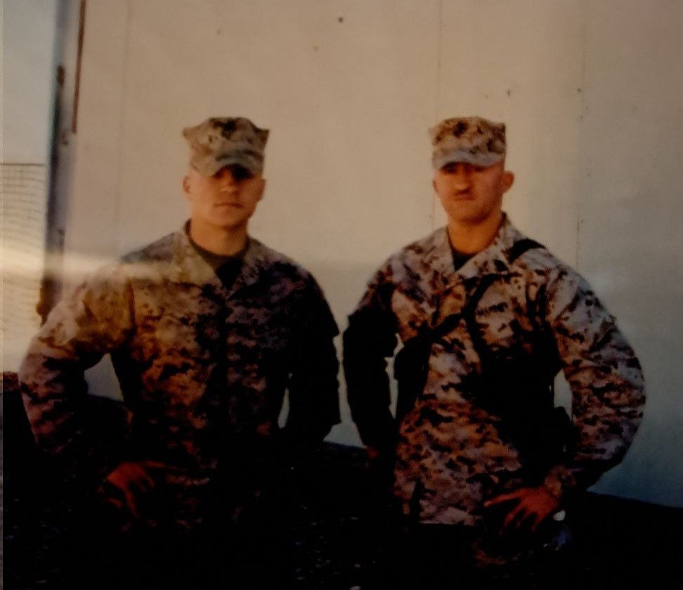
John & Michael Beard
Marine Corps
Uncle and Grandfather
of
Barrett Peveto

Slide 24
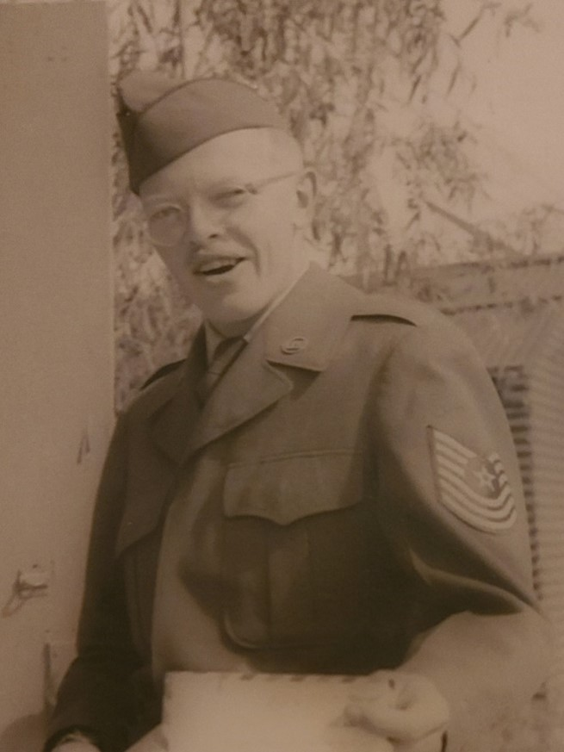
Harry Ketner
Air Force
Great Grandfather
of
Jeanette Miller

Slide 25
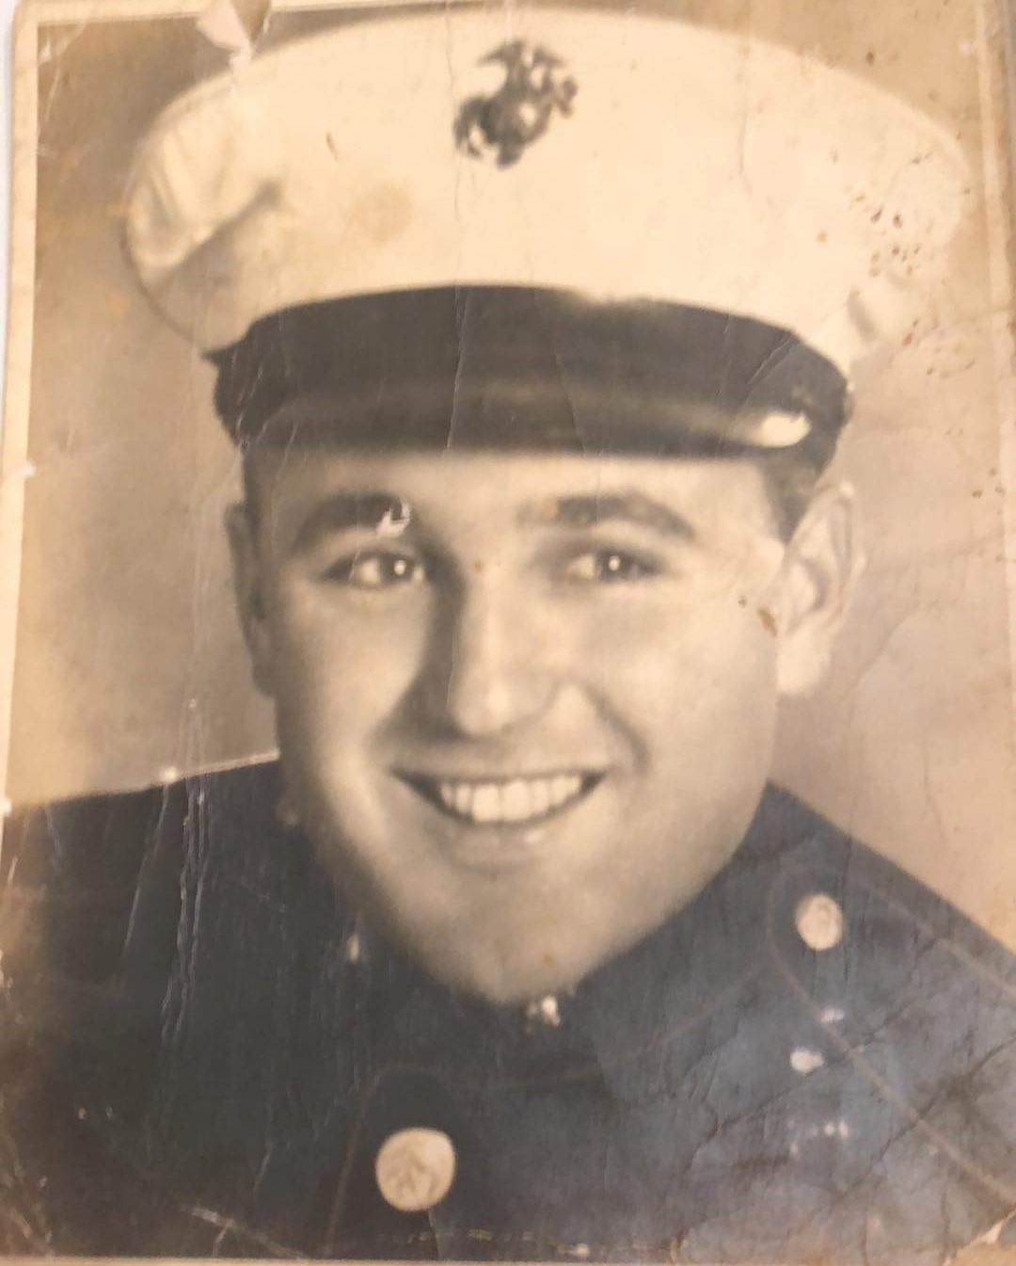
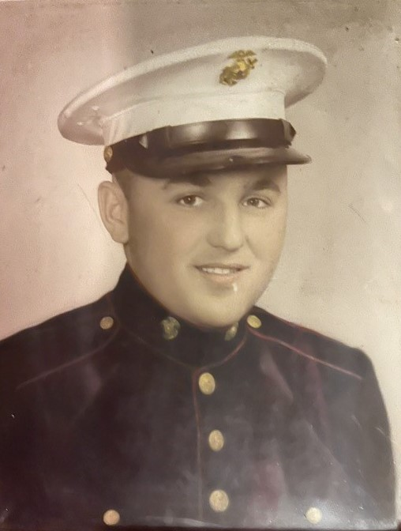
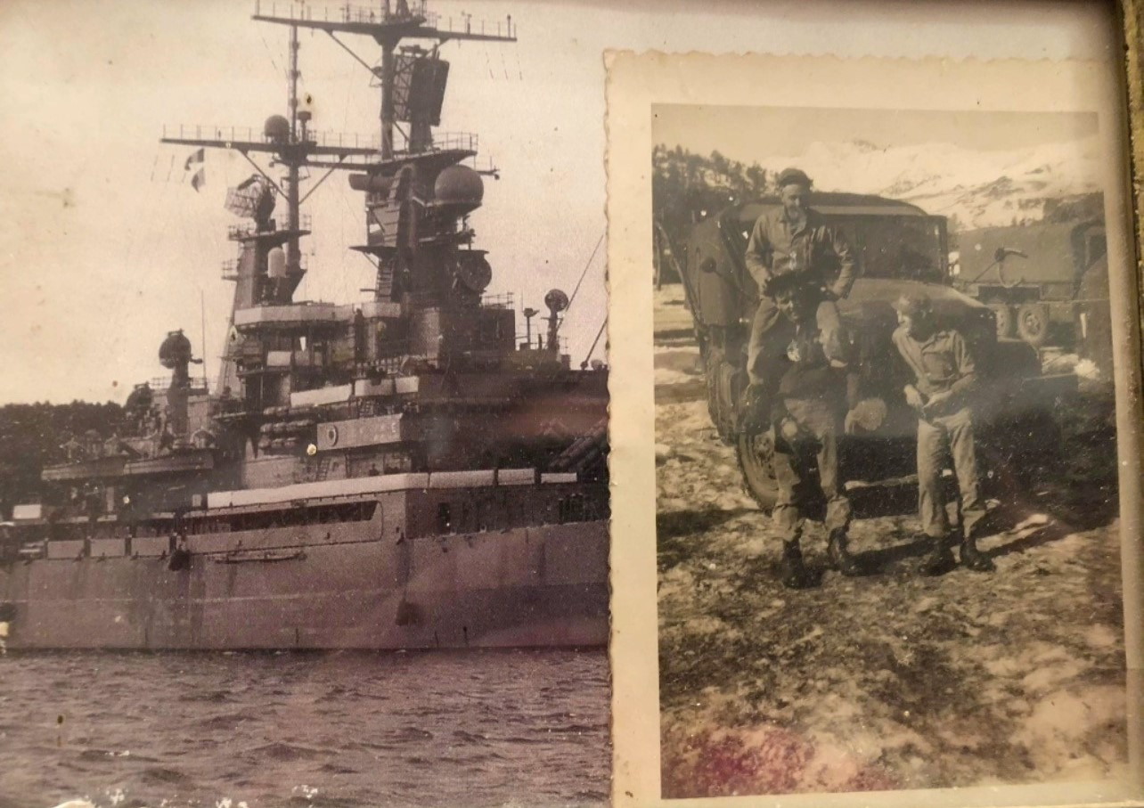
Ray Lee Gilbert
Marines
Grandfather
of
Riley Gilbert

Slide 26
Sebastian Cruz
Army
Active Member
Cousin
of
Gonzalo & Amalia Palomo

Slide 27
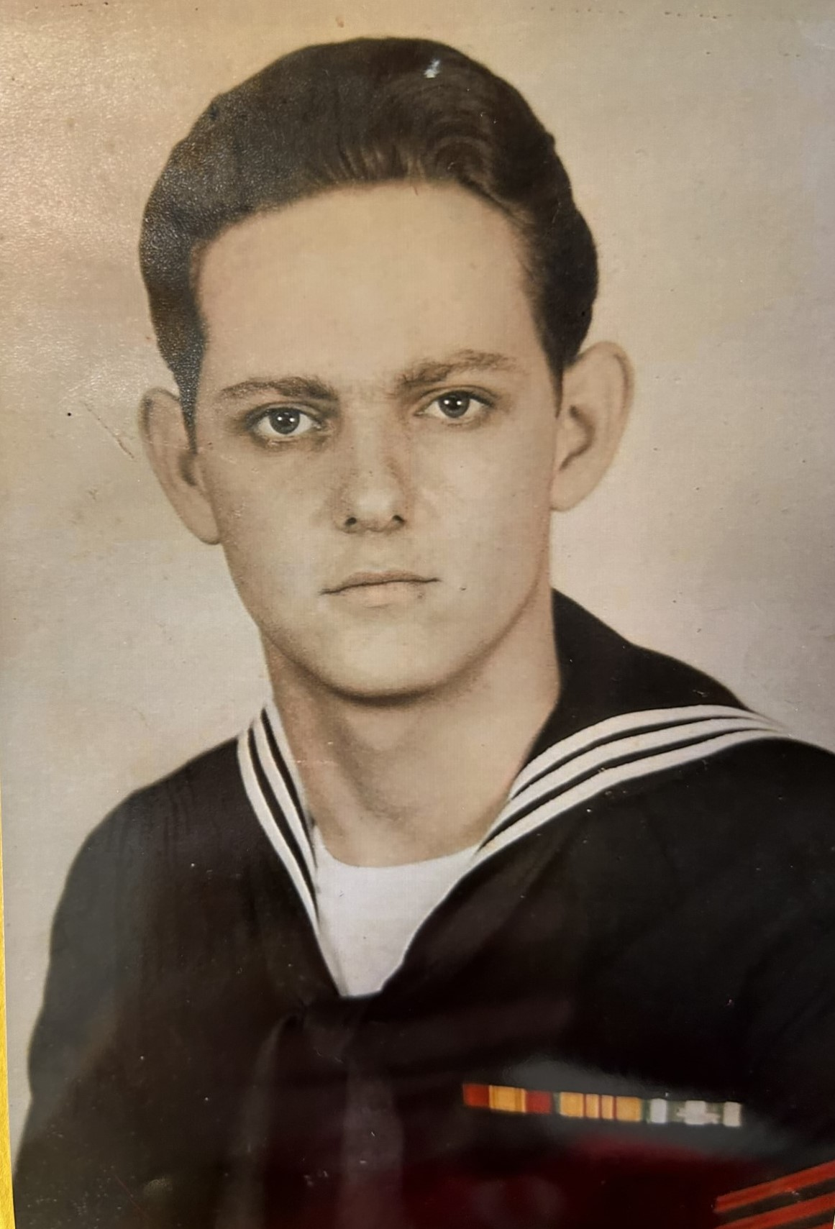
Ray Allen Trahan
Navy
USS Ranger
Jake Smith

Slide 28
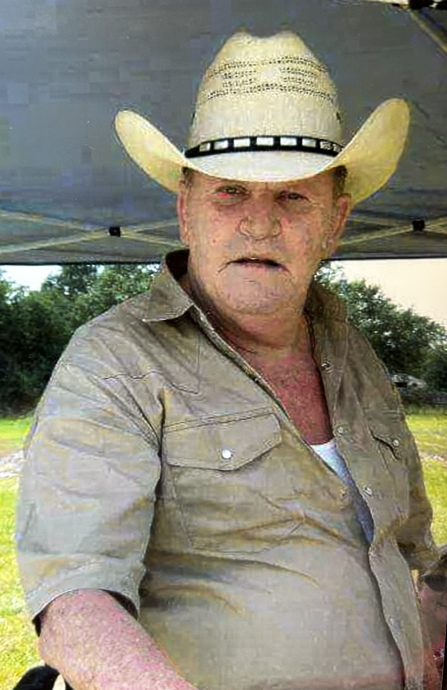
Eddie Ray McCarver
Army
Great Grandfather
of
Jake Smith

Slide 29
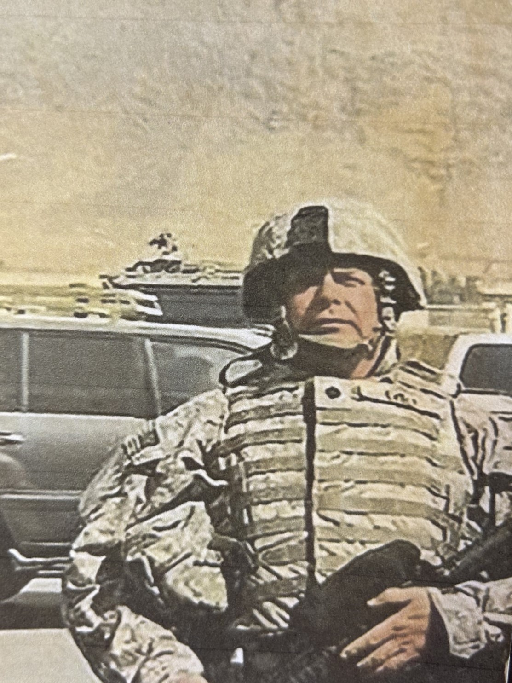
Richard Evely
U.S. Army Engineers
Brother-in-law
of
Ms. Koonce

Slide 30
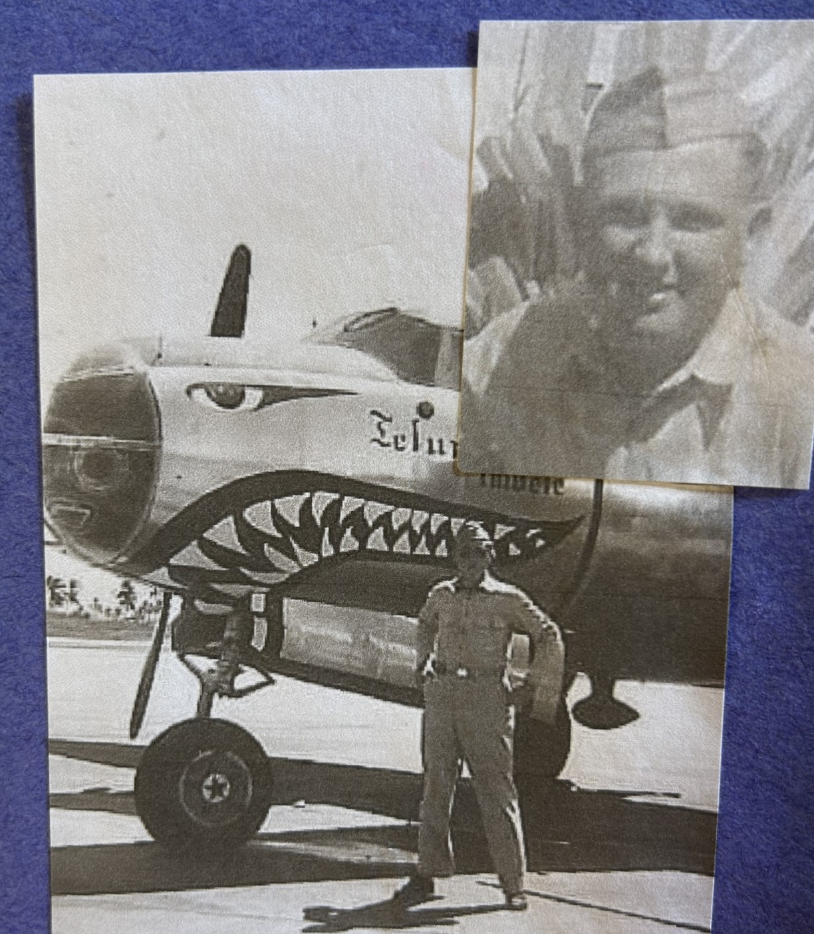
Norman Koonce
Army Air Force
Father
of
Ms. Koonce

Slide 31
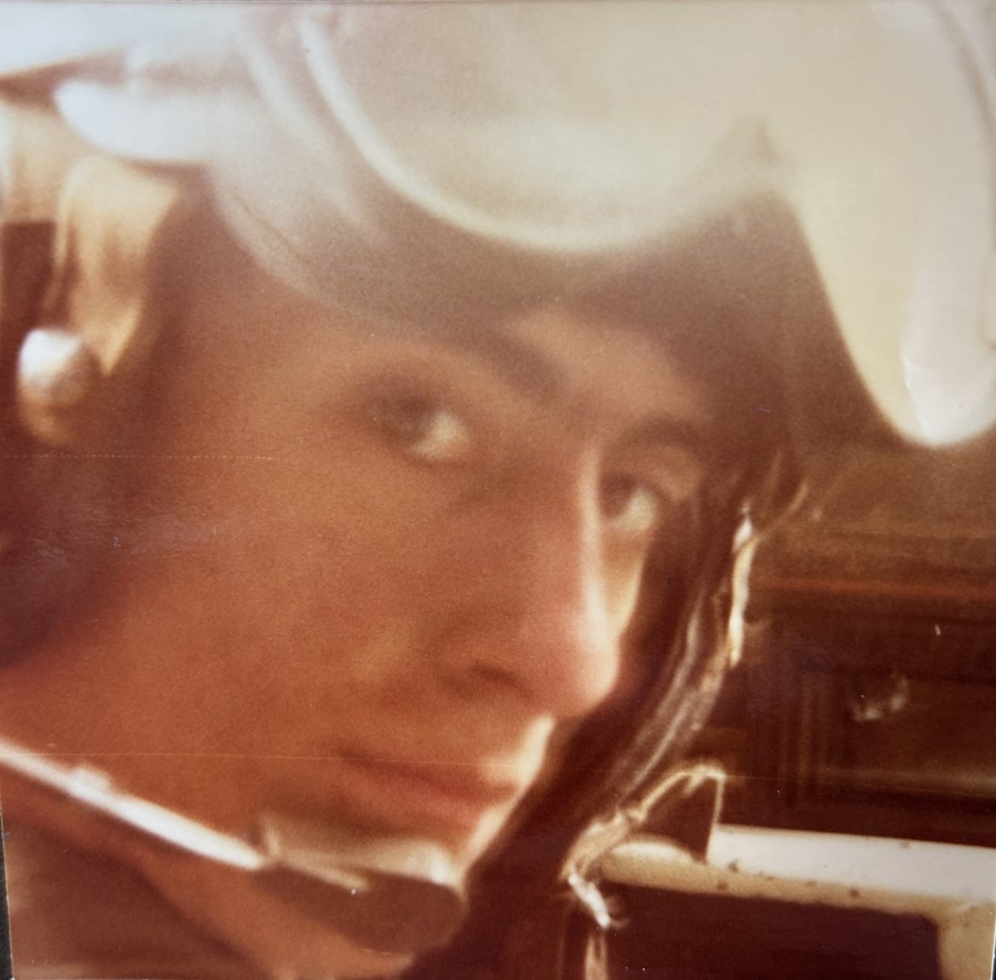
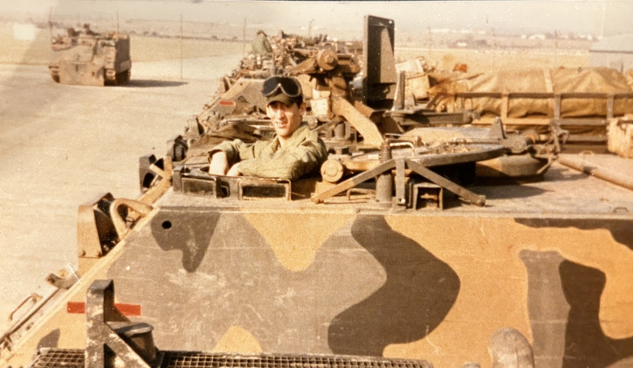
Charles J. Webb
Army
Grandfather
of
Karli Borrill

Slide 32
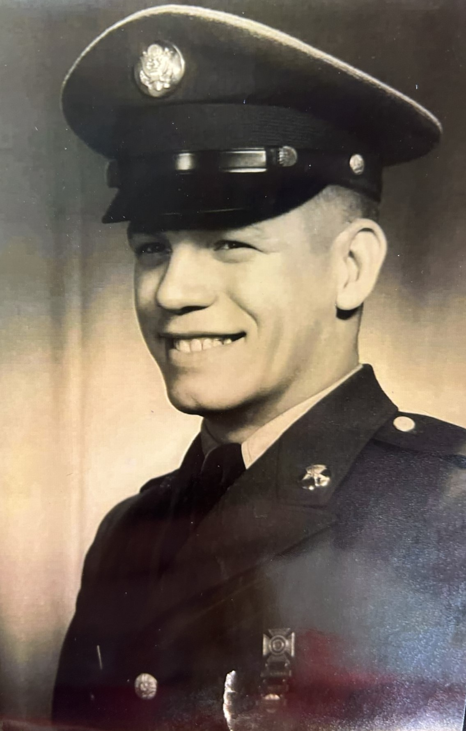
Homer Wentzel
Army SFC
Grandfather
of
Hagen Courmier

Slide 33
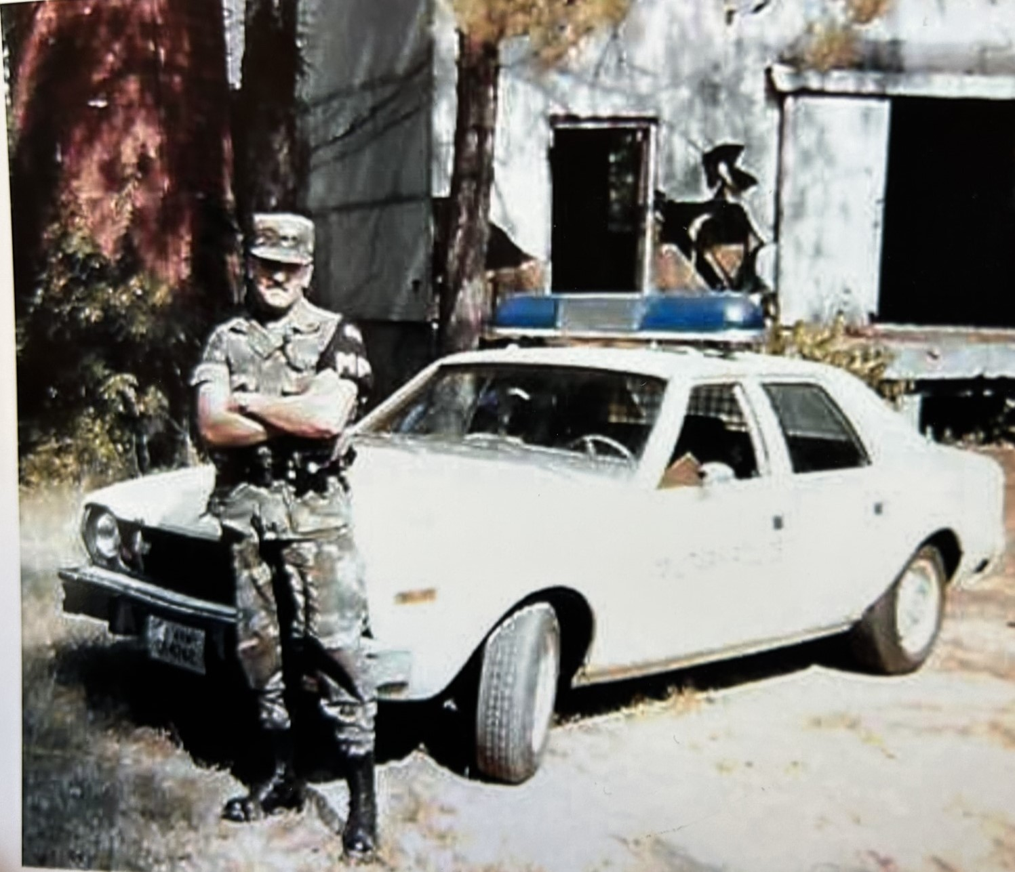
Mark Kampfer
Army, MP
PeePaw
of
Hagen Courmier

Slide 34
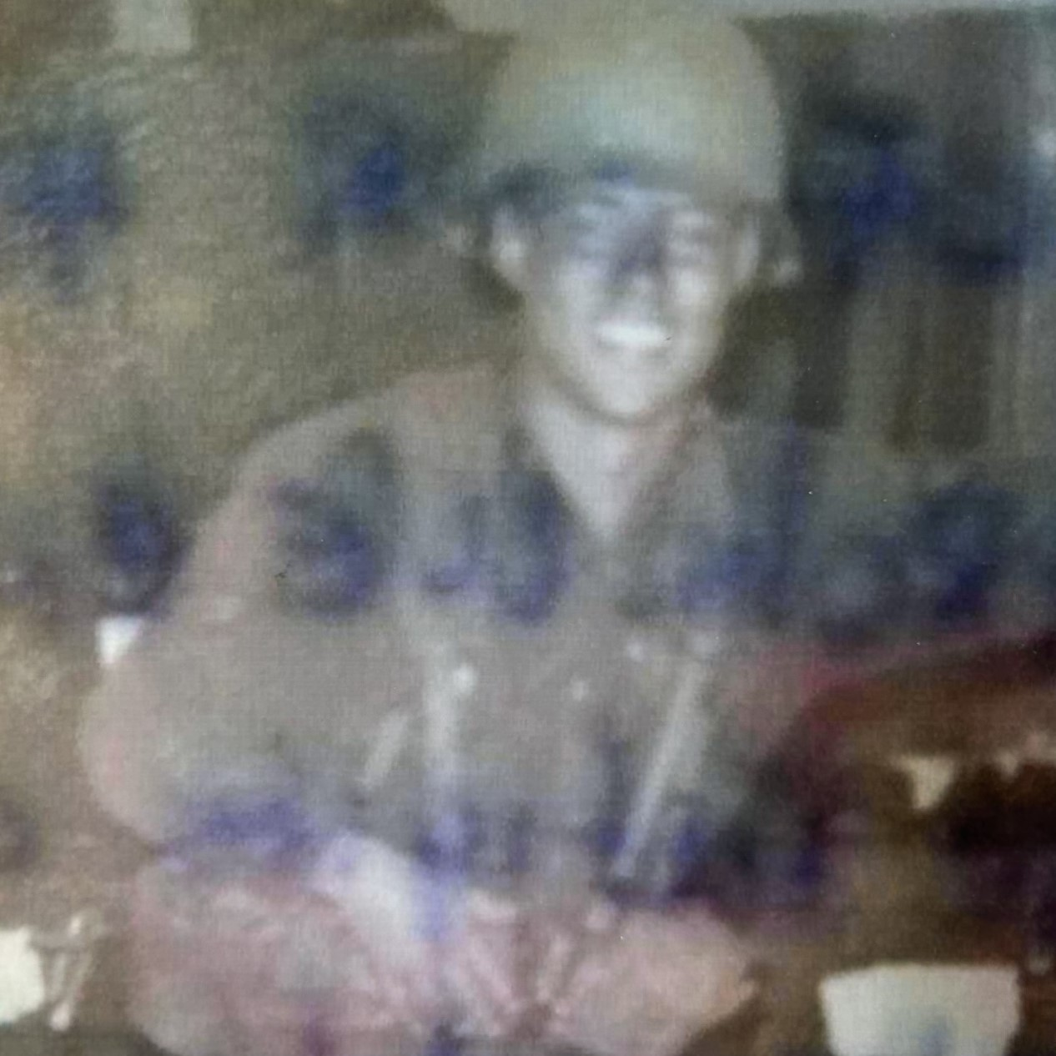
Lawrence Tillman
Air Force
Grandfather
of
London Budwine

Slide 35
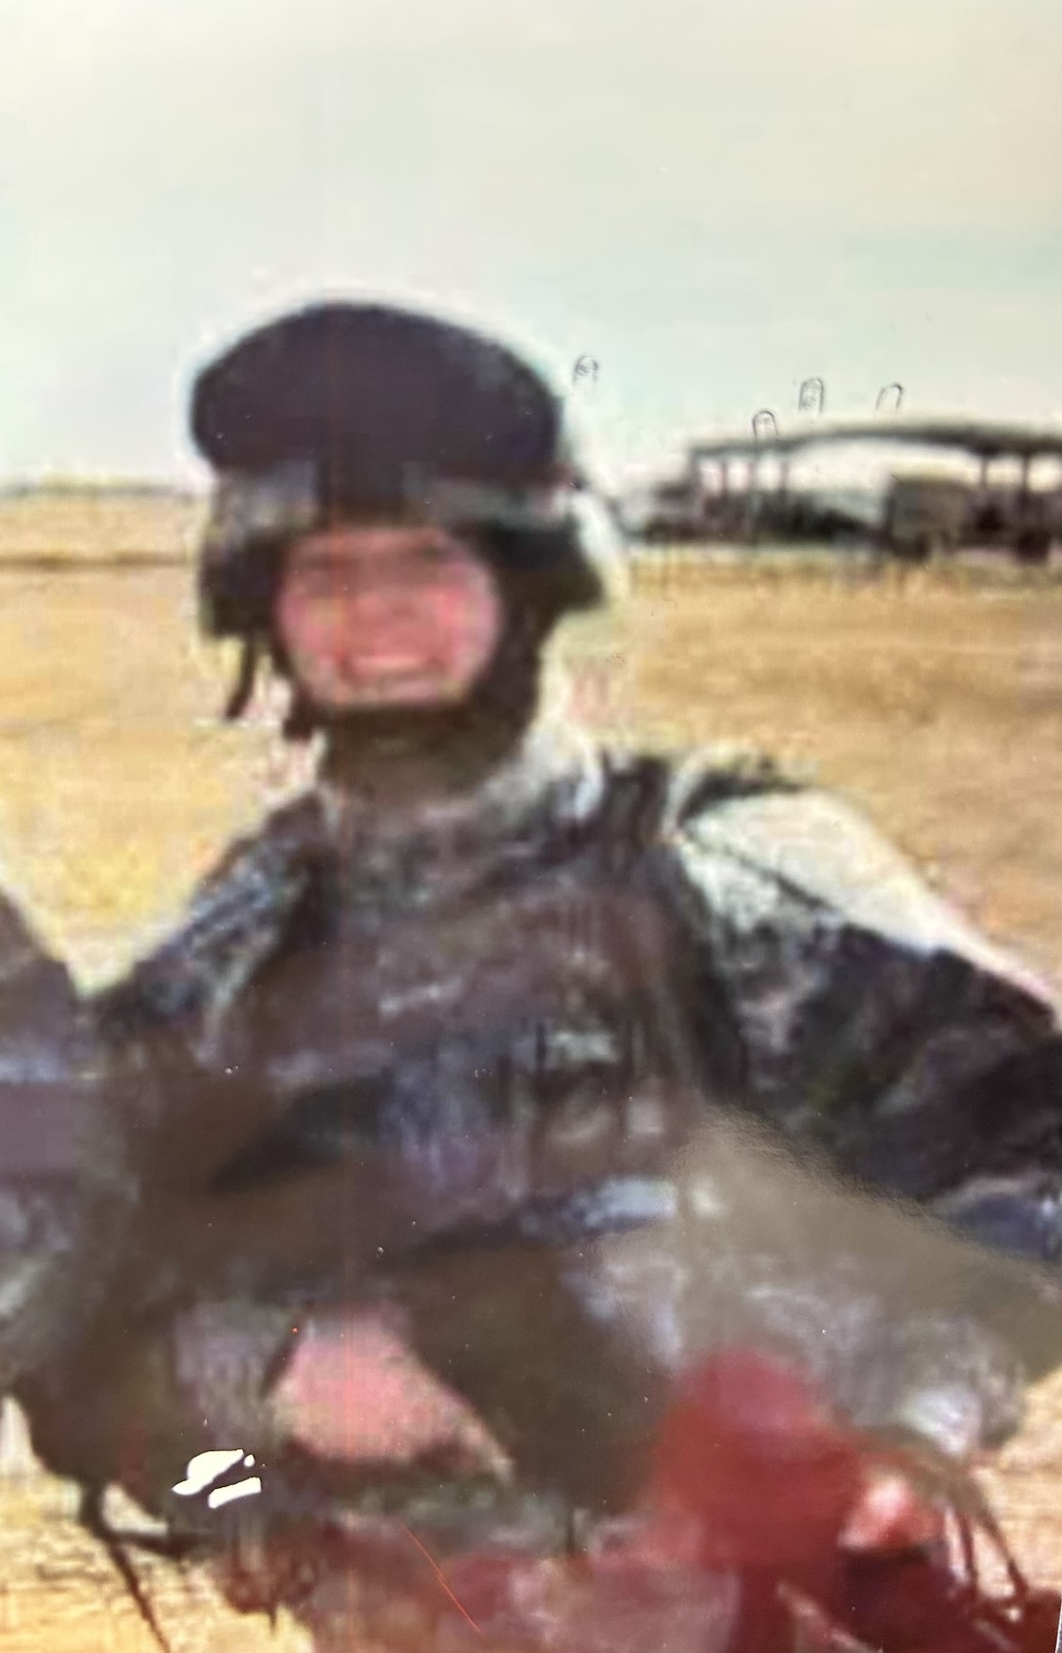
Gia Ginaldi Habetz
Army
Daughter-in-law
of
Mrs. Kim Habetz

Slide 36
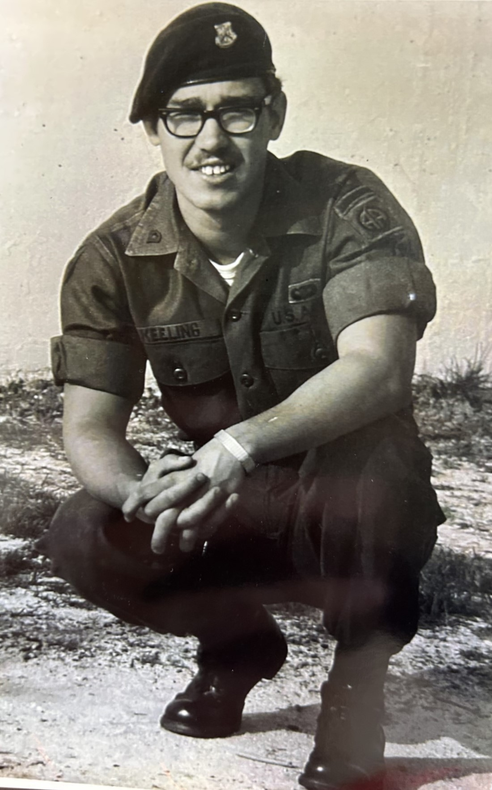
Daniel Keeling
Army
Grandfather
of
Hudson Dalfrey

Slide 37
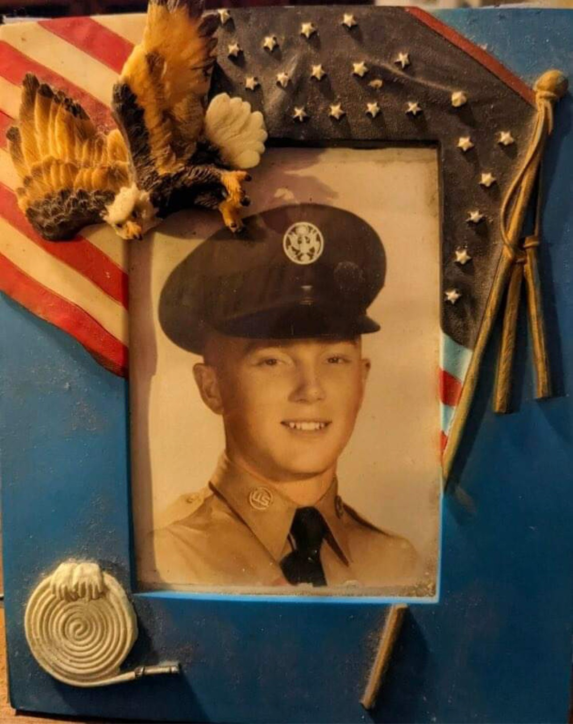
Harrison Leach
Air Force
Grandfather
of
Landen, Katherine, & Audrey Fautherree
&
Leila Foreman

Slide 38
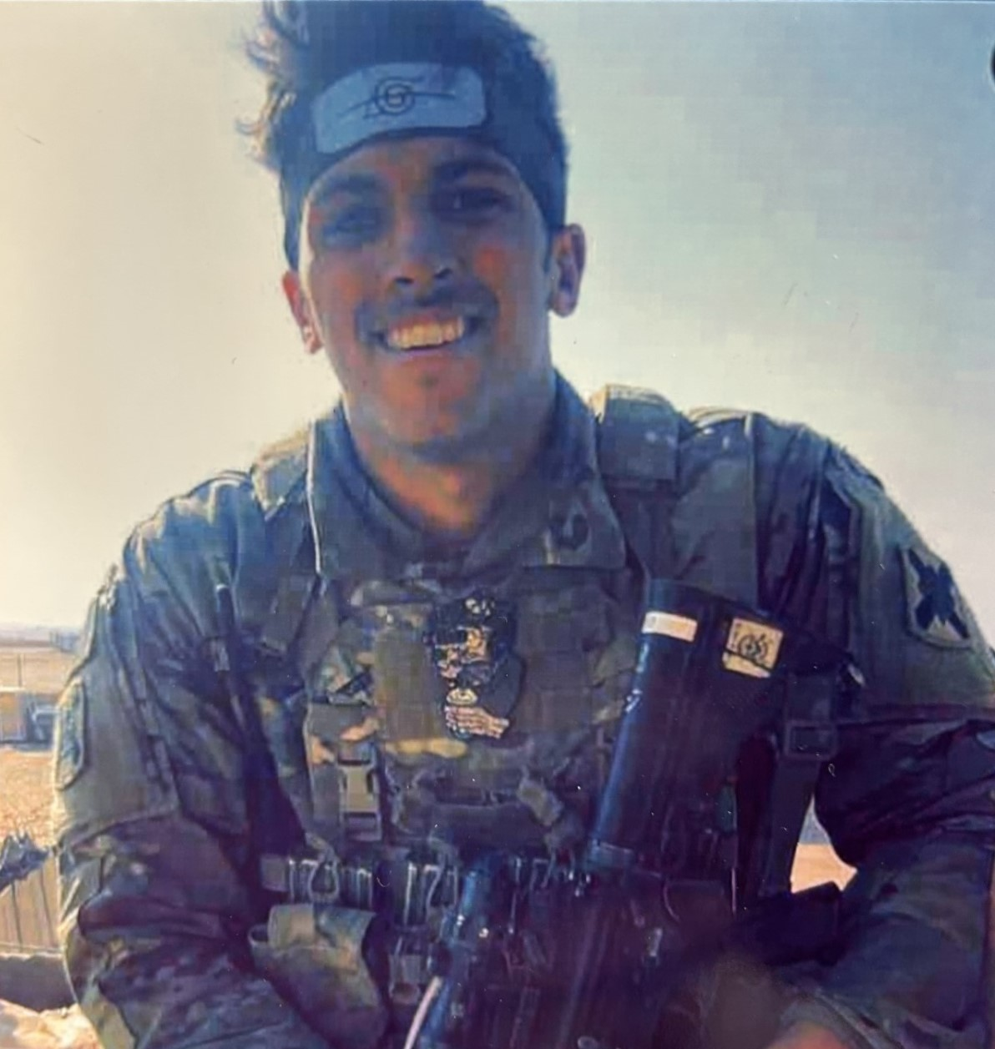
Larry Hutchins
Army
Vietnam War
Grandfather
of
Cameron Cox

Slide 39
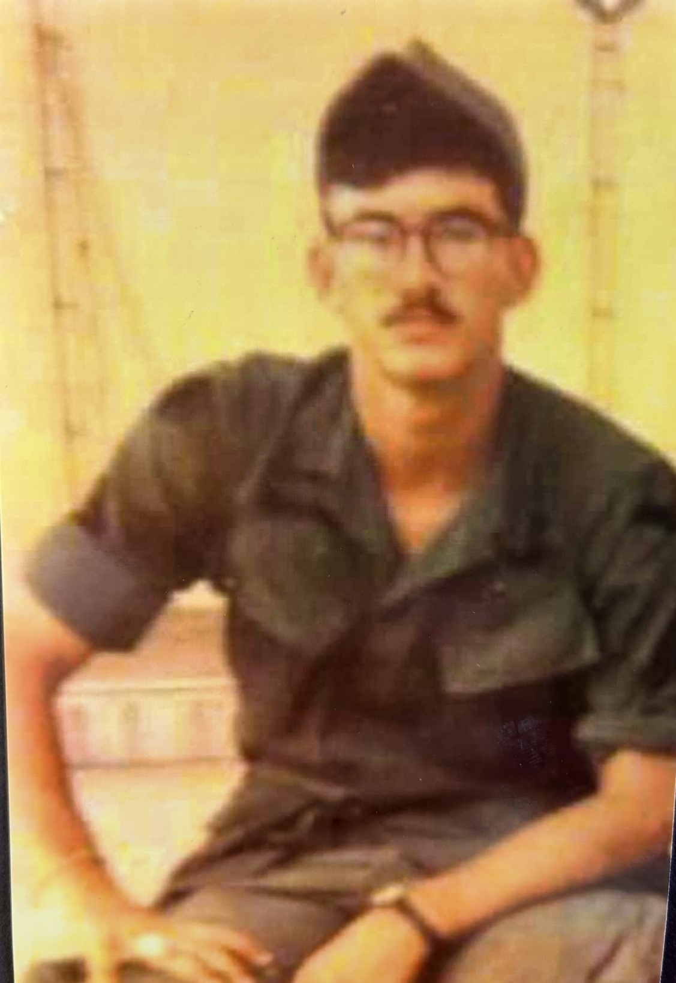
Bryce Cade Baron
Army
Iraq Tour
Uncle
of
Cameron Cox

Slide 40
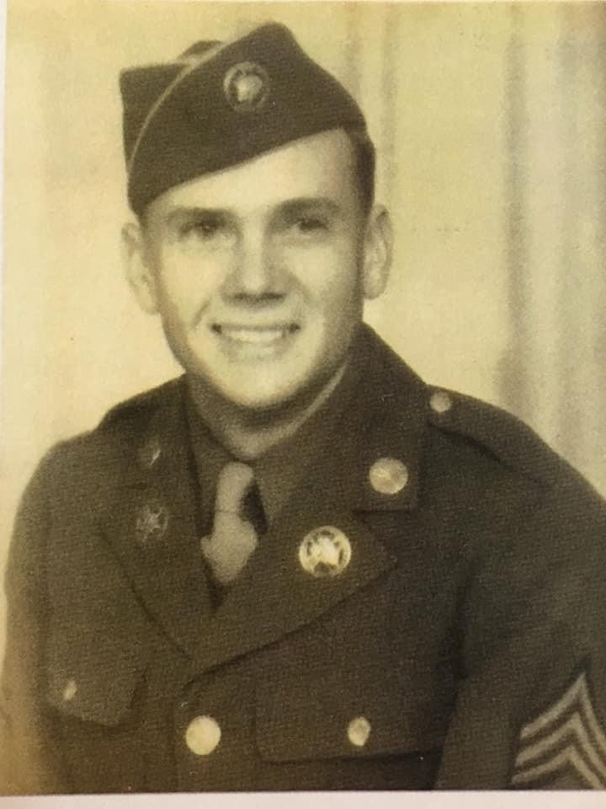
Sgt. George H. Moore
Army
World War II
Great Grandfather
of
Presley Moore

Slide 41
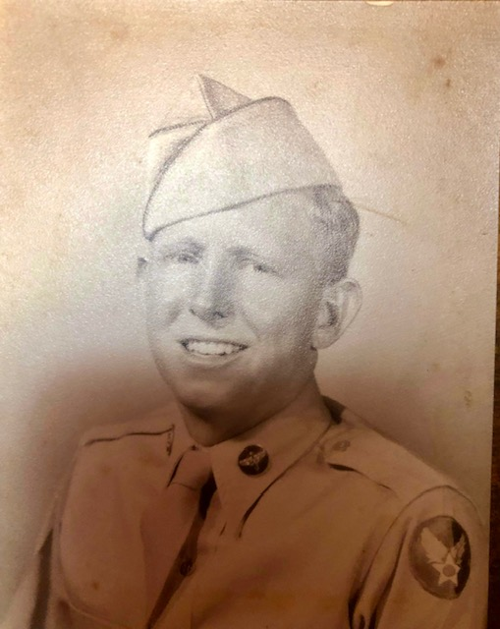
Joyce Parsley
Air Force
Korean War
Cousin
of
Presley Moore

Slide 42
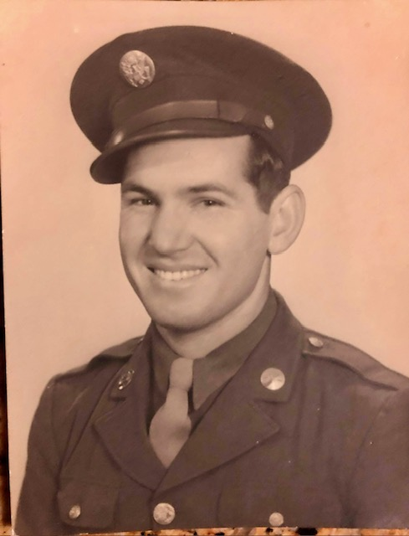
Ulysses Fruge
Army
World War II
Great Uncle
of
Presley Moore

Slide 43
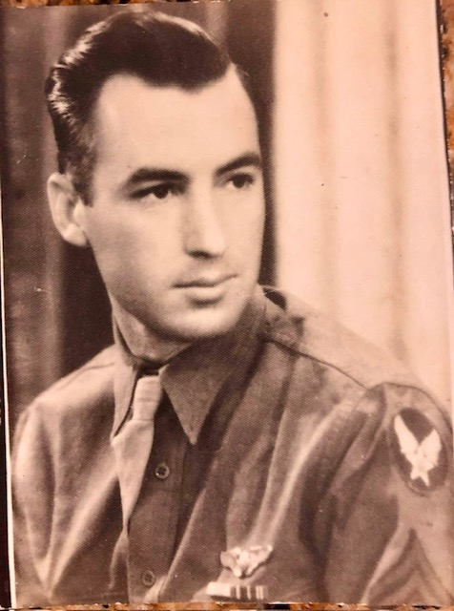
Sgt. Simon Fruge
Air Force
World War II
Great Uncle
of
Presley Moore

Slide 44
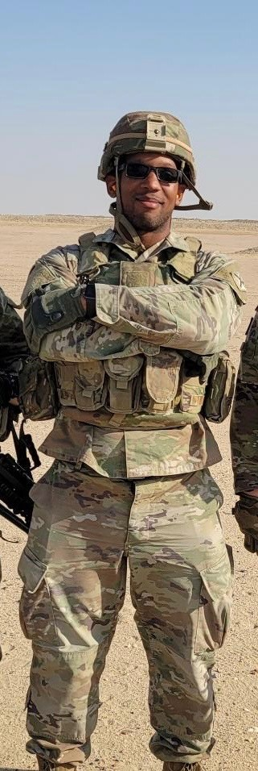
Peyton Simien
Army
Uncle
of
Maxton, Carter, & Carlee
Simien

Slide 45
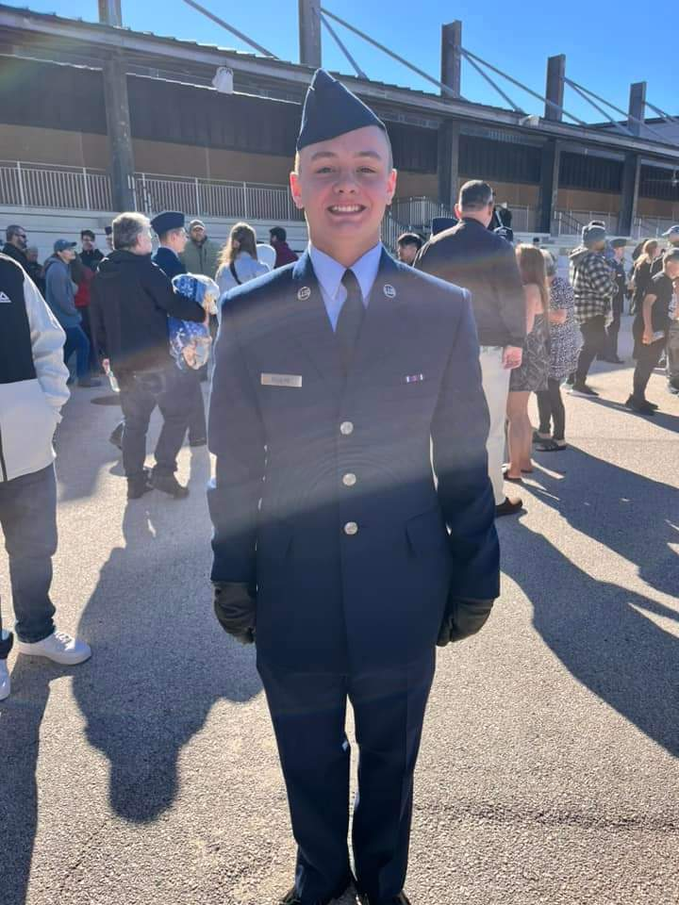
Jordan Rogers
Air Force
Former VES Student

Slide 46
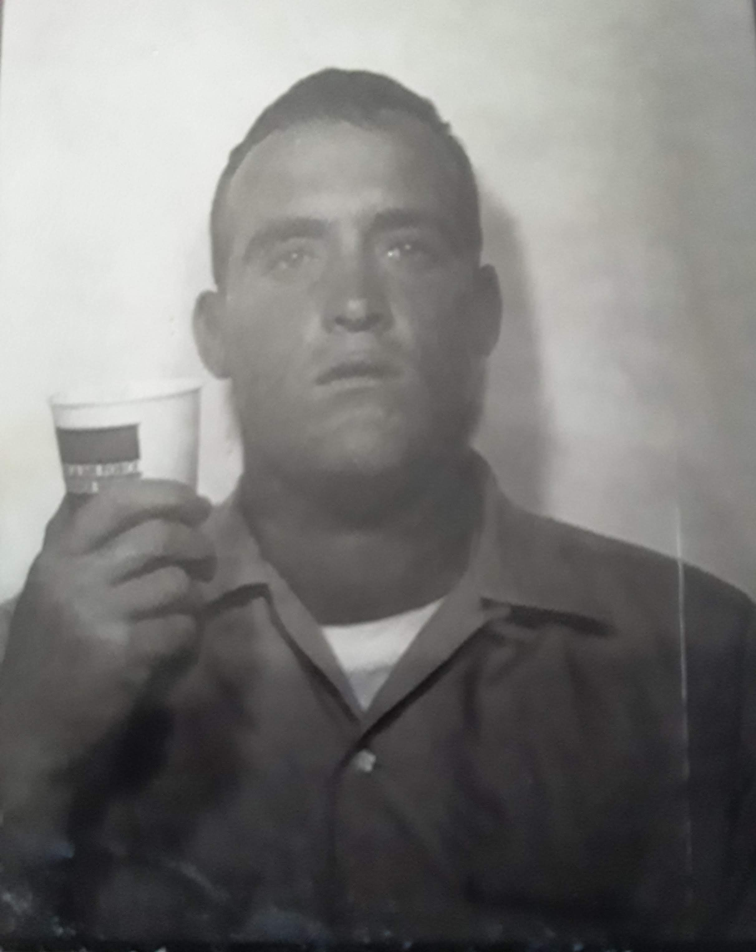
James Kibodeaux
Army
71st Air Defense
Artillery Regimen
National Defense
Service Medal
Sharpshooter M14
Great Grandfather
of
Nevaeh Erdem

Slide 47
Tyler Berry
Army
Former VES Student

Slide 48
Robert Wilson
Army
Great Grandfather
of
Nolan & Alivia English
&
Bryce, Kaisen, &
Karson Wilson

Slide 49
LCDR Chris Cupp
Navy
Uncle
of
Pete Dugas

Slide 50
Nick Aymond
Navy
E6 – 1st Class
Petty Officer
Uncle
of
Pete Dugas

Slide 51
Charles Clayton
Navy
Senior Officer
Great Grandfather
of
Pete Dugas

Slide 52
Garon Dugas
Navy
Aviation Ordinance
2nd Class Petty Officer
Father
of
Pete Dugas

Slide 53
Calvin Bankston
Navy
Ship’s Service Man (B)
3rd Class
Great Grandfather
of
Pete Dugas

Slide 54
Byron Cupp
Air Force
Great Grandfather
of
Pete Dugas

Slide 55
Henry Mouret
Navy
Great Grandfather
of
Burley & Brantley Hebert

Slide 56
Miguel Irwin
Marine Corps
Uncle
of
Burley & Brantley Hebert

Slide 57
James Malone
Marine Corps
Enlisted at 15
Korean War
Great Grandfather
of
Landen, Katherine,
& Audrey Fautherree
&
Leila Foreman

Slide 58
Codie Trahan
Army
Active Member
Cousin
of
Landen, Katherine, & Audrey Fautherree
Former VES Student

Slide 59
Marcus Fautherree
Air Force
Uncle
of
Landen, Katherine, & Audrey Fautherree

Slide 60
Wendy Prince Murphy
Army
Aunt
of
Brody & Izzy Trahan
Former VES Student

Slide 61
Ricky Blaine Prince
Army
Cousin
of
Brody & Izzy Trahan

Slide 62
Dustin Gelner
Army
Uncle
of
James LeBouef

Slide 63
Emmit Beaudeaux
Marine Corps
Brother
of
Kaden Beaudeaux

Slide 64
Paul Beaudeaux
Marine Corps
Uncle
of
Kaden Beaudeaux

Slide 65
Gary Morgan
Air Force
Great Uncle
of
Kason Findley

Slide 66
Norris Simon, Sr.
Army
Great Grandfather
of
Kason Findley

Slide 67
Eugene Morgan, Jr.
Army
Great Grandfather
of
Kason Findley

Slide 68
Larry Findley, Jr.
Navy
Father
of
Kason Findley

Slide 69
Kaileb Findley
Army
Brother
of
Kason Findley
Notes:
1 more slide - get ready to fade music

Slide 70
Reaux Frederick
Marine Corps
Great Grandfather
of
Collins, Saylor
& Hayes Fontenot
&
A’Miyah Nelson
Notes:
Fade music

Slide 71
Jim Anderson
Army
Great Uncle
Of
Brayden & Zoey Bryant
Notes:
Fade music

Slide 72
Thomas Malone
Army
Father
Of
Ms. Cooper
&
Great Grandfather
Of
Claire Malone
Notes:
Fade music

Slide 73
Nick Olier
Army
Father
Of
Riley Gilbert
Notes:
Fade music

Slide 74
Cody Gilbert
Navy
Uncle
Of
Riley Gilbert
Notes:
Fade music

Slide 75
Bobby Courtland Sykes
Navy
Uncle
Of
Riley Gilbert
Notes:
Fade music

Slide 76
Billy Leigh
Marine Corps
Uncle
Of
Riley Gilbert
Notes:
Fade music

