Slide 1
PBIS and SEL
Challenge Parent Overview
November 12, 2019

Slide 2

Agenda
What is the Intervention Triangle?
What is PBIS and what are examples at Challenge
What is SEL, and why teach it?
Overview of the Second Step K–8 Program
Implementation at Challenge
Other initiatives
Q&A

Slide 3
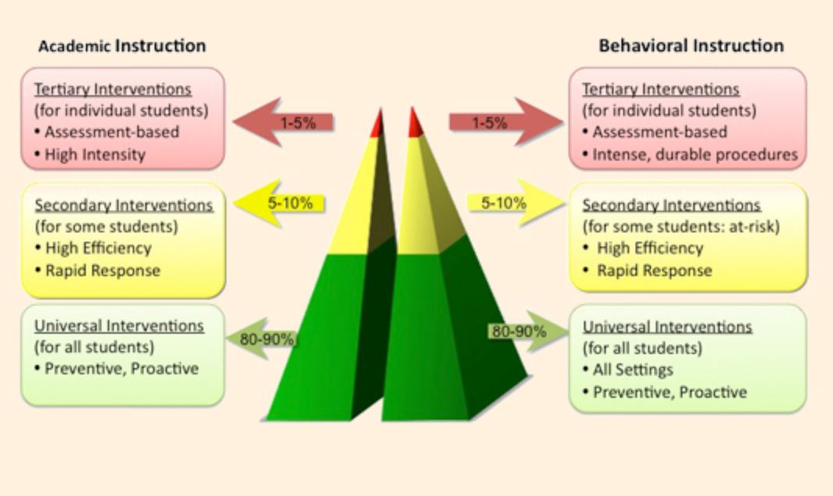
The Intervention Triangle
https://www.cde.state.co.us/mtss

Slide 4
PBIS

Slide 5
What is PBIS?
Positive Behavior Interventions and Supports
Implementation framework for maximizing the selection and use of evidence-based prevention and intervention practices along a multi-tiered continuum that supports the academic, social, emotional, and behavioral competence of all students.
Examples of PBIS activities at CHL:
PACK Language
PACK Awards
PACK Assemblies
Redefining Teacher and Office Managed Behaviors
Wonder Project
Common Sense Media Lesson Implementation
Mental Health and Wellness Summit
No Place for Hate

Slide 6
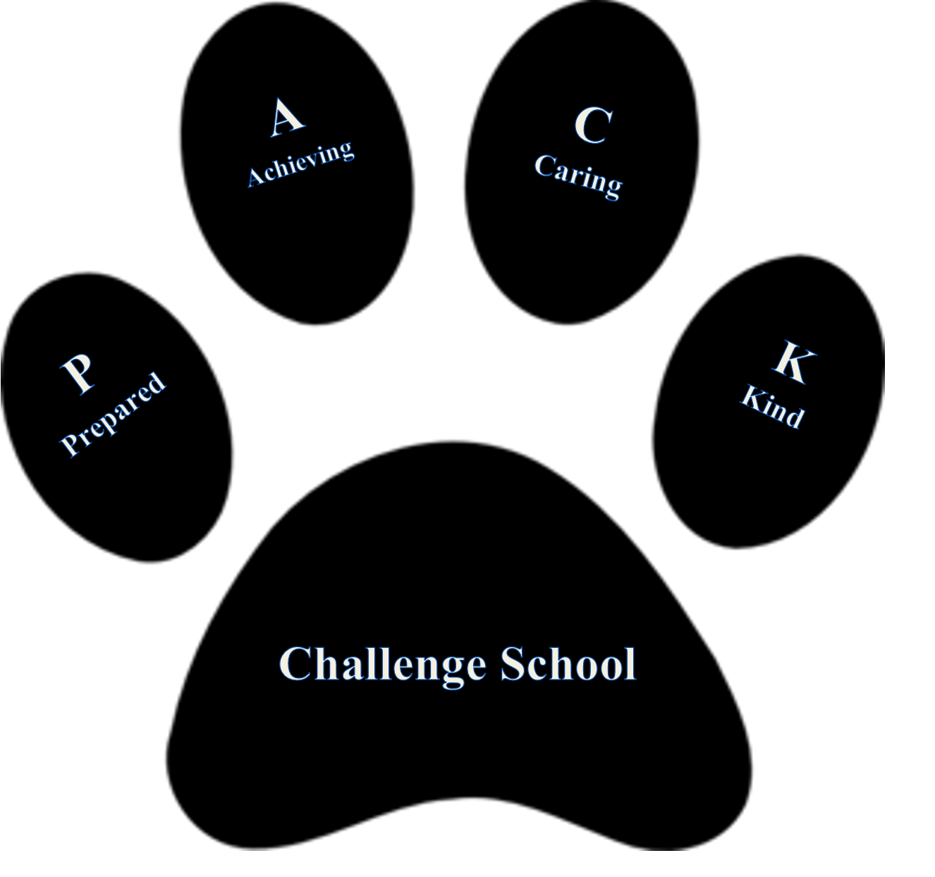
PACK

Slide 7
Who is on the CHL PBIS Team?
Matt K (Team A/B)
Dave Beck (Team C)
Carrie Beattie (Team D)
John Wiley (Team E)
Dan Smith (Team Encore)
Dave Strohfus (Administration)
April Hrovat (Administration)
Mindy Hartley (Mental Health)
www.pbis.org

Slide 8
Why teach SEL?
Notes:
Now that you know a bit about Committee for Children and how the program and add-on units came to be, I’ll go into each of the components in a bit more detail – starting with SEL as the foundation. And to do that, I want to start with this question, “Why teach SEL?”. I am going to assume that most of you who are joining us today have an interest in SEL, maybe even have spent time researching or teaching social-emotional learning to students already. So for those of you who are familiar, I include this information so that you may use it in your work being a champion for SEL and perhaps tasked with bringing others on board or presenting to a committee. For those that this question hasn’t been asked – the next few slides will help you see the foundation for why we developed Second Step and some of the research to support this work.
To start us off, first, I have a short video that we created that illustrates what Social Emotional Learning is, and why it’s important. You can find this video on our Second Step Youtube channel and on our website.

Slide 9




Think About It . . .
Challenges Kids Face
Skills They Need
Video What is SEL and Why It Matter
Notes:
Let’s start by thinking about middle schoolers. What challenges do they face? You probably have some in mind—it can be a really difficult time for some students, and you see them every day– Go ahead and type those in the chat box as you think of them.
While you’re doing that, just from our perspective, when we began looking at creating an SEL program for grade 6-8, this was a question we asked many times over . . . and then, we looked at how those challenges get in the way of learning and thriving in middle school. It’s a great place to start when thinking about solutions.
I see some of you are responding with some of your thoughts in the chat box . . .
Peer pressure
Bullying
Challenges at home that come to school
Self-esteem issues
Poor self-control, impulsivity
Lack of communication skills
Anger management
Difficulty solving problems and making decisions
Lack of empathy
Lack of positive relationships
As we make this list, hopefully you’ve started thinking about your classrooms and the inner world of your middle school students. It can be daunting to think about adolescence and the issues that keep them from being successful socially, emotionally, and academically during this age.
So now let’s look at the skills they need. Or let’s put it this way: if we had all the time, money, and buy-in from schools and staff, what skills would we teach them to help them be successful?
How about the ability to build positive relationships? Or good decision-making skills? Other skills we might add are (please feel free to use the chat box again to add yours) things like:
The ability to see others’ points of view Self-regulation skills
Respecting differences Communication skills
Ability to manage emotions Conflict management
Ability to make plans and follow through
They need these skills, and we can help. It really comes down to this: We teach middle schoolers math, history, science, and other academic subjects, but how do we help them become better people?
That question is at the heart of our 2017 middle school program. It’s a social-emotional curriculum that supports the whole child. On that note, I’d like to play a video for you . . .
[go to next slide when playing the video, link is in the notes]

Slide 10


Trusted Partner in SEL
The Collaborative for Academic, Social, and Emotional Learning is
a nonprofit collaborative with the mission to:
Advance the science of SEL
Expand effective practices
Improve policies
Provide guidance
https://casel.org/
Notes:
I hope that video helped explain the foundation of why SEL is important and how SEL helps students to be their best, in school and in life. Now, I want to share with you a few other resources that help to make the case for teaching SEL.
The first resource I’d like to share with you is one of our trusted partners in supporting SEL, The Collaborative for Academic, Social, and Emotional Learning, CASEL. They are a wonderful resource - if you haven’t gone to the CASEL website, I recommend you take a look at casel.org for a variety of really great resources. Their work is to Advance the science of SEL, to help schools and districts expand their effective practices, improve policies and, they have created the CASEL GUIDE that helps schools to choose quality programs that fit their needs. We are proud to be one of the programs that CASEL endorsed!

Slide 11
Five SEL Core Competencies
Self-Management
Self-Awareness
Responsible Decision-Making
Managing emotions and behaviors to achieve
one’s goals
Recognizing one’s emotions and values as well as one’s strengths and limitations
Making ethical, constructive choices about personal and social behavior
Relationship Skills
Social Awareness
Forming positive relationships, working in teams, dealing effectively with conflict
Showing understanding
and empathy for others

Slide 12
Research Links Evidence-Based SEL to Positive Outcomes
Research links SEL to student success
23% gain in social-emotional skills
9% gain in attitudes about self/others/school
9% gain in prosocial behavior
11% gain on academic achievement
And reduced risks for failure
9% difference in problem behaviors
10% difference in emotional distress
Durlak, J. A., Weissberg, R. P., Dymnicki, A. B., Taylor, R. D., & Schellinger, K. (2011). The Impact of Enhancing Students’ Social and Emotional Learning: A Meta-Analysis of School-Based Universal Interventions. Child Development, 82, 405–432.
Notes:
12

Slide 13

Learning Is Social and Emotional
Social-emotional development is multi-faceted and integral to academics—to how school happens and to how learning takes place.
Classroom instruction and academic activities that connect rigorous cognitive challenges with social interaction, or that spark students’ emotions, result in deeper, longer-term learning.
Cognitive Skills
Social and Interpersonal Skills
Emotional Competencies
Jones, S. M., & Kahn, J. (2017, September 13). The evidence base for how we learn: Supporting students’ social, emotional, and academic development. The Aspen Institute. Retrieved from https://assets.aspeninstitute.org/content/uploads/2017/09/SEAD-Research-Brief9.12_updated-web.pdf
Notes:
There are at least a dozen specific social-emotional skills that are clearly linked to school and life success and are relevant for both students and the adults who teach and care for them.
These skills can be grouped into three interconnected domains:
Cognitive skills, including executive functions, such as working memory, flexible attention, inhibitory control, and planning, as well as beliefs and attitudes that guide one’s sense of self and approaches to learning and growth
Emotional competencies that enable a person to cope with frustration, recognize and manage emotions, and understand others’ emotions and perspectives
Social and interpersonal skills that enable a person to read social cues, navigate social situations, resolve interpersonal conflicts, cooperate with others, work effectively in a team, and demonstrate compassion and empathy toward others.
Study: https://assets.aspeninstitute.org/content/uploads/2017/09/SEAD-Research-Brief-9.12_updated-web.pdf

Slide 14

SEL and Workforce Readiness
The Top 10 skills identified by the World Economic Forum for employment success in 2020:
  Complex Problem Solving
  Critical thinking
  Creativity
  People management
  Coordinating with others
  Emotional intelligence
  Judgment and decision-making
  Service orientation
  Negotiation
  Cognitive flexibility
  Source: Future of Jobs Report, 2015
Notes:
From 2015 to 2020, added on the list of top 10 skills needed in the workforce, Emotional Intelligence was added as a critical skill. And to be added at #6 tells me that it’s a really important piece for the future of the workforce.

Slide 15


The Second Step K-8 Program Overview

Slide 16
A Universal, Classroom-Based Program Designed to:
PROMOTE
Social-Emotional
Competence and
Self-Regulation
DECREASE
Problem Behaviors
INCREASE
Students’ School
Success
Notes:
The Second Step program is a universal, classroom-based curriculum designed to increase students' school success and decrease problem behaviors by promoting social-emotional competence and self-regulation. Educators turn to Second Step because of its record of results, its commitment to research, and its intuitive programs.
It teaches skills that strengthen students' ability to learn, have empathy, manage emotions, and solve problems.
The program targets key risk and protective factors linked to a range of problem behaviors.
Equipping students with Second Step skills creates a safer, more respectful learning environment that promotes school success for all.

Slide 17
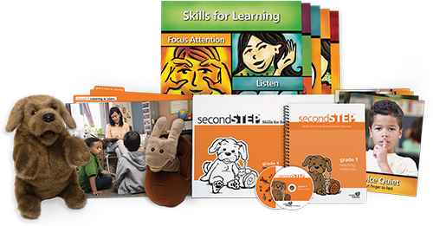

K–3 Classroom Kits
Lessons
Posters
Teaching Materials Notebook
Puppets (K–Grade 1)
Songs and videos
(on disc or streaming)
Online resources
Notes:
Here’s a look at the program materials for K - Grade 3, I’ll show Grade 4 & 5 next.

Slide 18
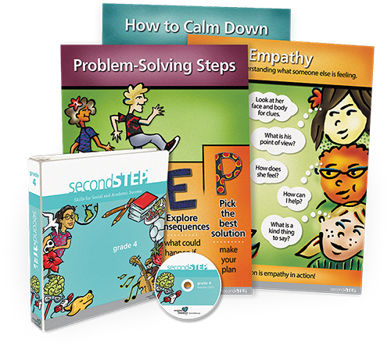

Grade 4–5 Classroom Kits
Posters
Following Through Cards
Unit Cards
Lesson notebooks
DVD or streaming media
Online resources

Slide 19

Program Skills and Topics
K–5
Skills for Learning
Empathy
Emotion Management
Problem Solving
Add-On Units:
Bullying Prevention (K–5)
Child Protection (EL–5)

Slide 20




Middle School Skills and Strategies
Weekly lessons last approximately 25 minutes and require minimal prep time.
UNIT 1 Mindsets and Goals 7 lessons per grade
UNIT 2 Values and Friendships 5 lessons per grade
UNIT 3 Thoughts, Emotions, and Decisions 5 lessons per grade
UNIT 4 Serious Peer Conflicts 9 lessons per grade
Notes:
The program includes four units: Mindsets and Goals; Values and Friendships (Values and Relationships in Grade 8); Thoughts, Emotions, and Decisions; and Serious Peer Conflicts. Because we all work with our students in various roles, we want to be sure everyone is familiar with these concepts and strategies.
We’ll be sure to provide opportunities throughout the year for staff to become fluent in this schoolwide language. Today we’re going to take a quick look at the way the program teaches these four core skills areas to students.

Slide 21
Implentation at CHL

Slide 22
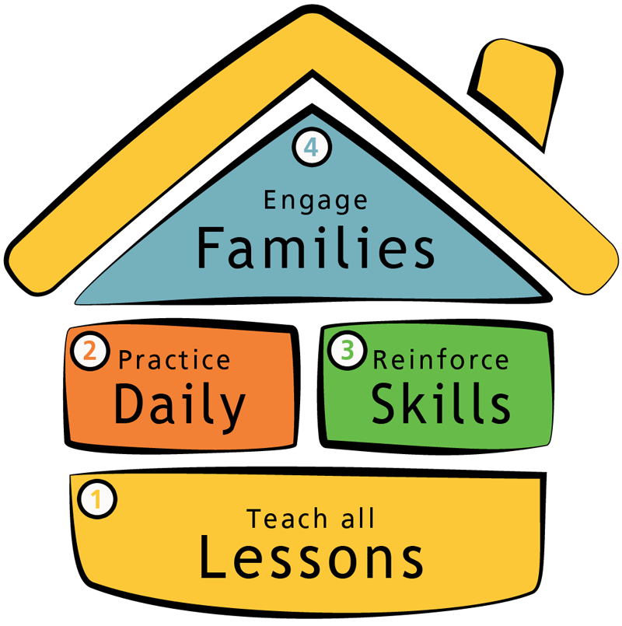
Implementing with Fidelity

Slide 23
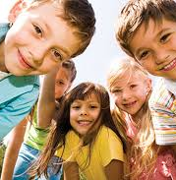
Elementary Implementation
Elementary Curriculum:
  Kindergarten taught to all kindergarten students by Mr. McComber
  1st Grade Team – Mr. K and Ms. Graeve
  2nd Grade Team – Ms. D’Amico and Ms. Padilla
  3rd Grade Team – Mrs. Krenz(McGahey) and Ms. Lamb
  4th Grade Team – Mr. Beck, Mrs. Casner, Mrs. Macey

Slide 24
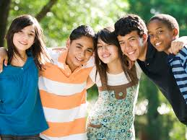
Middle School Implentation
Second Step is taught every Wednesday during Connections. Connections on Wednesdays is referred to as “Den Meetings” and reads Advisory on Powerschool.
Connections teachers will be assigned to teams of four, each teacher becoming a grade level expert in 5th, 6th, 7th, or 8th curriculum.
Students attend Connections on Wednesday with their assigned grade level expert.

Slide 25
Middle School Connections Teams
Team 5th Grade– Beattie, Draper, Nagle, Voreis
Team 6th Grade – Blythe, Bartlett, King, Lackey
Team 7th Grade – Harmon, Bennett, Wright, Wiley
Team 8th Grade – Erixon, De La Cruz, Smith, Kessler

Slide 26
Other programs
Trusted Adult Training
Signs of Suicide 7th and 8th Grades
Warning Signs When Friends Need Adult Help 5th and 6th Grades
These trainings are provided by Dr. Hartley (School Psychologist) and Ms. Thomas (Counselor)

Slide 27
Thank you!

