Slide 1
October’s
Virtual Office Hours –
Unique Learning System
10/27/2020 & 10/29/2020

Slide 2
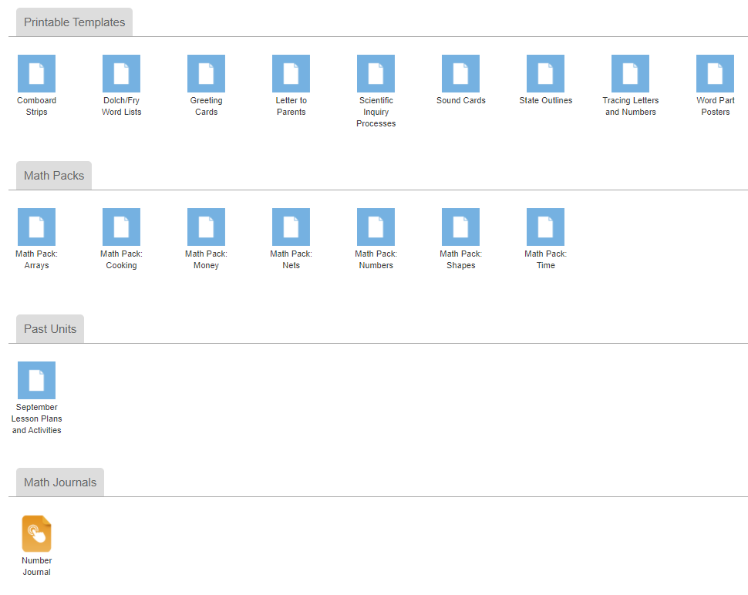
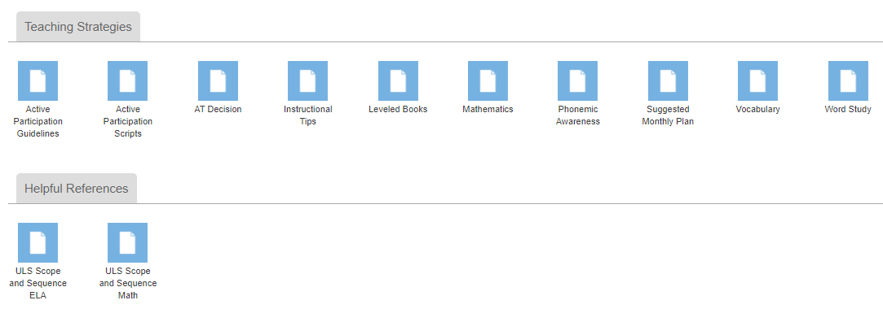
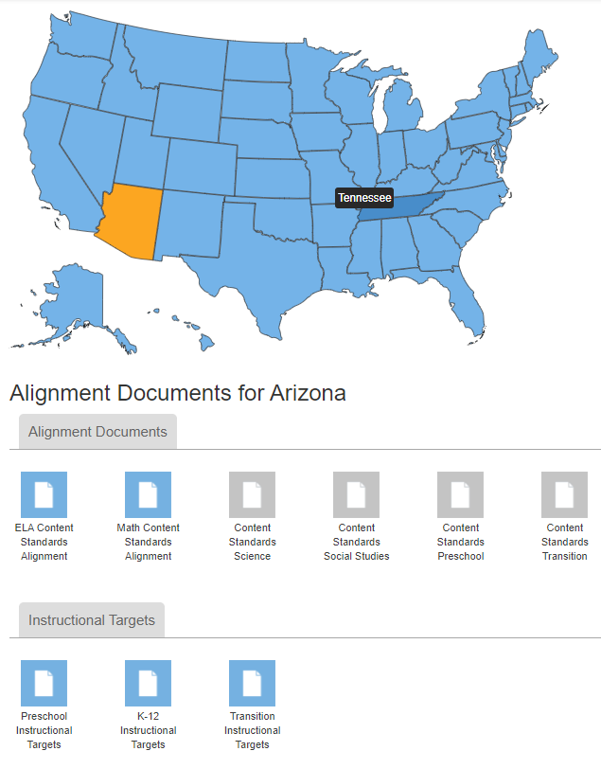
Teacher Reference Materials

Slide 3
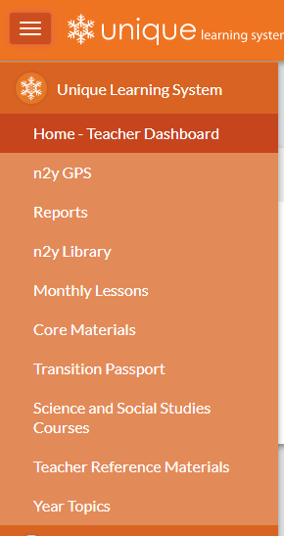
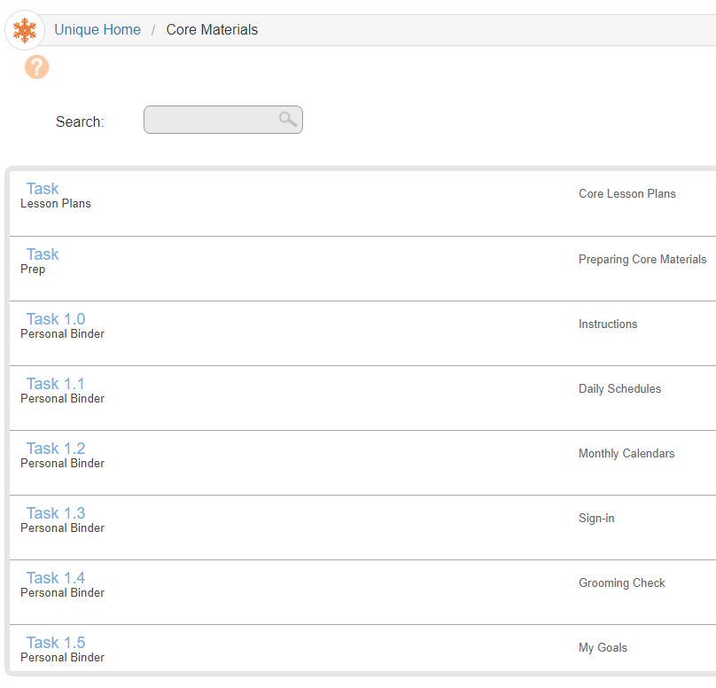
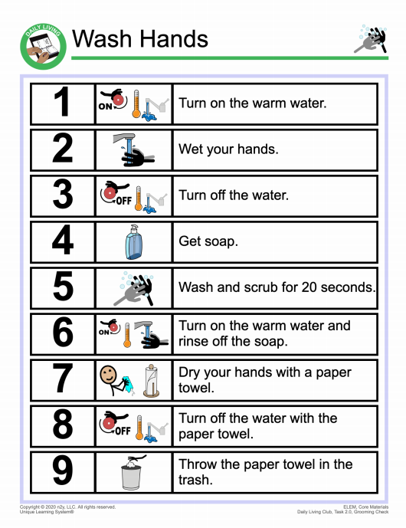
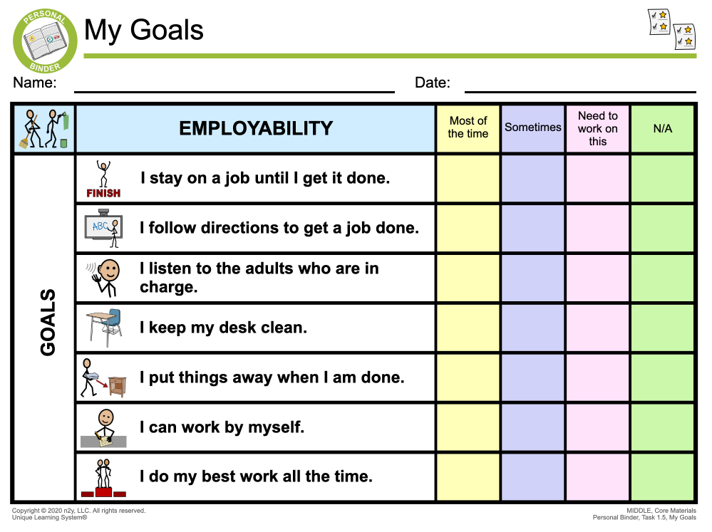
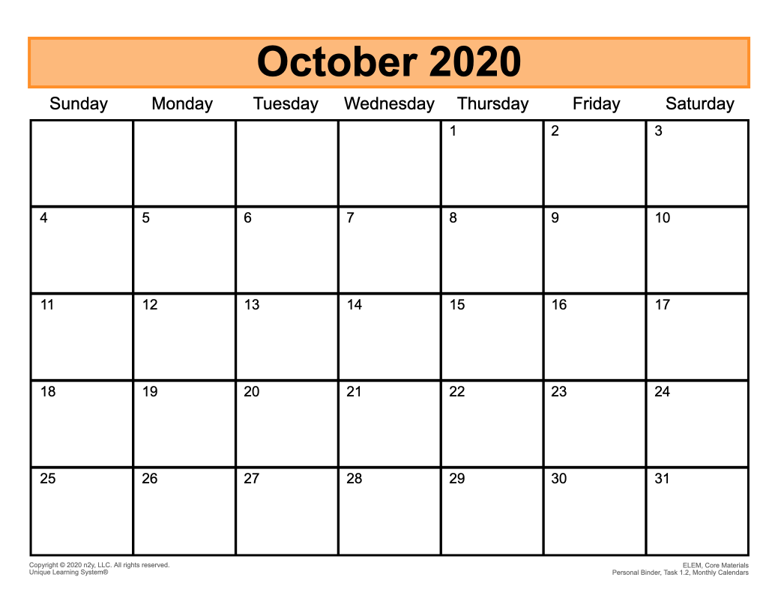
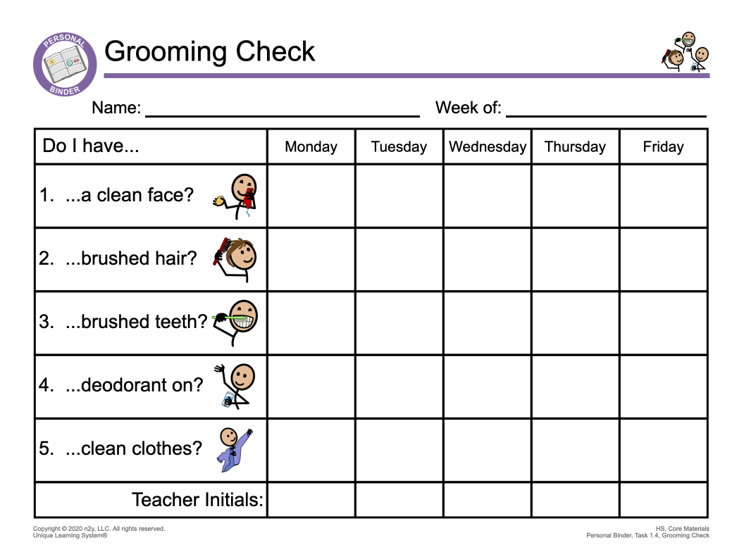
Core Materials
Core materials provide a foundation for the routine activities in the classroom.
These activities provide a means to address transitional skills including communication, employability, self-advocacy, social strategies, and daily living.
Student performance can be addressed in these areas by using the Core Rubrics.
Elem. Band
HS Band

Slide 4
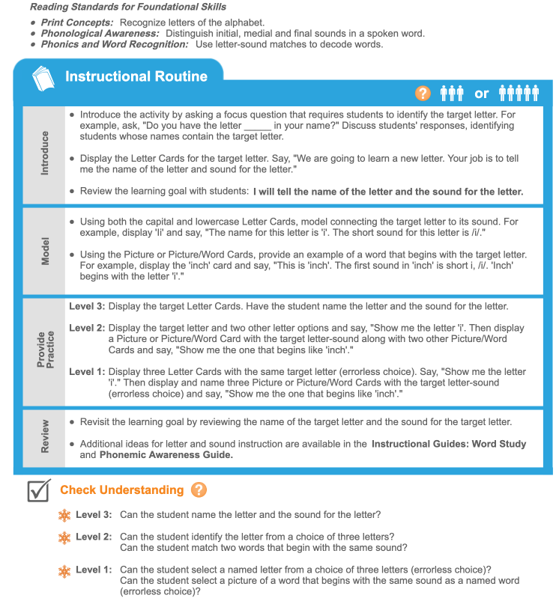


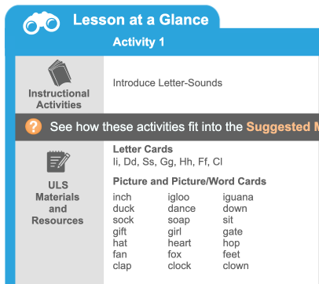
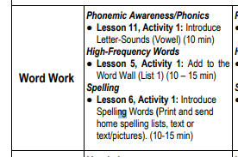
Monthly Lessons - Example

Slide 5
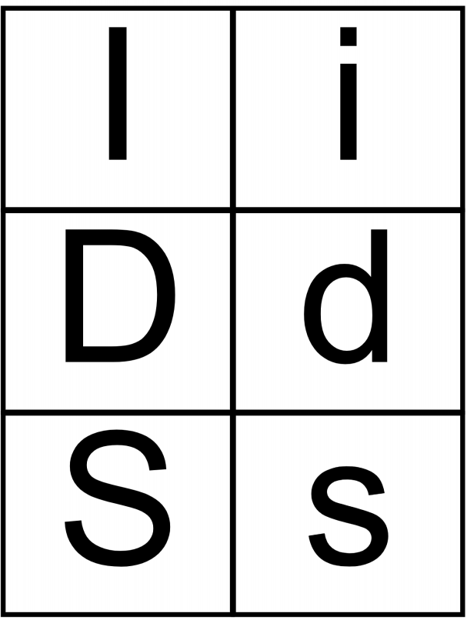


Lesson 11 – Activity 1 – Level 3
Student working at Level 3:
Teacher: “Tell me the letter name and sound”
Student: *points to Ii*; then says, “Ii, /i/”
*points to Dd*; then says, “Dd, /d/”
…

Slide 6



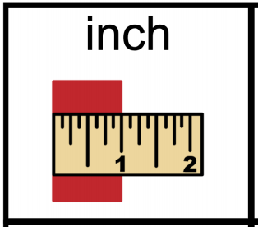

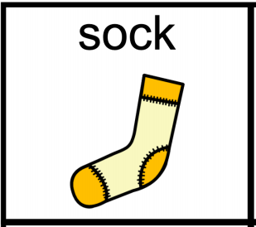
Lesson 11 – Activity 1 – Level 2
Student working at Level 2:
Teacher: “Show me the letter Dd”
Student: *points to the letter Dd*
Teacher: “Show me the one that begins like ‘duck’”
Student: *points to the picture indicating “down”*

Slide 7
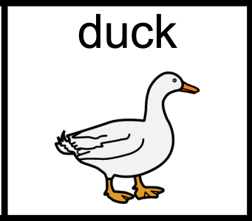


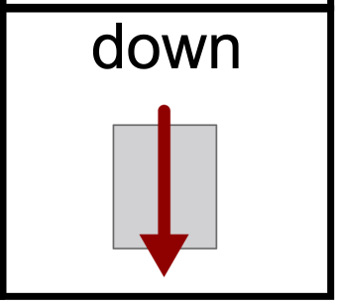
Lesson 11 – Activity 1 - Level 1
Student working at Level 1:
(errorless)
Teacher: “Show me the letter Dd”
Student: *points to the letter Dd*
(errorless)
Teacher: “Show me the one that begins like duck”
Student: *points to any of the three pictures with initial sound /d/*

Slide 8
Additional Qs?
Thank you! ☺

