Slide 1







QUARTERLY PROGRESS REPORTS (QPR)
Extended School Year (ESY)

Slide 2
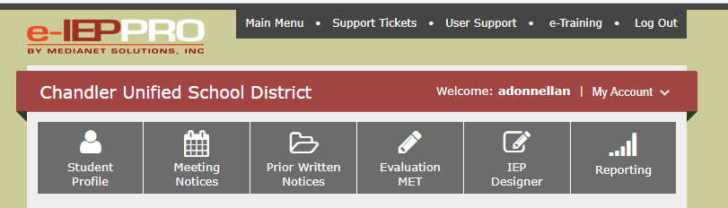
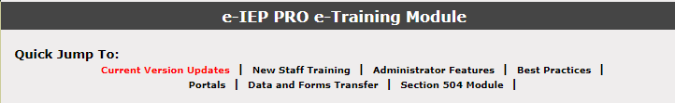
QPR’s (Quarterly Progress Reports)
Locating the guidance document in IEP-PRO
1
2
3
2nd option from the bottom of the list
Notes:
You can access a training guide in IEP Pro that will assist in the accurate completion of the quarterly progress reports.

Slide 3
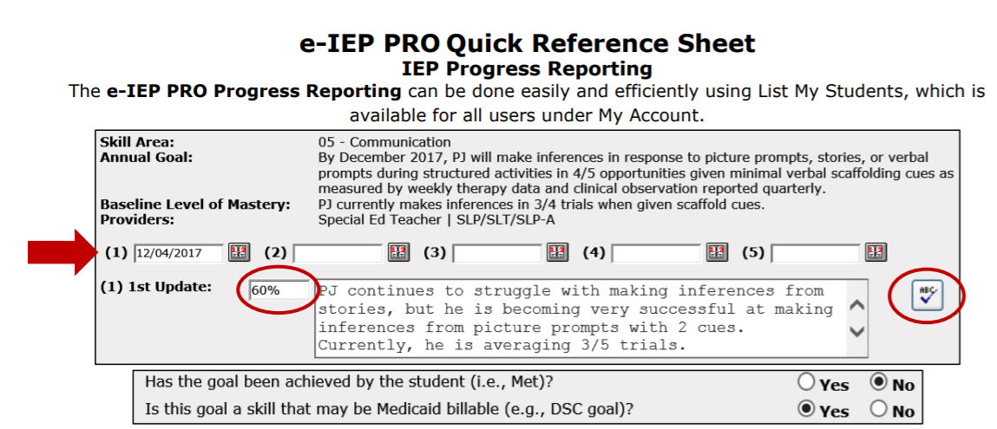
Notes:
This is the sample reference sheet that outlines the necessary data entry

Slide 4
Considerations
All information reported in QPR’s should be based on data. Avoid emotions.
If minimal/inadequate progress is reported, the team should have evidence of reviews based on data and documenting appropriate next steps – (increase service, adjust/maintain goal/outline relevant team discussion/ESY).
Be sensitive and protect student information. Do not speculate about lack of progress. Example: “Student has not attended due to mental health issues and therefore progress cannot be reported.”
If the student isn’t attending, the IEP isn’t being implemented, FAPE isn’t being provided, and the IEP team must address. Do not repeatedly note "insufficient data exists" without documentation of an IEP meeting.

Slide 5
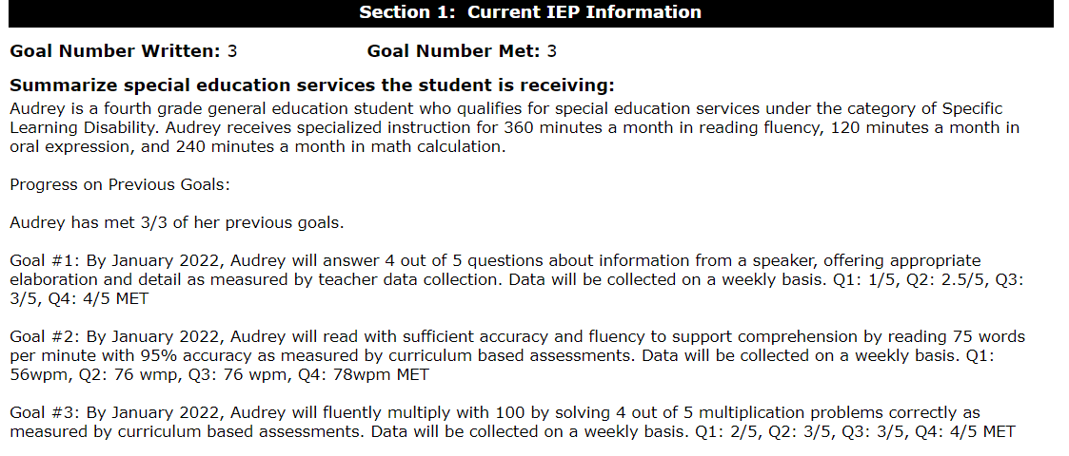






Reminders
At an annual IEP meeting, progress on goals and services from the previous IEP should be addressed when reviewing section 1.
This meets our legal obligation to “review” an IEP at least annually.

Slide 6
Also remember
Progress Reports are “live” in IEP PRO
Parents have immediate access to all information as you enter it.
Data should be finalized and entered as close to the end of the quarter as possible in order to accurately reflect performance for a full quarter.

Slide 7
Extended School Year
Use the link below for current ESY guidance:
https://www.cusd80.com/cms/lib/AZ01001175/Centricity/domain/6092/files/extended%20school%20year/ESY.pdf
Locating current information on the CUSD Special Education webpage:
DEPARTMENTS> SPECIAL EDUCATION/STUDENT SERVICES > STAFF LINKS > LOG IN>EXTENDED SCHOOL YEAR> PROCESSS FOR EXTENDED SCHOOL YEAR.

Slide 8
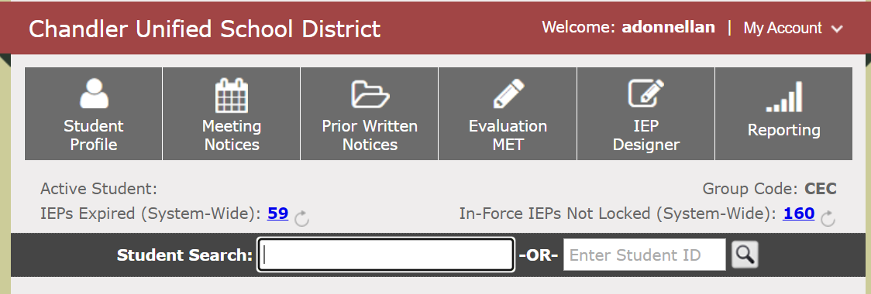
How to run an ESY report for your site
Department Chairs and Service Coordinators should review reports regularly to monitor eligibility for ESY and address clerical errors.
Notes:
Make note of any IEP due after the ESY deadline for the current school year.

Slide 9
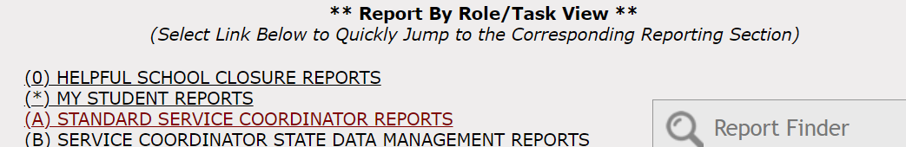
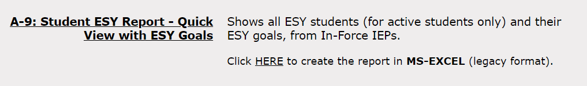
Notes:
Once the report opens in Excel, you can format it to best suit your informational needs.

Slide 10

Summer ESY:
June 2022
ALL ESY DECISIONS MUST BE MADE 45 DAYS PRIOR TO THE LAST DAY OF SCHOOL
April 11, 2022 is the deadline to provide parents with notification of ESY decisions.
If an IEP is due AFTER April 11th, the team must determine if a meeting should be held before the ESY deadline. Otherwise, the ESY determination is made during the regular IEP review.
Locations for ESY will be updated in the ESY training power point (Special education website) when determined

Slide 11
ESY - June 2022
CUSD operates other summer programs to include Summer Learning, Summer Academy, and Summer School.
If a student with an IEP meets the requirements for these programs, they are eligible to enroll and participate.
Please review current lists of eligible students with your principal.
Be aware of students with an IEP being recommended for summer programs.
We will need to address IEP accommodations for any student with an IEP.

Slide 12
Reminders
The ESY decision is based on a team review and discussion of the student’s data, progress, and all factors that impact performance. THE FINAL DETERMINATION IS NOT SOLELY BASED ON DATA POINTS OR ANY SINGLE PIECE OF INFORMATION.
IF ESY IS OFFERED AND A PARENT SHARES THE STUDENT WON’T ATTEND:
  THIS DOES NOT MEAN THE STUDENT IS NO LONGER ELIGIBLE.
  The team outlines the ESY determination in the PWN, and documents the parent's decision to decline the offer.

Slide 13

Frequency and Duration
DURING THE SAME MEETING WHEN A TEAM DETERMINES ELIGIBLITY FOR ESY, THEY ARE RESPONSIBLE FOR DETERMINING THE FREQUENCY AND DURATION OF SERVICES.
The IEP team should think about/talk about:
What services/duration will assist the student in maintaining progress?
**ESY is typically condensed into a 4 week period, 4 days each week, with 2-4 hours of service per day. Recommendations for services should be reasonable to maintain a skill, but also logistically make sense for the individual student. **
Frequency and Duration should be outlined in the PWN issued at the close of the meeting where eligibility is determined.
Notes:
The district’s final offer of ESY may “over serve” what your original offer of FAPE/ESY was. The district has final offer of location and schedule.

Slide 14

Next Steps:
- Run an ESY report and cross check any students that have been determined eligible
- Adjust IEP meeting dates to ensure the IEP team is meeting before the April 11th ESY determination deadline
- Once ESY programming has been finalized (location, hours, frequency, dates):
* contact parent/s to review
* draft the final PWN outlining the offer
* indicate parent’s denial or acceptance
* work with your department chair and the ESY Specialist to finalize all necessary details (as outlined in district ESY information provided on the special education website).

Slide 15

Are you or anyone on your Special Education team (teachers, paraprofessionals, related service providers) interested in working during ESY or Summer Programs?
M-TH during the month of June
8am-12pm
Please email names and area/s of interest to Andrea Donnellan
THANK YOU!
Notes:
If you have any questions regarding ESY – please contact Andrea Donnellan and include your Department Chair and Procedural Specialist. Thank you!

