Slide 1

Prior Written Notice (PWN)
Painting a Picture
2023-2024
Notes:
The PWN should paint a picture of the outcome of the meeting/offer being made by the district.

Slide 2


Agenda
Regulations
Components
Tips
Questions/Discussion
Notes:
After reviewing agenda: Ask participants to think of when a PWN is required and write that time on a post it. They can use as many post its as they need/want.

Slide 3
Regulations
Per IDEA 300.503 , a PWN must be provided in the following circumstances:
  (1) when the PEA proposes to initiate or change the identification, evaluation, or educational placement of the child or the provision of FAPE to the child; or
  (2) refuses to initiate or change the identification, evaluation, or educational placement of the child or the provision of FAPE to the child.
Notes:
Review post its to determine if there are times that a PWN is not required. Discuss relevance, importance, or irrelevance of those times.

Slide 4





When is a PWN Required?
Identification
Evaluation
Educational Placement
FAPE
Other Times
Referral
Given before the Review of Existing Data
Prior to collecting additional data
When eligibility is determined
Initial
DNQ
Change in LRE
Graduate/Age out
Revocation
Review/revise IEP
Changes to services
Changes to LRE
Changes to transition plans
Changes to ESY
Addenda to the IEP
Not required but could be appropriate
Notes:
Is a PWN required when a student is screened? No. Screenings are required for preschool, kindergarten, or for newly enrolled school aged children without appropriate records of screening, evaluation, or progress in school.
Is a PWN required when a student is referred for intervention? No. Any student can be referred for an intervention team, or to receive intervention(s) (child study team, teacher assistance team, etc.).
Is a PWN required when a parent requests an initial evaluation? Yes. This referral constitutes identification, as described in IDEA.

Slide 5
Purpose
The regulations that implement the IDEA require a school to provide parents with written notice a reasonable time before the public education agency (PEA) proposes or refuses to initiate or change the identification, evaluation, educational placement of the child, or the provision of a FAPE to the child.
Chandler practice: Within 5 school days, or less

Slide 6
Purpose
Provide parents with written notice of the school’s proposal or refusal to carry out an action that affects their child.
This is the decision that has been reached but NOT YET ACTED UPON.
Providing a timely PWN is essential to protecting the rights of children with disabilities, and their parents.
  The notice allows the parents time to seek resolution if they disagree with the school’s decision.
  Do not wait for parents to agree to a decision before issuing a PWN.
Notes:
The PWN provides a record for the child, parent, and school of the decisions that have been made, the basis for those decisions, and the actions that will or will not be taken as a result of those decisions. The PWN should be part of the student’s special education record and may be used as a reference document in circumstances such as subsequent staff or parent meetings, as a clarification and reminder to all parties of commitments made or by dispute resolution staff.

Slide 7
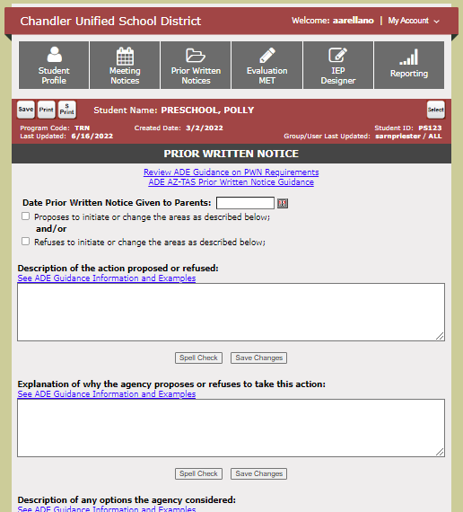

Content
Filling the Boxes
Notes:
Now that we know why and when to send a PWN, let’s talk about WHAT goes in it.
Talk about the resources available: Az-TAS, ADE Guidance and Examples in PRO

Slide 8
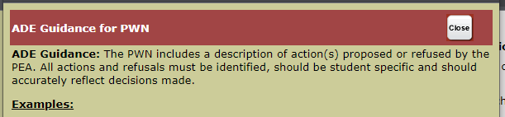
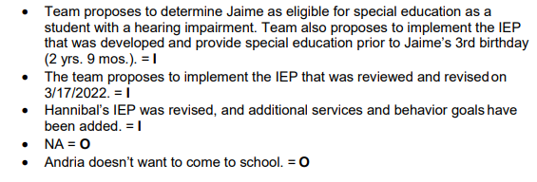
Description of the action proposed or refused
Items could be numbered so it is clear what is being proposed and the reasons for proposal
Use the student’s name
Ensure statements are detailed and in complete sentences
Write out acronyms (MET, MTSS, etc.)

Slide 9
Time for Practice
Description of the action proposed or refused
Notes:
Have each table work together to create a few items that would belong in this portion of the PWN.

Slide 10
Example or
Non-Example
Let’s EXAMINE some statements
Notes:
The following are actual statements taken from PWNs that have been issued to parents.

Slide 11
Description of the action proposed
Example 1
Example 2
At STUDENT's initial Individualized Education Program (IEP) meeting on 8/3/2023, the team created and proposed the attached IEP. The team developed an IEP verifying information and providing input in the Student Data, IEP Team Members, Present Level of Academic Achievement and Functional Performance, Considerations, Student Goals and Performance Objectives and Progress Reports, Accommodations, Assessment, Services and Environment, and Medicaid Services / DSC sections.
The team reviewed in an effort to provide FAPE in accordance with IDEA. Specialized services will be provided in the areas of: Reading, Writing, Math Calculation, Interpersonal/Social Skills, Occupational Therapy and Communication. STUDENT requires transportation 2x a day.
Accommodations will be provided in all academic areas.
Continuing speech therapy services for 120 minutes a month.
Notes:
After reading these Proposed statements

Slide 12
Description of the action proposed
Example 3
Example 4
An annual IEP meeting was held for STUDENT on 04/07/2023 via virtually.
IEP team proposed that services continue to be provided to STUDENT, as they remain eligible for special education services under Specific Learning Disability in the areas of Reading Fluency, Reading Comprehension, Math Calculation, and Math Problem-Solving.
IEP team proposed new goals for Reading Fluency, Reading Comprehension, Math Calculation, and Math Problem-Solving.
IEP team proposed changes and additions to STUDENT's accommodations.
The team proposes to implement the IEP developed on 08/28/2023 as written.

Slide 13
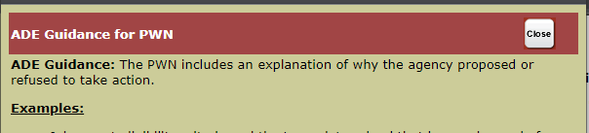
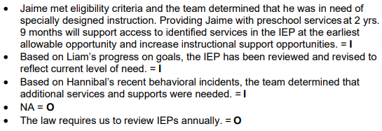
Explanation of why the agency proposes or refuses to take this action
Must be highly individualized and detailed
Reasons must be directly related to the actions described
If you are numbering items in one section, ensure that they correspond to the numbers here as well

Slide 14
Time for Practice
Explanation of why the agency proposes or refuses to take this action
Notes:
Have each table work together to create a few items that would belong in this portion of the PWN.

Slide 15
Example or
Non-Example
Let’s EXAMINE some statements
Notes:
The following are actual statements taken from PWNs that have been issued to parents.

Slide 16
Explanation of why the agency proposes or refuses to take this action
Example 1
Example 2
STUDENT qualified for special education and related services in the areas of motor/physical, adaptive, and communication skills, after a multidisciplinary team evaluation. She is in need of these services to help her be more successful in the classroom and on campus. Her disability impedes her success as a student and as a peer member of her class.
Under IDEA law, STUDENT's IEP has been reviewed and services have been adjusted according to her present level of performance.
IEP team proposed and agreed on new goals for Reading Fluency, Reading Comprehension, Math Calculation, and Math Problem-Solving
IEP team proposed and agreed on STUDENT's current accommodations as she continues to struggles to need support in her academics with low test scores, struggling with understanding concepts, and missing assignments.

Slide 17
Explanation of why the agency proposes or refuses to take this action
Example 3
Example 4
The team reviewed and revised STUDENT's previous goals according to his current present levels and grade level standards. STUDENT will continue to work on improving his reading skills.
The team reviewed and revised STUDENT's previous accommodations to reflect current supports in his general education class in order to service his disability needs.
The team reviewed and revised STUDENT's previous service times to align with supports in place to provide specially designed instruction to service his disability needs.
The team met to develop an IEP for STUDENT. The team discussed present levels, developed goals, and determined that her needs are best met in a Private Day School setting.
OR
STUDENT’S IEP was due for annual review. The team met to review present levels and progress toward goals. New goals were discussed, and service times were adjusted to meet their needs.

Slide 18
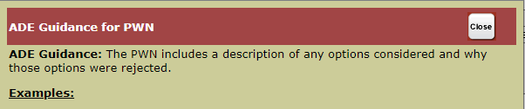
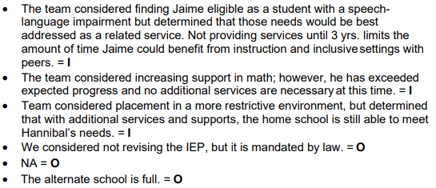

Description of any options the agency considered
These are options outside of those listed in the first section
Should not simply reflect the opposite of what is listed in Description of Action Proposed
Items discussed at the meeting leads to options considered

Slide 19
Time for Practice
Description of any options the agency considered
Notes:
Have each table work together to create a few items that would belong in this portion of the PWN.

Slide 20
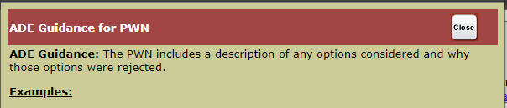






Reasons the above listed were rejected
Must be individualized and detailed
Reasons must be directly related to the options described

Slide 21
Time for Practice
Reasons the above listed were rejected
Notes:
Have each table work together to create a few items that would belong in this portion of the PWN.

Slide 22
Example or
Non-Example
Let’s EXAMINE some statements
Notes:
The following are actual statements taken from PWNs that have been issued to parents.

Slide 23
Description of any options the agency considered and Reasons the above listed were rejected
Example 1
Example 2
1. The team considered placement in a Math Strategies resource class.
2. The team considered placement in Resource English
1. The team determined STUDENT is capable of keeping up with the pace of on level Algebra 1 without accommodations other than for word problems, therefore, he does not require the support of a Math Strategies class.
2. The team determined STUDENT is able to perform in a general education English setting with the support of accommodations for access to the curriculum.
1. ESY services were considered by the IEP team.
2. IEP team considered conducting a comprehensive evaluation to determine eligibility, STUDENT will receive both a resource, co-taught, and general education, as this is the least restrictive environment to implement IEP.
1. ESY services were considered by the IEP team but were rejected because STUDENT maintains skills accuracy over break.
2. IEP team rejected conducting a comprehensive evaluation as STUDENT's disability and needs are well established.

Slide 24
Description of any options the agency considered and Reasons the above listed were rejected
Example 3
Example 4
Determining STUDENT is not eligible for special education services was considered and rejected. STUDENT struggles in the classroom with reading and math tasks. She has poor spelling as well.
STUDENT meets the criteria of a student with Specific Learning Disability. STUDENT is in need of specially designed instruction and related services in order to benefit from her educational program. She demonstrated a significant delay in her overall reading fluency and math problem solving skills.
The team considered and rejected placement in a private day school as her least restrictive environment.
The team considered and rejected placement in a private day school because the services that are needed can be provided by district staff. The team discussed the need for STUDENT to have access to typically developing peers in order to gain the most benefit from her general education and special education services.

Slide 25
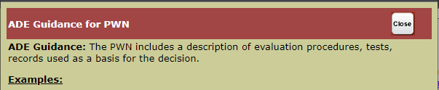
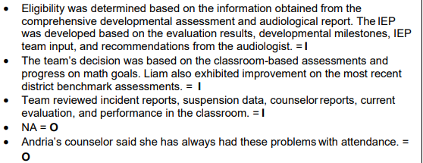
Description of each evaluation procedure, test, record, or report the agency used/will use as a basis for the proposed or refused action
A list of all sources the team reviewed and discussed
List those from whom the team considered input, including student and parents, and all members of the team
Reports from district and outside providers/agencies/medical personnel
Data (progress reports, state and/or district assessments, behavioral data, anecdotal data, attendance, grades, observations, etc.)
Review statement and remove sources not considered

Slide 26
Time for Practice
Description of each evaluation procedure, test, record, or report the agency used/will use as a basis for the proposed or refused action
Notes:
Have each table work together to create a few items that would belong in this portion of the PWN.

Slide 27
Example or
Non-Example
Let’s EXAMINE some statements
Notes:
The following are actual statements taken from PWNs that have been issued to parents.

Slide 28
Description of each evaluation procedure, test, record, or report the agency used/will use as a basis for the proposed or refused action
Example 1
Example 2
The team discussed the information in STUDENT's current comprehensive evaluation report by the Multidisciplinary Evaluation Team (MET). The team considered testing results reflecting STUDENT's development and potential educational performance, including the MET observation notes and additional family reports. All members of the IEP team provided input into what they noted as her strengths and needs, and how her disability could affect her success in the classroom and on campus.
IEP progress reports
Grade reports
Teacher input
Parent input
(As applicable) – Student’s input
Case Manager input
Transition Specialist input

Slide 29
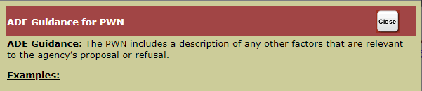

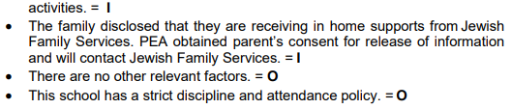

Description of any other factors that are relevant to the agency's proposal or refusal
Include meeting participants
Note if meeting was held virtually, or via phone
Note that Procedural Safeguards were offered, accepted/rejected
Contact attempts
Any excusal of team member/s
Document use of interpreter

Slide 30
Time for Practice
Description of any other factors that are relevant to the agency's proposal or refusal
Notes:
Have each table work together to create a few items that would belong in this portion of the PWN.

Slide 31
Example or
Non-Example
Let’s EXAMINE some statements
Notes:
The following are actual statements taken from PWNs that have been issued to parents.

Slide 32
Description of any other factors that are relevant to the agency's proposal or refusal
Example 1
Example 2
Procedural Safeguards were offered but the parent politely declined.
IEP team agreed on STUDENT's IEP and will be implemented as written.
The team agreed that STUDENT will receive special education and related services, accommodations, and other supports outlined in the IEP to promote her educational progress. It was agreed that if any team member felt that there needed to be a change in STUDENT 's IEP, they could and would propose a re-convening of the team to discuss any concerns or questions. As of this notification, all IEP team members are in agreement with STUDENT 's IEP and the proposed actions stated therein.
The family has decided not to enroll her into school until after her 3rd birthday on 10/21/23 so that she can continue to receive early intervention services until that time.

Slide 33

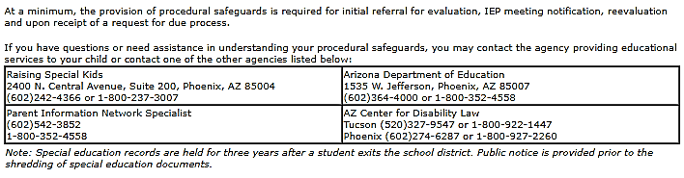
Prior Written Notice
Additional Requirements
A statement of how a copy of a description of the procedural safeguards can be obtained which includes a contact name or position, and phone number
Sources for parents to contact to obtain assistance in understanding their procedural safeguards
These are all included in the IEP-PRO template
Ensure translation in parent’s native language

Slide 34
TIPS
Ensure that each item is understood on its own merit and represents a stand-alone statement
Avoid abbreviations, acronyms, jargon, and terms which may not be understood by someone not familiar with Special Education
Spell check, use correct grammar, and write complete sentences
Statements and comments should be void of emotion, derogatory comments, and judgment
Provide to parent/guardian in a timely manner (before implementation)
Include parent concerns/questions
Avoid statements like, “team believes/feels”
Personalize

Slide 35
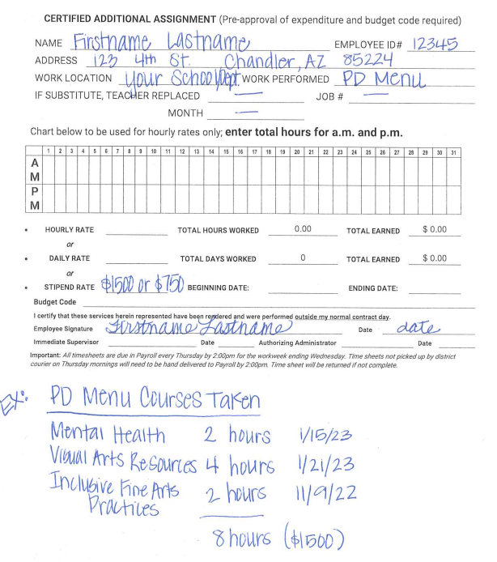
  You will need to complete a timesheet with your total hours, making sure to list the title of the courses you took to fulfill your required hours –one timesheet per participant.
  Please do not send multiple timesheets; you will receive a confirmation of receipt. Filling out multiple timesheets could delay payment.
  Refer to the email sent 8/30/22 for further instructions.

Slide 36
References
Individuals with Disabilities Education Act (IDEA)
https://sites.ed.gov/idea/regs/c/e/303.421
Sec. 300.503 Prior notice by the public agency; content of notice - Individuals with Disabilities Education Act
Arizona Department of Education (ADE)
2023-2024 Guide Steps.pdf (azed.gov)
2020-2021 PWN Final .pdf (azed.gov)

