Slide 1

MET Module
From Initial Referral to
Eligibility determination

Slide 2

MET Participants
Who participates in the MET meeting?
Though there are no legally required MET members, CUSD Best Practice is
  Individualized education program (IEP) team members
    The parents of the student
    Not less than one general education teacher
    Not less than one special education teacher
    A representative of the school district
    An individual who can interpret the instructional implications of the evaluation results
  Other qualified professionals

Slide 3
Initial Referrals
Referral Sources
PWN for Initial Referral
Arizona Early Intervention Program (AzEIP)
Head Start
Parent/Guardian
School-based referrals
Outlines the decision to refer a child to the multidisciplinary evaluation team (MET) and the reasons for that referral
Issued before the review of existing data and before the decision is made to collect additional data for possible qualification for special education services
§300.503(a)

Slide 4
Initial Referrals
Must be conducted within 60 calendar days of receiving informed parental consent
Must follow procedures to determine
  If a child has a disability, defined as: “having an intellectual disability, a hearing impairment (including deafness), a speech or language impairment, a visual impairment (including blindness), a serious emotional disturbance (referred to in this part as “emotional disturbance”), an orthopedic impairment, autism, traumatic brain injury, an other health impairment, a specific learning disability, deaf-blindness, or multiple disabilities, and who, by reason thereof, needs special education and related services” (§300.8)
  The educational needs of the child

Slide 5

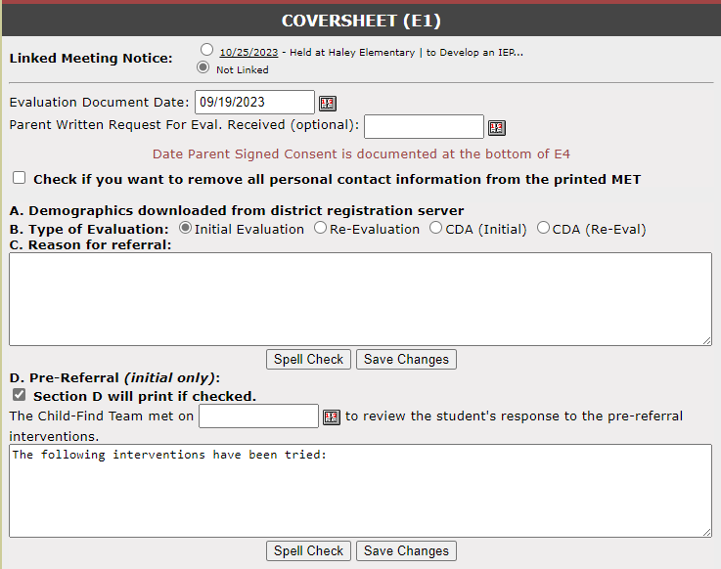
Coversheet (E1)
Link the meeting notice, if appropriate.
Ensure the correct type of MET is indicated – this drives the format of the forms throughout the MET.
Reason for referral must be completed as this section will print on the report.
Pre-referral data is necessary for most initial evaluations. A date must be entered to complete the heading sentence which prints on the report. If section D is not selected, it will not print.
§300.306(b)(iii) & ARS15- 761(2)(b)(iii)

Slide 6
Hearing and Vision
If a problem was identified through the vision or hearing screening, the problem must be resolved prior to continuing the evaluation
  UNLESS the nature of the problem is part of the evaluation process and the strategies/ instruments used during the evaluation take into account the issues with vision or hearing.
ADE Guidesteps II.A.4

Slide 7
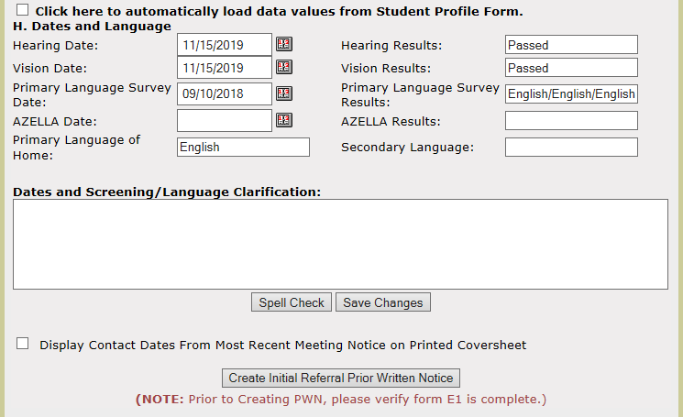
Coversheet (E1)
Hearing, vision, and language data may be loaded from the Student Profile page or entered manually.
Language information from the PHLOTE form is required.
If a meeting notice is linked, contact details can be selected to display on the printed coversheet
Remember: For a parent request for evaluation, an initial referral PWN is still required, and must be completed before the MET convenes
A PWN for Initial Referral is required when a student is referred for an INITIAL evaluation [§300.503(a)]

Slide 8

Initial Referrals
MET 1
Begin with a review of existing data
  Evaluations and information provided by the parents of the child
  Current classroom-based, local, or state assessments, and classroom-based observations
  Observations by teachers and related services providers
  Information from outside providers, homeschool providers, medical professionals
ROED
All of this information is collected before the decision of the need for additional data
§300.305(a)(1)(i) & ADE Guidesteps II.A.2

Slide 9
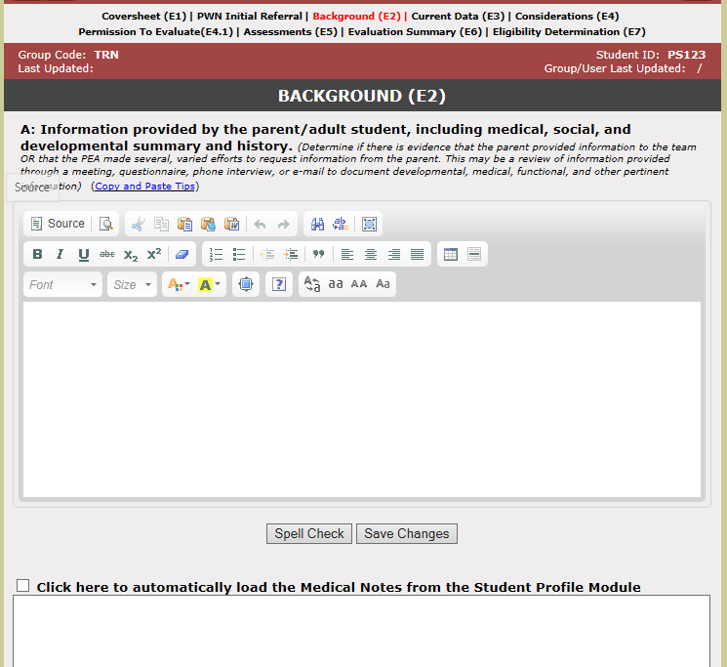
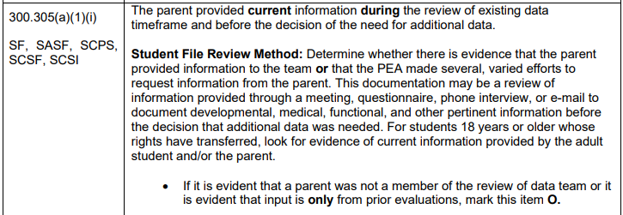
Background (E2)
A: This information must include CURRENT information provided by parents, not only a review of the student’s history
§300.305(a)(1)(i)

Slide 10
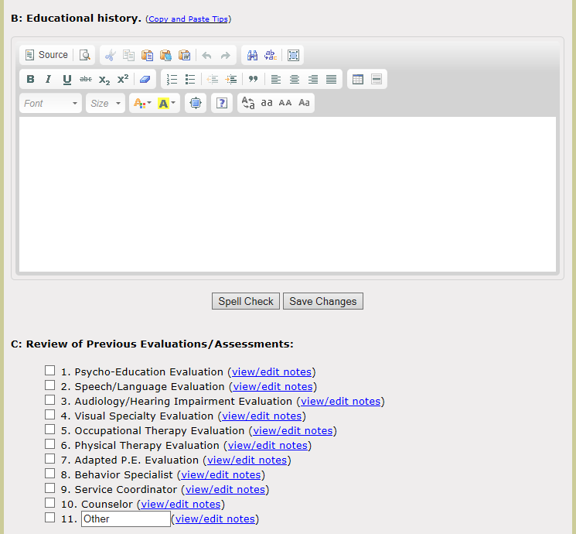
Background (E2)
B: This should reflect any information relevant to the student’s educational history
**For preschool this may reflect attendance to childcare or participation in a private preschool program or other activities with typically developing peers**
C: Document all previous evaluations/assessments for the child
Ensure each box is selected ( ) for areas that include information so it will print in the report.
§300.305(a)(1)(i)

Slide 11
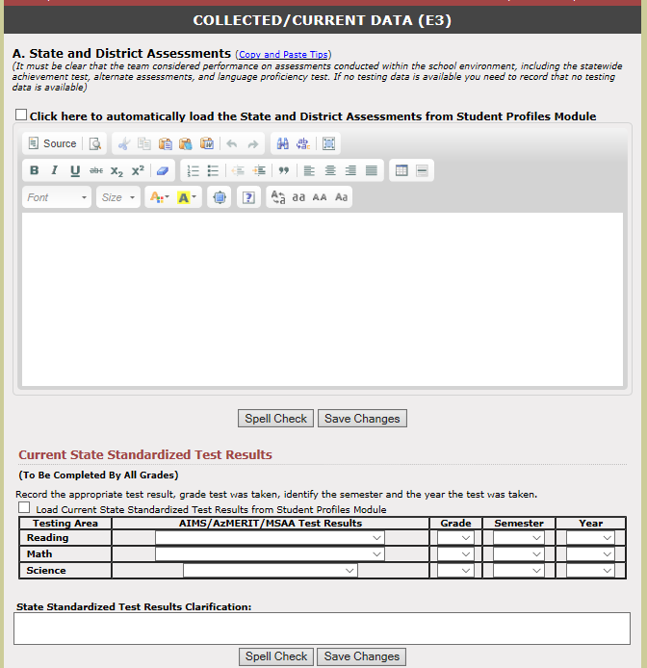
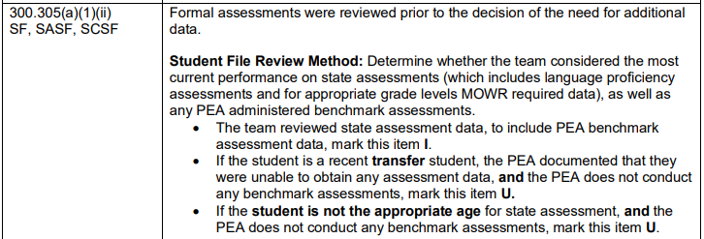
Collected/Current Data (E3)
CDA (Preschool) Initial MET does not display “Current State Standardized Test Results” as this is not required at this age
§300.305(a)(1)(ii)

Slide 12
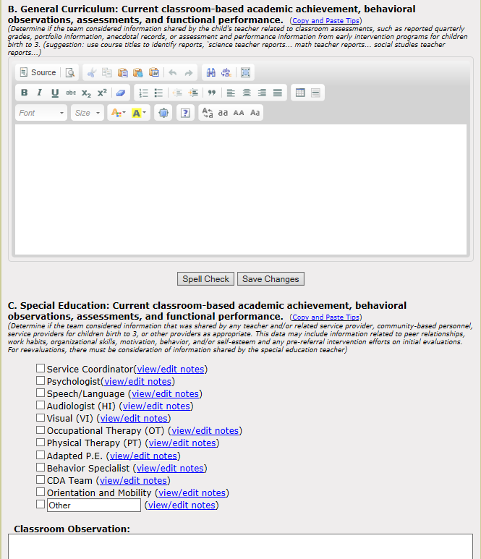
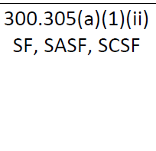

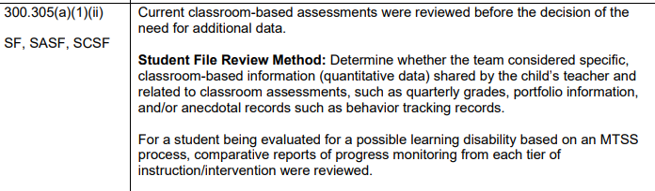
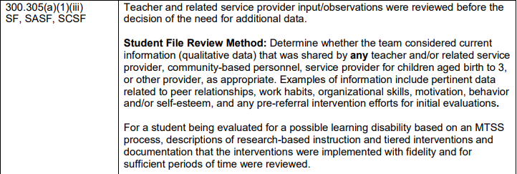
Collected/Current Data (E3)
CDA (Preschool) Initial MET displays “C: Special Education” since the child may have received early intervention services.
If left blank, it does not display on the printed report.
§300.305(a)(1)(iii)

Slide 13
Collected/Current Data (E3):
Information to Consider
School-age
Preschool-age
MTSS data
Progress monitoring data
Classroom assessments
Quarterly grades
Portfolio information
Anecdotal records
Behavior tracking records
State assessment data
  State test, AZELLA, ACT, SAT, MSAA
Information from birth to 3 service providers (Early Intervention)
Childcare provider input
Teaching Strategies GOLD data
Information from doctors, private therapy providers, and others
What are some other types of data?

Slide 14
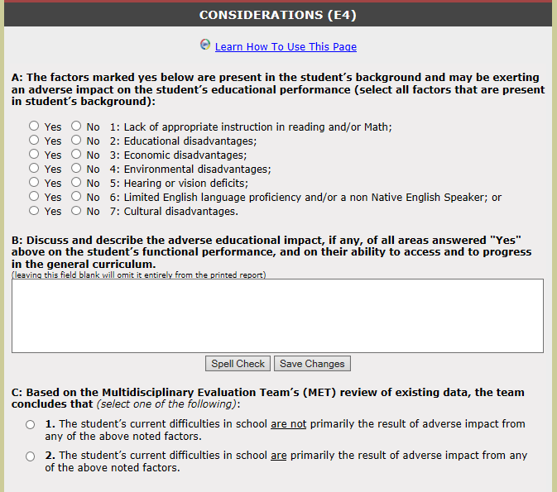
Considerations (E4)
A: Each factor should be considered individually
Lack of learning opportunities may include:
  Frequent school changes
  Poor attendance
  Multiple teachers in the same year
  Questionable home-school curriculum
*For preschool students, lack of formal schooling/childcare is not considered a lack of appropriate instruction in reading and/or math.
Rule-out statements are sufficient ONLY if there is no evidence of these factors
§300.306(b) (1); ARS 15- 761(2)(b)(i), (ii), (iii)

Slide 15
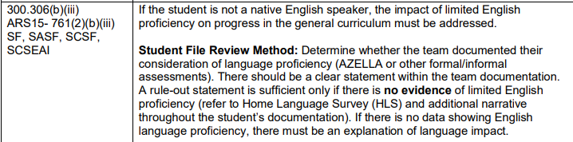
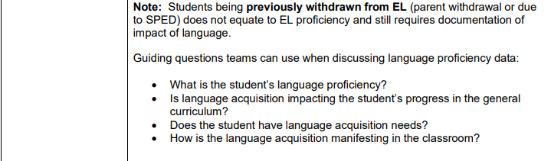
Considerations (E4)
A: Each factor should be considered individually
6. Limited English language proficiency . . .
§300.306(b) (1); ARS 15- 761(2)(b)(i), (ii), (iii)

Slide 16
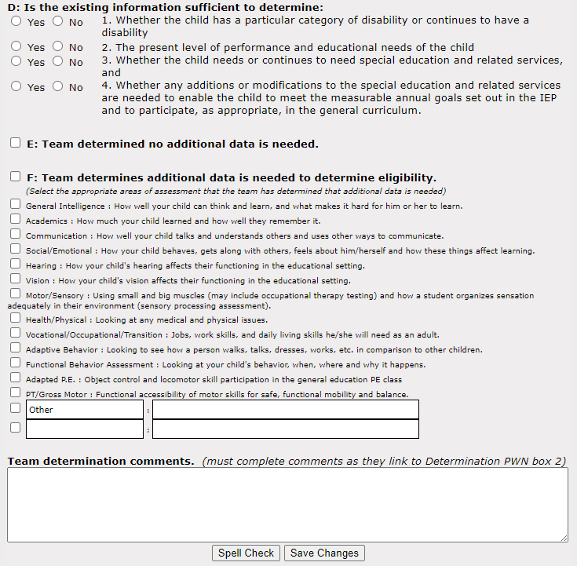
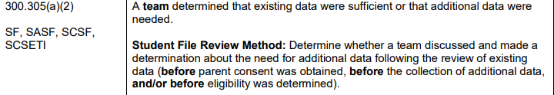
Considerations (E4)
If all answers = Yes,
then no additional data is needed
If any of the answers = No,
then additional data should be collected
Mark all areas of assessment in which data will be collected
Team determination comments entered will appear directly on the linked PWN, as well as on the Permission to Evaluate

Slide 17
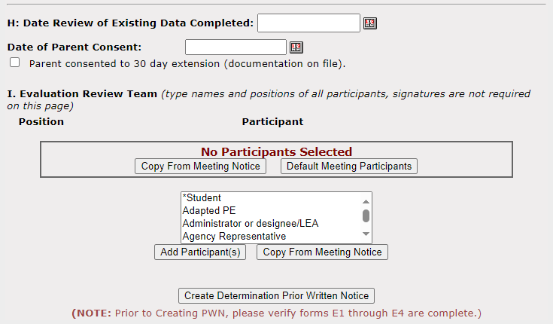
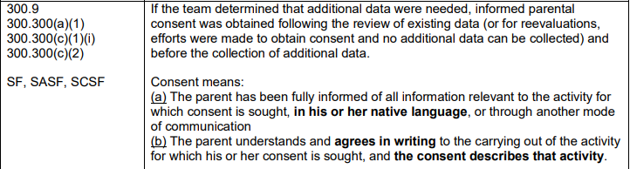

Considerations (E4)
If additional data will be collected, this box will appear
This information will only print if entered
Participants may be copied from the linked meeting notice or entered manually
Signatures are not required, but may be useful to identify who participated in the meeting
Team determination comments entered will appear directly on the linked PWN once created
PWN is needed as part of informed consent before gathering additional data

Slide 18

Initial Referral Consent
Informed Parental Consent must be obtained before conducting an intial evaluation (34 C.F.R. §300.300)
  parent has been fully informed of all information relevant
  native language
  understands and agrees in writing
  consent describes activities that will be conducted
The Permission to Evaluate form will populate after you check the box next to:
F: Team determines additional data is needed . . .
  34 C.F.R. §300.9

Slide 19
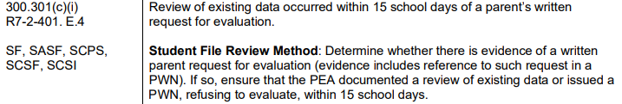
Special Circumstances
Parent Request for Evaluation
  CUSD must respond within 15 school days from the date it receives the parent's written request
    Begin the evaluation by reviewing existing data
    Provide prior written notice refusing to conduct the requested evaluation
§300.301; A.R.S. §15-766; A.A.C. R7-2-401.E.3–5

Slide 20
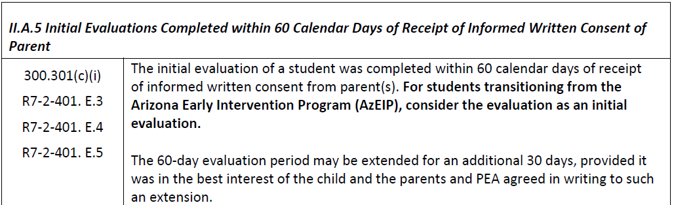

Special Circumstances
30-day Extension: the school and parents may agree to an extension
  If it is in the student’s best interests
  Must be done in writing
§300.301; A.R.S. §15-766; A.A.C. R7-2-401.E.3–5

Slide 21
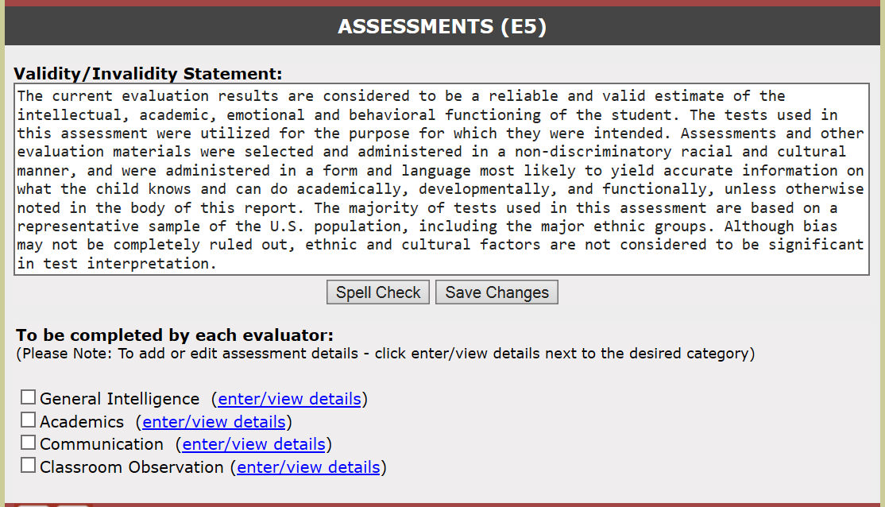
Assessment (E5)
Validity Statement is editable
Consider the validity of the assessments given and edit this statement as necessary
Each area selected on E4 will appear here as a section to enter the assessment results
Ensure the box is checked for each area so it will appear on the printed report
A classroom observation is a required part of the evaluation whether additional data is collected or not in order to determine whether a student has a specific learning disability (SLD)
**Student must be assessed in all areas related to suspected disability
**Preschool evaluation requires all 5 developmental areas be addressed
§300.304(c)4); §300.310; ARS 15- 761(24) and (34)

Slide 22
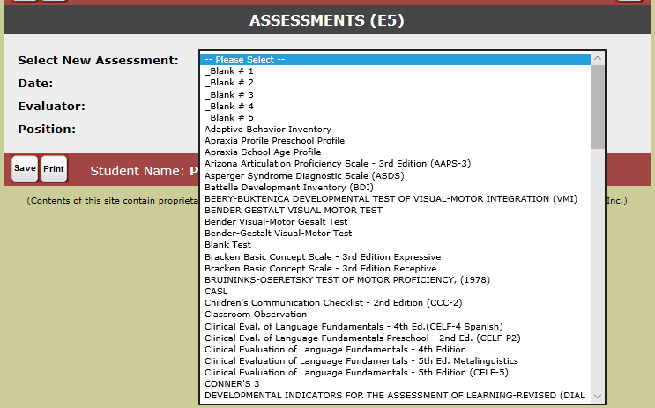
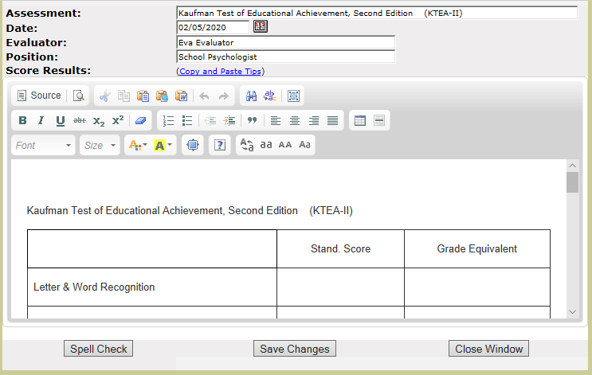
Assessments (E5)
Select the appropriate assessment from the drop-down options
After adding the assessment, remember to edit the name, if needed (e.g. “_Blank #1” – change to “Kaufman Test of Educational Achievement, Second Edition)
If there is an existing chart/explanation, you may edit the entire section and replace it with your own format

Slide 23
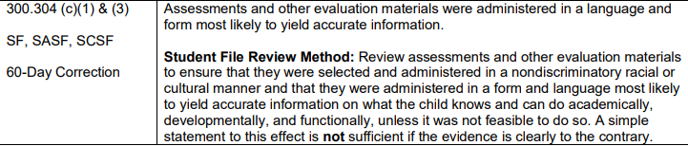
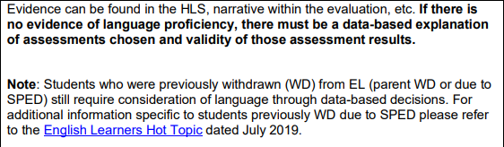
Assessment Data and E5
Evaluators should consider the following when entering assessment data:
  Was the student evaluated in all areas related to the suspected disability?
  Were the assessments and other evaluation materials administered in a language and form most likely to yield accurate information?
  Is the information included easily understandable to parents and other team members?

Slide 24
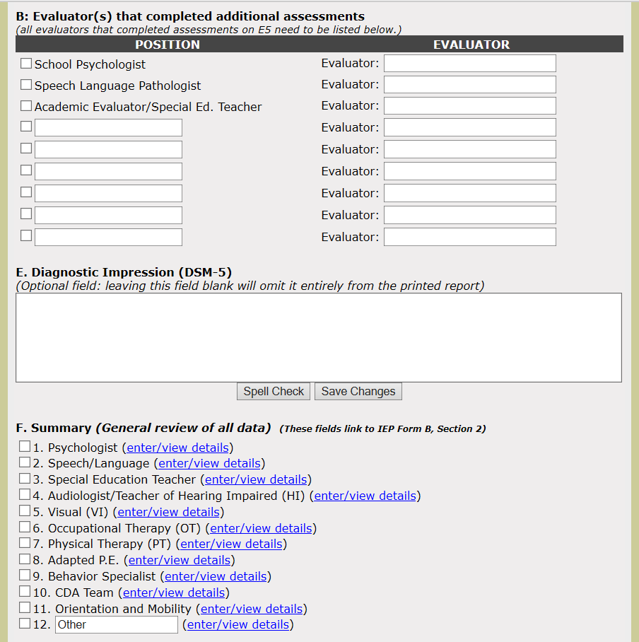
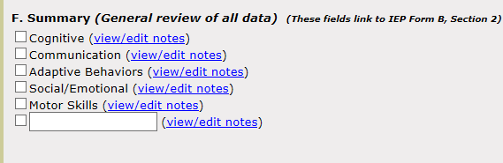
Evaluation Summary (E6)
Enter names and titles for all evaluators
Signature lines will appear on the printed copy – Qualified Medicaid Providers (QMP) will need to sign the evaluation
CDA MET: For each area, summarize ALL data reviewed and clearly capture the overall skills and needs of the student
Each discipline should complete a summary that clearly captures the overall skills of the student in each area, regardless if additional data was collected in that area or not
F: Summary information should not be a re-statement of the information on E5

Slide 25
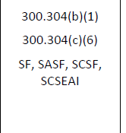
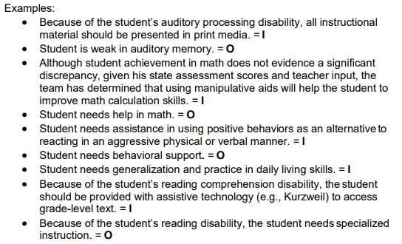
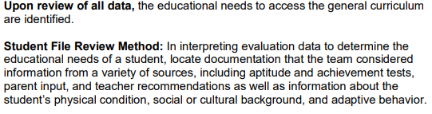
Evaluation Summary (E6)
This information can be included anywhere in the MET; however, the Evaluation Summary is a good place to put it, as this information will link to the IEP, providing guidance for the IEP team when determining goals, accommodations, and services for the student
§300.304(b)(1)(ii)

Slide 26
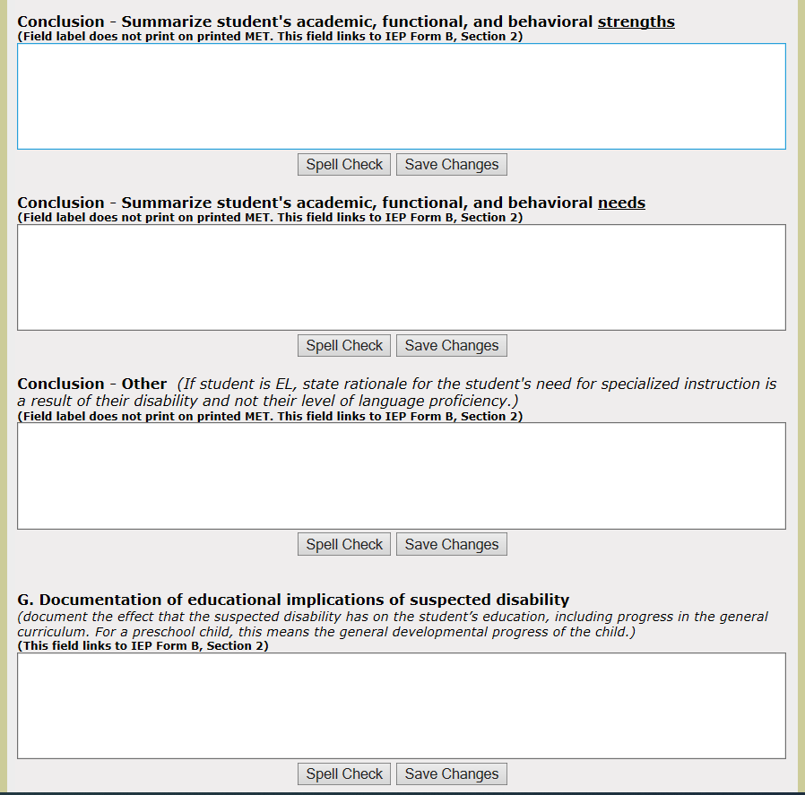
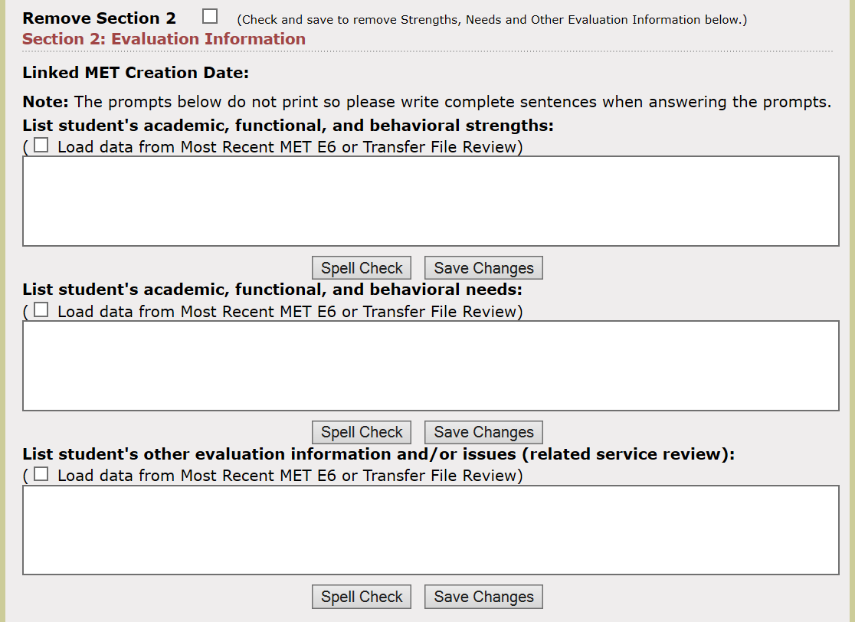
Evaluation Summary (E6)
These sections should be a review of all data collected during the evaluation process:
Input from parents
Current classroom-based data
Previous evaluation information
Additional data collected in all documented areas
IEP
Each of these fields link to the IEP Form B, Section 2
Headers do not print, so statements should be descriptive indicating areas of strength, need, etc.
§300.304(b)(1)(ii)

Slide 27
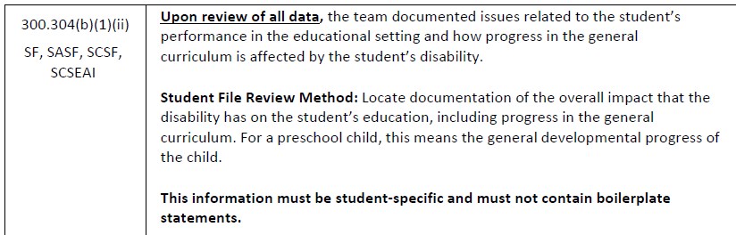
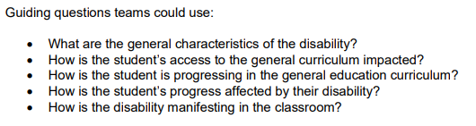
Evaluation Summary (E6)
IEP
If student is suspected of having a disability, specific statements detailing the implications of the student’s involvement and progress in the general education curriculum are required and must be student-specific
**For preschoolers this means the general developmental progress of the child**
If student is NOT suspected of having a disability, a statement is still required as this header (G) prints on the report
§300.304(b)(1)(ii)

Slide 28
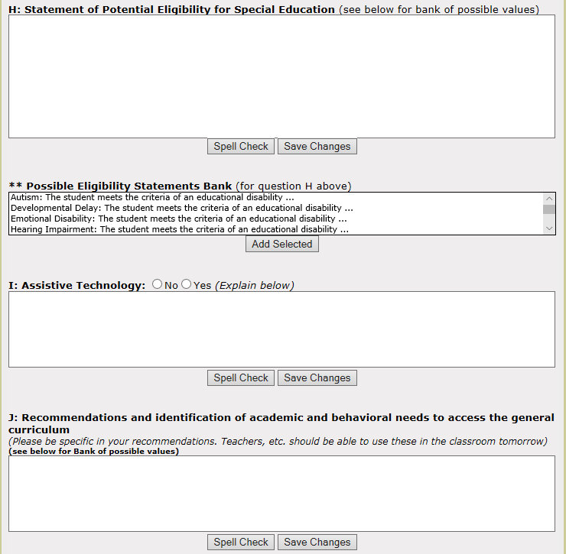
Evaluation Summary (E6)
Data addressing the following potential categories of special education eligibility were included in this evaluation, either through assessment or review. Please refer to the attached Eligibility Determination page for documentation of the MET's decision regarding this student's category or categories of eligibility for special education, if any.
Select all potential eligibility categories to be added to
H: Statement of Potential Eligibility
Assistive Technology should be thoughtfully considered for each student
Recommendations should be student-specific and be stated so teachers and other providers can use them in the classroom
300.324(a)(2)(v)

Slide 29
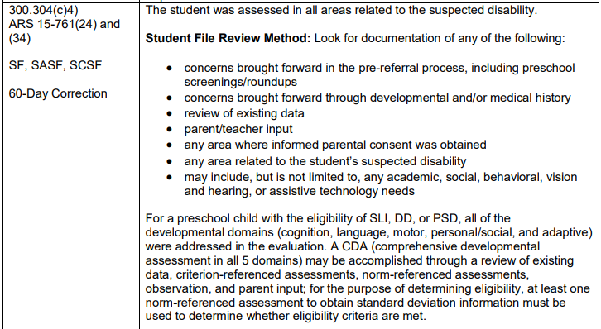
Evaluation Summary (E6)
Student was assessed in all areas related to the suspected disability
Preschool CDA – All 5 domains addressed
Review of data
Criterion
Norm-referenced
Observation
Parent input

Slide 30
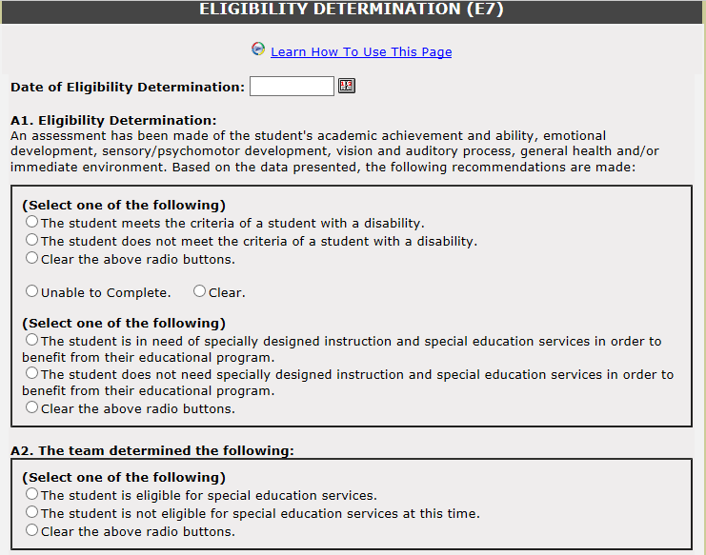
Eligibility Determination (E7)
Enter the date eligibility was determined. This links to the coversheet of the IEP and is used when a report is generated.
Both questions MUST be answered in order to determine if a student is eligible for special education
A2. Student is only eligible for special education services if both criteria are met above (meets the criteria AND is need of specially designed instruction)
§300.306(a)(1); ARS 15-761 (30) & (32)

Slide 31
Determining Eligibility
MET report generated by multiple people with a role in making the decision based on data from a variety of sources:
  aptitude and achievement tests
  parent input
  teacher recommendations
  information about the student’s physical condition, social or cultural background
  adaptive behavior
Thoughtfully
considered
Documented
§300.306 (c)(1)

Slide 32
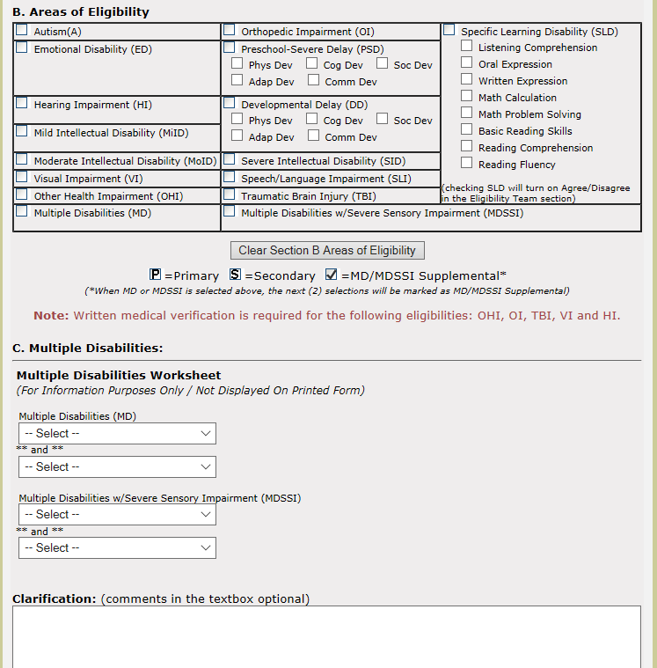
Eligibility Determination (E7)
Select all areas of eligibility.
Note: The first option selected will indicate “P” for Primary disability.
If Multiple Disabilities (MD) is selected, additional documentation of areas can be included in this section.
Enter further clarification here.
If blank, this section will NOT print.
§300.306(a)(1); ARS 15-761 (30) & (32)

Slide 33
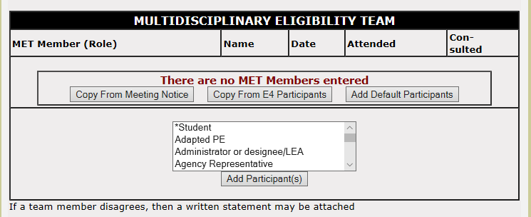
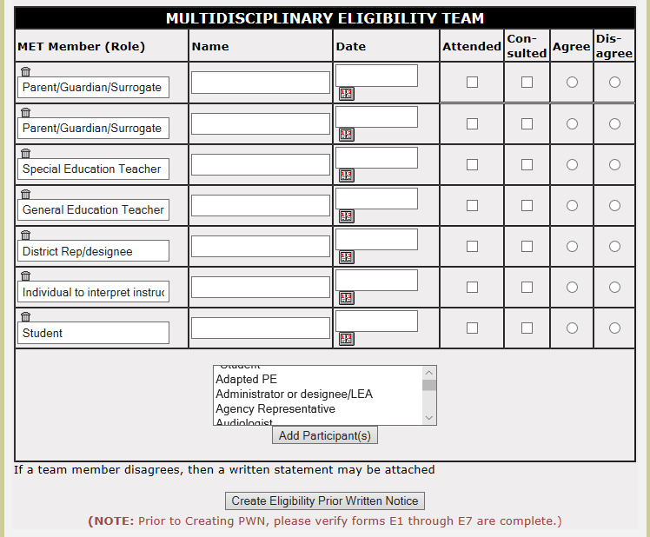
Eligibility Determination (E7)
Add MET participants
From meeting notice/E4 Participants/ Default/Individually selected
If eligibility is SLD, documentation of agreement from each team member, or disagreement, is require. The additional columns will appear once the form is saved.
Participants selected will appear once saved
These fields are editable
Information entered in forms E1-E7 will populate on the linked PWN (once created). Review for accuracy.
§300.8(c)(10); §300.307; § 300.309; §300.311; ARS 15-761(33) R7-2-401. E.7.d

Slide 34

Re-evaluations
Many components of the Initial Evaluation are repeated with Re-evaluations
Differences specifically related to Re-evaluations are noted on the following slides
Re-evaluations must occur every 3 years
  Unless a parent and the district agree it is unnecessary [§300.303 (b)(2)]
Re-evaluations may not occur more than once per year
  Unless a parent and the district agree otherwise [§300.303 (b)(1)]

Slide 35
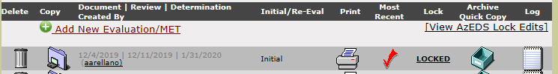
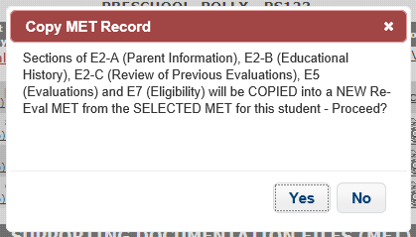
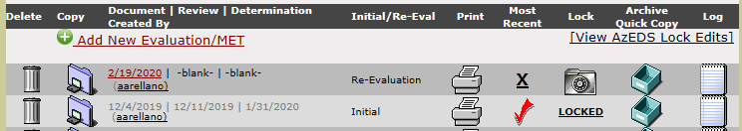
Copying a MET
ARCHIVE!
Evaluation information from E5 will copy to C: Review of Previous Evaluations on E2
All information copied over should be reviewed and edited as appropriate
If you copy the MET, some information from the Initial MET will be copied into a new Re-Eval MET
Copying is possible for
Initial to Re-Eval
Re-Eval to Re-Eval
Transfer to Re-Eval

Slide 36
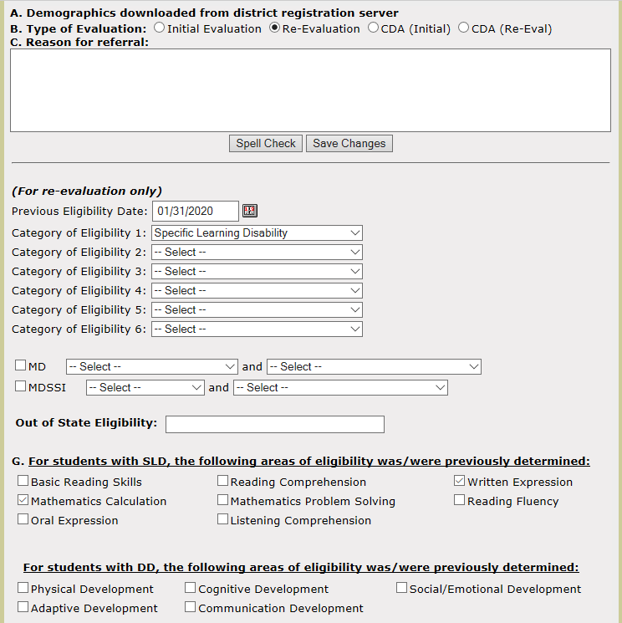
Coversheet (E1)
Reason for referral must be completed as this section will print on the report
Previous eligibility information will populate automatically if copied from previous MET
Otherwise, this information must be manually entered

Slide 37

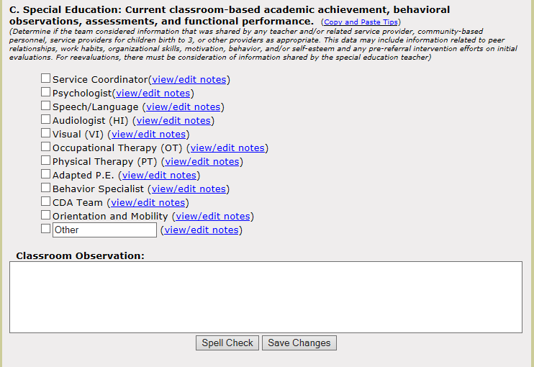
Collected/Current Data (E3)
CDA Re-eval: Team may include information from Teaching Strategies GOLD, curriculum “assessments”, Child Outcomes Survey (COS).
C: Each member of the team should provide information related to their specific discipline, as well as
Progress toward IEP goals
Observations
Work habits/motivation
When determining whether a student has a specific learning disability (SLD), a classroom observation may be noted here to fulfill the requirement for an observation.
§300.305(a)(1)(i)

Slide 38
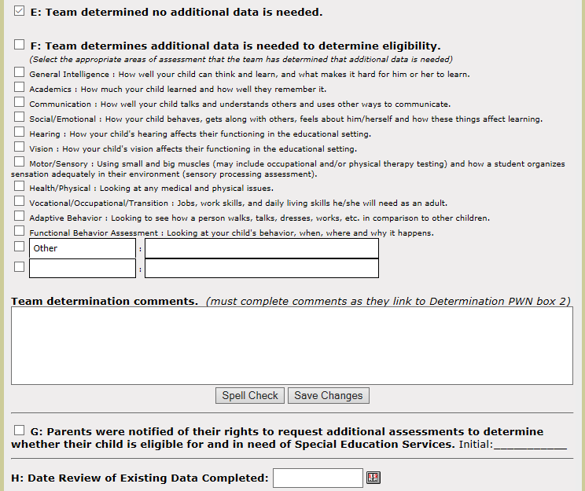
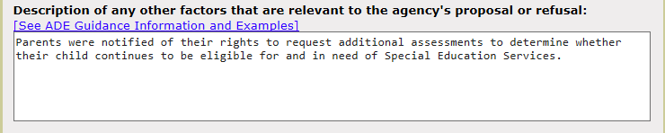
Considerations (E4)
If all answers = Yes,
then no additional data is needed
Parents must be informed of the reasons why no additional data is collected, as well as their right to request additional data
Select this box to indicate parents were notified. Once printed this should be initialed.
The same statement will appear on the linked PWN, when .created
Personalize it!
§300.305(d)

Slide 39
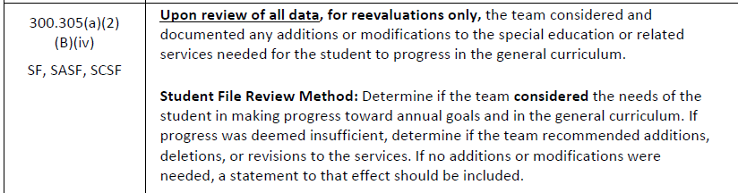
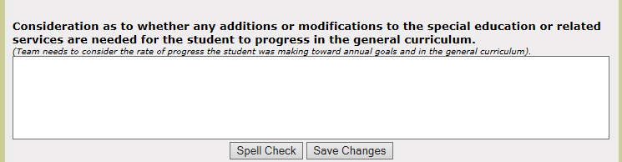
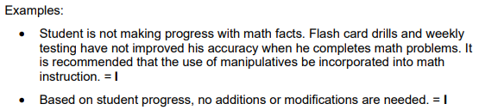

Evaluation Summary (E6)
Team must consider the needs of the student
Making progress toward annual goals
Making progress in the general curriculum
If progress was insufficient, document recommended
Additions
Deletions
Revisions
If not recommended, a statement is necessary to indicate this decision.
Carefully considered
Documented
§300.305(a)(2)(B)(iv)

Slide 40


Transfer MET
When a student transfers from another district
Another e-IEPPRO district
Non-e-IEPPRO district
The original paperwork will be transferred to our system electronically
Review the MET and check for compliance
Add a Transfer MET reflecting information received from previous district
The original paperwork should be uploaded to Supporting Documents
Add a Transfer MET and complete reflecting information received from previous district

Slide 41

Transfer MET
Information captured in the Transfer MET should be stated exactly as it appears on the out of district MET
No changes should be made to the information when entering it in the Transfer MET

Slide 42

Transfer MET
Check the appropriate conclusion
Enter the date of the review
Create a PWN

Slide 43
Eligibility Categories
Autism
Emotional Disability
Hearing Impairment
Mild Intellectual Disability
Moderate Intellectual Disability
Severe Intellectual Disability
Multiple Disabilities
Multiple Disabilities with Severe Sensory Impairment
Orthopedic Impairment
Other Health Impairment
Developmental Delay
Preschool Severe Delay*
Speech or Language Impairment
Specific Learning Disability
Traumatic Brain Injury
Visual Impairment

Slide 44
Eligibility Categories in Preschool
Hearing Impairment
Visual Impairment
Speech or Language Impairment
Developmental Delay
Preschool Severe Delay
These are the only categories that will be funded by the state.
All eligibility categories are allowable for preschool, except EDP.

Slide 45

Autism (A)

Slide 46


Developmental Delay (DD)
By a child who is at least three years of age, but under ten years of age,

Slide 47

Developmental Delay (DD)
By a child who is at least three years of age, but under ten years of age,

Slide 48

Emotional Disability (ED)

Slide 49


Hearing Impairment (HI)

Slide 50
Intellectual Disability (ID)
CUSD utilizes an Intellectual Disability Evaluation Model (IDEM)
  Evaluation guidelines and practices for the identification of students with Intellectual Disabilities (ID)
  Use of comprehensive multitrait, multimethod evaluation process
The IDEM manual is available in the Psychologist’s Shared Drive
Different definitions exist for
  Mild Intellectual Disability (MIID)
  Moderate Intellectual Disability (MOID)
  Severe Intellectual Disability (SID)

Slide 51


Intellectual Disability (ID)
Intellectual Functioning
Adaptive Behavior

Slide 52

Multiple Disabilities (MD)

Slide 53

Multiple Disabilities with Severe Sensory Impairment (MDSSI)

Slide 54

Other Health Impairment (OHI)

Slide 55

Orthopedic Impairment (OI)

Slide 56


Speech-Language Impairment (SLI)
Refer to District Matrices/Guidelines
For a preschool student, performance on norm-referenced language test that measures at least one and one-half standard deviations below the mean. The results of this norm-referenced measure must be corroborated by information from a comprehensive developmental assessment and from parental input. A CDA (comprehensive developmental assessment in all 5 domains) may be accomplished through a review of existing data, criterion-referenced assessments, norm-referenced assessments, observation, and parent input. For the purpose of determining eligibility, at least one norm-referenced assessment to obtain standard deviation information must be used to determine whether eligibility criteria are met. Additionally, eligibility can only be determined if the child is not eligible under another preschool category or developmental delay

Slide 57

Specific Learning Disability
CUSD utilizes a Learning Disabilities and Evaluation Model (LDEM)
  Evaluation guidelines and practices for the identification of students with Specific Learning Disabilities (SLD)
The LDEM manual is available in the Psychologist’s Shared Drive

Slide 58

Specific Learning Disability
Additional requirements for determining eligibility for Specific Learning Disability (SLD) include:

Slide 59

Traumatic Brain Injury (TBI)

Slide 60


Visual Impairment (VI)

Slide 61

Preschool Severe Delay (PSD)

Slide 62


Thank you for participating in this year's PD Menu!
Please fill out the course survey to help us continue to plan and improve.
Please type the Course Title, Instructor Name, and Start Date exactly as it appears on this slide.
Course Title: MET Report Writing
Instructor Name: Alicia Arellano
Start Date of Class: 10/23/23
PD Menu-Course Survey

Slide 63
IMPORTANT REMINDERS
$750 for 4 hours or $1,500 for 8 hours – payout in June after timesheet audit
  No partial credit (i.e. for 2 or 6 hours)
Only classes with "PD Menu" in title count, no exceptions
May not repeat courses previously taken for PD Menu
Be mindful of audience of each course – i.e., 2nd grade cannot take a HS Science only course
All participants (4 or 8 hours) MUST complete 2-hour PD Menu-Required Course
  Not eligible for stipend if missing requirement
One timesheet per participant – list all courses on one
All timesheets due APRIL 12, 2024
  Scan to Jane Craig (craig.jane@cusd80.com)
  Reach out to Jane if you do not receive confirmation within one week
  Save copy of submission & confirmation for your records
PD Menu 23-24

Slide 64

  You will need to complete a timesheet with your total hours, making sure to list the title of the courses you took to fulfill your required hours –one timesheet per participant.
  Please do not send multiple timesheets; you will receive a confirmation of receipt within one week. Filling out multiple timesheets could delay payment.
  Refer to the email sent 9/1/23 for further instructions.
Due April 12, 2024

Slide 65

THANK YOU
LEAVE ADDITIONAL QUESTIONS OR FEEDBACK ON YOUR TABLE

