Slide 1
The Role Of The
Citizens’ Oversight Committee
Hamilton Unified School District
September 30, 2019
Presented by:
Meredith B. Johnson, Bond Counsel

Slide 2
What is a
General Obligation Bond?
A constitutionally authorized debt or obligation;
voter approved;
secured by a pledge of property taxes;
subject to constraints in Education Code on borrowing.

Slide 3

How are G.O. Bonds Repaid?
Ad Valorem property taxes- “according to value”
Unlimited – no exemptions
Assessed Value $$$
x 1% = Regular Property Taxes
x .00?? = Debt Service on Bonds
Notes:
3

Slide 4
Proposition 39 Requirements
Establish a Citizens’ Oversight Committee (“COC”) that will:
  Review and Report on Uses of Bond Proceeds
  Conduct Open and Public Proceedings
  Issue Reports on the results of its activities.
(Education Code section 15278 et seq.)

Slide 5
Citizens’ Oversight Committee
(Ed. Code Sections 15278-82)
60 days after Election CERTIFIED
Minimum 7 Members, WITH ONE EACH:
  Senior Citizen
  Taxpayer Ass’n Representative
  Local Business Representative
  PTA Member (Foundation for CCD)
  Parent of Student
  (Enrolled Student for CCD)
Notes:
5

Slide 6

Purposes of the COC
To inform the public concerning the expenditure of bond revenues.
Review and report on expenditure of taxpayers’ money for school construction.
  Issue regular reports - at least once a year

Slide 7

Purposes of the COC (continued)
Powers not granted to the COC:
  Determining how bond funds may be spent
  Acting in advisory capacity to the District Board

Slide 8
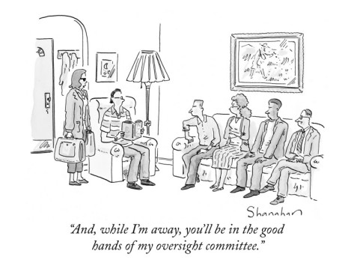

Slide 9

COC’s Scope of Authority
Ensuring bond revenues are expended only for construction, reconstruction, rehabilitation, or replacement of school facilities. (Article XIIIA, Section 1(b)(3) of the California Constitution.)
Ensuring no funds are used for any teacher and administrative salaries or other school operating expenses.
(Article XIIIA, Section 1(b)(3)(A) of the California Constitution.)

Slide 10
COC Activities
Review annual, independent financial and performance audits performed by an independent consultant.
Inspect school facilities and grounds to ensure that bond revenues are expended in compliance with law.
Review any deferred maintenance proposals or plans.

Slide 11

COC Activities (continued)
Review District efforts to maximize bond revenues through implementation of cost-saving measures:
  Professional fees
  Site preparation
  Joint use of facilities
  School site design efficiencies
  Reusable facility plans

Slide 12
Technical Assistance to COC
District’s Board to provide technical and administrative assistance to COC, such as:
  Website information posting.
  Brown Act agendas and minutes.
  Financial and progress reports.
  Submit independent financial and performance audits at same time as to District, no later than March 31st.
  Respond to findings, recommendations and concerns addressed in audits within 3 months.

Slide 13
Permissible Uses of Bond Proceeds
Construction, reconstruction, rehabilitation or replacement of school facilities
Furnishing and equipping of school facilities
Acquisition or lease of real property
Note: All projects must be within scope of project list adopted by Board as part of the measure

Slide 14

COC Legal Compliance
The Brown Act
(Government Code section 54950 et seq.)
Conflicts of Interest

Slide 15
The Brown Act
Government Code Section 54950 et seq.
Aka: The Sunshine Law
Or
The Open Meetings Law
REQUIRES THE PEOPLES’ BUSINESS TO BE CONDUCTED IN THE OPEN
Notes:
15

Slide 16
Basic Requirements
Posting of 72 Hour Notice
Agendas
Public Access
Right of Citizens to Speak
Notes:
16

Slide 17
Basic Requirements (cont.)
Limit on Closed Sessions
(None for C.O.C.’s)
No Secret Meetings
No Action on Items not on Agenda
Materials Considered at Meetings Must be Made Available to Public
Notes:
17

Slide 18

The Brown Act: Public’s Rights
Any person attending may videotape unless disruptive.
Agenda must allow comment on agenda items before or during consideration of that item.
Time must be set aside for public comment on any other matters under the COC’s jurisdiction.
The COC may place reasonable time limitations on particular topics or speakers.

Slide 19

Violations of the Brown Act can lead to criminal charges
Notes:
19

Slide 20
Conflicts of Interest
Laws that control conflicts of interest of California public officials:
  Section 1090 (Gov. Code, section 1090, et seq.)
  PRA (The Political Reform Act of 1974; Gov. Code, sec. 87100, et seq.)
  Incompatible Offices (Gov. Code, sec. 1125, et seq.)
  Common Law Conflict of Interest
Section 1090 and Incompatible Offices statutes are made applicable to COC members by Education Code section 15282(b).

Slide 21
Membership Conflicts of Interest
COC may not include as Members:
  Employees/Officials of the District
  Vendors of the District
  Contractors/Consultants of the District
Members’ immediate family should also be independent
Notes:
21

Slide 22

Conflicts of Interest: Section 1090
Prohibits public officials/employees from participating in the process by which a contract is developed, negotiated, or executed if the official or employee has a financial interest in the contract.
These contracts are void and cannot be enforced. (Gov. Code, § 1092.)

Slide 23
Conflicts of Interest:
Incompatible Offices
Prohibits public officials/employees from engaging in any employment, activity or enterprise for compensation that is inconsistent, incompatible, in conflict with or inimical to their duties as public officials/employees.

Slide 24

Questions?

Slide 25
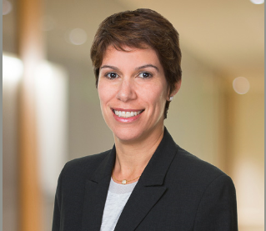
Thank you!
Meredith B. Johnson
Dannis Woliver Kelley
Tel │ 213.291.9144
Email │ mjohnson@DWKesq.com

