Slide 1
BATH COUNTY SCHOOLS
2024-2025
Tax Hearing
www.bath.kyschools.us
SEPTEMBER 26, 2024

Slide 2
Public Service Announcement
Homestead Exemption
In Kentucky, homeowners who are least 65 years of age or who have been classified as totally disabled and meet other requirements are eligible to receive a homestead exemption.
The value of the homestead exemption for the 2023-2024 assessment years is $46,350. This amount is deducted from the assessed value of the applicant's home and property taxes are computed based upon the remaining assessment.
For example, if the applicant's residence is assessed at a value of $100,000, property taxes would be computed on $53,650 ($100,000 – $46,350).
The amount of the homestead exemption is recalculated every two years to adjust for inflation.​

Slide 3
5,455 Homes in Bath County
House Value | Percentage of Homes | # Homes
Less than $50,000 | 18.3% | 995
$50,000 - $99,999 | 31.3% (49.6%) | 1703
$100,000 - 149,999 | 18.6% | 1012
$150,000 - $199,999 | 13.3% | 723
$200,000 - $299,999 | 12.3% | 668
$300,000 - $499,999 | 5.4% | 291
$500,000 - $999,999 | .9% | 48
$1,000,000 or more | .1% | 5
49.6% of all houses in Bath County are valued at or below $100,000.
Data from 2020 Census
Notes:
Data from 2020 Census
5,455 Homes in Bath County
Roughly 50% of homes are valued at $100,000 or less
We will use $100,000 as the standard since it is the median price
FYI: Approximately 83% of all homes in Bath County are under $200,000

Slide 4
Understanding Your Tax Rate
Property Assessment
Multiplied by Rate: 64.1
Amount You will Pay
$100,000
.00641
$641
Notes:
Using $100,000 as our assessment since it is the median home value
The math is very simple, take the rate of 64.1 and move the decimal to the right. This is the amount you pay.
For calculations take any amount and times it by .00641 to get the amount you would pay.

Slide 5
Current Rate vs Requested Rate
61.7
57.8
64.1
60.7
Nickel
Default 4%
Requested Rate
Default 4%
This rate is up for vote on November 5, 2024
This is the current rate pending the election
Rate requested should the Nickel fail at November election
Rate is non-recallable.
3.4 cents below the Requested Rate of 64.1
Notes:
61.7 is the 2022-23 requested nickel rate
All taxpayers have paid the default rate of 57.8. If the nickel passes in November the taxpayers will pay the additional 3.9 cents on next years bill.
Requesting the board approve the rate of 64.1 for 2024-25. This is above the 4% rate of 60.7 and 3.4 cents will be recallable.
60.7 is the default rate should 64.1 fail OR the board could choose to take the 4% and it would be the rate for 2024-25.

Slide 6
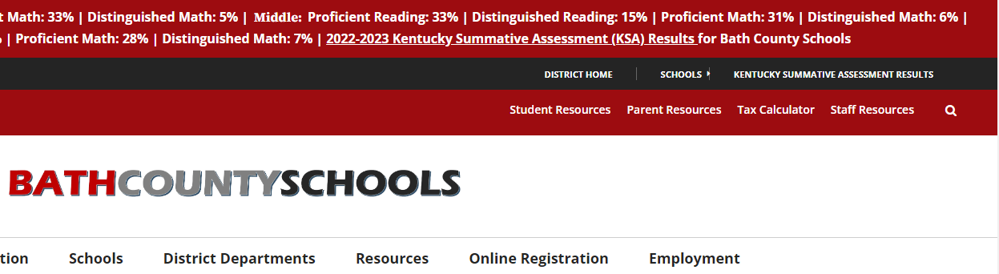
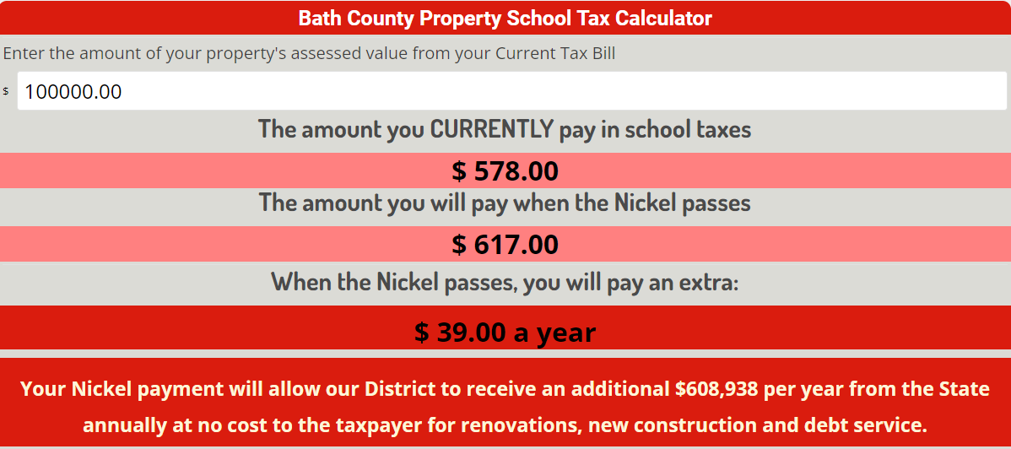
Tax Calculator
Notes:
On our district webpage we have a Tax Calculator link.
Clicking that link will take you to the calculator you see below.
This calculator is set for the current year. You see $100k has been entered as the property assessment. You have already paid the $578 for 23-24 (rate 57.8) and if the nickel passes in November the rate will adjust to 61.7 requiring the taxpayer in this scenario to owe an additional $39.
Note on the bottom that if the nickel passes the state will provide an additional $609,938 to the district for the next 20 years for construction, renovation and debt service. This is extremely important and will demonstrated in following slides.

Slide 7
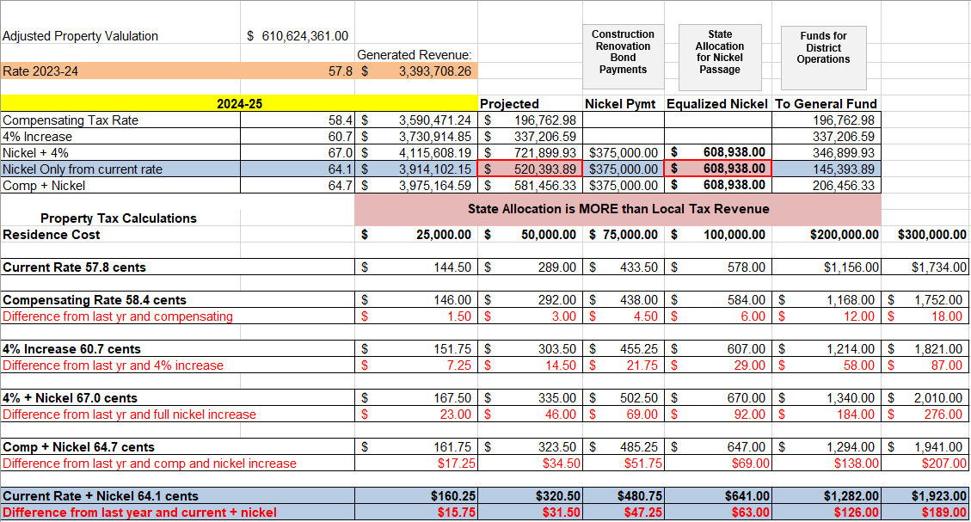
Notes:
This is the assessed property valuation as determined by the Bath PVA.

Slide 8
Notes:
Based on the rate of 57.8 generated revenue is projected at $3.3 million

Slide 9
Notes:
FYI: All rates are established by the state
The board has several options for tax rate
They can take the compensating rate of 58.4. This rate is designed to generate a revenue stream as close to last year with inflation factored in.
This rate would bring in a projected $196,762.08 to our general fund.
The 4% rate of 60.7 generate 4% more revenue from last year’s total.
This rate would bring in a projected $337,206.59 to our general fund.
The 4% rate is the highest rate a board can take and it not be recallable. Of non-recallable rates it puts the most money into the general fund.
All rates above 4% are recallable. *Only the amount above 4% is recallable, not the whole amount.
The board advertised 64.1 and cannot choose a rate higher than 64.1. This eliminates the Nickel + 4% and the Compensating + Nickel so we will not discuss those here.
The Nickel + Current rate of 64.1 will be discussed on the next slide.

Slide 10
Notes:
64.1 is projected to bring in an additional $520,393.
A nickel tax requires a local effort payment of $375,000. This is taken from the $502,393 collected from taxes. The $375,000 can only be used for Construction, Renovation, and Debt Service
The remaining $145,393.89 will go to the general fund.
The magic of the nickel is that the state, through equalization, will give the district $608,938 for the next twenty years. (Over $12 million)
This amount will also increase over time creating even more funds from the state for our district. Last year equalization was $477,000
Please note that the local taxpayer revenue of $520,393 is exceeded by the state’s $608,938 ($88,545 more from the state)
Because of this additional revenue our bonding potential, how much we can borrow, increases by $15 million dollars immediately. This is how we will be able to pay for the middle school and all future projects.

Slide 11
Notes:
If the 64.1 rate passes you can see here how much you would pay.
Using our $100k median 50% of Bath County homeowners would pay up to $63 more dollars than the previous year.
This breaks down to $5.25 more per month.
Your $63 dollars allows the district to receive $27 million for current and future projects. ($15 million in bonding plus $12 million in equalized funding over the life of the tax)

Slide 12
Rate Overview
Why request a Nickel Tax?
With our district facing more than than $65 million in needed improvements, including $35 million for a new middle school, a Nickel tax is the only solution to this financial issue. Construction prices have risen over 51% since 2007. The Nickel tax will increase our bonding by $15 million and the state will provide an additional $600K to our district for the next 20 years. The Nickel also makes our district eligible for “Gap Funding” providing the opportunity to receive millions in additional funding from the KY legislature.
Notes:
Read the slide
Construction costs have risen over 51% since 2007. They will continue to rise.
Even if the district if forced to renovate the middle school it will not have the funds to address the needs.
Renovation will simply push the inevitable demise of the middle school a little bit further down the road.
When that time comes and a new school is the only option the cost of the new school will be 10-20 million more than if we built this year.
For perspective, the original costs of a new middle school several years ago was 15-20 million, today we are looking at 35-45 million.
Taking the nickel now will save both the taxpayer and the district money.

Slide 13
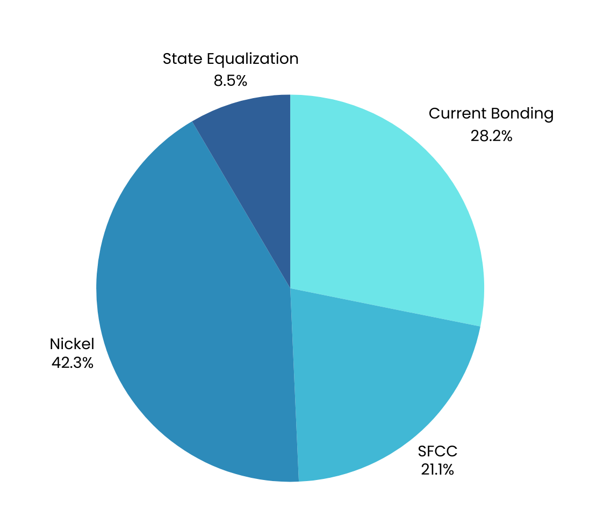
Bonding
How we finance the Middle School
Passing the Nickel will allow our district to allocate over $35 million for a new middle school

Slide 14
Board Leadership to Save the Middle School
As noted on the previous slide, for the Board to meet our financial responsibilities they must seek funding that meets the district need. Unfortunately, if the Nickel does not pass they must seek a higher tax rate to offset the issue. The problem is that these rates will NOT produce the needed funds necessary to cover required cost. This in turn creates a cycle of increasing the tax rate to simply maintain the status quo. In pursuing the Nickel this Board has demonstrated strong leadership by doing what is necessary for the betterment of the district even though it is not popular. I applaude them for their efforts and thank them publicly for their dedication to this district, our students, and this community.
Notes:
Read slide

Slide 15
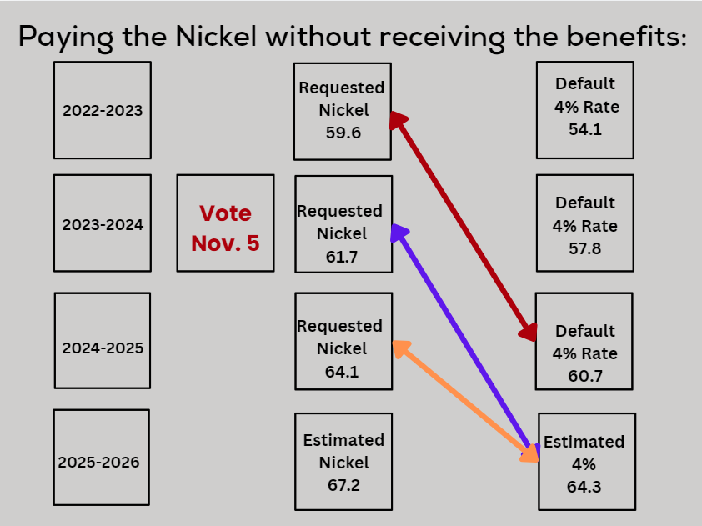
If the Nickel fails you still pay the Nickel
By 2025-2026 every requested Nickel rate will have been surpassed if the 4% rate is taken.
Notes:
In 2022-23 the board requested a nickel at the rate of 59.6. A recall petition was gathered and the board rescinded the nickel and accepted the default 4% rate of 54.1
Last year, 23-24, the board requested a nickel at the rate of 61.7. A recall petition was gathered and the board opted to put it to a vote this November.
The default rate of 57.8 was applied to taxpayers and should the nickel pass in November taxpayers will owe an additional 3.9 cents per $100k. This will be applied to next year’s bill.
Here is what everyone must understand, due to the districts $65 million in unmet need, without the nickel this board is trying to just maintain and not improve our properties due to the high cost of construction. As noted earlier the 4%, while it brings in the most money from non-recallable taxes, cannot provide the funds necessary going forward. But if the nickel is continued to be defeated the 4% is the ONLY tax they can and must take.
If the board approves the requested rate of 64.1 or opts to take the 4% rate of 60.7 both those rates will be greater than the 22-23 requested nickel.
If the board takes the 4% this year and next year the rate of 64.3 would be greater than all three previous requested nickel rates.
Understand, opposing the nickel only prevents the district from receiving an enormous amount of financial assistance from the state. It will not prevent the local taxpayer from eventually paying the nickel rate.
On the next slide I will show how opposing a higher tax rate actually increases your taxes faster.

Slide 16
Opposing the Nickel Raises Tax Rates 2-3 Times Faster.
  From 2014-2022 (8 years) the tax rate went from 44.2 to 52.4, an increase of 8.2 cents.
    (An average of 1.03 cents per year.)
  From 2023-2025 (3 years) the tax rate will have went from 54.1 to 64.1, an increase of 10 cents if the 24-25 Nickel passes.
    (An average of 3.33 cents per year.)
  OR 54.1 to 60.7 should the rate default to the 4%.
    (An average of 2.2 cents per year.)
  Simply stated, by opposing the Nickel, the rate is increasing at a rate of 2 to 3 times faster per year due to the Board attempting to make up for needed funding.
Notes:
No one wants to increase taxes. Not the community, not the board, nor me. But it requires taxes to run a school and the state is shifting more and more of the burden to districts than ever before.
Looking at the slide it may sound counterintuitive to say opposing a tax increases the rate, but this is a cold hard fact.
Read slide
If the nickel is passed the board can return to the average rate of 1.03 cents. If the nickel fails the board will be forced to take the 4% at a much higher rate causing taxes to increase at a much quicker and more significant rate.

Slide 17
Passing the Nickel will lower your taxes
The district has financial responsibilities
The district is responsible for salaries of employees, buses, fuel, electricity, water, sewer, HVAC, roofing, parking lots, waste management, lawn care, etc. We have a general fund operating budget of $5 million dollars. These financial responsibilities consume over 90% of our budget. There are very limited funds for renovations and new construction. By approving the Nickel the district receives a guaranteed revenue solely allocated for new construction, renovation, and bond payments. By allowing the district not to dip into the general fund to help pay for construction projects we will have more money available to meet our financial responsibilities and in turn the Board will be able to seek a lower tax rate and still be able to meet the financial needs of the district.
Notes:
Read slide

Slide 18
Final Message to Taxpayers
Nickel | Pace | Opposing the Nickel Increases the Tax Rate | Gesture of Good Will
Passage of the Nickel tax is the only option to ensure our facilities can be improved and maintained for the long term. Costs will continue to rise and our current tax rates cannot keep pace. | How important is the Nickel? The Board would have to take the 4% tax rate every year for the next 40 years to equal what the Nickel tax would bring to our district this year. | Regardless of whether you support the Nickel tax or not, tax rates always increase over time. You will pay the Nickel rate, but the district will never realize the financial benefits. This in turn will force future Boards to increase the rates more dramatically than if the Nickel had passed. | This Board understands the hardships we are all going through in these tough economic times. If the Nickel should pass in November the Board will revisit the tax rate passed at tonight’s board meeting and adjust the rate down accordingly while also taking considerations to take the compensating rate for the next several years as a show of good will and respect for our citizens.
Notes:
Read slide

Slide 19
BATH COUNTY SCHOOLS
Thank
You
www.bath.kyschools.us
SEPTEMBER 26, 2024

