Slide 1
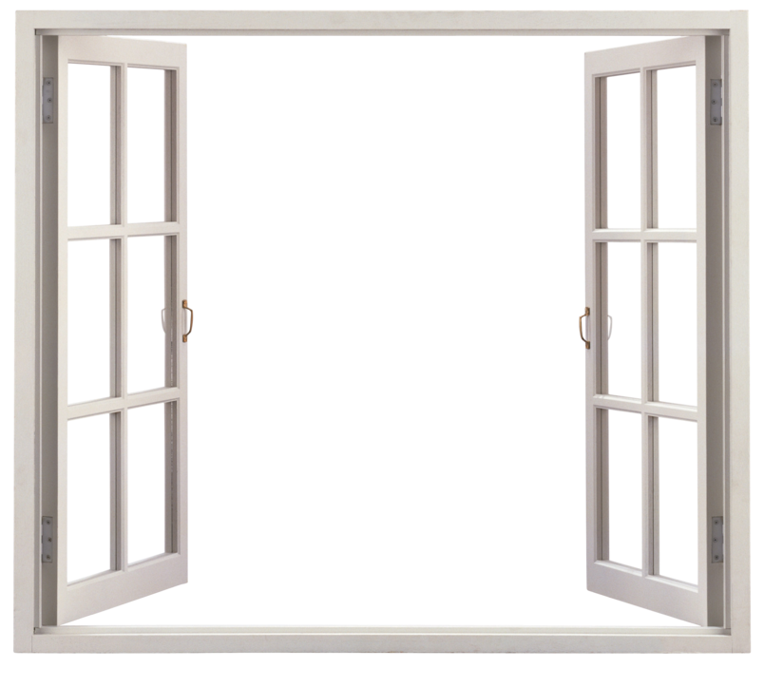

Window into the
Ross Valley School District
Scientific Modeling

Slide 2
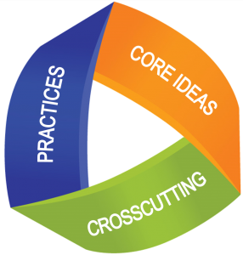
What are the dimensions of effective science instruction?
How are students engaging with the practices?
What science content is being addressed?
What connections are students making?

Slide 3


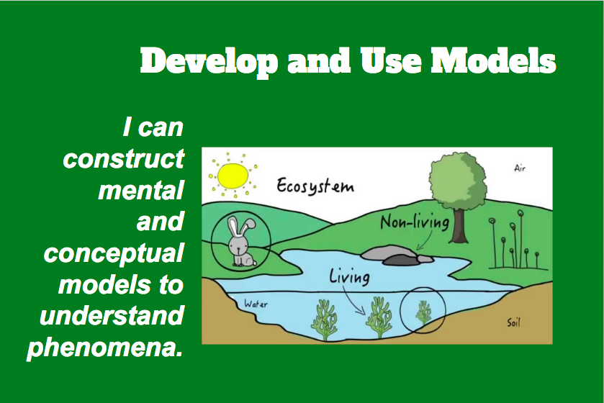
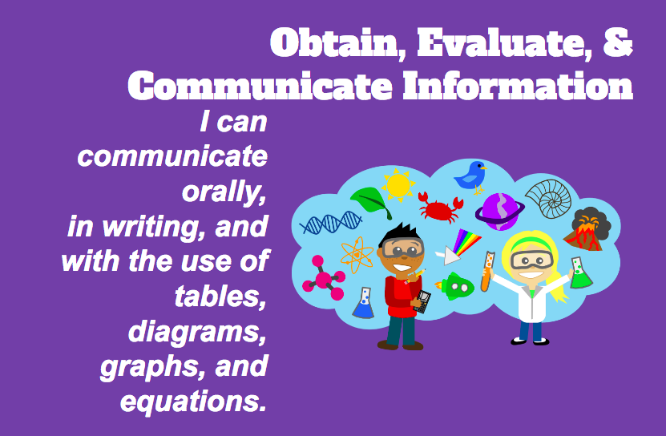
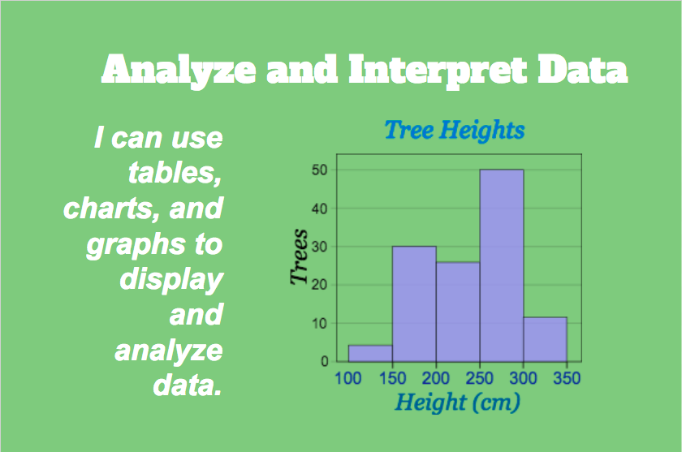
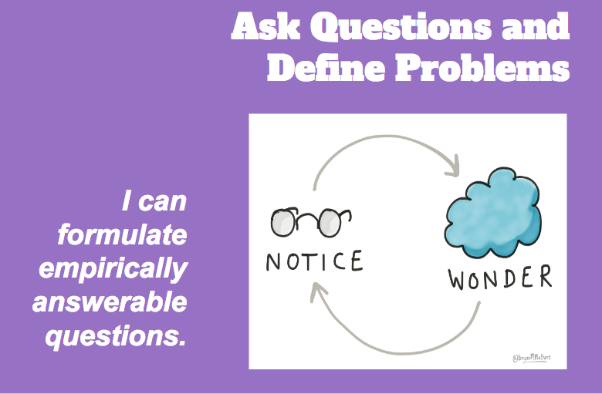
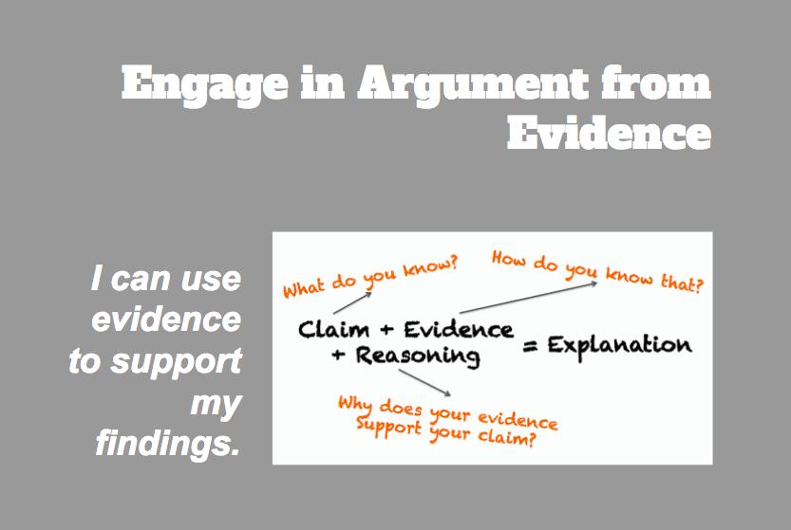
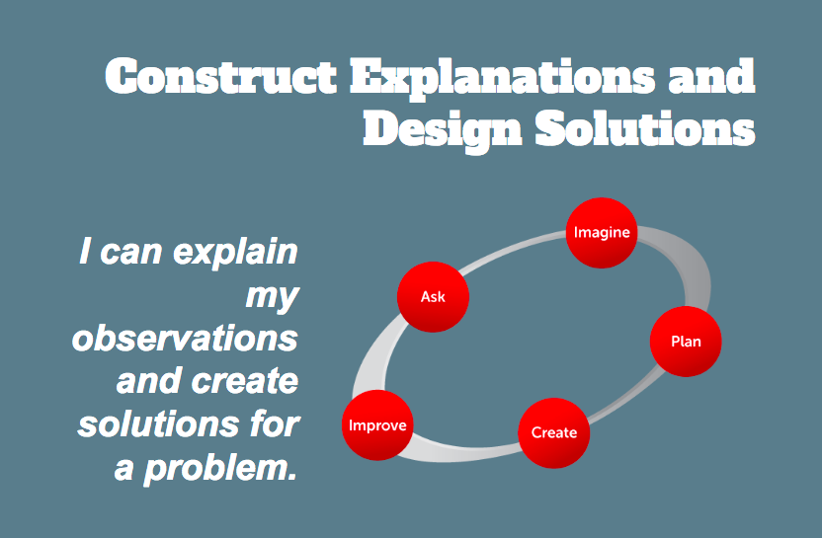
Science and Engineering Practices

Slide 4
Notes:
Talk for a moment about what models are and what they are not.

Slide 5
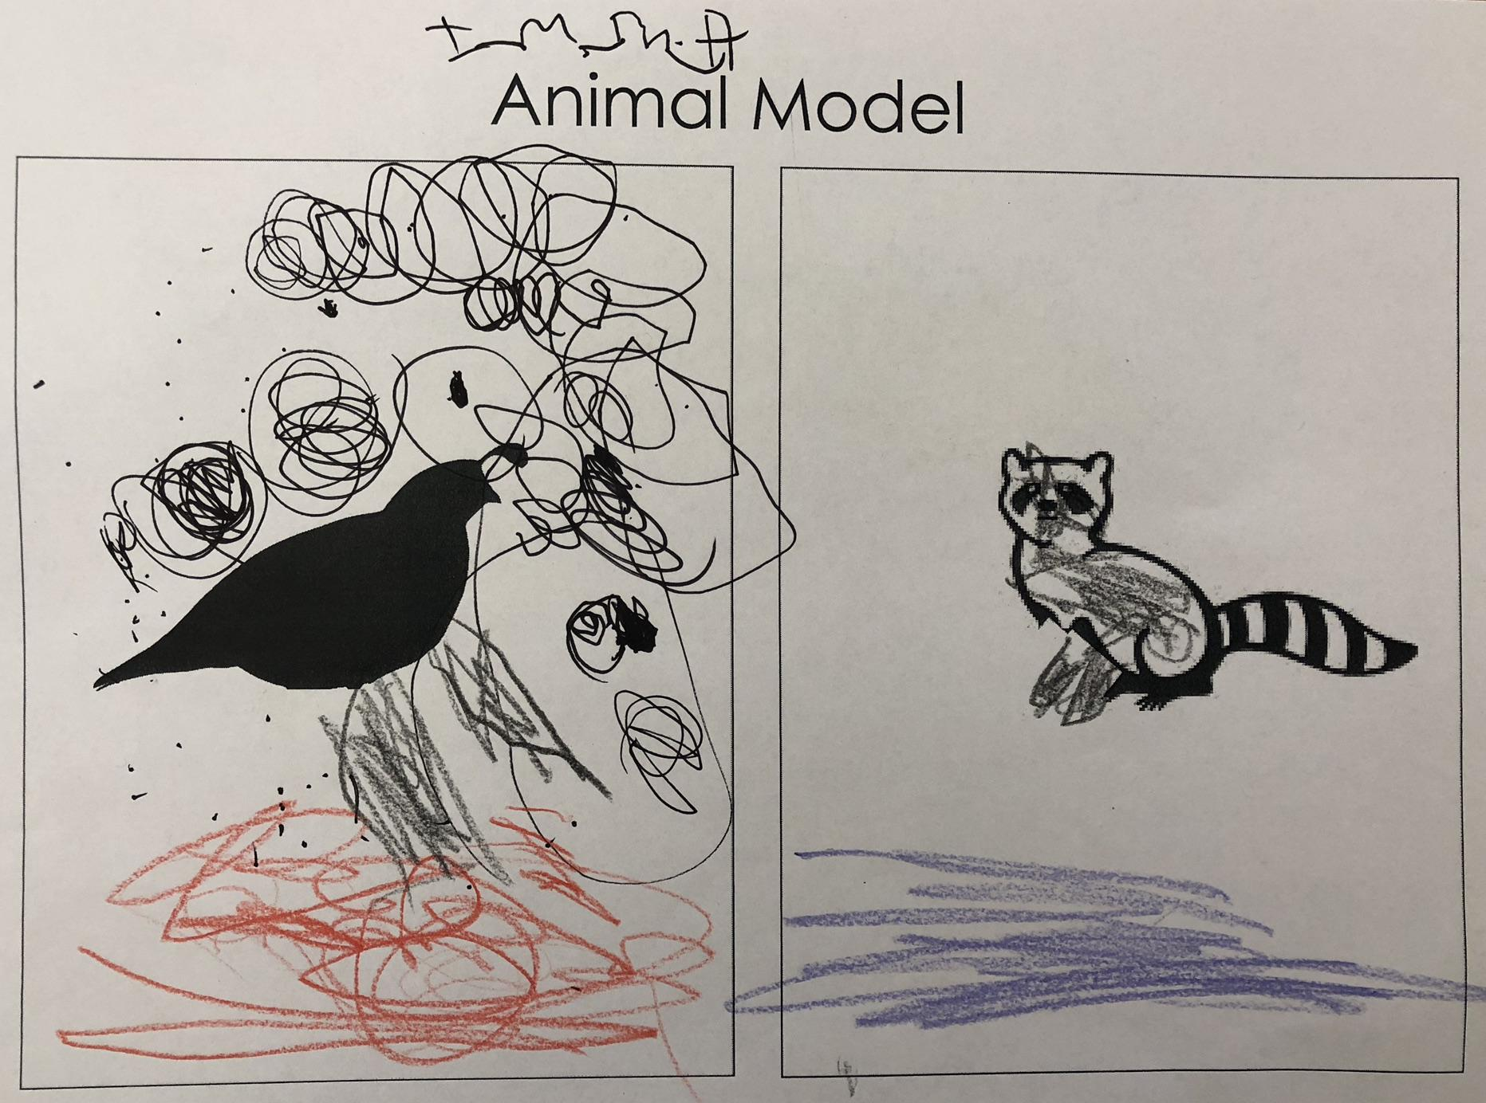
Kindergarten

Slide 6
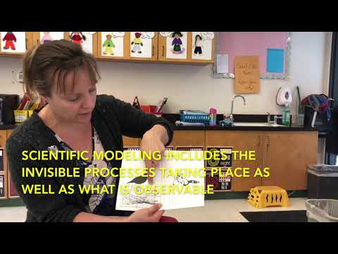
Kindergarten

Slide 7
KLS1.1 Use observations to describe patterns of what plants and animals (including humans) need to survive. ​
Disciplinary Core Ideas (DCIs) | Scientific & Engineering Practices (SEPs) | Crosscutting Concepts (CCC)
Students obtain information through observations of different animal behaviors. They use evidence from their observations to argue for their explanation of why animals are acting in these ways. Students act out the behaviors of different animals. | All animals need food in order to live and grow. They obtain their food from plants or from other animals. Plants need water and light to live and grow. | Patterns in the natural and human designed world can be observed and used as evidence.

Slide 8
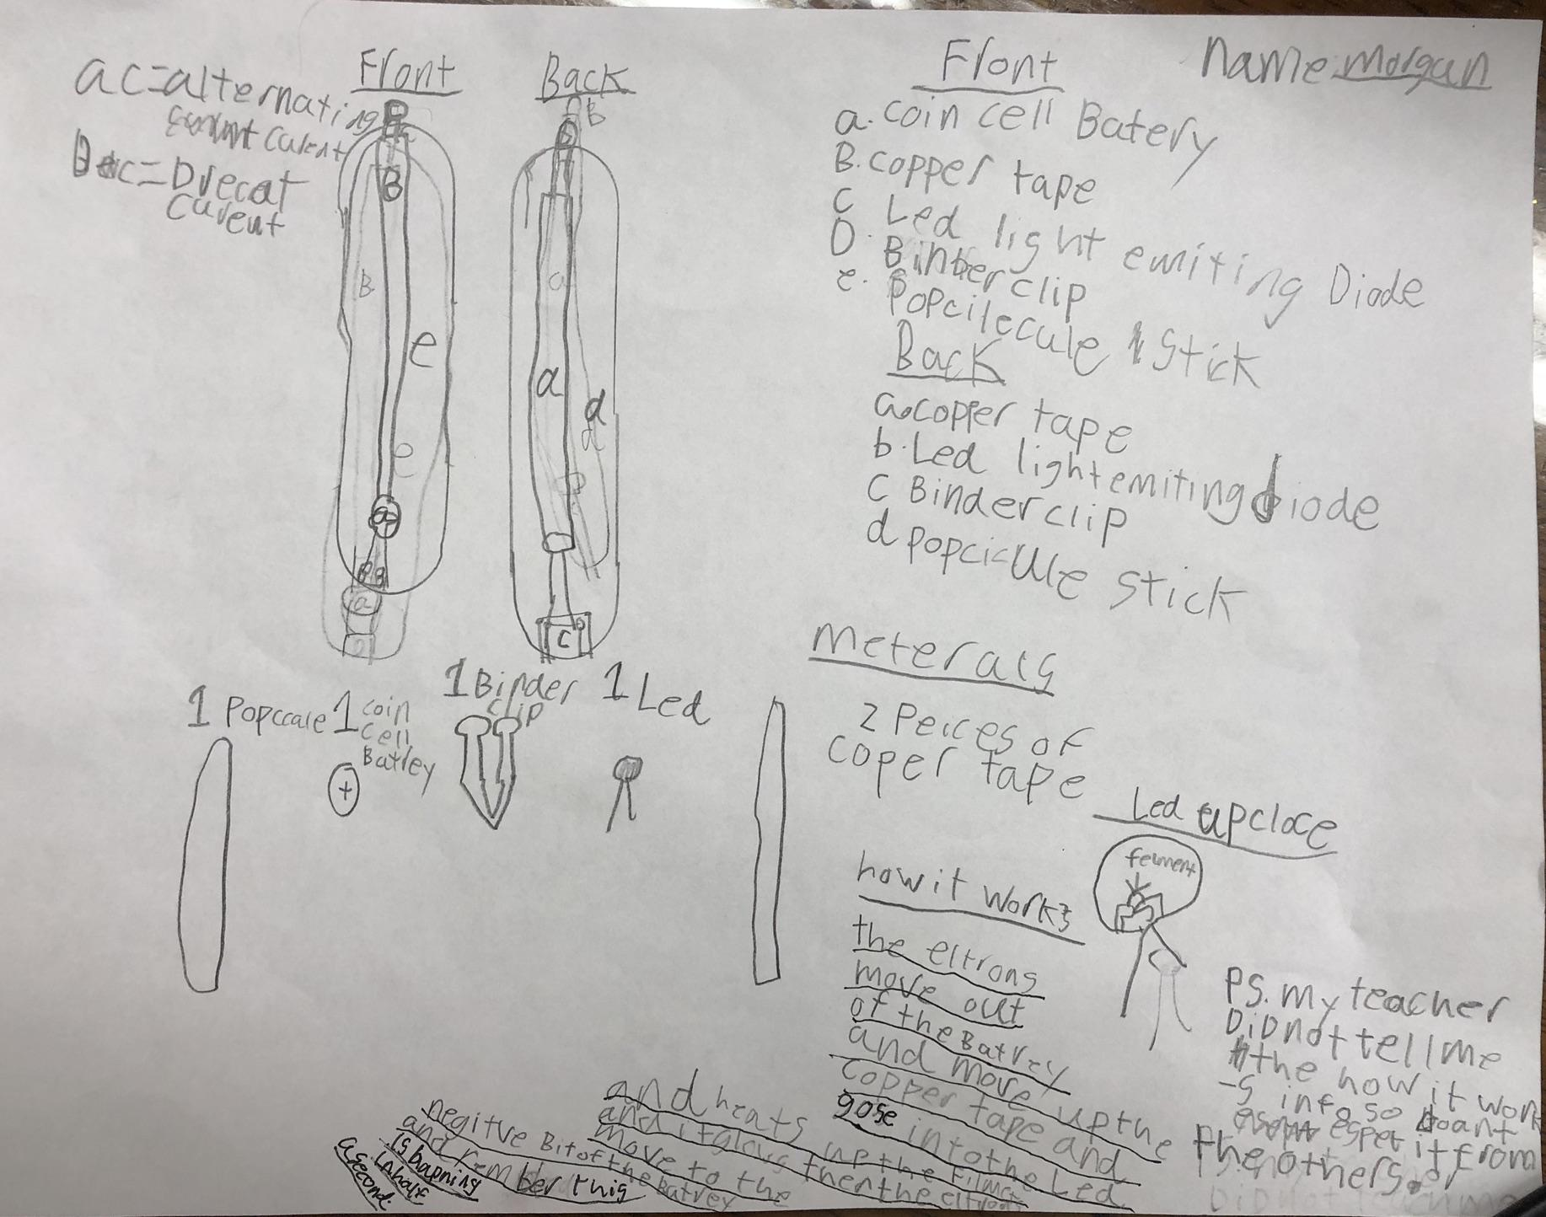
4th Grade

Slide 9
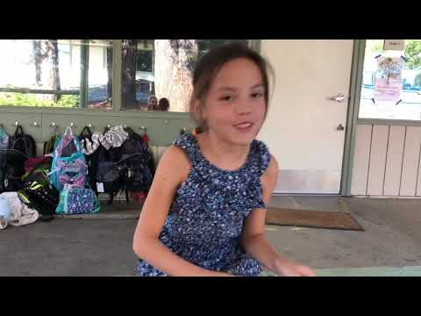
4th Grade

Slide 10
​4.PS3.2 Make observations to provide evidence that energy can be transferred from place to place by sound, light, heat, and electric currents.
Disciplinary Core Ideas (DCIs) | Scientific & Engineering Practices (SEPs) | Crosscutting Concepts (CCC)
Energy can be moved from place to place by moving objects or through sound, light, or electric currents. Energy can also be transferred from place to place by electric currents, which can then be used locally to produce motion, sound, heat, or light. | Make observations to produce data to serve as the basis for evidence for an explanation of a phenomenon or test a design solution. | Energy can be transferred in various ways and between objects.

Slide 11
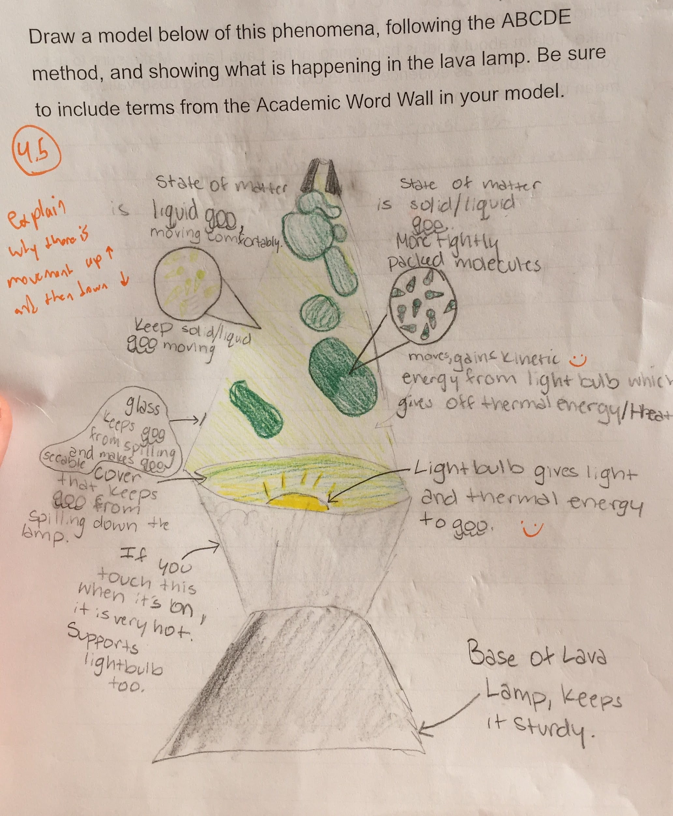
7th Grade

Slide 12
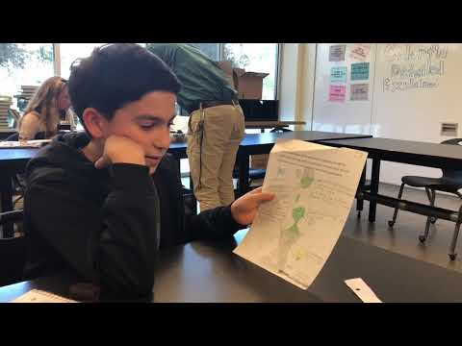
7th Grade

Slide 13
MS.PS1.4 Develop a model that predicts and describes changes in particle motion, temperature, and state of a pure substance when thermal energy is added or removed.​
Disciplinary Core Ideas (DCIs) | Scientific & Engineering Practices (SEPs) | Crosscutting Concepts (CCC)
Gases and liquids are made of molecules that are moving about relative to each other. In a liquid, the molecules are constantly in contact with others; in a gas, they are widely spaced except when they happen to collide. The changes of state that occur with variations in temperature or pressure can be described and predicted using these models of matter. | Modeling in 6–8 builds on K–5 and progresses to developing, using and revising models to describe, test, and predict more abstract phenomena and design systems. | Cause and effect relationships may be used to predict phenomena in natural or designed systems.

Slide 14
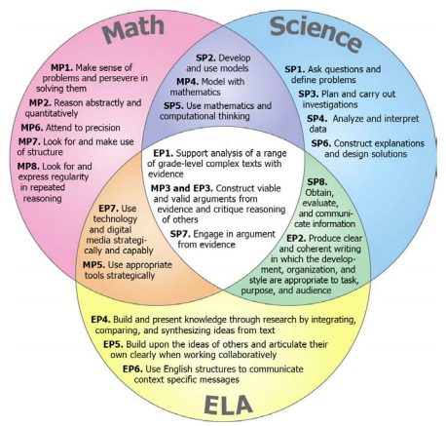
Relationships and Convergences Among Mathematics, Science, and ELA Practices

Slide 15
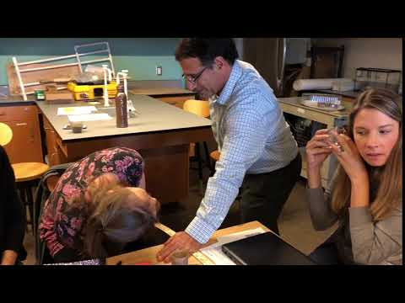
Thank you to our K-5 NGSS Team!
Myrel Jenks
Rebecca Hayhurst
Krista Hood
Krista Tarantino
Susan Ardigo
Ericka Stieg
Danielle Diaz
Lindsay Hess
Jenny Cavanna
Caley Hirsch
Sarah Horky
Nicole Stuart
Notes:
I love this video!

Slide 16
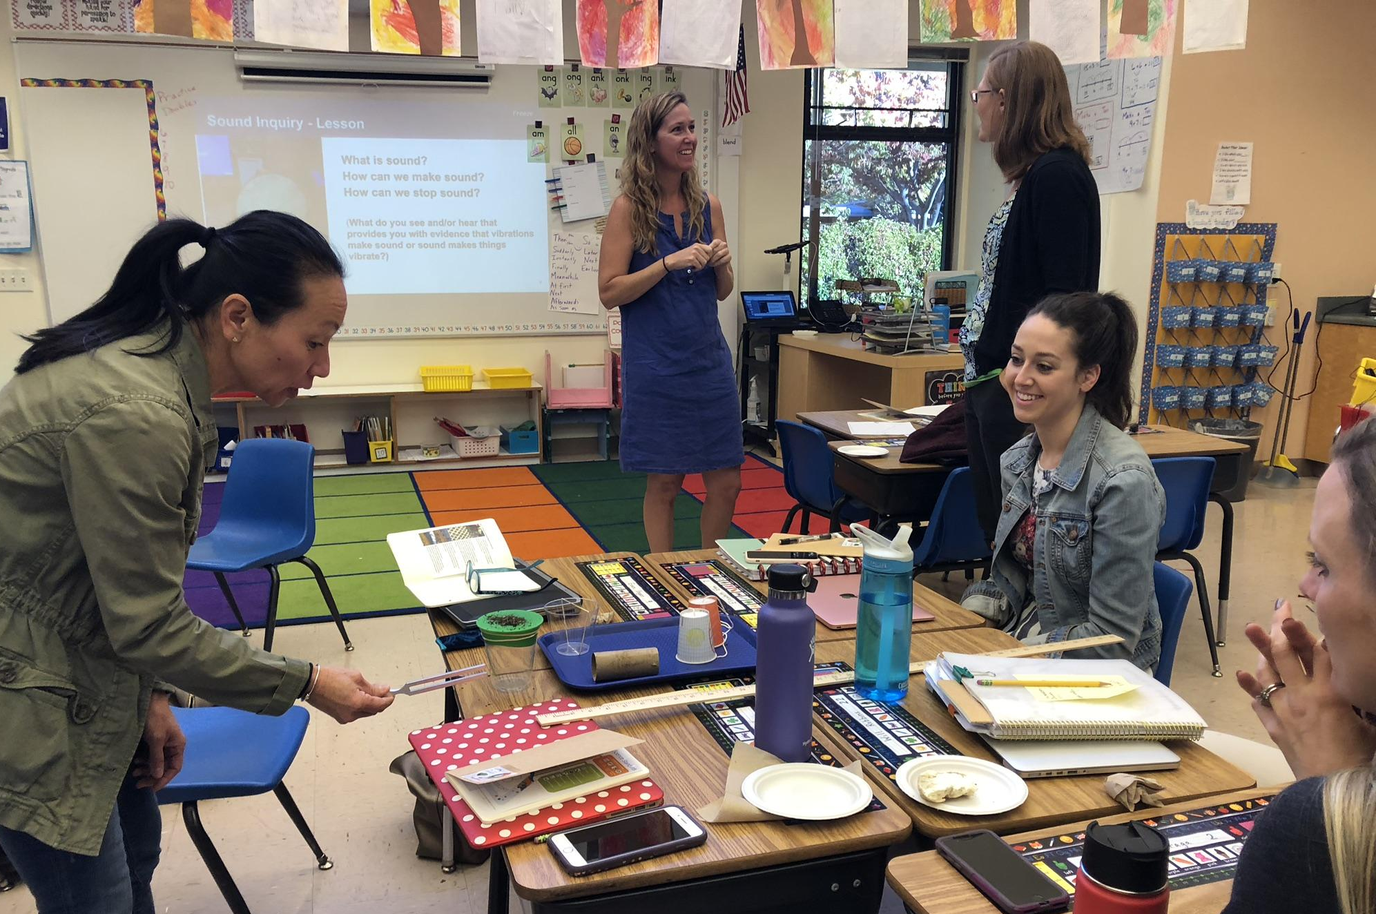
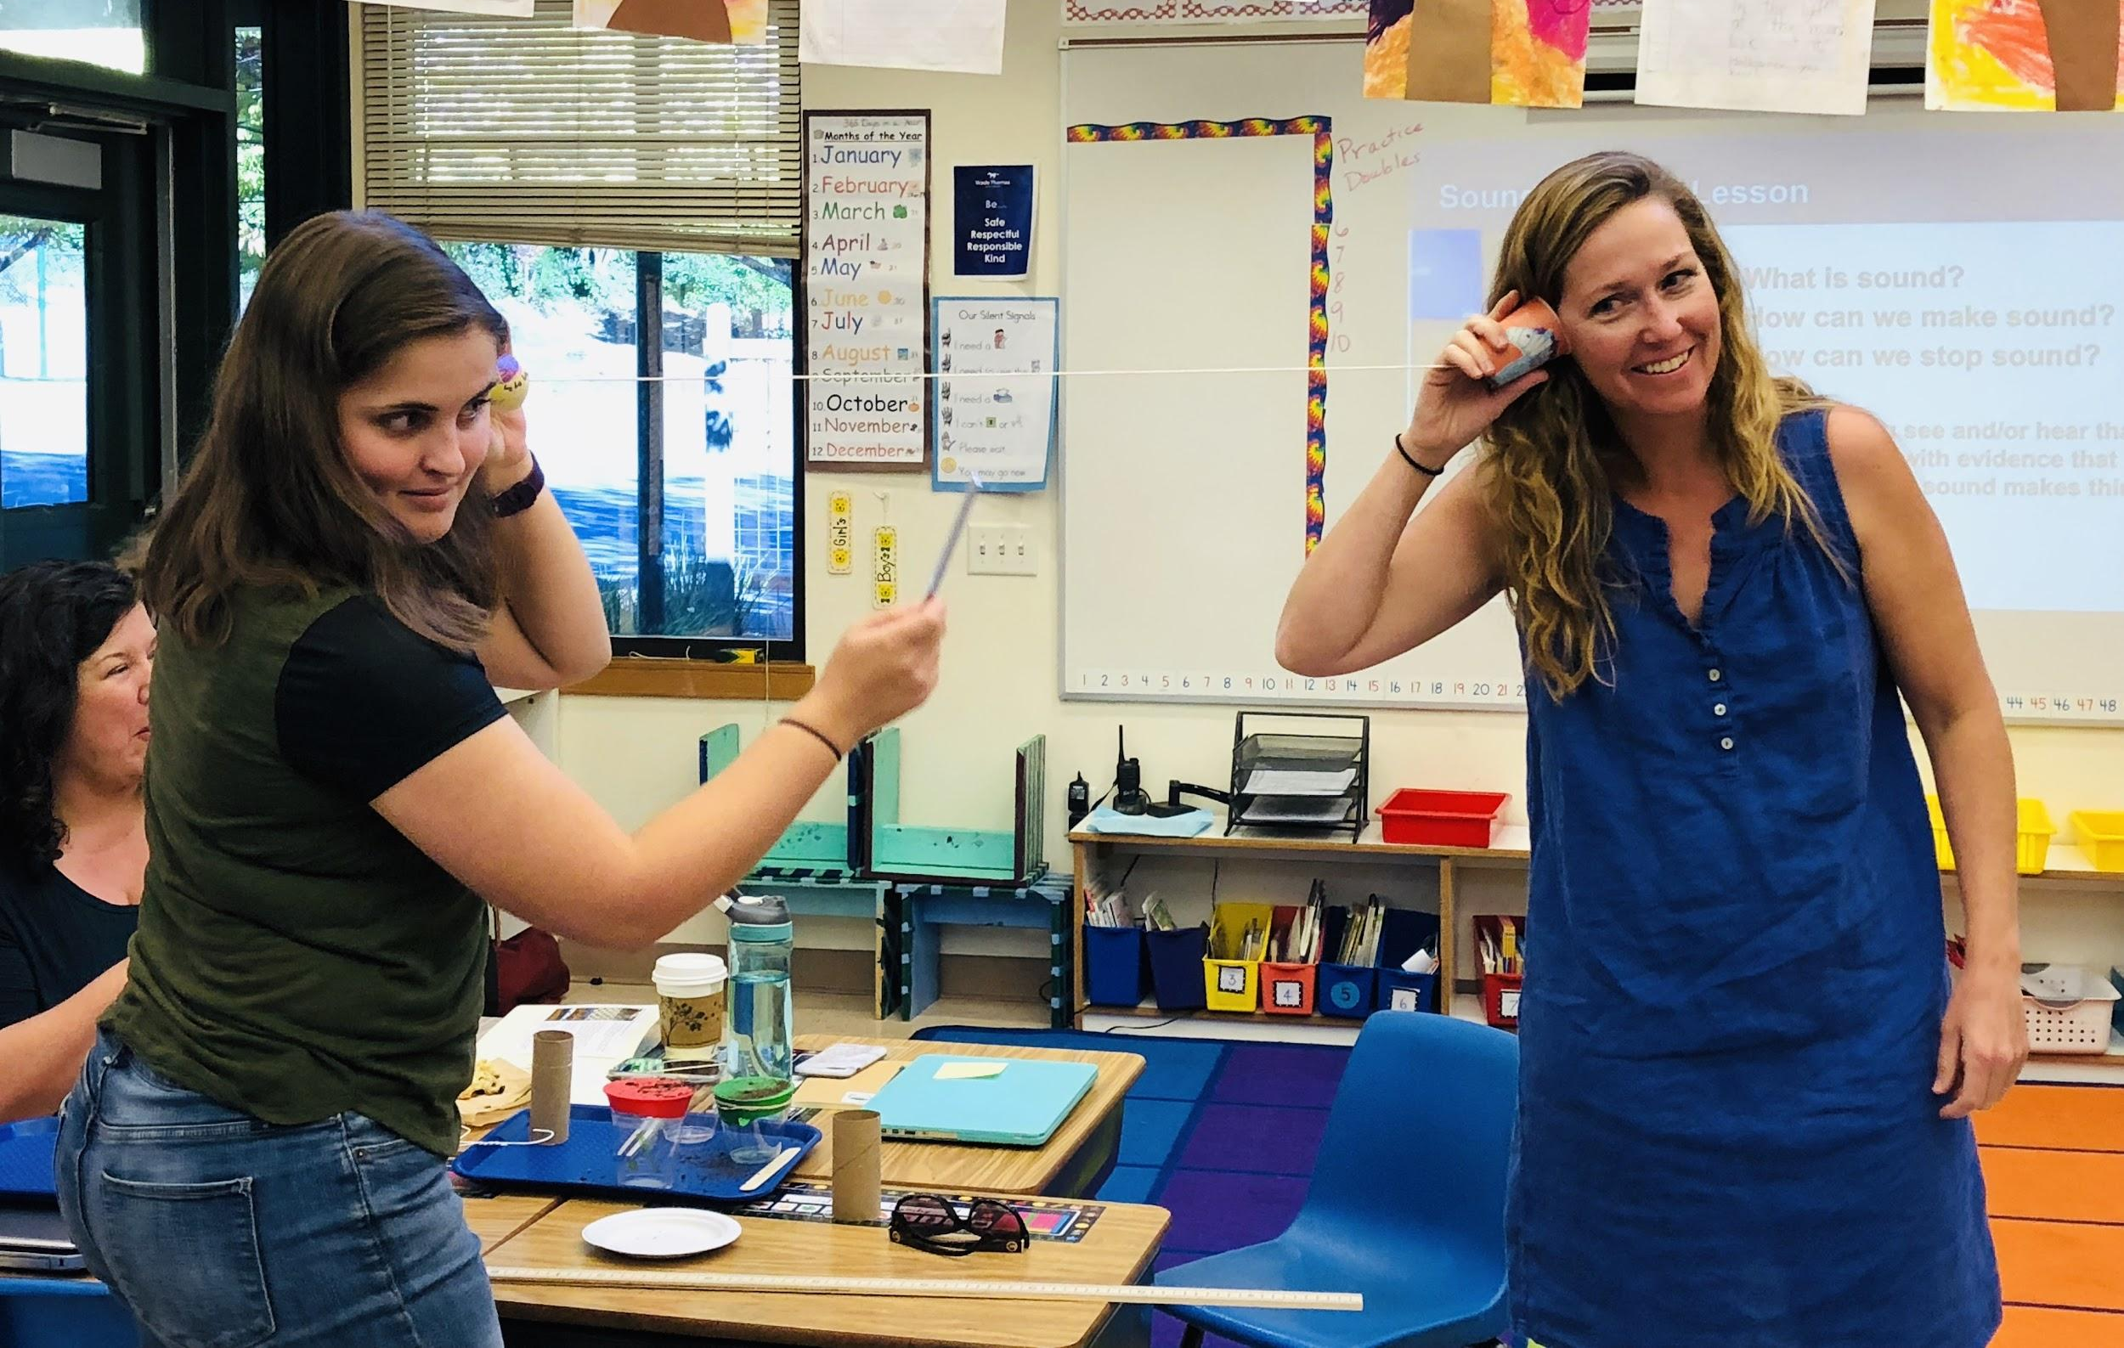
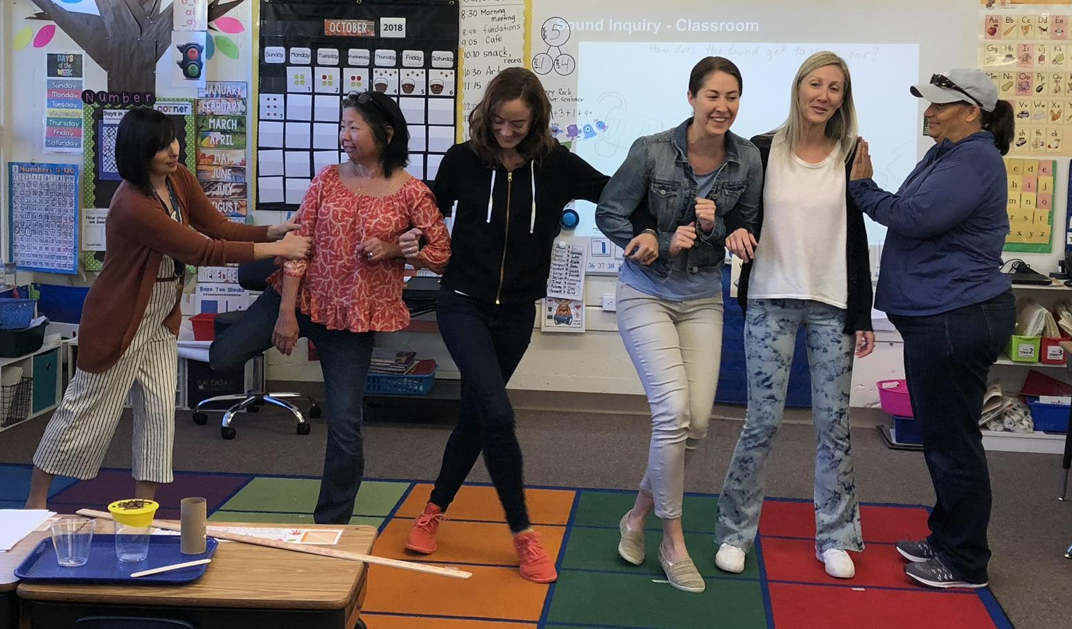
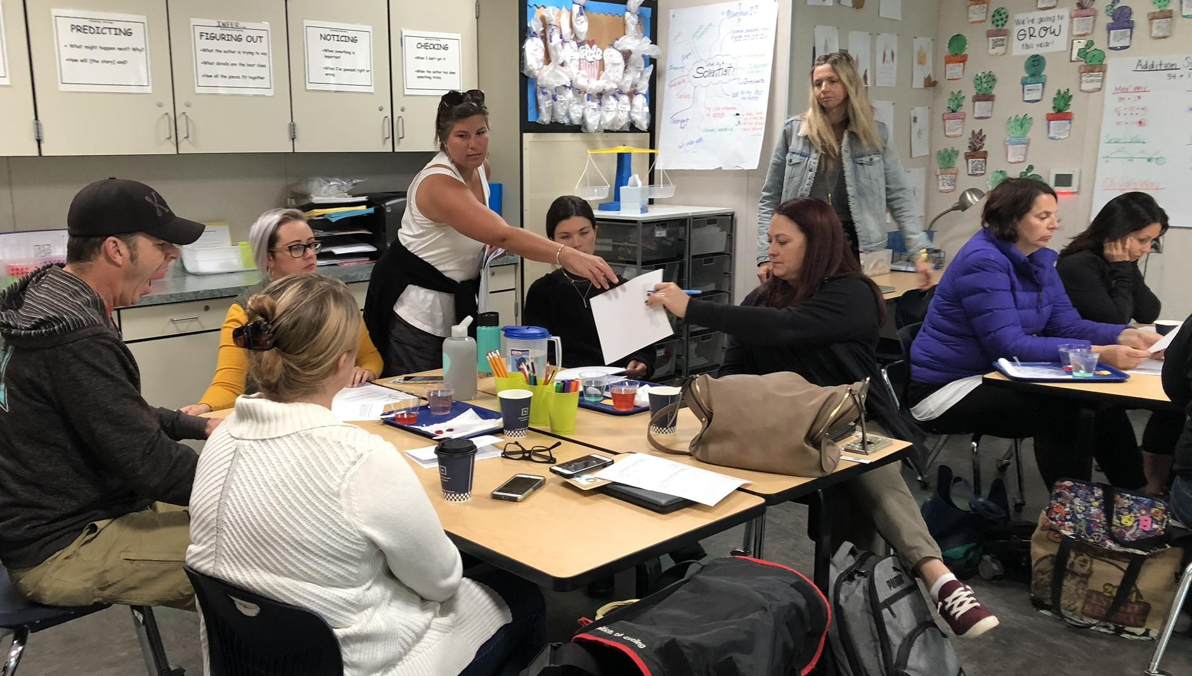
October 8th Staff Development Day: TK - 5th

Slide 17
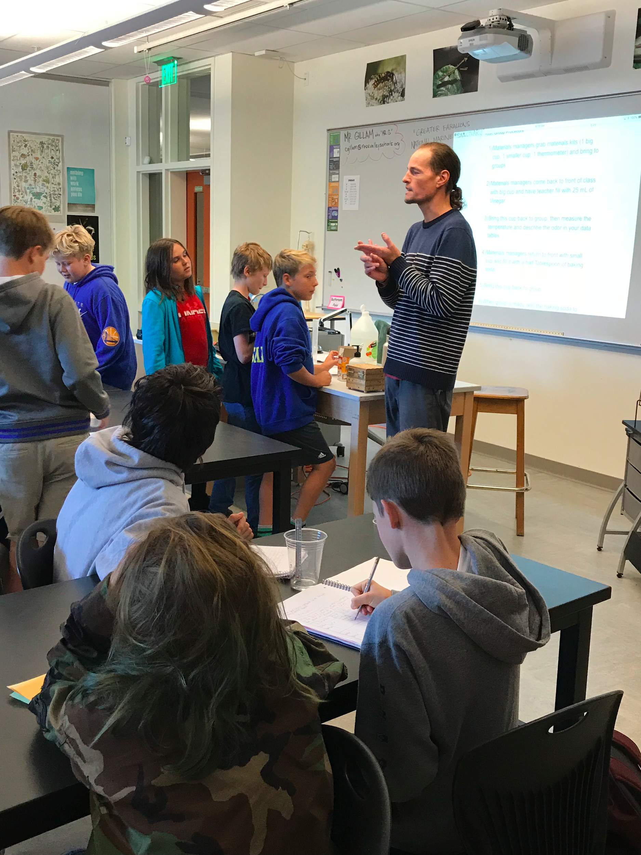
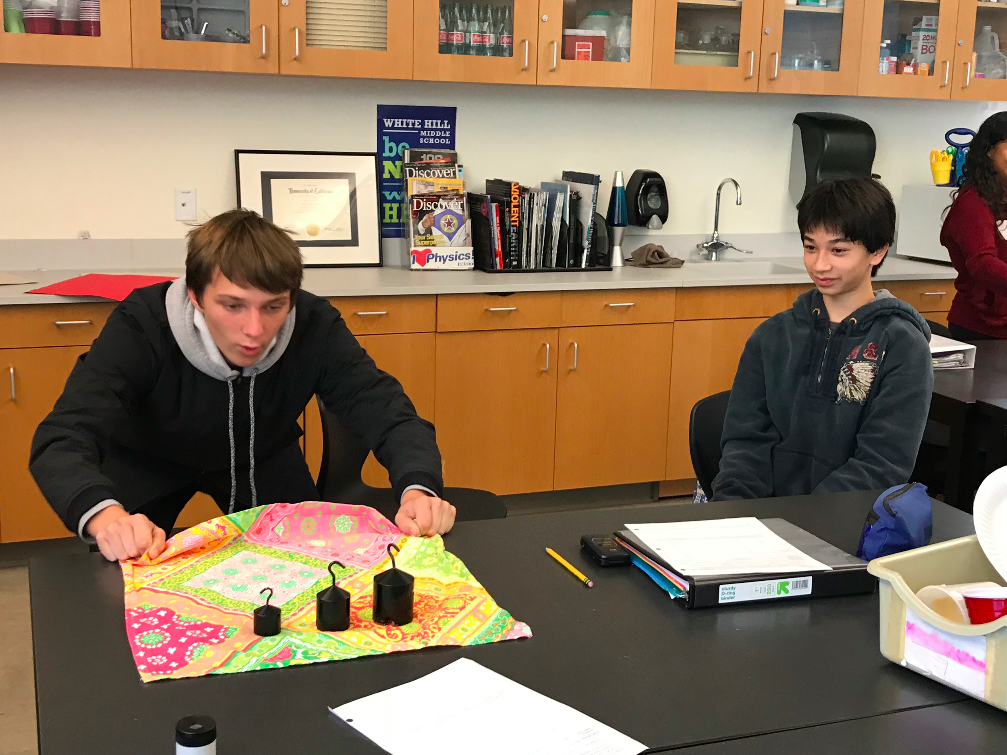
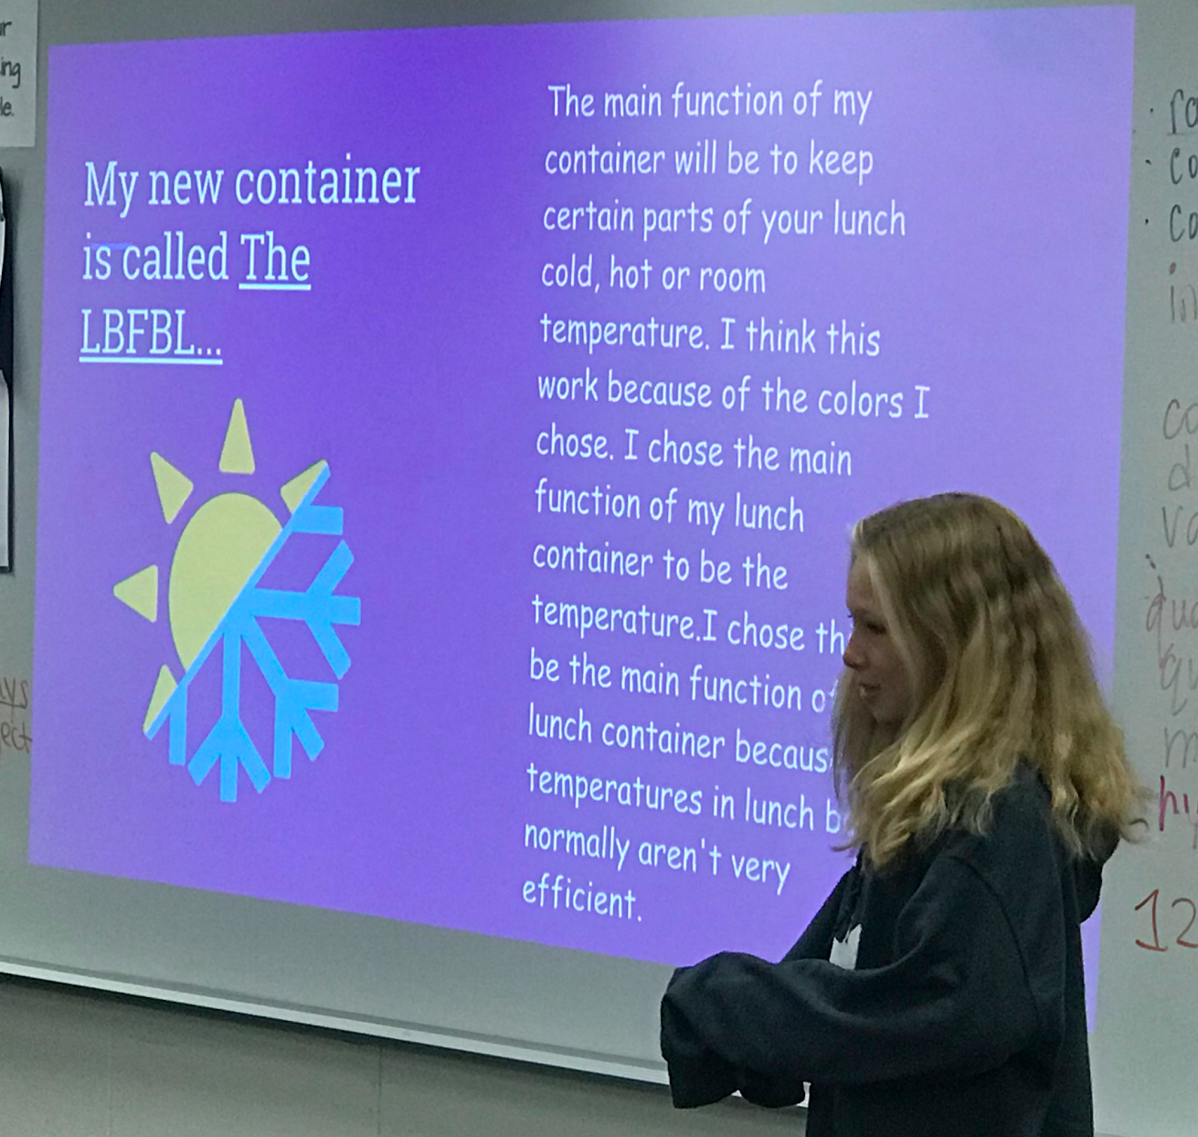
And our White Hill Science Department!
Cade Hardin, dept. head
Heidi Moore
Alex Obenshain
Calder Gillam
Andrea Watson
Mel Hickman
Erin Megary

Slide 18
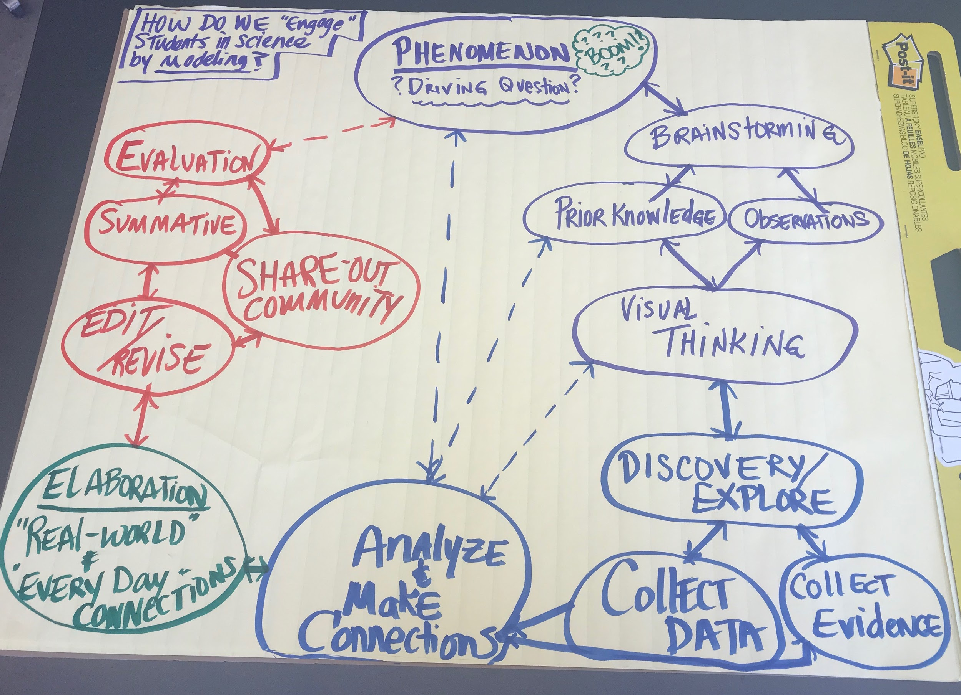
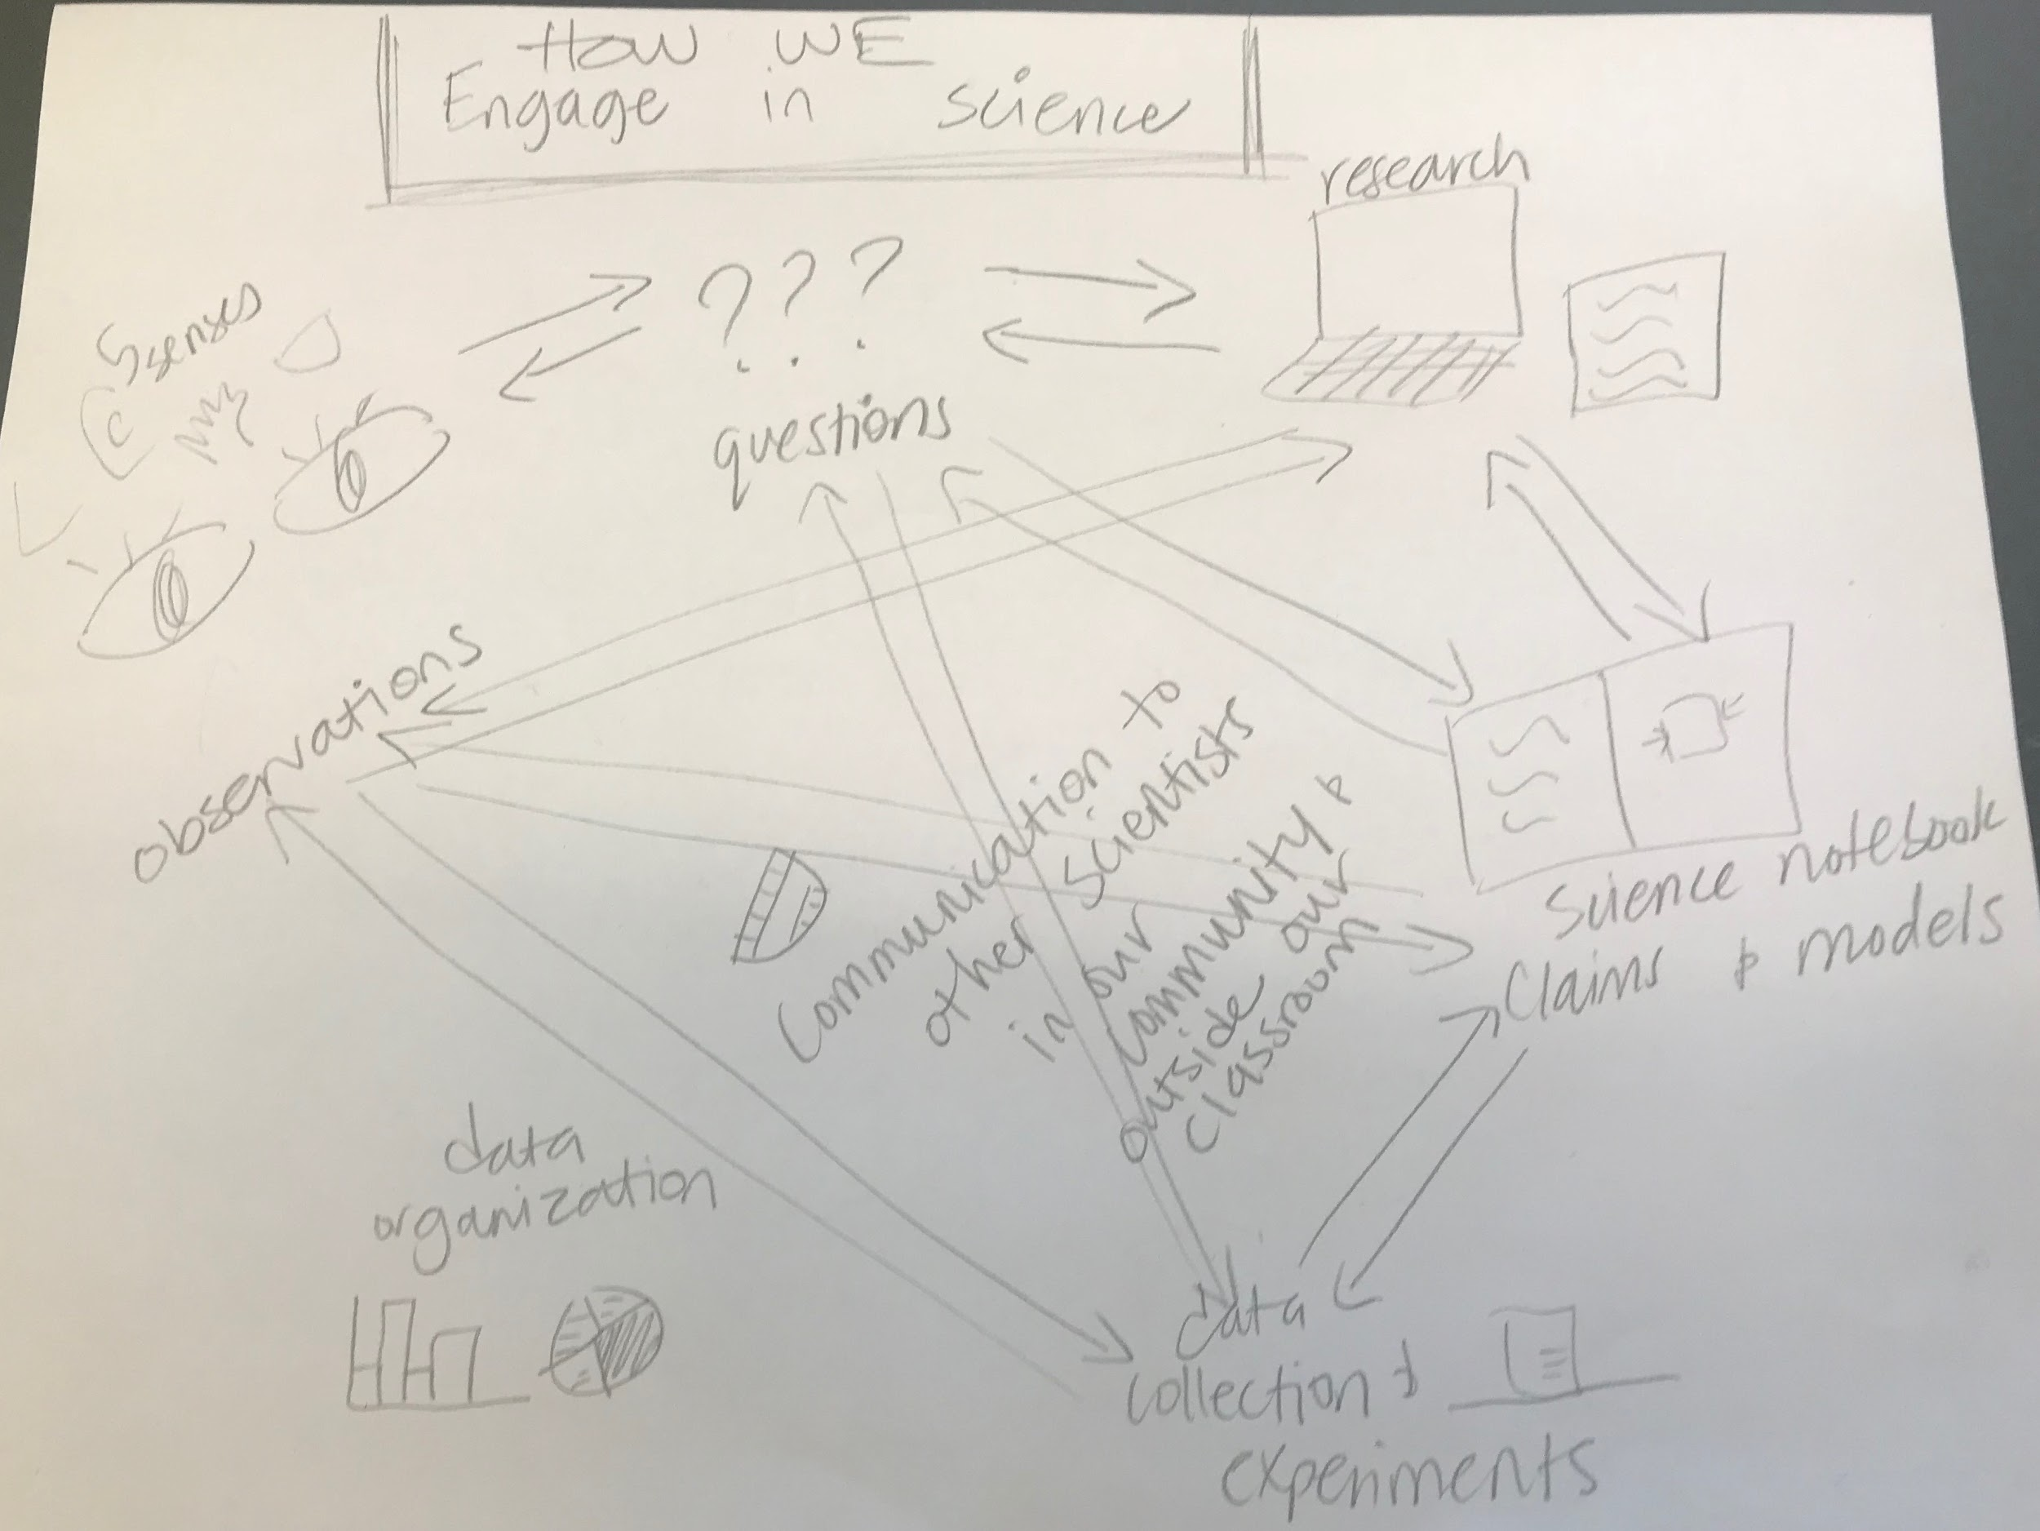
October 8th Staff Development Day: 6th - 8th

Slide 19


