Slide 1
Horizon High School 2022-2023 Title I, Part A Annual Parent Meeting
Date: September 28, 2022
Time: 4:30 PM
Notes:
Campuses: September 28, 2022 Please add the date and time at the bottom

Slide 3
The Purpose of Today’s Meeting
Your son/daughter attends a Title I School in Clint ISD
All Title I, Part A schools receive federal funding to support improving student achievement and closing achievement gaps
A full description of how our Title I funds are being used can be found on our Campus Improvement Plan on our campus website
Some examples of additional support for students:
Additional teachers and staff to address specific needs
Campus tutoring
Supplies for instructional programs such as Makerspace, AVID, etc.
Instructional Technology such as Chromebooks, headphones
Parent & Family Engagement activities to support you at home

Slide 4
Parent & Family Engagement
Parents and Families are an important part of the school community as you help your child at home
Horizon High School has a:
Parent & Family Engagement Policy describes how the school will support parents/families in the academic success of your children
School-Family-Student Compact is an agreement between the school, families, and students as we work together as partners to meet state standards and show academic progress for all students

Slide 5
Building Capacity To Get Involved
All schools in Clint ISD will work to build a partnership between the
school and parents/families to improve student academic outcomes
Horizon High School will:
Provide assistance to parents in understanding state testing standards and various assessments
Provide materials and training to help parents work with their children to at home
Send all information in an understandable format
Send information in the preferred language of parents
Provide different types and times of parent meetings and learning sessions
Share information for those parents who cannot participate

Slide 6
The Role of Parents in the
Decision-Making Process at School
Parents have the right to be involved in the decisions on activities, trainings and learning sessions, such as:
Participating in campus/district committees
Sharing feedback on surveys
Meeting with campus administration, teachers and staff
Becoming a campus volunteer

Slide 7
Communication Between
School & Parents
Horizon High School understands how communication with parents is essential for student success.
Our school commits to:
Send timely information about programs and events
Provide frequent reports to parents on their child’s progress
Schedule meetings with school staff such as teachers and/or administration, upon your request
Ensure we maintain regular two-way communication between home and school

Slide 8
Opportunities To Work Together
There are various ways parents and families can get involved at our school
Title I Part A, Annual Parent Meeting (today)
Parent Teacher Conferences
Attendance Information & Monitoring Student Progress Meetings
STAAR Testing Information Meeting
Academic Program Information Meetings
Social Emotional Development/PBIS Parent Meetings
District Program Information Parent Meetings
Annual Parent & Family Engagement Evaluation Meeting
Notes:
Campuses: Please list a few events when parents can get involved or more engaged by participating.

Slide 9
Ways to Support Student Achievement
With parents and families as partners, students will be successful in school by having you:
Use the Skyward Parent Portal
Keep in regular contact with your child’s teacher
Praise effort and hard work
Use failure opportunities to learn and try again
Have your child teach you what they are learning
Read with your child every day
Attend school events and parent meetings
Notes:
Campuses are welcome to add anything on this list that pertains to their programs.

Slide 10
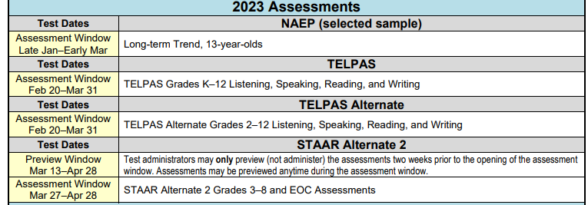
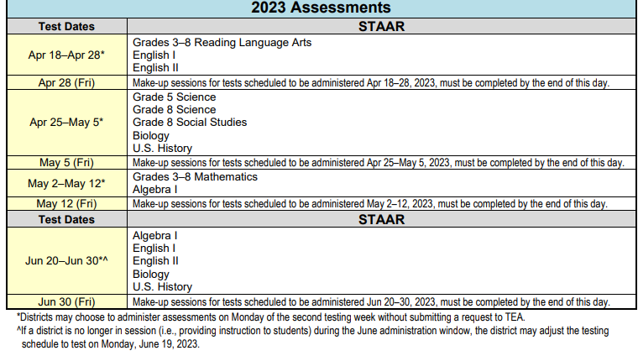
2022-2023 STAAR Testing Calendar
Please visit the Texas Education Agency website regularly for any updates to the testing calendar - https://tea.texas.gov/student-assessment/testing/student-assessment-overview/testing-calendars

Slide 11
Who Do You Contact With Questions?
Horizon High School (915) 926-4200
Principal:
Elena E. Acosta (915) 926-4202
Grade Level Assistant Principals:
Annette Loomis (915) 915-926-4203 (Alpha A-D)
Mariaelena Mesquita (915) 926-4204 (Alpha E-L)
Alejandro Navarro (915) 926-4206 (Alpha Re-Z)
Andres Peña (915) 926-4205 (Alpha M-Ra)
Principal Secretary:
Gabriela Barraza (915) 926-4202
Counselor(s):
Arturo Chavira (915) 926-4220 (Alpha A-Garcia)
Christina Casillas (915) 926-4222 (Alpha Gardea-O)
Johanna Sosa (915) 926-4219 (Alpha P-Z)
Nurse:
Gabriela Garcia (915) 926-4215

