Slide 1
SCHOOL MARKETING

Slide 2
EDUCATION EVOLUTION
More educational opportunities
Innovative teaching models
Need for fresh marketing strategies

Slide 3
SCHOOL BRANDING
There is no other school or academic program like yours.
Your uniqueness is your greatest advantage.
Identify the various ways that your school/program stands out from others.
Brand
Distinction
Brand
Statement
Brings together your school’s distinctions, mission and vision.
Represents your commitment to your school community and target audience.

Slide 4
YOUR MARKETING PLAN

Slide 5

IDENTIFY YOUR GOALS
  50/50 socioeconomic status
  Increase market share
  50/50 English & Spanish speakers – Dual Language

Slide 6
KNOWING YOUR AUDIENCE
SCHOOL COMMUNITY
For higher retention, establish a strong and consistent communication with your current school community.
Parent Newsletter
Parent Meetings
Staff Newsletter
Staff Meetings
School Messenger
Share newsletters with parents & volunteers
Social Media
Website
Marquee
Learn which communication method your staff and parents prefer.

Slide 7
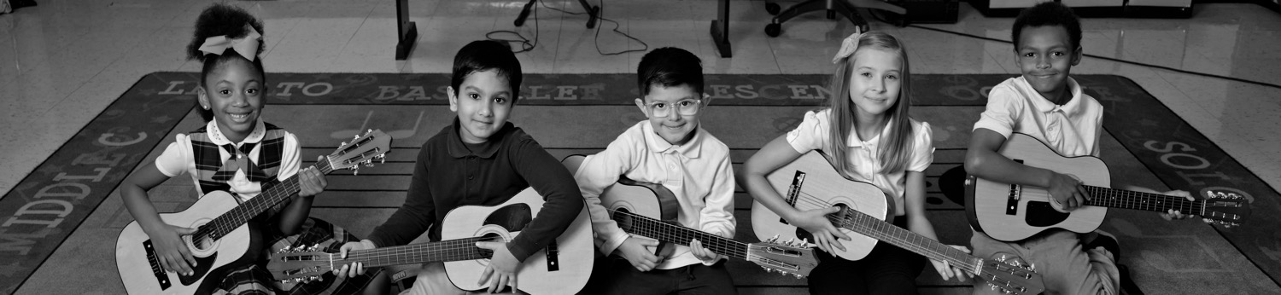
KNOWING YOUR AUDIENCE
RECRUITMENT
Identify your targeted audience
Diversity
Socioeconomic status
Out-of-district families

Slide 8
MEETING YOUR AUDIENCE WHERE THEY ARE
  Social Media Groups
  Grocery Stores
  Recreation Centers
  Churches
  Community Events
  Apps like WhatsApp & Next Door

Slide 9
MARKETING RESOURCES
Campus Brochures
Social Media Platforms
Web Pages
Newsletters
Videos
Ambassadors

Slide 10
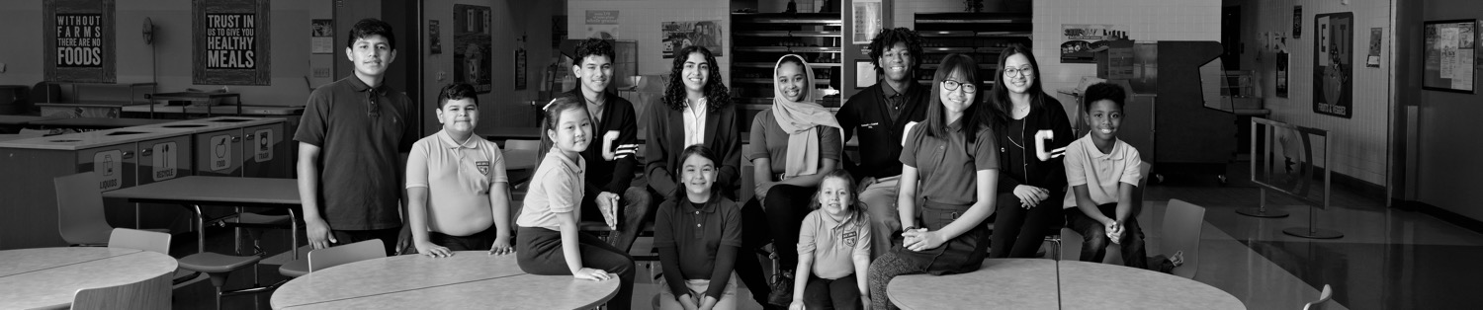
AMBASSADORS
  Parents
  Students
  Staff
  Partners and Volunteers

Slide 11


Slide 12
MEASURE YOUR
MARKETING SUCCESS
  Increasing parental engagement
  Increase student diversity
  Higher recruitment and retention
  Increase market share
  50/50 low and high socioeconomic status
  50/50 English language speakers

Slide 13
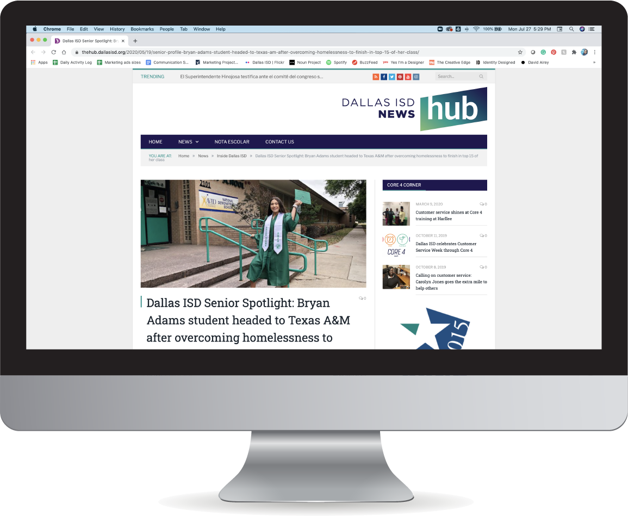

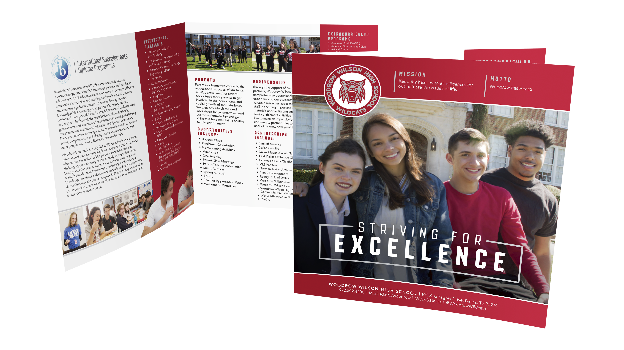
HOW WE CAN HELP YOU!
WE ARE YOUR AGENCY!
Discover Dallas ISD
Virtual community meetings
Campus brochures
Digital toolkits
Social Media Outreach
Marketing plan
Feature stories
(HUB, social media and
news outlets)
Mailers
Flyers
Messaging
School logos

Slide 14
CONTACT US
SANDRA VERDUZCO
Marketing Director
sverduzco@dallasisd.org
972-925-3922
972-249-5111

