Slide 1
Beginning Teacher Support
Beaufort County Schools
Mark Doane-Assistant Superintendent
Cindy Apple-HR/Licensure Specialist
Mary Godley-Benefits Specialist

Slide 2
“The mediocre teacher tells. The good teacher explains. The superior teacher demonstrates.
The great teacher inspires.”
-William Ward

Slide 3
“The longer I live, the more I realize the impact of attitude on life. Attitude, to me, is more important than facts. It is more important than the past, than education, than money, than circumstances, than failures, than successes, than what other people think or say or do. It is more important than appearance, giftedness or skill. It will make or break a company...a church....a home. The remarkable thing is we have a choice every day regarding the attitude we will embrace for that day. We cannot change our past...we cannot change the fact that people will act in a certain way. We cannot change the inevitable. The only thing we can do is play on the one string we have, and that is our attitude...I am convinced that life is 10% what happens to me and 90% how I react to it. And so it is with you...we are in charge of our attitudes.”
― Charles R. Swindoll

Slide 4
Goals of Beginning Teacher Induction
  Acclimate first-year teachers to BCS prior to school year
  Provide a “toolkit” to assist in a new role
  Familiarize teachers with the NC Professional Teacher Standards and NC Teacher Evaluation process
  Build relationships with colleagues and support personnel

Slide 5
NC Policies for BT Support Program (TCED-016)
  Induction requirement
  Assignment/experience requirements
  BT Professional Development Plan
  Optimum working conditions for BTs
  Orientation
  Mentor assignment/guidelines for selection
  Mentor training
  BT Support timetable
  Licensure Conversion process
  Observations/evaluations

Slide 6
Induction &
Assignment/Experience Requirement
    Initial Professional License issued by the state to teachers with fewer than 3 years of teaching experience
    Offer ongoing support to teachers within their first three years of teaching-provided by district, school and mentor
    Beginning Teachers will be assigned in their area of licensure
    Three years of teaching experience are required to complete the BT Support Program

Slide 7
Optimum Working Conditions
    To ensure that BTs have the opportunity to develop into capable teachers, the following are strongly recommended:
    Mentor support
    Induction that details expectations
    Limited class preparations
    Limited non-instructional duties
    ***No extra-curricular assignments unless requested in writing by the BT

Slide 8
Orientation
    BTs should be provided an orientation that is conducted prior to the arrival of students that includes
    Overview of school district policies/procedures
    NC Standard Course of Study/Curriculum Goals
    State Licensure Requirements
    Teacher Evaluation Process

Slide 9
Teacher Evaluation Process (Quick Guide)
  Teacher Evaluation Process-self-assessment/orientation; professional development plan (initial, mid-year and final review); four 45 minute observations-three by administration and one by a peer (formal pre-conference to proceed the first observation); post-observation conference after all observations; Summative Evaluation

Slide 10
Mentor Assignments/BT Support Timetable/
Licensure Conversion
    BCS Mentor Support & Buddy Teachers; Grade Level & District Support
    BT Support Program -three years
    Initial Provisional License converts to Continuing License after successful teaching experience and completion of the BT Support Program

Slide 11
Ongoing Beginning Teacher Support
District-wide support from various departments (Curriculum, HR, Accountability, EC, ESL, etc.)
BT meetings held during the year to offer targeted professional development
BT Newsletter monthly
Mentors for BTs
BCS Beginning Teacher Webpage

Slide 12
Beginning Teacher Website https://www.beaufort.k12.nc.us/departments/human-resources/beginning-teacher-support

Slide 13
Professionalism Checklist

Slide 14
RELATIONSHIPS
CLASSROOM MANAGEMENT
DIFFERENTIATION
STUDENT DATA/ASSESSMENTS
PLANS / CONTENT / RIGOR
FACILITATE LEARNING

Slide 15
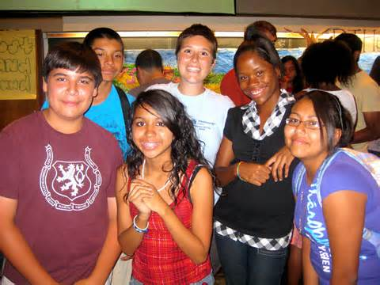
Conclusion
You are not alone!
Ask questions!
Ask for help!
Keep a great
attitude!
Place students first!

