Slide 1

BOARD OF EDUCATION MEETING
May 10, 2017
Serving All or Portions of the Following Communities:
Blue Island * Burnham * Calumet City * Dixmoor * Dolton * East Hazel Crest * Harvey * Hazel Crest * Lansing * Markham * Phoenix * Posen * Riverdale * South Holland * Thornton

Slide 2
Open Session

Slide 3
Roll Call

Slide 4

Pledge of Allegiance

Slide 5
Committee of the Whole
Report from Curriculum Committee
Report from Finance Committee
Report from Policy Committee
Report from Discipline Committee
Report from Facilities Committee

Slide 6
Consent Agenda
Approval of District 205 Bills dated: April 13 through May 10, 2017
Personnel: Approval of Resignations, Leave of Absence, New Hires and Terminations dated May 10, 2017

Slide 7
Public Participation
We now open the Public Participation section of our agenda. At this time, members of the community are invited to address the Board. We ask that you state your name and town, limit your total time to two minutes, and talk only about items on the current Board Agenda.
In addition, if your comments are of a critical nature about specific people, the Board requests that you present your comments during the personnel portion of the “executive session.”
Your name will not be called if you do no sign in and list a topic or the topic is not on the current Board agenda or if public participation has begun.

Slide 8

Freedom Of Information Act
Dr. Doss
FOIA

Slide 9
Communications
Mr. Arrington

Slide 10


Class of 2017 Graduation
Sunday, May 21, 2017
3:00 p.m.
All 3 Schools

Slide 12


Slide 13
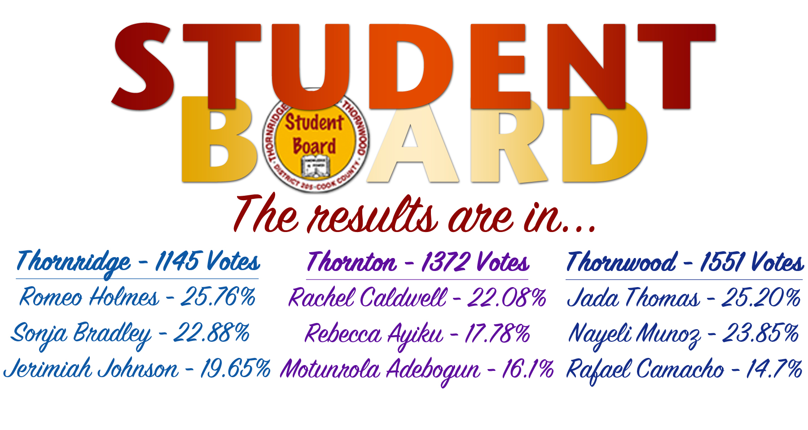
Student Representatives-At-Large
Jamiah Glover – TR Patience Butler – TT Olukayode Adebogun – TT
Kaylynn Arrington – TT Kamryn Nelson – TW Abraham Cruz – TW

Slide 14
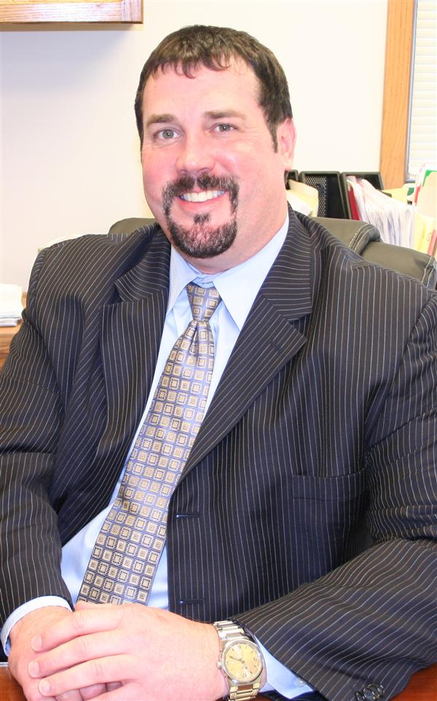
Congratulations to Brett Fickes, Director of Curriculum & Instruction, on being selected as one of the 2017 recipients of the Josephine Elizabeth Seaton Franklin Foundation, Inc. Vision Quest Awards. The award will be presented on May 20, 2017.

Slide 15

The TR Band students received a Superior Rating Division I (39.5 out of 40) for Jazz Band at the 2017 IHSA State Organizational and a Superior Rating Division I (49.6 out of 50) for Concert Band.
TR hosted its 3rd Annual AVID Awards Banquet, and seniors Imani Burns and Samiah McKinney were presented with scholarship awards. We look forward to our seniors excelling in their postsecondary endeavors.

Slide 16
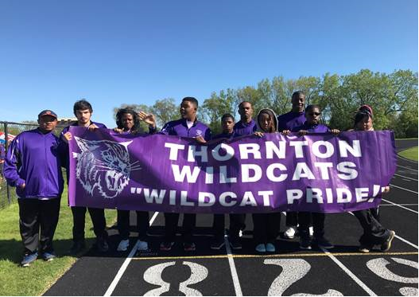

CONGRATULATIONS WILDCAT OLYMPIC TEAM
The Wildcat Olympic Team won 9 Gold medals 4 Bronze medals and 8 Athletes Qualified for State Competition
Destiny Walker & Cindy Sanders 50m run and long Jump
Shannon Herron & Terrell Hall 100m run and long Jump
Ben Bell Softball Throw
Manny Johnson long Jump
Soccer Individual Skills
Liz Morales & Alexis Lockett

Slide 17
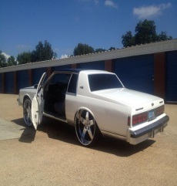
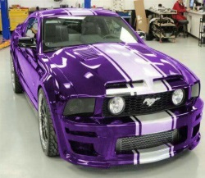

Thornton Advisory Council Presents…….
The parents, community and alumni teamed up Sunday, May 7th for a good ole fashioned Old School vs. New School basketball game. The old school team gave the new school team a run for their money.
Final Score: New School 85 Old School 81

Slide 18
Congratulations to 2 of Thornton’s IB students David Clay and Maribel Salgado who were accepted to very prestigious universities and will have their educations almost completely paid for.
David L. Clay II was accepted to Vanderbilt University with an award letter of $68,000 per year.
Maribel Salgado was accepted to Wesleyan University with an award letter of $69,000 per year.

Slide 19
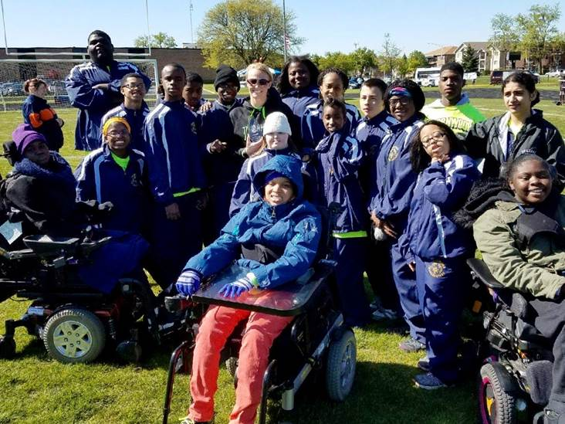

On Saturday, May 6th 18 of our Special Olympic Athletes compete in the Area 7 Track and Field Meet at Richards High School and they did AMAZING! All of the 1st place athletes will advance to the State Track and Field Meet at ISU June 9th-11th!
Congratulations to the following students:
Kaitlan Blow Nicholas McDonald
Phenicia Butler Quinton Mills
Antonio Carr Stephanie Rodgers
Kendra Cox Serenity Ross
Jaylen Echols Maciah Scott
Sereem Frazier Tayjah Sole
Jordan Fuller Victoria Traylor
Nayeli Gutierrez Mekalah Wade
Marcy Mayes Larry Williams

Slide 20
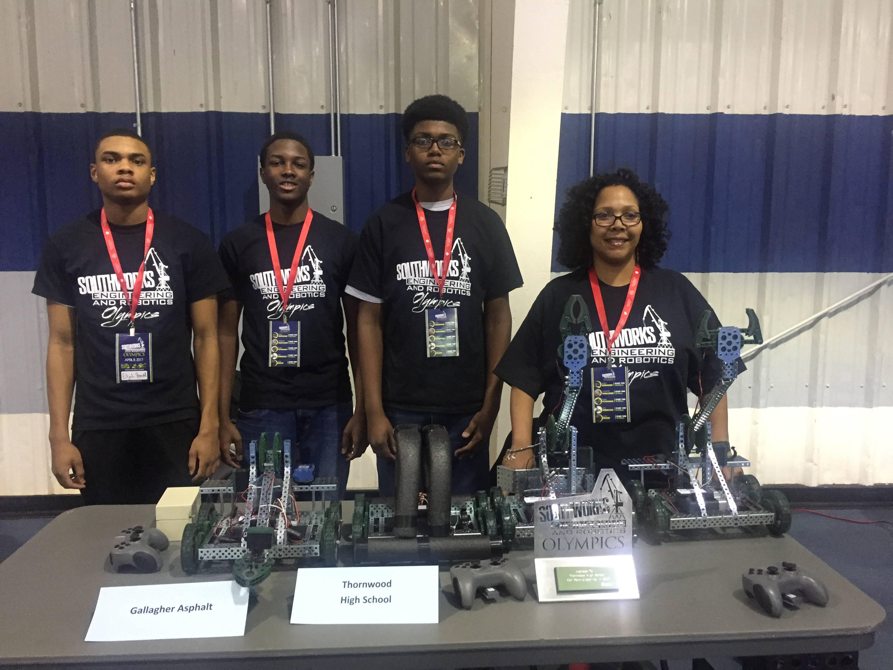
The TW Engineering Robotics team brought home 1st in the semifinals and advanced to win the 2nd place award at the Southworks Robotics Olympics, a regional robotics competition hosted by the South Suburban Mayors and Managers Association (SSMMA), the Chicago Southland EDC. The TW robotics team consisted of three students Elijah Smith, Leonard Sykes, Calab Ragland with Robotics coach Ms. Arlene Stephens-Hayes.

Slide 21
Unfinished Business

Slide 22
New Business
InsureSource & The Gloria J. Taylor Foundation – Scholarship Presentation
  Dr. Theresa Dixon & Cliff Taylor

Slide 23
New Business
Recommended Approval of Out-of-State Field Trip, Student Board (Policy Section 6:240) –
  Dr. Doss (Approval Needed)

Slide 24
New Business
Recommended Approval of IRA Educational Foundation (ProStart Culinary Curriculum) –
  Mr. Horton (Approval Needed)

Slide 25
New Business
Recommended Approval of Thornridge CTE Technology Purchase–
  Mr. Horton (Approval Needed)

Slide 26
New Business
Recommended Approval of Asbestos / Mercury Abatement–
  Mr. Horton (Approval Needed)

Slide 27
New Business
Recommended Approval of Tuck Pointing Phase 1–
  Mr. Horton (Approval Needed)

Slide 28
New Business
Recommended Approval of Stadium Upgrades Phase 2 –
  Mr. Horton (Approval Needed)

Slide 29
New Business
Recommended Approval of Bathroom Renovations Bid Results–
  Mr. Horton (Approval Needed)

Slide 30
New Business
Recommended Approval of Fieldhouse Renovations Bid Results–
  Mr. Horton (Approval Needed)

Slide 31
New Business
Faculty Association –
  Mr. Dwayne Bearden, President

Slide 32
Superintendent’s Report

Slide 33
Executive Session
Closed session pursuant to Section 2(c) of the Open Meetings Act to consider:
  “The appointment, employment, compensation, discipline, performance, or dismissal of specific employees of the public body or legal counsel for the public body, including hearing testimony on a complaint lodged against an employee of the public body or against legal counsel for the public body to determine its validity.”
  Student discipline
  Collective negotiating matters, and
  Litigation, when an action against, affecting or on behalf of the particular public body has been filed and is pending before a court or administrative tribunal, or when the public body finds that an action is probable or imminent.

Slide 34
Reconvene Open Session

Slide 35
Action Items Following Executive Session
Possible Action Regarding Student Discipline
Recommended Approval of Notice to Remedy for Teacher 1
Recommended Approval of Notice to Remedy for Teacher 2
Possible Action Concerning Teacher 1 Suspension Letter
Possible Action Concerning Teacher 2 Suspension Letter
Action Concerning AFSCME Grievance
Recommended Approval of Property Tax Assessment Appeal Settlement

Slide 36
Adjournment
NEXT MEETING
Wednesday, June 14, 2017
6:30pm
Thornwood High School

