Slide 1
Pathways in Technology Early College High School (P-TECH)
Virtual Open House 2020

Slide 2
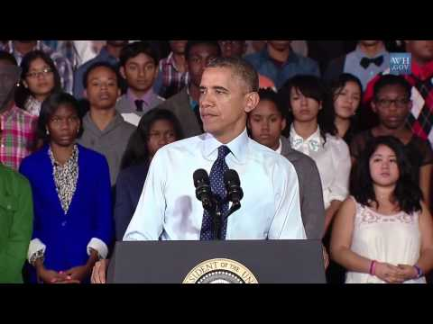

Slide 4
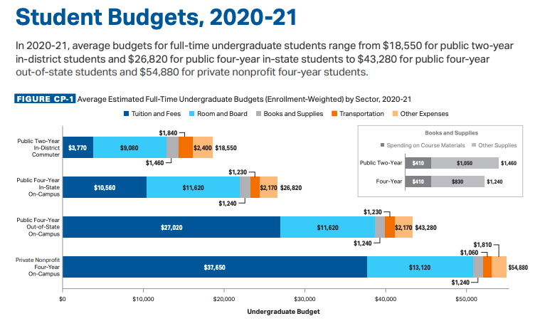

Slide 9
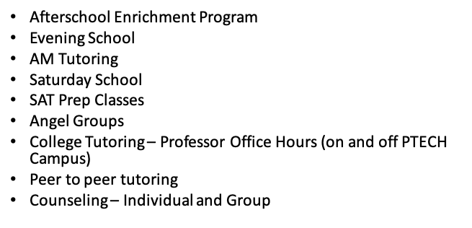
Academic Intervention

Slide 10
Clubs and Activities
Cheer/Dance Team
Robotics
Singing and Songwriting Club
Society of Hispanic Engineers (SHEP)
National Society of Black Engineers (NSBE)
Chess Club (Students compete amongst each other and outside competition)
Student Government Association
National Honor Society
Rap/Poetry Club
STEP

Slide 11
PSAL Sports
Soccer (Coed)
Cross Country (Boys & Girls)
Indoor Track (Boys & Girls)
Varsity Basketball (Boys & Girls)
JV Boys Basketball
Handball (Coed)
Tennis(Coed)
Baseball
Outdoor Track (Boys & Girls)

Slide 12
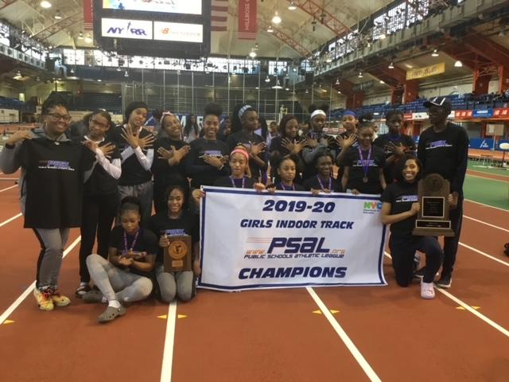
Girl Track (Milesplits “Queens of NYS”)
Outdoor City Champions 2016
Indoor City Champions 2018
Outdoor City Champions 2019
Indoor City Champions 2019
There have been countless MVP awards for the girls team, and three individual Wingate Awards (Highest PSAL honor)

Slide 13
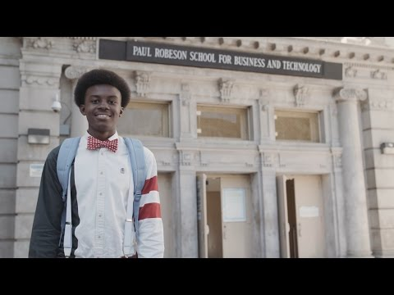
P TECH Brooklyn

Slide 14
Shudon Brown, ℅ 2016
AAS Computer Information Systems, Age 16 from CUNY City Tech
PTECH Honors Graduate June 2016
Bachelor’s Degree in Business Analytics, Age 18 from William Peace University
Masters of Science in Information Technology, Age 20 from North Carolina A&T State University
Doctoral Student at North Carolina A&T State University, Age 21

Slide 15
PTECH is an Educational-Option school
PTECH ranks some applicants based on their academic record and attendance record
A percentage of offers are made based on randomly assigned numbers, and some offers are made based on ranking numbers for programs that rank applicants.
Brooklyn residents are the top priority group. All qualifying applicants in the first priority group will get offers first.

Slide 16
Ranking Criteria
Component | Weight (#Points) | Percentage
Attendance | 20 | 20%
Overall Subject Average | 10 | 10%
NYS Math Test Score | 20 | 20%
NYS ELA Test Score | 10 | 10%
Math Subject Average | 20 | 20%
ELA Subject Average | 20 | 20%
Total Points | 100 | 100%

Slide 17
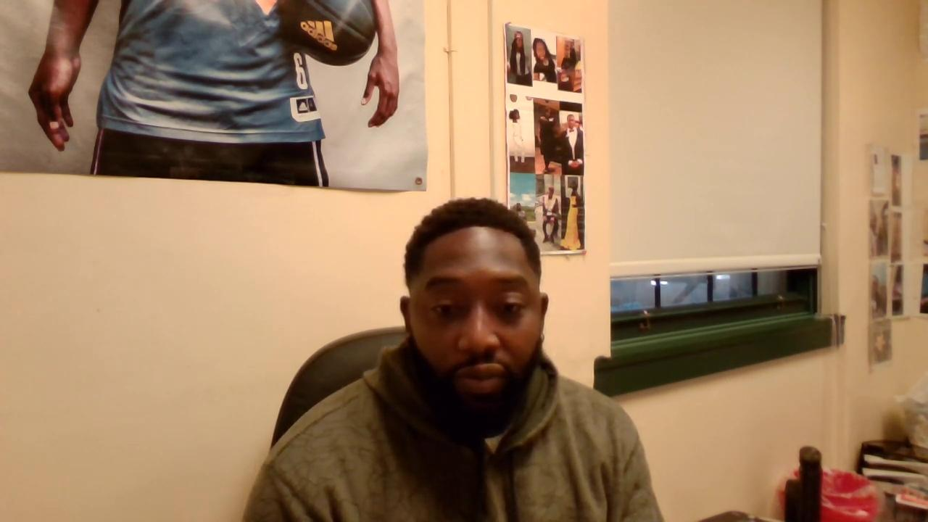
Mr. Smith, Parent Coordinator
Contact information:
Email: csmith@ptechnyc.org
Phone: (347) 225-7167

Slide 18
Additional Contact Information
Website: https://www.ptechnyc.org
Website: https://www.ptech.org
Email: info@ptechnyc.org
Phone: (718) 221-1593

Slide 19
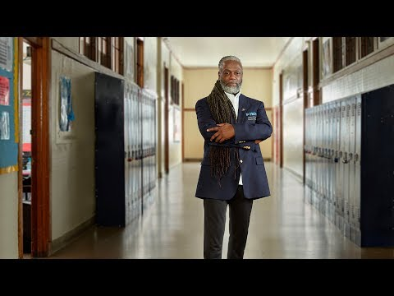
Equity and Excellence in Motion

Slide 20
Thank you for your interest in our program!
The floor is now open for questions.

