Slide 1


Elmsford Union Free School District
Pupil Personnel Services
Jo-Anne Dobbins
Director of Special Education
and
Pupil Personnel Services
4/12/2023

Slide 2
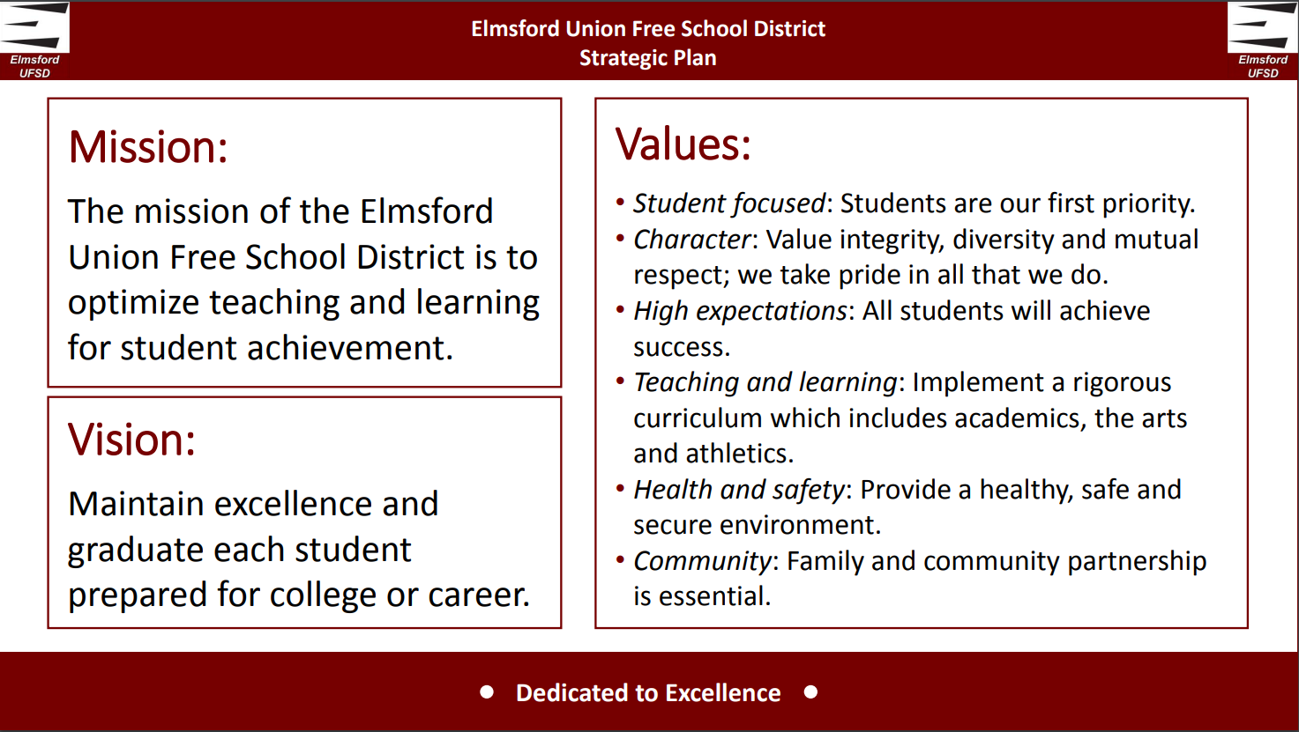

Slide 3
What are Pupil Personnel Services?
Pupil Personnel Services are those legally required services that enable students to benefit from the instructional program, such as nursing, guidance, psychology, social work and special education.
Pupil Personnel Services staff serve ALL children in the district, including general education students, students with disabilities, pupils at risk, undocumented students, students who live out of district, students who live out of district and attend parochial or private schools in our district, students who attend charter schools and live in our district.
Registration
Special Education
Nursing
Guidance
McKinney-Vento
CPSE
Home Tutoring
Home Schooling
Foster Care
Non-Residents
Incarcerated Youth

Slide 4
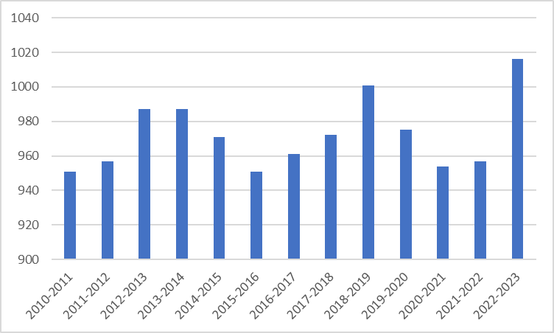
Registration Numbers - excluding UPK

Slide 5
Registration Protocol
To access online registration:
Proceed to EUFSD.org
Left hand column to tab “Departments”
Choose “Registration”
Choose “Begin Online Registration”
Click on “Online Registration”
ALL INFORMATION CAN BE TRANSLATED INTO ANY LANGUAGE BY USING THE TRANSLATE BUTTON LOCATED ON THE UPPER RIGHT OF THE WEBSITE.
Online registration has eliminated many errors - ex. name spellings, addresses, phone numbers, custody issues.
For those with difficulties accessing the website, we make appointments to assist.

Slide 6
Registration Protocol
(Continued)
Procedures followed to complete a registration:
Online application
Appointment to either request assistance or bring in needed paperwork
Who are Elmsford students?
Residents
Charter School students who reside in Elmsford
Parochial and private school students who reside in Elmsford
Incarcerated Youth
Undocumented students
McKinney-Vento eligible students
Online registration has eliminated many errors - ex. name spellings, addresses, phone numbers, custody issues.
For those with difficulties accessing the website, we make appointments to assist.

Slide 7
Registration Protocol
(Continued)
Identifying Non-Residents
Currently there are 512 families who are renting in Elmsford.
Starting in May 2023, letters will be going out to ALL renters requesting updated information regarding their residential status.
Deadline for updating status will be August 31st.
Schedules will be withheld until status is updated.
Online registration has eliminated many errors - ex. name spellings, addresses, phone numbers, custody issues.
For those with difficulties accessing the website, we make appointments to assist.

Slide 8
Registration Protocol
(Continued)
Protocol for Requesting Removal from District due to Non-Residency:
Knowledge of non-residency
Known new address, if possible
Assign private investigator
Data must be obtained for at least 1 month (daily)
Report received from Investigator
1st letter advising family of non-residency issue (provides for a 2 week response time)
If response received, 2nd letter is sent acknowledging appeal.
Superintendent final determination letter
Appeal of Superintendent decision to Board of Education
Board of Education decision
Appeal to Commissioner of Education
Decision of Commissioner
Online registration has eliminated many errors - ex. name spellings, addresses, phone numbers, custody issues.
For those with difficulties accessing the website, we make appointments to assist.

Slide 9
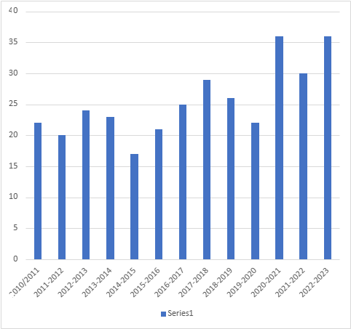
Committee on Preschool Special Education (CPSE)
The school district administers the CPSE section of Part 200 for the Department of Social Services. It is an unfunded mandate. We are responsible for students aged 2.9 years to entering kindergarten. We are responsible for obtaining evaluations, placing students, providing related services.

Slide 10
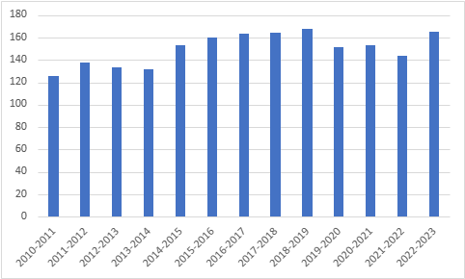
CSE Students 2010/11 through 2022/23

Slide 11
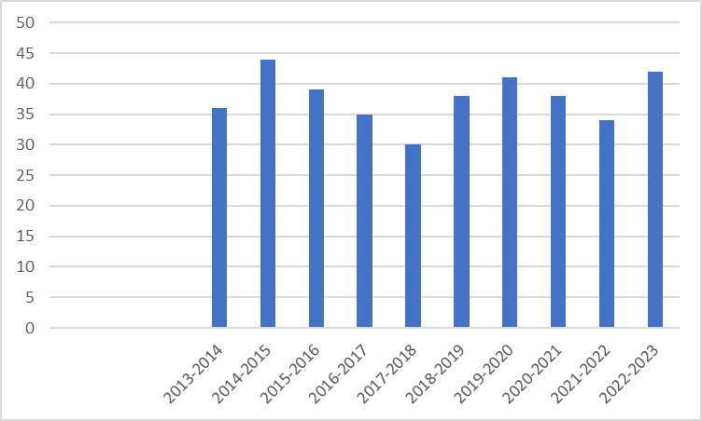
Out of District
Students with Disabilities
This is considered by the CSE on an Individualized basis. The CSE looks at the programs available in-district as they pertain to the needs of the student. The CSE will strive for the LRE (least restrictive environment) per Part 200 Regulations.

Slide 12
Disabilities Serviced
13 Classifications
2022-2023
Autism (25) Visual Impairment (1)
Emotional Disability (6) Orthopedically Impaired (4)
Learning Disability (62) Other Health Impaired (27)
Intellectual Disability (5) Multiple Disabilities (3)
Deafness (0) Deaf-Blindness (0)
Hearing Impaired (0) Traumatic Brain Injury (1)
Speech/Language Impaired (31)

Slide 13
CONTACTS
Pupil Personnel Services
Jo-Anne Dobbins
Director
(914) 592-4615
email: jdobbins@eufsd.org
Jennifer Herrera
Assistant to Director
(914) 592-4615
email: jherrera@eufsd.org
Diana Barbato
Registration Assistant
(914) 592-3758
email: dbarbato@eufsd.org
Please feel free to contact us anytime.

Slide 14
QUESTIONS ?
Thank you for this opportunity!
Elmsford Union Free School District

