Slide 1
College Financial Aid Night
Colleen mulrooney
Director of
Student financial assistance
Sacred Heart University

Slide 2
Tonight’s Discussion Will Highlight:
Types of Financial Aid
Financial Aid Application Process
Determining Financial Aid Eligibility
Tools, Tips & Thoughts
Q & A

Slide 3
Who Qualifies for Financial Aid?
Principles of Financial Aid
  Parents and students are primarily responsible for financing an education.
  Sacrifice is assumed.
  Financial aid assessment is an evaluation of economic strength, not cash flow.
  Standardized calculations that assess ability to pay, not a willingness to pay.
  Financial aid is a supplement whose intent is for student access and choice.

Slide 4
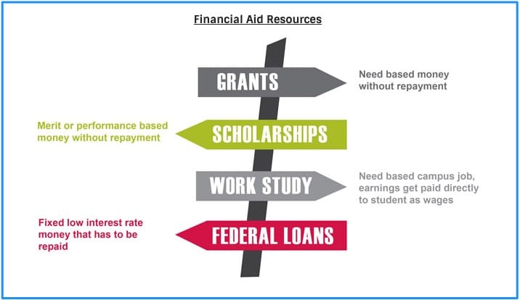
Types of Financial Aid
Grants
Scholarships
Work Study Program
Higher Education Loans
  Students
  Parents

Slide 5
2022-2023 $240.7 Billion Total Student Aid Undergraduate & Graduate
Source of Information: The College Board “Trends in Student Aid 2023”
To learn more visit: https://research.collegeboard.org/trends/student-aid
Average aid per full-time equivalent (FTE) student in 2022-23 was:
  $15,480 per undergraduate student $28,300 per graduate student
Grant Aid
$144.5 billion in grant aid received by undergraduate and graduate students in 2022-23.
Federal grant aid was $37.7 billion including $27.2 billion in Pell Grants.
State grants: Aid from states varies by state. In 2022-23, state grant aid was $13.6 billion.
Institutional grant aid: Aid from colleges and universities grew rapidly over the past 10 years to $76.9 billion in 2022-23.
Private and Employer grants: Aid from private sources have declined 7% in last 10 years to $17.2 billion in 2022-2023.
Loans
$98.2 billion in total was borrowed by parents and students from federal $83.5 billion and nonfederal loans $14.7 billion in 2022-23.
The 12th consecutive year that annual borrowing declined.
Student Debt
$29,400 is average debt among borrowers for 51% of bachelor’s degree recipients in 2021-2022.
As of March 2023, 32% of borrowers owed less than $10,000 and 21% owed between $10,000 and $20,000 in federal loan debt. These borrowers held 4% and 8% of the outstanding federal debt, respectively.

Slide 6
Important First Steps
Rely on College Websites for Most Up-to-Date Information!
Consider Admission Application & Deadlines
  Early Decision
  Early Action
  Regular/Rolling Admission
  You don’t need to wait to be accepted before completing financial aid applications
Review Required Financial Aid Applications & Deadlines
  Each college has their own deadlines
  Submit two weeks before earliest deadline
  Evaluate Financial Aid Programs the College Offers
Compare Costs
Net price calculators are on all college websites and can provide an estimate of financial aid eligibility and remaining college costs.

Slide 7
Types of Financial Aid Applications
Free Application for Federal Student Aid (FAFSA)
  Required for Federal & State Aid
    https://studentaid.gov/h/apply-for-aid/fafsa
CSS Profile
  Not used by every college; primarily by private colleges
    https://cssprofile.collegeboard.org/
Institutional Applications
  Check school publications and websites
Be Organized!
  Have all required information and/or data necessary to ensure prompt processing and to enable an informed decision can be made with respect to the applications.

Slide 8

Federal Student Aid Background for What’s Ahead
FUTURE Act
Enhances the FAFSA experience by allowing the U.S. Department of Education to automatically obtain federal tax information from the IRS for students, parents, or other contributors (such as a spouse or stepparent) who provide consent and approval.
FAFSA Simplification Act
Expands access to federal student aid and introduces significant changes to the FAFSA process, including changes to the FAFSA form, how students and families will complete it, and the eligibility calculation.
Visit StudentAid.gov for information, resources, and guidance for students, contributors, and borrowers.

Slide 9
Federal Student Aid – What’s Next?
“Contributor” is a new term being introduced on the 2024–25 FAFSA form.
A contributor is anyone who is required to provide their information and signature on the FAFSA form as well as provide consent and approval to have their federal tax information transferred from the IRS directly into the form via direct data exchange.
Contributor participation does not indicate financial responsibility.
Students and Contributors must provide consent and approval to have their federal tax information transferred from the IRS directly into the form via data exchange.
Student and contributor federal tax information will be used to determine the student’s eligibility for federal student aid.
If a student or required contributor doesn’t provide consent and approval, the student will not be eligible for federal student aid—even if they manually enter tax information into the FAFSA form.

Slide 10

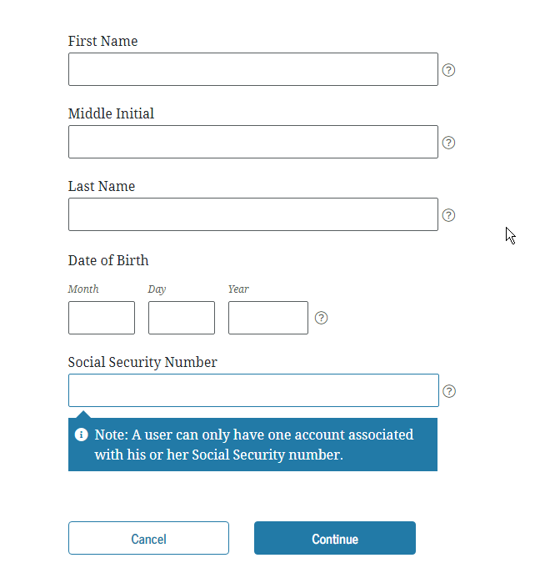
Federal Student Aid – What’s Next?
Everyone contributing to the FAFSA must have their own StudentAid.gov account and FSA ID.
Create an account at StudentAid.gov/fsa-id/create-account.
All students and contributors will need their own StudentAid.gov account before filling out the FAFSA form.
Students and their families need to create their accounts early to be prepared. Information needs to be confirmed with the Social Security Administration.
New FSA regulations allow a contributor to create a StudentAid.gov account without a Social Security number with verification of additional data elements.

Slide 11
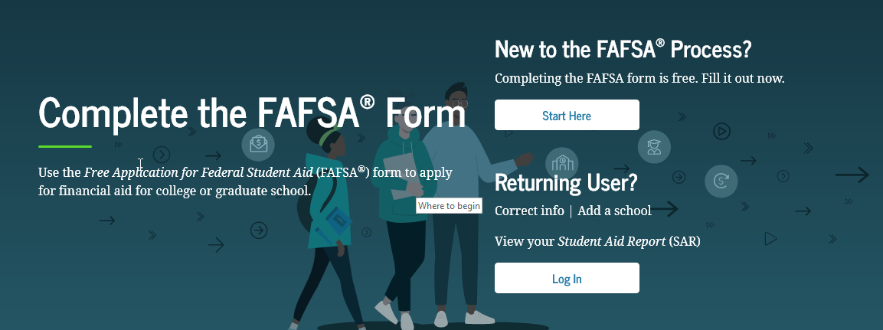
Federal Student Aid – What’s Next?
2025-2026 FAFSA expected launch December 1, 2024
The parent wizard within the FAFSA offers a series of filtering questions that determine which parent(s) a dependent student will need to invite to be a contributor.
Students and contributors will access the FAFSA form using their own StudentAid.gov accounts.
Student and contributor data from the respective StudentAid.gov accounts will prepopulate from IRS Data Direct Exchange after consent and approval.
  Will use 2023 tax information
  If divorced/separated, parent providing the most financial support
Completed each year student is enrolled
One FAFSA per student, not per family
Students will go to fafsa.gov to fill out their FAFSA form.

Slide 12
Federal Student Aid – What’s Next?
After Submitting the FAFSA …..
Review the FAFSA Submission Summary (FSS) for errors
If necessary, make corrections and resubmit the FAFSA
If selected for verification, you will be notified
  You may be required to submit tax transcripts and/or other forms to verify data to the college
  Financial aid awards are tentative until verification is complete
If 2023 tax information is not representative of your current income, contact each college about an appeal/professional judgment
Do not alter the FAFSA information on your own

Slide 13
Federal Student Aid – What’s Next?
Understanding the Student Aid Index (SAI) …..
The SAI is a measure of family’s financial strength and is calculated according to a formula established by law
  It is NOT the amount of money you will be required to pay to a college
  It is NOT the amount of assistance you will receive
It is a number used by your college to calculate the amount of federal student aid you are eligible to receive, state student aid eligibility, need-based institutional grants, endowments, etc.
  The SAI is subject to school verification and adjustments

Slide 14
Institutional Student Aid – What’s Ahead?
Institutional grant aid: Aid from colleges and universities grew rapidly over the past 10 years to $76.9 billion in 2022-23. According to the 2023 College Board Trends in Student Aid.
Institutions may calculate an alternate Institutional Estimated Family Contribution (EFC) to award institutional and private sources of financial assistance.
  The calculation considers information reported on an application like the CSS Profile, institutional or other private forms.
  Will provide colleges that use the CSS Profile with an estimated Student Aid Index (SAI) to estimate student's federal student aid eligibility.

Slide 15
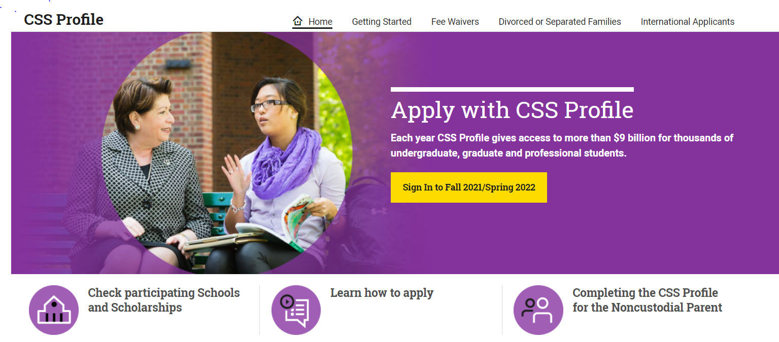
CSS Profile Application Process
Used by approximately 400 schools to more closely examine a family’s financial situation.
Available October 1st of every year
Parent & student tax information required
  If divorced/separated, use custodial parent information (same as contributor on FAFSA)
  Some schools may require Non-Custodial Parent Profile
1 Profile per student, not per family
$25 fee for first application submission, $16 for each submission after.
    Fee waiver available for qualifying applicants.
www.collegeboard.org

Slide 16
Financial Aid Process
FA Application(s)
filed
Results sent to Colleges
Colleges
Assess / Verify Application information
College makes award offers

Slide 17
The Cost of Attendance
Direct Costs + Indirect Costs = Total Cost of Attendance
Direct Costs
  Tuition and mandatory fees
  Housing and meals for resident students
Indirect Costs
  Books and supplies
  Transportation to and from campus
  Miscellaneous personal expenses

Slide 18
Elements of Federal Methodology
Uses both student and contributor information (dependent students)
Parent’s income is the major determinant for dependent students
Uses standard income and asset protections allowance
Parents’ assets range from 2% to 6% of total
Students’ assets range from 25% to 35% of total
Number of students in college no longer considered
Federal Methodology (FM) does not consider Home Equity or Qualified Retirement Assets
The FAFSA
Income
# in family
Assets
FM SAI

Slide 19
Elements of Institutional Methodology
Institutional Methodology (IM) treats income and assets differently than FM
  Typically uses home equity
  Considers number in College
  Protection for emergencies
  Protection for college savings
  May allow for medical expenses
  May adjust for regional cost of living
Institutional options!
CSS Profile or Other
Medical
Home Equity
Allowances
IM EFC

Slide 20
Financial Aid Eligibility
Financial aid packages will differ by college even though the Federal SAI remains the same.
Total Cost -
Federal SAI =
Financial Need
Private School
$54,000 -
$12,000 =
$42,000
Public School
$27,000 -
$12,000 =
$15,000

Slide 21
What is Gift Aid?
Gift Aid are forms of financial aid that do not need to be paid back. Types of gift aid include:
Need-Based
Federal Pell Grant
Merit-Based
Academic Achievement
State Grant
Athletic Achievement
Institutional Grant
Leadership Awards

Slide 22
Self Help Aid
Self-Help aid typically requires work or repayment, with some types subject to a student’s demonstrated financial need.
Work
Federal Work Study
Loans
Federal Direct Loan
College Student Employment
Private Loan

Slide 23
Student Loans
A significant percentage of college students utilize loans to finance their education. Loan options available to you include:
  Federal Direct Student Loan
    Solely in the student’s name
    Subsidized vs. Unsubsidized
    No credit check, student cannot be in default on a previous loan
  Federal Parent PLUS Loan
    Solely in the parent’s name
    Requires a credit check
  Private Loan
    Student will need a co-signer
    Requires a credit check

Slide 24
The Financial Aid Award Package
Total Cost = $54,000
Total Cost = $54,000
Gift Aid: $35,000
Unmet Need: $13,000
Gift Aid: $22,000
Work: $1,500
Work: $1,500
Loan: $5,500
Loan: $5,500
SAI: $12,000
SAI: $12,000

Slide 25
The Financial Aid Award Package
Total Cost = $54,000
Total Cost = $54,000
Gift Aid: $35,000
Cost after Merit: $8,000
Academic: $21,000
Work: $1,500
Loan: $5,500
Athletic: $25,000
SAI: $12,000

Slide 26
Financial Aid Reality
Total Cost of Attendance
Gift Aid Awarded
Family Share

Slide 27
Finding the Family Share
Ask people if they know of any private scholarships you could apply for – employer, guidance office, faith-based organizations, clubs family may belong to and local library. Do research on the web. There are many free, quality websites for scholarship searches. Be imaginative!
Families should save as much as they can – no amount is too small!
Sign up for monthly payment plan through the institution, generally will allow you to pay the remaining balance over 10 months.
If you find it difficult to pay within a 10-month period, research long-term financing options.
  Federal Parent Loan (PLUS) Interest Rate 2024-2025 9.08%
  Connecticut Family Education Loan Program (CHESLA) Interest Rate 2024-2025 6.45%
  Private Alternative Loan for Education
  Personal Family Options

Slide 28
Financial Aid Resources
www.irs.gov/transcript To request a copy of your Tax Return Transcript (if selected for verification)
StudentAid.gov To completed Federal Direct Loan paperwork and Apply for Plus Loans
www.nasfaa.org Consumer tips for students, parents and counselors as well as financial aid tools for completing required applications and avoiding common errors
savingforcollege.com/intro-to-529s/does-a-529-plan-affect-financial-aid Unbiased, independent resource to understand the benefits of 529 college savings plans

Slide 29

State of Connecticut Programs
Connecticut Office of Higher Education
    Roberta B. Willis Scholarship Program
    Veterans Benefits
    www.ctohe.org/SFA
CHESLA Loan Program
    The CT Higher Education Supplemental Loan Authority
    www.chesla.org
CT’s Program for Free Community College
    https://www.ct.edu/PACT

Slide 30
Outside Scholarships
Seek opportunities where there may be less applicants: Town/City, County, State
Potential Sources:
  Local businesses
  School guidance office
  Civic and community organizations
  Ethnic & cultural organizations
  Parents’ employer
  Churches/religious groups
Online Resources:
FastWeb – www.fastweb.com
Scholarship America – www.scholarshipamerica.org
College Board - https://bigfuture.collegeboard.org/pay-for-college/scholarship-search
Consider making a specific email account
  Juliescholarships@gmail.com

Slide 31
Questions to ask and not assume!
When will I receive my financial aid award?
How do outside awards affect the aid package?
What is the school’s policy on non-custodial parents?
Are the scholarships/grants renewable each year?
What happens if financial circumstances change?

Slide 32
Tips & Thoughts
Consider a financial “safety” school
The best deal is not always the best fit!
Keep in mind your financing plan should cover the 4 year education
Appeal with financial aid counselors if circumstances change
Spend time with scholarship and grant search tools – they make a difference!
Many factors involved in awarding aid can result in different financial aid packages from different schools
Carefully review award letters as well as the Federal College Financing Plan which is available to you at all colleges!
Questions?

