Slide 1
Illinois State Career Pathway Endorsement
Gina Schuyler
CTE Department Chair/ Careers & Community Partnerships
Grayslake D127 (Central & North HS)
Pilot District for State Career Pathway Endorsement

Slide 2
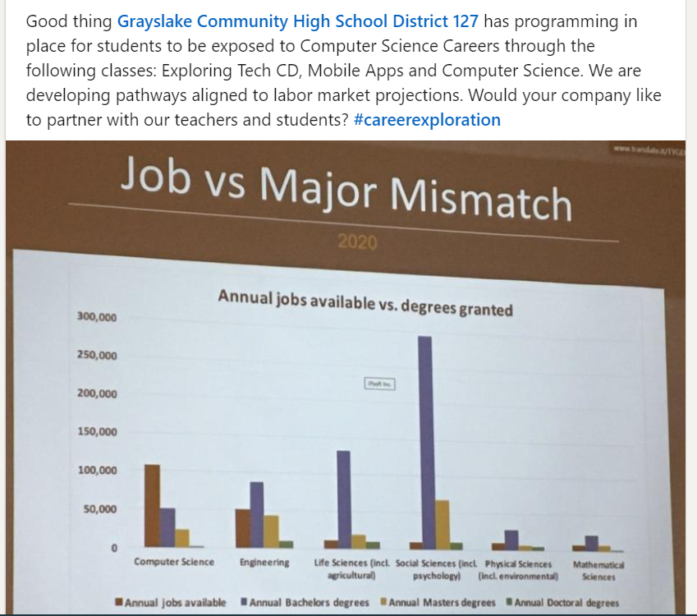
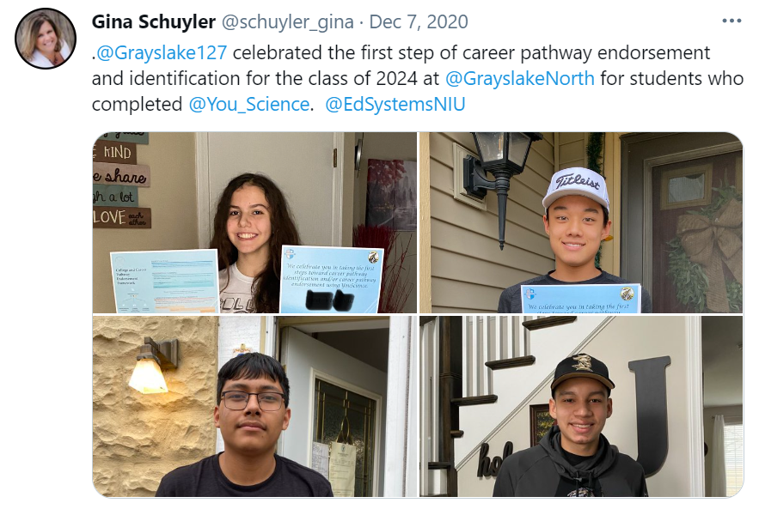
Background & Resources
Education System Center at Northern Illinois University
ISBE webinars
Applied for $10,000 2 year grant
YouScience (part 1 of student identification of pathway of interest)
Transportation to sites for career exploration
Counselor education on endorsements

Slide 4
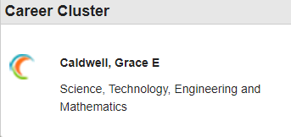
Step 1: Identify Career Goals and Make a Plan
Individualized plan (BLUE):
Identification of interest & APTITUDE
YouScience
11 brain-based games
Combines interest and aptitude
Visually allows students to explore career pathway options of IN-DEMAND OCCUPATIONS
Information of career pathway gets submitted into PowerSchool to allow all working with the student to be aware of their pathway goal

Slide 5
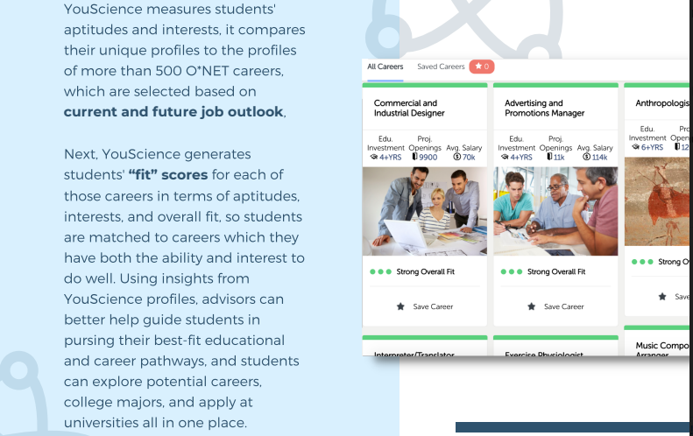
YouScience

Slide 6
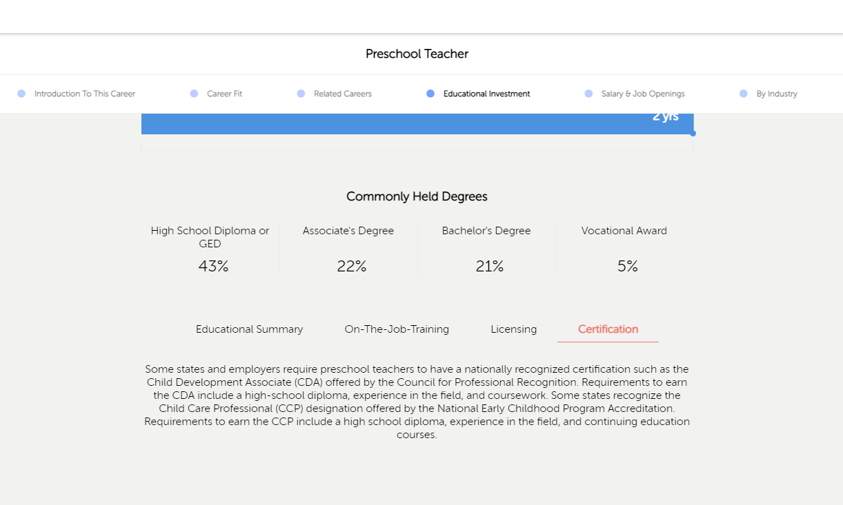
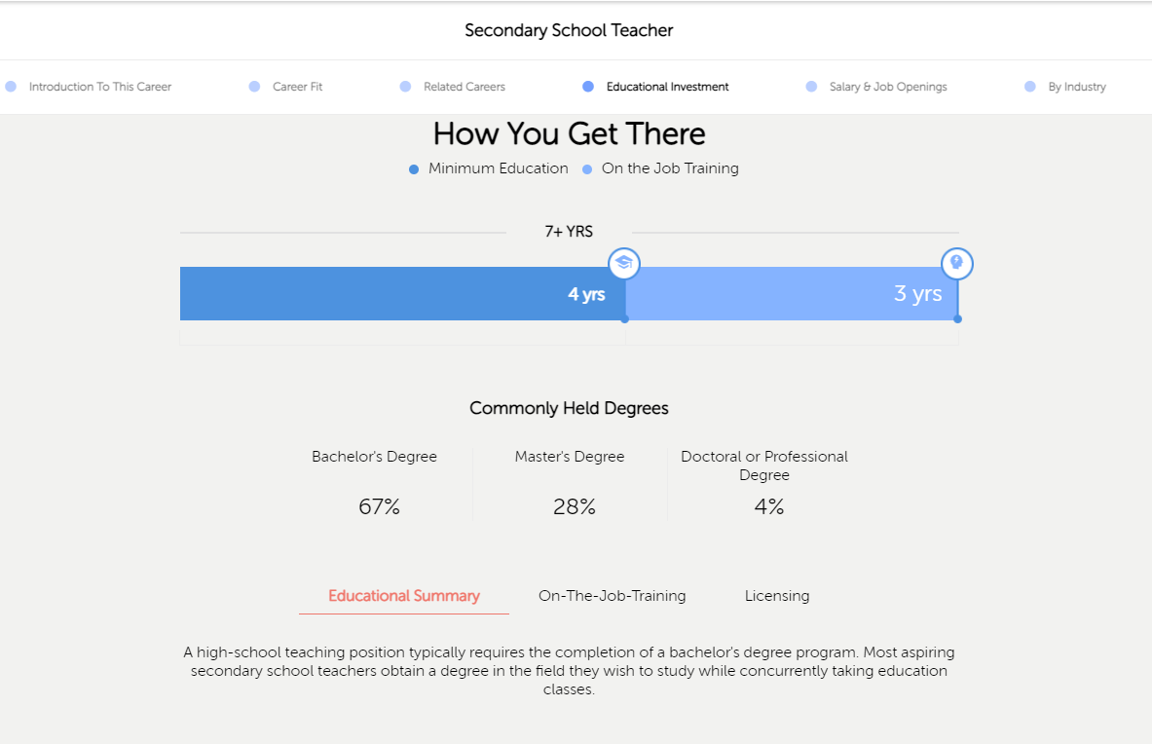
Providing Students Several Pathway Options

Slide 7
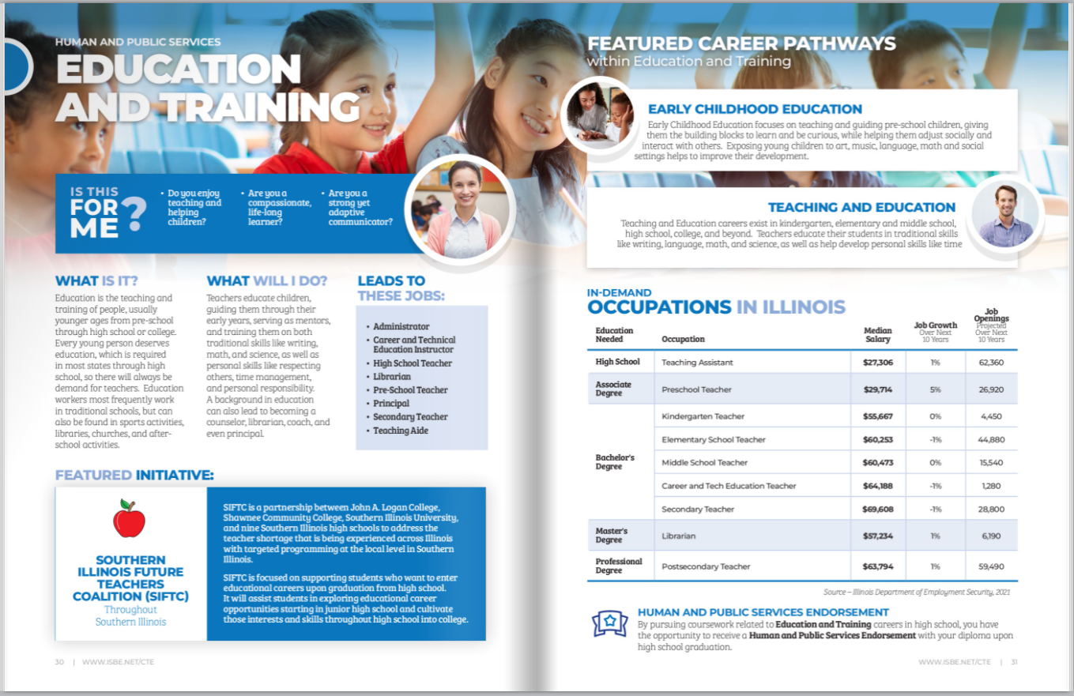
Endorsements are now highlighted in ISBE’s Career Guide

Slide 8
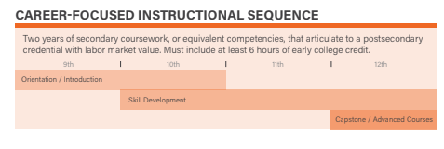
Step 2: Provide Career Focused Sequential Instruction
Career Focused Instruction (YELLOW):
Districts/community colleges articulate classes with labor market value
Early College Credit (6)

Slide 9
Step 3: Provide Opportunity for Students to Interact with the Workplace
Professional Learning (GREEN):
In both yellow and green sectors students gain essential employability skills in the identified labor areas
Awareness activities: speaker
Exploration:job shadow
Preparation: equipment or certification
Virtual is an option currently

Slide 10
Step 4: Readiness for Non-remedial Courses
Academic Readiness (RED):
Goal is that education past high school is not incurring cost for that of remedial math and english
Transitional math and english offered in district for students that need an alternative path (if they do not naturally meet postsecondary readiness for math and english)

Slide 11
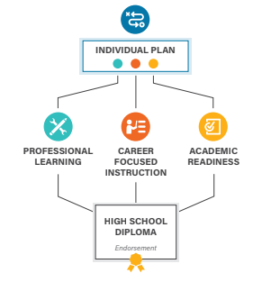
What the high school does
D127 identified career pathway and identities that with student information in powerschool
Professional Learning Activities collected in powerschool
All 4 areas are uploaded into ISBE data base
Endorsement then appears on transcript
*Looking into SchooLinks

Slide 12
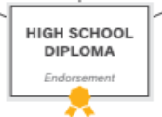
Who benefits from the endorsement process?
Students
Exploring areas of careers of interest while in high school
Feedback from instructor AND employers
Networking
Getting better prepared for their industry
Separating themselves from their peers
Celebrating what we find we like just as much as what we find we don’t like
Employers
Awareness of industry AND specific companies prior to graduation
Creating a pipeline of talent with YOUR input
Playing an active role in the skills gap with high school partnership
Becoming aware of talent entering the field
Means of identifying those who’s high school pathways included workforce readiness
Industry credentialing in high school saving employer time and money

Slide 13
Education Pathway
Early Childhood Studies (D127)
ECE 141 CLC Health Safety & Nutrition Young Children (3 credits)
Teaching Practicum (D127)
ECE 116 CLC Creative Activities Young Children (3 credits)
Family Relations
(D127)
ECE 117 CLC Creative Activities Infants & Tods
(3 credits)
Future Teachers Club with those from industry
Competitions in lesson planning judged by industry experts
Gateways Credential
Practicum involves students interning at local elementary schools
Summer internships
Attending Tech Campus upon the above classes completed and working in lab school setting

Slide 14
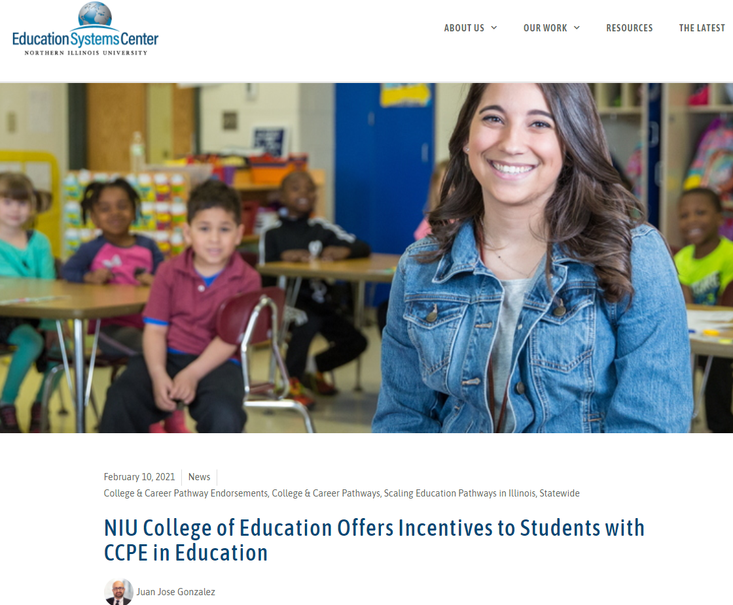
In December 2020, EdSystems announced a similar partnership with Golden Apple Scholars of Illinois, which is automatically advancing any applicants who have earned or are on track to earn the CCPE to the final stage of the application process. Organizations interested in designing incentives for any of the pathway endorsement areas should contact Juan Jose Gonzalez.
February 2021, admitted students with the endorsement are automatically advanced as finalists to receive select scholarships and to participate in the college’s innovative Educate and Engage program.
“Illinois is facing a critical shortage in educators, and we believe high school graduates who earn the College and Career Pathway Endorsement will become a vital stream in our state’s teacher pipeline, and the NIU College of Education is ready to help these students reach their full potential,” says Dean Laurie Elish-Piper, Ph. D., of the NIU College of Education. “The rigor of the endorsement program ensures us that these Education Pathway graduates will be some of our strongest candidates for admission.”
INCENTIVES for Education Pathway Endorsement

Slide 15
Using all D127

Slide 16
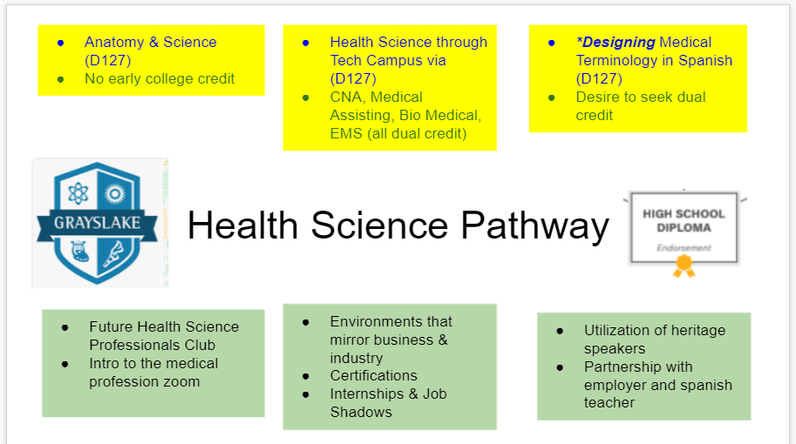
Using all Tech Campus

Slide 17
Still building

Slide 18
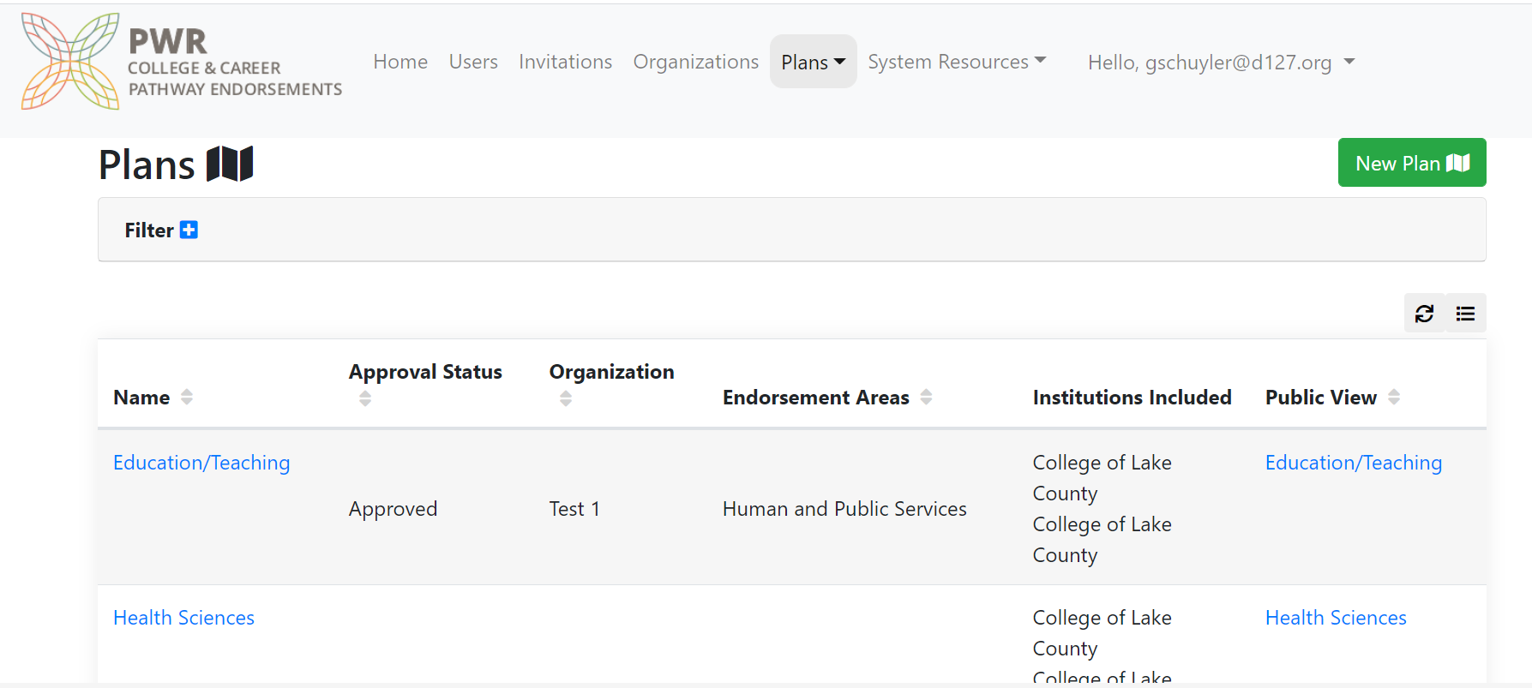

Slide 19
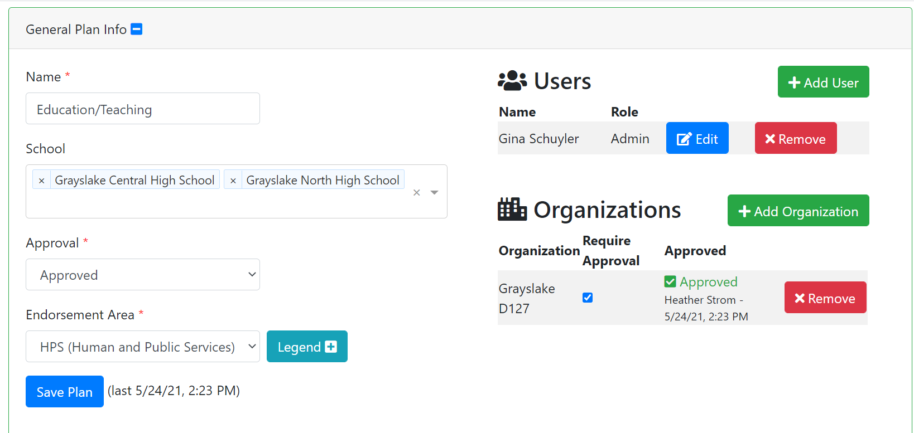

Slide 20
Grayslake D127
Health Science *
Education*
Manufacturing
Information Technology
Transportation
Construction
Foods
Additional Pathways

Slide 21
How do YOU start?
Who?
What can you tackle now?
Where do I get more information?
What can we collectively do?
Where do I begin?

Slide 22
It’s OK not to have all the answers
Just start something!

Slide 23
Starting Points
& Community Connections
Pilot for the Career Pathways program
Involving D46, D127, and CLC students
July 19-22 (mornings)
1. Recruit up to 12, D127 students, preferably students enrolled in CTE classes, that would serve as volunteer mentors to D46 MS students.
2. Identify the hands-on experiences that would best help MS students learn about what the D127 CTE has to offer.
3. Put together information/ a presentation about what would next steps be and how these experiences can be turned into a career pathway and awareness of career pathway endorsement process.
CAN YOU SEE THIS IN YOUR DISTRICT?
The Mobile Maker
Cre8tory

Slide 24
Resources
Workforce Innovation and Opportunity Act (WIOA)
Illinois Every Student Succeeds Act (ESSA)
Illinois Postsecondary and Workforce Readiness Act (PWR)
ILACEP
Resources:
ISBE Endorsement
Career Pathway Framework
Career Pathway Dictionary
Recommended Employability Competencies
Career Development Experience Toolkit
Program Models of Study
NIU Incentives for Education Pathway
YouScience

Slide 25
Thank you!
Gina Schuyler
CTE Department Chair/ Careers & Community Partnerships
Grayslake D127 (Central & North HS)
Pilot District for State Career Pathway Endorsement
Gschuyler@d127.org
847-986-3103
Twitter: @schuyler_gina
LinkedIn: linkedin.com/in/gina-schuyler-a4700791

