Slide 1
Ecosystems: Types & Succession

Slide 2
The Cycling of Materials
Three ways that materials are reused in an ecosystem
  The carbon cycle
  The nitrogen cycle
  The phosphorus cycle

Slide 3
The Carbon Cycle
Carbon is cycled through
  The atmosphere
  The land
  The water
  The organisms
Complete diagram
Some carbon may enter long-term cycle
  Carbonates
    Make up bones and shells
    Deposits over time in the form of limestone
    Over millions of years will turn into fossil fuels

Slide 4
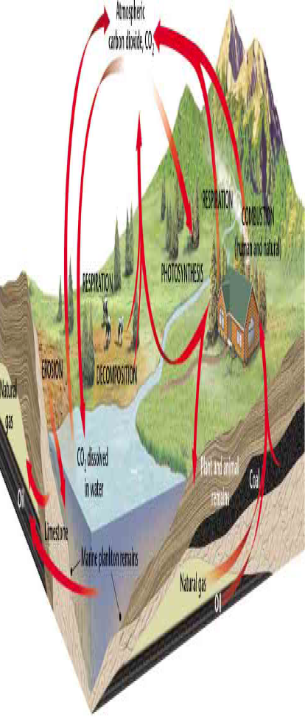
The Carbon Cycle

Slide 5
How Humans Affect the Carbon Cycle
Cars, factories, power plants burn fossil fuels
  This process releases carbon into the atmosphere in the form of carbon dioxide
Burning wood and forest fires add carbon
Half the carbon dioxide stays in the atmosphere
  Contributes to global warming
The rest of the carbon is absorbed by the ocean and plants.

Slide 6
Quick Lab
Page 125

Slide 7
The Nitrogen Cycle
All organisms need nitrogen
  Build proteins which builds new cells
Organisms can not just get nitrogen from the atmosphere
Nitrogen-fixing bacteria
  Bacteria that can turn nitrogen from the atmosphere into usable nitrogen
  Live on legumes (beans, peas, clover)
  Can also live in the soil

Slide 8
The Nitrogen Cycle
  Nitrogen is cycled through the atmosphere, bacteria and other organisms.
Complete diagram
Decomposers help to keep the nitrogen cycle going
Nitrogen is constantly being reused in an ecosystem.

Slide 9
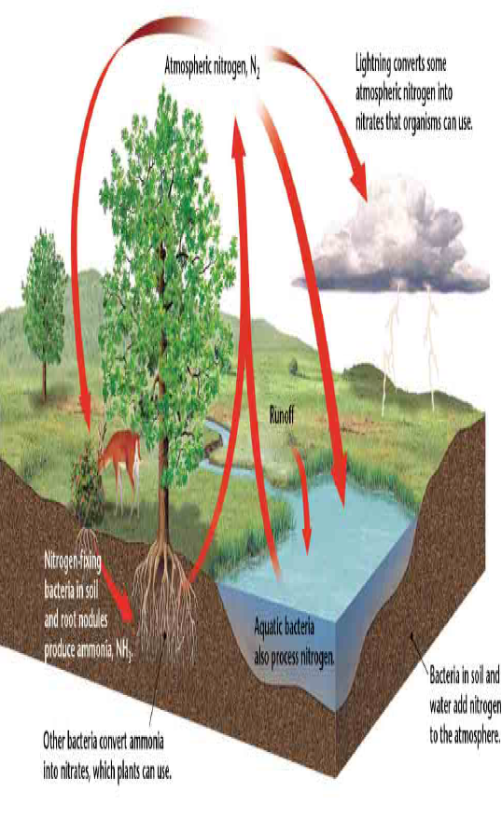
The Nitrogen Cycle

Slide 10
The Phosphorus Cycle
Importance of Phosphorus
  Animals need phosphorus to form bones and teeth.
  Plants need phosphorus for daily functions.
The Phosphorus Cycle
  Movement of phosphorus from the environment to organisms and then back to the environment
  Cycle goes slowly
  Phosphorus doesn’t normally occur as a gas in the atmosphere.
  Complete diagram

Slide 11
The Phosphorus Cycle

Slide 12
The Nitrogen & Phosphorus Cycles
Fertilizers
  Add nitrogen and phosphorus to the soil
  Allows plants to grow bigger and faster
  If too much nitrogen and phosphorus is added, it will cause excess growth in a waterway.
    Algal bloom
      Takes away available oxygen from aquatic organisms
Environmental problem with nitrogen and phosphorus cycles
  Acid precipitation

Slide 13
Section 2 Assignment
Page 128
# 2-6

Slide 14
How Ecosystems Change
Ecological Succession
  Gradual process of change and replacement of species in a community.
  May take hundreds to thousands of years
  Two stages of ecological succession
    Primary succession
      Occurs where no ecosystem existed before
      Primarily occurs on rocks, cliffs, sand dunes
    Secondary succession
      Occurs where an ecosystem has existed before
      Occurs after the ecosystem has been disturbed by humans, animals or natural process (storm, flood, earthquake, volcano)

Slide 15
Secondary Succession
Pioneer species
  First organisms to live in an area after the land is cleared
  These organisms begin the ecological succession in that area most times after a natural disaster.
Climax community
  A final and stable community
Fires
  Some forests depend on fires
    Feed on plants that grow after a fire
    Some plants need high heat to release their seeds

Slide 16
Old-Field Succession
Occurs when farmland is abandoned
Pioneer grasses and weeds grow very quickly
Over time taller plants begin to grow
Next fast growing trees take over
Last, slower growing trees take over the area
  Oaks, hickories, beeches, maples
After a century, the land will return to almost where it was before it was farmed

Slide 17
Primary Succession
Occurs in certain areas
  New islands created by volcanoes
  Areas exposed when a glacier retreats
  Any other surface that has not previously supported life
Occurs much slower than secondary succession because of no soil present

Slide 18
Primary Succession, cont.
Lichens
  Colorful, flaky patches on trees or rocks
  Made of fungi
    Absorbs nutrients from the rocks
    Holds water
  Also made of algae
    Makes food through photosynthesis
  Together it breaks down the rock

Slide 19
Making of Soil in New Areas
1. Lichens begin to break down rocks
2. Freezing and thawing processes further break down the rocks
3. Mosses begin to grow and break down rocks
4. Mosses die and become organic matter
5. The organic matter begins to pile up
6. The organic matter turns into soil over time
7. Plants begin to grow in the newly formed soil

Slide 20
Assignment
Page 133
Section 3 Review
# 1-6

Slide 21
Review Questions
Pages 135-137
#7-8, 16-18, 21-23, 34-35

