Slide 1

Seeds of Revolution
Why did colonists begin to push for independence from Britain?

Slide 2

Economic Reasons
England controls all trade in and out of colonies (mercantilism)
  Merchants want to expand trade outside of England
  Many trade illegally

Slide 3
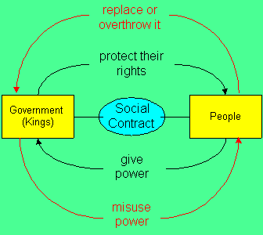
The Enlightenment
Philosophical movement- science, human reasoning and logic can solve social problems
  Social Contract (John Locke)- government gets authority from the people
    All people have rights to liberty and equality
Wealthy colonists are educated in the Enlightenment movement

Slide 4
Colonists want to govern themselves
Early colonists govern selves in Town Meetings and elected assemblies
  Do not like England telling them what to do
1689 English Bill of Rights
  Parliament (elected assembly) gains power over the King
    Colonies follow by electing more assemblies

Slide 5

Stop and Think
Is it worse to never have had rights, or to be given certain rights only to have them taken away.
  Pause, think (1 minute), discuss with your neighbor (2 minutes)

Slide 6
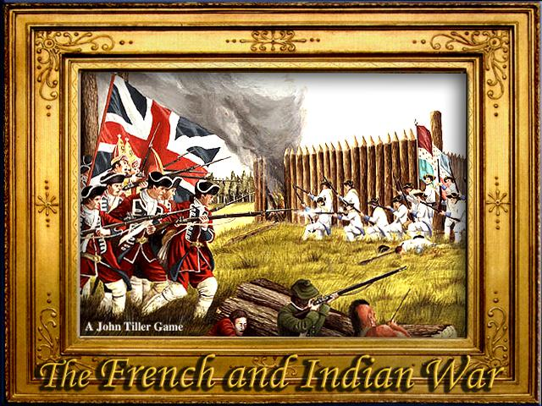
The French and Indian War
England, France, and Natives fight over western lands (Ohio Valley)
  Colonists unite and help England win war
Effects of War
  Colonists feel united and militarily strong
  War is expensive= England raises taxes
  England keeps permanent troops in the colonies
  King George III bans western settlement= colonists angry

Slide 7
Two Points of View
British Empire | 13 Colonies
Taxes Millions spent fighting the war in the colonies, the colonies should help pay for it | Taxes New taxes hurt business and make life difficult “No taxation without representation”
British troops in the colonies Natives and Spanish are still threats, troops to keep colonists safe | British Troops in the Colonies British troops seem like foreign invaders Colonists can keep themselves safe
Government Colonies work for Britain, not the other way around Law and order must be maintained | Government Colonists proved they can govern themselves Want a vote in Parliament
Colonial Expansion Westward expansion would lead to more wars with natives | Colonial Expansion Not enough farmland; need to expand as more people settle in colonies
Trade Laws The British Empire is the largest in the world, plenty of trade opportunities | Trade Laws We should have the freedom to trade with whoever we want

